Slide 1
WBS 476.02.03.04.01 – 30 Straight Section Reconfiguration
g-2 Accelerator – 30 Straight Section Reconfiguration
D. Still
Fermilab
Muon g-2 IDR, June 5-7

Slide 2
WBS Structure
476.02.03.04.01 D30 Straight Section Reconfiguration
Scope: To provide a preliminary and final plan and schedule to implement and coordinate the necessary work to reconfigure the 30 straight section tunnel and service building in order to accept the newly built M3 and M4 beam lines into the Delivery Rings.
Deliverables: A reconfigured 30 straight section tunnel and service building.

Slide 3
Risks
There are 2 main risks:
This is an intersecting area of many beam lines across multiple projects and AIP’s that interdepend on each other. There are risks for conflicts in planning in the preliminary and final design phases. Additionally, there are risks to schedule and manpower during the implementation phase.
Mitigation:
Mitigation of the this risk is good detailed planning in the preliminary and final design phase and good coordination and scheduling during the implementation phase.
2) The design for the Mu2e in tunnel shielding can have great bearing on the plan for reconfiguring the 30 straight section. Demands for shielding can change plans for reconfigurations.
Mitigation:
Mitigation of the this risk is track and understand the Mu2e shielding design and plan accordingly for the 30 straight section reconfiguration

Slide 4
Muon Campus Overview
This the area that will be involved in the reconfiguration.
It is defined as the 30 straight section. (AP30 Service Building)

Slide 5
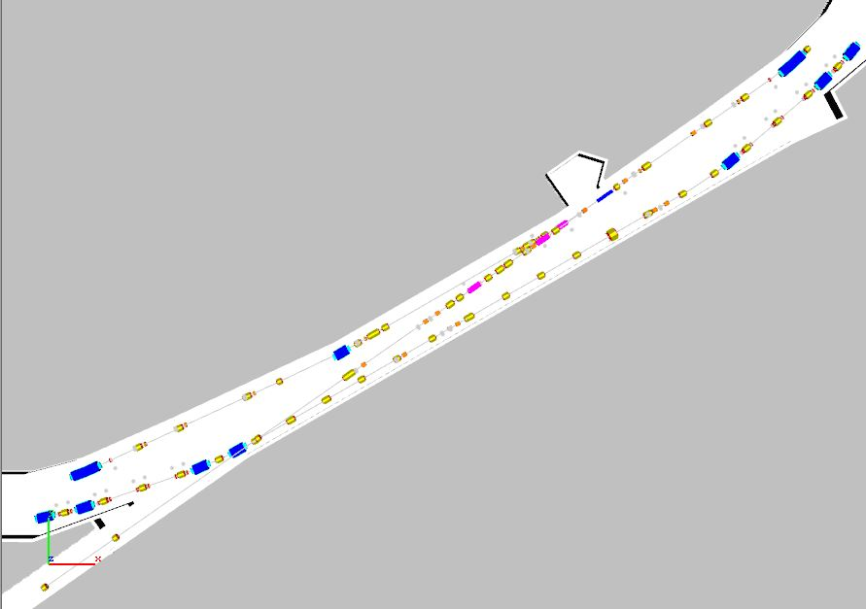
Current 30 Tunnel Section Layout
Overview of what needs to be reconfigured
Obsoleted AP3 Line
Obsoleted Accumulator
Remove the AP3 Line.
Store magnets in the tunnel
reuse.
Current Debuncher - Future Delivery Ring

Slide 6
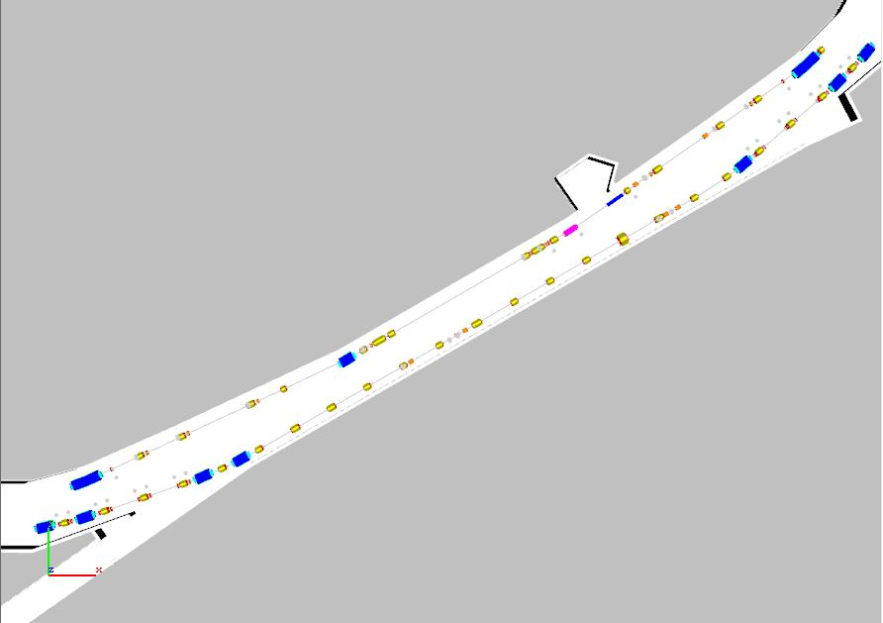
Remove the AP3 Line
Remove the Accumulator components
in the 30 straight section.
Note: Most AP3 Line components will be reused in the M2,M3,M4 and M5 beam lines.
Elements will need to be stored in the tunnel and categorized.

Slide 7
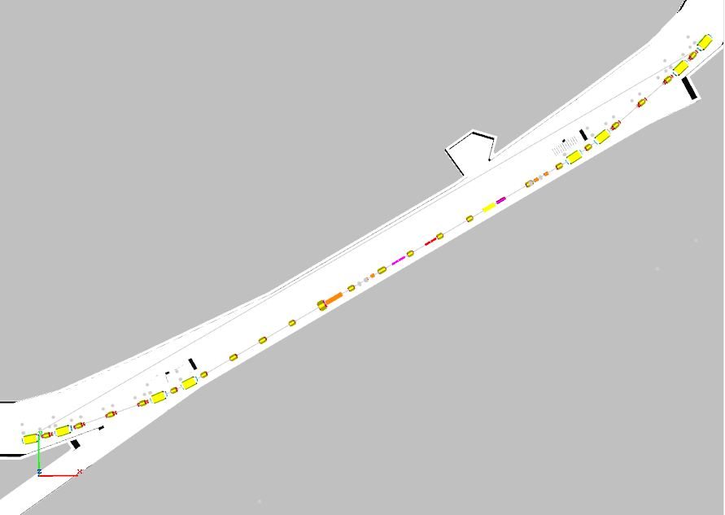
Prepare Room for M3 and M4 Installation
Remove and store all DR components
from D3Q11 to D3Q2.
Note: Most Accumulator magnet components will be reused in the M2, M3, M4 and M5 beam lines and stored in the tunnel until installed.
Collider equipment 10 stochastic cooling tanks will be removed from the tunnel.

Slide 8
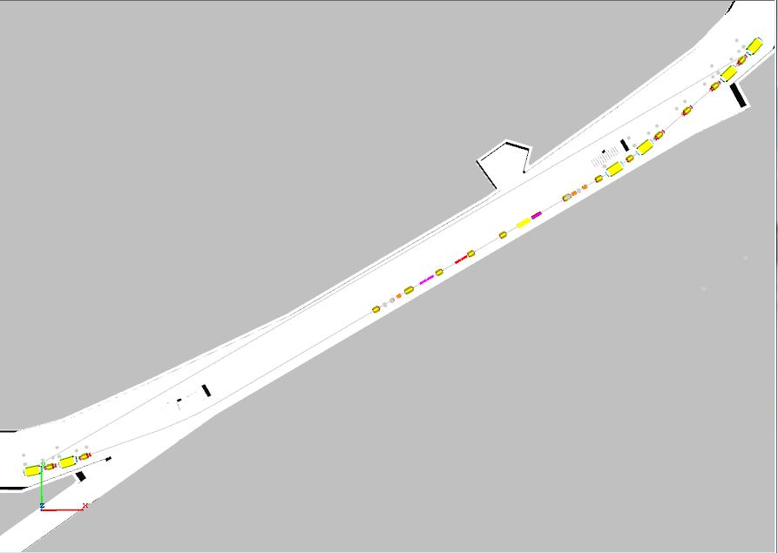
Remove the DR M3 Side
Remove and store all DR components
from D2Q4 to D2Q11.
Note: Collider equipment
8 stochastic cooling tanks and DRF3 will be removed from tunnel.

Slide 9
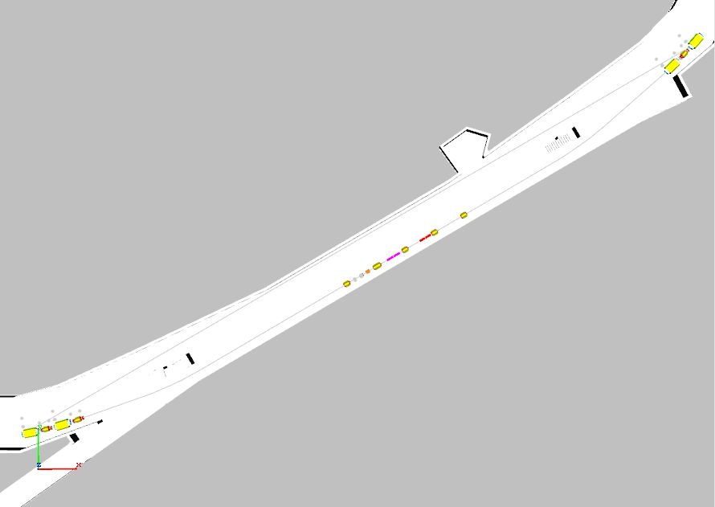
Remove DR on M4 Side
Install the DR Injection devices and the M3 Beam Line

Slide 10
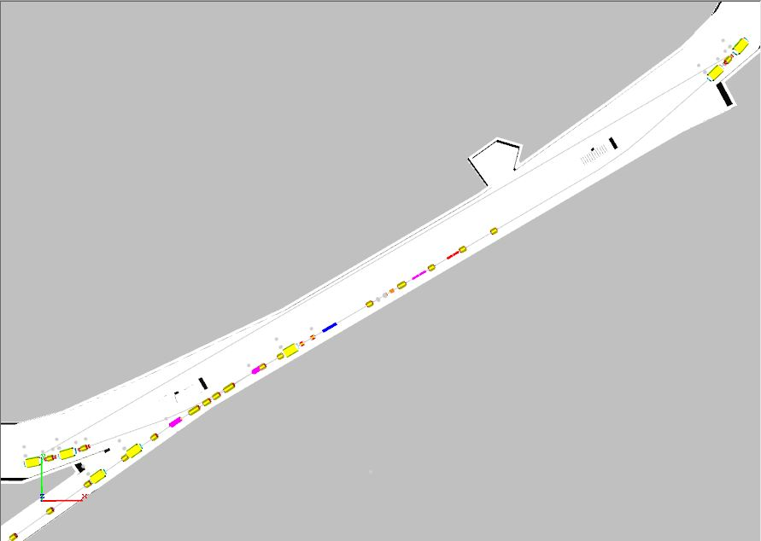
Install the M4 Beam Line
Install the DR extraction devices and the M4 Beam Line

Slide 11
Install M4 Beam Line + DR Extraction Components
Reinstall the DR from D3Q11 to D3Q3
And D2Q4 to D2Q11

Slide 12
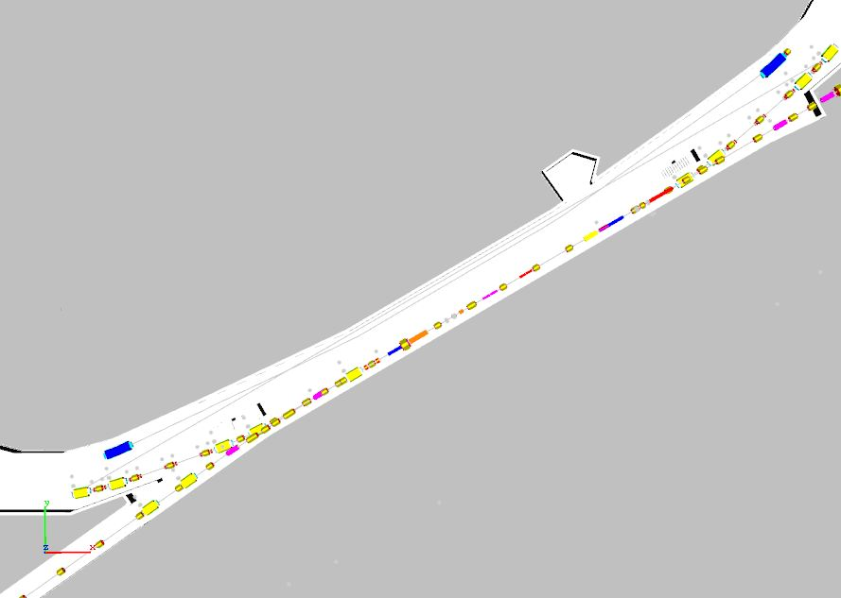
Completed Reconfiguration of 30 Straight Section
New M4
Beam Line
New Extraction Devices
New Injection Devices
Delivery Ring
New M3 Beam Line

Slide 13
30 Straight Section Reconfigured
M4 Beam Line
Delivery Ring
M3 Beam Line

Slide 14
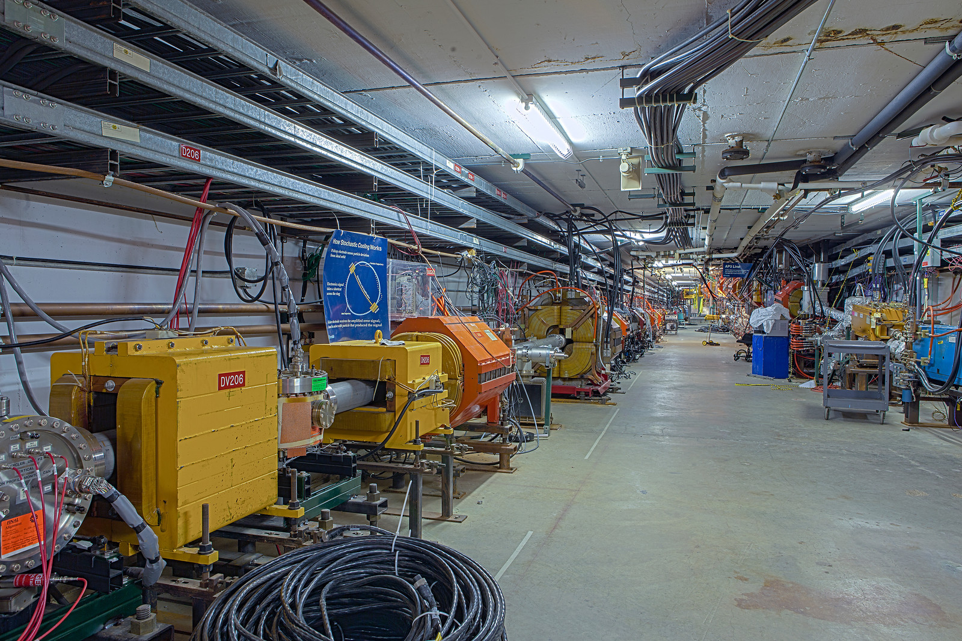
30 Straight Section Tunnel
All ceiling components
Move or removed
Cable tray moves
AP3 Line and Accumulator
Removed
M4 Line Installed
AP3 Line
M4 Side of
Delivery Ring
Accumulator

Slide 15
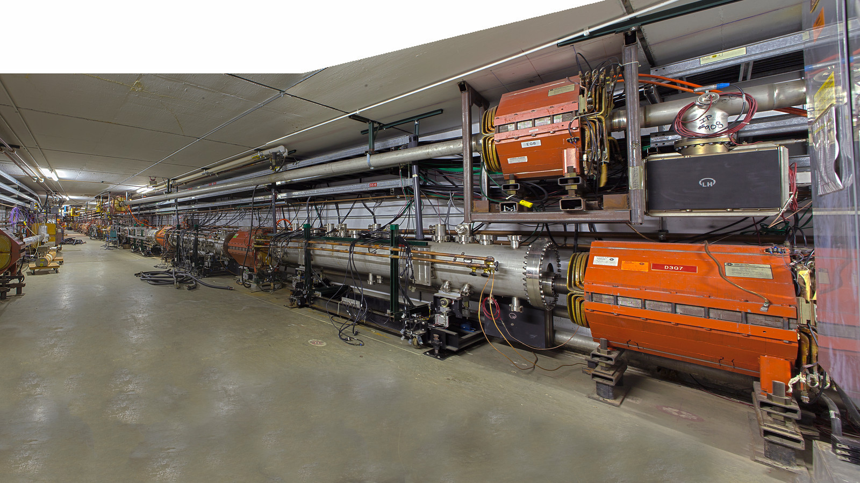
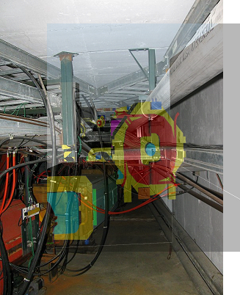
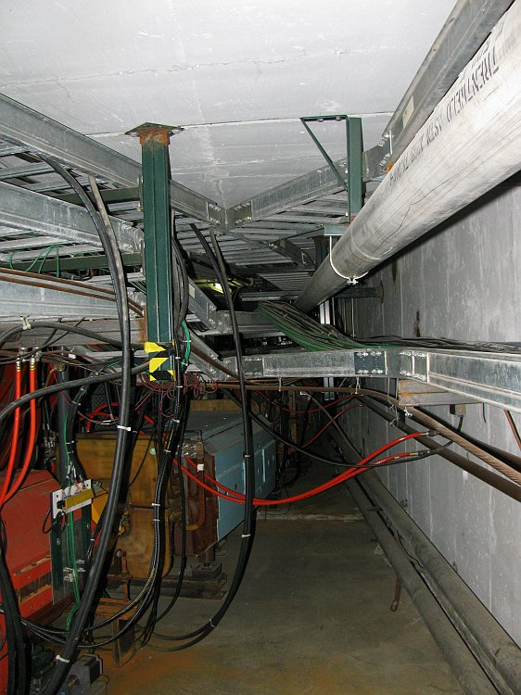
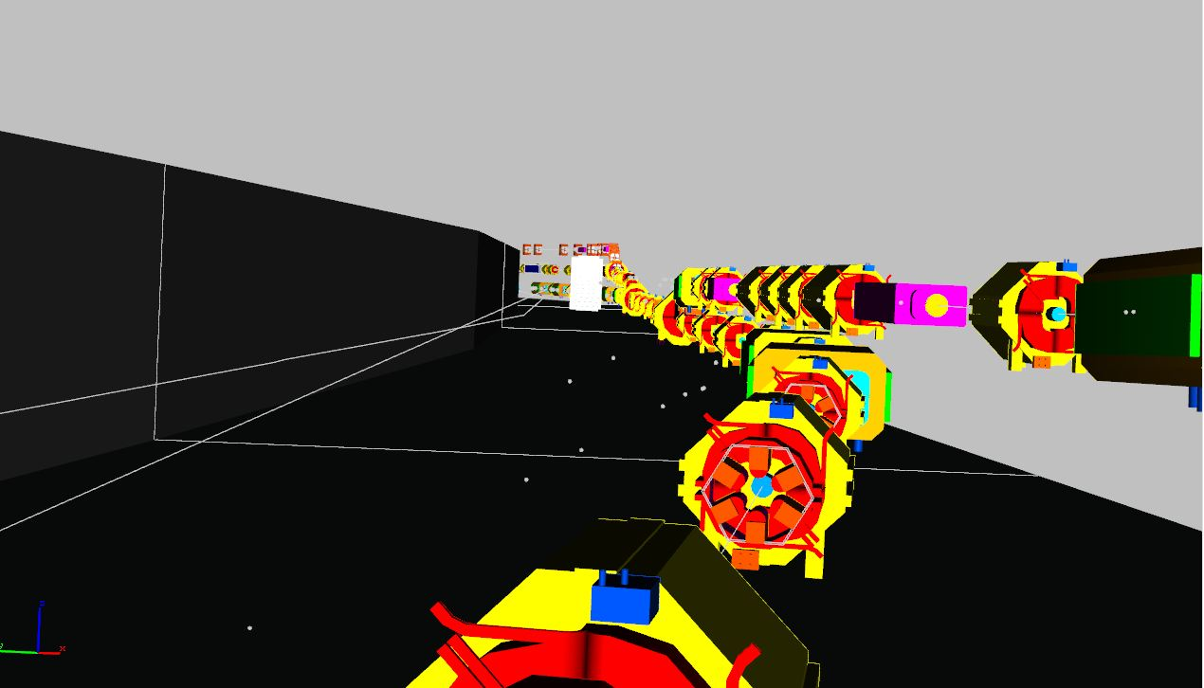
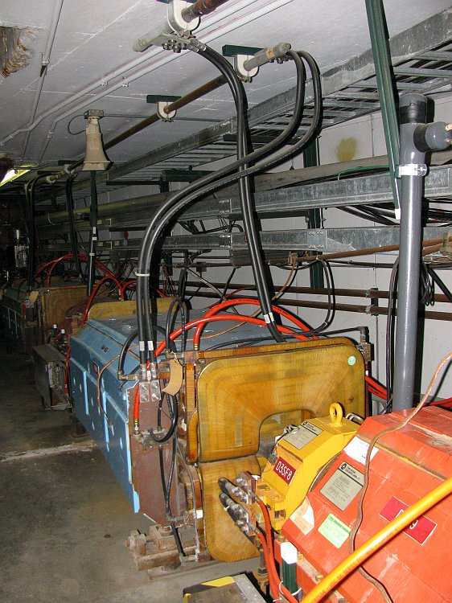
The Reality of Reconfiguring
AP3 Line
AP3 Line
Debuncher
M3 Line
Debuncher
There are many interferences, obstacles and infrastructure that need to move to prepare for the installation of the M3 and M4 beam lines.
Most or all of these components will need to move:
cable tray & cables
cable penetrations (reassigned not moved)
tunnel lighting
DR buss work
LCW headers
Collider Equipment

Slide 16
Mu2e must transfer magnets to M4

Slide 17
M4 Tunnel GPP
Coordinate Tunnel
Opening
M4 Diagnostic Absorber get installed
During tunnel GPP but need steel ready before hand

Slide 18
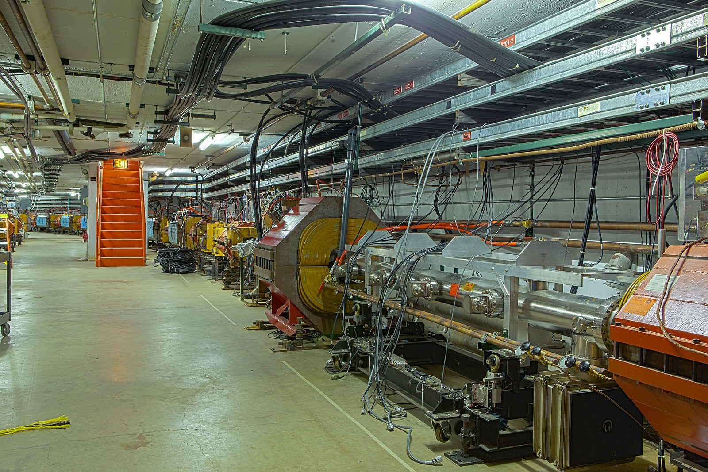
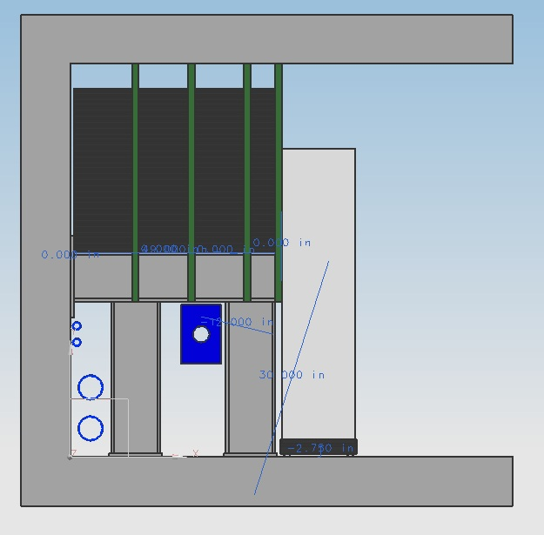
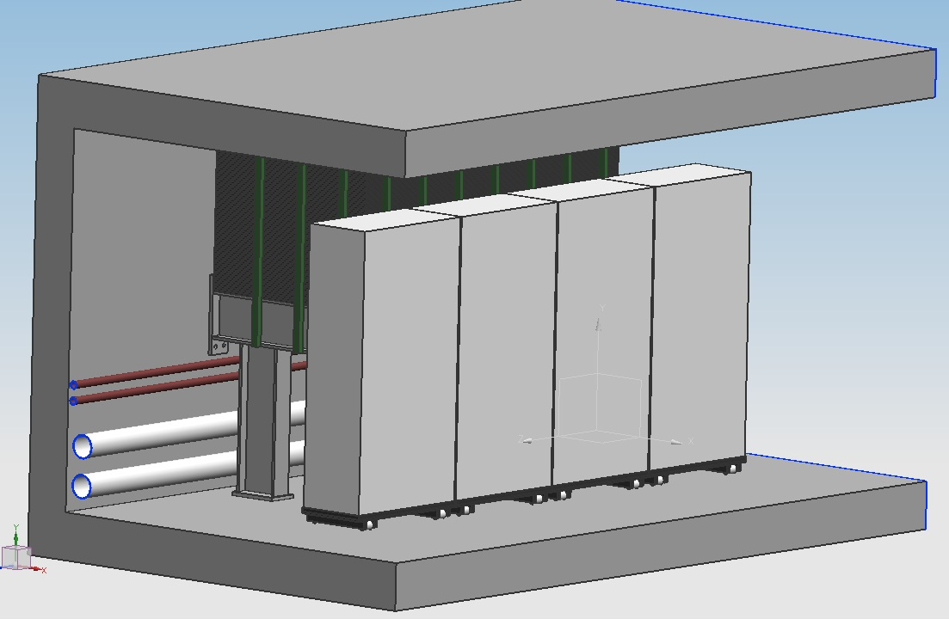
Cable Trays and Cables
The design and relocation of the cable trays is the one of the most challenging items.
All the cable tray must be relocated for 2 reasons:
M3 and M4 beam lines interfere with current location.
Mu2e is designing in-tunnel shielding to mitigate skyshine.
All the cables in the tray must be evaluated as to whether to be extended, removed and pull new or removed completely.
Cable penetrations cannot be occluded by shielding.
(C. Crowley - Mu2e In-Tunnel Shielding Concept to mitigate skyshine – May 2013 )

Slide 19
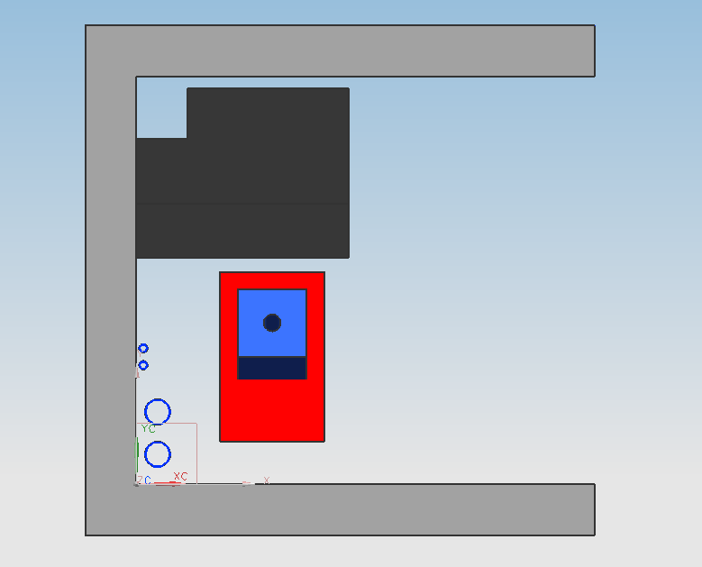
Mu2e In Tunnel shielding

Slide 20
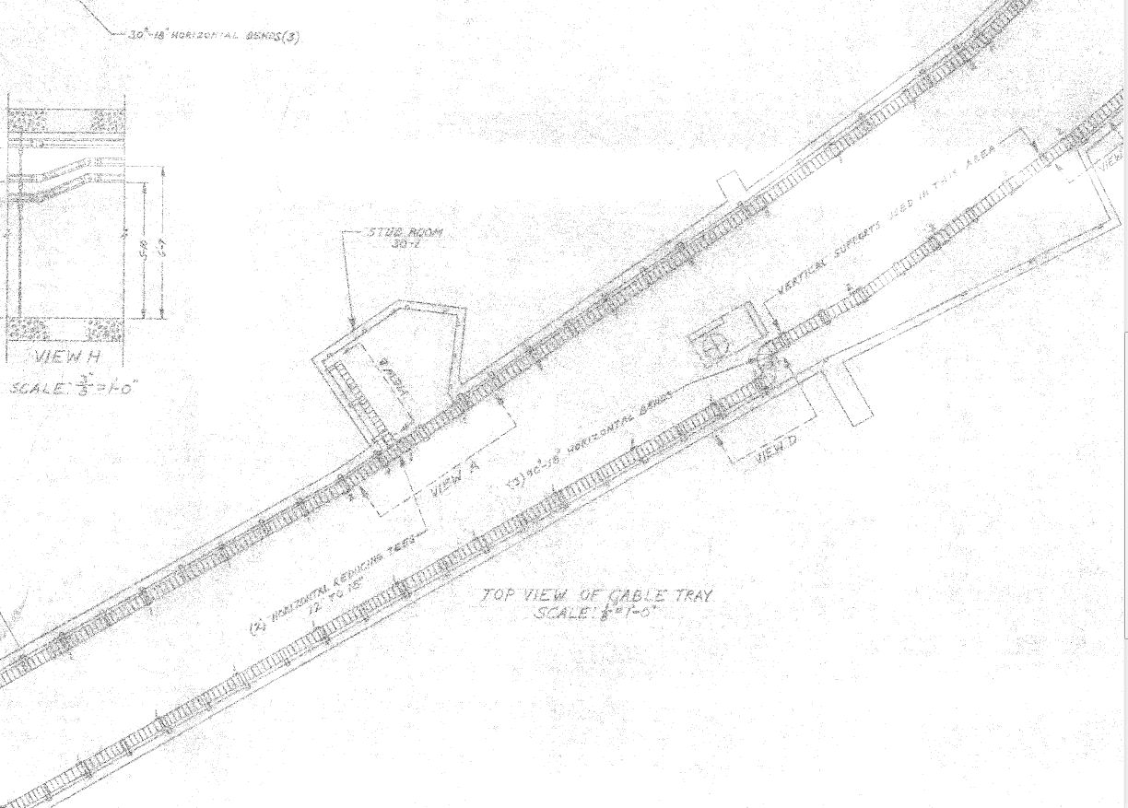
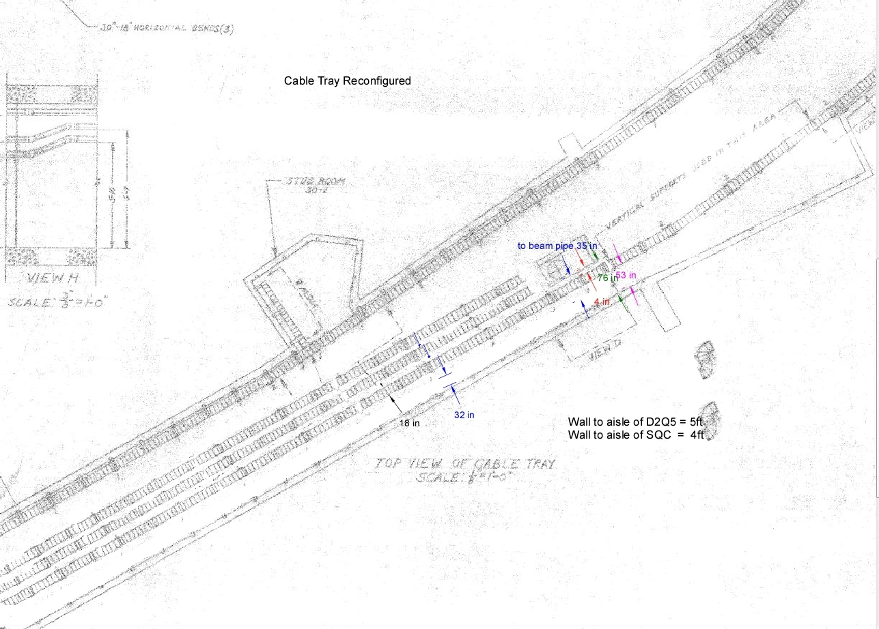
Current Cable Tray Design
All 3 accumulator cable trays will need to be cleaned out to make room for cables servicing M3 and M4 line devices. Additional accumulator side trays may be needed.
Delivery Ring cable trays will move to tunnel center 3 wide to allow for height of fork lift for tunnel shielding.
Current Cable tray Configuration
Conceptual Design of Cable Tray

Slide 21
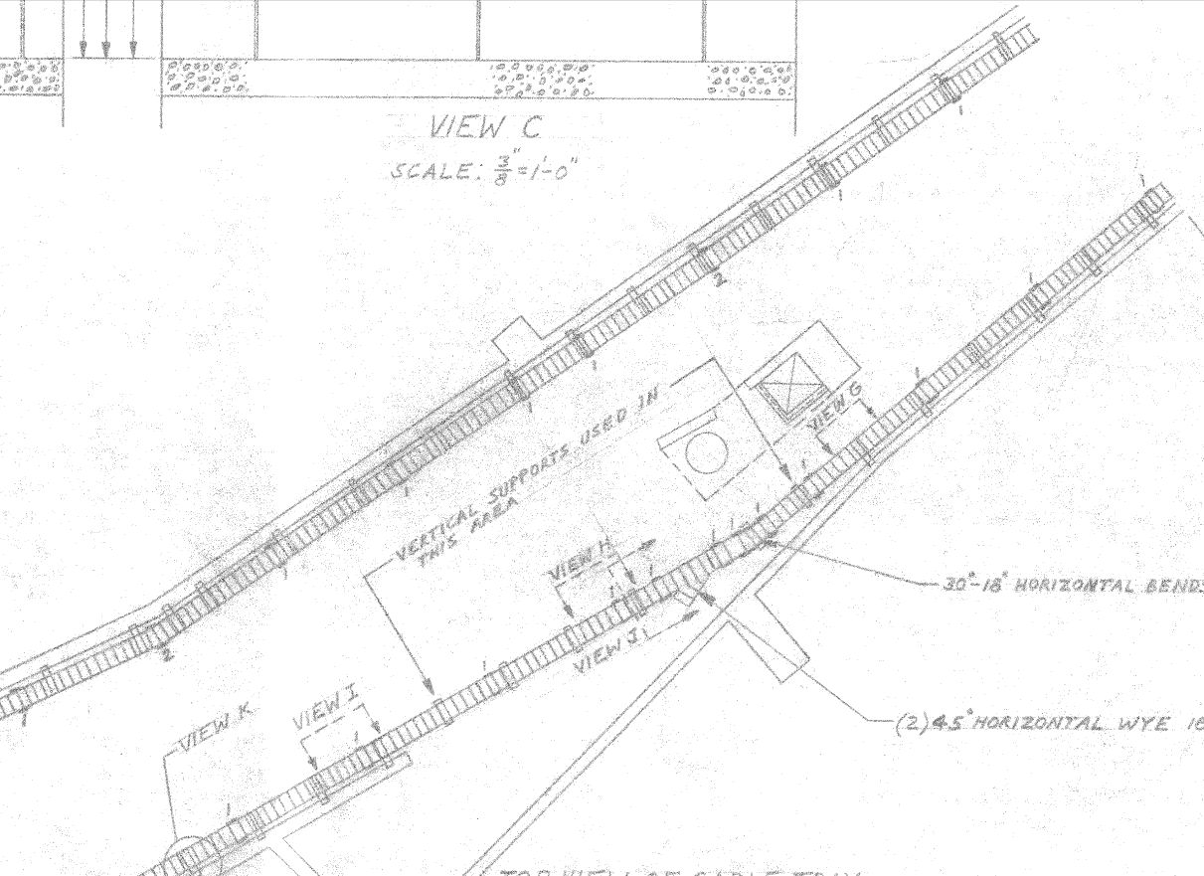
M3 Side Cable Tray Reconfigure
Proposed Tray Reconfiguration
Current Tray Configuration

Slide 22
Interfaces with Beamline AIPs
(AIP=Accelerator Improvement Project)
Mu2e
Delivery Ring AIP
D10
D50
D30
M5
g-2 is responsible for the D30 Straight Section reconfiguration and extraction from the Delivery Ring (different devices used for g-2 and Mu2e)
Recycler RF AIP
g-2
The Delivery Ring AIP is responsible for Delivery Ring injection devices (common)
Beam Transport AIP

Slide 23
List of Mu2e and AIP Milestones that Coordinate Activities
Mu2e
Ready to Install In tunnel shielding
In tunnel Shielding complete
Ready to remove magnets from Acc. to M4
Magnet move from Acc. to M4 complete
Ready to install Mu2e Extraction Device
Mu2e Extraction device installation complete
AIP
Ready to Install injection devices
Injection Devices Installation Complete
GPP
Ready to install M4 Diagnostic Absorber
M4 Diag Absorber installation Complete

Slide 24
Milestones – 476.2 Accelerator
# | Description | Baseline Date | Float (mos)
1.3 | M4 and M5 Accelerator Lines Operational | 1st Qtr FY18 | 6
2.1 | M1 Line Final Focus complete | 3rd Qtr FY17 | 3
2.2 | M2 Power Supplies Operational | 2nd Qtr FY17 | 3
2.3 | M2 Line Fully Operational | 2nd Qtr FY17 | 3
2.4 | M3 Power Supplies Operational | 2nd Qtr FY17 | 3
2.5 | M3 Line Fully Operational | 2nd Qtr FY17 | 3
2.6 | D30 Straight Section Complete | 1st Qtr FY18 | 3
2.7 | Delivery Ring Power Supplies Operational | 1st Qtr FY18 | 3
2.8 | Delivery Ring Line Fully Operational | 1st Qtr FY18 | 3
2.9 | M4/M5 Lines Fully Operational | 4th Qtr FY17 | 3
2.10 | Ready to Begin Beam Tests of Delivering Muons to g-2 | 1st Qtr FY18 | 3
*L2 milestones held jointly by FPD and PPD Head, L4 PM, L5 Level II Managers
Frequency of L4/L5 Milestones by Fiscal Year
Many important L4/L5 milestones currently fall in the final fiscal year
Level | FY13 | FY14 | FY15 | FY16 | FY17 | Tot
4 | 0 | 3 | 0 | 1 | 23 | 27
5 | 5 | 27 | 24 | 10 | 40 | 106

Slide 25
Interfaces between Muon Campus Projects
Interface milestones are the basis for communicating schedule impacts between the AIP’s, GPP’s, g-2 and Mu2e
Each AIP has a Requirements document
Signed by AIP manager, g-2 and Mu2e Project Managers, MC Program Coordinator, and lab management
Milestone Name | Responsibility | Impacts | Forecast
MC-1 Bldg Beneficial Occupancy for Cryo | MC-1 Building GPP | Cryo AIP | 1/8/14
MC-1 Bldg Beneficial Occupancy for g-2 Ring | MC-1 Building GPP | g-2 | 2/18/14
Beamline Enclosure Beneficial Occupancy | Beamline Enclosure GPP | g-2 | 6/9/15
Cryo Compressor Cooling Established | MC Infrastructure GPP | Cryo AIP | 9/30/14
MI-52 Bldg Extension Beneficial Occupancy | MC Infrastructure GPP | Beam Transport AIP | 9/30/15
Cryo Ready to Cool g-2 | Cryo AIP | g-2 | 1/2/15
Cryo Ready to Cool Mu2e | Cryo AIP | Mu2e | 10/1/17
Recycler RF Complete | Recycler RF AIP | beam to g-2, Mu2e | 9/30/16
Beam Transport Complete | Beam Transport AIP | beam to g-2, Mu2e | 1/4/16
End of Circulating Beam Studies | g-2, Mu2e | g-2, Mu2e, Delivery Ring AIP | 4/1/14
Delivery Ring Complete | Delivery Ring AIP | beam to g-2, Mu2e | 3/30/17
MC-1 Cryo Room Controls Available | g-2 | Cryo AIP | 9/22/14
D30 Straight Section Ready for New Installation | g-2 | Delivery Ring AIP | 2/3/16

Slide 26
Muon g-2 Accelerator Schedule
CD-0
CD-1
CD-2/3a
CD-3
CD-4
Conceptual Design
Forecast
KPPs Satisfied
End of circulating beam studies
Recycler RF complete
Prelim Design
Final Design Ctrls, D30 Straight
Beam Transport complete
Delivery Ring complete
Ctrls to MC-1
MC-1 cryo room controls available
D30 straight ready for new installation
D30 Straight Section reconfiguration
Final Design
Final focus
AP2/AP3 disassembly
M2/M3 installation
M2/M3 magnet, power supply work
DR extraction
Beamline enclosure BO
M4/M5 magnet, power supply work
M4/M5 installation
Instrumentation
Target Station
Safety system

Slide 27
Mu2e Schedule
CD-1
CD-3a
CD-2/3b
CD-3
CD-4
Superconductor R&D
Engineering Design of Solenoids
Fabricate and QA Superconductor
KPPs satisfied
Solenoid Fabrication and QA
Detector Hall Design
Site work/Detector Hall Construction
Solenoid Infrastructure
Solenoid Installation
Field Mapping
Install Detector
Detector Construction
Accelerator and Beamline
Common Projects
g-2 Commissioning/Running
Q3 | Q4 | Q1 | Q2 | Q3 | Q4 | Q1 | Q2 | Q3 | Q4 | Q1 | Q2 | Q3 | Q4 | Q1 | Q2 | Q3 | Q4 | Q1 | Q2 | Q3 | Q4 | Q1 | Q2 | Q3 | Q4 | Q1 | Q2 | Q3 | Q4 | Q1 | Q2 | Q3 | Q4
FY13 FY14 FY15 FY16 FY17 FY18 FY19 FY20

Slide 28
CD-1
CD-2/3a
CD-3
Conceptual Design
End of circulating beam studies
Forecast
KPPs Satisfied
Prelim Design
Final Design Ctrls, D30 Straight
Recycler RF complete
Beam Transport complete
Ctrls to MC-1
MC-1 cryo room controls available
Delivery Ring complete
D30 straight ready for new installation
D30 Straight Section reconfiguration
Final Design
Final focus
AP2/AP3 disassembly
M2/M3 installation
M2/M3 magnet, power supply work
Beamline enclosure BO
DR extraction
M4/M5 magnet, power supply work
M4/M5 installation
Instrumentation
Target Station
CD-1
CD-3a
CD-2/3b
CD-3
Safety system
CD-4
Superconductor R&D
Engineering Design of Solenoids
28
Fabricate and QA Superconductor
KPPs satisfied
Solenoid Fabrication and QA
Detector Hall Design
Site work/Detector Hall Construction
Solenoid Infrastructure
Solenoid Installation
Field Mapping
Install Detector
Detector Construction
Accelerator and Beamline
Common Projects
g-2 Commissioning/Running
FY13 FY14 FY15 FY16 FY17 FY18 FY19 FY20

Slide 29
List of g-2 Milestone
476.02.03.04.01 | 1 |  | 4 | L4 - Preliminary of Design of D30 Straight Section Reconfiguration Completed
D30 SS reconfig | 2 |  | 4 | L4 - Final Design of D30 Straight Section Reconfiguration Completed
 | 3 |  | 4 | L4 - D30 Straight Section Tunnel Reconfiguration Ready to Begin
 | 4 |  | 4 | L4 - D30 Straight Section Service building Reconfiguration Ready to Begin
 | 5 |  | 4 | L4 - Move DR M3 Side Component Complete
 | 6 |  | 4 | L4 - Move DR M4 Side Component Complete
 | 7 |  | 4 | L4 - Remove Accumulator Component Complete
 | 8 |  | 4 | L4 - Remove DR Cooling Tanks & DRF3 Complete
 | 9 |  | 4 | L4 - Remove AP3 Line Complete
 | 10 |  | 4 | L4 - Remove DR Cable Tray Complete
 | 11 |  | 4 | L4 - Ready to Transfer Magnets to M4/M5 lines
 | 12 |  | 4 | L4 - Transfer Magnets to M4/M5 Complete
 | 13 |  | 4 | L4 - Ready to install M3 Line components
 | 14 |  | 4 | L4 - Ready to install M4 Line components
 | 15 |  | 4 | L4 - Ready to install Injection components
 | 16 |  | 4 | L4 - Ready to install Extraction components
 | 17 |  | 4 | L4 - M3 Line Installation Complete
 | 18 |  | 4 | L4 - M4 Line Installation Complete
 | 19 |  | 4 | L4 - Install Injection components Complete
 | 20 |  | 4 | L4 - Install Extraction Components Complete
 | 21 |  | 4 | L4 - Reinstall DR M3 Side Component Complete
 | 22 |  | 4 | L4 - Reinstall DR M4 Side Component Complete
 | 23 |  | 4 | L4 - DR Cable Tray Installation Complete
 | 24 |  | 4 | L4 - Acc. Cable Tray Installation Complete
 | 25 |  | 4 | L4 - D30 Straight Section Reconfiguration Completed

Slide 30
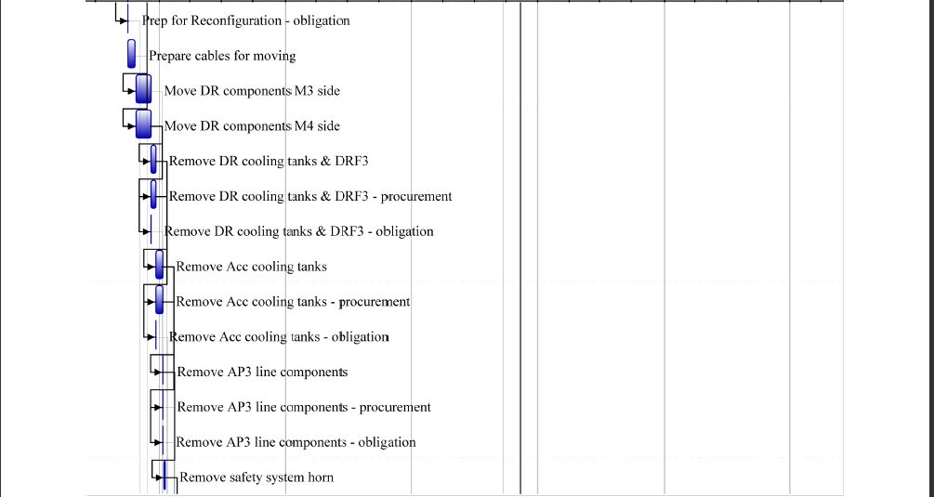
D30 SS Schedule

Slide 31
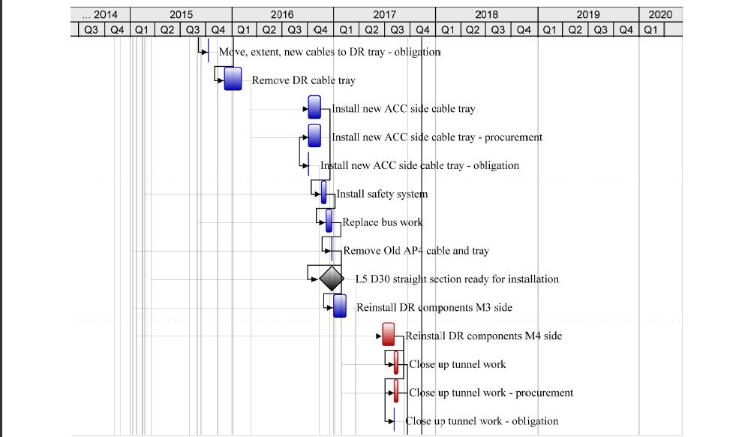
D30 SS Schedule (2)

Slide 32
D30 SS schedule (3)

