Slide 1
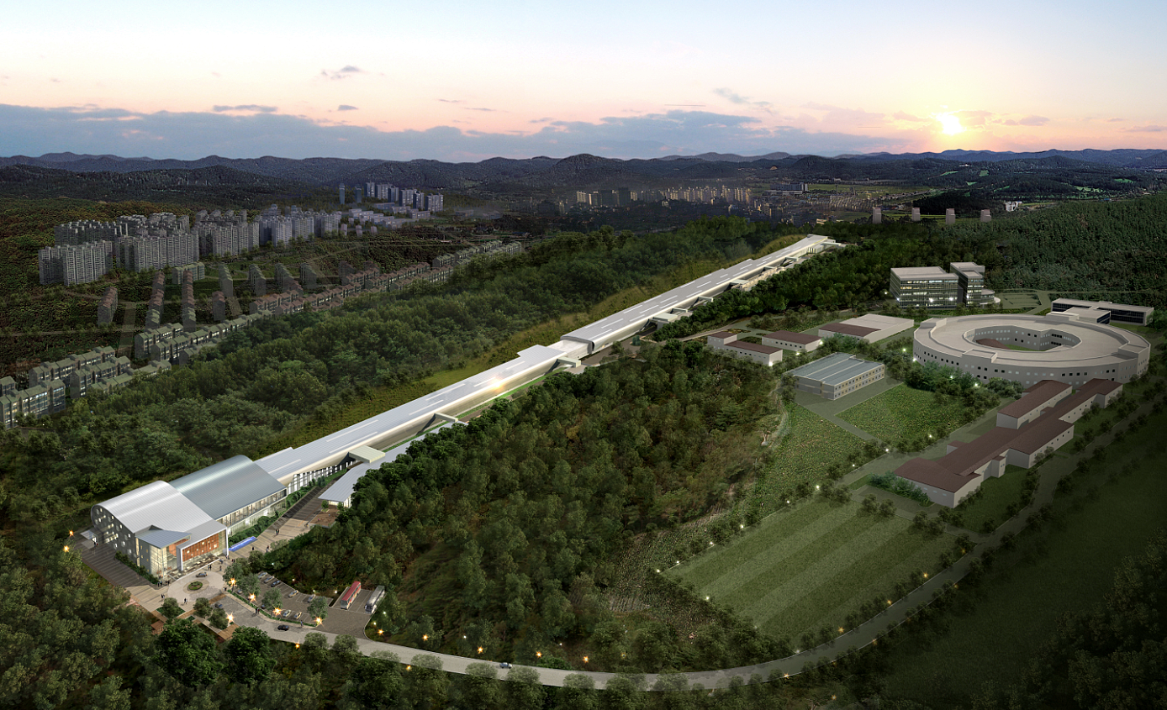
Consideration of Particle Charge at Shielding Analysis of Heavy Ion Accelerator
Apr. 29, 2014
Hee-Seock Lee, Joo-Hee Oh, Leila Mokhtari Oranj
PAL, POSTECH
Mario Santana Leitner
SLAC
Apr. 28-30. SATIF12, Fermi lab

Slide 2
Outline
Introduction
Treatment of Charge State at Monte Carlo Codes
Application of Charge Consideration at PHITS and FLUKA codes
Improved Example on PHITS
Summary and Suggestion for Tomorrow

Slide 3
Introduction - Backgrounds
Large Accelerator Projects in Korea
Three-Year Project : “Development of Core Safety Technology for Large Accelerator Facility”
- Setup Safety Standard for Large Accelerator
Shielding Analysis Project of RISP Accelerator, RAON

Slide 4
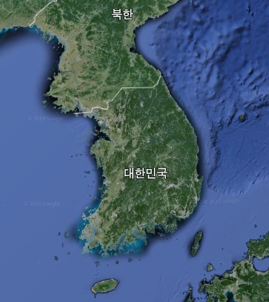
Large Accelerator Facilities in Korea
Pohang Accelerator Laboratory (PAL)
- PLS II
- PALXFEL (Const.)
Proton Therapy
- KNCC
- Samsung Medical
Center
RI Accelerator
- RISP/IBS (Const.)
Carbon Therapy
- KIRAMS (Const.)
High Power Proton Linac
- KAERI

Slide 5
Introduction
Standard Technology for Safety Inspection of Large Accelerator Facility
What is optimum method for shielding design?
What is acceptance level in shielding analysis?
How serious is the activation issues? (hadron facility)
How important is the accident analysis and What is it?
What should be included in Radiation Safety Analysis Report? (Decommissioning?)
Needs of Many Helps from SATIF community !!!

Slide 6
Introduction
Rare Isotope Science Project (RISP)
has started to construct Rare Isotope Accelerator with ISOL and IF Target in 2012
High intensity RI beam : ISOL & IF
High energy, high intensity & high quality neutron-rich RI beams
Varity of isotopes with high intensity
Upgradable to higher energy, higher current
World leading RI science facility for next 20-30 years

Slide 7
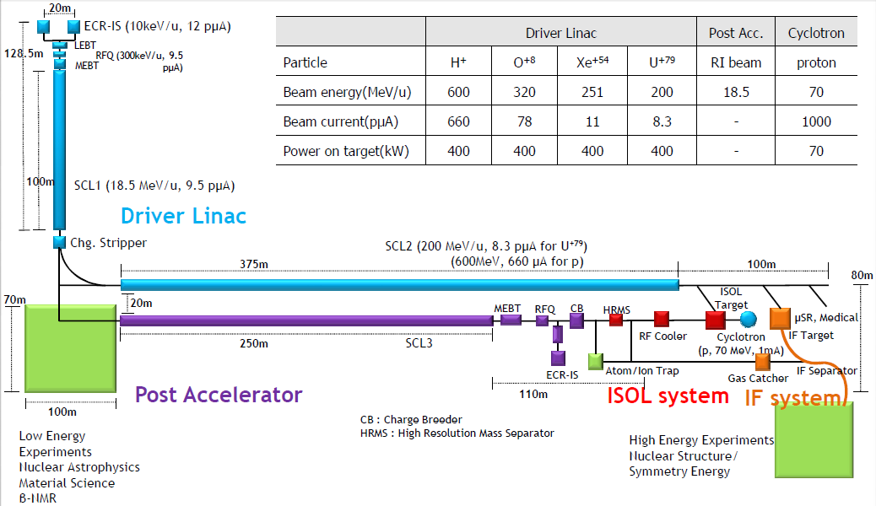
Introduction – RAON :
RISP RI Accelerator

Slide 8
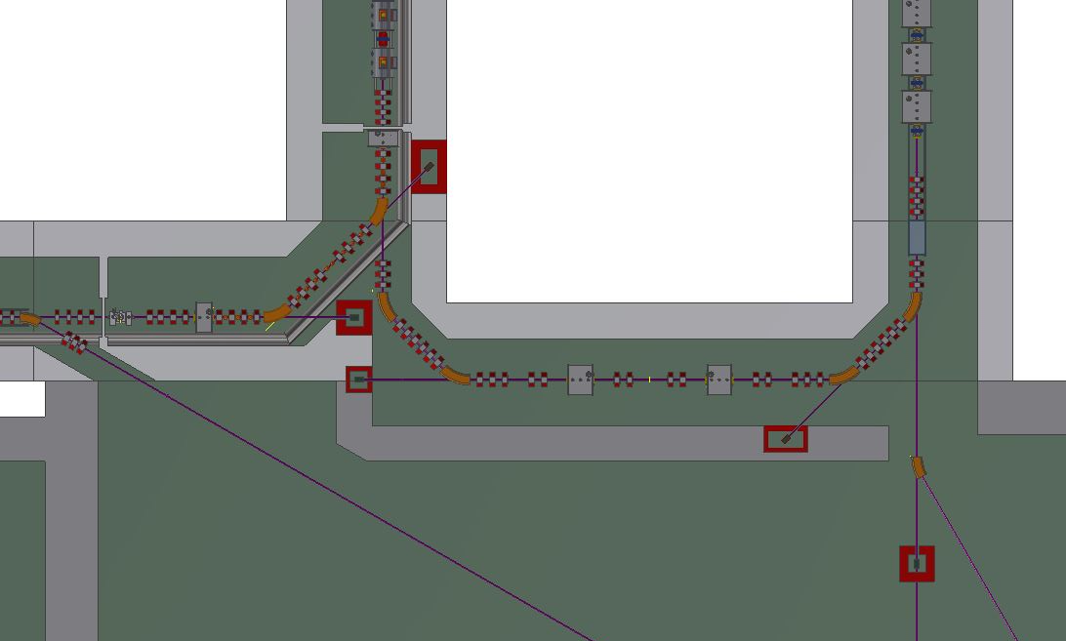
Bending Section and Multi-Charged Beam from Carbon Stripper
In the case of major U-238 beam
U-238 (79+ & others)
19.7 MeV/u
Or Sn-152 (46+ & others)
Sn-152 (20+)
16.5 MeV/u,
9.5 pμA (?)
Carbon stripper
(1.3 μm)
SRF cavity
U-238 (33+&34+)
18.5 MeV/u,
9.5 pμA

Slide 9
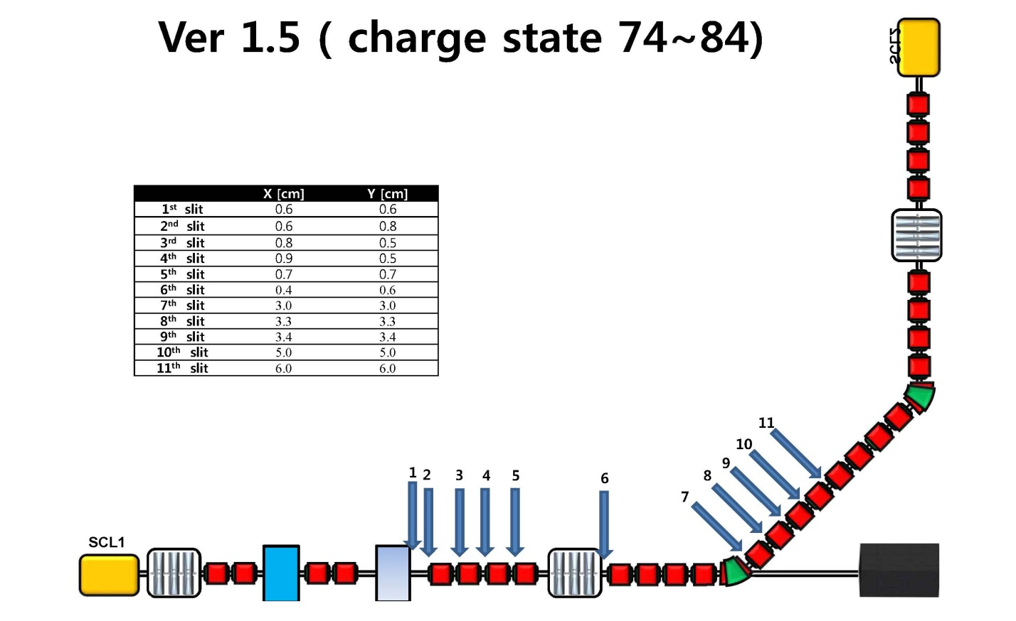
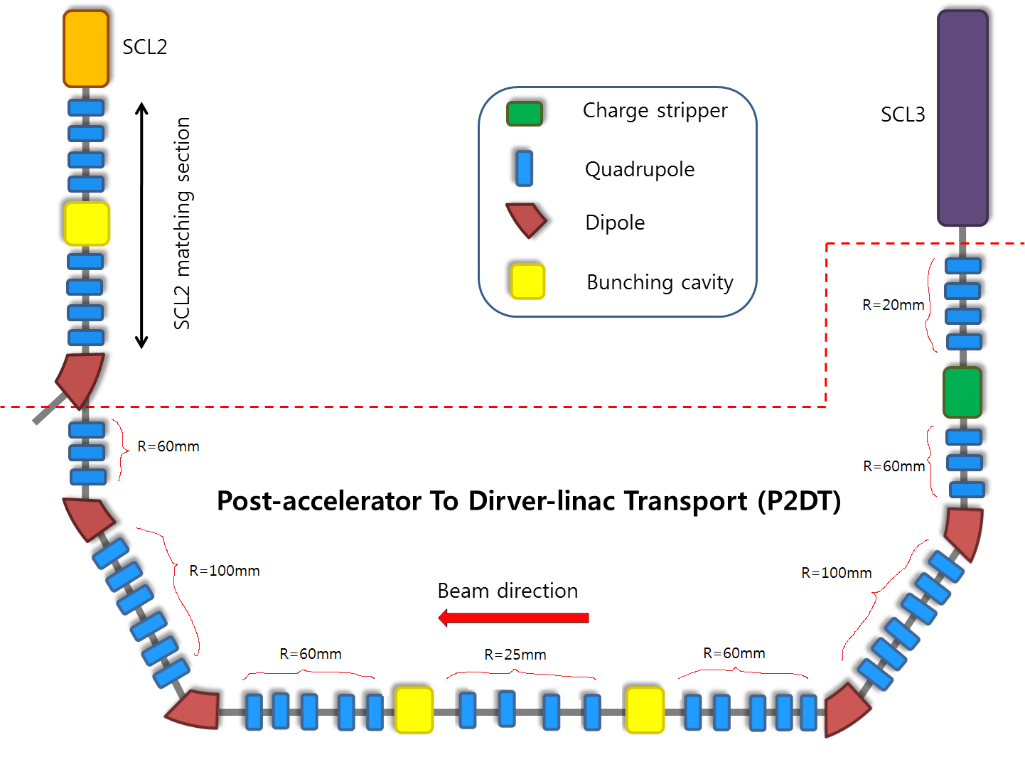
Details of Bending Section

Slide 10
Charge State Study after Carbon stripper using LISE++ code
²³⁸U charge distribution after stripper
depending on U-238 (33+) beam energy (16 ~ 20 MeV/u)
* Charge distribution method: GLOBAL+L (Leon)
Incident energy [MeV/u] | Center charge state
16 | 76
17 | 77
18 | 77
18.5 | 78
19 | 78
20 | 79

Slide 11
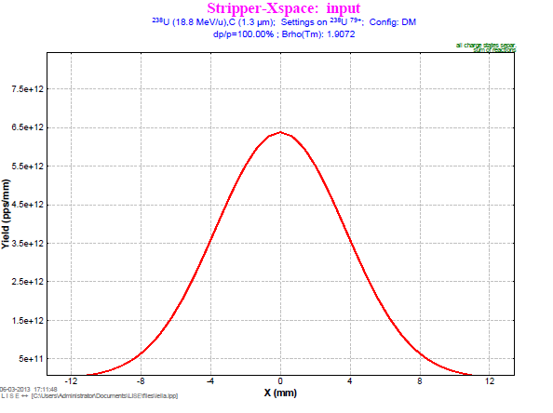
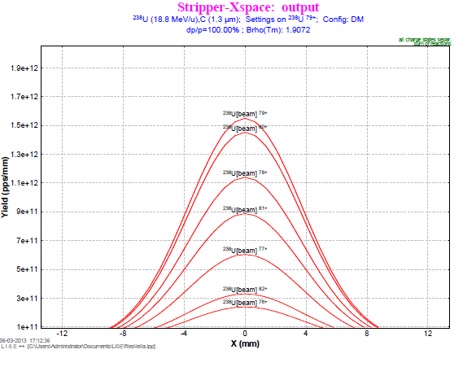
Charge State Study after Carbon stripper using LISE++ code
Emission profile of U-238 ions with different charge after stripper in X space
Charge | 72 | 73 | 74 | 75 | 76 | 77 | 78 | 79
Fraction (%) | 0.009 | 0.055 | 0.282 | 1.159 | 3.776 | 9.504 | 17.903 | 24.313
Charge | 80 | 81 | 82 | 83 | 84 | 85 | 86 | 87
Fraction (%) | 22.755 | 13.888 | 5.161 | 1.0715 | 0.111 | 0.004 | 7.90e-05 | 3.36e-07

Slide 12
Particle Charge Treatment at Selected Monte Carlo Codes
Particle Transports in Magnetic Fields and Electric Fields
Particle Charge Effect
at Physical Interactions
of Monte Carlo Codes ???
Very Importance Information
in Radiation Protection

Slide 13
PHITS
2009/03/02: PHITS 2.15
2011/2/3: Release of PHITS 2.24
(GUI-software SimpleGEO can be used for making PHITS geometries)
2011/9/6: Release of PHITS 2.30L
The updates mainly concern the following:
1. Improvement of the DPA calculations including the Coulomb scattering.
2. Incorporation of the function to generate delta-rays
3. Release of the photon-atomic data library
4. Revision of the manual
2013/03/05: Registration of PHITS2.52 in OCED/NEA databank
(PHITS can separate charge state of ions using parameter as ‘izst’ with magnetic field and electric field)
2013/10/28: Release of PHITS2.63
2013/11/20: Release of PHITS2.64 (Bug correction)
2014/03/05: Registration of PHITS2.64 in OCED/NEA databank

Slide 14
FLUKA (courtesy from FLUKA tutorial)

Slide 15
MAGNETIC FIELD TRACKING
MCNP6
Two Methods for including B-field effect on charged particles 1. COSYP AND COPY CARDS
2. BFLD AND BFLCL CARDS (Particle Ray Tracking)
Adopted from the MARS high energy particle transport code

Slide 16
Particle ray tracking (BFLD and BFLCL)
Input parameter | Description
n | The value n represents the magnetic field number.
type | If type=CONST, magnetic field is a dipole field. If type=QUAD, magnetic field is a quadrupole field. If type=QUADFF, magnetic field is a quadrupole field with fringe field edge kicks.
Keyword | Value(s)
FIELD | For type=CONST, FIELD=the magnetic field strength(Tesla) For type=QUAD or QUADFF, FIELD=the magnetic field gradient(Tesla/cm)
VEC | For type=CONST, VEC=the direction of the magnetic field For type=QUAD of QUADFF, VEC=the pane that corresponds to the x-axis of a focusing quadrupole. (DEFAULT : VEC=0 0 1)
MXDEFLC | Maximum deflection angle per step size (mrad). (DEFAULT : MXDEFLC=10)
MAXSTEP | Maximum step size (cm). (DEFAULT : MAXSTEP=100)
The following keywords only apply to quadrupole fields :
AXS | The direction cosines of the quadrupole beam axis-do not need to be normalized. (DEFAULT : AXS=0 0 1)
FFEDGES | List of surface numbers to which fringe field edge kicks are to be applied. (Applies to type=QUADFF only)
REFPNT | A point anywhere on the quadrupole beam axis. (DEFAULT : REFPNT=0 0 0)

Slide 17
BUT
All particle tracking methods in MC codes were ONLY for fully-ionized ion beam like ²³⁸U⁹²⁺
Another consideration should be applied for specific heavy ion accelerator
like rare isotope accelerator

Slide 18
Transport of different charge state ions using PHITS 2.15 or 2.24

Slide 19
Applications of Charge consideration
Apply simple method by changing the magnetic fields of each dipole magnet and quadrupole for different charge state
$$\frac{mv^{2}}{R}=q(\vec{v}×\vec{B})$$
B(charge state) = B(79+) x [Q(79+)/Q(charge state)]
For Dipole:
Q(77+) on B(79+) = Q(92+) on B(94+, 0.9840 T)
Q(79+) on B(79+) = Q(92+) on B(92+, 1.0054 T)
Q(81+) on B(79+) = Q(92+) on B(90+, 1.1419 T)

Slide 20
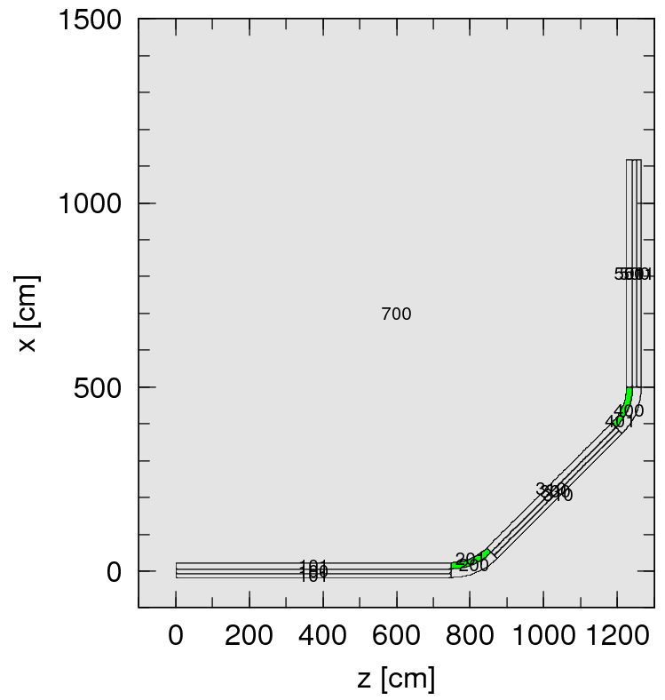
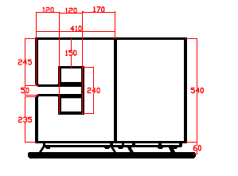
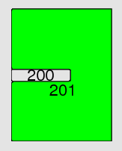
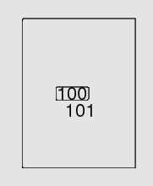
90 degree Bending section
x-y cross sectional view
x-z cross sectional view
Type : C-type dipole magnet
Length : 125.66 cm
Gap : 5 cm
Material: Iron (7.87 g/cm³)
(mm)
618
Dipole magnet
Dipole magnet
Beam transport line
748
480
238U,
18.5 MeV/u

Slide 21
Magnet field correction for ²³⁸U⁹²⁺ in PHITS ver 2.15 or 2.24
[ Magnetic Field ] $ for 92+
reg typ gap mgf trcl
1 4 6.2 3.143*(79/92) 0 $ QM2-1
4 4 6.2 -5.7649*(79/92) 0 $ QM2-2
7 4 6.2 3.7187*(79/92) 0 $ QM2-3
10 4 6.2 0.2248*(79/92) 0 $ QM2-4
15 4 6.2 -2.8556*(79/92) 0 $ QM2-5
17 4 6.2 3.9561*(79/92) 0 $ QM2-6
20 4 6.2 1.9344*(79/92) 0 $ QM2-7
23 4 6.2 -4.6555*(79/92) 0 $ QM2-8
198 2 5.0 -10.0539 0 $ 1st dipole
701 4 10.2 6.4276*(79/92) 1 $ QM3-1
704 4 10.2 -4.3276*(79/92) 1 $ QM3-2
707 4 10.2 -6.2334*(79/92) 1 $ QM3-3
710 4 10.2 5.6328*(79/92) 1 $ QM3-4
713 4 10.2 5.6328*(79/92) 1 $ QM3-5
716 4 10.2 -6.2334*(79/92) 1 $ QM3-6
719 4 10.2 -4.3276*(79/92) 1 $ QM3-7
722 4 10.2 6.4276*(79/92) 1 $ QM3-8
398 2 5.0 -10.0539 0 $ 2nd dipole
B(charge state) = B(79+) x [Q(79+)/Q(charge state)]
For Dipole:
Q(77+) on B(79+) = Q(92+) on B(94+, 0.9840 T)
Q(79+) on B(79+) = Q(92+) on B(92+, 1.0054 T)
Q(81+) on B(79+) = Q(92+) on B(90+, 1.1419 T)
Charge correction factor
[ Magnetic Field ] $ for 92+
reg typ gap mgf trcl
901 4 6.2 -4.6555*(79/92) 3 $qm2-2-1
904 4 6.2 -1.9344*(79/92) 3 $qm2-2-2
907 4 6.2 -3.9561*(79/92) 3 $qm2-2-3
910 4 6.2 -2.8556*(79/92) 3 $qm2-2-4
913 4 2.7 2.4503*(79/92) 3 $qm1-1
916 4 2.7 -3.3422*(79/92) 3 $qm1-2
919 4 2.7 2.0529*(79/92) 3 $qm1-3
922 4 2.7 0.63677*(79/92) 3 $qm1-4
Base Charge State is 79+ after the carbon stripper
Notes:
자기장 보정.
79+ 전하에 해당하는 자기장을 Lorentz force 공식을 적용하여 92+ 전하에 해당하는 자기장으로 환산한다. (79+=92+ 라고 가정하면, 자기장 내 전하에 작용하는 F값은 동일하므로)
78+ = 93+
79+ = 92+
80+ = 91+
…

Slide 22
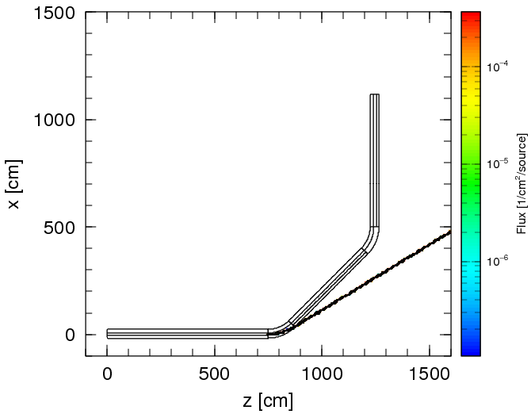
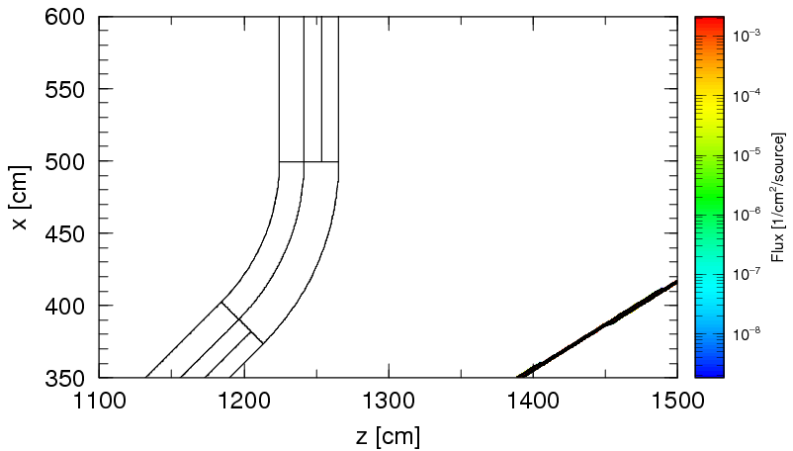
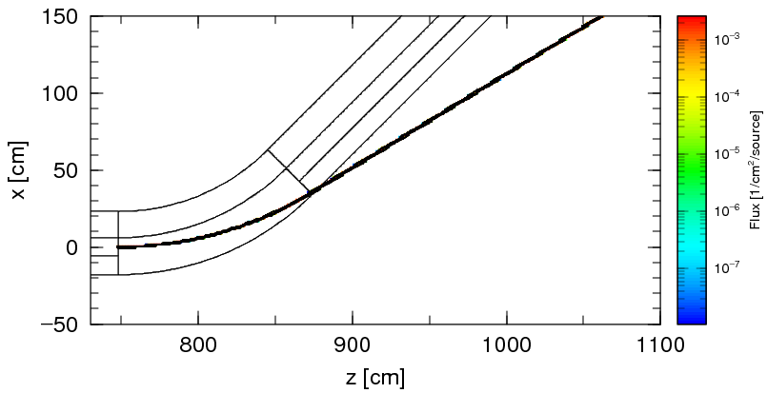
Track of U(33+) at B-field(1.1708T) for U(79+)
All
²³⁸U
+33
+33
²³⁸U
Setting for PHITS
Q = 92+
B = 0.6703 T
equivalent to B-field for U(+138)
+33

Slide 23
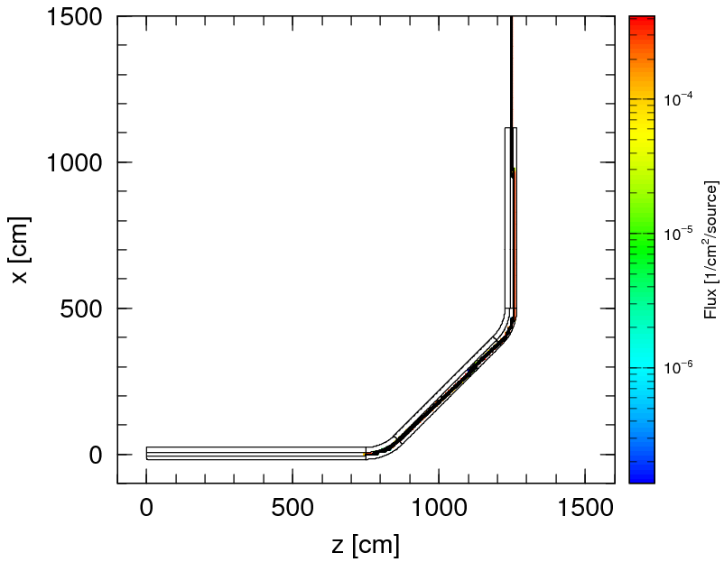
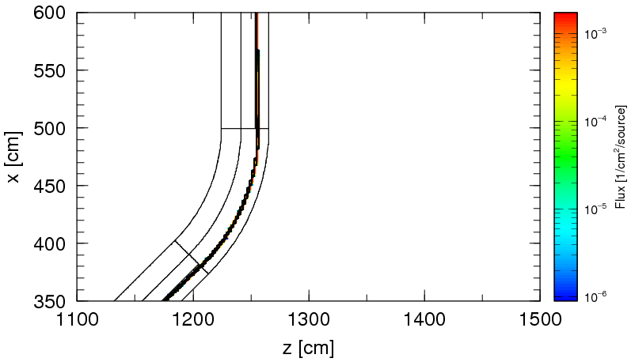
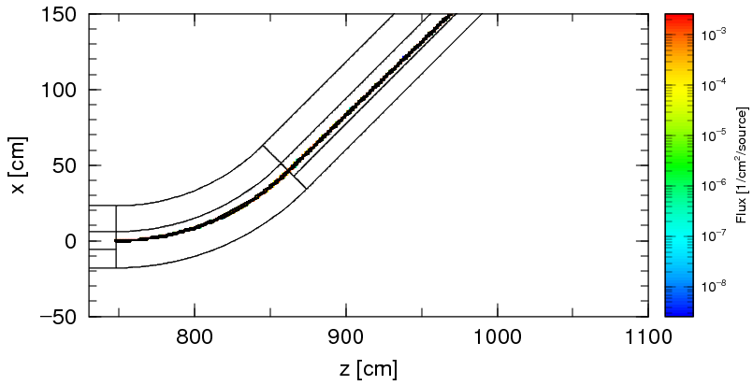
Track of U(77+) at B-field(1.1708T) for U(79+)
All
²³⁸U
+77
+77
²³⁸U
Setting for PHITS
Q = 92+
B = 0.9840 T
equivalent to B-field for U(+94)
+77

Slide 24
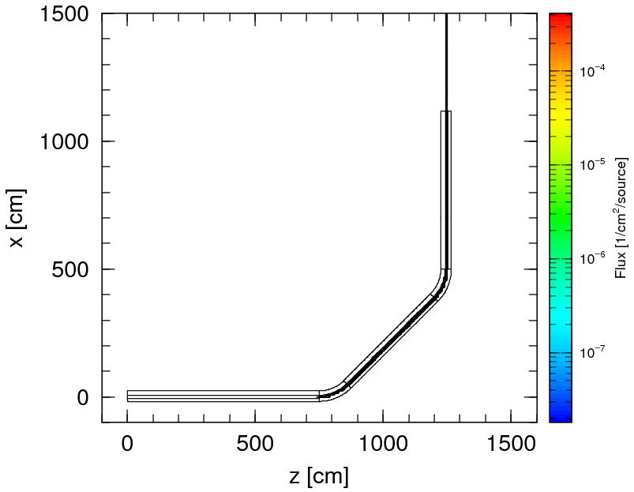
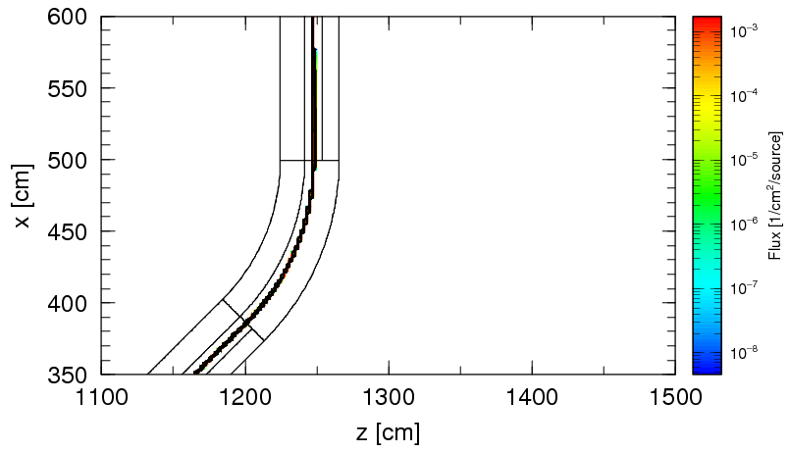
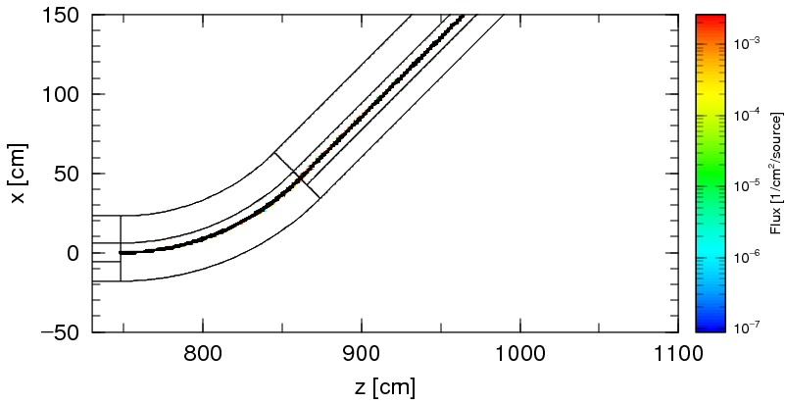
Track of U(79+) at B-field(1.1708T) for U(79+)
All
²³⁸U
+79
+79
²³⁸U
Setting for PHITS
Q = 92+
B = 1.0054 T
equivalent to B-field for U(+92)
+79

Slide 25
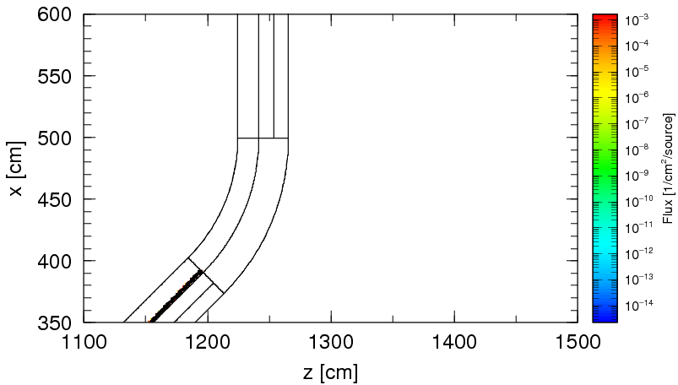
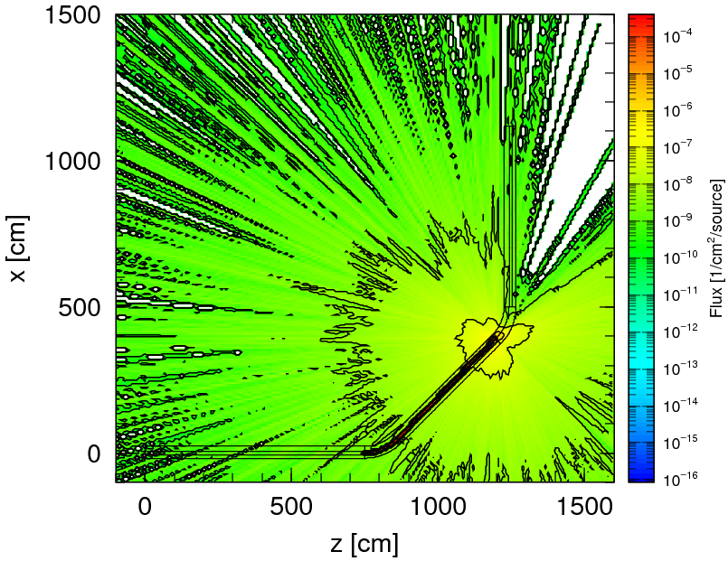
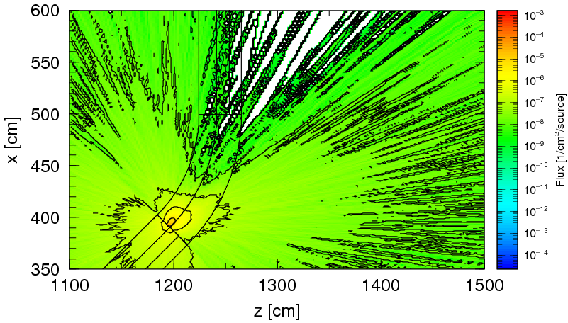
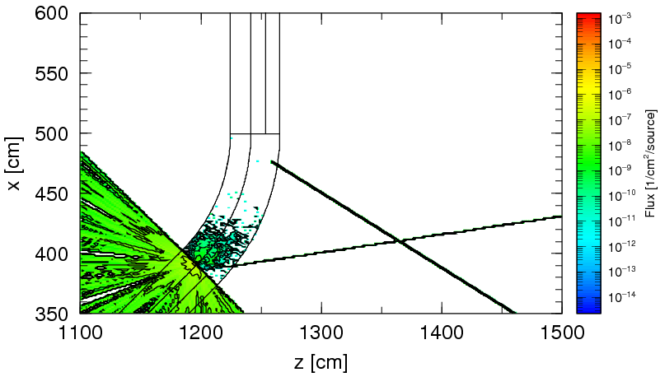
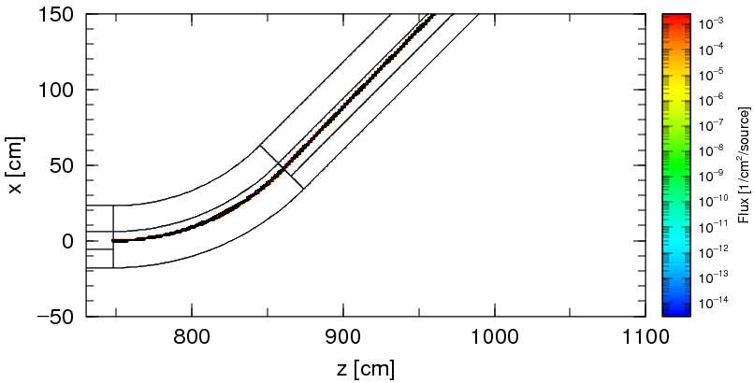
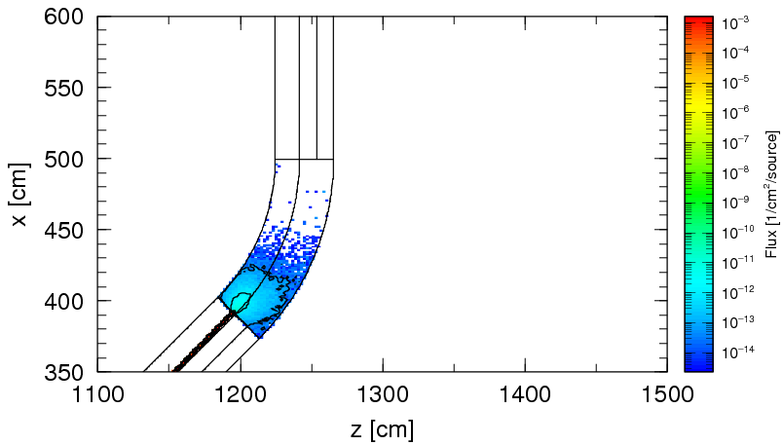
Track of U(+81) at B-field(1.1708T) for U(+79)
²³⁸U
All
+81
Neutron
Proton
²³⁸U
+81
Nucleus
Setting for PHITS
Q = +92
B = 1.0277 T equivalent to B-field for U(+90)

Slide 26
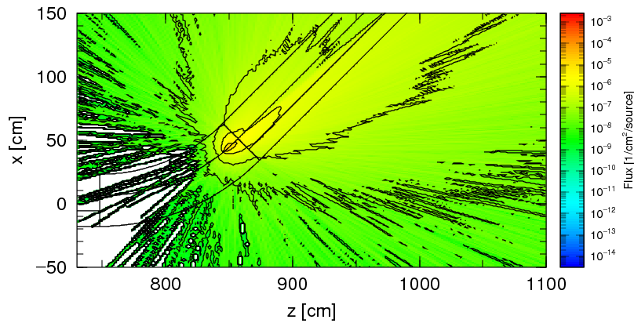
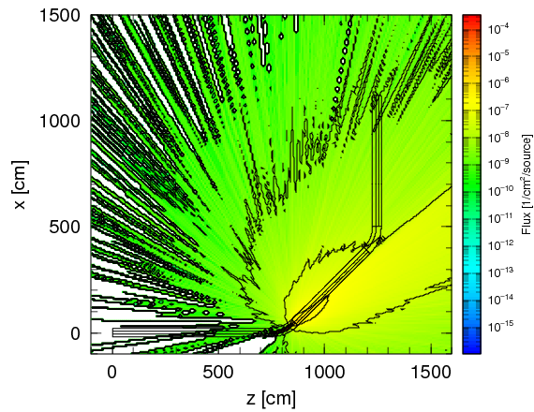
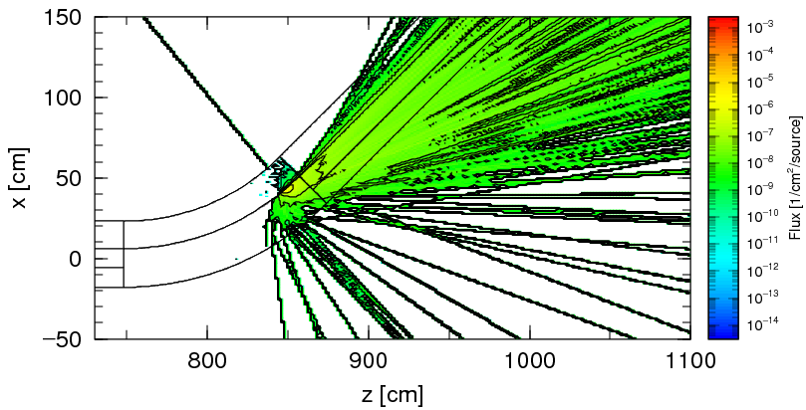
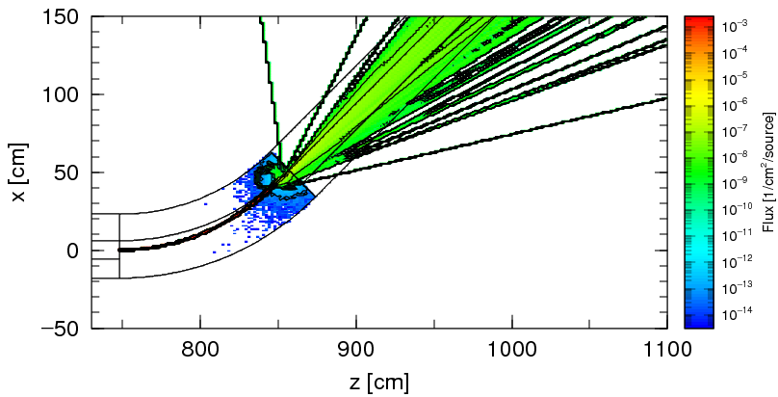
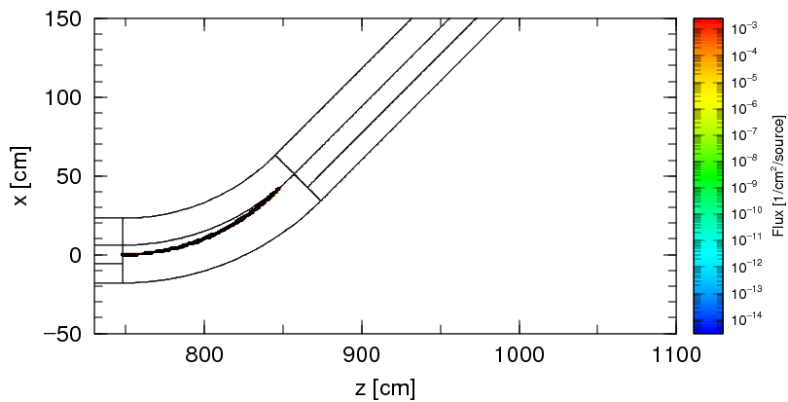
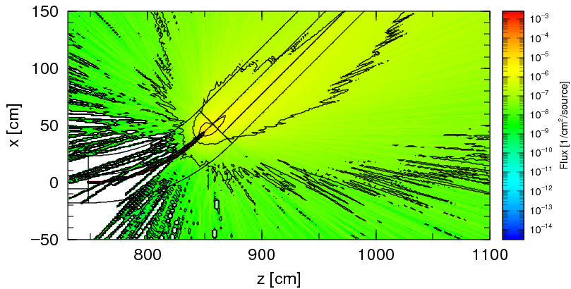
Track of U(+92) at B-field(1.1708T) for U(+79)
All
Neutron
Proton
²³⁸U
Nucleus
+92
Setting for PHITS
Q = +92
B = 1.1708 T equivalent to B-field for U(+79)
All

Slide 27
Transport of multi-charge state ions using FLUKA

Slide 28
Using given subroutine of FLUKA
Geometry
- With a sophisticated system of pre and post-process software are interfaced to FLUKA
Multi-charge transport
- Special routines sample and attached a virtual charge state to each particle exiting the foil and track them appropriately through the magnets
- Probability of different charge states of ions calculated using LISE++ code was used within FLUKA to attach a charge to each ion
Magnetic & Electric fields
- Magfld.f routine is vastly customized to enable multi-charged transport
- There are 2 accelerating stage (SRF cavities) in 90° bending section as far as FLUKA may be implemented electric fields in vacuum, the momentum correction factors are computed. These factor are applied to the corresponding section of the accelerator

Slide 29
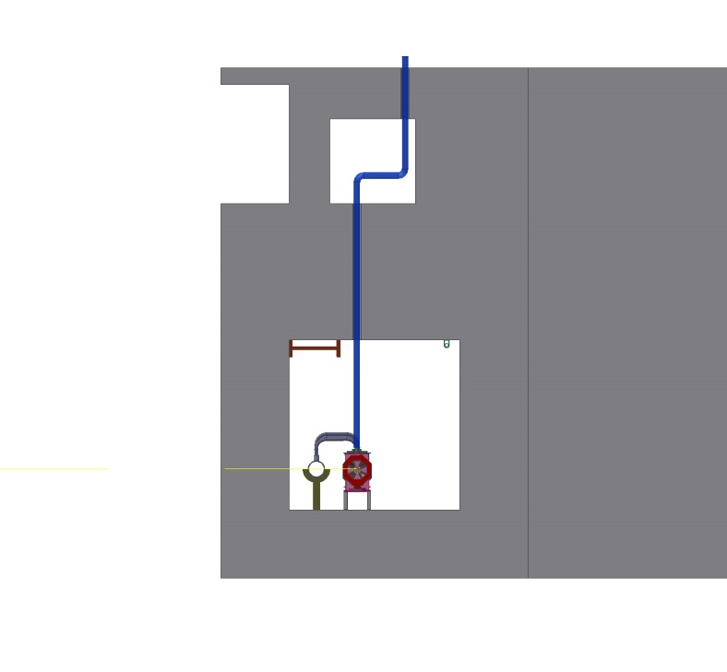
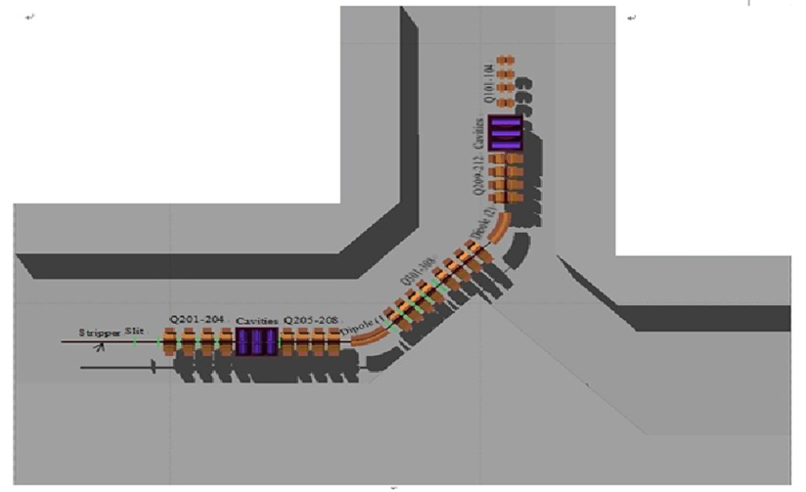
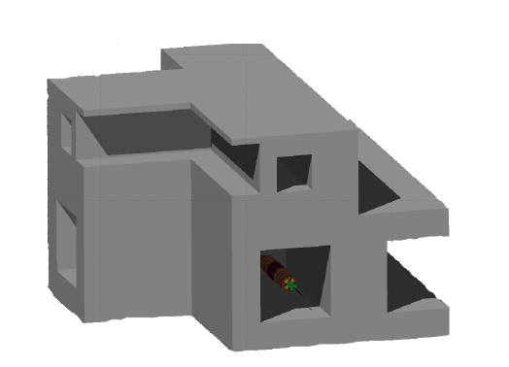
90° bending section implemented using FLUKA
Components: Charge stripper, Quadruple, Bending magnet, Slit, SRF cavity

Slide 30
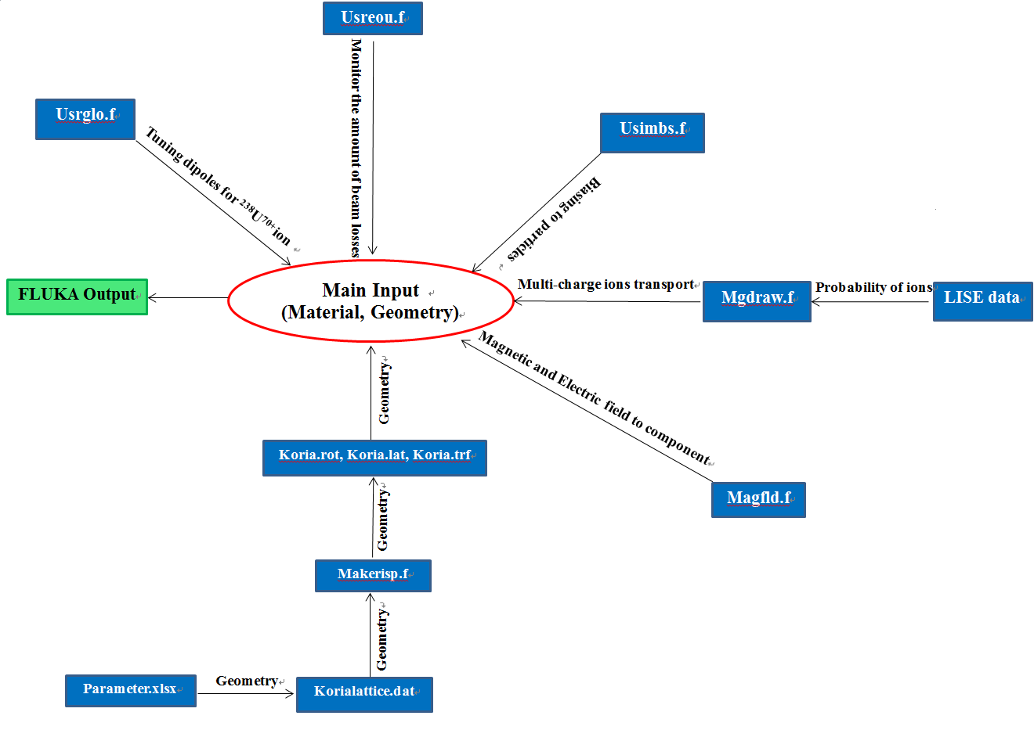
Building a FLUKA input for multi-charged ions transport at Magnetic and Electric field

Slide 31
Implementation of Charge Correction in B-field Application
Variables:
Tcharge(2): Actual charge of ion
Tcharge(1): The charge to which dipoles are set for transport
Zfrttk: effective charge (FLUKA uses an internal effective charge)
Quadruples charge factor : chfact = Tcharge(2)/abs(Zfrttk)
Dipoles charge factor : chfact2 = Tcharge(2)/Tcharge(1)

Slide 32
Implementation of momentum correction for Cavity Effects in B-field application
Because of SRF cavities, the real momentum of charged ions are different at the different period of particle transport beam line
This is to compute the momentum dispersion correction to the charge and the presence of otherwise not accounted for electric fields.
$$pc=\sqrt{E^{2}− {E0}_{}^{2}} = \sqrt{E_{k }\left(E_{k}+2E_{0}\right)}$$
Depend on magnet positions,
Correction factors will be applied

Slide 33
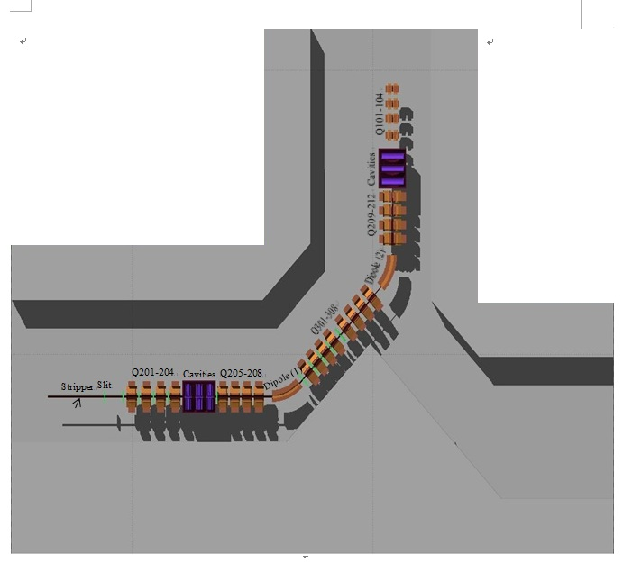
Implementation of momentum correction
²³⁸U ion energy along the Beam line
Before the first cell of cavities : 18.5 MeV
Between two cell cavities: 19.3 MeV
After second set of cavities : 19.7 MeV
Second accelerating stage
First accelerating stage

Slide 34
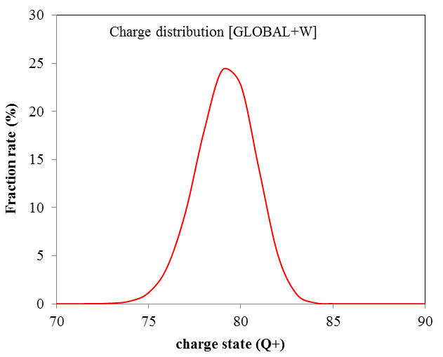
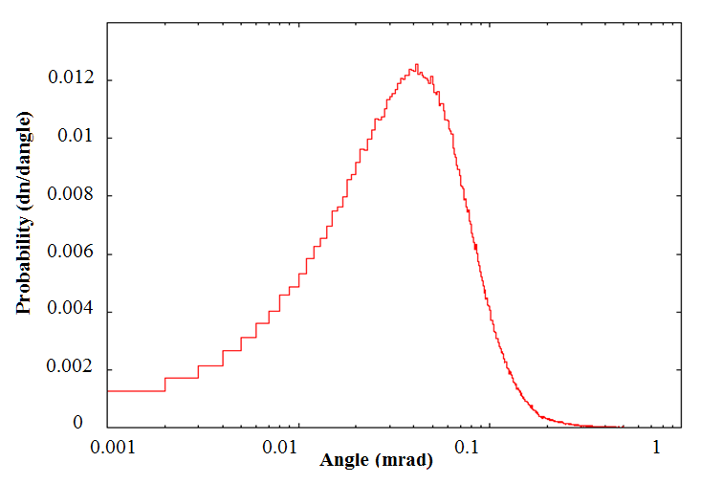
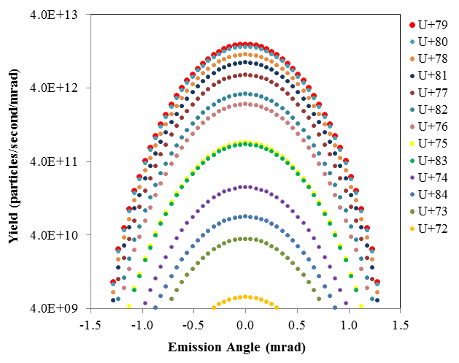
In FLUKA, define actual multi-charged Ions obtained using LISE++
LISE ++: Charge distribution of ²³⁸U ion after stripper
Using Mgdraw.f subroutine
FLUKA
LISE
Multi-charged ion transport
FLUKA: Angular spectrum of ²³⁸U ions at the exit of the 1.3 μm stripper

Slide 35
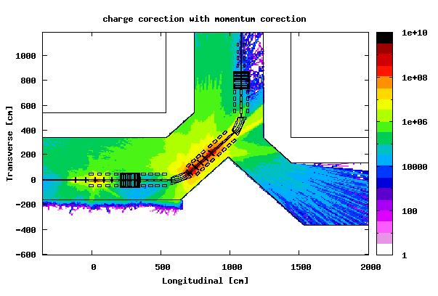
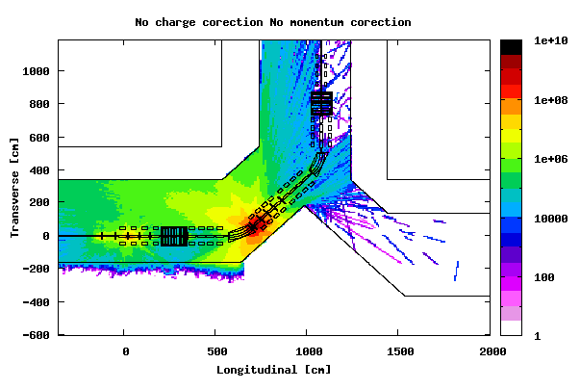
Dose rate equivalent (μSv/h) for 9.5 pμA of ²³⁸U^{33+,34+} through a 1.3 μm carbon stripper
With charge correction and momentum correction
Without charge correction and momentum correction

Slide 36
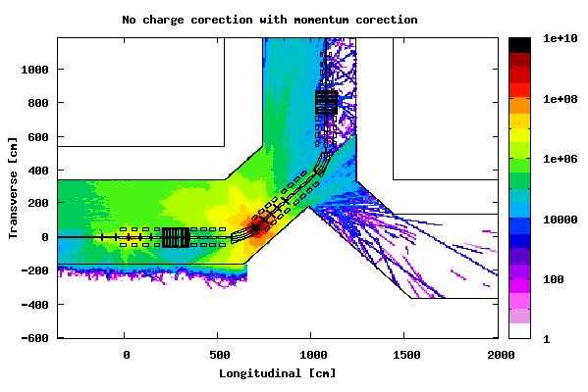
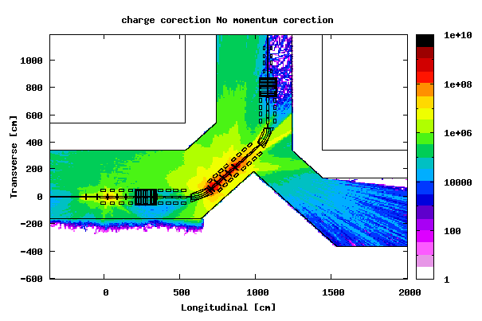
Dose rate equivalent (μSv/h) for 9.5 pμA of ²³⁸U^{33+,34+} through a 1.3 μm carbon stripper
Without charge correction
With momentum correction
With momentum correction
Without momentum correction

Slide 37
Dose rate equivalent (μSv/h) for 9.5 pμA of ²³⁸U^{33+,34+} through a 1.3 μm carbon stripper
Without charge correction with momentum correction
With charge correction and momentum correction
With charge correction without momentum correction
Without charge correction and momentum correction

Slide 38
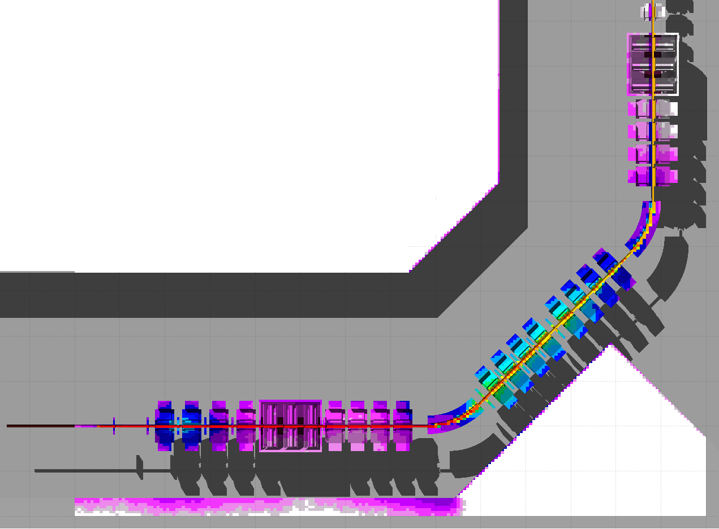
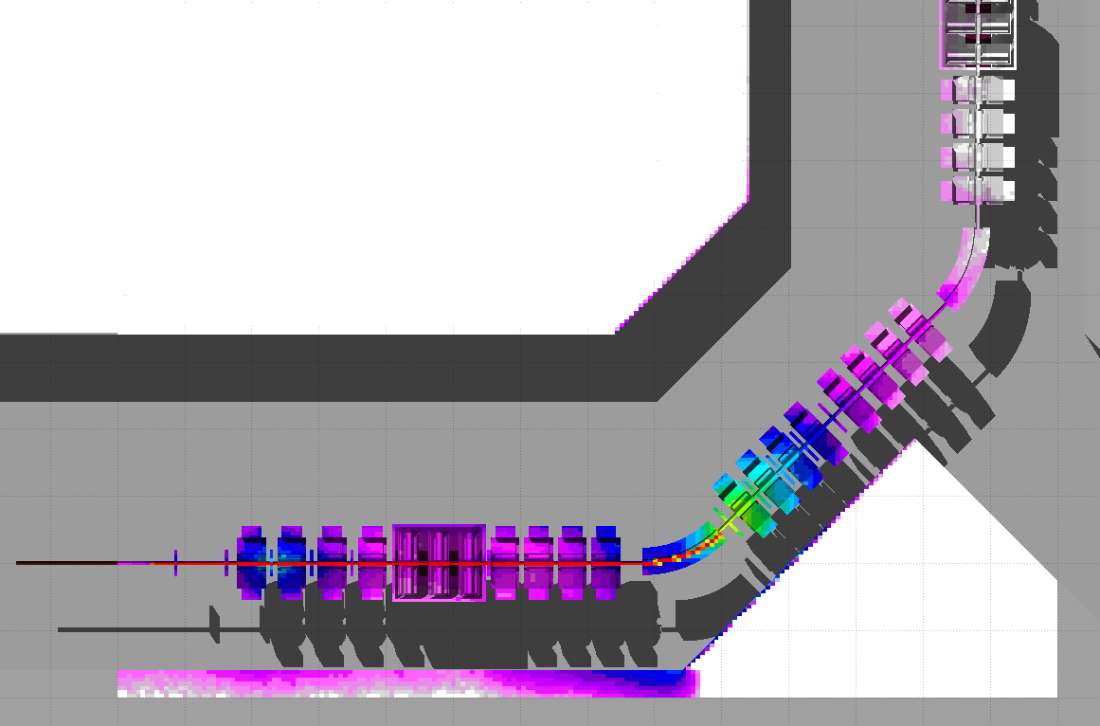
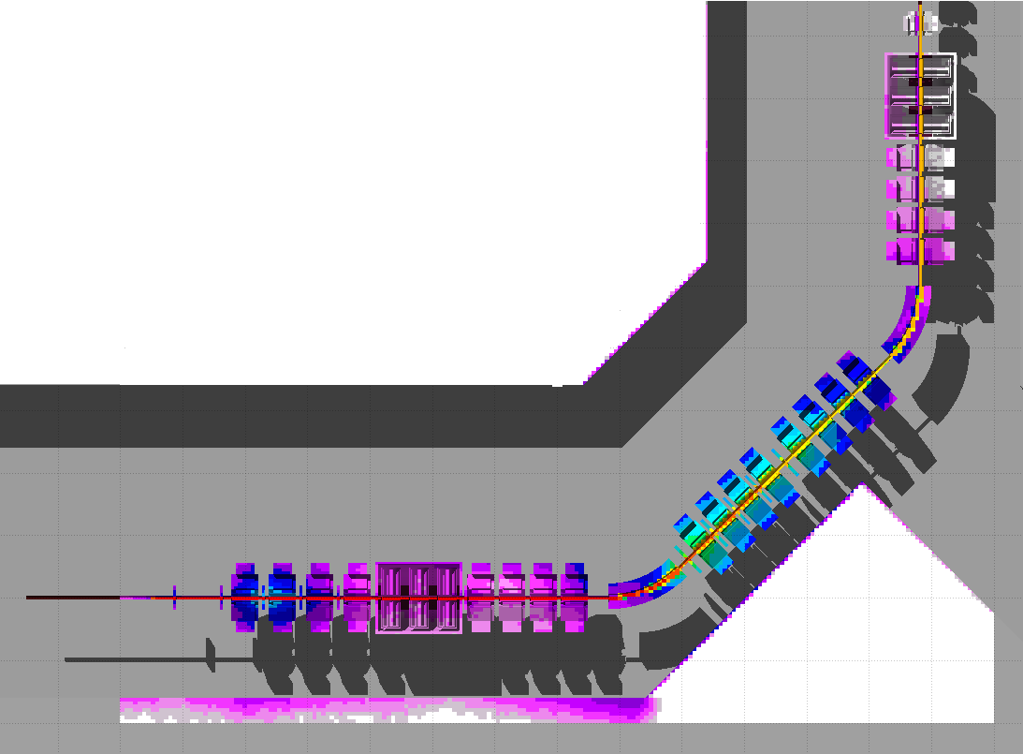
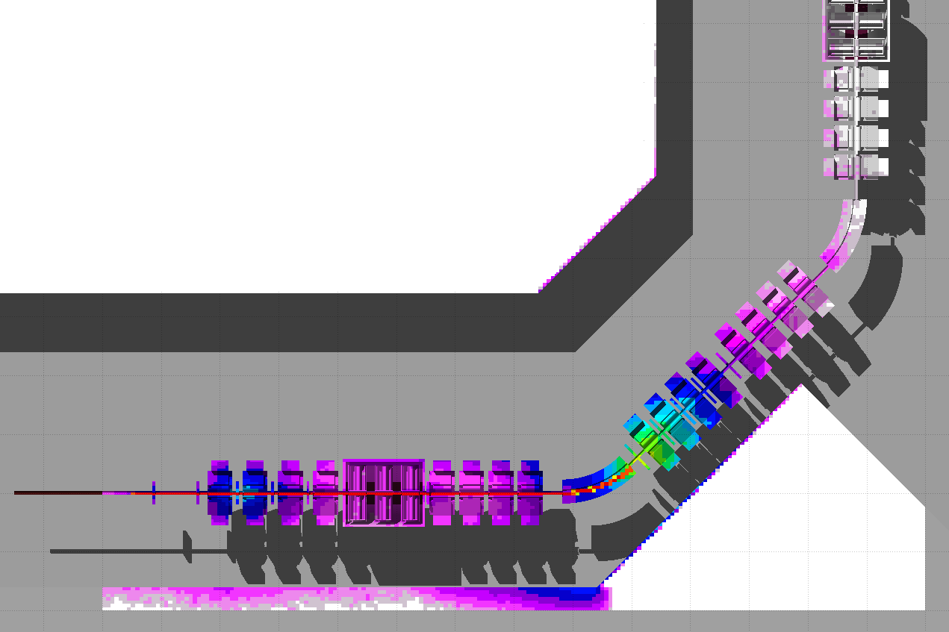
Transport Rate for 9.5 pμA of ²³⁸U^{33+,34+} through a 1.3 μm carbon stripper
(in particle fluence distribution)
With charge correction and momentum correction
Without charge correction and momentum correction
Efficiency : 32.38%
Efficiency : 0.0
With charge correction without momentum correction
Without charge correction with momentum correction
Efficiency : 25.43%
Efficiency: 0.0

Slide 39
Improved Example on PHITS
Transport of multi-charge state ions using PHITS 2.64

Slide 40
Setting for Magnetic and Electro-Magnetic field at latest version of PHITS
[Parameters] section
Imagnf : Magnetic field (D=0)
= 0 without Magnetic field
= 1 with Magnetic field
Ielctf : Electro-Magnetic field (D=0)
= 0 without Electro-Magnetic field
= 1 with Electro-Magnetic field
[soruce] section
izst : Charge state of source particle (D=charge of particle specified with proj=)
* This has an effect only on a motion in the magnetic and electric fields defined in [magnetic field]
and [electro magnetic field] sections.
The charge number defined with izst doesn’t change while the particle moves.
It should be noted that particles produced from nuclear reactions are not affected by the value
of izst; the charge of the produced particle is given as its atomic number.

Slide 41
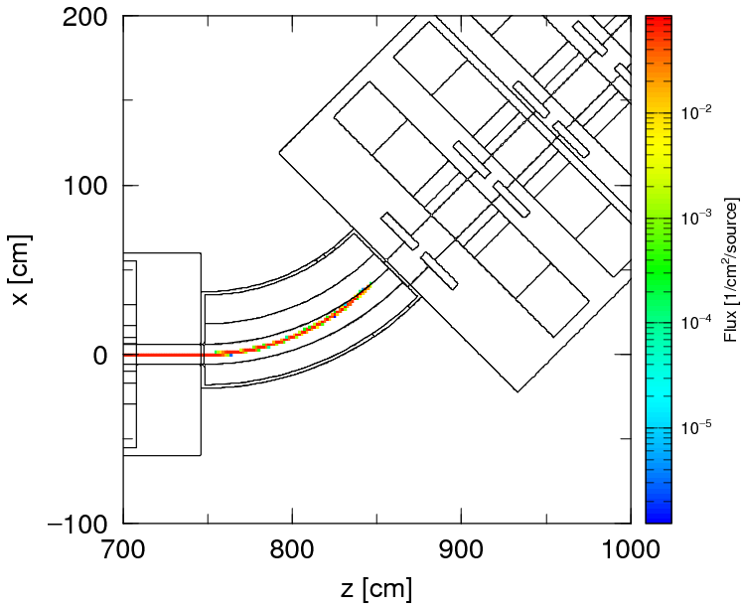
Performance Check : Transport of ²³⁸U⁹²⁺ at magnetic field for ²³⁸U⁷⁹⁺
[ S o u r c e ]
s-type = 3 $ point
proj = 238U
e0 = 18.5
x0 = 0
x1 = 0.4 $ FWHM=0.4cm
y0 = 0
y1 = 0.4 $ FWHM=0.4cm
z0 = 0.1
z1 = 0
dir = 1.0
[ S o u r c e ]
s-type = 3 $ point
proj = 238U
e0 = 18.5
x0 = 0
x1 = 0.4 $ FWHM=0.4cm
y0 = 0
y1 = 0.4 $ FWHM=0.4cm
z0 = 0.1
z1 = 0
dir = 1.0
izst = 92
Default charge state is set as atomic number (fully charged state) of projectile particle.

Slide 42
²³⁸U^{73+, 79+, 84+} transport at magnetic field for ²³⁸U⁷⁹⁺
Multi-Source
[ S o u r c e ]
totfact = 3
<source> = 1
s-type = 3 $ point
proj = 238U
e0 = 18.5
x0 = 0
x1 = 0.1 $ FWHM=0.1cm
y0 = 0
y1 = 0.1 $ FWHM=0.1cm
z0 = 0.1
z1 = 0
dir = 1.0
izst = 79
<source>=1
s-type = 3 $ point
proj = 238U
e0 = 18.5
x0 = 0
x1 = 0.1 $ FWHM=0.1cm
y0 = 0
y1 = 0.1 $ FWHM=0.1cm
z0 = 0.1
z1 = 0
dir = 1.0
izst = 84
<source>=1
s-type = 3 $ point
proj = 238U
e0 = 18.5
x0 = 0
x1 = 0.1 $ FWHM=0.1cm
y0 = 0
y1 = 0.1 $ FWHM=0.1cm
z0 = 0.1
z1 = 0
dir = 1.0
izst = 73
Beam portion: 100 %
84+
79+
73+
Notes:
우라늄 전하 구분계산이 되는지 확인하기 위해서 비율을 100%로 설정하고 계산함.
Izst (Charge state of source particle) 는 [source]정의하는 부분에서 사용할 수 있다. PHITS2.50부터 사용가능 (PHITS2.24에서는 각 전하에 맞는 자기장으로 변화해서 사용했었음)

Slide 43
²³⁸U^{71+ to 85+} transport at the magnetic field for ²³⁸U⁷⁹⁺
Around 2nd dipole
Around 1st dipole
Beam size: FWHM 0.4 cm
Beam position: 0.1 cm after C stripper
History: 100X10⁵ (Result from 43X10⁵
, 16 h @ Window PC)
The fraction rate of produced ²³⁸U ions after carbon stripper using LISE++
99.99 %

Slide 44
²³⁸U^{71+ to 85+} transport at the magnetic field for ²³⁸U⁷⁹⁺
Nucleus
with
²³⁸U^{71+ to 85+}
Neutron
Photon
Proton
ymin = -60 cm
ymax = 60 cm
Beam: ²³⁸U^{79+ to 85+} (18.5 MeV/u)
Beam size: FWHM 0.4 cm
Beam position: 0.1 cm after C stripper (t=1.33 μm)
Notes:
계산시간이 길어진 것은 [t-heat]계산을 동시에 돌려서 입니다.
* 동일한 지점(x=2cm, z=8.5cm 크기)의 중성자 선속량으로 비교했을 때 (izst 사용 전 vs izst 사용 후) : 결론은 생성된 중성자속 값으로 비교했을 때 보정 하여 사용한 방법이 타당하다는 것을 입증함. (내용은 아래와 같음)
* Izst 사용 전 (각 전하에 맞는 자기장 값을 보정하여 적용, 각 전하의 빔 비율을 100%로 입사, 71+ ~ 85+를 전하별로 따로계산)
: 중성자속은 9.39E-10 (n/cm2/source)이다. 71+ ~ 85+의 해당하는 비(LiSE++)율 적용함.
Izst 사용 후 (71+ ~ 85+ 전하를 한꺼번에 전송, multi-source정의 할 때 LISE++ 비율적용함) : 중성자속은 6.76E-10 (n/cm2/soruce)이다.
izst적용전(olde method)의 중성자속이 izst 적용후(New method)에 비해 1.39배 정도 높다. (이유는 izst 적용후의 계산 이력수가 2배정도 작다)

Slide 45
Energy Deposition from ²³⁸U^{71+ to 85+} transport
ymin = -60 cm
ymax = 60 cm

Slide 46
Summary
Multi-charged ion beam transport was implemented in FLUKA and PHITS codes with charge distribution and angular distribution obtained by LISE++.
The contribution of the charge and/or momentum correction was proved very clearly.
To obtain a realistic model of beam losses along beam transport line, it is obligatory to consider charge and momentum of projectile ions.
It can be available to estimate the transport efficiency at specific beam transport section

Slide 47
Suggestion for tomorrow
Even minor improvement for charged ion beam is expected to MC code developers considering some accelerator components with E-M field.
If possible, user-friendly subroutine is preferred.
How accurate is this particle tracking tool at MC codes in comparison with codes used in beam physics?
How is the contribution effects of orbital electrons in physical interaction with matter?

Slide 48
One approach for U beam
Benchmarking experiment using Low Energy Uranium beam
- Be stripper section of RIKEN RIBF
- Beam : 50 MeV/u, ²³⁸U⁶²+
- Passive detectors are applied

Slide 49
Thank You for Your Attentions !

