Slide 1
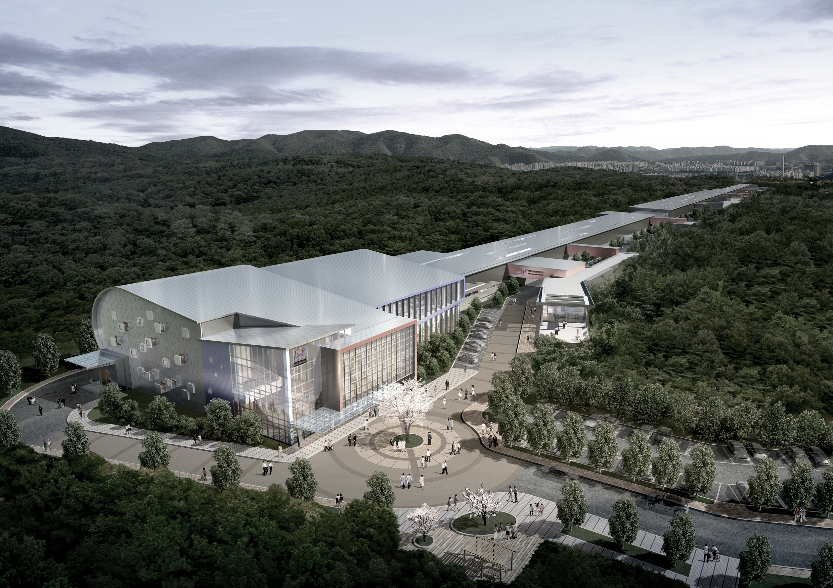
Design for Radiation Shielding of PAL X-ray Free Electron Laser
Nam-Suk Jung, Hee-Seock Lee, Joo-Hee Oh
Radiation Protection Team
Pohang Accelerator Laboratory/POSTECH

Slide 2
Outline
Introduction of PAL-XFEL and Safety Control
▷ Safety Policy & Area Classification
Beam Loss Scenarios and Radiation Shielding Design
▷ Normal Loss & Accidental Loss Scenario
▷ Bulk Shielding
▷ Entrance, Trench, Sleeve, Duct Design at Tunnel with Target Assumption
▷ Tune-up Dump Design (Preliminary)
▷ Main Beam Dump Design
▷ Safety Shutter at Accidental Loss Scenario (Preliminary)
▷ Neutron Skyshine Evaluation
Summary

Slide 3
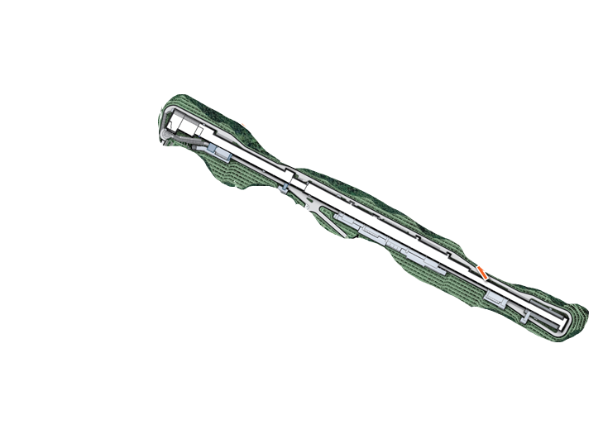
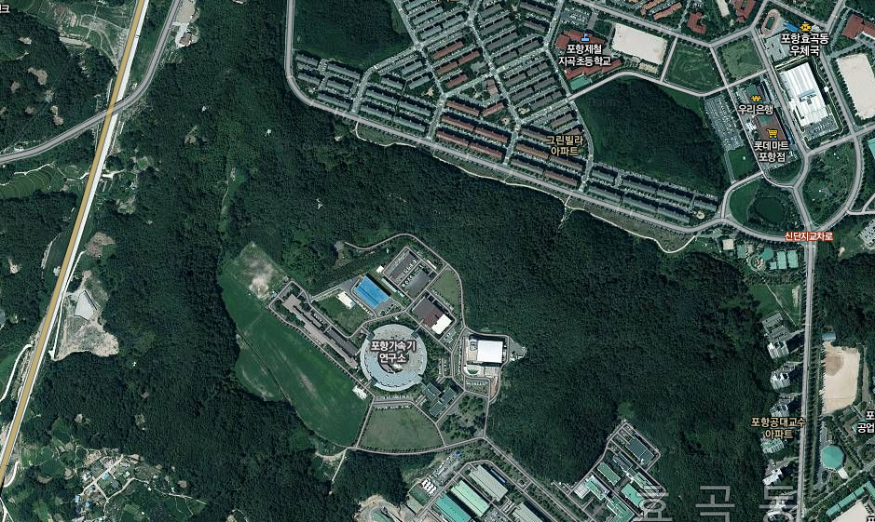
Bird-Eye-View of PALXFEL
PALXFEL
(4th SR)
PLS-II
(3rd SR)

Slide 4
What is the PAL-XFEL ?
Pohang Accelerator Laboratory (PAL)
Hard X-ray FEL using 10 GeV electron
Soft X-ray FEL using 3.15 GeV electron
Linac | Beam energy, GeV | 10
 | Beam charge, nC | 0.2
 | Slice emittance, mm-mrad | 0.4 (0.6⁺)
 | Injector gun | PC RF-gun
 | Peak current at undulator, kA | 3
 | Repetition rate, Hz | 60
 | Number of bunch | Single or Two
 | Linac structure | S-band
Undulator | Undulator type | Out-vacuum
 | HX undulator gap (minimum), mm | 7.2
FEL | Hard X-ray wavelength, nm Soft X-ray wavelength , nm | 1 ~ 0.06 10 ~ 1.0
 | FEL radiation power @ 0.1 nm wavelength and 60 fs photon beam length, GW | 30⁺⁺
 | Photon flux @ 0.1 nm, photons/pulse | > 1.0 E+12
Electron beam power : 120 or 240 W
Notes:
⁴

Slide 5
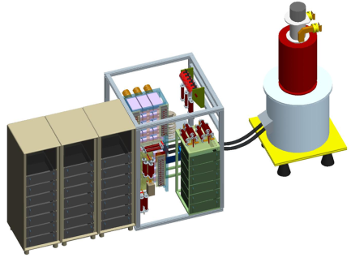
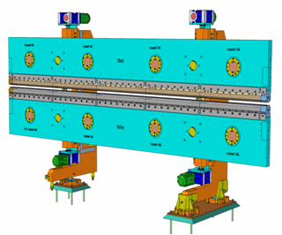
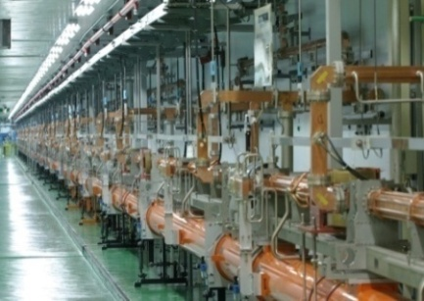
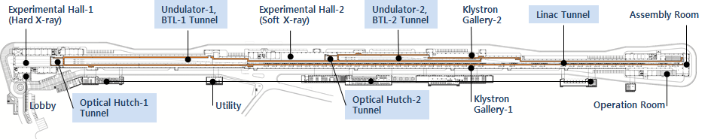
General Layout of PALXFEL
Out vacuum Undulator
(EURO-XFEL undulator design )

Slide 6
Safety Policy of PAL
□ Radiation Control Policy based on Korean Regulation
- Annual dose limit for radiation worker: 20 mSv/year
- Annual dose limit for publics: 1 mSv/year
- Environmental limit (Site boundary): 0.25 mSv/year
- 6 mSv/yr for frequent visitors, 10 μSv during 1 hour for temporary visitors
□ Shielding Criteria based on ALARA
- 10 mSv/year on Surface (2000 h ⇒ 5 μSv/hour)
- 1 mSv during 1 hour for accidental event
- Area requirements (e.g. 0.4 mSv/week)
□ Area Classification
- Restricted Area: 0.25 mSv/y < Dose < 1 mSv/y
- Generally-Controlled Area: 1 mSv/y < Dose < 20 mSv/y
(a dosimeter is required)
- Radiologically-Controlled Area: 20 mSv/y < Dose < 1 mSv/h
- High Radiation Area: 1 mSv/h < Dose
(No Access)

Slide 7
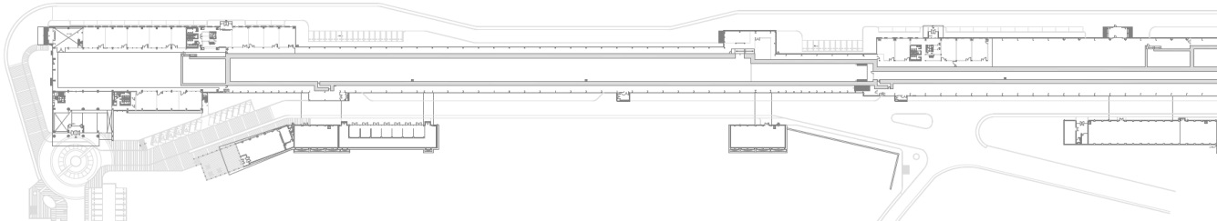
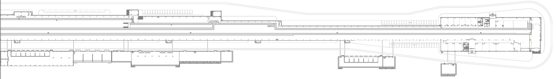
Area Classification of PAL-XFEL
High Radiation Area (Radiologically-Controlled Area after machine OFF)
Radiologically-Controlled Area
Generally-Controlled Area
Safety Shutter closing
1F

Slide 8
Normal Beam Loss Scenario
Normal beam loss scenario of the PAL-XFEL
1) Full power beam loss at main beam dump
: 120 or 240 W for HX linac (10 GeV, 0.2 nC, 60 Hz, 1 or 2 bunch)
2) Low power beam loss at linac and undulator section
  < Limit of loss level from beam physic group >
  - Linac : 1.2 W, 1% (2.4 W for 2 bunches)
  - Undulator : 0.12 W, 0.1% (0.24 W for 2 bunches)
  3) Low power beam loss at several dumps such as
  tune-up dump (10 Hz) and spectrometer dumps
  (60 Hz at 330 MeV, less than 10 Hz at 3.15, 10 GeV)
  4) Low power beam loss upstream the main dump magnet : 0.1% loss
  5) Beam halo interaction with collimator : not considered yet
  6) Beam interaction with diagnostics like screen, wire scanner

Slide 9
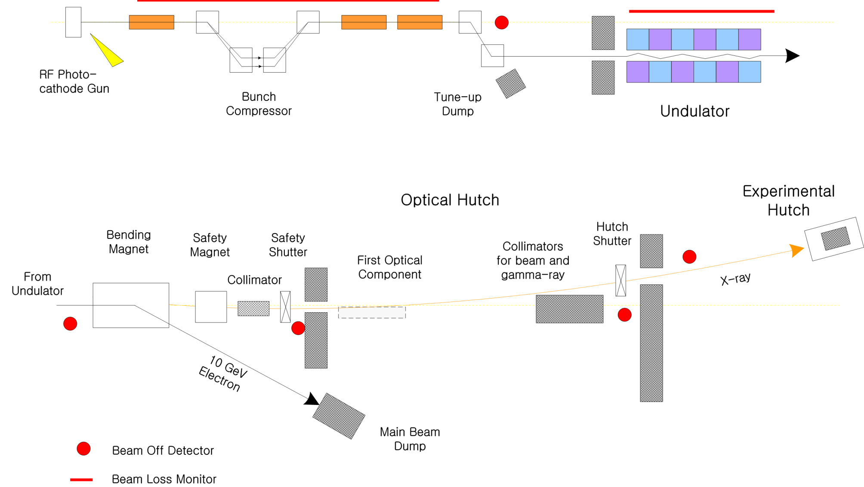
Accidental Beam Loss Scenario
Accidental beam loss scenario of the PAL-XFEL
1) High power beam loss above loss limit at linac and undulator section
⇒ Interlocked by MIS and PSIS
2) Failure or malfunction of main dump magnet
3) High power beam loss upstream the main dump magnet
⇒ High energy radiation at forward direction can reach experimental area.
<Redundancy>
- Beam Off Detector
- Charge Comparator
- Safety magnet
(permanent)
- Collimators
- Fixed beam stopper
- Shutters

Slide 10

Shielding Analysis Methods
Bulk tunnel shielding using fundamental semi-empirical formula
: Methods different to one for PLSI & II, SHIELD11 (SLAC)
: using Monte Carlo code, FLUKA
Analyzing for detailed geometries such as entrance, trench,
sleeve and duct at the tunnel
: using Monte Carlo code, FLUKA
Analyzing for complicated area after undulator to hutch
including main beam dump : using Monte Carlo code, FLUKA
Skyshine : using Monte Carlo code PHITS(with known eq.& SHINE-III)
Muon shielding : using Monte Carlo code, FLUKA
Gas bremsstrahlung : Ferrari & Tromba’s equation (Negligible!)

Slide 11
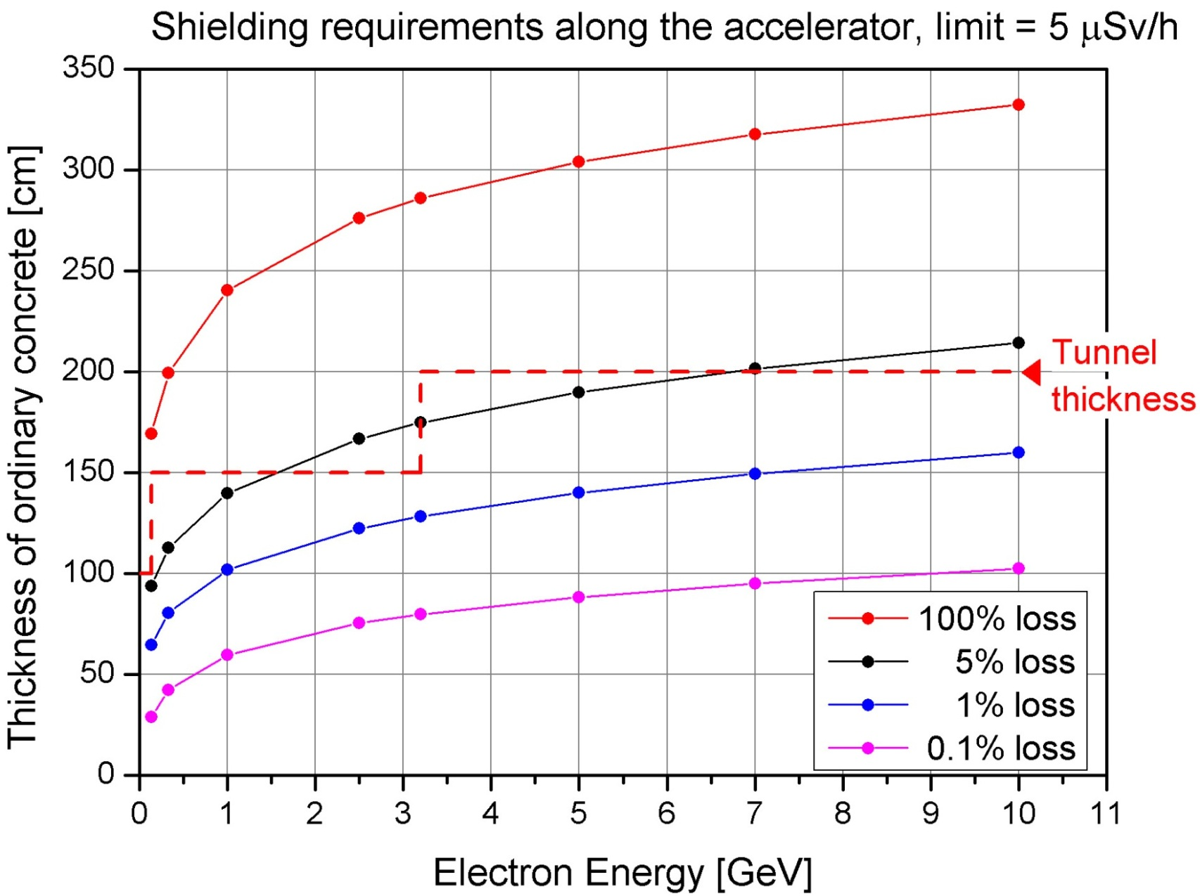
Required Thickness at Different Energy
Using SHIELD11

Slide 12
Tunnel Thickness
Determine the different thickness according to the electron energy
Section | Electron energy [GeV] | Thickness of the concrete [cm]
Injector | 0.139 | 100 (*L), 150 (R)
Linac | < 3 | 150 (L, R)
 | 3 ~ 10 | 200 (L, R)
SX undulator | 3.15 | 150 (L, R)
HX undulator | 10 | 200 (L, R)
* L : left side toward beam direction, R : right side
Main beam dump (100x100x130 cm³ iron) installed at the pit
: changing beam direction using main dump magnet

Slide 13
Door, Maze, Trench, Sleeve, Duct
< Target assumption for FLUKA calculation >
• Location of door, maze, … : Sideward direction (90º)
⇒ Assumption of the target which produces intense radiation fields
toward the sideward direction is required to evaluate
conservative shielding design.
• 10 GeV, 3.15 GeV electrons on 1X₀, 10X₀, 20X₀ thickness iron target
(1X₀ of iron = 1.76 cm)
1) Calculation of maze entrance at the HX and SX undulator tunnel
⇒ Decide the thickness of target
2) Calculation of upper trench(square hole) and sleeve at the SX
undulator tunnel
⇒ Decide the relative position between target and structures

Slide 14
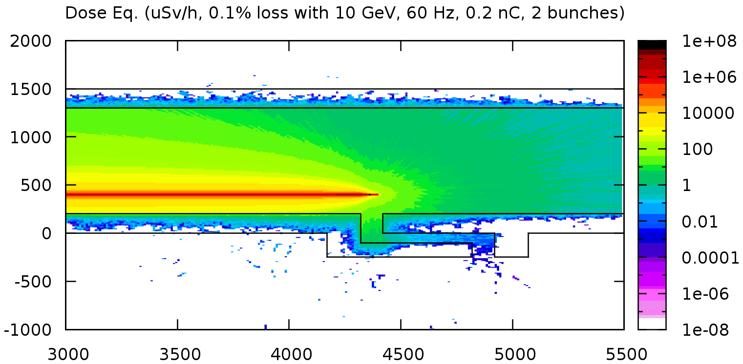
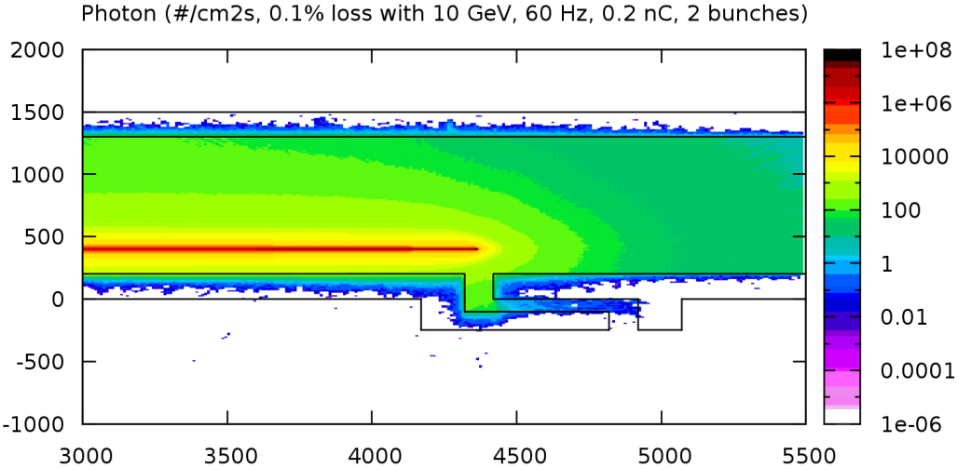
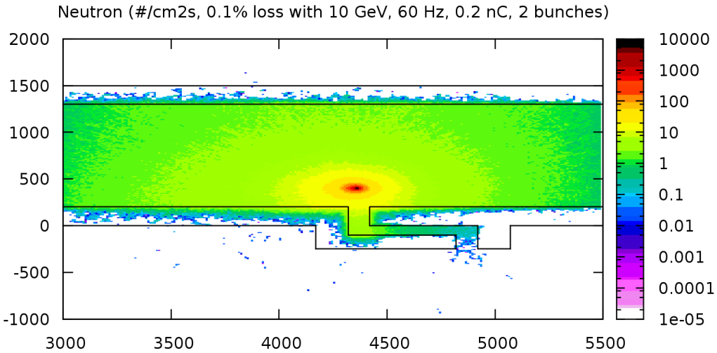
Door, Maze, Trench, Sleeve, Duct
< 10 GeV electrons on 1X₀ iron target >
⇒ Not effective for sideward structure but reasonable assumption for accidental loss
scenario such as ‘high power beam loss upstream the main dump magnet’

Slide 15
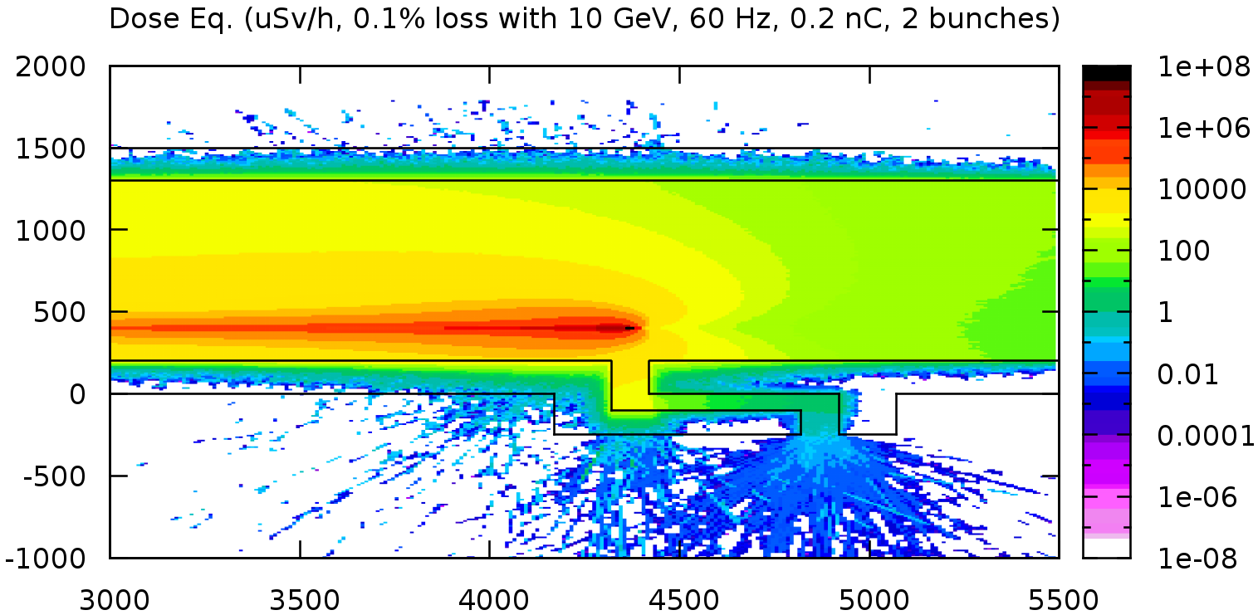
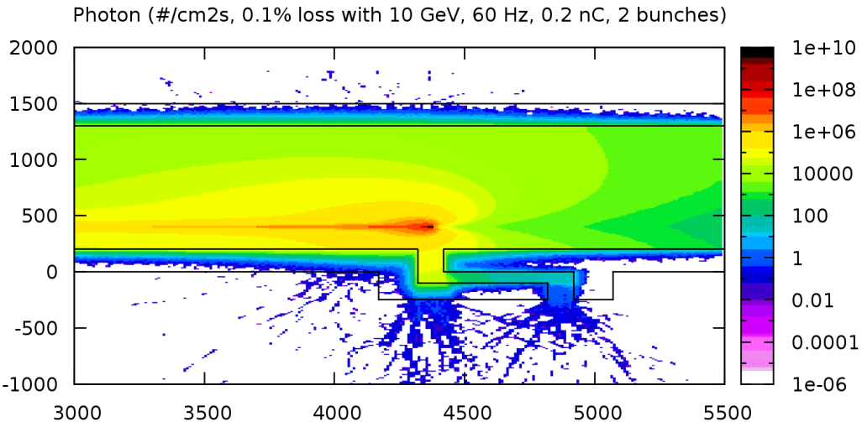
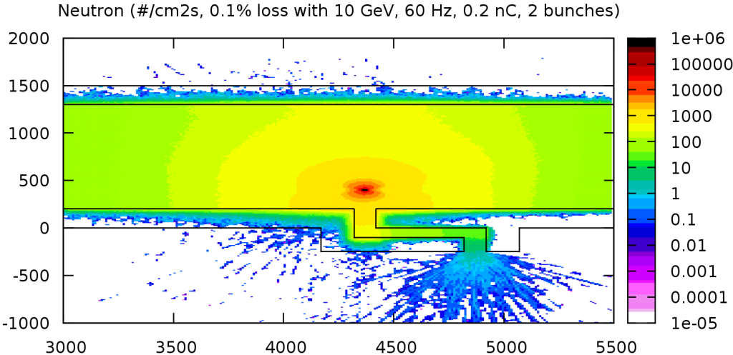
Door, Maze, Trench, Sleeve, Duct
< 10 GeV electrons on 10X₀ iron target >
< 1 μSv/h

Slide 16
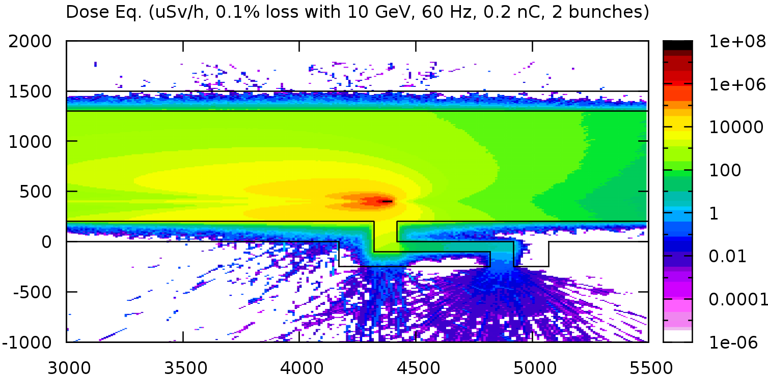
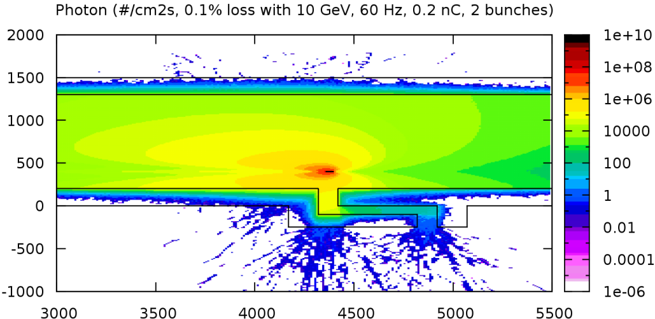
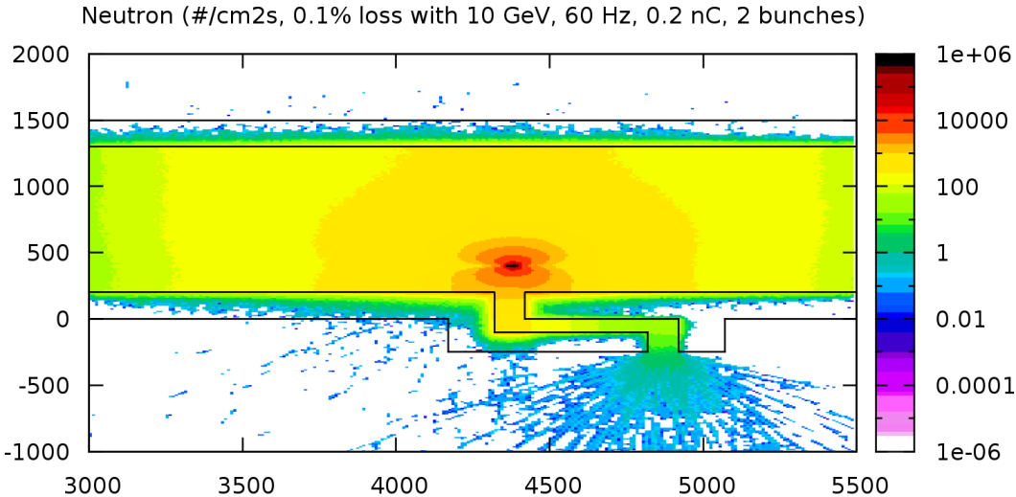
Door, Maze, Trench, Sleeve, Duct
< 10 GeV electrons on 20X₀ iron target >
< 1 μSv/h
⇒ leakage dose eq. rate (maze exit or tunnel wall) with 10X₀ and 20X₀ Fe < 1 μSv/h (similar)

Slide 17
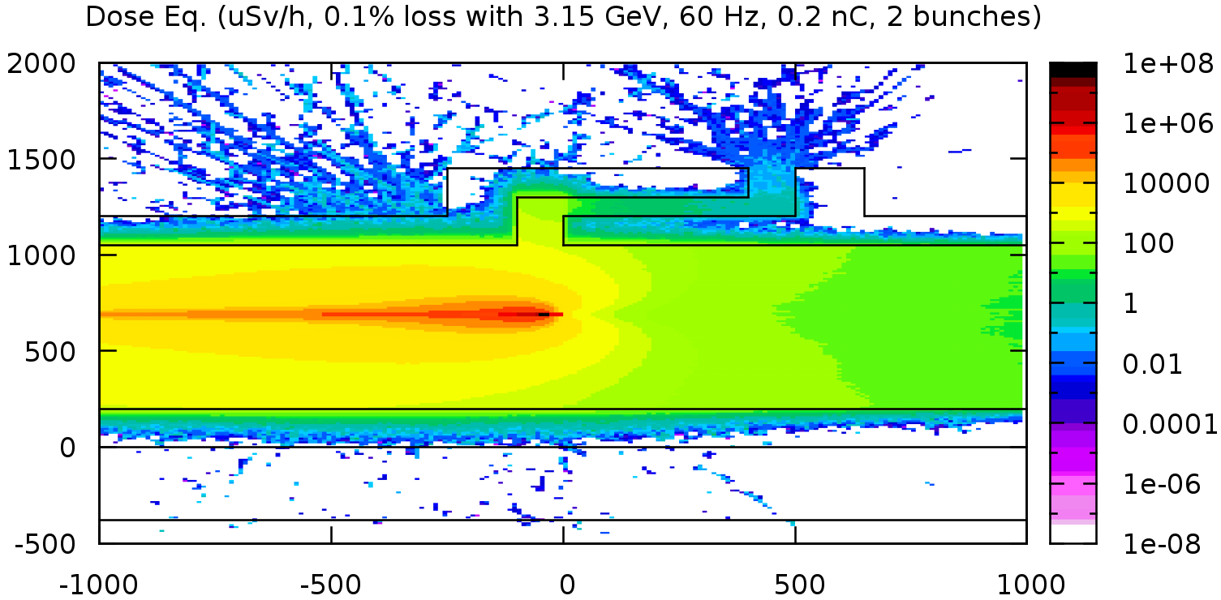
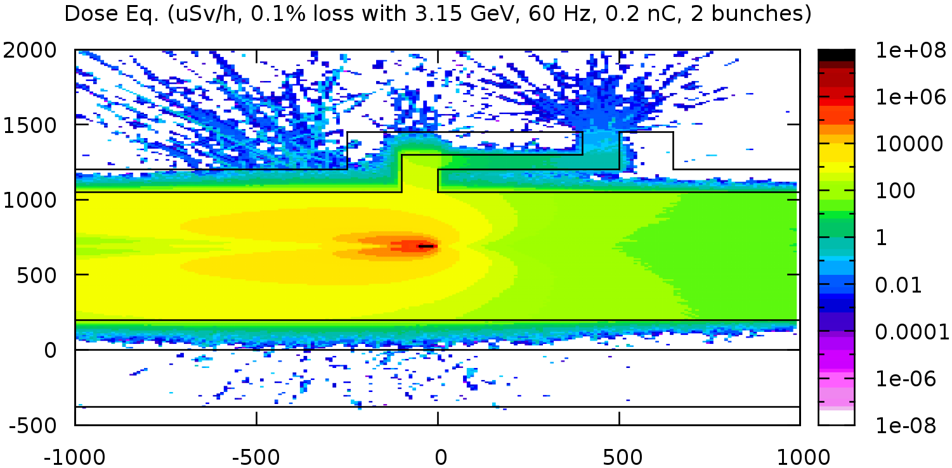
Door, Maze, Trench, Sleeve, Duct
< 3.15 GeV electrons on 10X₀, 20X₀ iron target >
< 1 μSv/h
⇒ leakage dose eq. rate
(maze exit or tunnel wall)
with 3.15 GeV electrons
on 10X₀ and 20X₀ Iron
< 1 μSv/h (similar)
10X₀
< 1 μSv/h
∴Select 20X₀ thick iron
for sideward shielding
calculation
20X₀

Slide 18
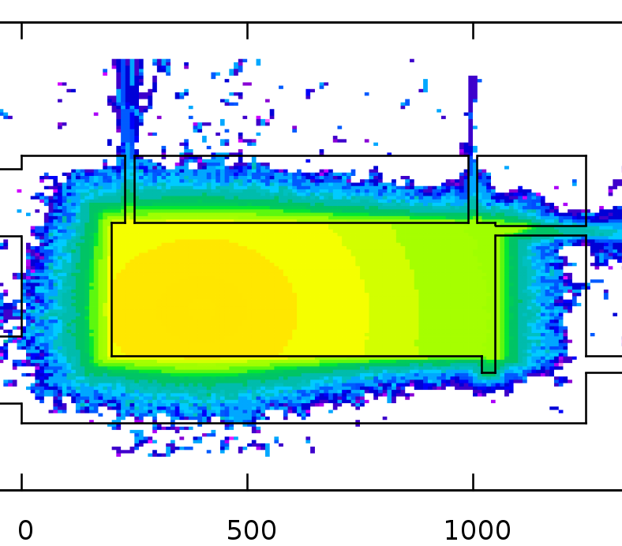
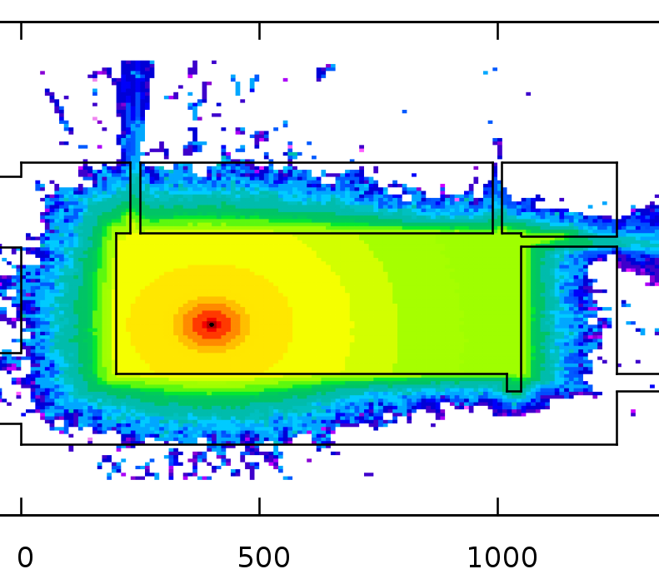
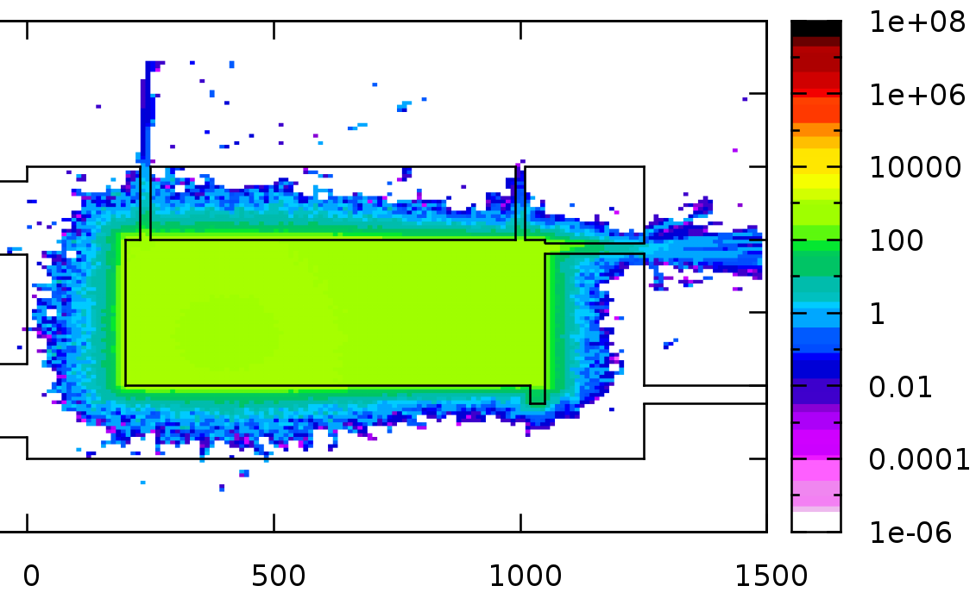
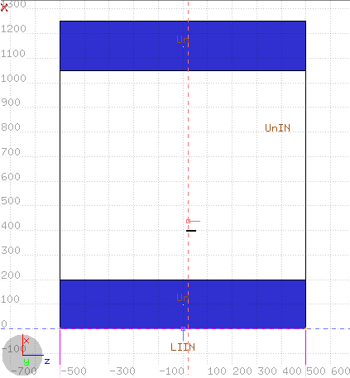
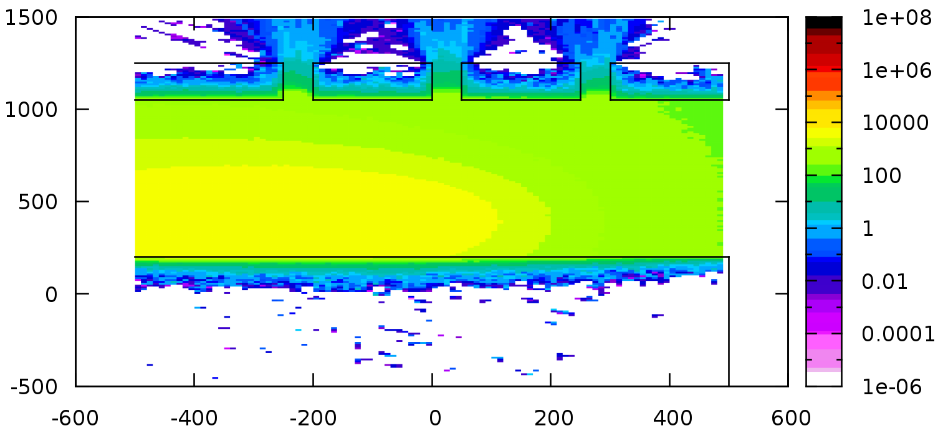
Door, Maze, Trench, Sleeve, Duct
< Position assumption of thick target >
Dose Equivalent, μSv/h, XY plane, 0.1%
1
2
3
1
2
3
2.5 m 2.5 m
Dose Equivalent @ ZX plane, square hole height
Target, 20X₀
⇒ position (90º from thick target)
: reasonable assumption w/o position definition
2

Slide 19
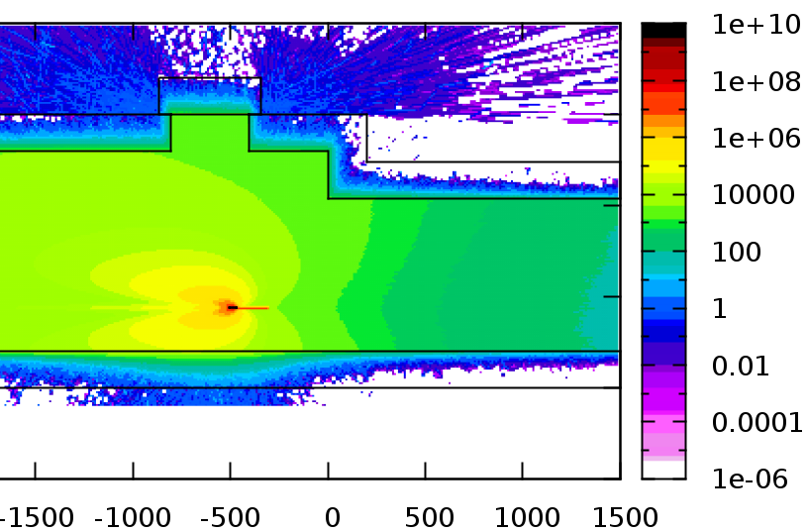
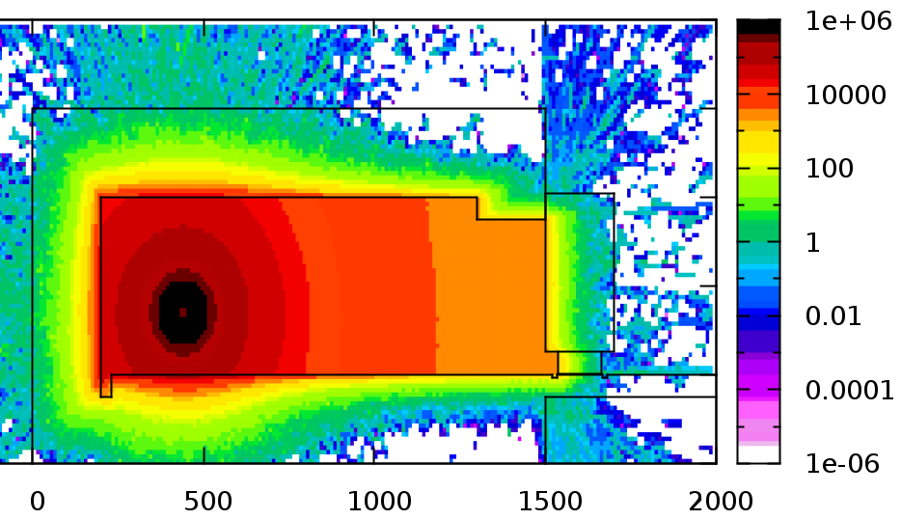
Tunnel Entrance : Door
< Example of sliding door >
Dose Equivalent, μSv/h, ZX plane
3 μSv/h
2 μSv/h
- Material & thickness : O.C., 2 m
(wheel location) : Iron, 1.26 m
- Gap bet. door and floor : 10 mm
- Gap bet. door and tunnel wall
: 15 mm
- Overlap length : 60 cm (all sides)
- Thick iron target
- 2.4 W loss (1%, 2 bunches)
3 μSv/h
3 μSv/h
2 μSv/h
3 μSv/h
3 μSv/h
Dose Equivalent, μSv/h, XY plane

Slide 20
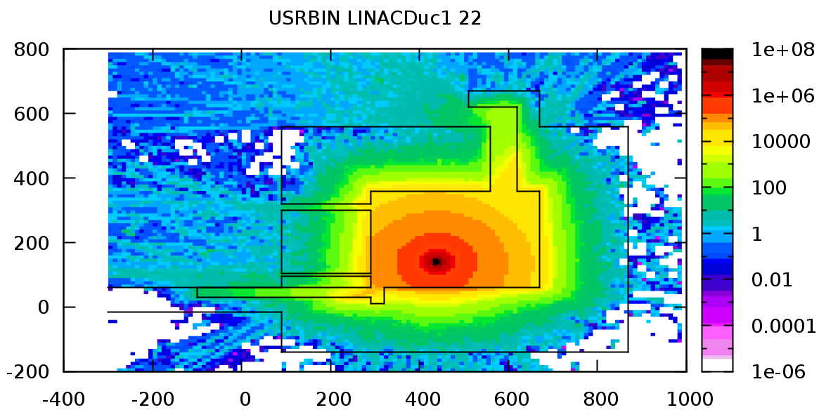
Trench, Sleeve, Duct at Tunnel
< 5 μSv/h
8
6
5
4
7
Dose Equivalent, μSv/h, XY plane
1
3
2
- Thick iron target
- 2.4 W loss
(1%, 2 bunches)
Exit of waveguide sleeve : 7.2 ± 1.9 μSv/h
Exit of LCW sleeve (upper) : 6.8 ± 0.9 μSv/h
Trench exit, 1 m away from wall : 5.5 ± 0.7 μSv/h
Duct exit : 40.3 ± 1.5 μSv/h
1 m away from duct exit : 6.8 ± 1.6 μSv/h
2.7 m away from duct exit : 3.0 ± 2.0 μSv/h
Opposite side of duct exit : 5.7 ± 2.4 μSv/h
Roof of duct : 2.2 ± 1.1 μSv/h
Trench, sleeve
: Measure dose and
install additional
shield if required
Duct : Do the access
control to the tunnel roof
(fence installation)

Slide 21
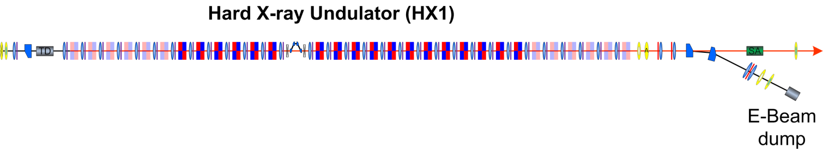
Tune-up dump
▷Purpose of tune-up dump
: Protection of undulator magnet through the mis-aligned electron beam
in the undulator during tune-up period
▷Concept of PAL-XFEL tune-up dump
: Deflecting beam to beam stopper (collimator) by inserting the dipole magnet
▷Location and initial condition of PAL-XFEL tune-up dump
Preliminary !
10 or 4 GeV, 0.2 nC
10 Hz operation (Goal)
: 20 W or 8 W

Slide 22
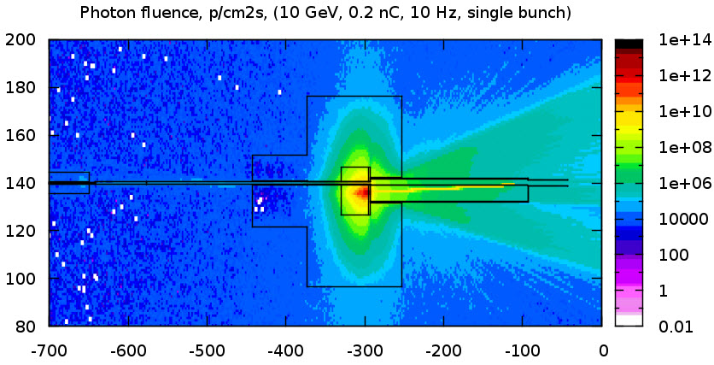
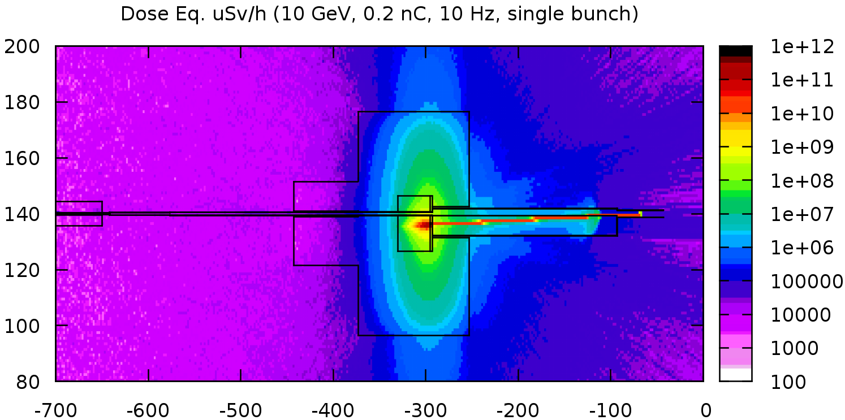
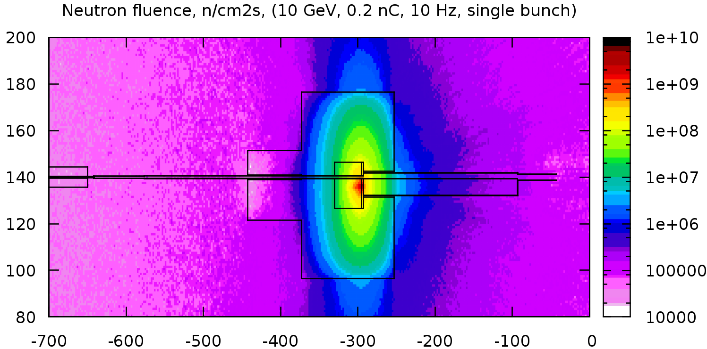
Tune-up dump
▷ Electron stopper : ( 2.1 cm(6X₀) W + 25 cm Cu ) x Ф20 cm
▷ Additional Shielding : Iron
Preliminary!!
- Vacuum pipe : Ф13 mm (outer),
1 mm thickness Al
- Cut the bottom of vacuum pipe &
install 50 μm Al foil for wake problem
- Neutron fluence limit @ magnet
: 10¹¹ n/cm²
(from result of T-493 experiment
using 13.6 GeV electron @ SLAC)
- Calculated neutron flux @ magnet
: 7 x 10⁷ n/cm²hr
⇒ Lifetime : ~ 1500 hr
70 cm
80 cm
40 cm
We will perform design correction
including 17 cm thickness
quadrupole@z = -590

Slide 23
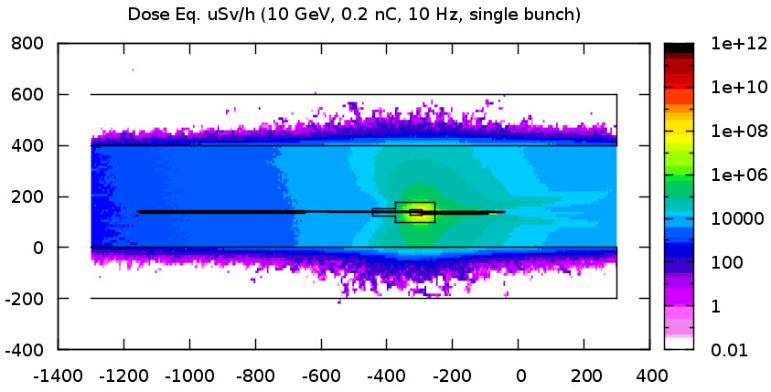
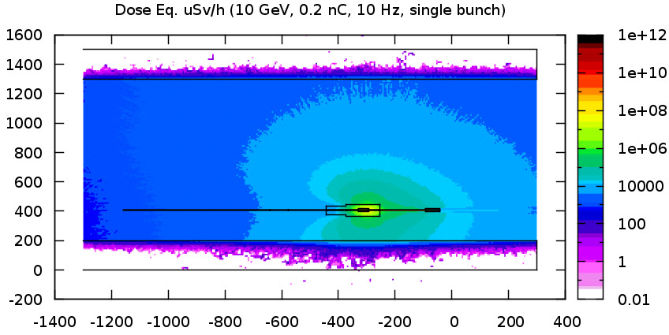
Tune-up dump
Preliminary!!
Tunnel outside
: Effective!!
Lower than
shielding criteria
Dose Equivalent @ ZY plane (vertical view)
Dose Equivalent @ ZX plane (plan view)

Slide 24
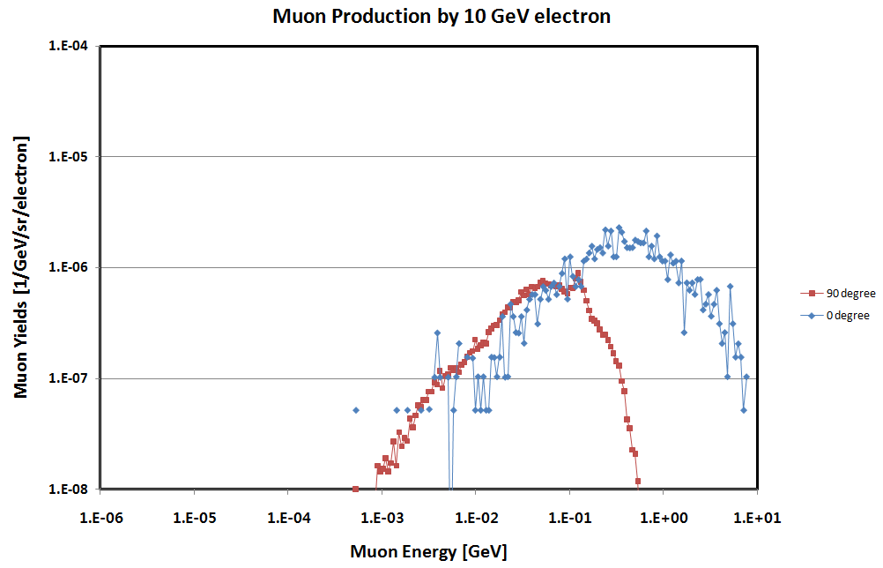
Muon Yield Estimation
Using FLUKA code
  120 W beam, 20 m from beam loss point
  Dose from muon (0 degree) = 100 ~ 240 uSv/h
  Range of 1 GeV Muon = 0.8 m Iron
At least 80 cm-thick Iron beam stopper at optical hutch

Slide 25
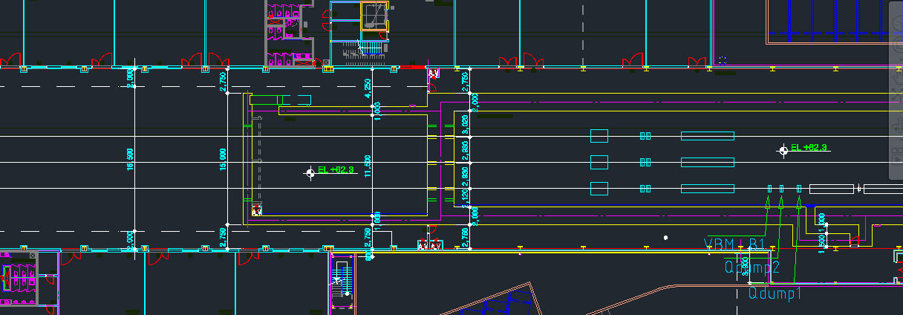
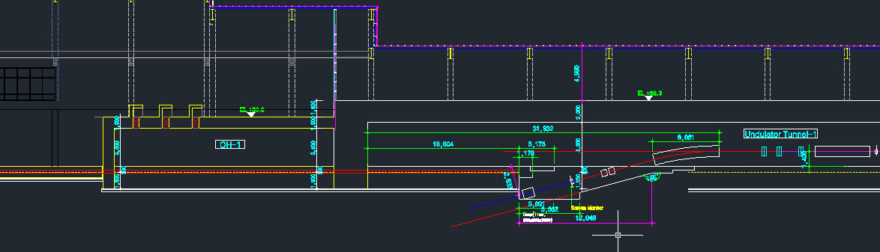
Major Points of Shielding Issues

Slide 26
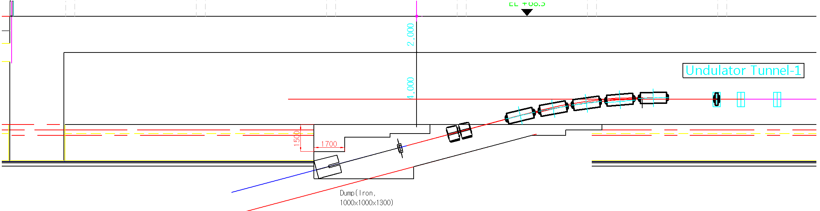
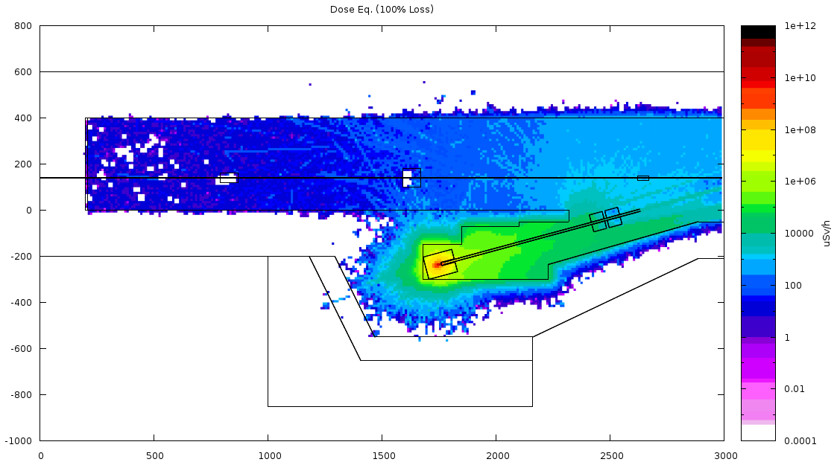
Prompt Dose around Main Beam Dump
Concrete cover
Main dump magnets
Main beam dump
(Iron)
Size : 100(H)x100(W)
x130(D) cm³
Hole : 15(H)x15(W)
x60(D) cm³

Slide 27
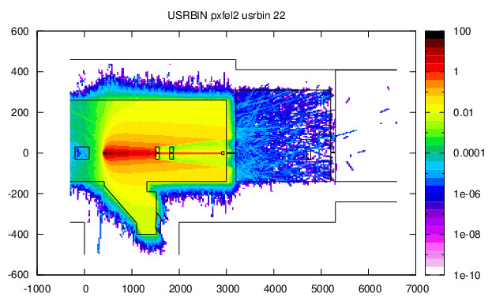
Safety Shutter at Accidents
Dose Equivalent, μSv/h, ZY plane
Units :
x 2.7E+8 μSv/hr
<Assumption>
: 100% beam loss on
thin target near
main dump magnet
50 cm thickness Tungsten ⇒ Effective!!
- Detail design including separating and reducing the thickness
are performing.

Slide 28
Environmental Radiation
Operation Condition
- Electron Beam
- 10 GeV, 0.2 nC/pulse, 60 Hz, 2 bunches : 240 W
- Major Shielding of Linac and Undulator Tunnel
2 m-thick Ordinary Concrete
- Operation Time : 6000 hour/year
- Beam loss: < 1% at Linac tunnel (60 hours)
< 0.1% at undulator tunnel (6 hours)
Dose Control Level (Site boundary) : 0.25 mSv/year
- On-site & Off-site background level : < 0.1 μSv/hour
Levels For the Public
Practical Condition
- On the top of mountain, at 130 m from residents apartment

Slide 29
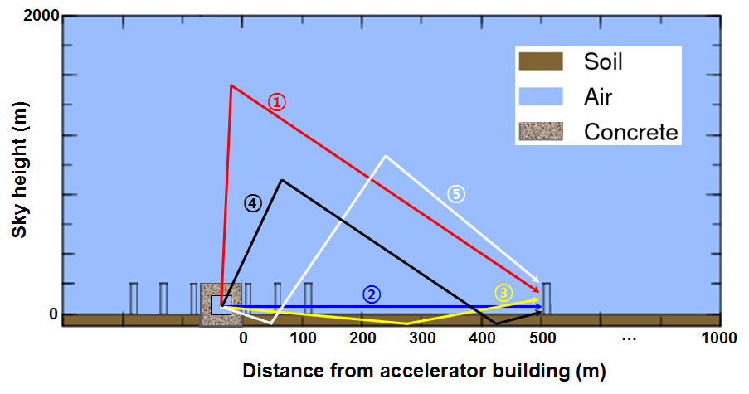
Concept for Skyshine Evaluation
Using PHITS code (photoneutron calculated by FLUKA)
Skyshine term
Direct term
Groundshine term
Multipleshine term
Multipleshine term
① sky → detectors
② accelerator tunnel → detectors
③ ground → detectors
④ sky → ground → detectors
⑤ ground → sky → detectors

Slide 30
Skyshine effective dose (0.1% loss)
Dose at 100 m
= 0.0548 mSv/y < 0.25 mSv/y
Dose by pure skyshine at 100 m
= 0.0062 mSv/y < 0.25 mSv/y

Slide 31
Summary
Radiation shielding of the PAL-XFEL was designed.
- Beam loss scenario was established.
- Bulk tunnel thickness was determined using semi-empirical formula,
SHIELD11. : Ee > 3.15 GeV, 2 m tunnel thickness
- Complicated tunnel structures like entrance and duct were analyzed using
Monte Carlo code, FLUKA.
- Main beam dump and preliminary tune-up dump was designed.
- Thickness requirement for safety shutter was evaluated : 50 cm Tungsten
- Neutron skyshine was evaluated. : less than the limit at residence apartment
Thank you for your attention!!

Slide 32
Backup slides

Slide 33
Area Classification of PAL-XFEL
High Radiation Area
1) Tunnel inside during accelerator operation
2) OH inside with opening of the safety shutter(SS)* during accelerator operation
Radiologically-Controlled Area
1) Tunnel inside after the accelerator operation
2) OH inside with closing of the SS during accelerator operation
3) Tunnel roof during accelerator operation
Generally-Controlled Area
1) Experimental Area
2) Klystron Gallery
3) Loading Area, Control room and Office
* Safety Shutter(SS) : the shutter installed bet. frontend and OH, and located at undulator tunnel end
Notes:
4세대 구역 설정안 발표 하겠습니다.
고방사선구역으로

Slide 34
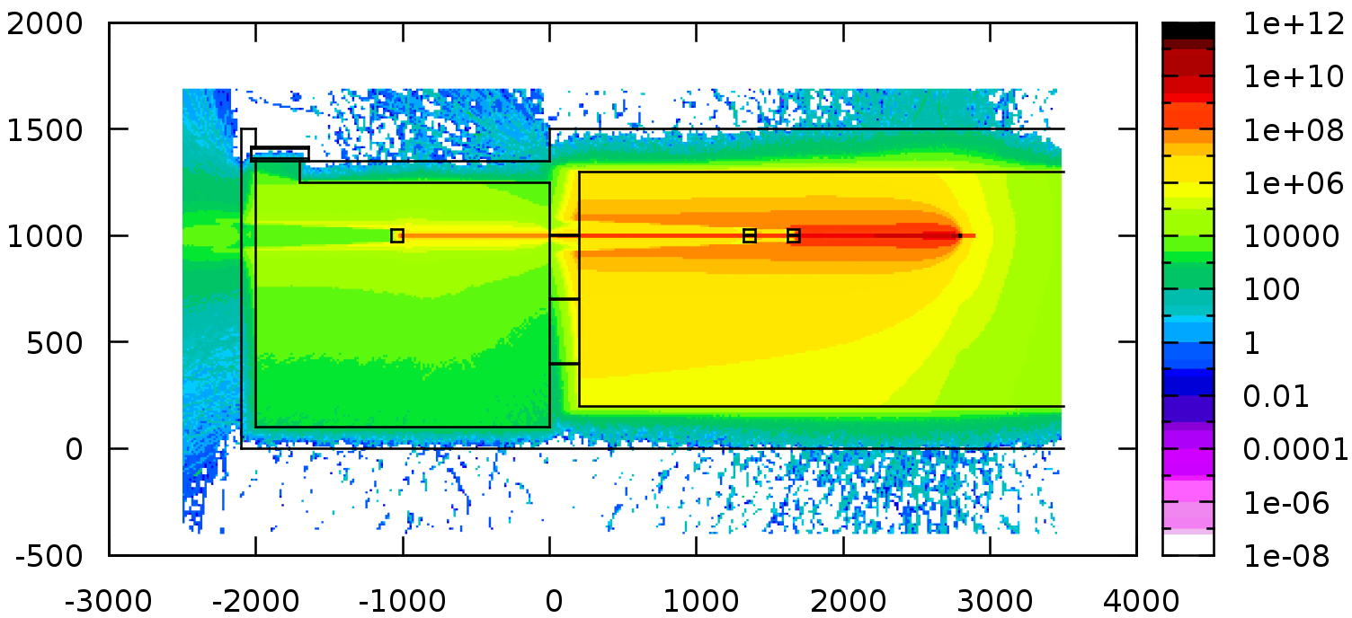
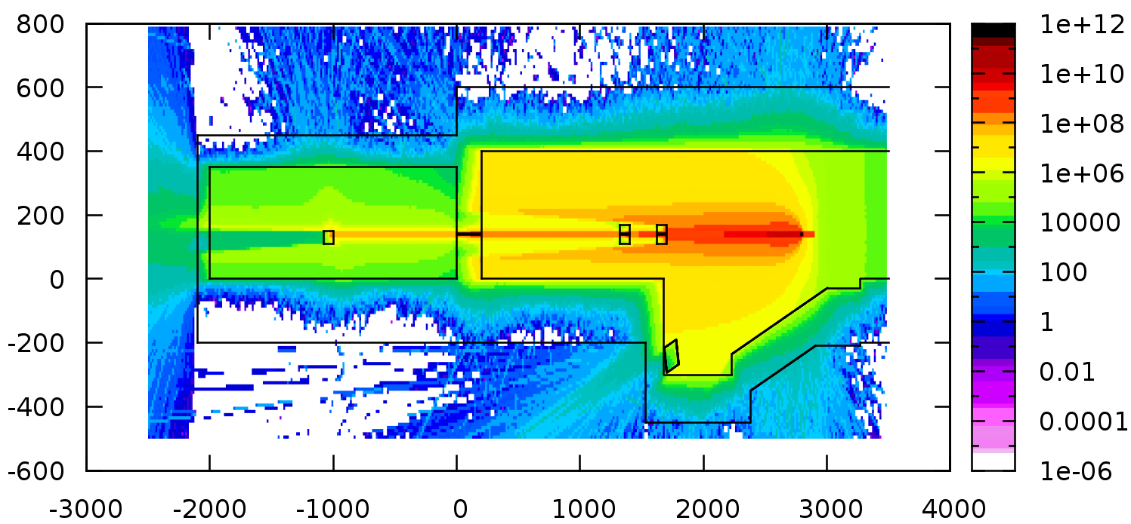
BL Shielding Effectiveness at Accidents
Dose Equivalent, μSv/h, ZX plane
< Example of accidental loss >
※ Assumption
- 100% beam loss on thin target
near main dump magnet
- Tungsten safety shutter is
not operated yet.
- 80 cm iron fixed stopper at
optical hutch with 3 cm offset
Fixed stopper is effective but
high dose eq. at uncovered area
⇒ Detailed consideration about
offset and stopper should be
required.
Dose Equivalent, μSv/h, ZY plane
54 mSv/h
150 μSv/h
Preliminary!!

Slide 35
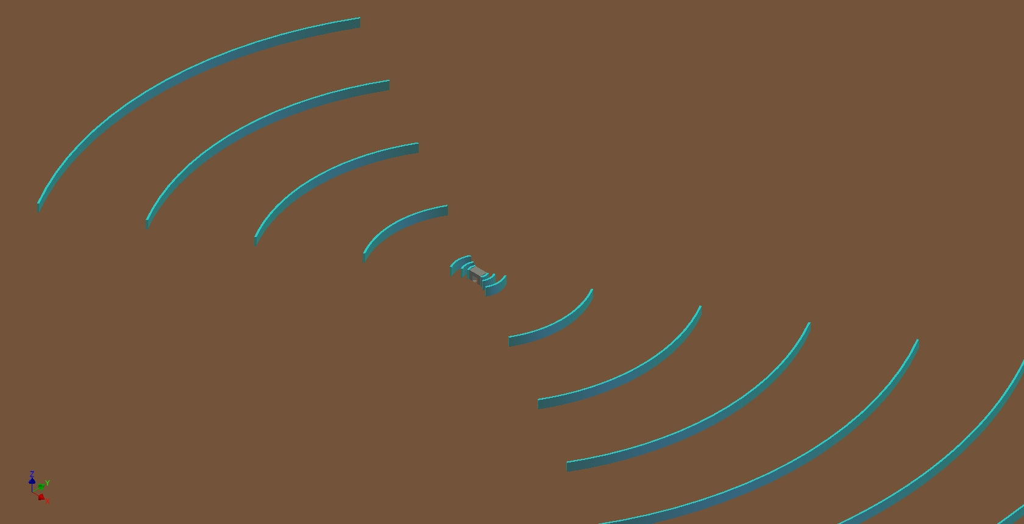
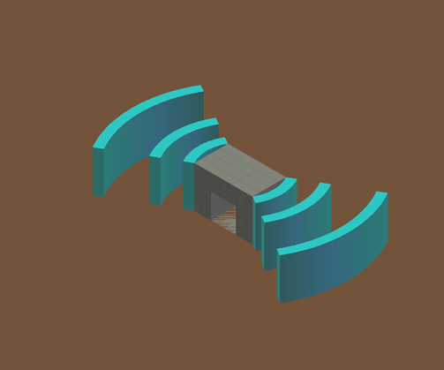
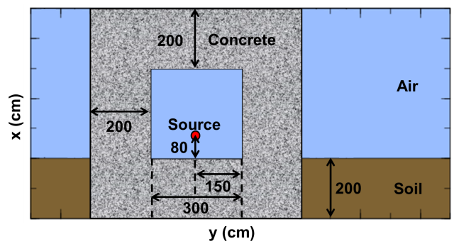

Geometry at PHITS Simulation
E-beam
Geometry of accelerator building
Cylindrical shell (t-track) at 0, 5 10, 50 100, 150, 200, 250, 300, 350, 400, 500, 600, 700, 800, 900, 1000 m from outer surface of tunnel

