Slide 1

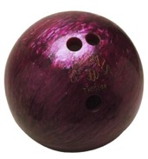
Fast Neutron Measurements at the Booster Neutrino Beamline for Future Coherent Elastic Neutrino-Nucleus Scattering (CENNS) Experiment at Fermilab
To probe a “large” nucleus (few × 10⁻¹⁵ m)
Recoiling nucleus is detection signature
E_{ν}
M
E

Slide 2
Motivations for CENNS
Never seen – despite dominant cross section
Non-standard interactions
Supernova neutrinos
Form factors
SM tests: measure sin²θ_{W}
Reactor monitoring
Irreducible dark matter background
Neutrino Cross Sections vs. Energy
Coherent
⁴⁰Ar
electrons

Slide 3
Motivations for CENNS
Never seen – despite dominant
cross section
Non-standard interactions
Supernova neutrinos
Form factors
SM tests: measure sin²θ_{W}
Reactor monitoring
Irreducible dark matter background
Dark Matter Sensitivity

Slide 4

3 Essential Ingredients for CENNS
Produce low-energy
neutrinos
Detect low-energy
neutrinos
Reject backgrounds
that resemble neutrinos

Slide 5
A New Alternative Approach at FNAL
Booster Neutrino Beam at FNAL is a pion decay in-flight source (8 GeV p⁺)
On-axis multi-GeV neutrinos – not useful for CENNS
BUT far off-axis spectrum is much “softer” – usable!
BNB flux at 20 m, cos θ < 0.5
Φ^{BNB} = 5×10⁵ s⁻¹ cm⁻²
Angle Off-Axis Neutrino Rate
J. Yoo & S. Brice, Booster Neutrino Beam Monte Carlo

Slide 6
A New Alternative Approach at FNAL
Booster Neutrino Beam at FNAL is a pion decay in-flight source (8 GeV p⁺)
On-axis multi-GeV neutrinos – not useful for CENNS
BUT far off-axis spectrum is much “softer” – usable!
BNB flux at 20 m, cos θ < 0.5
Φ^{BNB} = 5×10⁵ s⁻¹ cm⁻²
Off-Axis Neutrino Energy Spectrum
J. Yoo & S. Brice, Booster Neutrino Beam Monte Carlo

Slide 7
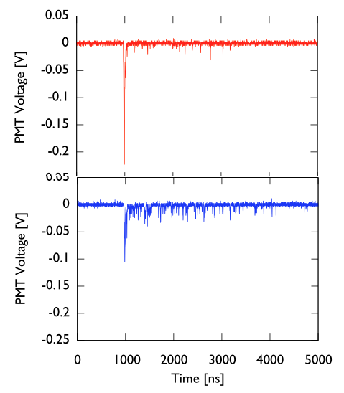
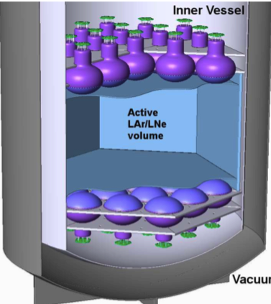
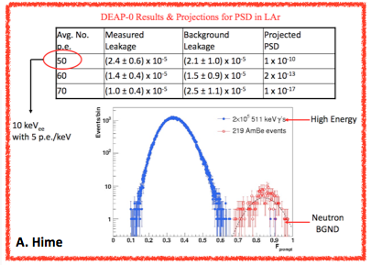
Detection of Coherent Scattering
Detection in general: pick a dark matter technology
Our proposal: 1-ton, single-phase liquid Argon (LAr)
Use copious LAr VUV scintillation for readout
200 events ton⁻¹ year⁻¹
(30 keV threshold, 32 kW)
n.r.
e.r.
Results from
DEAP collaboration

Slide 8

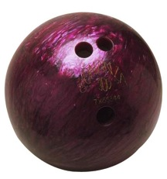
Typical Sources of Uncertainty
Duty factor (~ 10⁻⁵) give total exposure ~ 300 s / year
→ cosmic background small
Neutrino flux uncertainty
~ 5-10% → improvements?
Quenching & scintillation efficiency L_{eff} uncertainties
Beam-correlated neutrons mimic neutrino signal
Neutron Scatter on ⁴⁰Ar
E_{n}
M
E_{r}
where

Slide 9
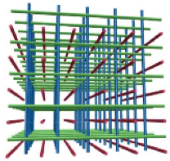
SciBath Detector
80 L open volume of mineral oil based liquid scintillator
Neutrons recoil off protons, create scintillation
768 wavelength shifting fibers readout
IU built custom digitizer: 12 bit, 20 MS / s

Slide 10
SciBath Principle of Operation

Slide 11
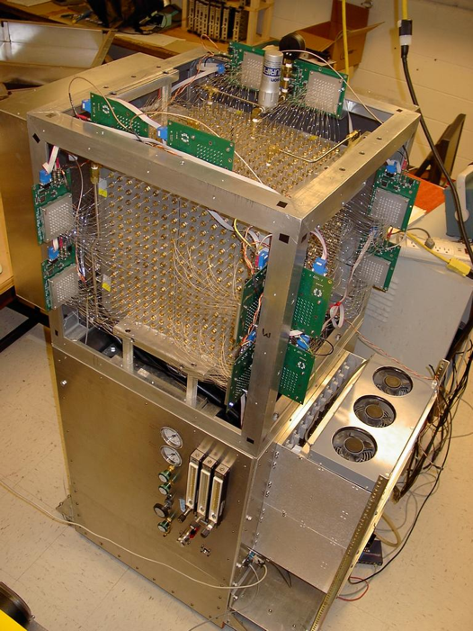
SciBath Detector
80 L open volume of mineral oil based liquid scintillator
Neutrons recoil off protons, create scintillation
768 wavelength shifting fibers readout
IU built custom digitizer: 12 bit, 20 MS / s

Slide 12
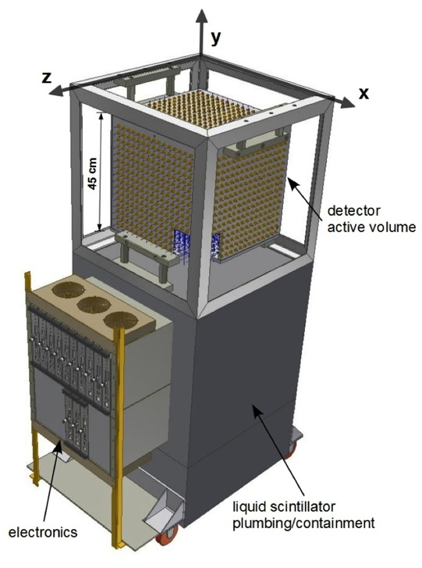
SciBath Detector
80 L open volume of mineral oil based liquid scintillator
Neutrons recoil off protons, create scintillation
768 wavelength shifting fibers readout
IU built custom digitizer: 12 bit, 20 MS / s

Slide 13
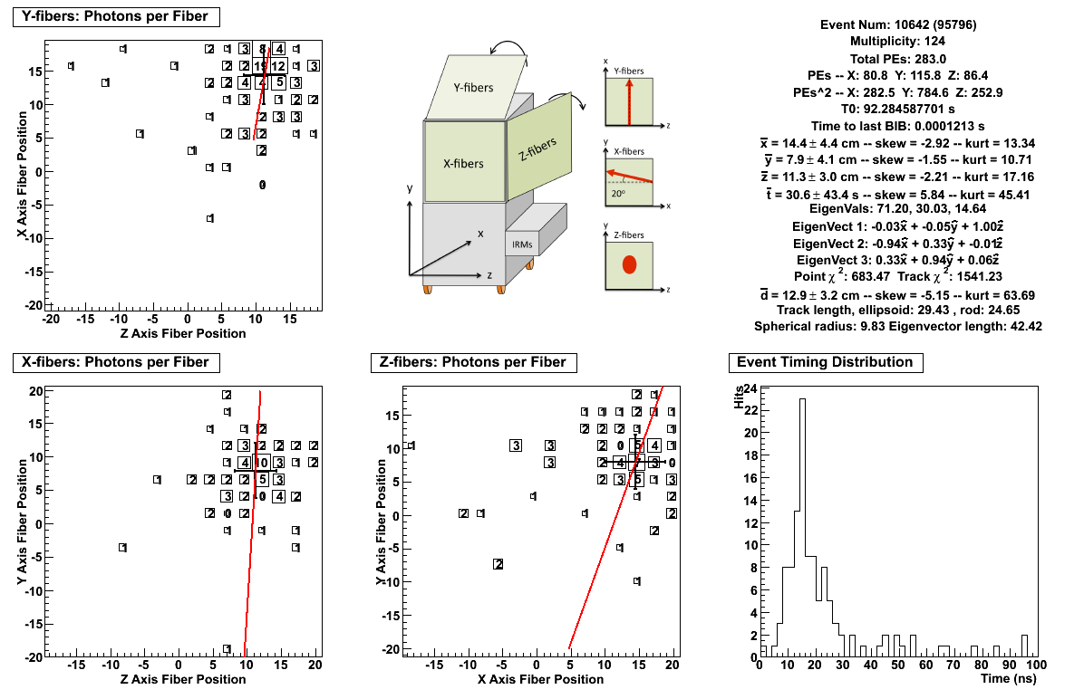
Sample Neutron Candidate Event

Slide 14
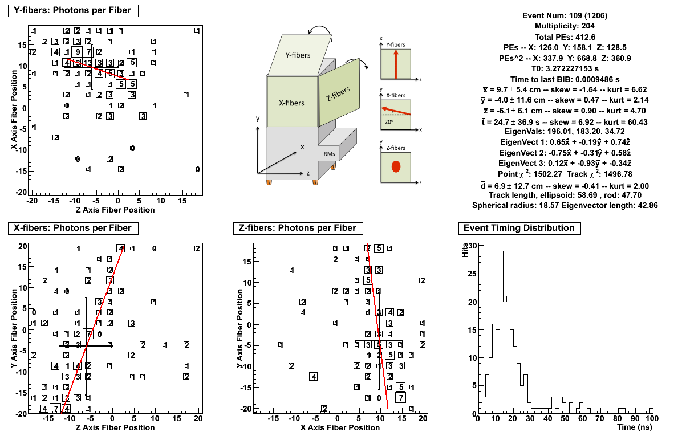
Sample Muon Candidate Event

Slide 15
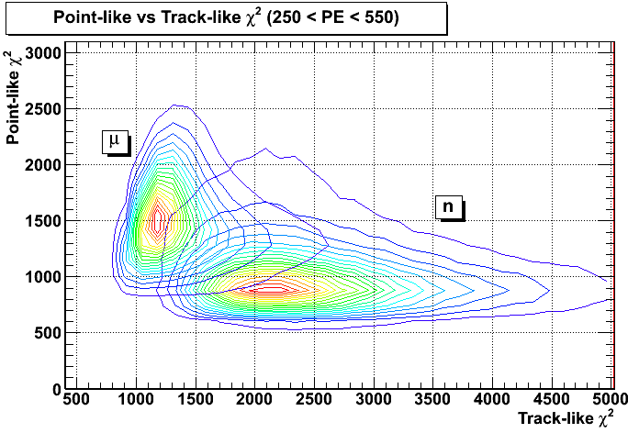
n / μ Particle Discrimination

Slide 16
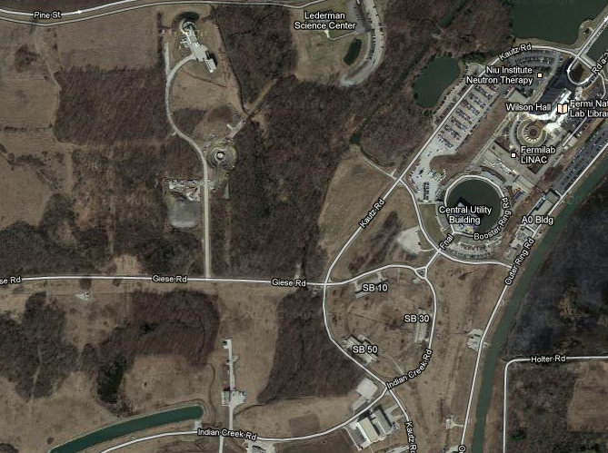
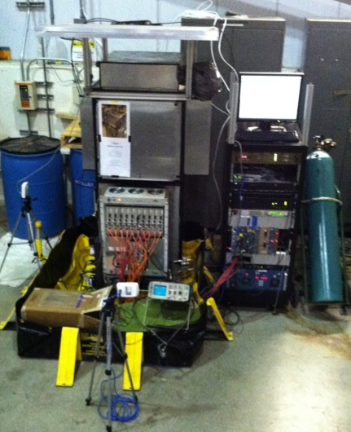
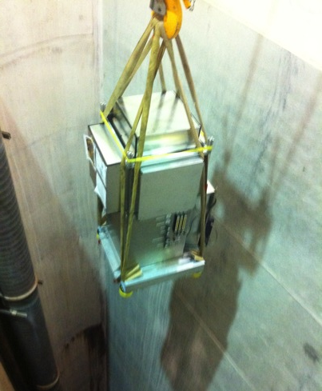
Fermilab Measurement Sites
MINOS Near
2/12– 5/12
10/11 – 2/12
BNB Target
NuMI Target

Slide 17
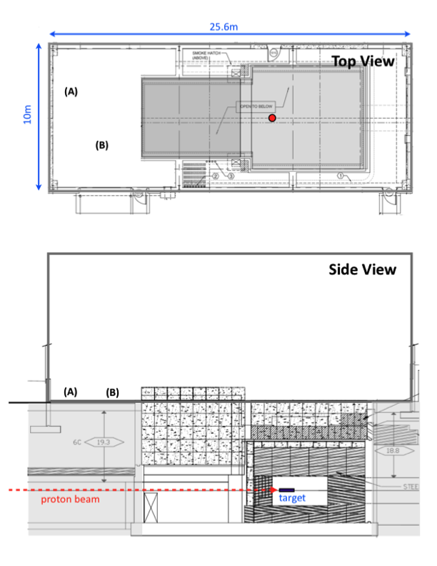
MI-12 Neutron Background Run
Neutron flux ~20 m from target
In-line behind beam target (ground)
29 Feb. – 23 Apr.
4.9x10¹⁹ total protons on target (POT)
(4.5x10¹² per pulse)

Slide 18
MI-12 Beam Time Per PE “Group”
HIGH PE group (proxy for high energy) is consistent with beam time structure
MEDIUM PE group has a few μs excess – consistent with slower neutrons and moderation in shield
LOWEST PE group has significant excess – 200 μs lifetime from n(p, d)γ neutron capture reaction

Slide 19
BNB Neutron Energy Spectrum
E_{n} unfolded from PEs using fit and MC response function
Soft threshold at 10 MeV
2.44 ± 0.34 pulse⁻¹ m⁻²
(E_{n} > 40 MeV)
Fit loses sensitivity above 200 MeV; fit truncated
Neutron spectrum
20 m from BNB
Raw PE Spectrum In-Beam

Slide 20
BNB Neutron Energy Spectrum
E_{n} unfolded from PEs using fit and MC response function
Soft threshold at 10 MeV
2.44 ± 0.34 pulse⁻¹ m⁻²
(E_{n} > 40 MeV)
Fit loses sensitivity above 200 MeV; fit truncated
Neutron spectrum
20 m from BNB
Unfolded Neutron Energy Spectrum
Stat and Syst errors

Slide 21
Direction Spectrum
High PE protons will be track-like; can be imaged
Principle component analysis yields eigenvector
Back-projecting direction spectrum tends to point upstream of target ?!
Tracking validated with cosmic rays and NuMI beam
High-PE, Proton Direction Spectrum

Slide 22
Direction Spectrum
High PE protons will be track-like; can be imaged
Principle component analysis yields eigenvector
Back-projecting direction spectrum tends to point upstream of target ?!
Tracking validated with cosmic rays and NuMI beam

Slide 23
Further Studies
House the SciBath detector to test shield configuration
Many standard concrete shielding blocks at FNAL
Typical size (1.5’ x 3’ x 5’)
Return this Fall
to measure more
neutrons

Slide 24
CENNS-10
Goals
Neutron background study
Demonstrate detector performance
Light collection R&D
(energy threshold study)
Status
Parts ordered (initial phase is 2× R5912-02MOD (8” PMT)
Assembly nearly complete

Slide 25
Conclusions
Discovery Potential vs. detector threshold (nominal BNB)
Fermilab BNB with 1-ton LAr is proposed
SciBath shows neutrons
are manageable – will return this fall for more neutron measurements
See our recent paper
Phys.Rev.D 89, 0072004 (2014)

Slide 26
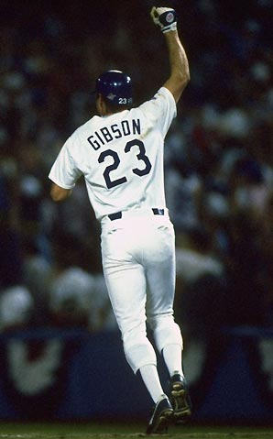
Pinch Hitters (Backups)

Slide 27
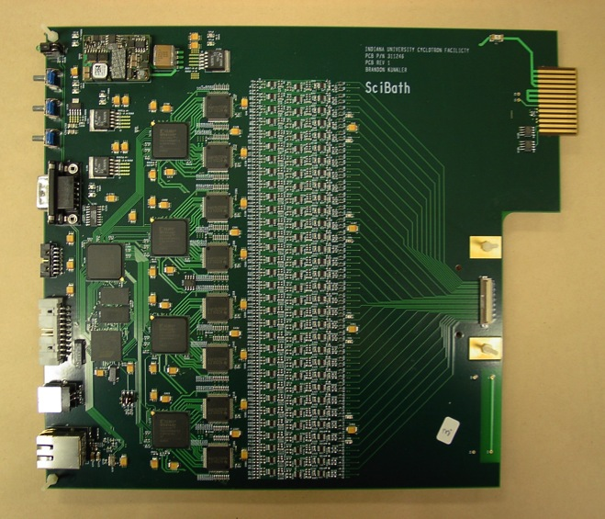
SciBath Detector
80 L open volume of mineral oil based liquid scintillator
Neutrons recoil off protons, create scintillation
768 wavelength shifting fibers readout
IU built custom digitizer: 12 bit, 20 MS / s

Slide 28
Photoelectron to ADC Calibration
Photoelectron (PE): an optical photon ejects an electron from PMT surface via the photoelectric effect
Low-light LED calibrates ADC to single photons
Approximately 30 ADC channels per PE
PMTs balanced with HV

Slide 29
Photoelectron to ADC Calibration
Photoelectron (PE): an optical photon ejects an electron from PMT surface via the photoelectric effect
Low-light LED calibrates ADC to single photons
Approximately 30 ADC channels per PE
PMTs balanced with HV
Single-PE LED Calibration

Slide 30
Cosmic Ray Calibrations
Cosmic ray muons are minimum ionizing
Deposits approximately
65 MeV at 390 PE peak
6 detected PE / MeV
n(p, d)γ 2.2 MeV gamma rays validate calibration
Expanded calibration program underway
MIP Cosmic Ray Calibration Peak

