Slide 1
Towards the next generation RIB facility using the ISOL Method: radiological protection and shielding challenges
P. Vaz, R Luís, Y. Romanets, J.C. David, A. Dorsival, D. Ene, I. F. Goncalves, Y. Kadi, C. Kharoua, S. di Maria, F. Negoita, R. Rocca, L. Tecchio, V. Vlachoudis, J. Vollaire
IST /Centro de Ciências e Tecnologias Nucleares
Grupo de Protecção e Segurança Radiológica
@ SATIF-12 Meeting, Fermilab, 29th April 2014

Slide 2
A few underlying questions...
And a word of caution
SATIF objective: a forum to promote discussion and exchange of information amongst experts
Despite the impressive developments on Monte Carlo programs and tools for radiation transport simulation during the last decades,
    Are we (sometimes) adopting an over-confident attitude?
    Do we (sometimes) overlook the complexity of the problem to be simulated ?

Slide 3
Outline
Introduction
  setting the scene…
A purely computational (Monte Carlo) Design Study:
  Shielding and RP assessment of the EURISOL facility
Computational (Monte Carlo) studies versus mesurements:
  Shielding and RP assessment of ISOLDE/HIE-ISOLDE @CERN
Issues and challenges - conclusions and questions
  Validation/benchmarking of Monte Carlo tools
  Uncertainties

Slide 4
Setting the scene…
Radiological protection and radiation safety studies of next generation emerging and innovative nuclear technology facilities (ADS, RIBs, SNS, etc.) involve:
  Multi-MegaWatt targets (~ GeV protons, ~ mA beam intensity) impinging on a target of heavy element (Hg, Pb, Bi, W, ...)
    Very high dose-rates (n, γ)
    Activation of structural components
    Radiotoxicity of targets
    Radiation damage
    Inspection & Repair
    Etc.
  Design studies which heavily rely on Monte Carlo simulation results...

Slide 5
EURISOL
The next generation facility for the generation of Radioactive Ion Beams (RIBs) using the ISOL (Isotope Separation OnLine)
A summary of the main results achieved for the target unit

Slide 6
EURISOL
Objectives, applications
Objectives of the EURISOL project:
  To undertake scientific, technological and engineering studies and design of the “next-generation” European ISOL RIB facility
  To produce RIBs with intensities 2 to 3 orders of magnitude higher than those obtained at current ISOL facilities or those under construction (HIE-ISOLDE, SPES, SPIRAL2, etc.)
Production of RIBs for basic research and applications:
  Nuclear Structure, Nuclear Astrophysics, Fundamental Interactions, Solid State Physics, Material properties, Medicine, Life Sciences, etc.
EURISOL Design Study (2005-2009) - Funded by the European Union
  20 participant institutions, with 21 additional collaborators

Slide 7
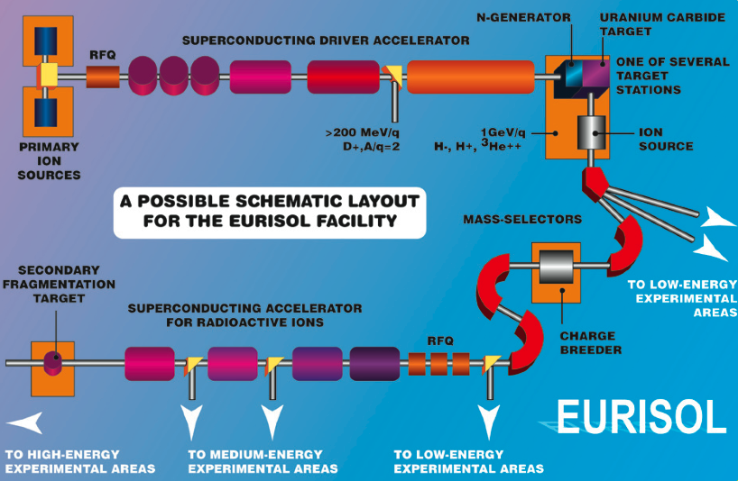
The EURISOL facility
4 MW Proton Accelerator
(1GeV, up to 4mA)
Multi MW Target Station (Liquid Mercury target
Uranium fission targets))
Post Accelerator
Mass Separator

Slide 8
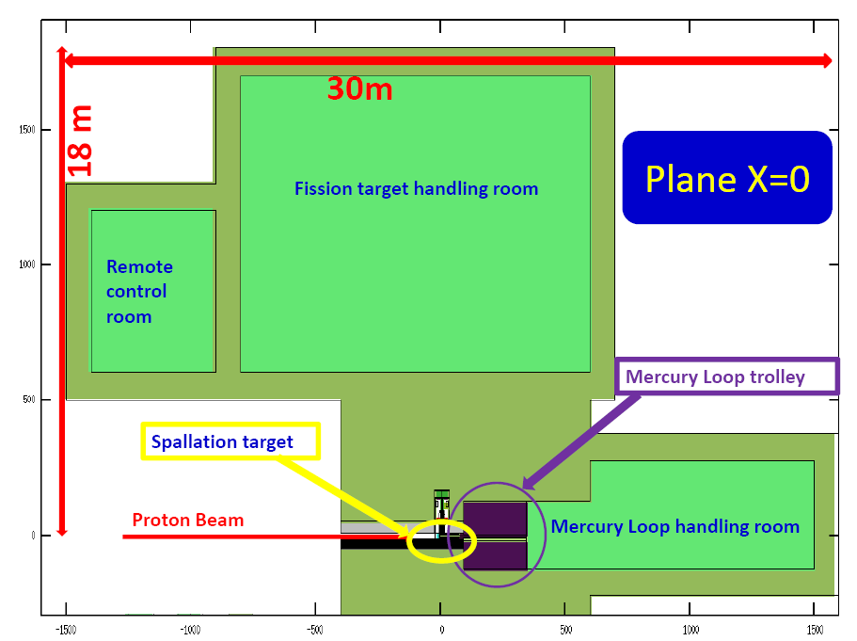
EURISOL
Targets and control areas layout
shielding (concrete)

Slide 9
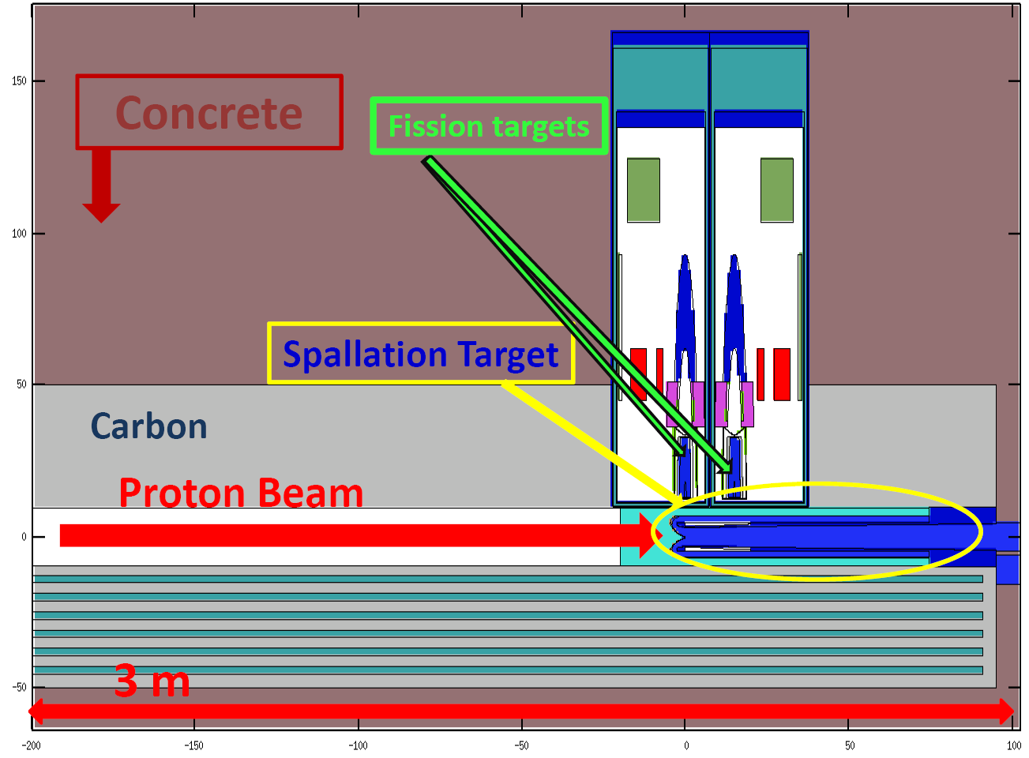
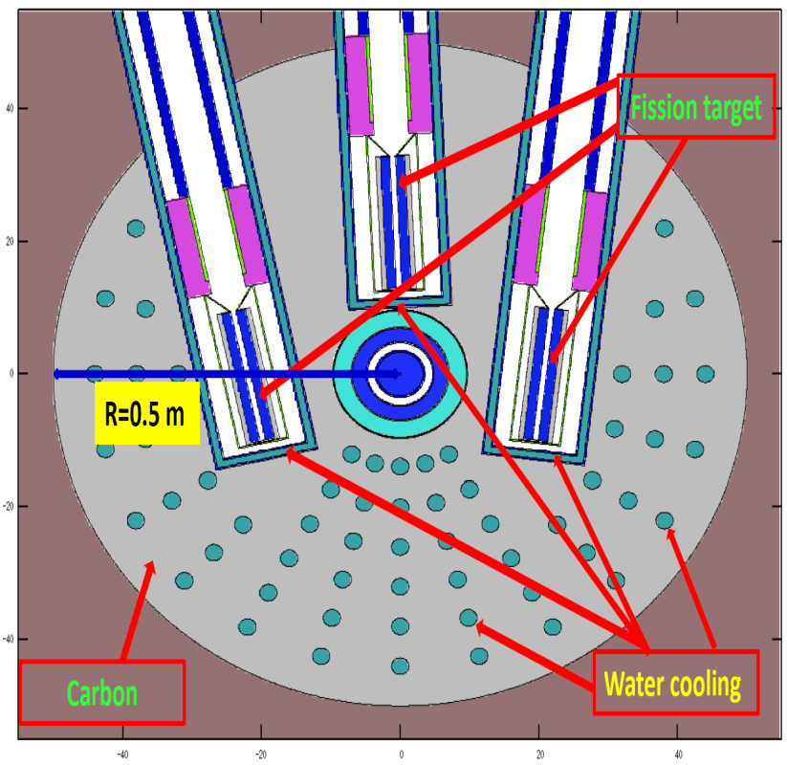
Target Unit layout
Longitudinal view
Transverse view

Slide 10
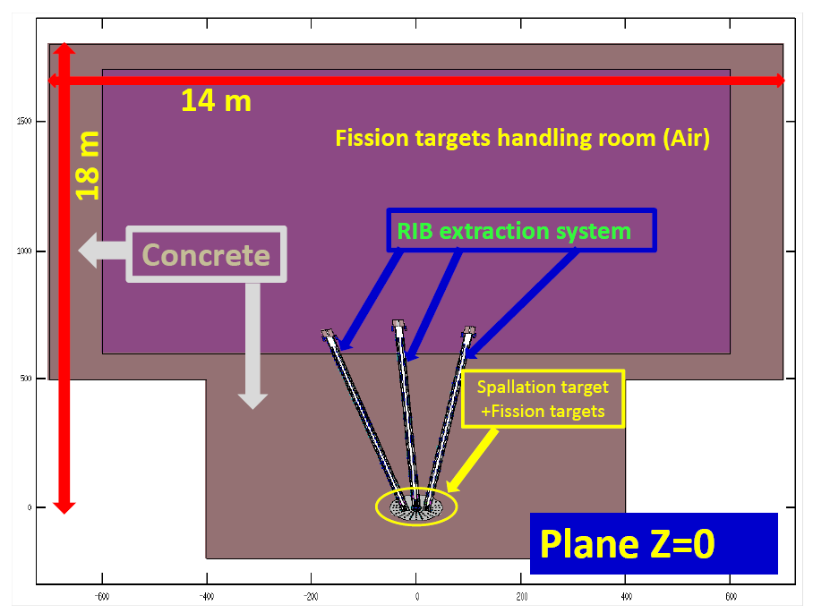
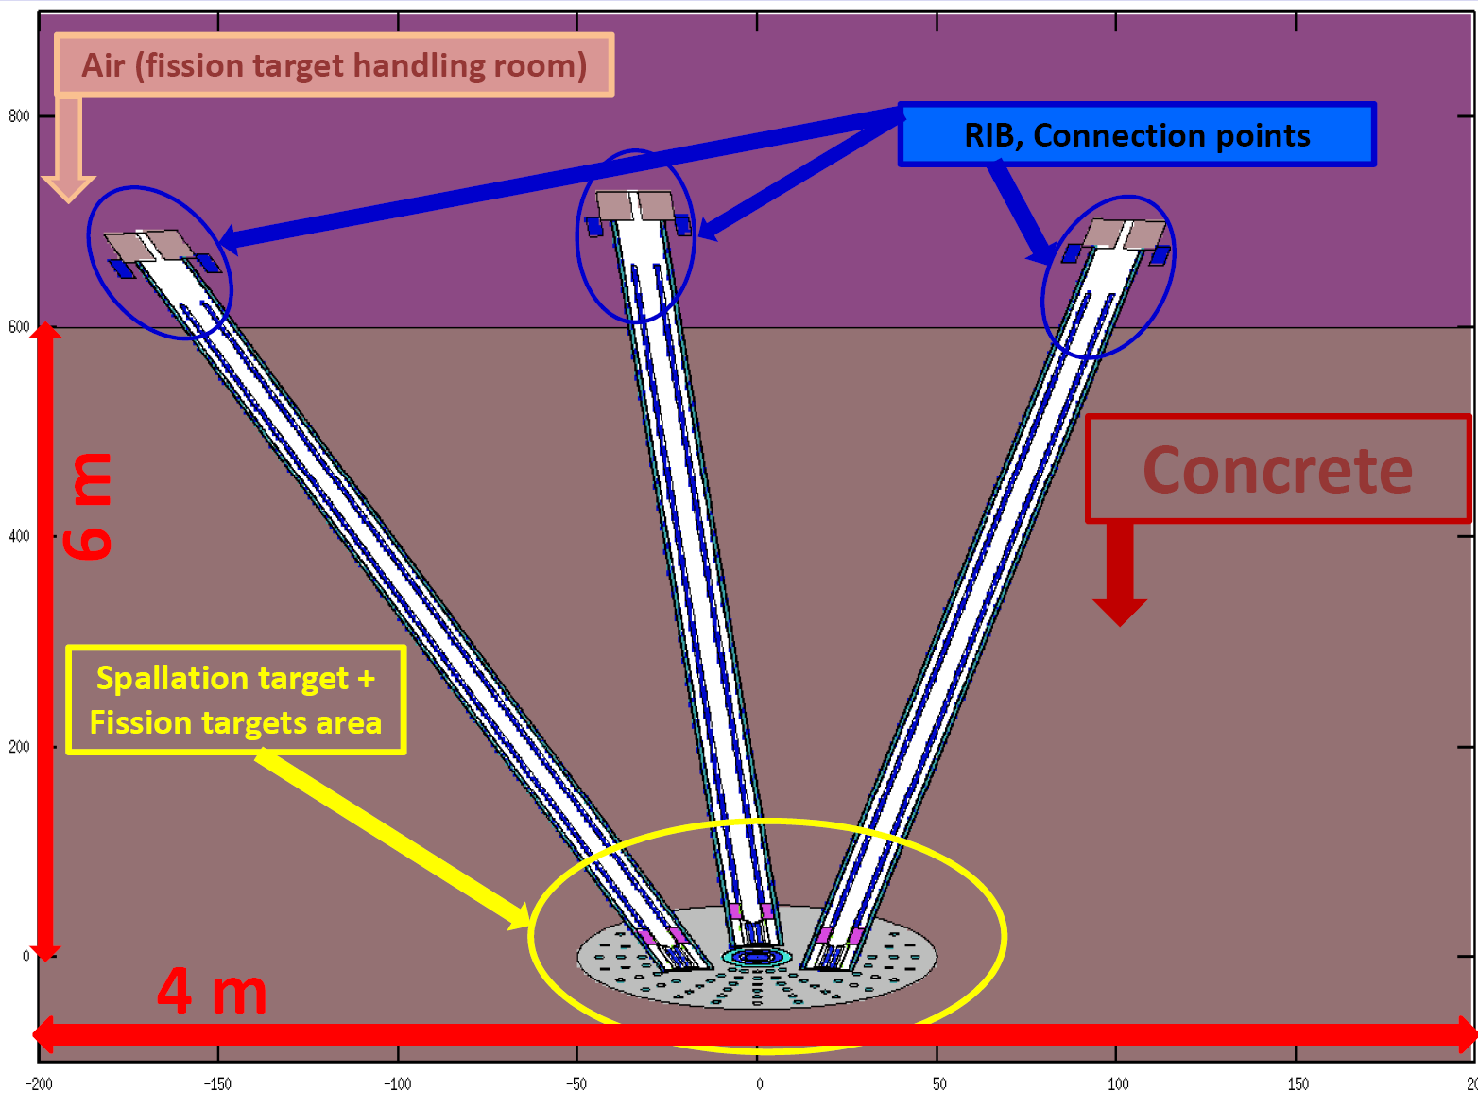
Target Unit layout

Slide 11
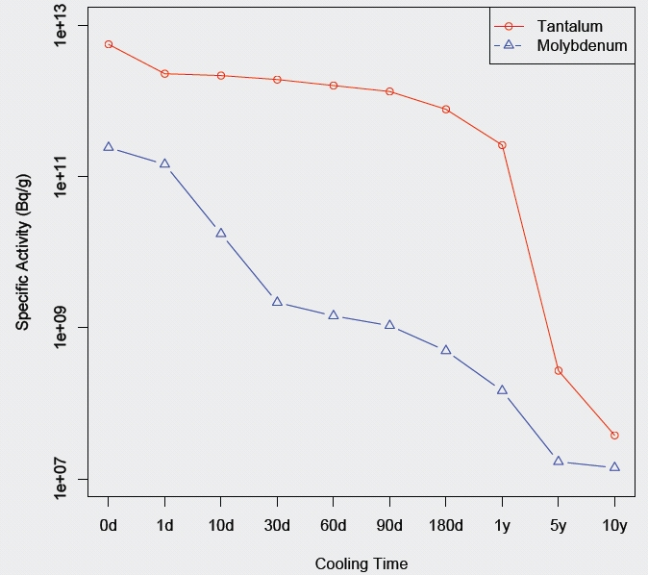
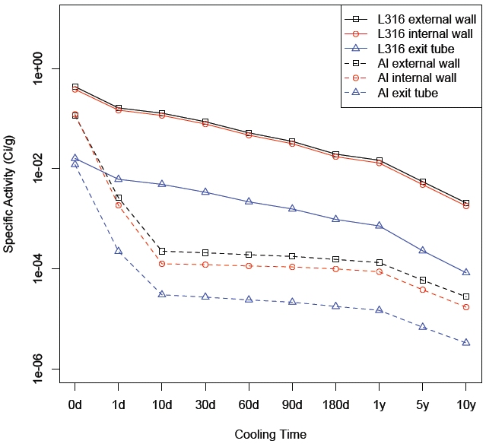
EURISOL Design Study
(Residual) activity (after beam shutdown)
fission targets container
Extraction tubes
From R. Luís & Y. Romanets – FLUKA MC simulations

Slide 12
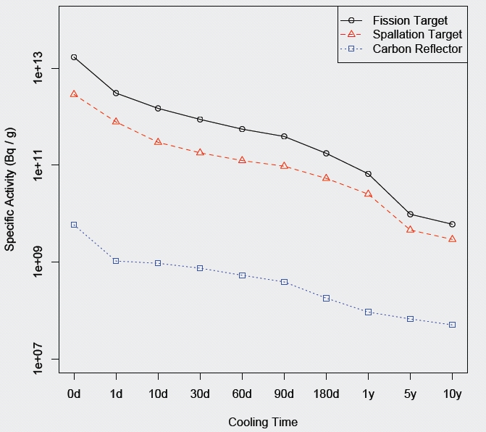
EURISOL Design Study
(Residual) activity (after beam shutdown)
From R. Luís & Y. Romanets – FLUKA MC simulations

Slide 13
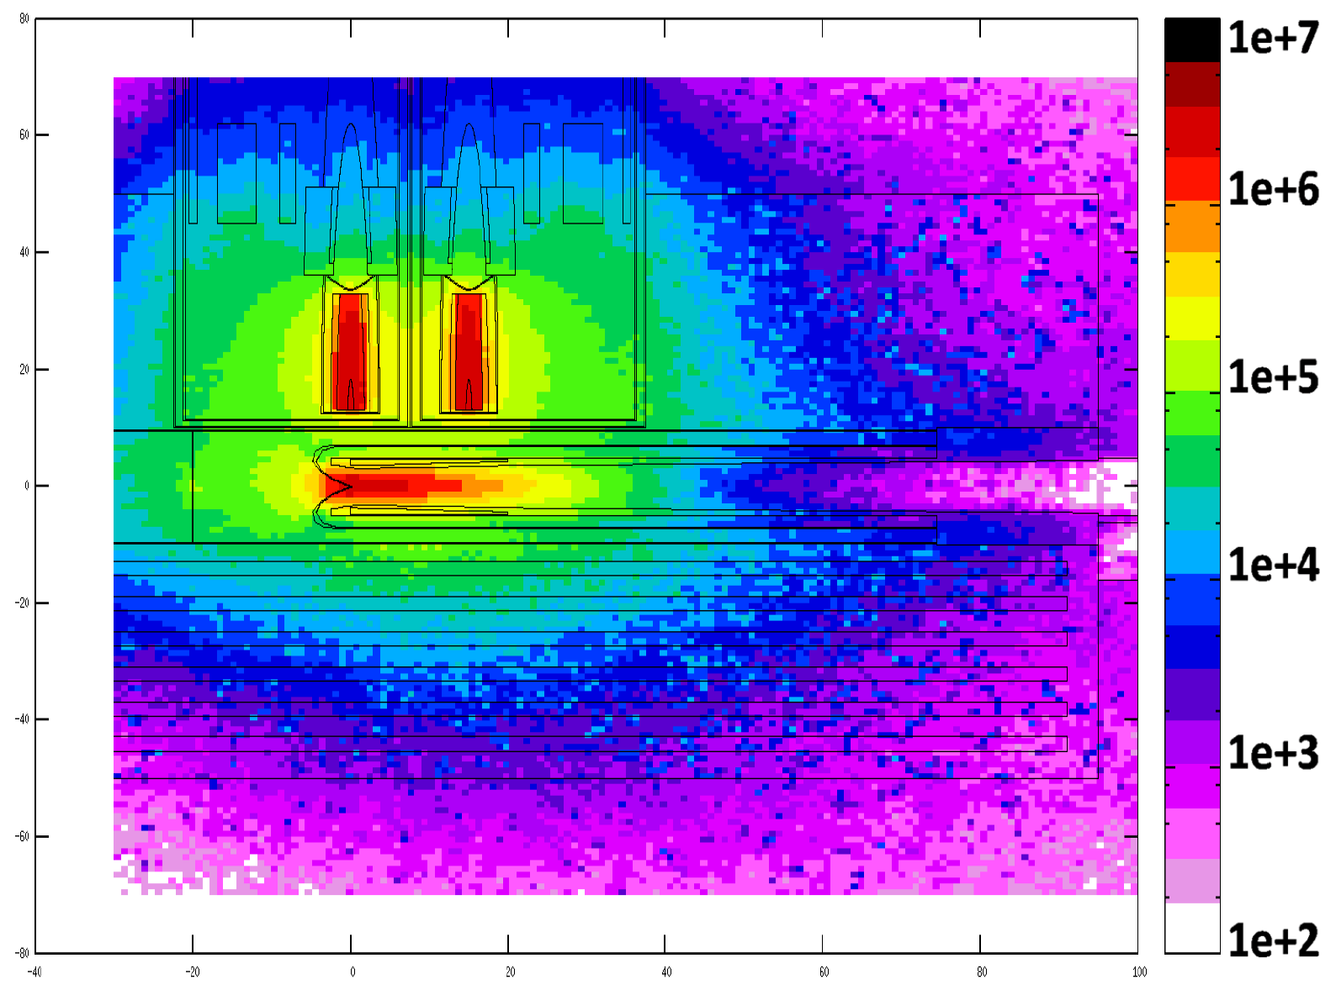
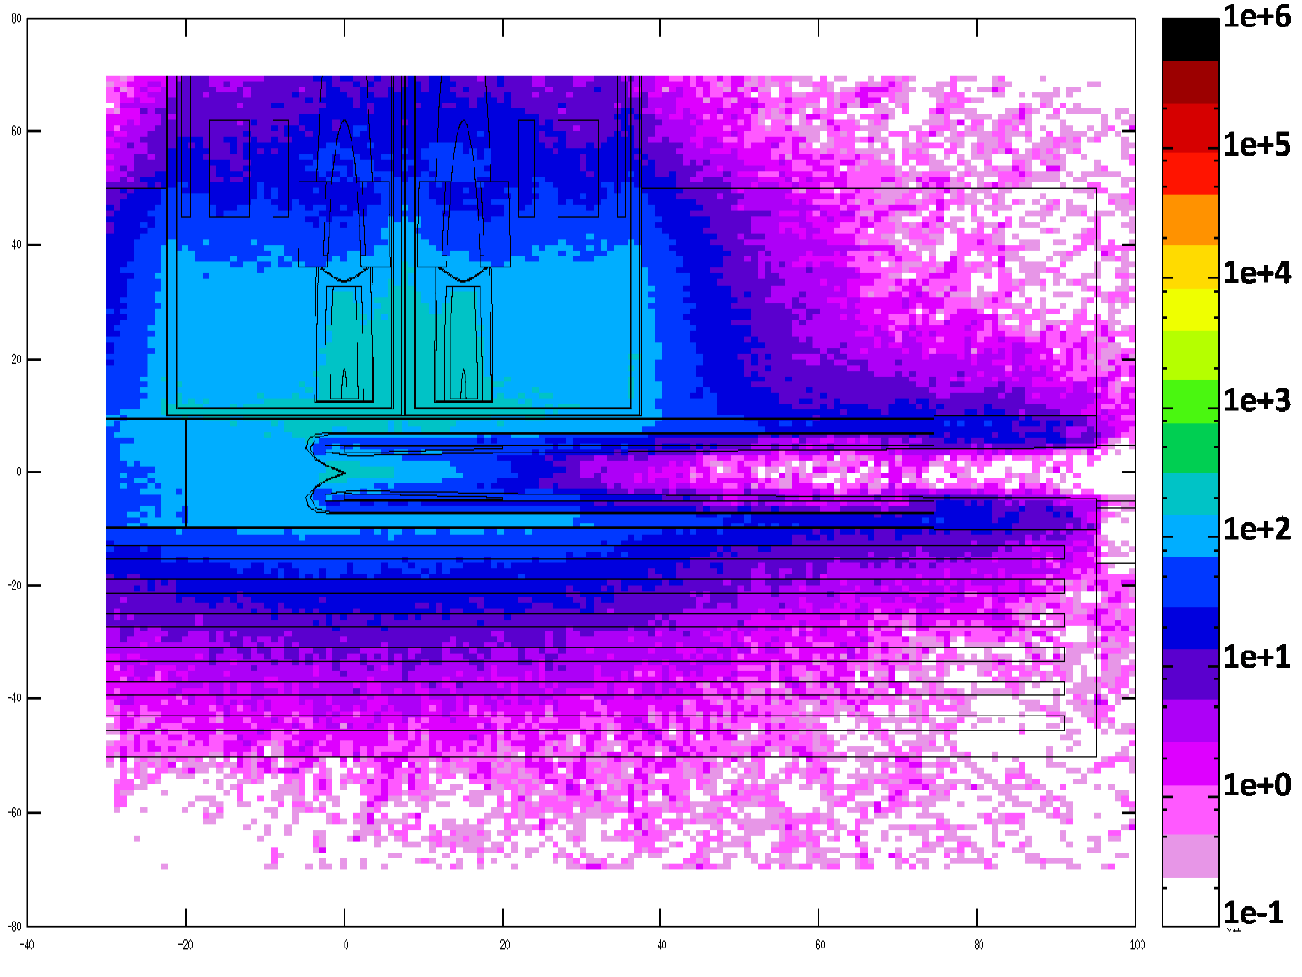
EURISOL Design Study
Dose equivalent rate (Sv/h)
beam shutdown (t=0)
10 years after beam shutdown
1.6 m
1.6 m
1.4 m
1.4 m
From R. Luís & Y. Romanets – FLUKA MC simulations

Slide 14
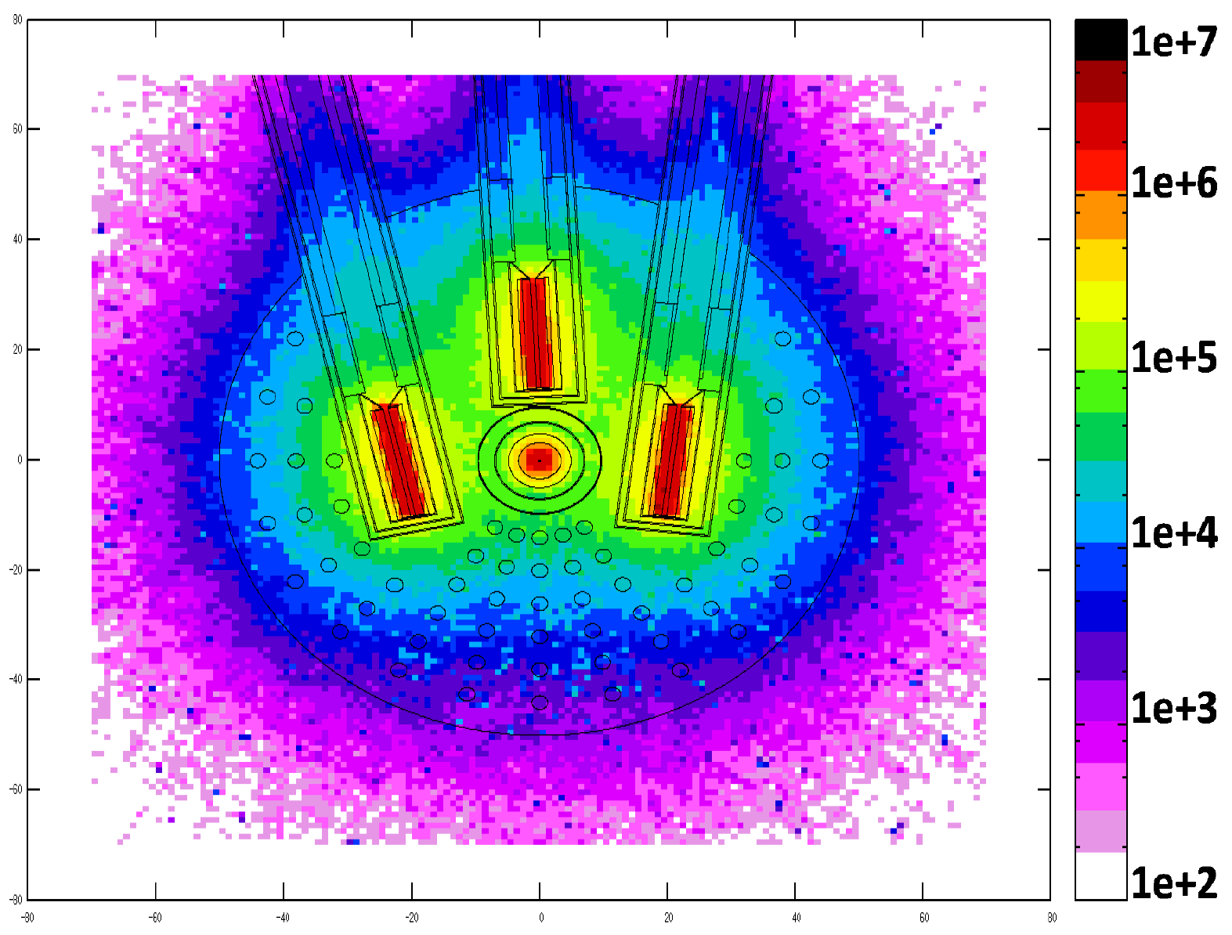
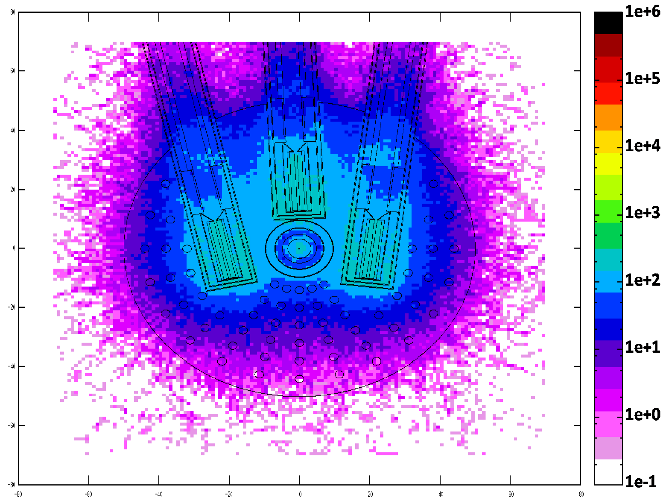
EURISOL – Targets
Dose equivalent rate (Sv/h)
beam shutdown (t=0)
10 years after beam shutdown
1.6 m
1.6 m
1.6 m
1.6 m
From R. Luís & Y. Romanets – FLUKA MC simulations

Slide 15
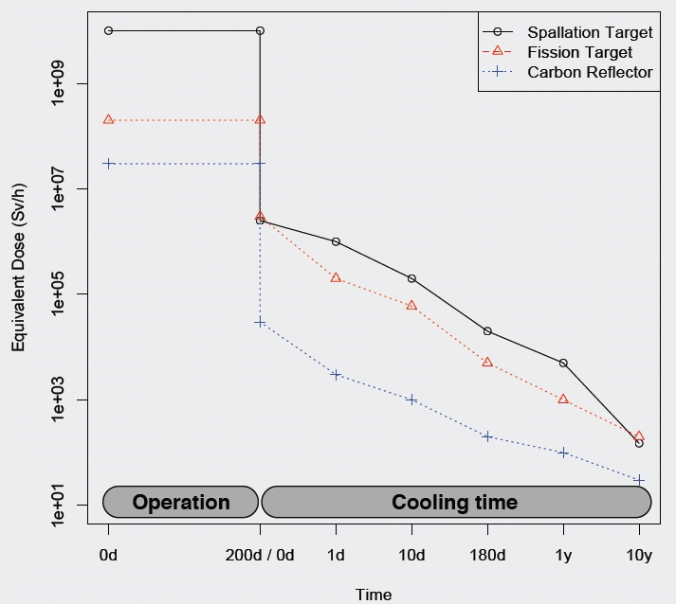
EURISOL Design Study
Dose equivalent rate vs. time
100 Sv/h
From R. Luís & Y. Romanets – FLUKA MC simulations

Slide 16
EURISOL - Radiological Protection and Radiation Safety challenges
The feasibility of the EURISOL project raises several scientific, technological, engineering and nuclear and radiation safety challenges, namely (not exhaustive list):
  Mercury target container integrity (dpa assessment, etc.)
  Mercury radiotoxicity, volatility, chemistry, etc.
  Inspection and repair
  ⇒ very high residual activity of structural components
  Radioactive waste management and disposal
The main findings are heavily supported by MC simulation results

Slide 17
ISOLDE @ CERN
HIE-ISOLDE (ISOLDE upgrade)

Slide 18
ISOLDE @ CERN
The ISOLDE facility is in operation at CERN since 1967
One of the most important facilities worldwide producing radioactive ion beams using the ISOL method
Production and transport of more than 600 isotopes with half lives down to milliseconds of almost 70 elements (Z=2 to 88)
More than 1000 radioactive isotopes have been produced at ISOLDE
  These isotopes are produced following the bombardment of various primary targets with a pulsed proton beam from the Proton Synchrotron Booster (PSB)
  Nominal proton beam parameters:
    Beam energy: 1.4 GeV
    Beam Intensity: 2 μA

Slide 19
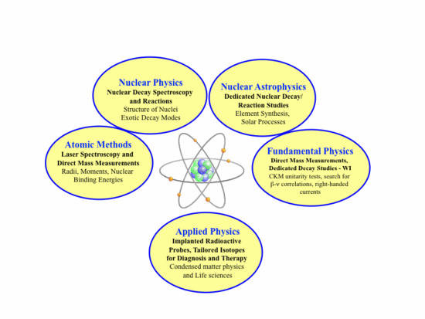
ISOLDE @ CERN
Most of these isotopes can be accelerated in REX-ISOLDE to energies up to 2.8 MeV/u

Slide 20
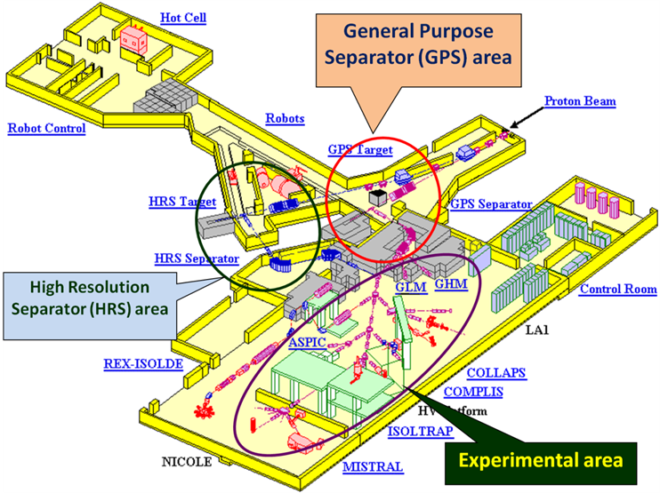
ISOLDE facility layout
(1)

Slide 21
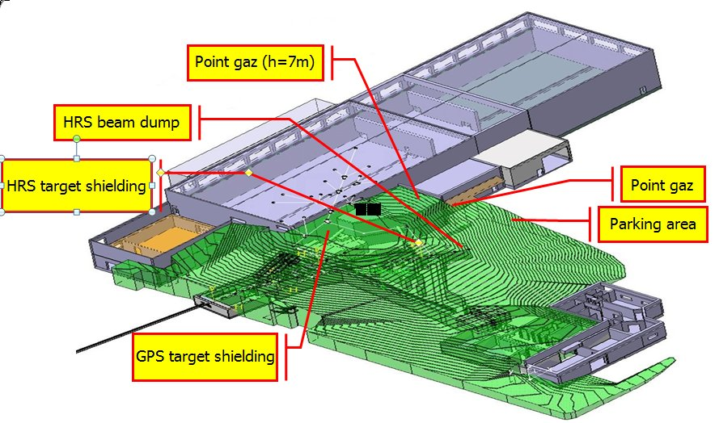
ISOLDE facility layout
(2)
Proton beam

Slide 22
HIE-ISOLDE
(ISOLDE upgrade)
High Intensity and Energy ISOLDE (HIE-ISOLDE) - major upgrade of the ISOLDE facility
Upgrade: increase (5x) of the primary beam power (proton)
  New injector (LINAC4) for the Proton synchrotron booster (PSB)
    Proton beam energy 1.4 GeV → 2 GeV
    Proton beam intensity 2 µA → 6 µA
Improvements of the quality, intensity and energy of radioactive ion beams:
  Higher intensities
  Improved mass resolution
  Facility for accelerating RIB will be replaced by a superconducting linac that can deliver a maximum energy of 10 MeV/u for a mass-to-charge ratio of A/Q = 4.5

Slide 23
HIE-ISOLDE
Study objectives
Evaluation of the shielding performance of the existing facility
  Neutron and photon flux distribution
  Ambient dose equivalent rate distribution
Radiation protection and shielding assessment for the upgraded facility:
  Ambient dose equivalent rate mapping
  Dose rate at “critical locations”
  Area classification
  Need for upgrade geometry and shielding
Validation: simulation results versus measurements (2010)

Slide 24
HIE-ISOLDE
Materials and Methods
Monte Carlo simulation program (FLUKA)
  Deep penetration simulation – thick (tens of meters) shielding
  Use of variance reduction technique (bias)
  Simulation running time: days (using the CERN cluster), 10⁶-10⁸ primaries
  ICRP-74 conversion coefficients
Proton beam energy:
  1.4 GeV
  2.0 GeV
Spallation targets:
  Ta (Tantalum,)
  UC_{x} (Uranium Carbide)
Measurements´ equipment (Radiation safety group CERN)
  FH40 gamma survey meter
  FHT 762 Wendi-2 Wide Energy neutron detector

Slide 25
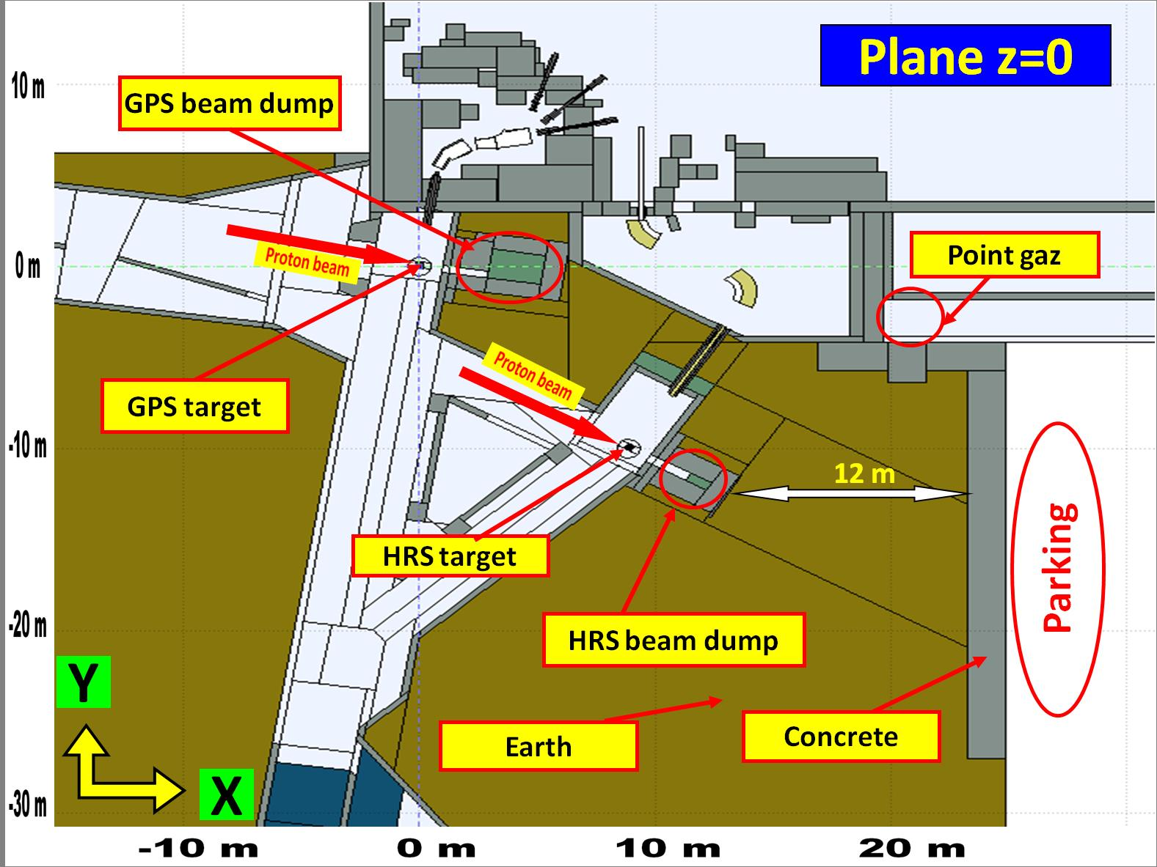
Implemented ISOLDE Geometry

Slide 26
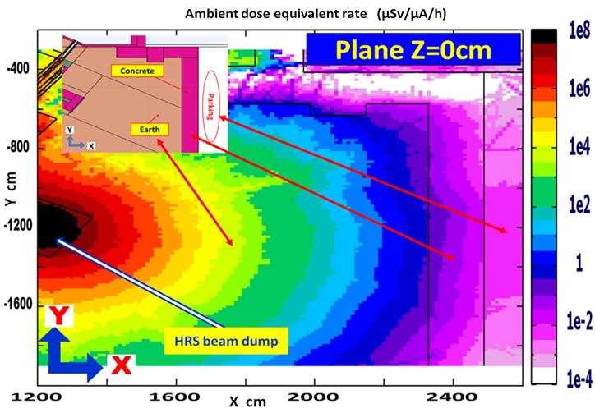
Dose rate
The parking area
HRS target area, proton beam energy: 2 GeV, no target in place.
(µSv/h per µA)

Slide 27
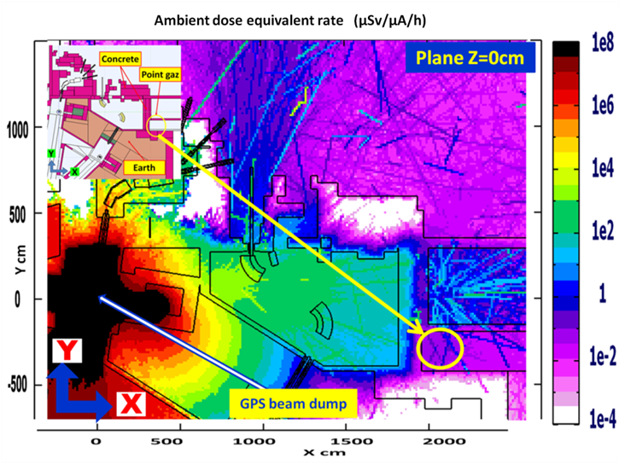
Dose Rate in the “Point Gas”
GPS target area, 1.4 GeV proton beam energy, UC_{x} target in place.
(µSv/h per µA)

Slide 28
Dose Rate – in the “Point Gas”
Simulations vs measurements
 |  | Point Gas (µSv/h per µA)
 |  | GPS operation mode |  | HRS operation mode
Target material |  | Ta | UC_{x} | Ta | UC_{x}
Measurements (1.4 GeV proton beam) | γ | BDF | BDF | - | BDF
 | n | 0.167 ±25% | 0.180 ±12% | - | 0.047 ±33%
Simulations |  | Total (γ + n)
1.4 Gev proton beam |  | 0.1-0.3 | 0.1-0.3 | 0.1-0.7 | 0.5-0.9
2.0 GeV proton beam |  | 0.1 -0.5 | 0.2-0.4 | 4.0-6.0 | 0.5-0.9
BDF – Background dose-rate level (Bruit de Fond)
The displayed values define the range of ambient dose equivalent rate, due to the uncertainty on the exact location of the detector

Slide 29
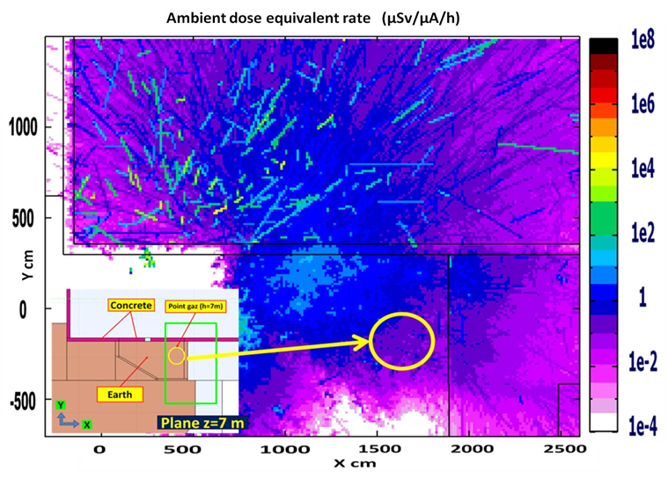
Dose rate in the “Point Gas (h=7m)”
GPS target area, Proton beam energy: 1.4 GeV, UC_{x} target in place.
(µSv/h per µA)

Slide 30
Dose rate in the “Point Gas (h=7m)”
Simulations vs measurements
 |  | Point Gas (h=7m) (µSv/h per µA)
 |  | GPS operation mode |  | HRS operation mode
Target material |  | Ta | UC_{x} | Ta | UC_{x}
Measurements (1.4 GeV proton beam) | γ | BDF | 0.034 ±12% | - | BDF
 | n | 0.052 ±49% | 0.119 ±17% | - | 0.084 ±22%
Simulations |  | Total (γ + n)
1.4 GeV proton beam |  | 0.1-0.5 | 0.1-0.5 | 0.5-1.5 | 0.5-0.9
2.0 GeV proton beam |  | 3.0-7.0 | 0.5-1.5 | 1.0-5.0 | 1.0-4.0
BDF – Background dose-rate level (Bruit de Fond)
The displayed values define the range of ambient dose equivalent rate, due to the uncertainty on the exact location of the detector

Slide 31
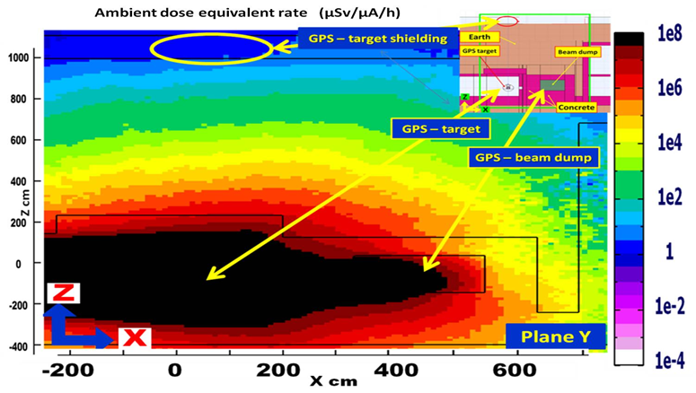
Dose rate
GPS – target shielding
GPS target area, Proton beam energy: 2.0 GeV, Ta target in place
(µSv/h per µA)

Slide 32
Dose rate
GPS – target shielding
 |  | GPS – target shielding (µSv/h per µA)
 |  | GPS operation mode
Target material |  | Ta | UC_{x}
Measurements (1.4 GeV proton beam) | γ | BDF | 0.030 ±57%
 | n | 0.054 ±59% | 0.060 ±24%
Simulations |  | Total (γ + n)
1.4 GeV proton beam |  | 1.0-3.0 | 0.3-0.9
2 GeV proton beam |  | 1.0-5.0 | 2.0-4.0

Slide 33
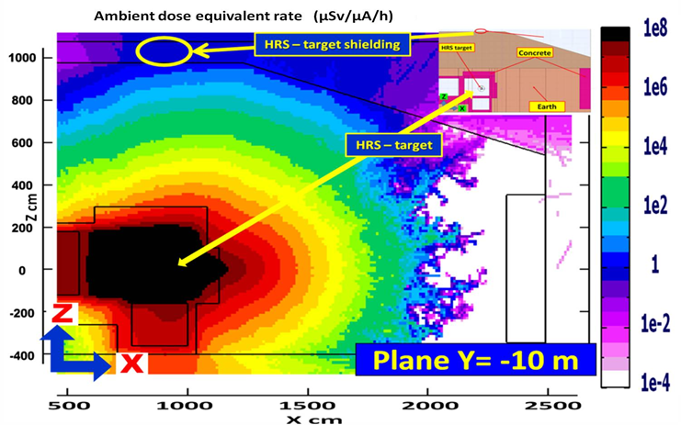
Dose rate
HRS – target shielding
HRS target area, 1.4 GeV proton beam energy, UC_{x} target in place
(µSv/h per µA)

Slide 34
Dose rate
HRS – target shielding
 |  | HRS – target shielding (µSv/h per µA)
 |  | HRS operation mode
Target material |  | Ta | UC_{x}
Measurements (1.4 GeV proton beam) | γ | - | 0.047 ±39%
 | n | - | 0.365 ±9%
Simulations |  | Total (γ + n)
1.4 GeV proton beam |  | 1.0-5.0 | 0.4-1.0
2 GeV proton beam |  | 2.5-5.5 | 1.0-5.0

Slide 35
Open questions / Issues
Uncertainties in the Monte Carlo simulations ?
  Soil composition (“typical CERN soil”) ?
  “Detailed” geometry (too complex – only approximate) ?
  Material composition (idem) ?
  Physics (cross-section data, etc.) ?
  Statistics (despite VRT) ?
Uncertainties in measurements ?
  High energy neutrons (detector response and sensitivity range ?)
How do these uncertainties and the discrepancies between measurements and MC simulations affect
  Shielding assessment and design ?
  RP operational aspects (classification of areas, access, etc.) ?
  Financial costs ?

Slide 36
Conclusions
The computed ambient dose equivalent rates as well as the measurements are on average lower than the maximum admissible value at CERN.
The obtained results pinpoint a significant increase of the ambient dose equivalent rate values in some critical points.
A reasonable agreement between Monte Carlo simulation results and measurements is observed for most locations.
However, discrepancies between measurements and simulated values are observed in a few positions. These can be explained by:
  The simplified geometry description of the facility
  The uncertainty in the detailed composition of some shielding materials (soil, etc.)
  Limited statistics even using variance reduction techniques
  The quality and uncertainties of the nuclear cross-section data for n, p and other hadrons interactions

Slide 37
Acknowledgements & bibliography
Acknowledgments are due to:
  the CERN-RP and HIE-ISOLDE teams
  Fundacão para a Ciência e a Tecnologia (FCT) for financial support under project CERN/FP/123598/2011
Bibliography:
  EURISOL Design Study - CERN-ITN report:
    EURISOL Multi-MW Target – MAFF configuration – Radiological Protection, Radiation Safety and Shielding Aspects, Y. Romanets and R. Luís, 2009
  CERN reports:
    CERN-DGS-2010-006-RP-SN: “Evaluation du blindage de la zone cible ISOLDE”, M. Deschamps et al., 2012
    HIE-JS-EN-0001: “Radiation protection, radiation safety and radiation shielding assessment of HIE-ISOLDE”, Y. Romanets et al., 2013
  Article:
    “Radiation Protection, Radiation Safety and Radiation Shielding Assessment of HIE-ISOLDE”, Y. Romanets et al., Rad. Prot. Dos (2013)

Slide 38
Anexos

Slide 39
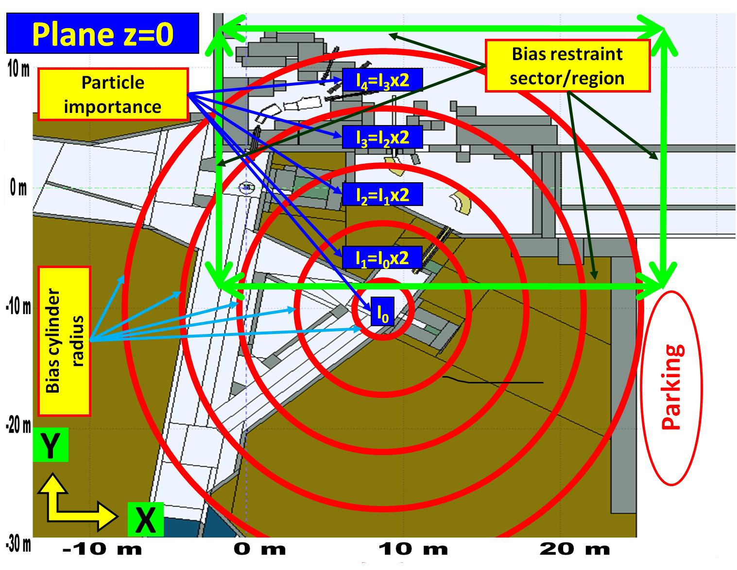
Variance reduction
Cylindrical bias

Slide 40
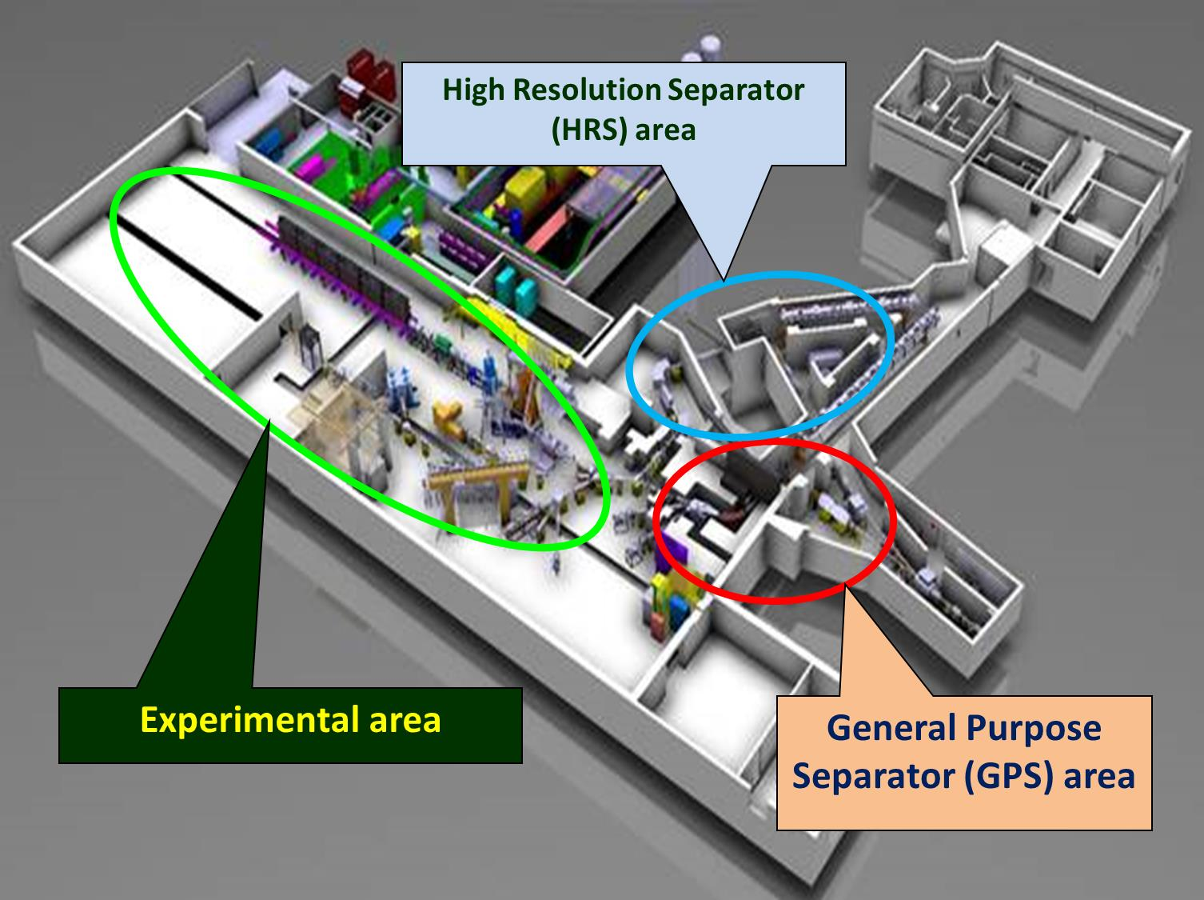
ISOLDE facility layout
(3)

Slide 41
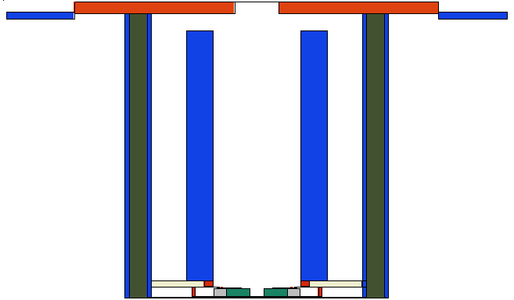
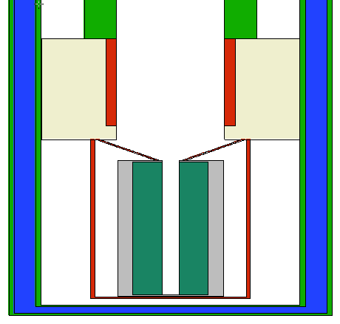
EURISOL
Extraction tube
Exit Tube
External Wall
Internal Wall
Cooling Water
Neutron Reflector
Fission Target
Fission Target Container
Neutron Reflector
Notes:
in this image i show the bottom of the extraction tube in detail. The extractions tubes have to be exchanged from time to time, due to the burnup of the fission targets, and so we have to know in which conditions they are going to be handled. It is very important to know the activities in all the regions of the extraction tubes, to have a notion of the dose someone would be subject to if in contact with the extraction tubes. So we took our analysis one step further and tried to know the activities and the nuclides responsible for that activities in the different regions of the extraction tubes for several cooling periods. These image shows some of the most important zones of the extraction tubes for which we performed this calculations. These are the external and internal walls, the cooling water that flows between these two walls, the fission target, the fission target container, the neutron reflectors and the exit tube, from which the ion beams are extracted,

Slide 42
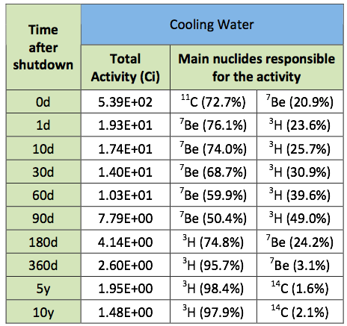
Activities in the Cooling Water
Time evolution
Cooling Water
Notes:
Here i show the results for the activities in the cooling water, which is this blue region between the internal and external walls. The cooling water circulates between the internal and the external walls, and is very important because it needs to be removed before the extraction tubes are exchanged, and the activity of the water have to be known, to decide how to deal with it. We can see total activities of about 500 Ci at the moment of shutdown and about 15 Ci ten years after shutdown. More importantly, i wanted to show that we also looked for the nuclides responsible for these activities, and found that for most of the cooling periods tritium and beryllium 7 are the main nuclides responsible for these activities.

Slide 43
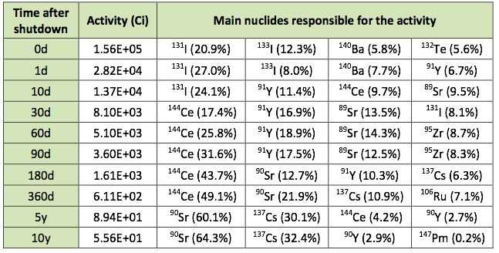
Activities in the fission targets
Time evolution
Fission Target
Notes:
The same here for the fission target. The evolution of the activities in the left column, and the main nuclides which are responsible for that activities. The fission target is the most activated regions of the extractions tubes, because of the production of radioactive fission products, and therefore we also wanted to know these activities in detail for the different cooling periods and the nuclides responsible for these activities. In this table only a few are represented, because the lists are indeed very long.

