Slide 1
Radiation Skyshine calculation
For the slow resonant extraction system at the AP 30 Service Building
mu2e experiment
Anthony Leveling
SATIF 2014
Notes:
The Anti-proton source facilities were designed for relatively low beam power, 13 watts of 8 GeV protons and mWatts of secondary beams. The mu2e experiment requires an 8 kW, 8 GeV proton beam which is to be transferred from the repurposed Debuncher Ring to a new experimental facility by 1/3 integer, slow-resonant extraction. The radiation shield available at the AP30 service building where the resonant extraction system is located is 10 ft (3.048 m). Early for estimates for beam loss due to the slow resonant extraction process were in the range of 2% to 5%. An extensive series of shielding schemes have been examined, all of which had been judged as either insufficient or cost prohibitive. In previous modeling efforts, beam loss was modeled as a simple scraping loss in a single magnetic element because the details of the slow resonant extraction system had not been developed. Don Cossairt produced and reported on the initial skyshine calculations based upon data from early beam loss measurement data. Both Don and Nikolai Mokhov provided extensive and helpful guidance in the development of the various analytical and MARS-based radiation SKYSHINE calculations.
In the work presented here, a slow resonant extraction system is modeled which includes electrostatic septa, quadrupole magnets, a Lambertson extraction magnet, C-magnet, and EDWA bending magnet representing all elements in the extraction process. An in-tunnel steel shield system has also been developed and is included in the model. With the more realistic beam loss distribution included in this current effort, a beam extraction scheme is found that meets laboratory radiation safety requirements of the Fermilab Radiological Controls Manual (FRCM).

Slide 2
outline
Facility overview
Extraction system
Supplemental shielding system
MARS simulations
Stage 1
Stage 2
SKYSHINE
DIRECT
MARS results
Conclusions

Slide 3
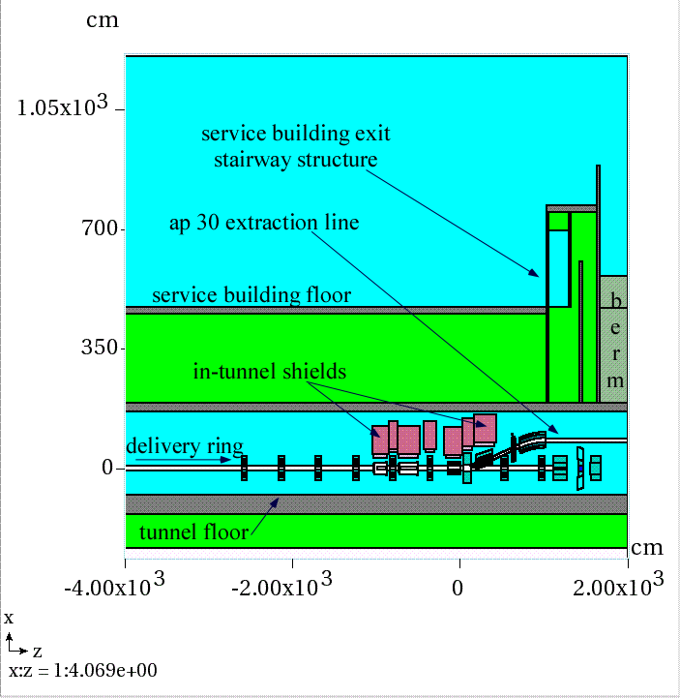
Facility overview
AP30 Anti-proton source service building
10 foot tunnel shield in service building
sufficient for 13 watts of 8 GeV protons
Building is to be repurposed for mu2e experiment
10 foot shield remains unchanged
Mu2e requires 8 kW of 8 GeV protons
Beam is to be extracted beneath the service building by 1/3 integer, slow resonant extraction
A lossy process
In addition, there is an exit stairway just downstream of the beam extraction point
Longitudinal elevation view
Notes:
If this facility was to be built in a “green field”, a more appropriate choice of shield thickness would be 18 to 22 feet depending upon the desired occupancy requirements in the service building. Due to the shielding arrangement available to us, personnel occupancy at the AP10, AP30, and AP50 service buildings will be excluded during beam operations.
Other views of the exit stairway are included in extra slides section following this talk.

Slide 4
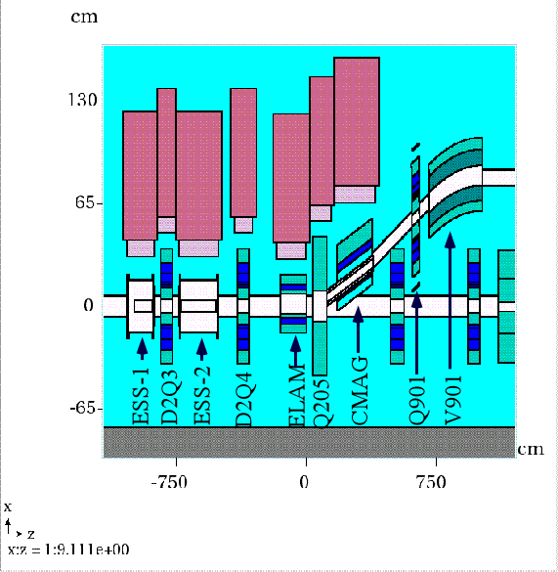
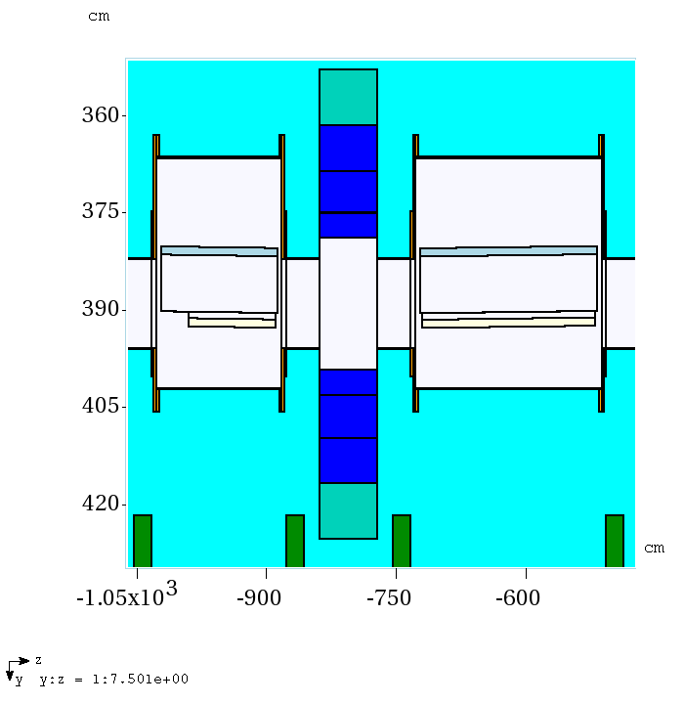
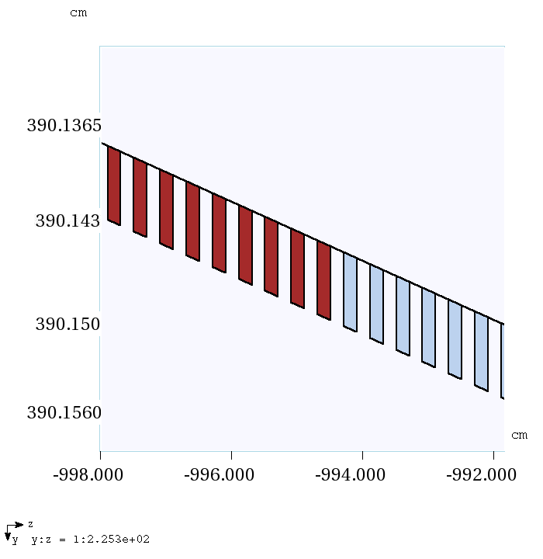
Extraction system
Graphite
diffuser foils
W foils
Foils are
2 mm x 2 mm every 4 mm
Extraction system is modeled with full details of magnets, star chambers, magnetic fields, and extraction septa foils (850)
Notes:
Details of the extraction system are shown here. The detailed nature of the septa model is illustrated. The final dimensions and materials choices for the septum foils remains to be determined. In addition, the extraction system shown has the beam extracted to the outside of the Delivery Ring. It is alternately being considered to make the extraction system toward the inside of the Delivery Ring. For these reasons, this work will need to be repeated to incorporate the final design features.

Slide 5
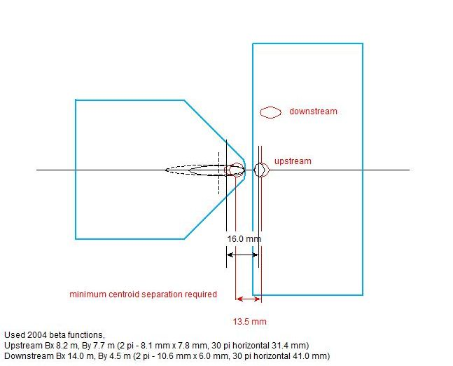
Extraction system
field free region
circulating aperture
vertical bending field
extraction aperture
Cross section of
Lambertson Magnet
critical extraction system
region where beam loss
will occur
Notes:
The circulating beam in the Delivery Ring (formerly the Debuncher Ring) passes through the non-field region of the Lambertson magnet (left side) while the extracted beam passes through the extraction channel at right where it is deflected vertically.
A large part of the beam which hits the wire plane scatters and is loss in the Lambertson magnet at the septum, a 3 mm wide steel divide between the circulating and extraction channels. The septum is required as a magnetic field flux return. The thickness of the septum is design constraint which results in unavoidable beam loss.

Slide 6
Extraction system
Plan view
Elevation view
Extraction system tuning was required to optimize apertures and minimize losses
Diffusion section wires modeled as black holes to eliminate scattering during aperture scans
Beam loss is determined to be 1.25%
Notes:
At left is a trial run with a few hundred protons directed to the extraction orbit of the Delivery Ring. The septa wires material is black hole in the illustration at left to prevent scattered beam tracks interfering with tune up of other device positions. In the left image, beam entering the extraction channel is touching the Lambertson septum which has initiated a shower. The Lambertson magnet is subsequently moved magnet so that both the circulating and extracted beams miss the septum. At right, an elevation view of the circulating and extracted beams are shown to be lossless. After this tune up is completed, the wire materials are changed back to graphite and tungsten for purposes of the shielding calculations.

Slide 7
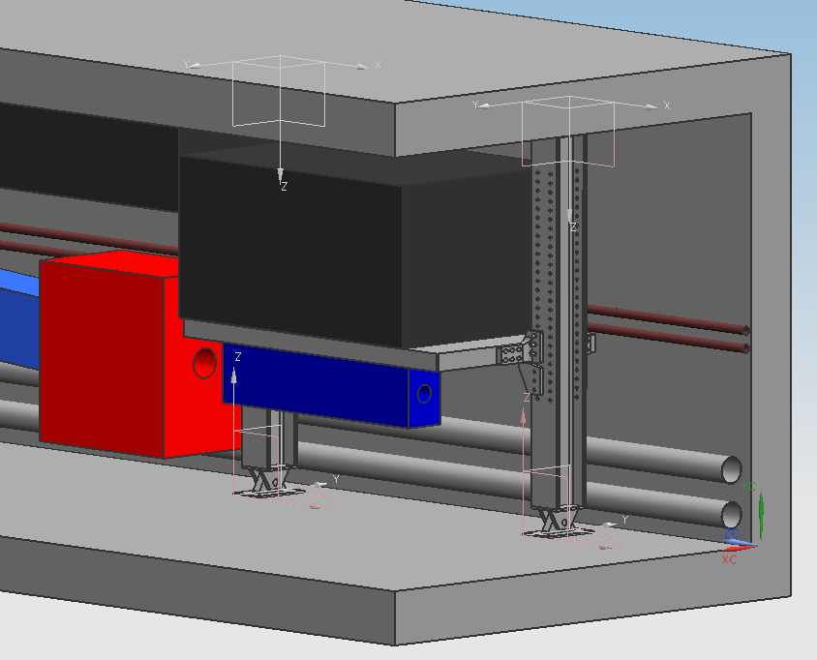
Supplemental shield system
81 cm thick steel shield
quadrupole
C-magnet
Lambertson magnet
10 cm thick steel shelf
Support columns
Notes:
Modular shield design can be adopted at any required location. The tunnel where the Debuncher Ring is located presently has cable tray running through the region where the shield is shown. All cable trays are to be removed in the tunnel beneath the AP30 service building and relocated to the other side of the tunnel. The supplemental shield system could then also be used at the injection region if it is found to be necessary.

Slide 8
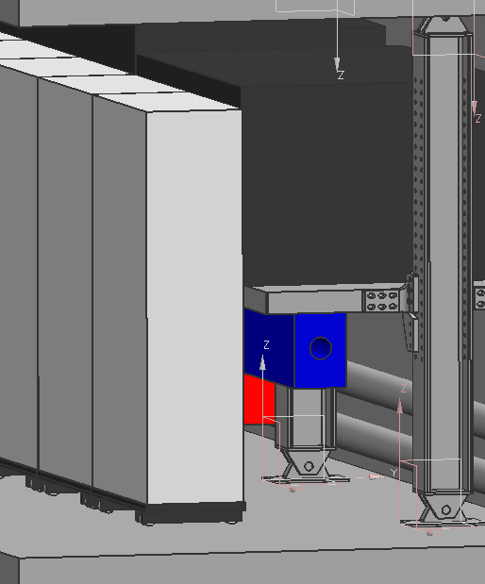
Supplemental shield system
Aisle way shield is required to limit worker exposure during maintenance activities
45 cm concrete
10 cm marble (not shown)
Notes:
Residual radiation dose rates for the extraction system devices have been calculated. The aisle shield will be useful in minimizing personnel exposure. No significant improvement was noted in earlier shielding calculation comparisons between the “no aisle shield” and “aisle shield” cases.

Slide 9
MARS simulations
Stage 1 – generate a particle source file at an intermediate surface, source term for Stage 2 run
Stage 2 – generate a particle source file at surface of service building floor for SKYSHINE and DIRECT calculations
SKYSHINE calculation
Effective dose rate at ground level vs. distance from AP30 service building
DIRECT calculation
Effective dose rate at Wilson Hall by floor elevation
Includes direct and skyshine contributions
Stage 2
Stage 1
Notes:
The number of incident particles chosen for the Stage 1 run is determined by the size of particle source file which is required for the Stage 2 run. The recommended number of particles ranges from 2E5 to 1E6 lines. Cuts can be made to exclude particles such as neutrinos and low energy particles which cannot penetrate the 10 foot thick shield. The overwhelming majority of particles crossing the Stage 1 surface are neutrons.
For the Stage 2 run, the Stage 1 generated particle file is used as the source term. The main output of the Stage 2 run is yet another particle output file to be collected at the Stage 2 surface indicated in the sketch. The Stage 2 surface also included the top surface of the exit stairway structure, though this is not indicated in the sketch. Particles of all energies are collected in the Stage 2 output file with lowest energy thresholds of the mcnp option. The EGS5 compiler option was not used in this work, so some low energy beta/gamma components, thought to be unimportant for the skyshine calculation are omitted. As in the Stage 1 run, the number of particles desired in the Stage 2 particle output file is 2E5 to 1E6.
Additional weighting factors are applied to the particle source files to ensure proper normalizations occur among the 4 MARS runs.

Slide 10
Stage 1 & 2 total flux results – mars.hbook histograms
Stage 1
Stage 2
Dashed lines indicate surface of shower particle collection
Notes:
The Stage 1 run flux histogram is shown at left. The yellow dashed line is the particle collection surface for the run.
The Stage 2 run flux histogram is shown at right. The Stage 2 particle file includes particles from both surfaces indicated by the yellow dashed lines.

Slide 11
SKYSHINE model
Not to scale
Concrete base, radius 5 km x 2m
Tissue equivalent detector, 5 km x 0.3 m
Atmosphere, 5 km radius x 10 km
A histogram volume (air) 170 cm high and 100 m x 100 m is used to determine effective dose rates in service building, parking lot, and Indian Road
Stage 2 surface lies between TE detector and histogram volume (red horizontal bar)
Tissue equivalent detector volume is just below the Stage 2 surface
In histogram volume, effective dose contribution from Stage 2 surface and reflected SKYSHINE is calculated
The tissue detector only receives reflected shower particles since the Stage 2 surface is above it
Histogram volume
Stage 2 surface
Concrete base
TE detector
Notes:
The particle file generated in the Stage 2 run is the source term for the SKYSHINE run. The values of x and z and dcx and dcz are exchanged because the model axes for the Stage 1&2 runs are rotated 90 degrees from the SKYSHINE and DIRECT runs. The source term is placed above the TE detector so that the particles are not attenuated by the TE mass. The effective dose rate resulting reflection of SKYSHINE source is recorded in the TE detector. The histogram volume receives both the DIRECT component from the Stage 2 particle source file and the reflection of the SKYSHINE. In this way, both the SKYSHINE effective dose rate as a function of distance and the total effective dose rate in the vicinity of the AP30 service building can be determined in a single SKYSHINE run.

Slide 12
SKYSHINE model
The full model
Atmosphere extends vertically 10 km in 1 km layers
Radius is 5 km
Tissue equivalent detector is subdivided radially
1 m radial bin steps to 50 m 10 meter bins to 5 km

Slide 13
SKYSHINE model – air density correction technique
MATER.INP file
A2B7 SKYSHINE calculation, 5 km - 7/31/13
1 'CONC‘
2 'TISS‘
3 'AIR' 0.00116889
4 'AIR' 0.00105969
5 'AIR' 0.000958479
6 'AIR' 0.000864832
7 'AIR' 0.00077835
8 'AIR' 0.000698646
9 'AIR' 0.000625341
10 'AIR' 0.000558071
11 'AIR' 0.000496482
12 'AIR' 0.000440233
STOP
Notes:
In previous work, it was thought that the atmosphere involved in the SKYSHINE calculation was limited to about 500 meters. Without atmospheric density corrections, the resulting skyshine plume is significantly compressed which results in a different effective dose rate distribution. The calculation could be further improved with a continuous density distribution function.

Slide 14
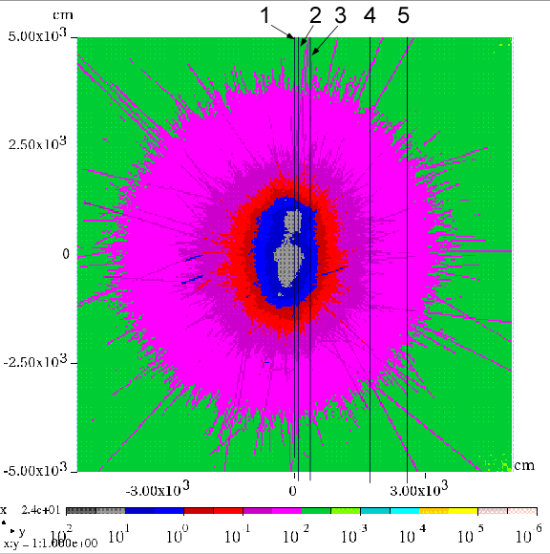
SKYSHINE result
Total effective dose rate (mrem/hr)
Includes direct and SKYSHINE contributions
Line 1: Delivery Ring centerline
Line 2: Tunnel outer concrete edge
Line 3: Edge of service building
Line 3/4: Parking Lot
Line 5: edge of Indian Road
Notes:
At left is an aerial view of the Antiproton Source facility. The blue arrow points to the AP30 service building. The image at right shows the SKYSHINE histogram result of prompt dose rate due to the direct and reflected showers. The resulting effective dose rates meet all requirements of the FRCM for the parking lot adjacent to the AP30 service building and for Indian Road. The AP30 service building will not be occupied during beam operations.

Slide 15
X/Z plane, total effective dose rate mrem/hr
Y/Z plane, total effective dose rate mrem/hr
mrem/hr
Notes:
The full model, total effective dose rate due to radiation skyshine in units of mrem/hr are shown for the xz plane and the yz plane through the center of the Stage 2 source term. The tilt in the plume in the xz plane is due to particle momentum of the emerging particle shower. The slight tilt to the left in the yz plume is due to the proximity of the Delivery Ring extraction components to the tunnel shield wall.

Slide 16
Effective dose rate (mrem/hr) – 8 kW normal losses vs. altitude
Layers 1 through 5
Layers 6 through 10
Notes:
The average effective dose rate of each of the 10 layers of 1 km of atmosphere are shown resulting from a 1.25% beam loss.

Slide 17
8 kW beam operation with 1.25% extraction losses
Determined from SKYSHINE tissue equivalent detector layer
Bin size transition
Notes:
The average annual effective dose rate for continuous operation of the 8 kW beam with 1.25% beam loss is shown as a function of distance. The effective dose rate is averaged over the volume of each of the bins. The first 50 bins are 1 meter and the remaining bins are 10 meter wide. The break in the statistical error is due to the huge increase in bin volume starting with bin 51. Wilson Hall (0.17 mrem/year) is located at a distance of 500 meters. The West Booster Tower (1.18 mrem/year) is at 200 meters and the new MC-1 service building is approximately 100 meters from the AP30 service building (3.3 mrem/year).

Slide 18
DIRECT model
Root Geometry:
Cylindrical shell
500 m radius
0.3 m thick
70 m high
Divided into 16 levels
Divided in azimuth into 36 ten degree segments
Purpose: To capture effective dose rate at Wilson Hall as a function of floor
An addition to the SKYSHINE model
Used for determination of effective dose rate at Wilson Hall
No credit taken for the massive shielding afforded by the concrete structure
Azimuthal angle of interest is 23 degrees CW wrt incident beam direction
Notes:
The DIRECT model is essentially the SKYSHINE model with an additional tissue equivalent detector 70 meters high, 0.3 meters in thickness, and with a radius of 500 meters. The cylinder is subdivided into 16 slices, each of which is an approximate representation of a floor in Wilson Hall. Each of the layers is further divided in azimuth into 36 ten degree bins. Wilson Hall is located at 23 degrees relative to the 0 degrees in which the incident beam is directed. The center of the cylindrical shell is located at the center of the AP30 beam loss point. The tissue equivalent detector is meant to measure the direct component of the shower resulting from the Stage 2 surface as well as the reflected SKYSHINE component.

Slide 19
DIRECT and SKYSHINE annual effective dose rate
8 kW extraction at AP30, continuous operation
Wilson Hall
Notes:
The combined DIRECT/SKYSHINE effective dose rate as a function of floor elevation in Wilson Hall is given at the indicated arrow in the plot. The difference between the 1st floor and other floor effective dose rates is due to the DIRECT effective dose rate. Wilson Hall is a rather massive concrete structure. No credit is taken for the shielding provided by the building. Consequently, the calculation is conservative where offices are not located in the crossovers at the south face of Wilson Hall.

Slide 20
Conclusions
A model of the resonant extraction system has been created
1.25% beam losses are realistically distributed
Supplemental shield system design appears adequate
Calculated SKYSHINE and DIRECT effective dose rates can be tolerated
the resulting effective dose rates fall within all FRCM requirements
However:
An active protection system is required to limit radiation effective dose rates significantly higher that those calculated here
Other potential sources of beam loss at the antiproton source facilities must be considered when/if they are observed
Notes:
FRCM is the Fermilab Radiological Controls Manual
Septa design by JPARC colleagues have indicated beam loss of 0.5% is possible. Thus, this calculation may prove to be conservative.
A new radiation detector system called the Total Loss Monitor System has been conceived, built, and tested to limit beam loss as a credited safety system at the Anti-proton Source Facility. We expect preliminary approval for the use of the TLM system in the near future.
Consultation with a rather large group of people was required to produce this work. First and foremost, the author acknowledges the contributions by Don Cossairt and Nikolai Mokhov for insights in the SKYSHINE problem and for application of the MARS code to solve it.
Vladimir Nagaslaev provided the incident beam parameters for the resonant extraction system as well as the layout of the ESS septa placement and angles.
Jim Morgan provided the design layout of the extraction system along with beam line coordinates and magnet currents.
Carol Johnstone provided starting alignment data for the extraction line components.
Corey Crowley designed the modular in-tunnel shielding system.
Brian Hartsell provided the preliminary electrostatic septa mechanical design adapted for the model.
Mike Vincent provided the C-magnet geometry.
Rob Kutschke and Andrei Gaponenko made advances in MARS grid job submission procedures and taught me to use them.
Steve Werkema provided general help and consul in the development and execution of this model and the many previous versions. He also reviewed this talk is partly responsible for whatever clarity of thought it may provide.
Finally, the calculations used to produce results presented here required many, many years of cpu time. This work would not have been possible without the support of the grid computing system. 10 years ago, such work would have been impossible.

Slide 21
Extra slides

Slide 22
Facility overview
Exit stairway details are included in the simulation
Notes:
Some other cross sections of the exit stairway

Slide 23
Normal 8 kW beam operation – Skyshine only Total effective dose rate (mrem/hr) vs distance in tissue detector
Notes:
Histogram of effective dose rate in mrem/hr due to SHYSHINE in the TE detector volume

Slide 24
DIRECT model angle of interest
Wilson Hall
500 m radii circles
Centered on
AP10
AP30
AP50
Service buildings
AP30
Notes:
The red circles are 500 m in radius with centers located at each of the three Anti-proton source service buildings. The angle of the incident beam is 0 degrees; Wilson Hall is 23 degrees CW in azimuth relative to the incident beam direction. One can imagine the cylindrical shell of the DIRECT detector (slide 18) placed upon the red circle centered on the AP30 service building.

