Slide 1
Comparison of Radionuclide Activity in the NuMI Decay Pipe to Results from the MARS Monte Carlo
S. Diane Reitzner
Satif-12
28-04-2014

Slide 2
Outline
Introduction
NuMI beamline
Core sample results
MARS simulation
Nuclide distribution results
Activity results
Conclusions

Slide 3
Introduction
Tritium is highly mobile.
  Transfers from one medium to another
Important to understand tritium production in beamline shielding.
  Develop method of tritium inventory
Difficult to assess tritium activity in solid samples
  Need to extract the tritium first before measuring its activity.
    Not guaranteed to extract the tritium.
  Tritium is difficult to contain.
Try MC methods to predict tritium production in shielding
  Compare MARS output to activity from other radionuclides in core samples taken from the NuMI decay pipe shield at Fermilab.

Slide 4
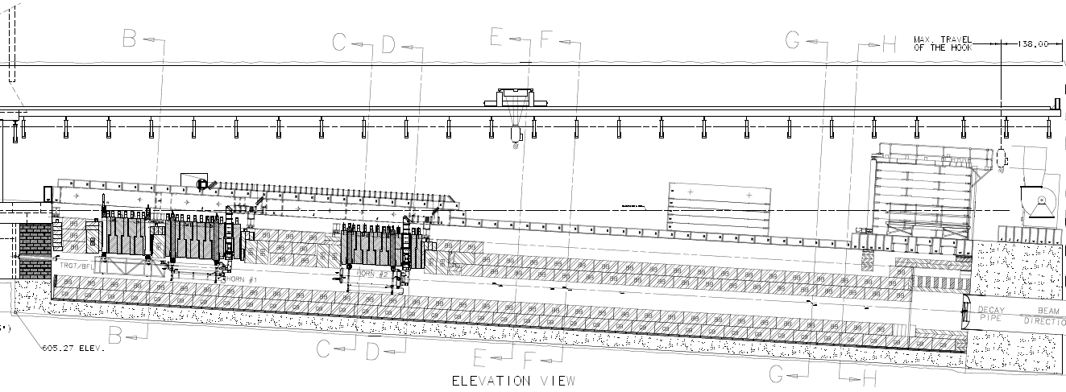
NuMI Target Hall
Target/Baffle Carriage
Graphite Target
120 GeV
proton beam
Decay
Pipe
Horn 1
Focus resultant
pions and kaons
Horn 2
Steel Shielding
Flowable Fill
ρ= 2.2 g/cm³

Slide 5
Dolomite
2.9 m outer
radius of shield
98 m
To Target
Hall
93 m
2 m diameter pipe
Decay Pipe Walkway
NuMI Decay Pipe
675 m long
Neutrinos to MINOS in Soudan MN
3.7 m outer
radius of shield
249 m
To Absorber Hall
683 m
2.1 m outer
radius
Pions and kaons
decay to neutrinos and muons

Slide 6
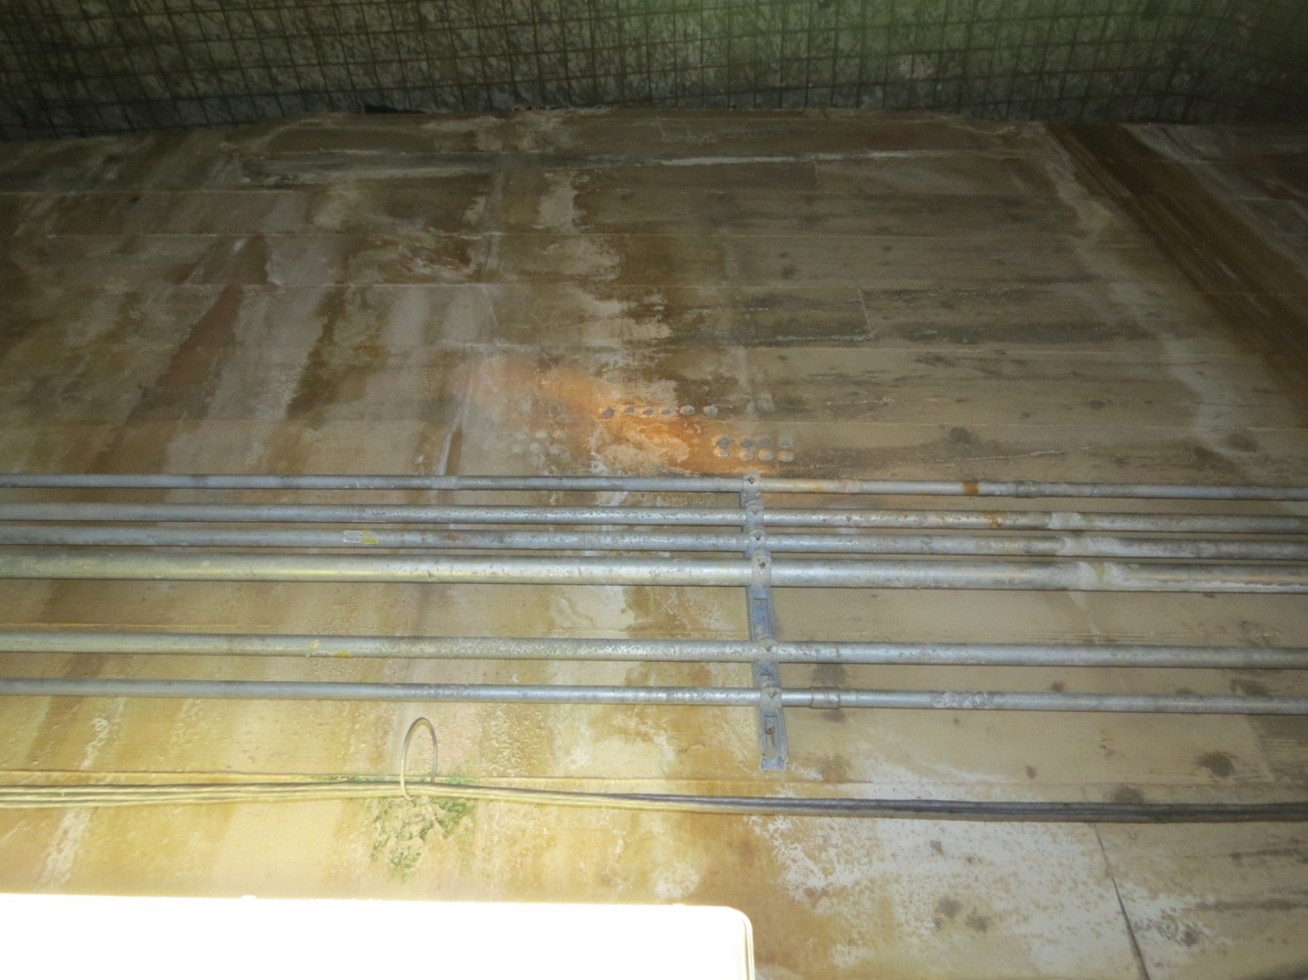
Face of the NuMI decay pipe shield where the core samples were extracted.

Slide 7
Activity in Decay Pipe Shield
2010
Tritium Activity
Dehumidifiers installed in target hall between 2006 and 2010
Fixed Radionuclide Activity
Maximum depth from surface: 30”

Slide 8
Activity in Leachate
ST9.99
2010
2010
Comparison of ²²Na Activity in solid sample to leachate
Leaching fraction for ²²Na as a function of depth

Slide 9
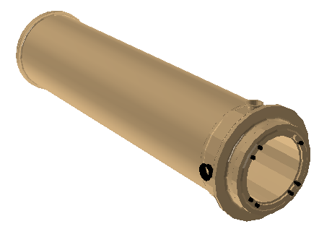
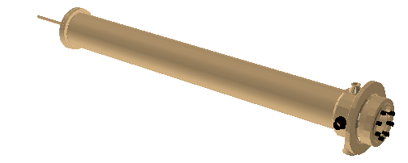
MC Analysis of Nuclide Production
Use MARS to predict nuclide distribution in the NuMI decay pipe shield.
  Compare to fixed nuclide distributions such as ⁷Be and ⁵⁴Mn
Simple model of NuMI target hall and decay pipe in MARS
Detailed horns and target
Idealised horn magnetic field
Horn2
Target
Horn1

Slide 10
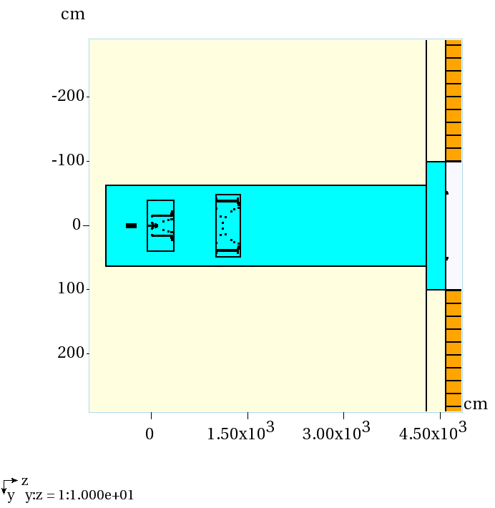
NuMI Target
Hall in MARS
Baffle
Target
Decay Pipe
Entrance
Horn 1
Horn 2

Slide 11
MC Analysis
Core samples extracted at large radius.
  1.5 m < R < 3.7 m
  Inner radius of decay pipe shield: 1.0 m
  Thick shielding problem.
  Decay pipe shield has large volume.
Use star densities with fine bins to extract spatial distributions.
Use coarse radial bins for nuclide production.
  Run MARS in MCNP mode
    E_{n,th} = 1 meV

Slide 12
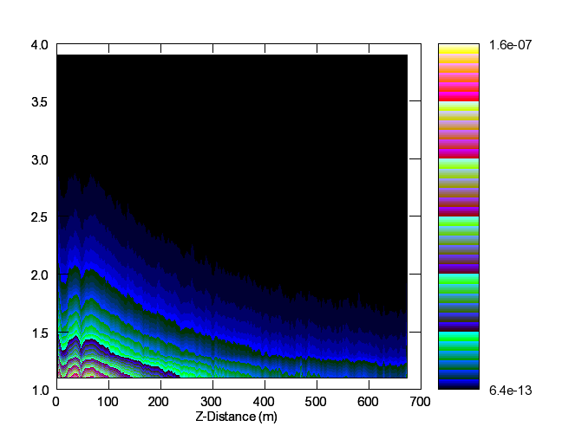
Star Density per Proton in the Decay Pipe Shield
stars/cm³/s per proton
Radius (m)

Slide 13
Longitudinal Distribution Comparison
R = 2.1m

Slide 14
Radial Distribution Comparison
Z=93 m

Slide 15
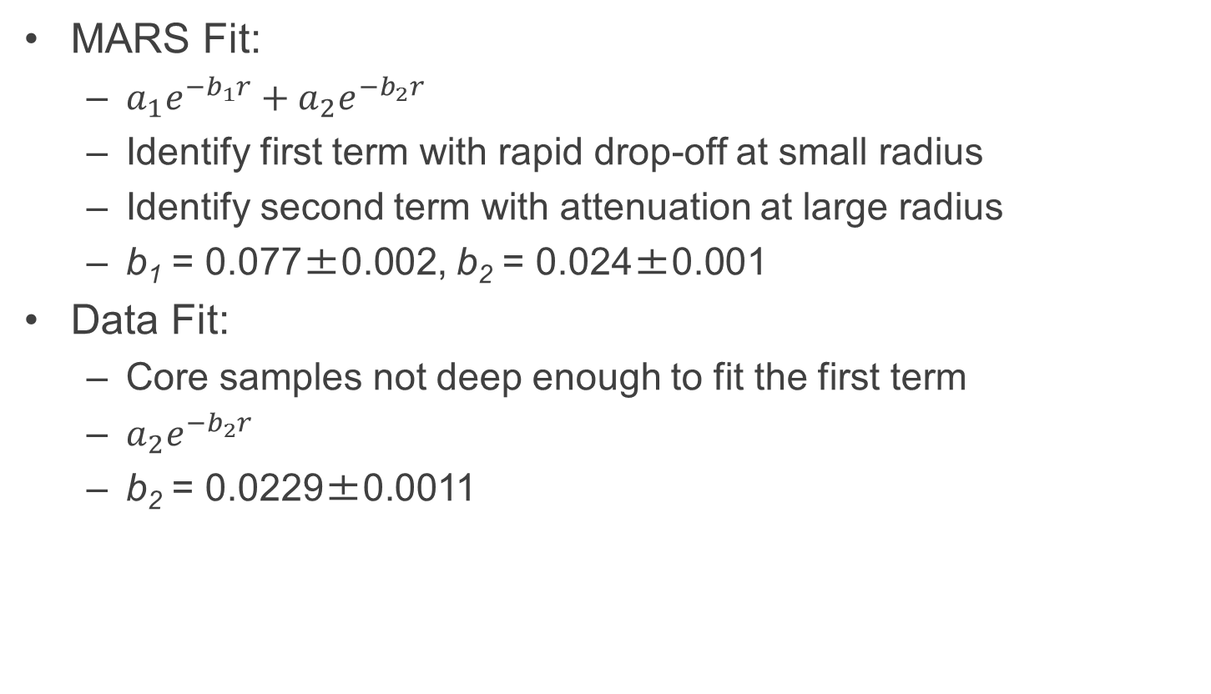
Radial Distribution Fits
MARS Fit:
  $a_{1}e^{−b_{1}r}+a_{2}e^{−b_{2}r}$
  Identify first term with rapid drop-off at small radius
  Identify second term with attenuation at large radius
  b₁ = 0.077±0.002, b₂ = 0.024±0.001
Data Fit:
  Core samples not deep enough to fit the first term
  $a_{2}e^{−b_{2}r}$
  b₂ = 0.0229±0.0011

Slide 16
Nuclide Production Calculation
Extract nuclide production per proton for R>1.7m
Use DETRA to calculate activity A_{tot}.
  Intensity based on NuMI POT data
  Integrate over 375 days (300 day beam on, 75 day s beam off) to compare to 2006 results
Intensity profile input to DETRA

Slide 17
Nuclide Activity Comparison
Nuclide | MARS Activity (pCi/g) | DATA Activity (pCi/g) | MARS Ratio ⁷Be/X | Data Ratio ⁷Be/X
⁷Be | 454±91 | 346±52 | 1 | 1
²²Na | 111±22 | 78.7±11.9 | 4.1±0.7 | 4.4±0.9
⁵⁴Mn | 25.1±5.0 | 19.7±3.0 | 18.1±3.4 | 17.6±3.7
³H | 229±46 | 57.9±0.9 | 2.0±0.4 | 6.0±0.9
The activity at R=2.1 m and Z=93m (from Horn 1) in the NuMI decay pipe for 300 days of beam on followed by 75 days beam off.
Activities for ⁷Be, ²²Na, and ⁵⁴Mn agree with the activity seen in the core samples.
Ratio of ⁷Be/²²Na, ⁷Be/⁵⁴Mn agree very well with data.
MARS reports greater activity for tritium
  Tritium underreported in data as a single leach cycle does not collect all of the tritium

Slide 18
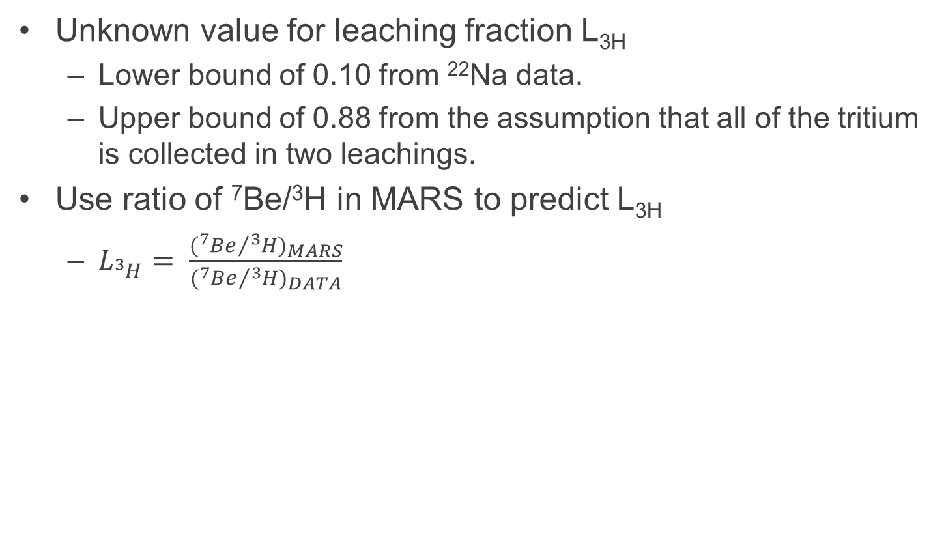
Tritium Leaching Predictions from MARS
Unknown value for leaching fraction L_{3H}
  Lower bound of 0.10 from ²²Na data.
  Upper bound of 0.88 from the assumption that all of the tritium is collected in two leachings.
Use ratio of ⁷Be/³H in MARS to predict L_{3H}
  $L_{{}_{}^{3}H}= \frac{({{}_{}^{7}{Be}}/{{}_{}^{3}{{H)}_{MARS}}}}{({{}_{}^{7}{Be}}/{{}_{}^{3}{{H)}_{DATA}}}}$

Slide 19
Predicted Leaching Fraction
Location from Horn 1 | Year | Radius | ⁷Be/³H from Data | Estimate L_{3H}
93 m | 2006 | 2.1 m | 6.0 | 0.33±0.09
683 m | 2006 | 1.5 m | 8.0 | 0.25±0.07
93 m | 2010 | 2.1 m | 2.9 | 0.41±0.11
98 m | 2010 | 3.0 m | 1.8 | 0.66±0.17
249 m | 2010 | 3.0 m | 2.9 | 0.41±0.11
693 m | 2010 | 1.5 m | 3.0 | 0.40±0.10
Ratio of ⁷Be/³H from MARS:
2006: 2.0
2010: 1.2

Slide 20
Conclusions
Activity in samples taken from the NuMI decay pipe shielding in 2006 and 2010 demonstrate the mobility of ³H.
Fixed nuclides like ⁷Be and ²²Na can be used to benchmark Monte Carlo codes used for radionuclide production in shielding.
  MARS prediction of nuclide distributions match data.
  Predicted activity of fixed nuclides agree with data.
Comparison of tritium activity predicted by MARS to the activity seen in the samples implies that only 41% of the tritium collected in the deep samples.

