Slide 1
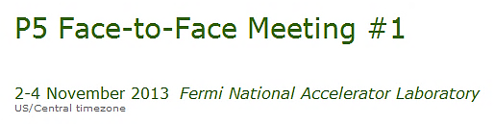

Strategic Planning
for the Japanese Program
Atsuto Suzuki (KEK)

Slide 2
Outline
Strategy of JHEP Project
Large Projects (1): ILC & LHC Upgrade
Large Projects (2): Large Neutrino Detector
Medium/Small Projects
Summary

Slide 3
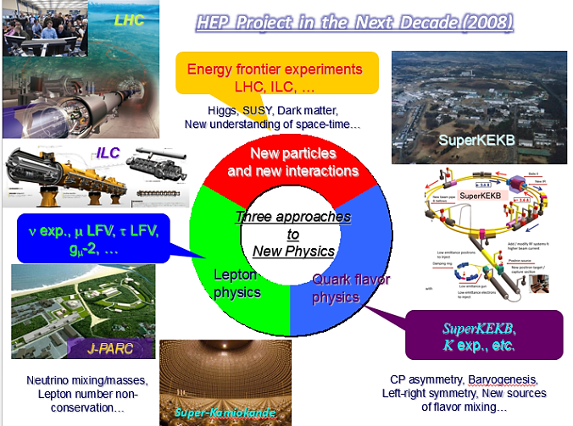

Strategy of JHEP Project

Slide 4
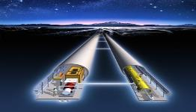
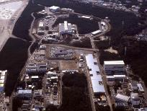
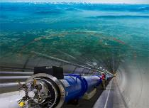
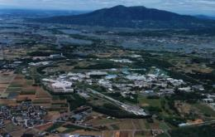
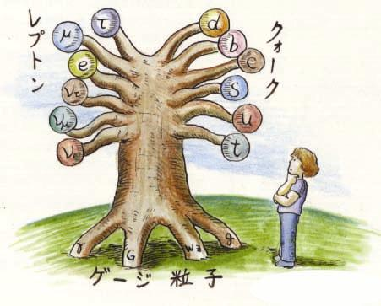
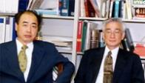

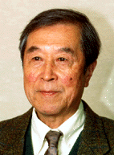
Prioritization of Accelerator Project
International Linear Collider（ILC）
Scientific Activities
Technology Innovations
Talented Human Resources
Lepton CP Asymmetry
Beyond Standard Physics
Power-Upgrade
SuperKEKB
J-PARC
KEK-B
Quark CP Asymmetry
LHC
Lepton
Quark
ν_{τ}
[Origin of Matter]
ν_{μ}
Quest for Neutrinos
ν_{e}
Quest for 6 Quarks
[Origin of Force]
Higgs Particle [Origin of Mass]

Slide 5
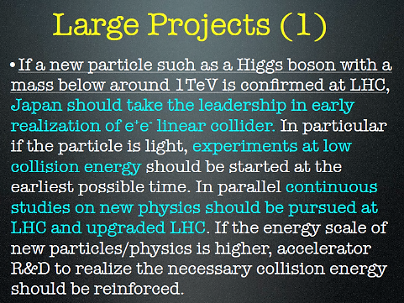
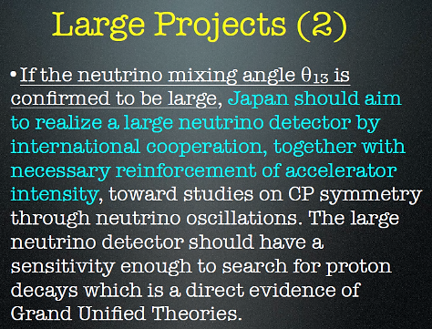
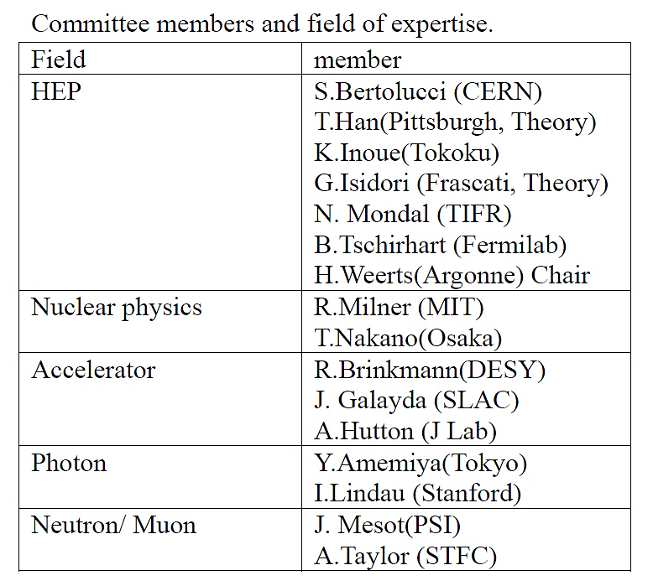
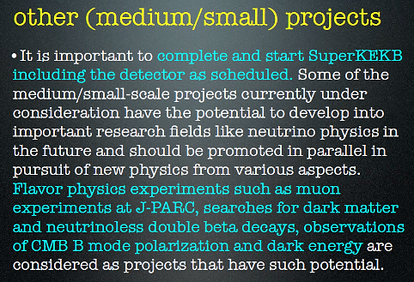
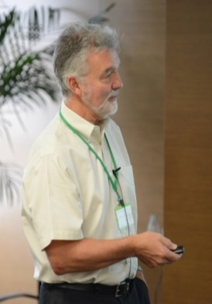
High Energy Physics Committee in Japan (2012)
April 2, 2013
Dr. H. Weerts
(ANL)

Slide 6
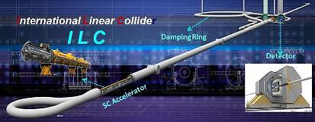
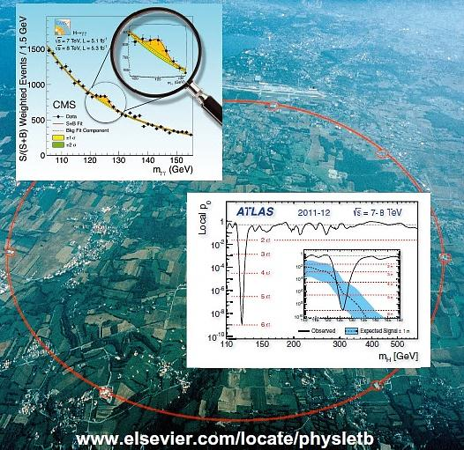
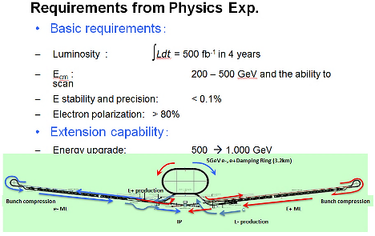
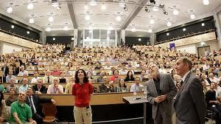

Large Projects (1)
:
ILC & LHC Upgrade
Staging Extension
250 GeV -> 370 GeV -> 500 GeV -> 1 TeV

Slide 7
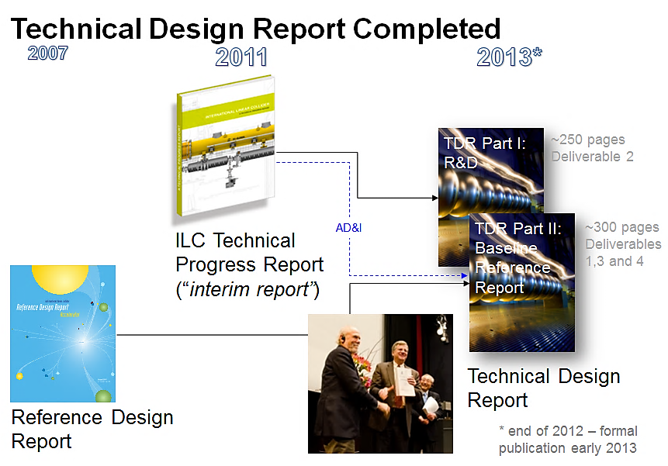
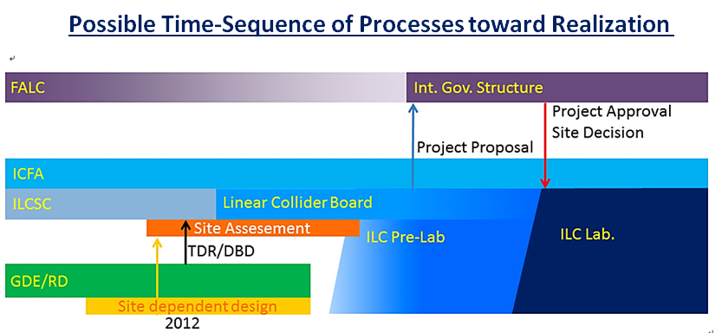
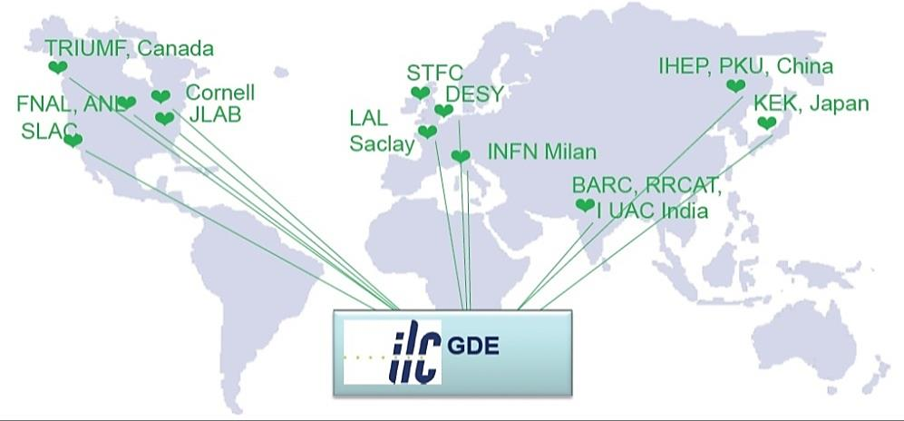
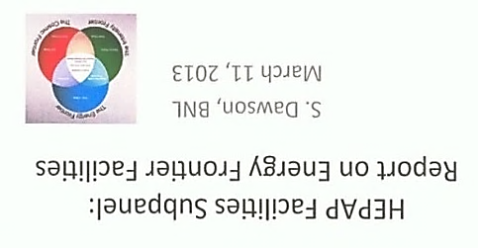
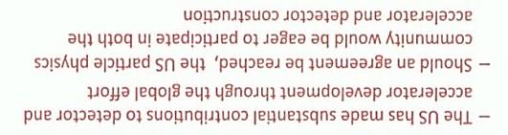
Accelerator/Detector R&D
Detailed Design for Construction
Project Proposal
Detailed Design for ILC Lab.
Chart-out of Approval Process
for instance, ICFA→IUPAP→
OECD → Governmental Board

Slide 8
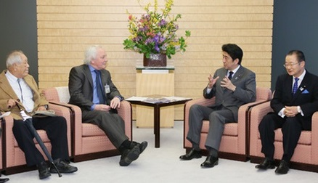
Toward ILC Construction : Japan Activities
at European Strategy Meeting
Dec. 11, 2012
2012
2013
2014
2015~6
Positive Reference
from New Prime Minister
ILC Project Office
ILC Strategy Council
Establish ILC Pre-
J-Lab.
Establish ILC Pre-
J-Lab.
ILC Pre-Lab.
Establish ILC -Lab.
Set-up JLCB and JLCB
JLCC
ILC -Lab.
HEP
Researchers
Cite Decision
Design ILC Lab.
～2013.9
Cite/Host
Establish
Project Proposal to Science Council of Japan
Formal Message
on Hosting ILC in Japan
ILC Host Recommendation to Government
Detailed Design of International Country
Japan Policy Council
Oct. 16
starting governmental negotiations toward hosting ILC in Japan

Slide 9
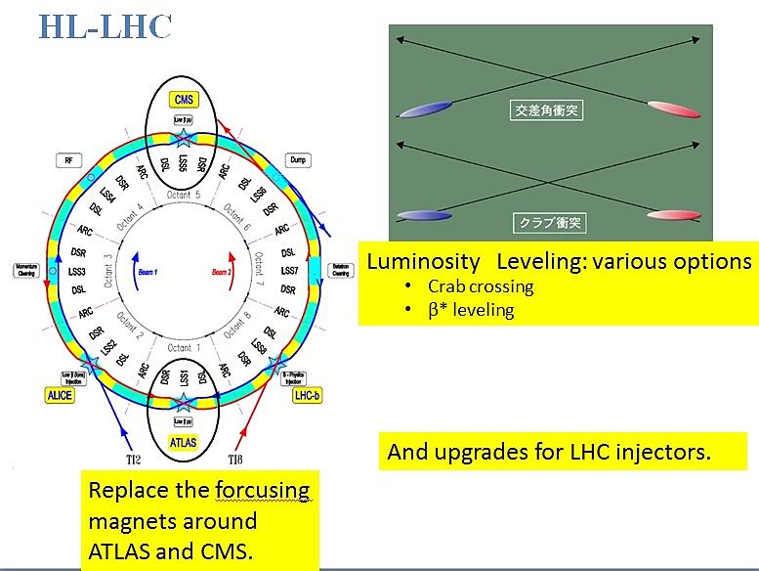
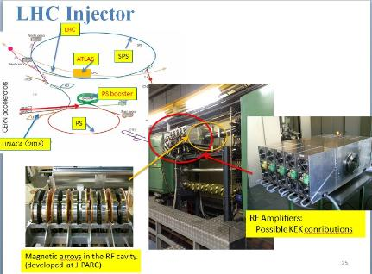
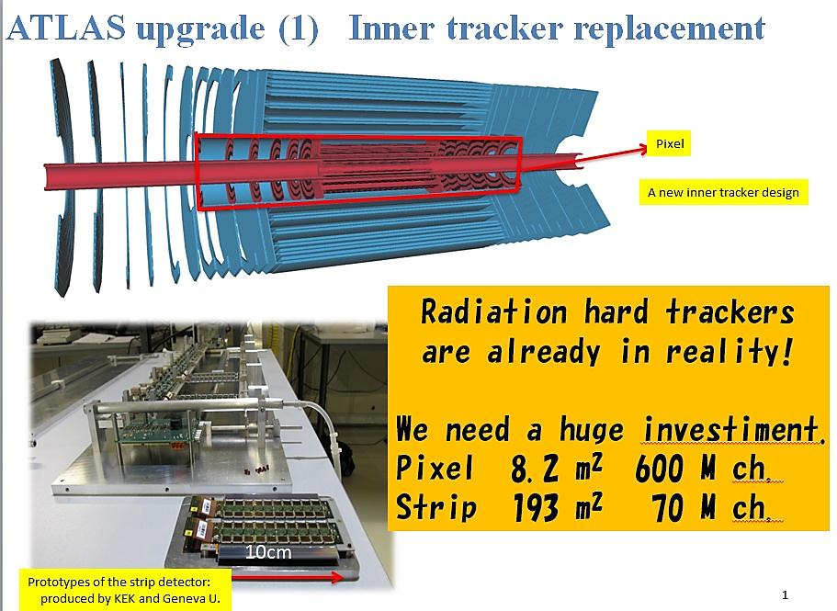
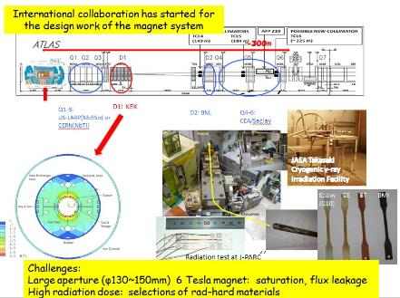
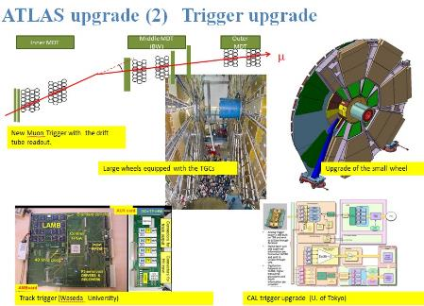
LHC Upgrade

Slide 10
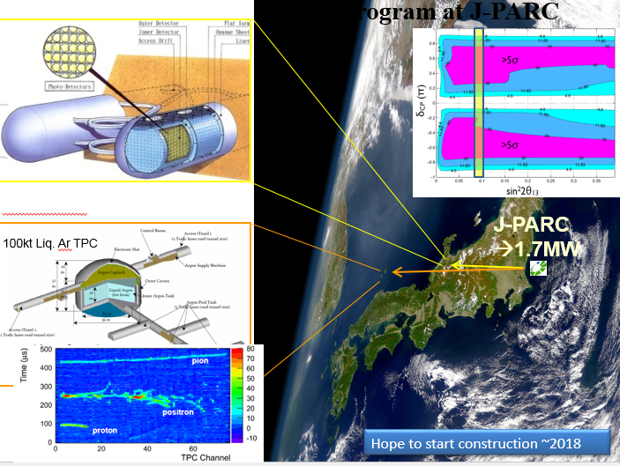
3. Large Projects (2)
:
Large Neutrino Detector

Slide 11
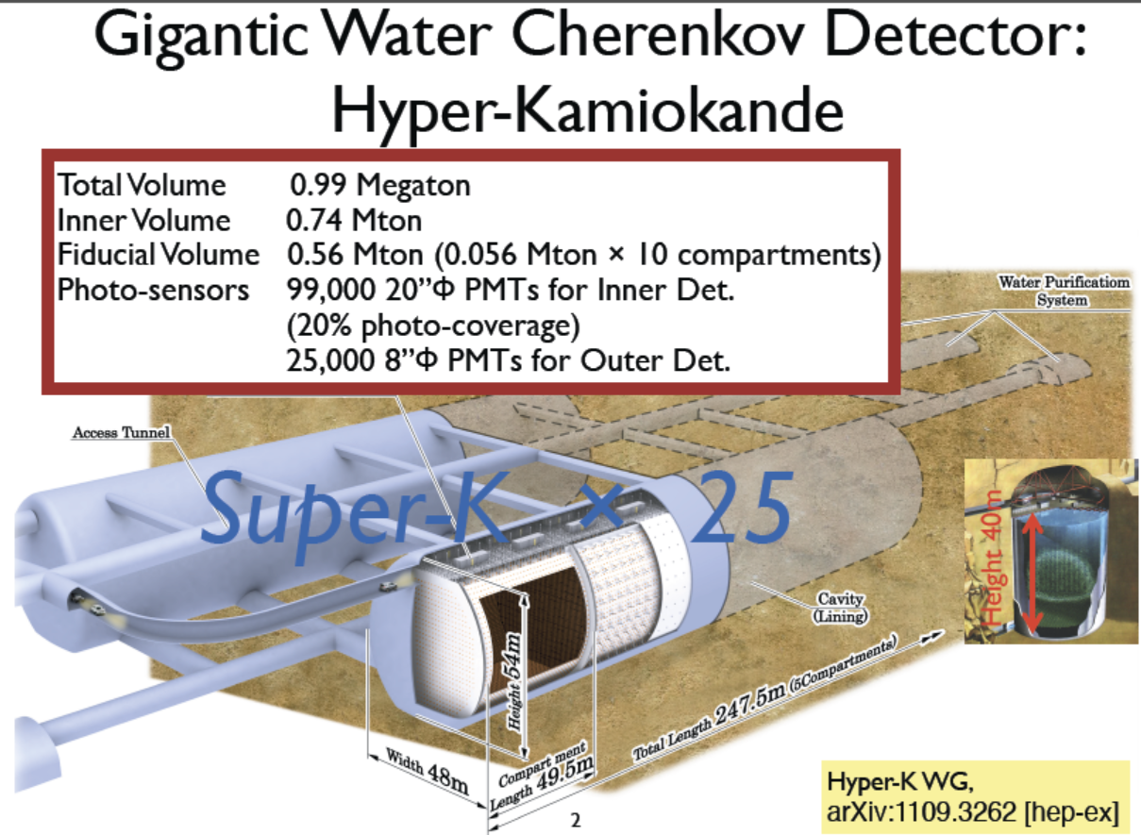
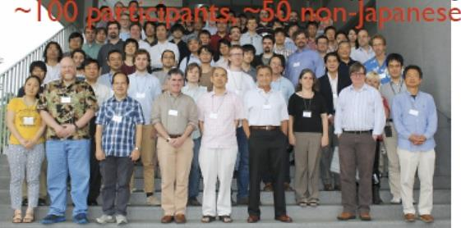
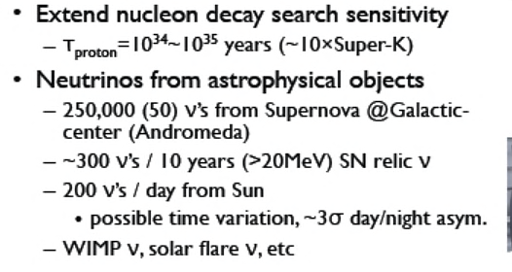
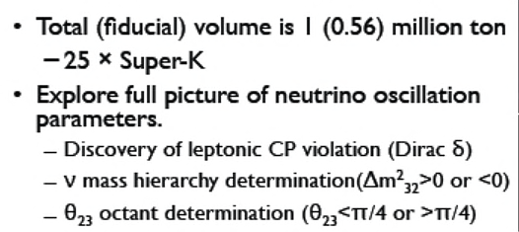
Super-K
50kt H₂O
12,000 20” PMTs

Slide 12

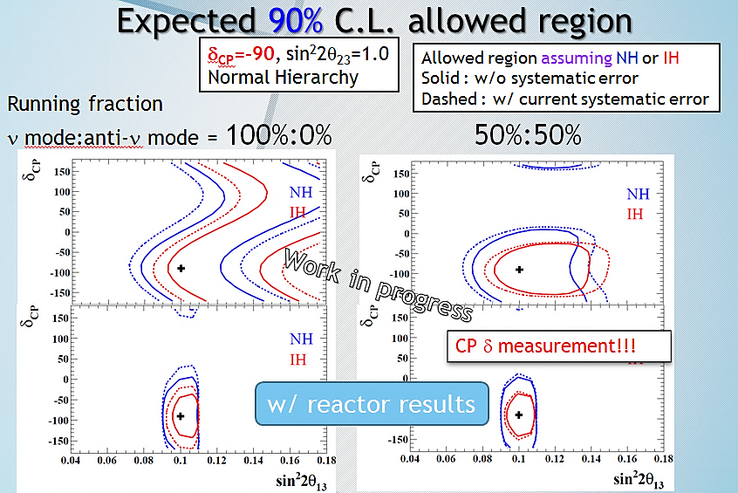
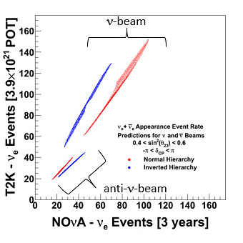
May 2012 | 2014 | 2018
190kW | 300kW 500kW | 750kW
> 1MW
Assuming
beam and anti-ν beam = 1:1 for both experiment
Expected number of events distributed by unknown CP δ (-π<δ<π) and θ₂₃ (0.4<sin²θ₂₃<0.6)

Slide 13
4. Medium/Small Projects

Slide 14
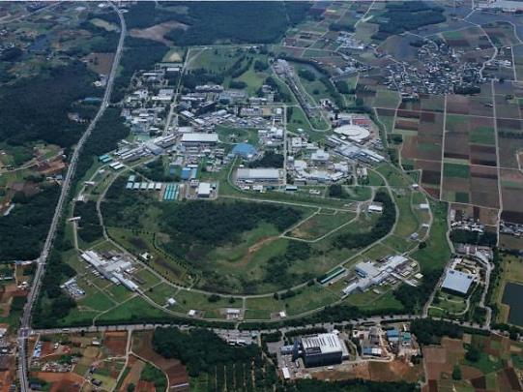

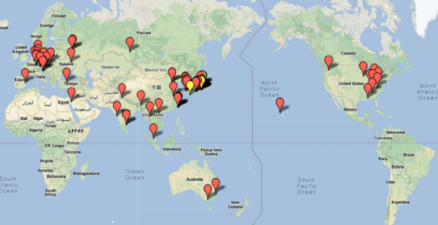
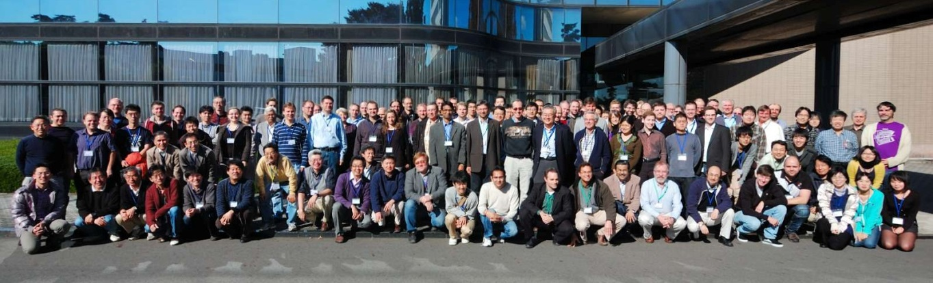
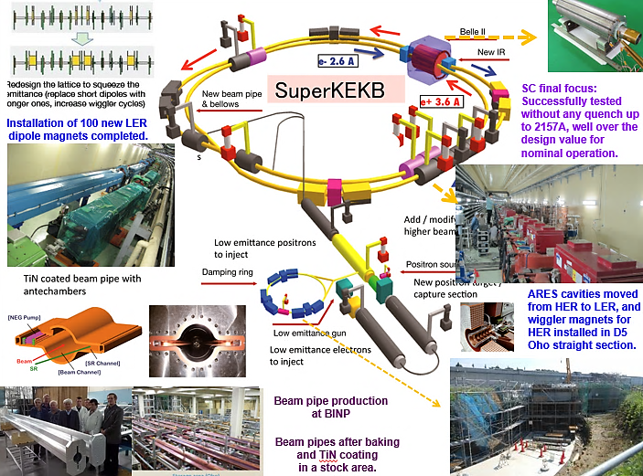
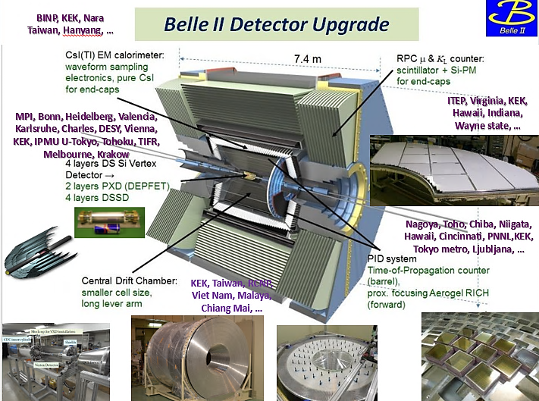
~500 collaborators from 76 institutions in 21 countries

Slide 15
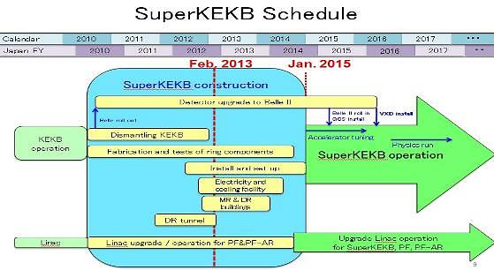
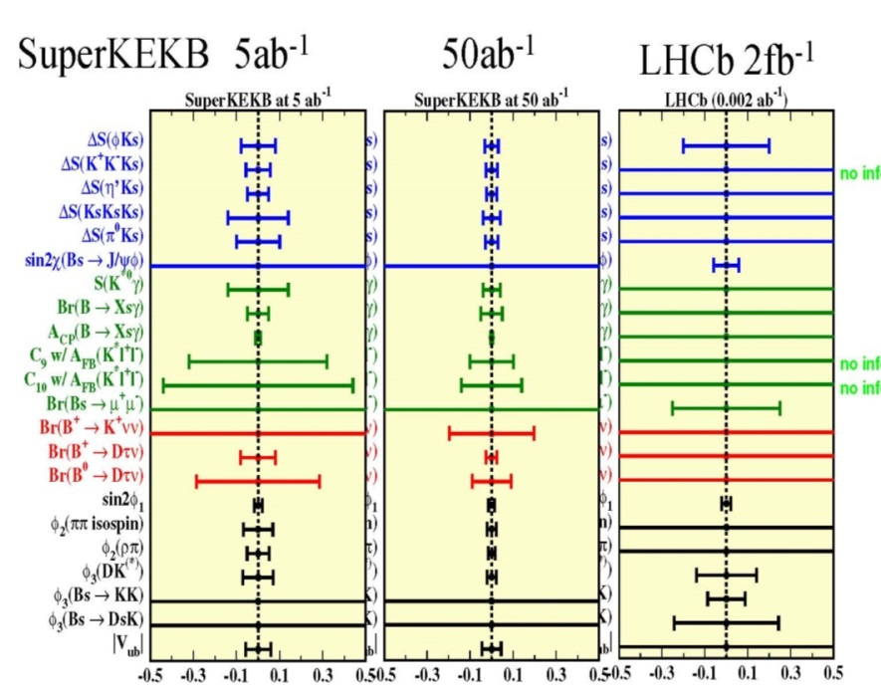
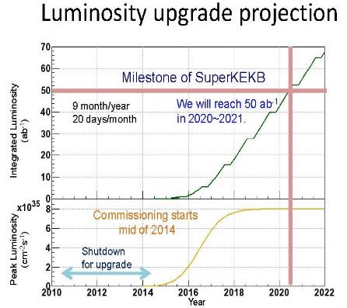
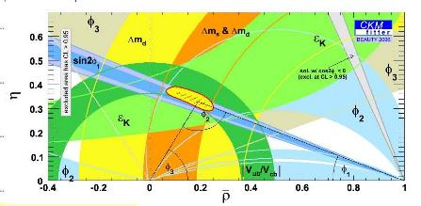
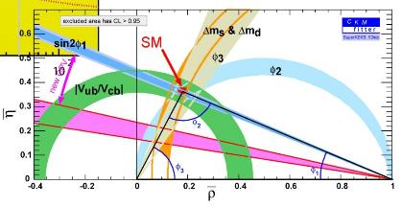
physics run
Inconsistency in unitarity triangle?
2015
B -> φK_{s}

Slide 16
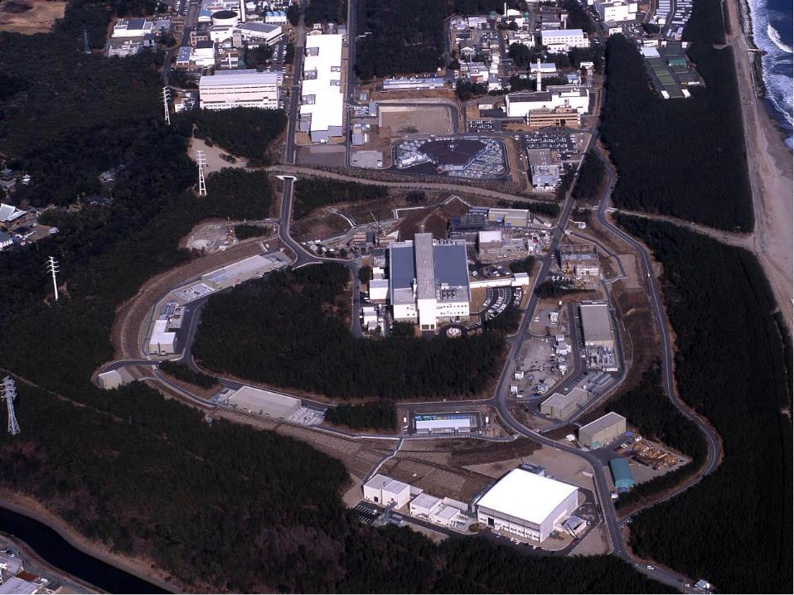
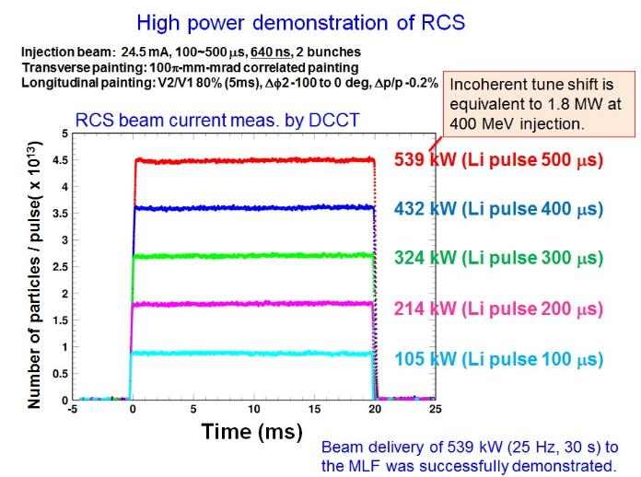
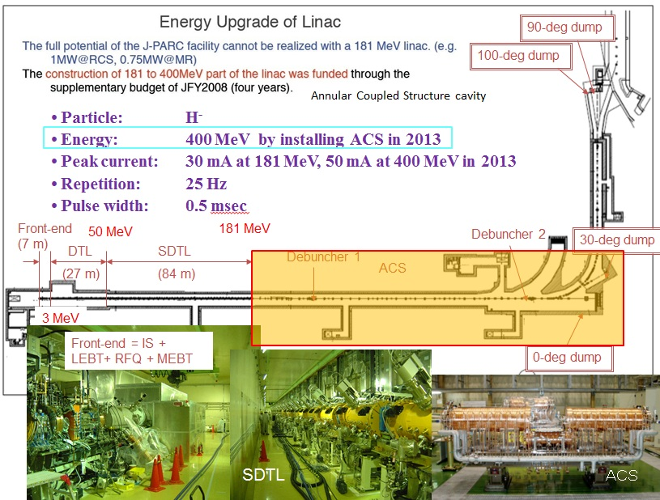


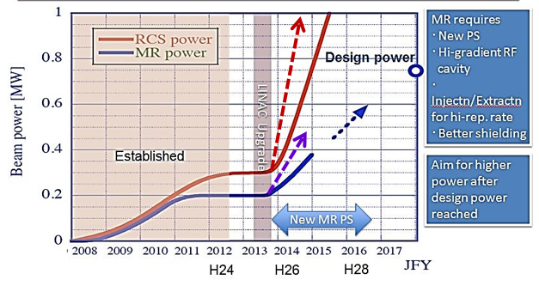
J-PARC
Linac
15 mA → 24.5 mA
RCS (3 GeV)
Neutrino beams to SK
MLF (Material and Life science experimental Facility): n, μ
ＭＲ (30 GeV)
Hadron experimental hall : K

Slide 17









J-PARC Hadron Facility
COMET: μ → e Conversion
Signal : μ- + (A,Z) → e- + (A,Z)
  131 members
  from 12 countries
2016-2017
2021

Slide 18








Intended Schedule

Slide 19



Muon g-2/EDM
98 members from 21 institutes
KEK, Osaka,
TRIUMF, Winnipeg,
(Manitoba, UBC)

Slide 20







XMASS
KamLAND-Zen
Phase-1: 100kg liq. Xe for dark matter search
→ now running
XMASS1.5 : upgrade to 5t for better
→ sensitivity σ_{SI}< 10⁻⁴⁶ cm² (at m_{χ}∼100 GeV)
to be launched in 2015
Final Goal: 10t fiducial mass
→ Dark Matter (sensitivity σ_{SI}< 10⁻⁴⁷ cm² ),
→ Double Beta decay and pp-⁷Be solar νs
Zero Neutrino double beta decay search
Results from 89.5kg-yr data
PRL 110:
062502 (2013)
XMASS1.5
SI
〈mββ〉
<0.12~0.25 eV
@90% C.L.

Slide 21








Size of CMB Fluctuation
Berkeley, LBNL, Colorado, APC, San Diego, Imperial C., KEK, McGill, Cardiff
SuMIRe
Subaru Measurement of Images and Redshifts
CERN COURIER
53, 8, October 2013

Slide 22

4. Summary
Time line of particle physics program in Japan

Slide 23


5. Summary
Time line of particle physics program in Japan

