Slide 1


Accelerating Science and Innovation
The European Strategy for Particle Physics and CERN
R.-D. Heuer, CERN P5, Fermilab, Nov 2, 2013
Notes:
1

Slide 2
European Strategy for Particle Physics approved May 2013 by CERN Council
Strategy of Europe for Particle Physics
Strategy in a global context
Strategy developed with international input
CERN is essential in executing this strategy in and for Europe

Slide 3
European Strategy for Particle Physics
Organisational Issues
Future major facilities in Europe and elsewhere require collaboration on a global scale.
CERN should be the framework within which to organise a global particle physics accelerator project in Europe, and should also be the leading European partner in global particle physics accelerator projects elsewhere. Possible additional contributions to such projects from CERN’s Member and Associate Member States in Europe should be coordinated with CERN.
Strategy comprises four high priority items
for large-scale scientific activities which could/should
be organised as international projects

Slide 4
European Strategy for Particle Physics
High-priority large-scale scientific activities
After careful analysis of many possible large-scale scientific activities requiring significant resources, sizeable collaborations and sustained commitment, the following four activities have been identified as carrying the highest priority.
c) The discovery of the Higgs boson is the start of a major programme of work to measure this particle’s properties with the highest possible precision for testing the validity of the Standard Model and to search for further new physics at the energy frontier. The LHC is in a unique position to pursue this programme.
Europe’s top priority should be the exploitation of the full potential of the LHC, including the high-luminosity upgrade of the machine and detectors with a view to collecting ten times more data than in the initial design, by around 2030. This upgrade programme will also provide further exciting opportunities for the study of flavour physics and the quark-gluon plasma.

Slide 5
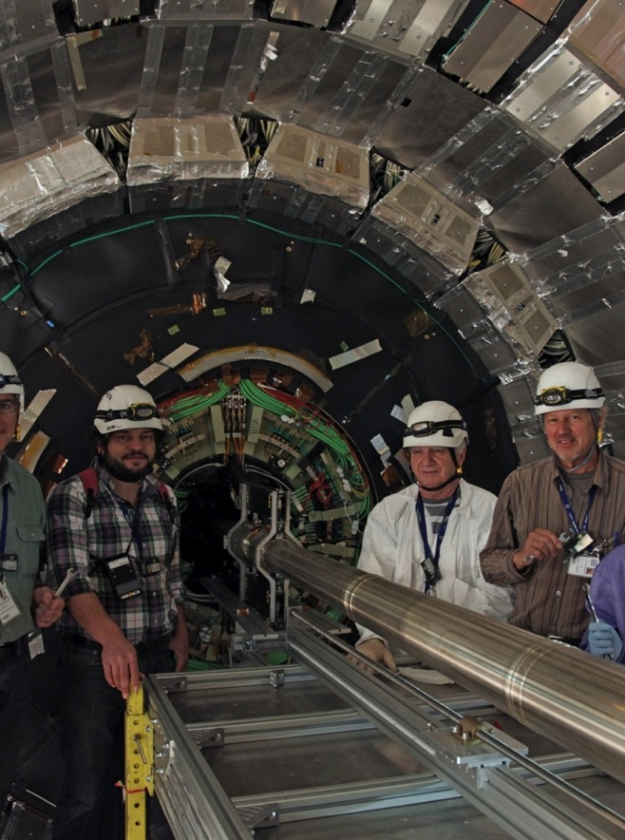
post- H(126)-discovery
Good reasons to expect more
  We have really just begun the searches
  Much space has yet to be accessed
  And there are important new physics models yet-to-be invented
Precision and rare physics
  Beyond our direct production reach
      LHC is a superb intensity frontier machine
Investment is critical
  Powerful detectors, triggers, computing
    A sustained period of important results
    And practical applications
The LHC is the only Higgs, (top, Z, W…) factory on the planet for many years to come!
5

Slide 6
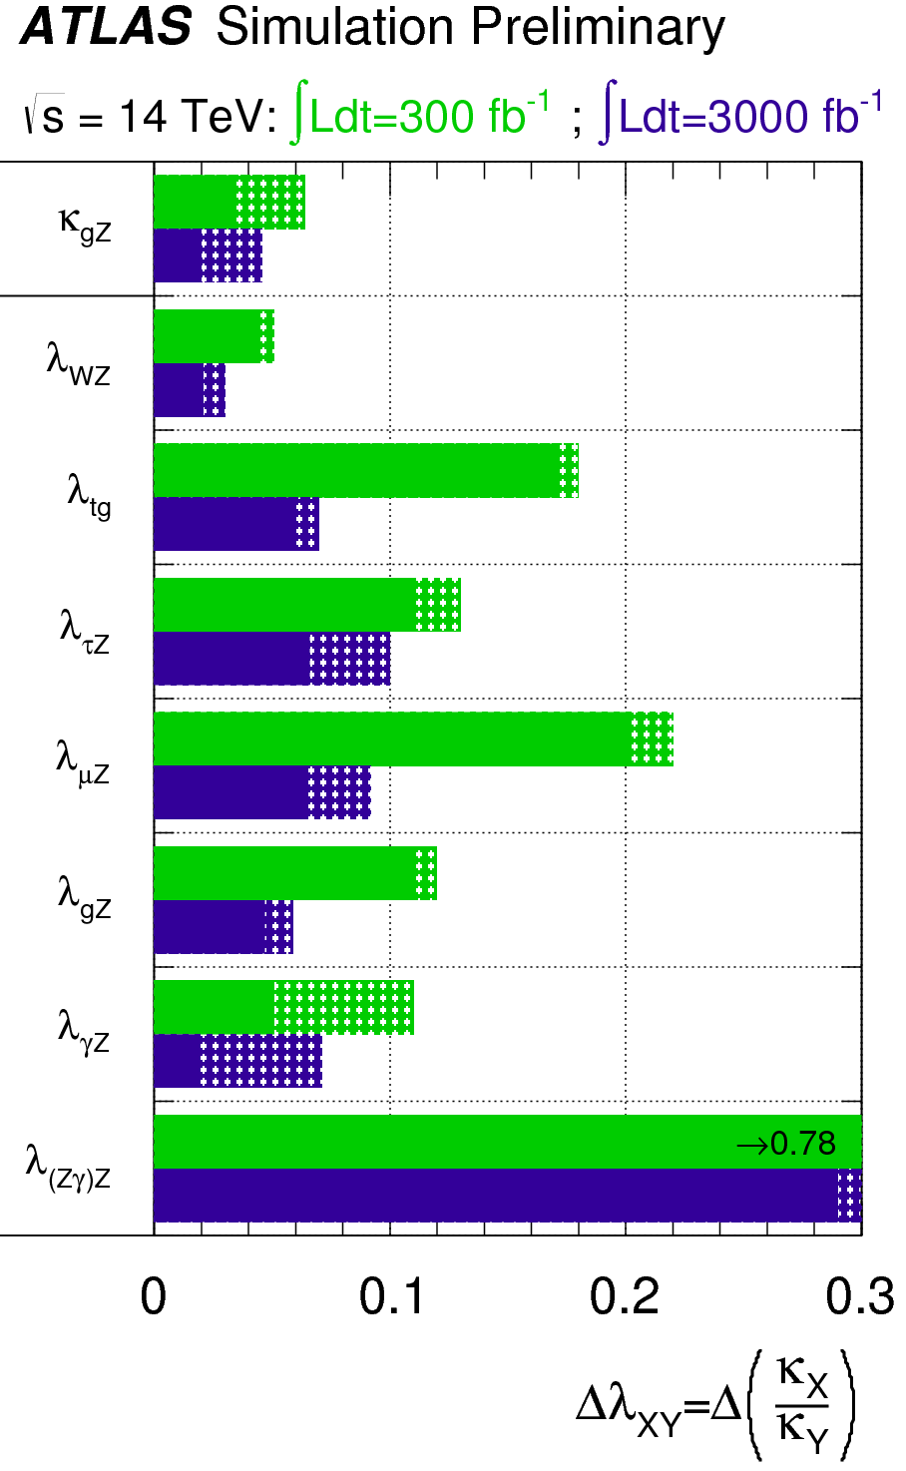
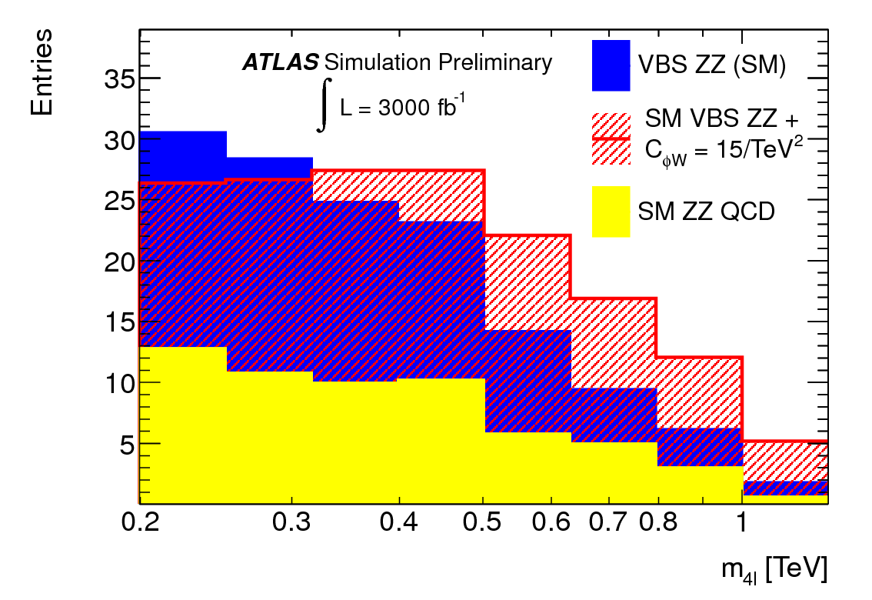
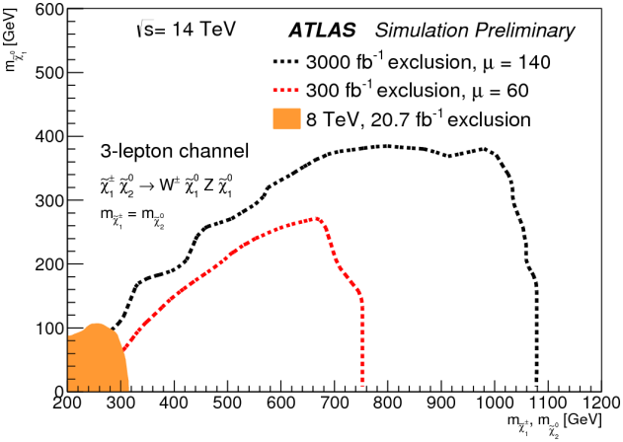
HL-LHC Physics
The HL-LHC data sample of 3000 fb⁻¹ at 14 TeV centre-of-mass energy will provide unprecedented and unparalleled physics opportunities at the energy frontier:
  to measure the H(125) in many production and decay modes, and to measure HH production in order to probe the HHH coupling
  to extend the mass reach for new particle searches by ~1 TeV
  to probe for new physics in longitudinal vector-boson scattering
  to study in depth further new physics which may be discovered at the LHC in the next decade
Higgs coupling precisions for 300 and 3000 fb⁻¹, with different systematic error assumptions
ATLAS-PHYS-PUB-2013-014
Invariant mass distribution for vector-boson scattering , in SM and with anomalous coupling
ATLAS-PHYS-PUB-2013-007
Example search sensitivity (95%CL ) for sample SUSY model with EW-ino production and decays including 3 prompt leptons
ATLAS-PHYS-PUB-2013-011

Slide 7

Key message
LHC
Upgrades to accelerator complex,
detectors, and computing Grid are
vital to fully exploit the physics potential of LHC
There is a program at the energy frontier with the LHC beyond 2030:
7 and 8 TeV
14 TeV design luminosity
14 TeV high luminosity (HL-LHC)

Slide 8
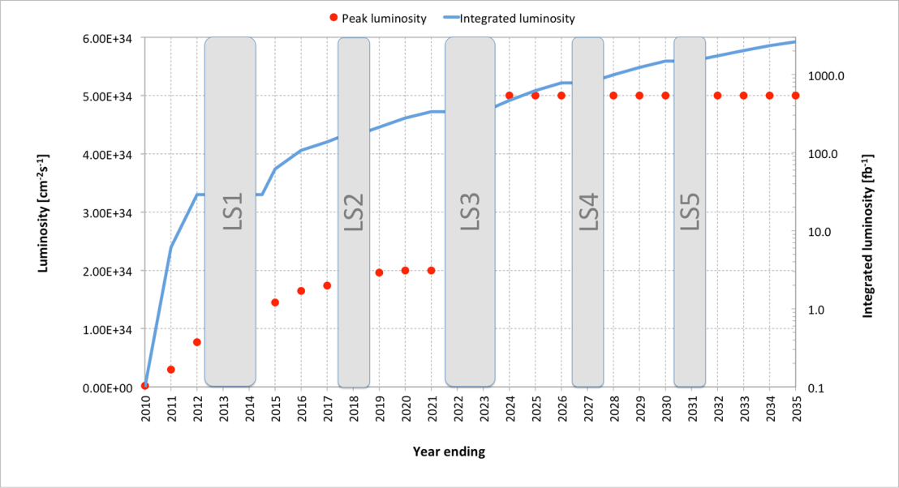
Possible plan of HL-LHC (baseline)
Very preliminary and very likely to change
Levelling at 5 10³⁴ cm⁻² s⁻¹: 140 events/crossing in average, at 25 ns; several scenarios under study to limit to 1.0 → 1.3 event/mm
Total integrated luminosity of 3000 fb⁻¹ for p-p by 2035, with LSs taken into account and 1 month for ion physics per year.

Slide 9
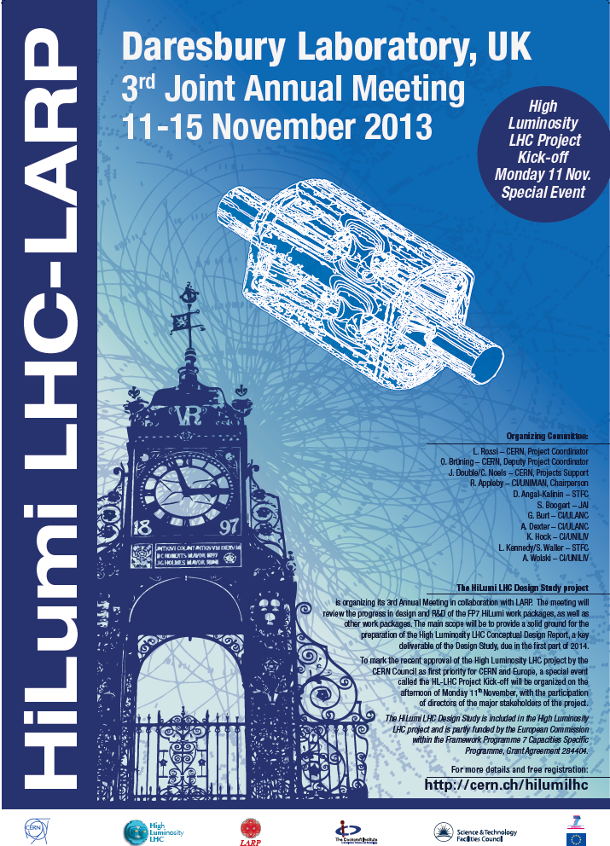
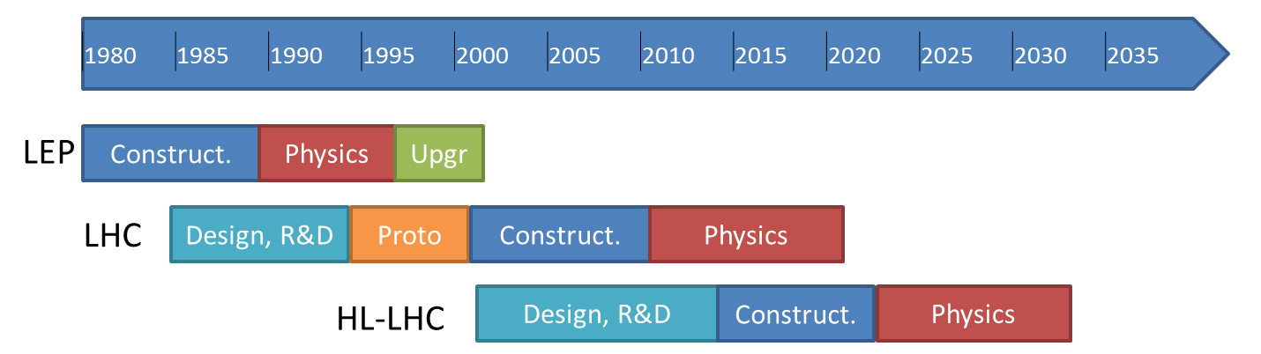
“…exploitation of the full potential of the LHC, including the high-luminosity upgrade of the machine and detectors…”
=> High Luminosity LHC project
today
Project
Kick-off meeting: 11th Nov. 2013 (Daresbury)
http://cern.ch/hilumilhc

Slide 10
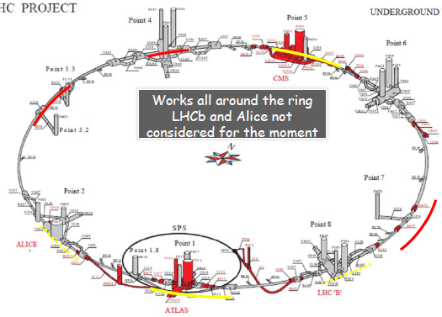
The HL-LHC Project
New IR-quads Nb₃Sn (inner triplets)
  New 11 T Nb₃Sn (short) dipoles
  Collimation upgrade
  Cryogenics upgrade
  Crab Cavities
  Cold powering
  Machine protection
  …
Major intervention on more than 1.2 km of the LHC

Slide 11

Setting up International collaboration
with national laboratories but also involving industrial firms
Q4
Baseline layout of HL-LHC IR region

Slide 12

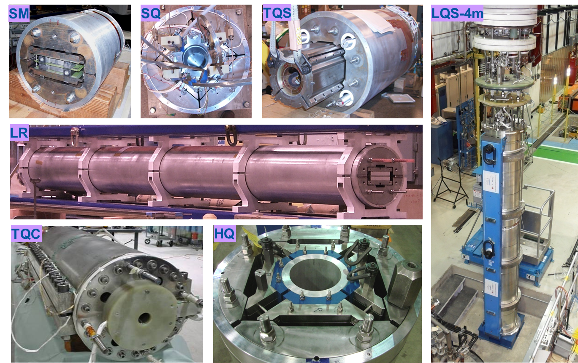
US leads high field magnet development thanks to Basic Programs and LARP
Exemples of LARP magnets in Nb3Sn

Slide 13
Next Milestones: High Luminosity LHC
Jun. 2014: PDR (Preliminary Design Report) and
re-baseline (costing, time) of the project
Sep. 2015: First short model QXF (inner triplet)
Nov. 2015: TDR and end of FP7 Design Study
Sep. 2016: First full size MQXF (long triplet Quad)
2016-17: Test Crab Cavities in SPS
Start Construction
LS2 (2018): Installation in LS2 of Cryogenics P4, SC horizontal link P7, 11 T dipole and DS collimators in P2, first Molybdenum collimators
LS3 (2022-23) : installation of all HL-LHC hardware synchronized with experiments’ upgrades
Schedule will be updated early 2014 after alignment of experiments’ and accelerators shutdown requirements and decision on length of Xmas technical stops

Slide 14
Experiments from LHC to HL-LHC
An extensive and rich physics program
Maintain full sensitivity for discovery
  And precision measurements at low p_{T}
Pileup
  <PU> ≈ 50 events per crossing by LS2
  <PU> ≈ 60 events per crossing by LS3
  <PU> ≈ 140 events per crossing by HL-LHC
    Lumi-leveling at 5x10³⁴cm⁻²s⁻¹
Radiation damage
  Requires work to maintain calibration
  Limits performance-lifetime of the detectors
    Light loss (calorimeters)
    Increased leakage current (silicon detectors)

Slide 15
R&D
R&D is key to cost-effective solutions to high radiation, PU
  R&D has been ongoing for many years in some cases
    Tracker, Track Processor, Trigger, Calorimeters, etc.
  Final design choices needed in 3-4 years for current baseline schedule
  Key areas of development include
      Radiation tolerant silicon sensors (pixels and strips)
      Radiation tolerant ASIC development (including 65 nm processing)
      High bandwidth and radiation tolerant optical data transmission
      Radiation tolerant powering scheme
      Light structures, detector assemblies, high density interconnections
      Fast processors for track-triggers
      Rad-tolerant crystals, tiles, fibres, photo-detectors for calorimeters
      High rate gas chambers with improved spatial and timing resolution
      Demonstration of high precision timing in calorimeter pre-sampling
      Software for new technologies (multicore processing, GPU, etc…)
Many of these areas are common between experiments

Slide 16
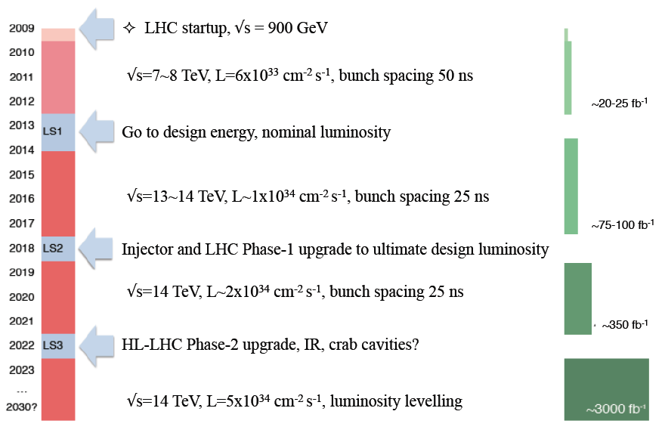
A general overlook (ATLAS)
Phase-0
New inner pixel layer
Detector consolidation
Phase-1
Improve L1 Trigger capabilities to cope with higher rates
Phase-2
Prepare for <µ>=200
Replace Inner Tracker
New L0/L1 trigger scheme
Upgrade muon/calorimeter electronics

Slide 17
ATLAS Phase-2 Upgrades
Key goals for HL-LHC physics will be
  to measure the H(125) in as many production and decay modes as possible, and to measure HH production
  to extend the mass reach for new particle searches by ~1 TeV
  to study any further new physics discovered in Run-2 and Run-3
In ATLAS, the main changes planned are:
  Replace the inner detector, which cannot handle pileup above 80 (front-end chips), and will be reaching end-of-life after ~15 years of operation and ~350 fb⁻¹ of data
  Allow for a higher-rate hardware trigger to allow to keep thresholds low for specific event topologies
    Introduce a “level-0”/“level-1” trigger split to enable inclusion of tracking at level-1
    Replacement of LAr analogue readout electronics with all-digital system
    Substantial changes to readout architecture and readout electronics of all systems
  Potentially install a new small forward calorimeter replacing, or in addition to, the existing one, which otherwise risks major degradation at the highest luminosities
Higgs coupling precisions for 300 and 3000 fb⁻¹, with different systematic error assumptions
Example search sensitivity (95%CL ) for sample SUSY model with Ewino production and decays including 3 prompt leptons

Slide 18
CMS Upgrade program
LS1 consolidation: Complete/consolidate for nominal LHC beam conditions:
Prepare for: 13 TeV, 1 x 10³⁴ Hz/cm² , Ave. Pileup (<PU>)∼25
Complete Muon system (4th endcap station) and improve readout electronics
Replace HCAL photo-detectors and backend electronics in a couple of regions
Make it possible to operate the Tracker -20∘C (almost 30 C colder than before)
LS1
2013-14
Phase 1 upgrades: Prepare for 1.6 x 10³⁴ Hz/cm² , <PU> ∼40, ≤ 200 fb⁻¹ by LS2
Prepare for 2.5 x 10³⁴ Hz/cm², <PU> ∼ 60, ≤ 500 fb⁻¹ by LS3
New L1-trigger system ready for 2016 data taking
New Pixel detector ready for installation in 2016 Year End Technical Stop (YETS)
Install new HCAL photodetectors and electronics in 2015 YETS and LS2
LS2
2018
Phase 2 upgrades: Prepare for ≳ 5 x 10³⁴ Hz/cm², <PU> ∼140
    Total of 3000 fb⁻¹ in ∼10 yrs operation
  Replace subsystems that no longer function due to radiation damage
    Tracker including Pixels, Endcap calorimeters
  Maintain physics performance very high PU
    New Electronics and Trigger, enhanced detector coverage
LS3
2022-23

Slide 19
US Engagement in ATLAS/CMS Upgrades
US-ATLAS/CMS technical and physics expertise is crucial for the successful, timely implementation of the upgrades, as it has been both in the construction and operation/analysis phases to date
US-ATLAS/CMS is already investing in essential R&D for Phase-2 upgrades, has key expertise, and a leading role in substantial areas
The scale of the upgrades needs investment by all partners to fully exploit the unparalleled physics opportunities at the HL-LHC
The US, at its current share, is a backbone of ATLAS and CMS

Slide 20

ALICE Upgrade Strategy
The upgrade plan entails building
  New, high-resolution, low-material ITS
  Upgrade of TPC with replacement of MWPCs with GEMs and new pipelined readout electronics
  Upgrade of readout electronics of: TRD, TOF, Muon Spectrometer, ZDC
  Upgrade of the forward trigger detectors
  Upgrade of the online systems
  Upgrade of the offline reconstruction and analysis framework
  New 5-plane silicon telescope in front of the hadron absorber covering the acceptance of the Muon Spectrometer
It targets 2018/19 LS2
Strong US participation
LoI approved
in 2012
Add. LoI
Sep 2013

Slide 21


Roadmap of the LHCb upgrade
  2011 - LoI submitted: LHCC encouraged to proceed to TDRs
  2012 - “Framework TDR” with costing (~57 MSF envelope) and technical options submitted. Endorsed (LHCC) & approved (RB: “LHCb upgrade approved to be part of the long-term exploitation of the LHC”) Submission of Addendum to MoU for Common Projects
  2012/13 - R&D towards technical choices
  2013/14 - Technical Design Reports & MoUs of sub-systems (updated costs still within the evaluation of the FTDR)
  2014 - Prototype validation & Engineering Design Reviews
  2014/16 - Tendering & serial production
  2016/17 - Quality control & acceptance tests
  2018/19 -18 months installation during LS2
CERN-LHCC-2011-001
CERN-LHCC-2012-007
18 months installation time during LS2 is mandatory
a later start of LS2 in 2019 would be advantageous for LHCb (for contingency in construction and for funding availability)
further delay of the start of LS2 beyond 2019 would be disfavoured

Slide 22
Computing Model update
Goals:
  Optimise use of resources
  Reduce operational costs (effort at grid sites, ease of deployment and operation, support and maintenance of grid middleware)
Evolution of computing models – significant improvements that have already been done; areas of work now and anticipated; including several common projects
Evolution of grid model: use of new technologies
  Cloud/virtualisation
  Data federations, intelligent data placement/caching, data popularity service

Slide 23
Software
Moore’s law only helps us if we can make use of the new multi-core CPUs with specialised accelerators etc. (Vectorisation, GPUs, …)
  No longer benefit from simple increases in clock speed
Ultimately this requires HEP software to be re-engineered to make use of parallelism at all levels
  Vectors, instruction pipelining, instruction level pipelining, hardware threading, multi-core, multi-socket.
Need to focus on commonalities:
  GEANT, ROOT, build up common libraries
This requires significant effort and investment in the HEP community
  Concurrency forum already initiated
  Ideas to strengthen this as a collaboration to provide roadmap and incorporate & credit additional effort

Slide 24
Key message
HL-LHC
We need a strong engagement by all partners to make HL-LHC a success and to fully exploit its unique physics capabilities

Slide 25
European Strategy for Particle Physics
High-priority large-scale scientific activities
After careful analysis of many possible large-scale scientific activities requiring significant resources, sizeable collaborations and sustained commitment, the following four activities have been identified as carrying the highest priority.
d) To stay at the forefront of particle physics, Europe needs to be in a position to propose an ambitious post-LHC accelerator project at CERN by the time of the next Strategy update, when physics results from the LHC running at 14 TeV will be available. CERN should undertake design studies for accelerator projects in a global context, with emphasis on proton-proton and electron-positron high energy frontier machines. These design studies should be coupled to a vigorous accelerator R&D programme, including high-field magnets and high-gradient accelerating structures, in collaboration with national institutes, laboratories and universities worldwide.

Slide 26

“CERN should undertake design studies for accelerator projects in a global context, with emphasis on proton-proton and electron- positron high-energy frontier machines.”
today
Project
Kick-off meeting: 11th Nov. 2013 (Daresbury)
FCC Study : p-p towards 100 TeV
Kick-off meeting: mid-February 2014
FCC: Future Circular Colliders

Slide 27
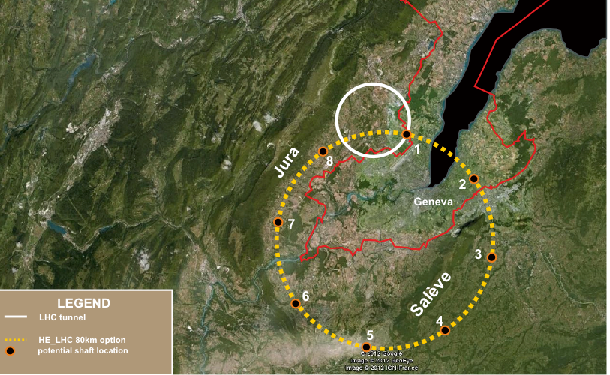
80-100 km tunnel infrastructure in Geneva area – design driven by pp-collider requirements
with possibility of e+-e- (TLEP) and p-e (VLHeC)
Conceptual Design Report and
cost review for the next ESU (≥2018)
FCC Design Study
Kick-off Meeting:
12-14. February 2014 in Geneva area
Establishing international collaborations
Set-up study groups and committees
15 T ⇒ 100 TeV in 100 km
20 T ⇒ 100 TeV in 80 km

Slide 28
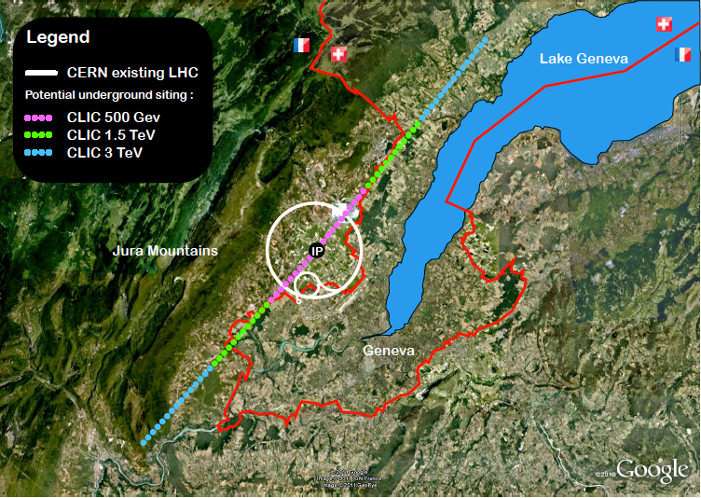
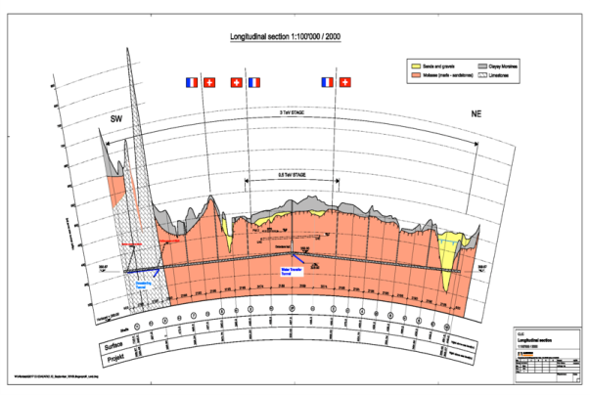
CLIC near CERN
Conceptual Design Report published
R&D continues (accelerator and detector)
in the framework of the LC effort and the
CLIC collaboration
(e.g. high gradient accelerating structures)
Tunnel implementations (laser straight)
Central MDI & Interaction Region

Slide 29
European Strategy for Particle Physics
High-priority large-scale scientific activities
After careful analysis of many possible large-scale scientific activities requiring significant resources, sizeable collaborations and sustained commitment, the following four activities have been identified as carrying the highest priority.
e) There is a strong scientific case for an electron-positron collider, complementary to the LHC, that can study the properties of the Higgs boson and other particles with unprecedented precision and whose energy can be upgraded. The Technical Design Report of the International Linear Collider (ILC) has been completed, with large European participation. The initiative from the Japanese particle physics community to host the ILC in Japan is most welcome, and European groups are eager to participate. Europe looks forward to a proposal from Japan to discuss a possible participation.
At CERN ILC efforts continue
in the framework of the LC efforts.
Hosting LCC Directorate at CERN

Slide 30
European Strategy for Particle Physics
High-priority large-scale scientific activities
After careful analysis of many possible large-scale scientific activities requiring significant resources, sizeable collaborations and sustained commitment, the following four activities have been identified as carrying the highest priority.
f) Rapid progress in neutrino oscillation physics, with significant European involvement, has established a strong scientific case for a long-baseline neutrino programme exploring CP violation and the mass hierarchy in the neutrino sector.
CERN should develop a neutrino programme to pave the way for a substantial European role in future long-baseline experiments. Europe should explore the possibility of major participation in leading long-baseline neutrino projects in the US and Japan.

Slide 31
CERN Neutrino “Platform”
- enable large scale detector development and tests for
neutrino detectors:
WA104 refurbish ICARUS T600
R&D on new Large LAr detector (“ICARUS++”)
R&D for air core muon detector
WA105 R&D on 2-phase LAr prototype
study for a neutrino (test)beam in the North Area started
Discussion with US (Fermilab) started concerning LBNE
common efforts on detector AND accelerator topics
Needs global collaboration and long-term sustained efforts and support

Slide 32
Global Collaboration
To realise our ambitious accelerator based large scale facilities and to fully exploit their excellent physics capabilities we need
coherent and strong efforts in all regions;
long term stability and support in all regions;
careful adjustment of schedules for these facilities
Global collaboration
≡
Global Partnership
with
long-term support

