Slide 1
Technology Development MAP Friday Meeting
Harold Kirk
Brookhaven National Laboratory
October 11, 2013

Slide 2
Outline
TD Highlights
L2 Summary reports
Topical Report – The MICE Cavity at the MTA , Ralph Pasquinelli, FNAL

Slide 3
Technology Development Highlights for Past Month
RF Studies
805MHz Modular Cavity delivery to FNAL delayed one month. Now end of October/ beginning of November (SLAC, LBNL)
201MHz Single-Cavity TiN processing of coupler still pending (LBNL,NTA)
Magnets
BISSCO 2212 coil tested to 416A at 4K, 12T.
15 TD Papers presented at NA-PAC

Slide 4
October 11, 2013
03 01: Normal Conducting RF
Derun Li
Modular cavity (collaboration with SLAC)
Cavity system scheduled to be delivered to Fermilab by end of FY13, but will be delayed, most likely later October or early November 2013
Test plan developed
Interface document ready
201 MHz MICE prototype cavity
Coupler fabrication continues at LBNL
Most parts made, dry assembly tested.
TiN-coating setup is in progress.
MICE magnets: SS and CC
Oversight of the fabrication of RF couplers for MICE prototype cavity
PO of Be plates for the modular cavity
Delay in modular cavity fabrication at SLAC due to layoffs and etc..
Modular cavity
Fabrication at SLAC continues
Bi-weekly meetings at SLAC to monitor/oversee fabrication progress
Daily report from SLAC
Face-to-face meeting once a month
LBNL support of the single cavity installation at MTA, Fermilab
MP simulation studies (reported at NA-PAC-2013)
Fabrication progress of the 201-MHz coupler at LBNL
Cryostat (vacuum vessel) prototype fabrication for MICE CC magnet continued at LBNL, and delayed due to some technical issues
Currently on-hold due to budget shortage
Continue the modular cavity fabrication
EP of the remaining MICE cavities at LBNL
Development of the modular cavity testing plan
Data analysis of previous 805 MHz testing results
MP simulation studies of the MICE cavity and coupler with external magnetic fields and explore other possible solutions
Fabrication of two 201 MHz RF couplers for the first MICE cavity in preparation for the testing at MTA
Support MTA RF testing programs
Continue the fabrication of the modular cavity, and low power RF measurement of the cavity at SLAC
Support of the 201 MHz installation at MTA, Fermilab
Oversight of the 201-MHz cavity coupler fabrication at LBNL
TiN-coating of the coupler setup testing at LBNL
Oversight of the CC cryostat fabrication at LBNL
Continue MP simulation studies of the MuCool/MICE 201 MHz cavities

Slide 5
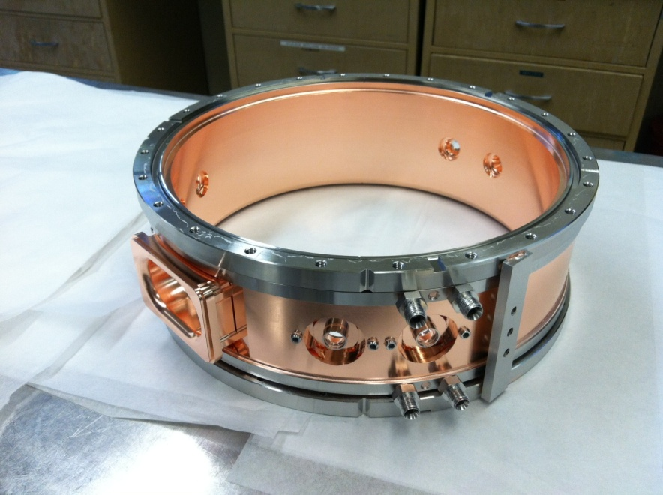
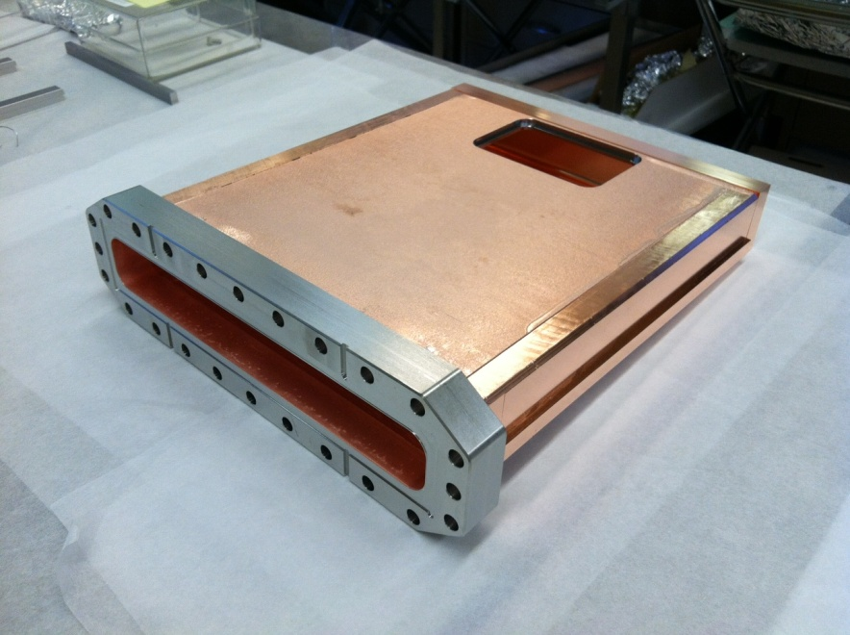
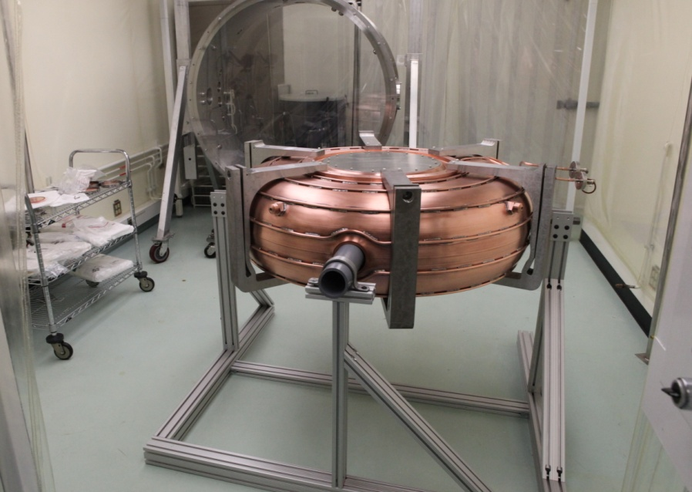
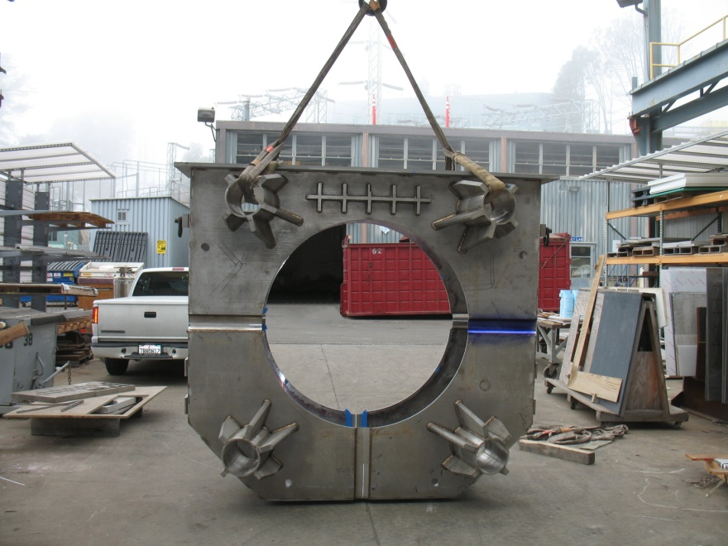
Modular Cavity and MICE Coupler
805 MHz modular cavity fabrication progress: cavity body and waveguide flange and end copper plate at SLAC
201 MHz cavity installation at Fermilab
Fabrication of the CC cryostat at LBNL

Slide 6
October 11, 2013
3.2 – Superconducting RF
Don Hartill
.
Research Instruments shipment of 500 MHz cavities
Electroforming Cu on 1.3GHz Nb cavity
Work continues with welding of beam tubes onto a test 500MHz cavity (Research Instruments)
Discussions with Epner Technologies to do testing of methods for electroforming of Cu on Nb..
Testing of 500 MHz explosion-bonded cavities
Preparation of Cu on Nb electroforming on an available 1.3GHz single cavity
Continued work by Research Instruments toward welding of the 500 MHz SRF cavity
Continue studies of techniques for electroforming Cu on Nb

Slide 7
October 11, 2013
Magnets – 03-03
J. Tompkins
[….]
Summary of Previous Month
HTS (2212) Program – The second coil was tested at 4.2 K, self field and 12 T. The coil reached 416 A at 12 T, when the background low-temperature superconducting magnet (T2) quenched.
HTS Magnets / ReBCO – No activity last month; scheduling limitations
Helical Solenoid (HCC- Nb3Sn) – A solid model of the mechanical parts has been developed; the model was reviewed internally with useful feedback . Completed a design of a 0.5 m period section (~2 m); the aperture is 210 mm but the operation margin is around 30%. Increasing the bore will decrease this margin considerably
General Magnet Design – Conceptual design studies of HF Storage Ring magnets were continued. Dipole and quadrupole magnet concepts for the matching sections, chromaticity correction areas and arcs have been developed.
Rapid Cycling Magnets / Conv –FEMM simulations of pole face shapes to improve the accuracy of our ultra low carbon steel dipole have been carried out.
Rapid Cycling Magnets / HTS – Continued fabrication of magnet and power lead cryostat components; preparation for the HTS cable and leads splicing. Completed analysis of HTS-based rapid cycling magnet design for MAP; comparison with NC magnets w/ larger beam gap was made.
HTS (2212 ) Program – Continue coils studies; receipt of new high pressure furnace anticipated which will improve J_{c} of reacted wire; further studies of acoustic emission sensors for quench location determination
HTS Magnets/ReBCO – Effort will resume w/ new fiscal year and funding is available
Helical Solenoid (HCC) – Finish the model and produce the drawings necessary to start the manufacturing of the support structure. Finalize the simulation of the one stage HS. Simulations including the end effects (fringe fields).
General Magnet Design – Protection of HF SR magnets from radiation and reduction of the dynamic heat load in the cold part of magnet cryostat present a serious problem and need further investigations and improvements including reiteration of the SR magnet system design
Rapid Cycling Magnets – Conv – Continue improvement of magnetic properties; pole shaping; etc.
Rapid Cycling Magnets – HTS Fabricate cryostats for magnet and leads; Continue study of HTS-based rapid cycling magnet technology for Muon Accelerator Write a APC Note on the feasibility of Muon Accelerator with HTS-based rapid-cycling magnet technology
Upcoming Work (Next Month)
HTS (2212) Program –- The coil’s critical current will be re-tested at 4.2 K up to 12 T and its quench characteristics will also be tested
HTS Magnets / ReBCO – No activity planned; scheduling limitations
Helical Solenoid (HCC- Nb3Sn) – Finish the model with more details; e.g., in and outlets for impregnation, holes for bolts etc. A report with the manufacturing procedure will be written. Continue design studies.
General Magnet Design – Protection of HF SR magnets from radiation and reduction of the dynamic heat load in the cold part of magnet cryostat is a serious problem and further investigations and improvements continue; iteration of the SR magnet system design continues in FY14
Rapid Cycling Magnets / Conv – continue with pole shaping simulations and obtain access to a floating OPERA-2D license for studies
Rapid Cycling Magnets /HTS – Perform splicing of magnet cable HTS strands to power leads; Complete fabrication of cryostat components for magnet and leads; continue study of HTS-based rapid cycling magnet technology for Muon Accelerators

Slide 8
October 11, 2013
03.04 Targets and Absorbers
Kirk T. McDonald
Ding: NAPAC13 THPMA11 on particle production.; continued clarification of best MARS switches for 3 Gev.
McDonald: Edit NAPAC13 Targetry papers.
Sayed: NAPAC13 TUPBA10, TUPBA11, THPHO11 on global optimization of Front End
Samulyak: NAPAC13 TUPBA09 on simulations of liquid jet disruption by proton beams.
Snopok: NAPAC13 THPMA10 on energy deposition in chicane magnets.
Zhan: Continued validation of the Level-set coding for ANSYS-FLUENT modeling.
Extend target system conceptual design up to start of buncher (including chicane in decay/drift region).
Begin studies of Staging Scenarios that start with a 3-GeV beam @ 1MW. Need more coordination with Proton Driver team to specify possible multiple beams on target.

Slide 9
October 11, 2013
3.5 – MuCool Test Area
Yağmur Torun
201-MHz vacuum RF: assembly work in progress
805-MHz vacuum RF: preparations for modular cavity on schedule; ASC running
Infrastructure – still slipping: beamline upgrade, RF switch, station-2 vacuum system
Data analysis: all-season cavity data under review
Mechanical support for RF program
Electrical support for beamline upgrade
FY14 funding
Single-Cavity Module assembly, installation
Pillbox with grid windows, all-season cavity high-B run
Beamline commissioning
All-season cavity: re-installed in solenoid, ~30 MV/m @ B=0 (A. Moretti, D. Peterson, YT)
Modular cavity: instrumentation interface designed (YT)
201-MHz Single-Cavity Module: coupler fabrication in progress (A. DeMello); progress on instrumentation (L. Somaschini, D. Peterson, R. Pasquinelli, A. Moretti, P. Lane, P. Snopok, YT); clean room prepared (YT), assembly continuing in Lab-6, water feed-throughs installed, tuner forks installed, surveyed (J. Gaynier, R. Pasquinelli, R. Schultz)
NA-PAC 2013: 7 MTA abstracts presented (M. Chung, B. Freemire, M. Jana, T. Luo, D. Peterson, L. Somaschini,YT)
Data analysis/publication
magnetic insulation
Be-Cu buttons
HPRF beam test
Current program
All-season cavity in magnetic field
B > 3T
Dielectric-loaded HPRF
Next on the list
Grid windows on pillbox cavity
201-MHz Single-Cavity Module
New 805-MHz modular cavity
Other
Beamline commissioning
805-MHz all-season cavity: operation in B>3T
DL-HPRF cavity: retesting without/with dielectric rod
Old pillbox cavity: install grid windows
201-MHz Single-Cavity module: instrumentation tests, install cavity in vessel, tuner transfer function measurement
Modular cavity: instrumentation and inspection setup

Slide 10
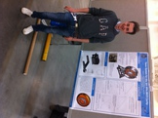
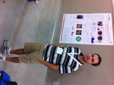
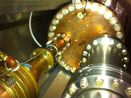
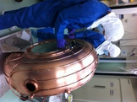
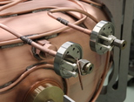
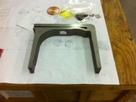
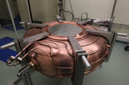
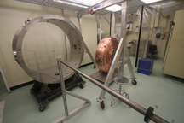
MuCool Test Area − Oct 2013
Looking good at NA-PAC’13
ASC in solenoid
MICE cavity assembly in Lab-6 clean room
Cooling tube
Machined fork
Tuners on cavity

