Slide 1
Status of CC Cryostat
MAP Collaboration Meeting
June 22, 2013
Allan DeMello
Lawrence Berkeley National Laboratory

Slide 2
Status of Coupling Coil Cryostat
Cryostat Vacuum Vessel
  LBNL mechanical shops are fabricating the first cryostat vacuum vessel
  Scheduled finish date is July 2013
Thermal Shield
  Drawings will be finalized by LBNL starting in early July
  LBNL mechanical shops will fabricate the first thermal shield
Cooling Circuit
  Drawings will be generated by LBNL
  LBNL mechanical shops will fabricate the cooling circuit parts
  LBNL will assemble components into sub-assemblies

Slide 3
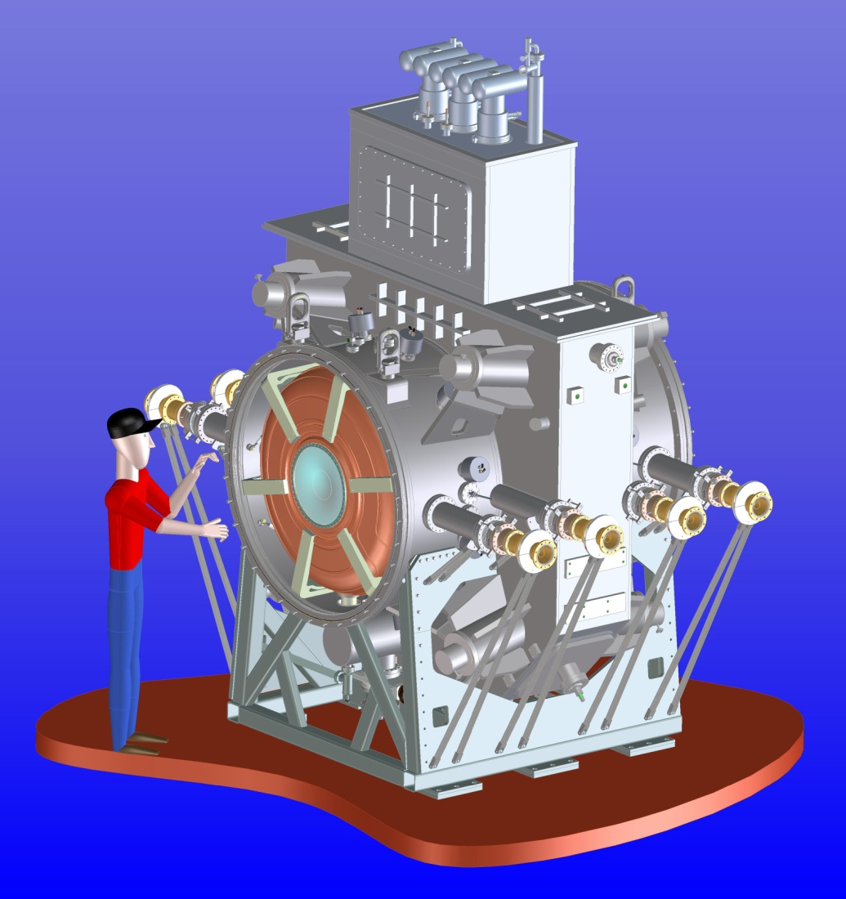
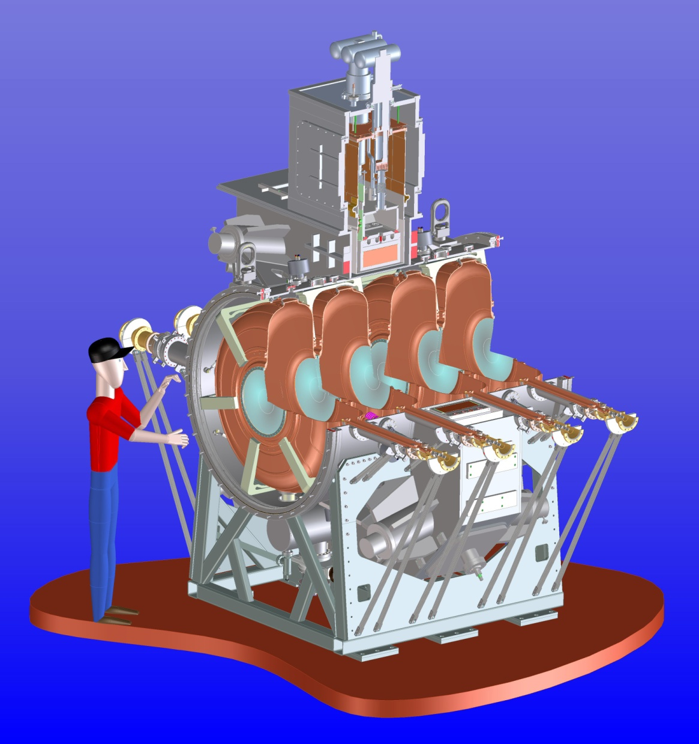
Coupling Coil of the RFCC Module
Coupling coil magnet integrated into the RFCC module
Notes:
3

Slide 4
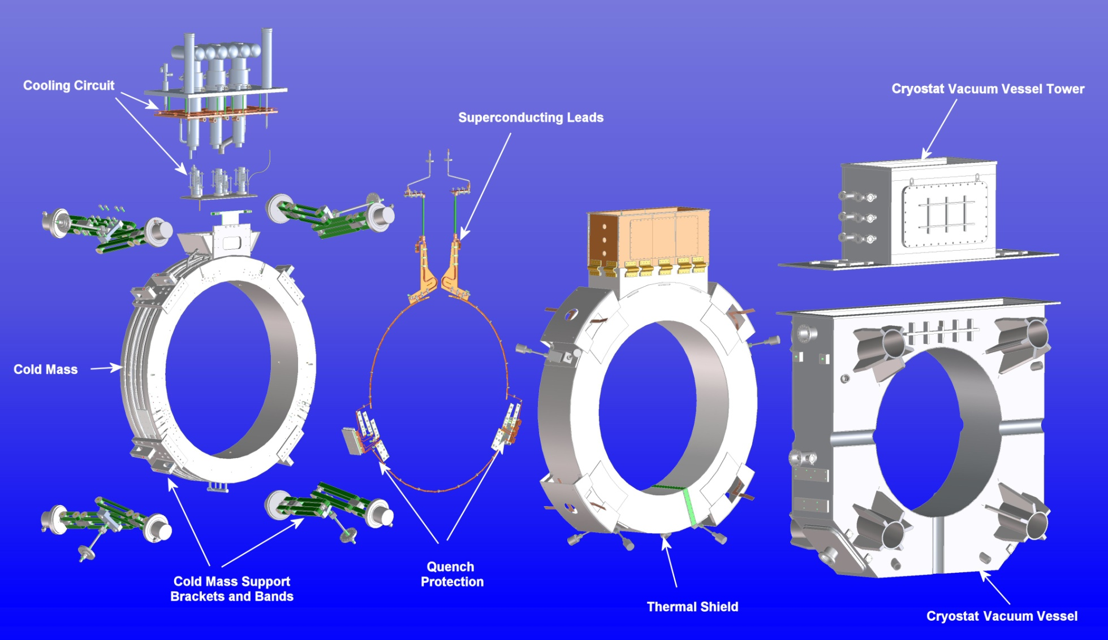
Coupling Coil Sub-assemblies
Notes:
4

Slide 5
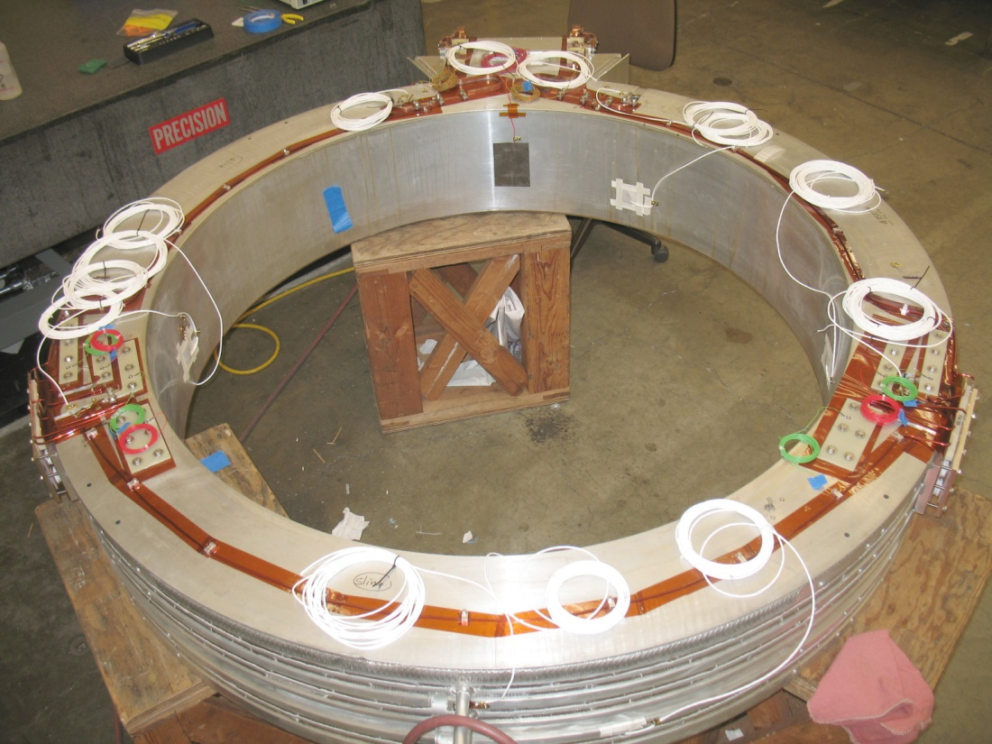
Coupling Coil Cold Mass - Review
  Superconductor Lead Stabilizers
  Preparation of cold mass coil #1 finished at LBNL January 2013
  Preparation cold mass coil #2, #3 and #4 at LBNL scheduled to begin in 2014
  Cernox Sensor
  Strain Gauges
  Voltage Taps
  Quench Protection

Slide 6
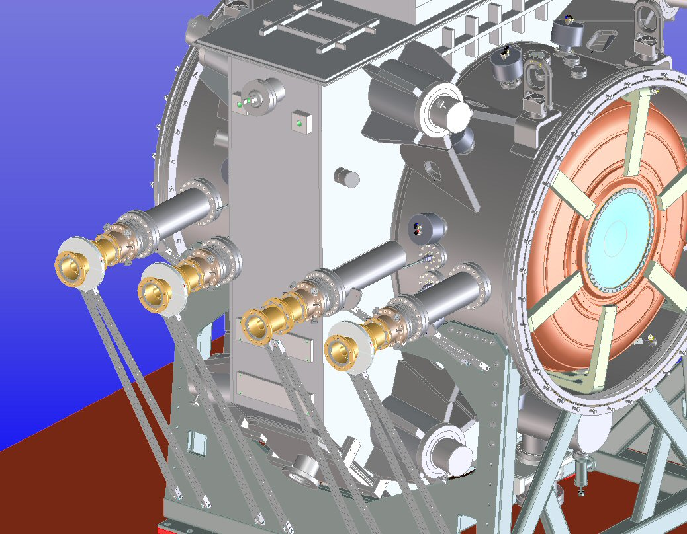
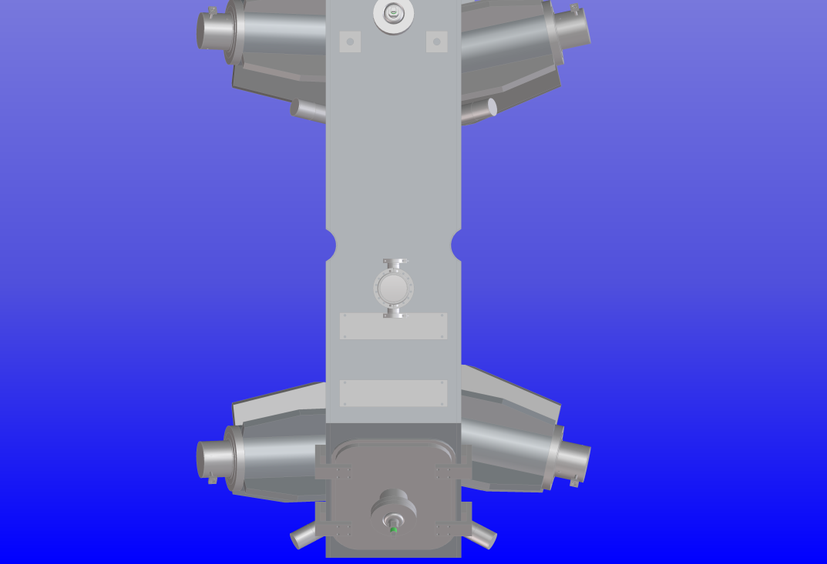
RF Coupler and Coupling Coil Clearance
Scallop in coupling coil cryostat for the RF coupler
RFCC vacuum vessel RF coupler spool is nested into the scallop in coupling coil cryostat vacuum vessel

Slide 7
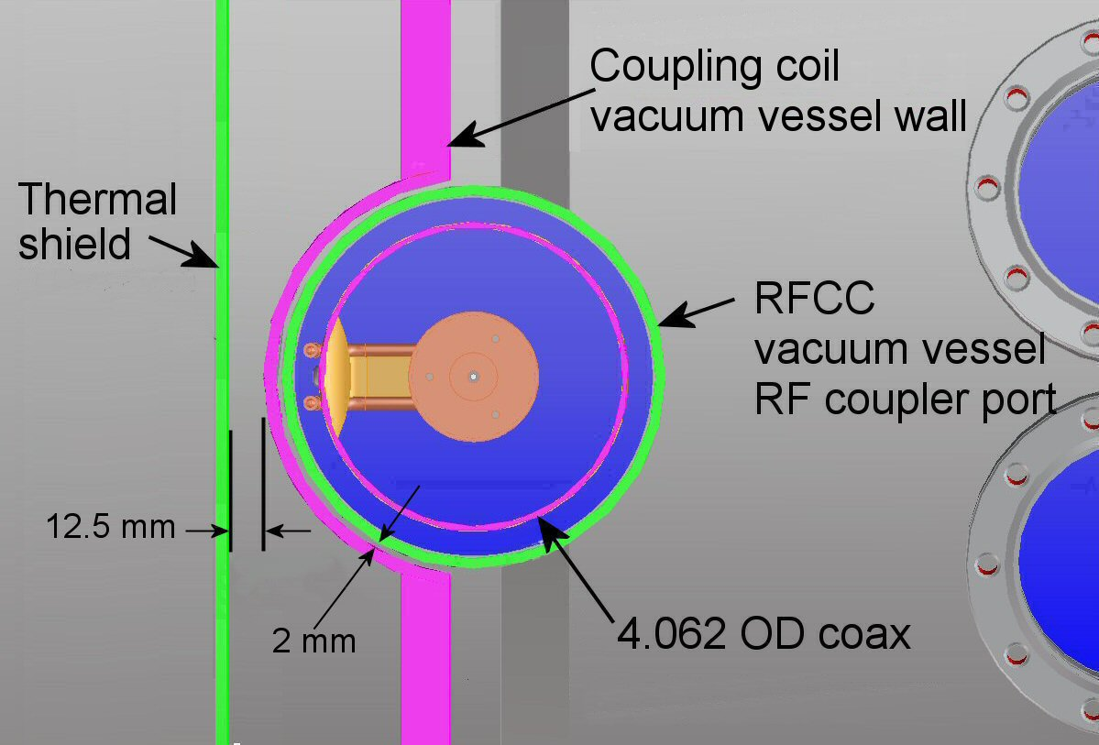
RF Coupler and Coupling Coil Clearance
Partial section view of the interface between the RFCC vacuum vessel and the coupling coil vacuum vessel

Slide 8
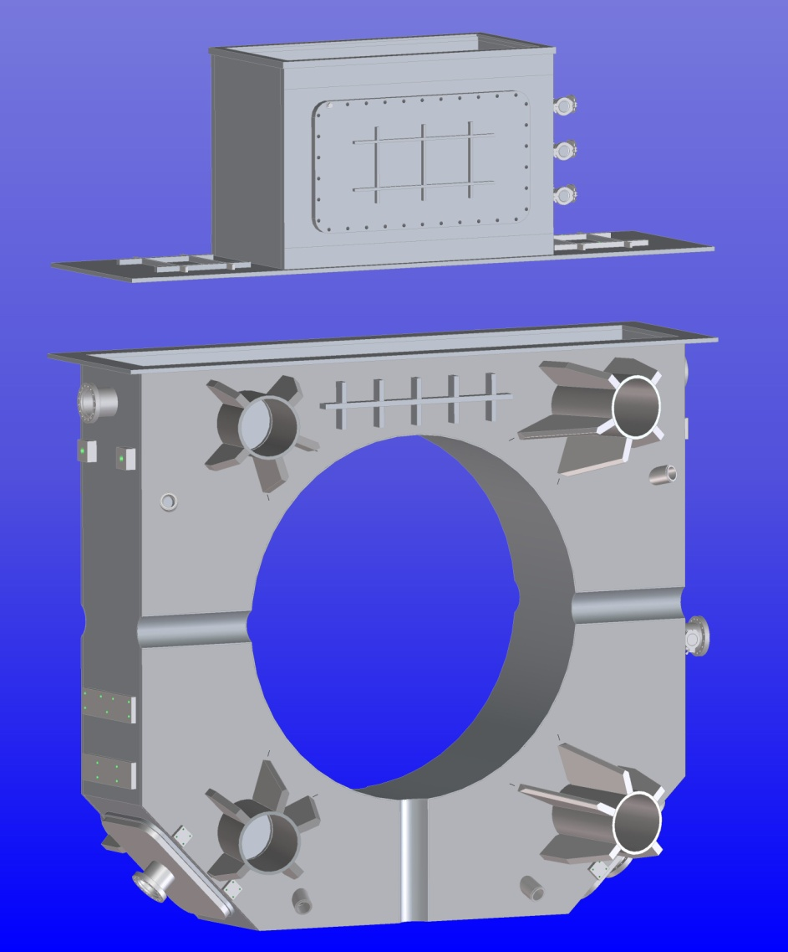
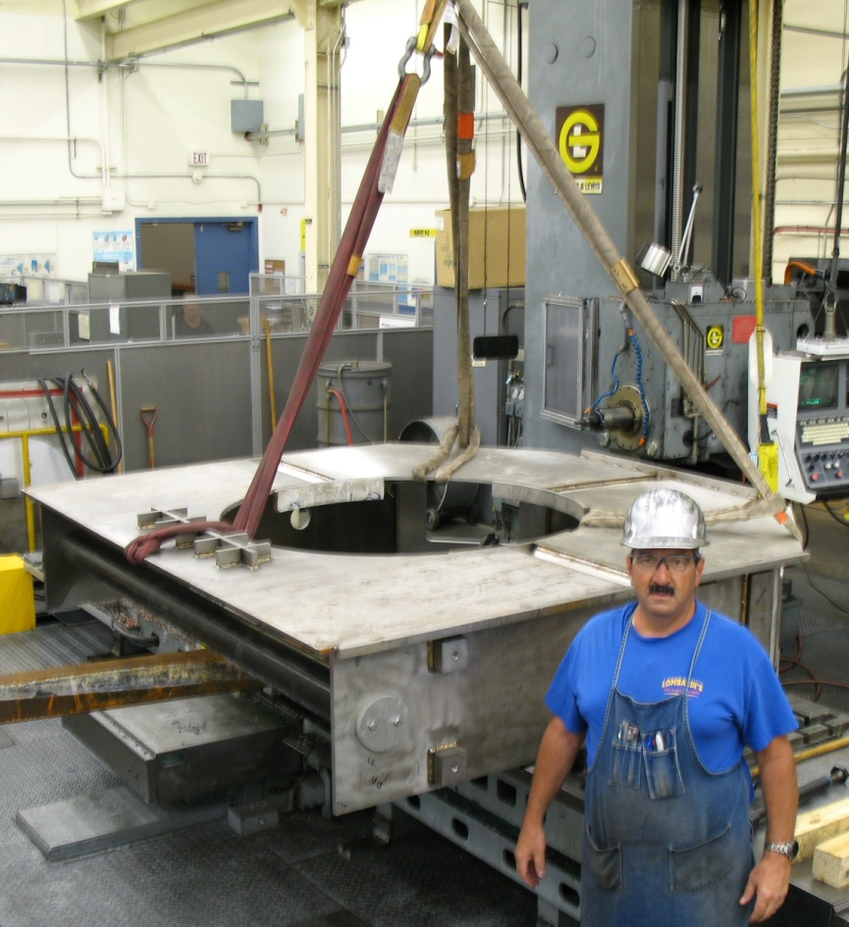
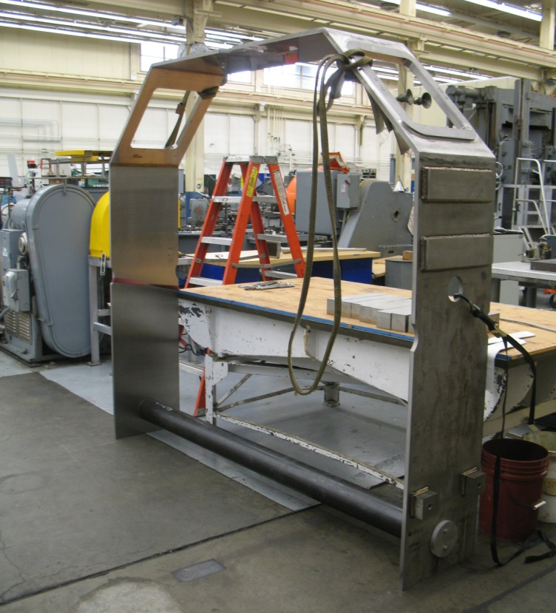
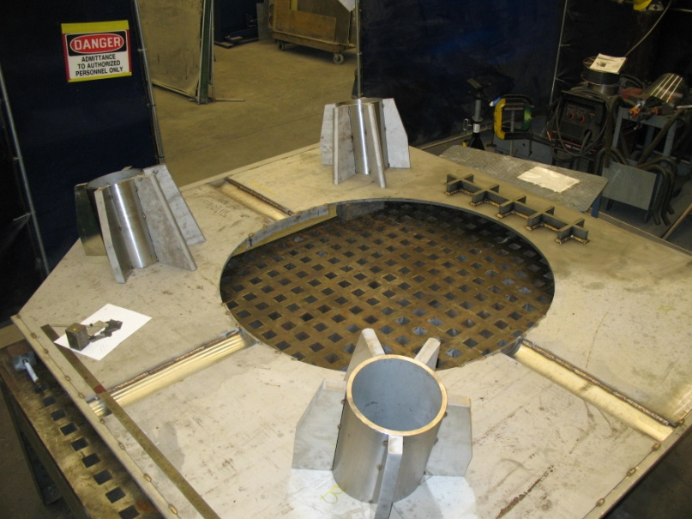
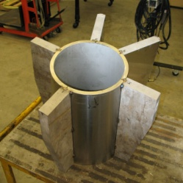
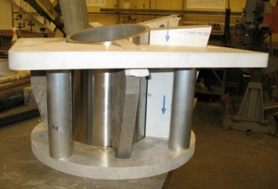
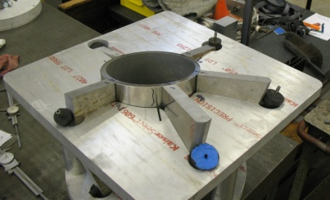
Coupling Coil Cryostat Vacuum Vessel
  LBNL mechanical shop is in the process of fabricating the first cryostat vacuum vessel
  Estimated completion July 2013
  Drawings will be updated to reflect the “as built” cryostat vacuum vessel

Slide 9
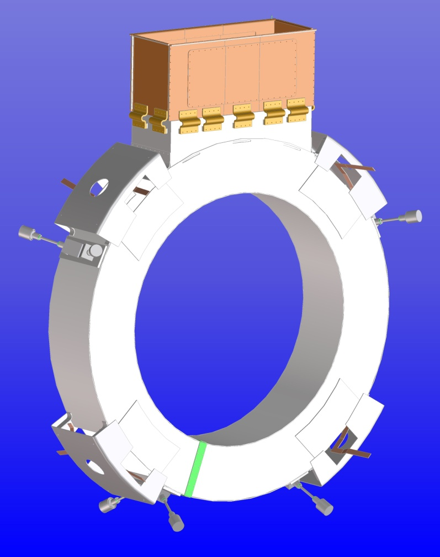
Coupling Coil Thermal Shield
    Remaining Tasks
    Thermal shield design is nearly complete
SINAP drawings will be finalized by LBNL starting in early July
    LBNL shops will fabricate the first thermal shield
    Scheduled to be delivered to Fermilab February 2014

Slide 10
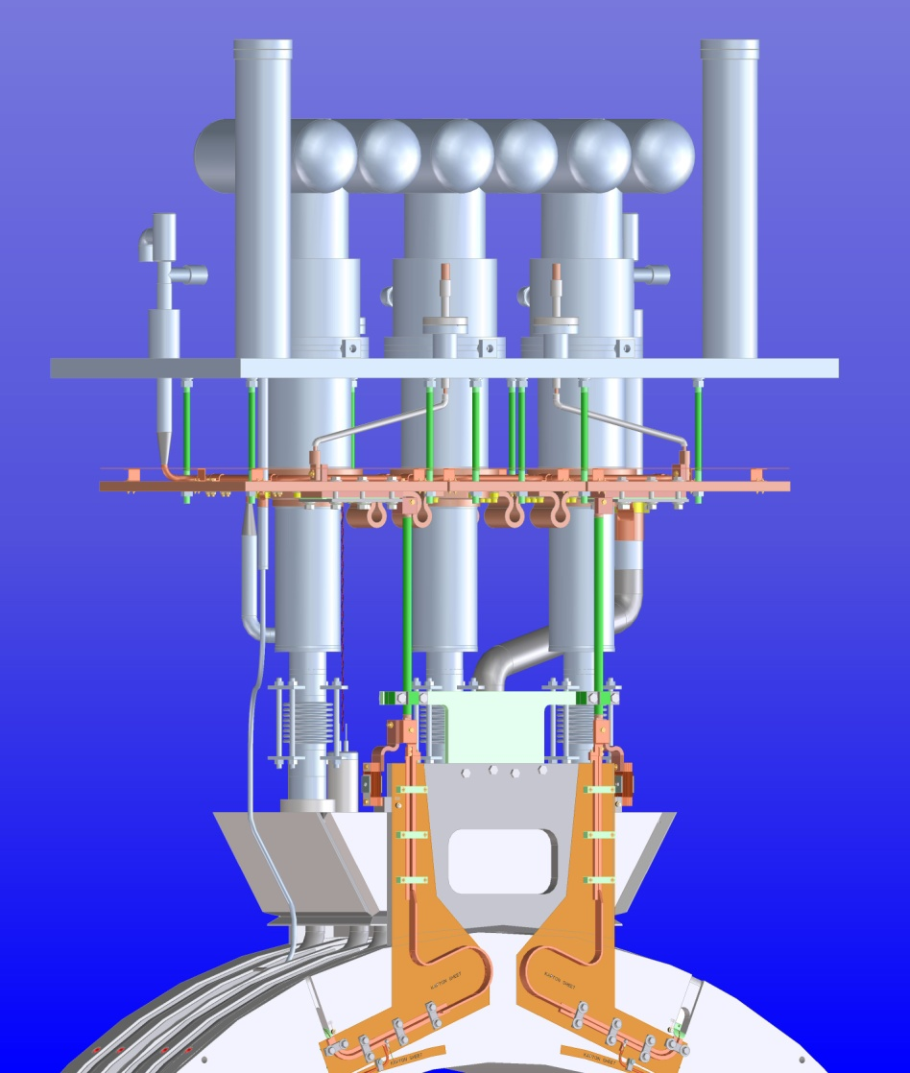
Cooling Circuit Assembly
    Remaining Tasks
    Finalize cooling circuit design
    Create detail fabrication drawings
    Fabrication of component parts
    Assemble components into sub-assemblies
    Scheduled to be delivered to Fermilab February 2014

Slide 11
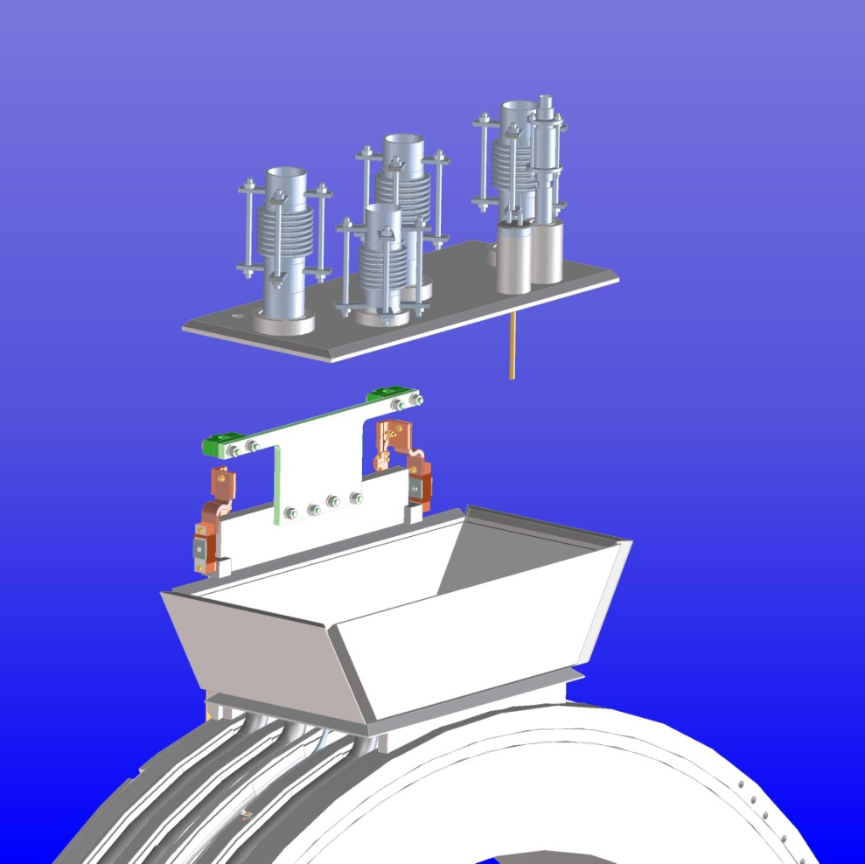
Cooling Circuit Reservoir Cover
    Remaining Tasks
    Assemble reservoir cover with feedthroughs and bellows
    Weld reservoir cover to top of cold mass
    Vacuum check the reservoir

Slide 12
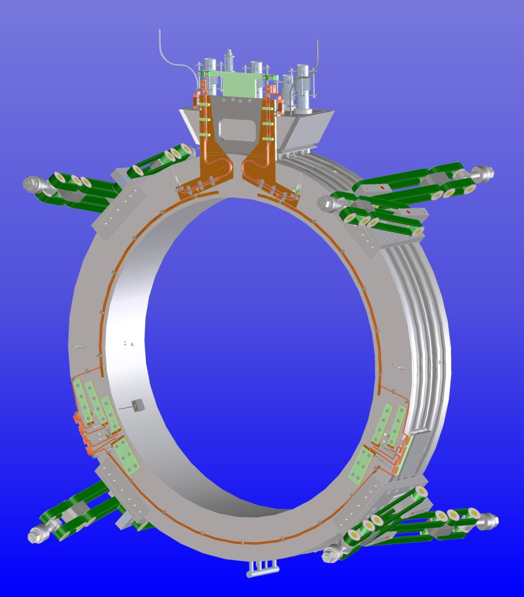
Cold Mass Assembly
Fill and top off tubes
    Remaining Tasks
    Complete the cooling circuit with the installation of the helium fill tube, top off tube and bottom manifold
    Install the cold mass support brackets and support bands
Wrap the cold mass with MLI
Bottom manifold

Slide 13
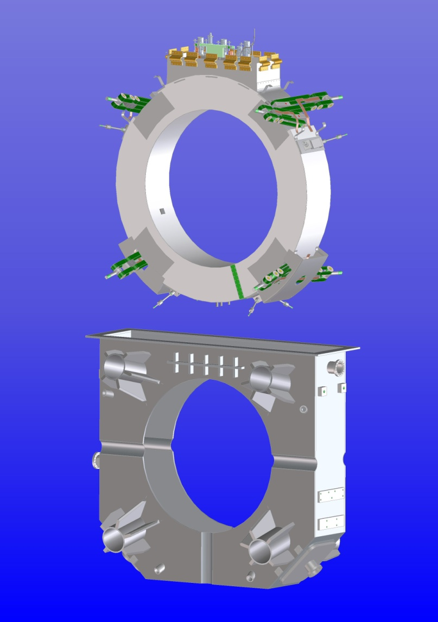
Coupling Coil Integration
    Remaining Tasks
Cold mass prepared for integration with cryostat vacuum vessel
  Assemble thermal shield around cold mass
  Wrap assembly in MLI
Insert cold mass into cryostat vacuum vessel from above (fixturing will need to be designed)
Attach cold mass support bands to cryostat vacuum vessel
Align magnet in the cryostat vacuum vessel

Slide 14
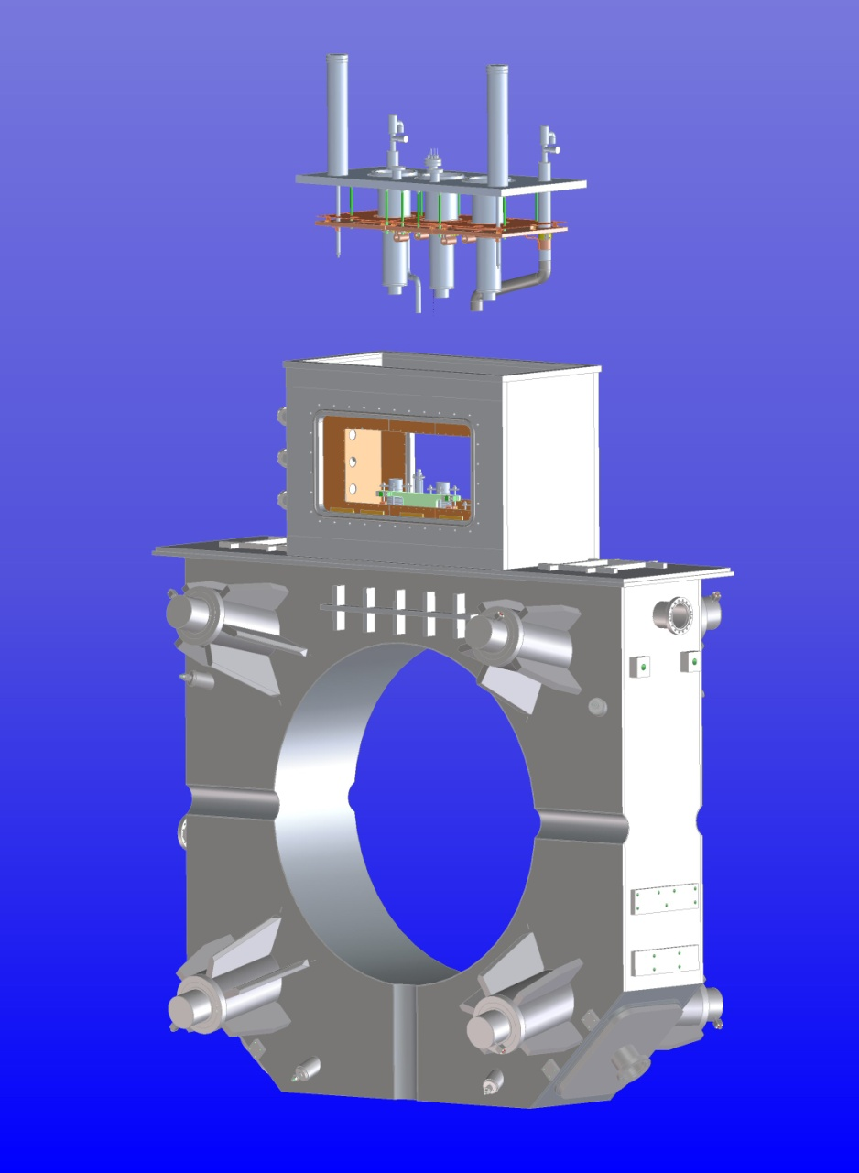
Finish Coupling Coil Integration
    Remaining Tasks
Weld tower assembly to cryostat vacuum vessel
Weld inner bore into cryostat vacuum vessel
Weld the upper cooling circuit to the tower
Weld the upper cooling circuit to the cold mass cooling circuit
    Vacuum check the cooling circuit

Slide 15
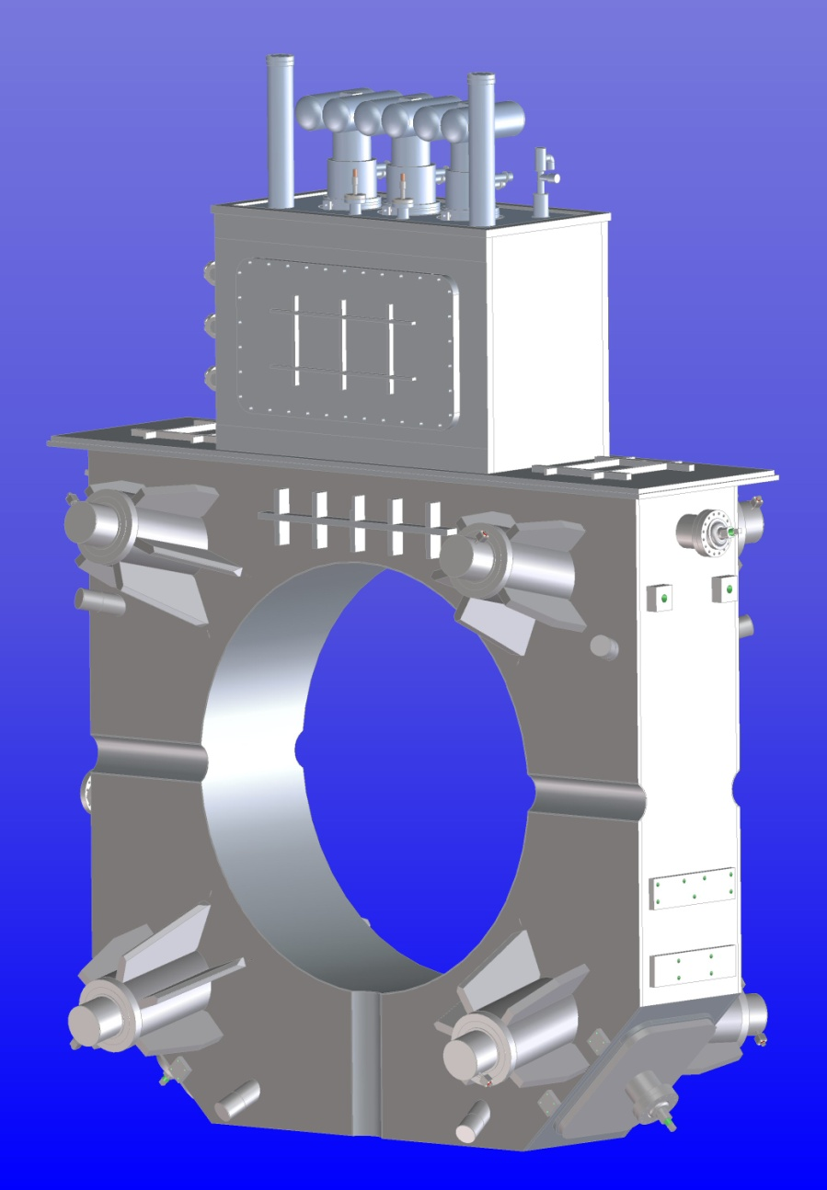
Test Prototype Coupling Coil
    Remaining Tasks
    Vacuum check the complete cryostat assembly
Add cryocoolers to cooling circuit
Coupling coil training and testing

Slide 16
Summary
    Cold mass is currently at Fermilab for magnetic testing
    Cryostat vacuum vessel is currently being fabricated at LBNL
    Will start the process of finalizing the drawing of the thermal shield beginning in early July
    Fabrication of the first thermal shield will take place at LBNL
    All drawings for the cooling circuit components will be generated at LBNL
    Fabrication of cooling circuit parts will be done at LBNL
    This week Derun Li and I met with Nikolai Andreev to begin defining the coupling coil integration process at Fermilab

