Slide 1
Technology Development Summary
  MAP Collaboration 2013
  FNAL
  June 22, 2013

Slide 2
The Key Technical Issues
High-gradient, Low-frequency (200-1000 MHz) RF Cavities
High-field Solenoids (≥ 20T)
Muon beam decay in storage rings
Fast-pulsed (400Hz) RCS dipoles

Slide 3
The RF Program
NCRF
    Vacuum RF
      201 MHZ
      805 MHz
    HPRF
SRF

Slide 4
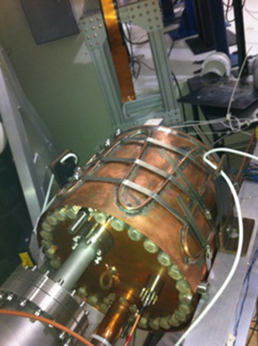
805 MHz
All-Season Cavity
29 MV/m gradient achieved at B = 0T
20 MV/m gradient achieved at B = 3T
La b G magnet re-trained to 5T Cavity will be re-measured with 5T background field

Slide 5
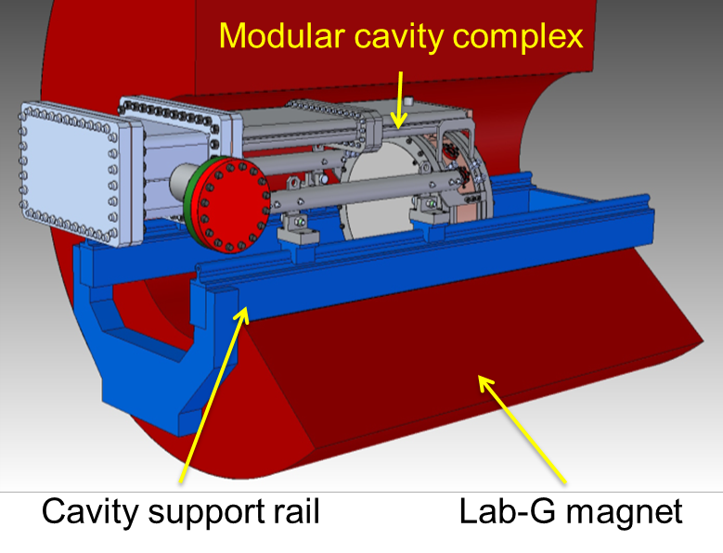
805 MHz Modular Cavity
Cavity design at LBNL and SLAC with new coupler design
Cavity Fabrication at SLAC
Delivery to MTA at end of FY13
Test with different windows (Cu/Be) and body lengths
Cornerstone of FY 14, 15 vacuum RF program

Slide 6
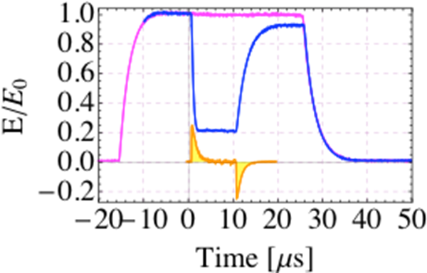
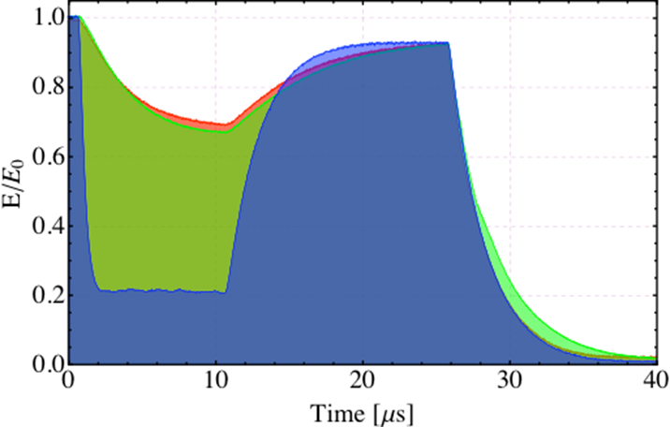
HPRF Program
Beam test with 400 MeV proton beam (up to 3x10¹¹)
Beam induced plasma-loading effect
Result with dopant (1% dry air) added

Slide 7
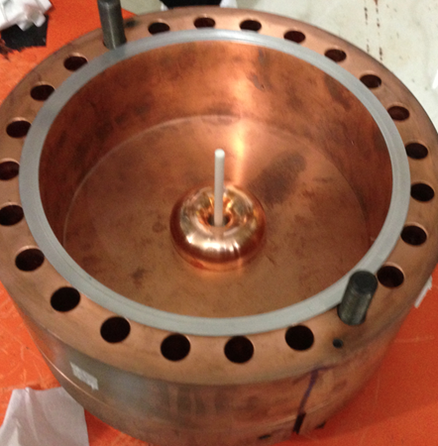
805 MHz HPRF
Goal:
Demonstrate that HPRF cavities can be used in the HCC
Results:
50 MV/m gradient achieved with H₂ gas above 400 PSI
No dependence on magnetic field observed up to B=3T
(Can now test to 5T)
First test with dielectric material
(Al₂O₃)

Slide 8
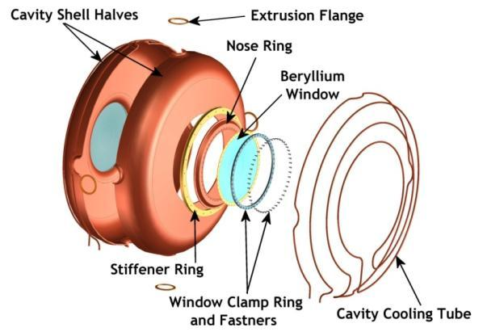
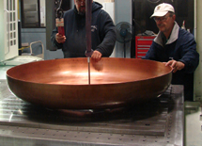
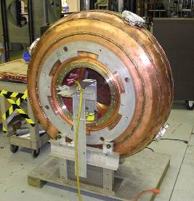
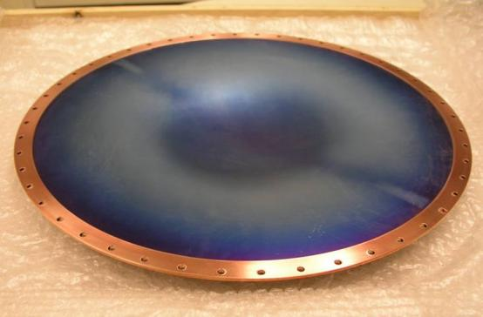
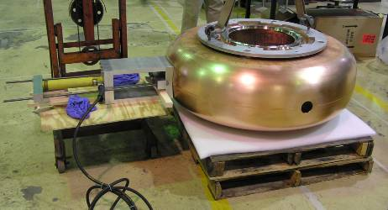
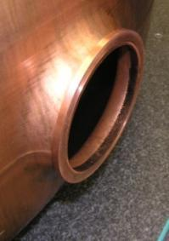
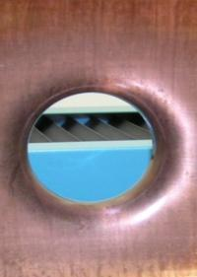
Development of 201 MHz Cavity
Cavity fabrication technique development, in collaboration with JLab; The cavity has been high power tested at MTA, Fermilab
42-cm

Slide 9
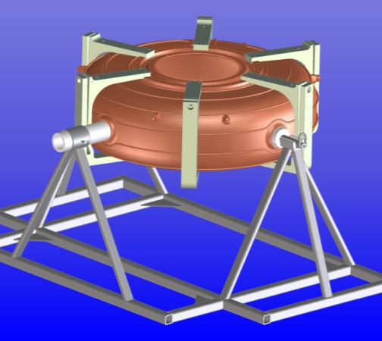
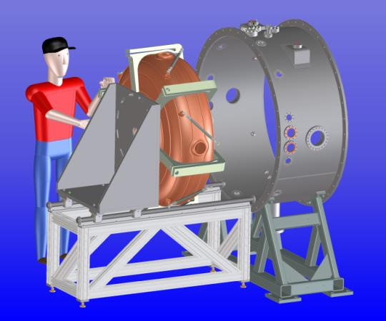
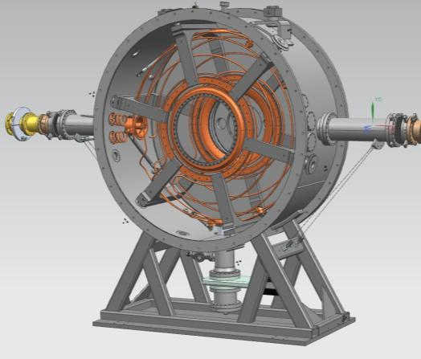
MICE Prototype Cavity Test at MTA
Installation of required infrastructure at the MTA
Testing to commence Q1 FY14

Slide 10
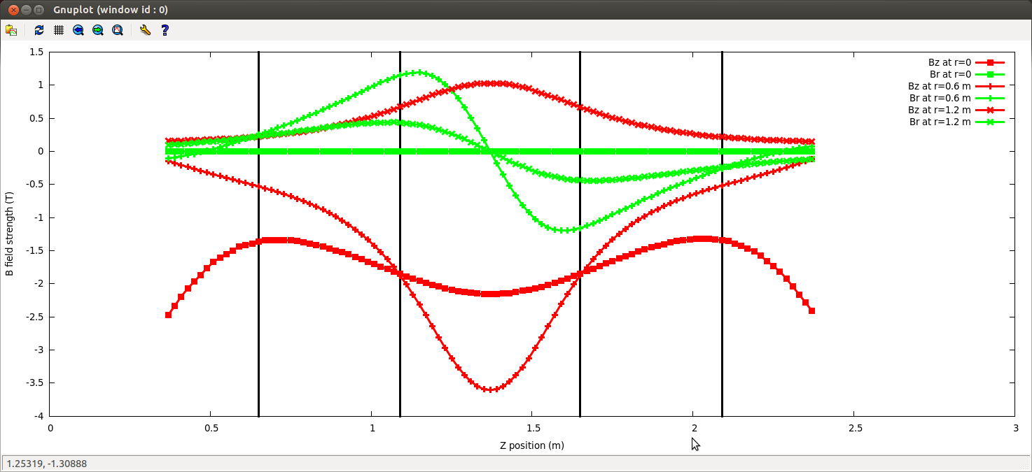
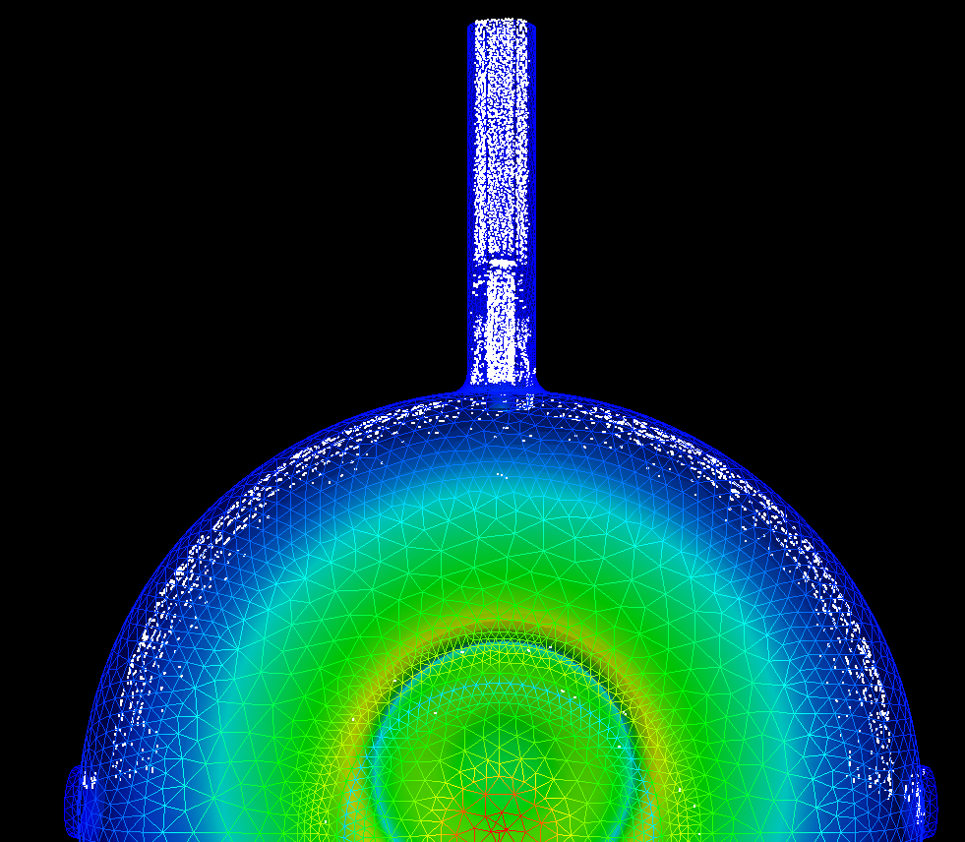
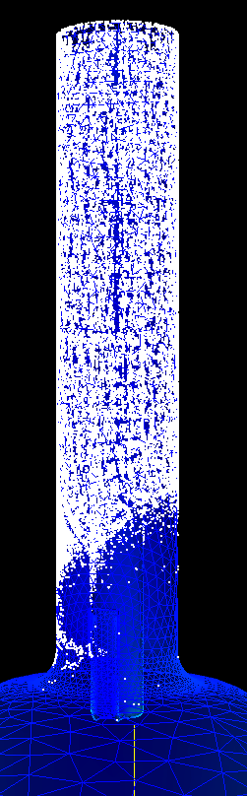
MP Simulation Studies
  Collaboration with SLAC using ACE3P, including some code development
  Simulation studies using MICE B-field map & cavity and coupler geometry
Studies providing valuable insight into high-power rf coupler issues

Slide 11
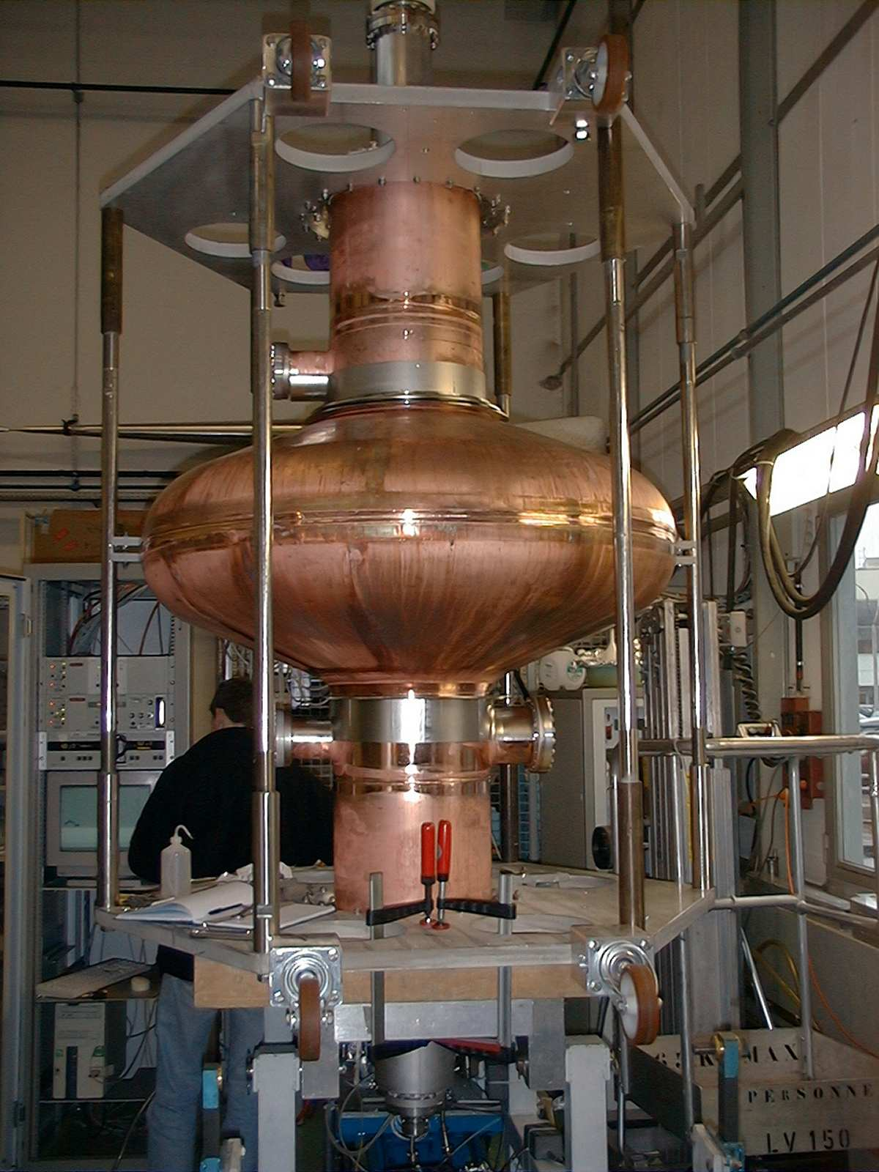
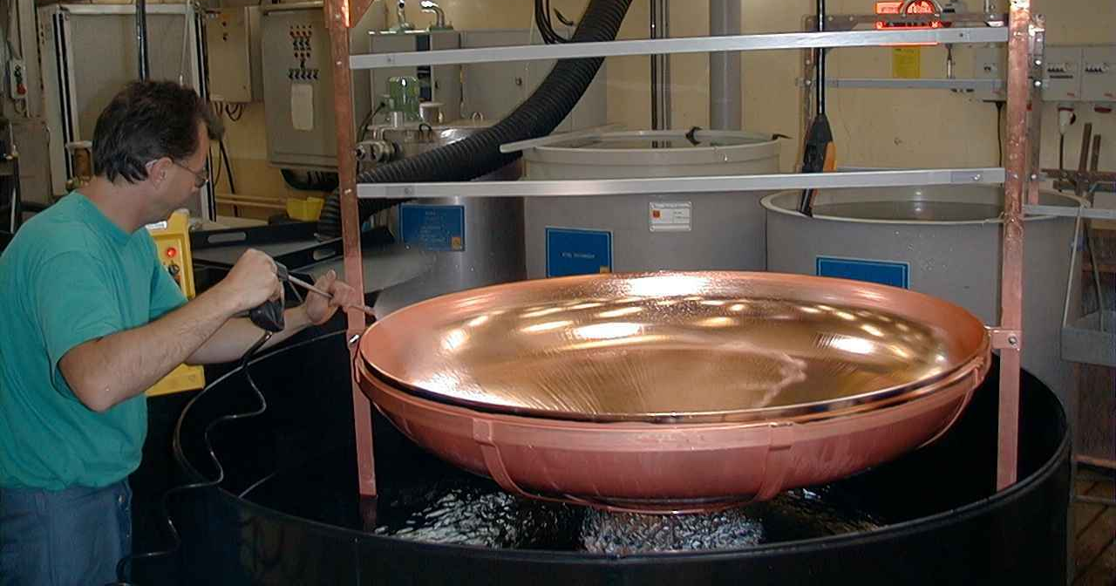
The 200 MHz SRF Cavity
Electro-polished half cell
DC voltage: 400-650 V
Gas pressure: 2 mTorr
Substrate T: 100 °C
RRR = 11
Tc = 9.5 K
Magnetron Nb film (1-2 μm) sputtering

Slide 12
Search for Nb/Cu Bonding
Two technologies are under consideration
Explosion Bonding
Electro-forming

Slide 13
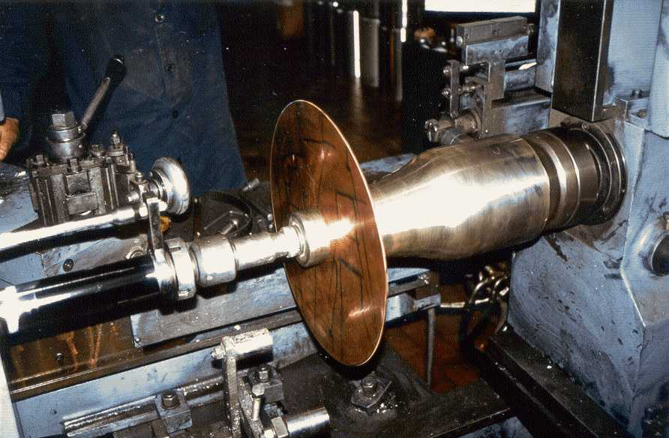
The Spinning Process

Slide 14
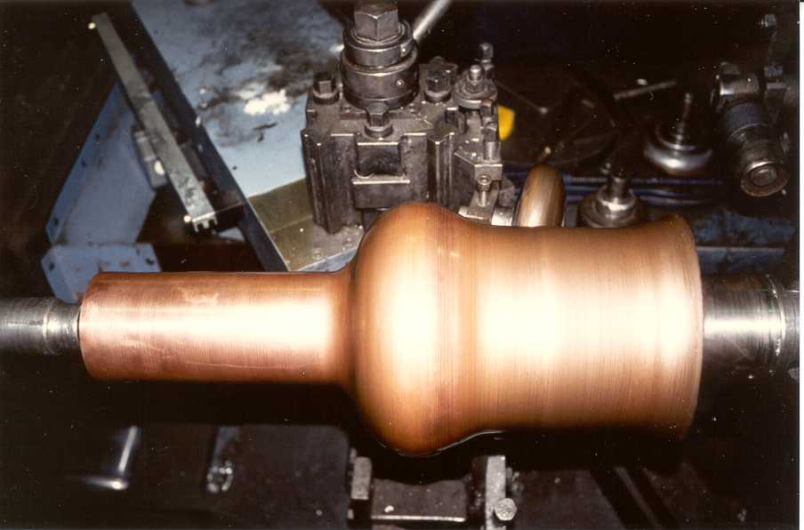

Slide 15
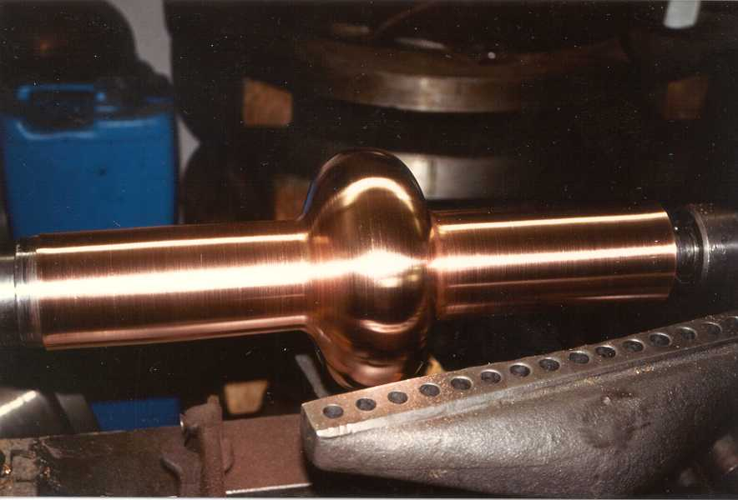

Slide 16
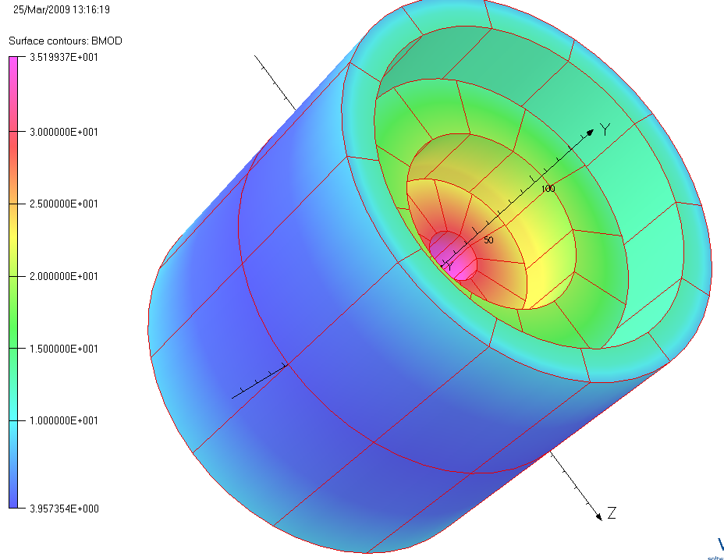
Path to Demonstrate a 30⁺ T Solenoid
Step-by-step R&D approach consisting of three (or more) coils:
>10 T HTS solenoid (midsert): SBIR Phase II with PBL
>12 T HTS (insert): SBIR Phase II with PBL
>8 T LTS (outsert): Not yet started
≥20 T HTS Solenoid (1 & 2):
≥30 T Solenoid (1, 2 and 3):
1
3
2

Slide 17
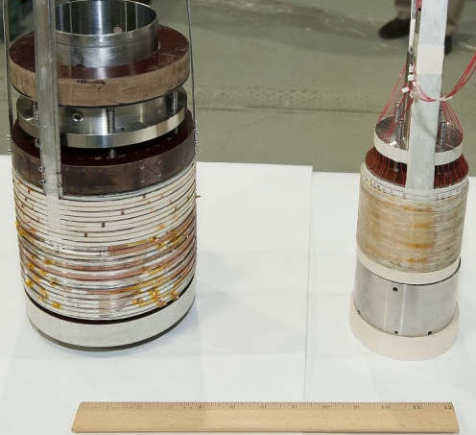
Fully Constructed (insert + midsert) HTS Solenoids for 20+ T Test
Achieved 6T with 12 of 24 pancakes (each pancake made with 100 m HTS)
Achieved 15T with 14 pancakes (each pancake made with 50 m HTS)

Slide 18
77 K Test of Full HTS Midsert
(full midsert contains 24 pancakes)
Tests performed in Nov. 2012

Slide 19
Resent Retest at 77⁰ K
16
6 out of 24 coils show degradation
15
8
11
5
1

Slide 20
Repairing of the Coils
Start with coil #15&#16 (the worst pair).
Splice joint is replaced with a new type of diagonal joint (used in another program)
First turn is removed from each pancake
Was Bad
Became Good
Was Bad
Became Good
Was Bad
Became Better (but not good enough)

Slide 21
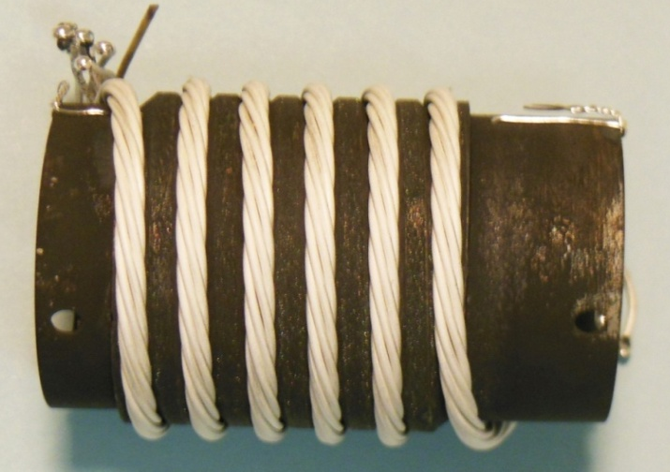
The cable J_{c} is significantly improved by overpressure processing
Bi2212 Solenoids
Tengming Shen, FNAL
OP 10 bar
Ends sealed; no leakage
10 bar overpressure processing increased the J_{c} by 4 times, and improved n-values.
Shen (FNAL), Jiang (FSU)

Slide 22
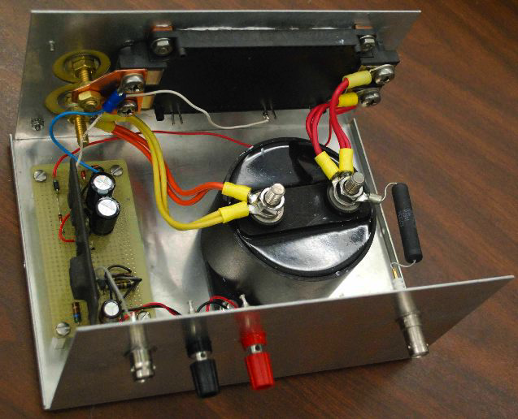
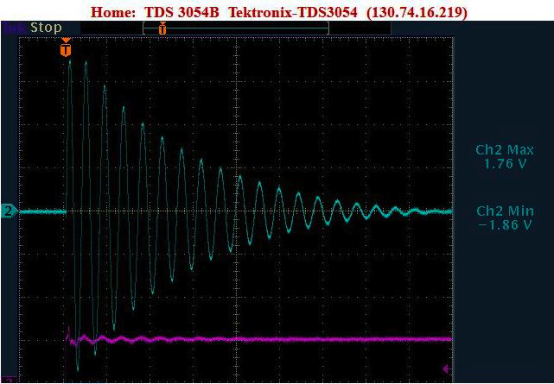
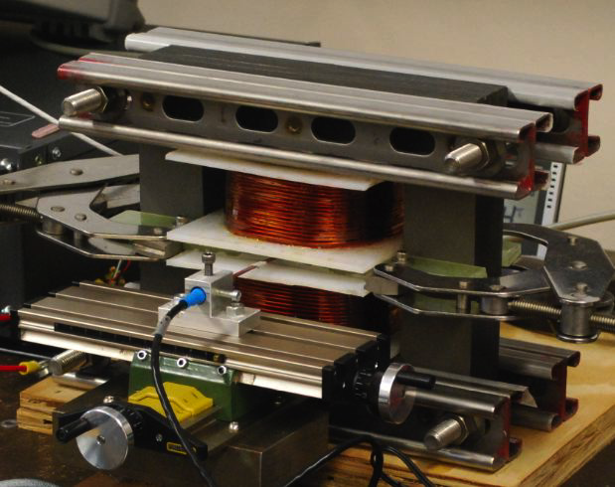
Fast Pulsed Magnets
Don Summers, UMiss
Grain oriented steel
±1.8T
1410 Hz achieved

Slide 23
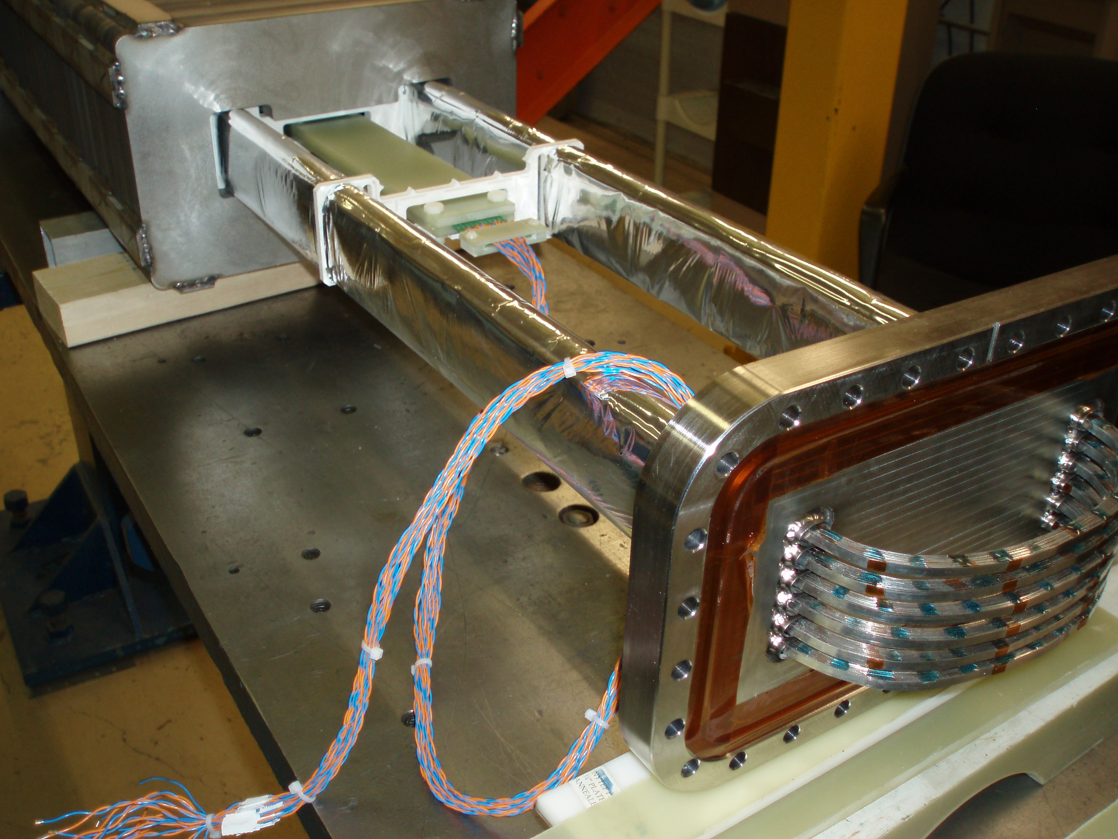
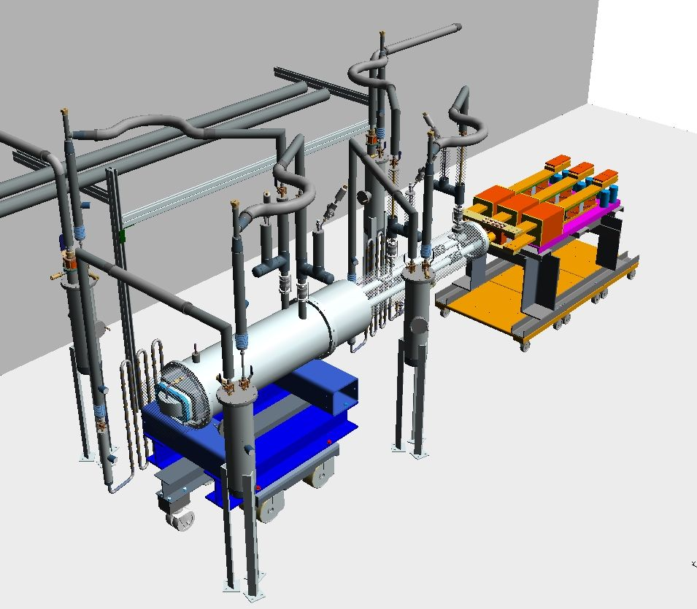
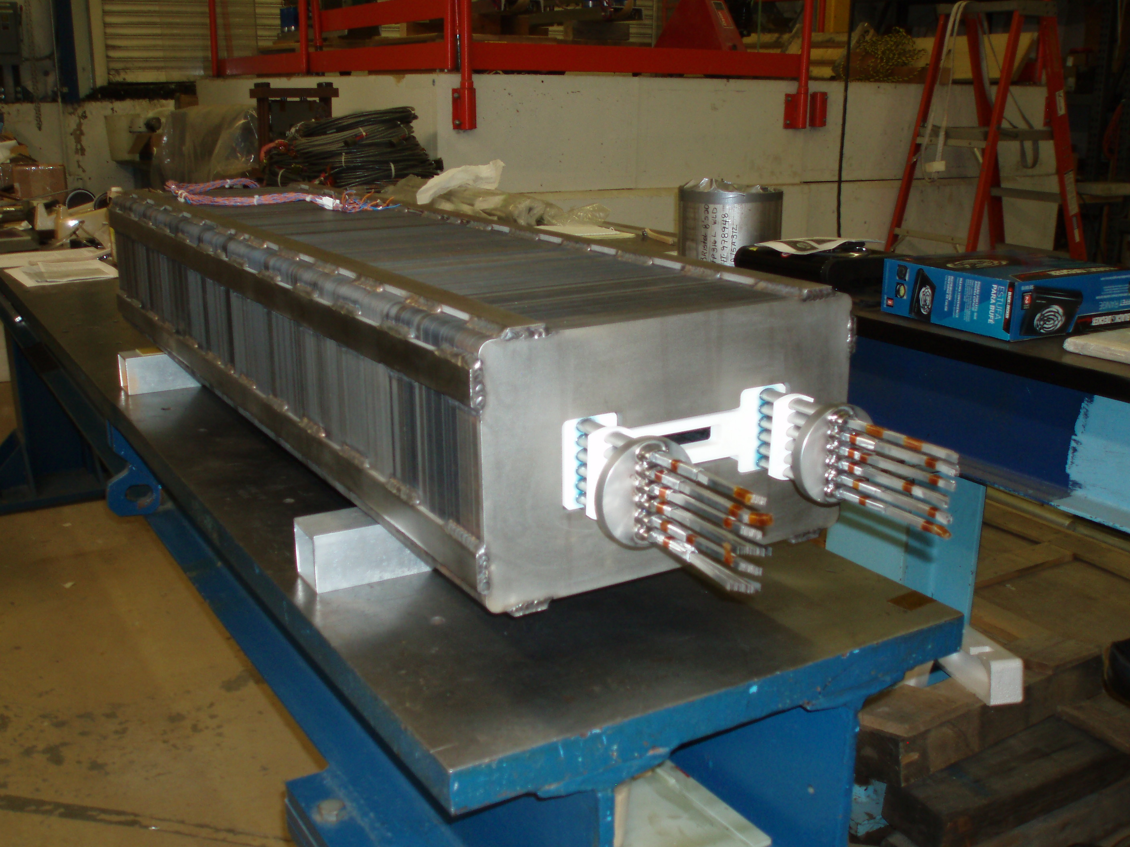
Rapid Cycling HTS Magnet
Henryk Piekarz, FNAL
Test magnet construction status
Ramping PS
Leads
HTS coil being inserted into magnet core
Magnet cryostat
Rapid-cycling HTS magnet test arrangement
0 to 1.8 T pulses
40 Hz Achieved
HTS coil installed in magnet core

Slide 24
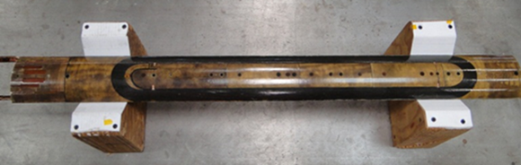
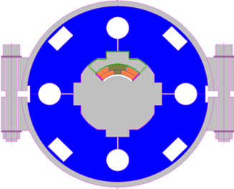
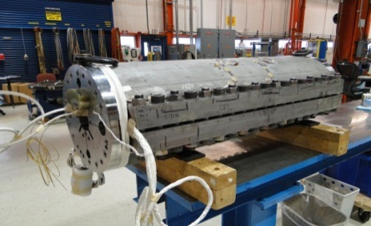
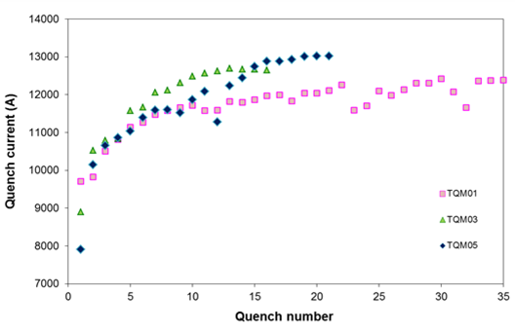
Radiation-Hard Insulation Studies
A. Zlobin, FNAL
Epoxy limits magnet radiation life-time
Search for radiation-hard material to replace epoxy started at FNAL 10 years ago (D. Chichili et al, ASC 2002)
  MATRIMID 5292 - a bismaleimide solution
  high radiation resistance
  tolerable viscosity and pot-life
  excellent mechanical, electrical and thermal properties
A 1 m long Nb₃Sn quadrupole coil was impregnated with MATRIMID and tested in 2012
  excellent impregnation quality
  quadrupole mirror structure (FNAL)
  good quench performance
MATRIMID is a potting material for future Nb₃Sn accelerator magnets
  LHC IRQ, ILC BDS, MC-NF-HF
R. Bossert et al., ASC2012, September 2012.
Quadrupole coil impregnated with Matrimid
Coil Test Structure (quadrupole mirror)
Matrimid
CTD101K epoxy
Coil training comparison

Slide 25
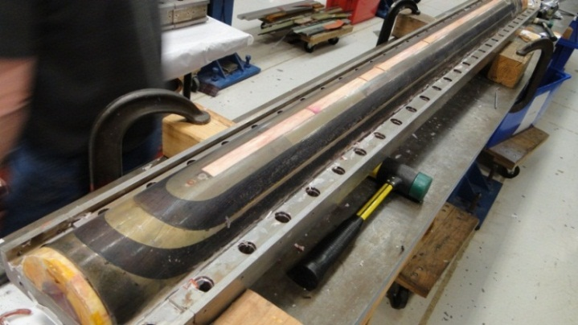
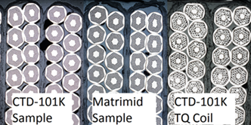
MATRIMID Coil Next Steps
A. Zlobin, FNAL
A.V. Zlobin et al., IPAC2013, May 2013.
Technology scale up
  2-m long Nb3Sn dipole coil with 60 mm
  bore and 15 mm wide cable has been
  impregnated with MATRIMID in Feb 2013
  Coil inspection is in progress
When resources allow
  5.5 m long dipole practice coil impregnation with MATRIMID
  1-2 m dipole coil fabrication and test in dipole mirror structure
The test stack program will be completed
  mechanical, thermal and electrical testing
  of stacks at room temperature and 4.5 K
  using cables of various types
Radiation testing of MATRIMID coil samples
is planned in collaboration with CERN
‘Synergistic’ interaction with LARP program
  directly applicable to MAP IR Magnets
R. Bossert et al., CEC/ICMC2013, June 2013.

Slide 26
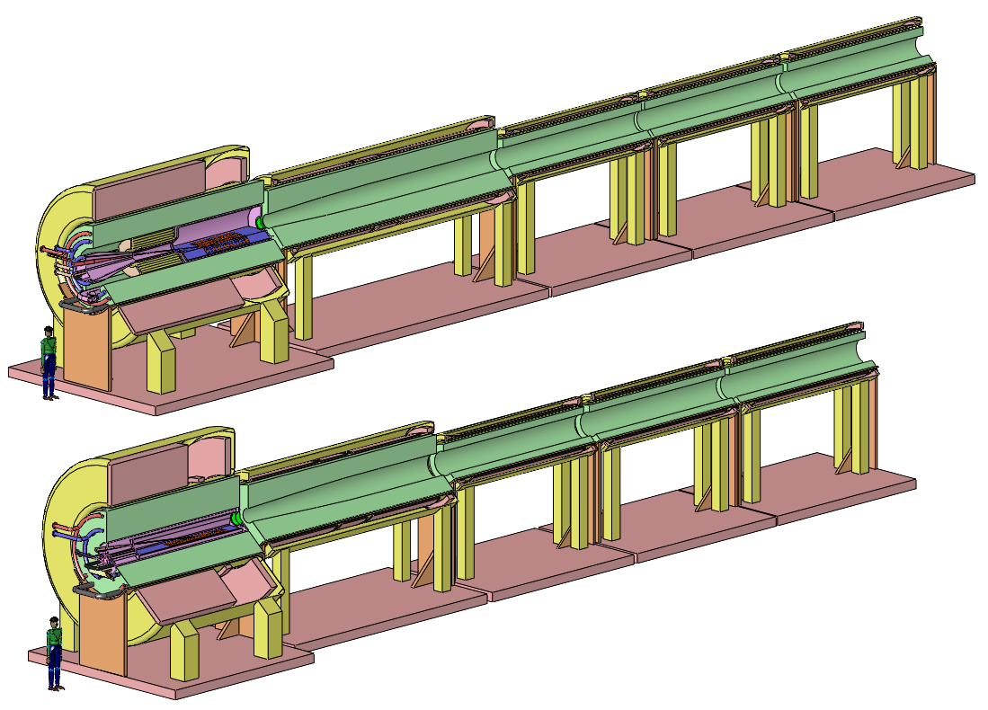
The High-Power-Target System
V. Graves, ORNL

Slide 27
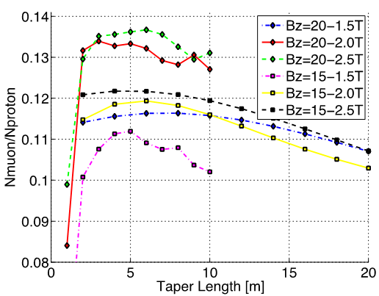
Taper Length Study
H. Sayed, BNL
Taper Lengths 5 to 7m optimal

Slide 28
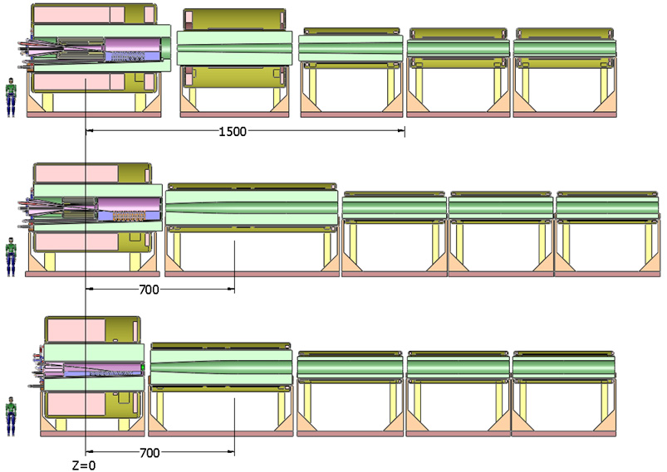
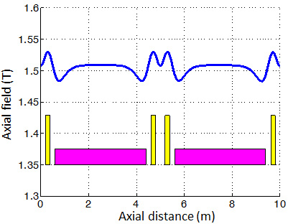
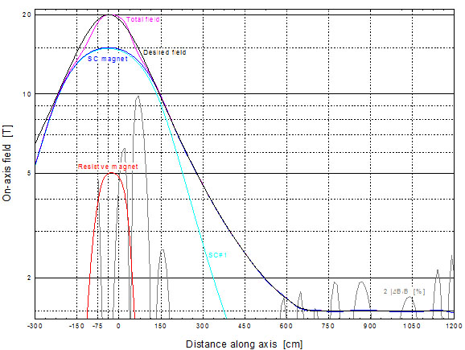
Magnet Coil Configurations
Bob Weggel (MORE/PBL) [IPAC13, TUPFI073]
Baseline (IDS-NF)
Field perturbations at the ends of the 5-m-long Decay channel magnets can lead to “stop bands.”
2 configurations with 7-m taper and 15-T peak
Revised coil configuration has essentially no ``stops bands (H. Sayed):
Axial field profile for a 7-m taper:

Slide 29
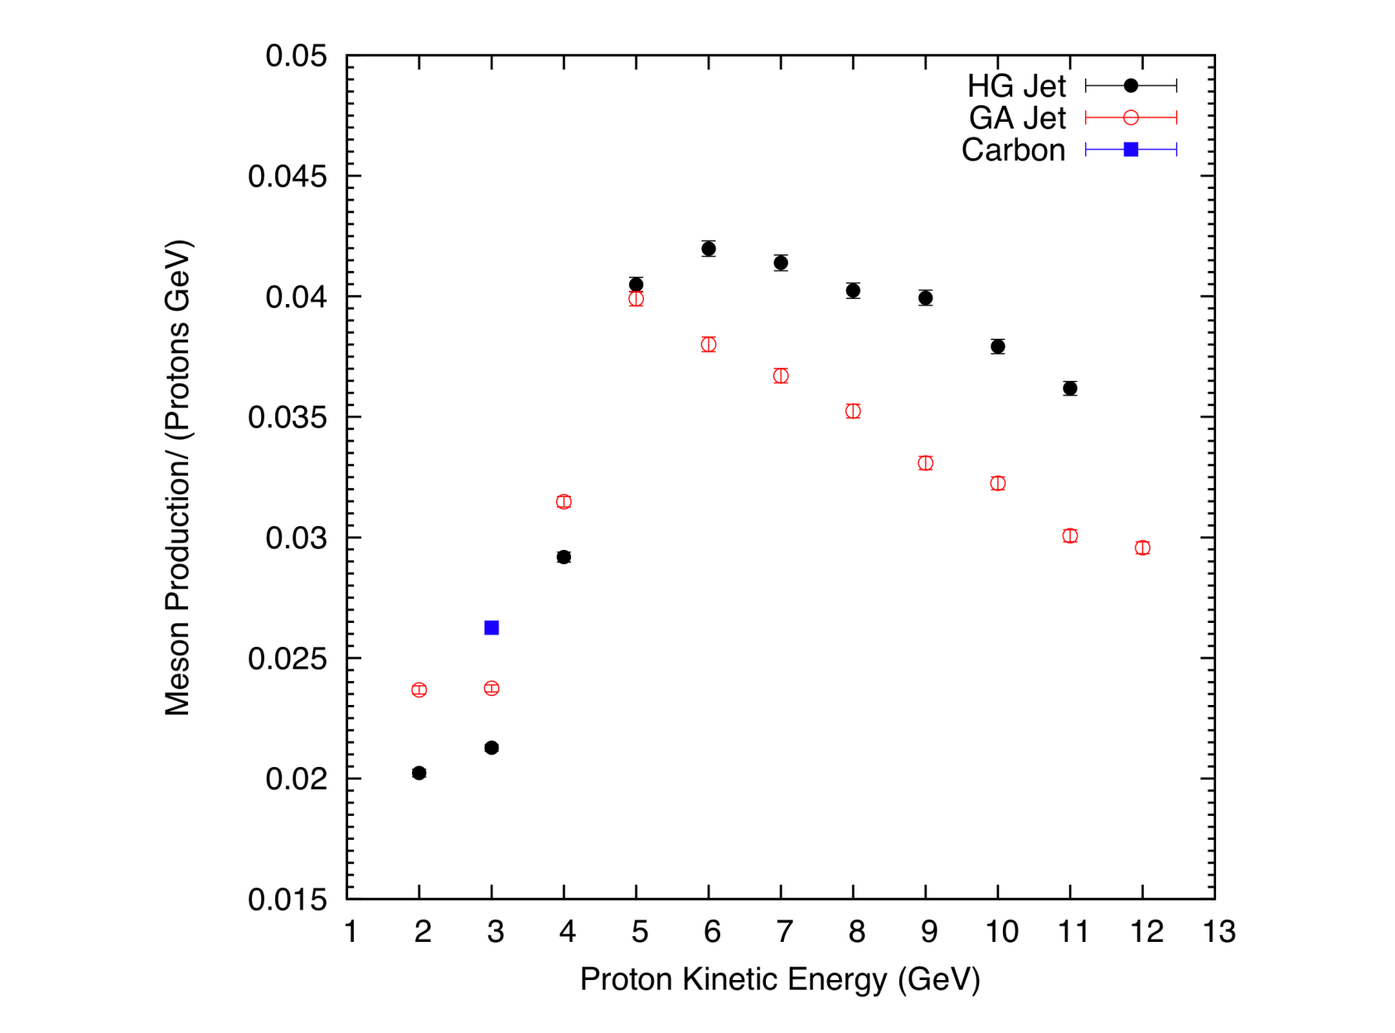
Comparison of Meson Production
X. Ding, UCLA
Preliminary
At 3 GeV,
Carbon gives more production than Ga or Hg.

Slide 30
Looking Forward FY 14,15
NCRF
Retest of 805 RF cavities up to 5T
Testing of MICE prototype 201 MHz cavity (with CC by end of FY15)
Testing the 805 Modular cavity at the MTA
Design, fabricate and test dielectric loaded HPRF cavity
Goal—test HPRF cavity with 2x 10¹² ppp
SRF
Test of bonding techniques (explosion, electroforming)

Slide 31
Looking Forward FY 14,15
Magnets
25T Solenoid demonstration
Design of 35T Solenoid
Design of fast-pulsed dipole system
100+m of Biscco cable
Radiation reduction in ring magnet cold-mass
Target Systems
Target configuration for 1MW, 3GeV proton beam

Slide 32
Backup Slides

Slide 33
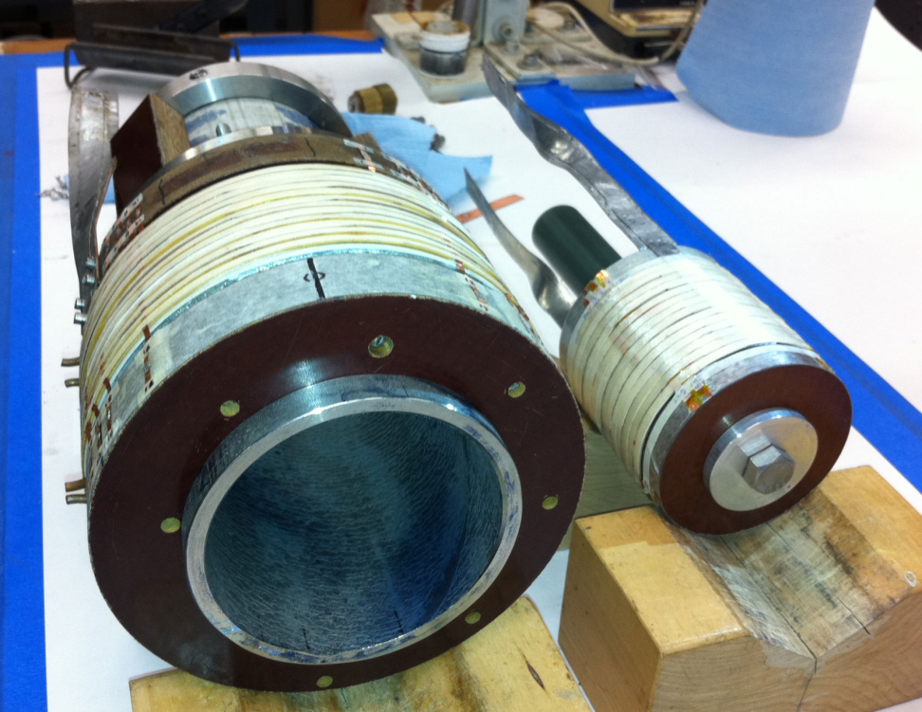
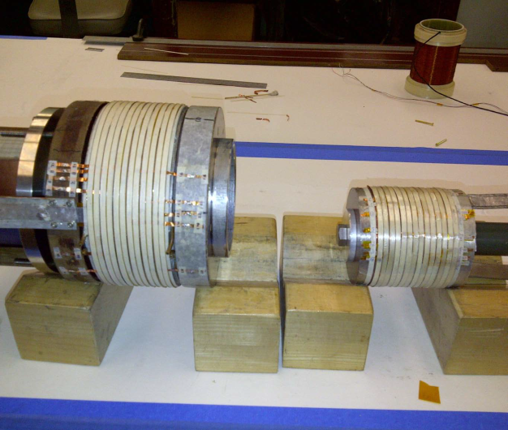
Two Solenoids are being built and tested
Solenoid #1
(Mid-sert)
ID = 10cm
OD=17cm
24 Pancakes
Solenoid #2
(Insert)
ID = 2.5cm
OD=9.1cm
14 Pancakes

Slide 34
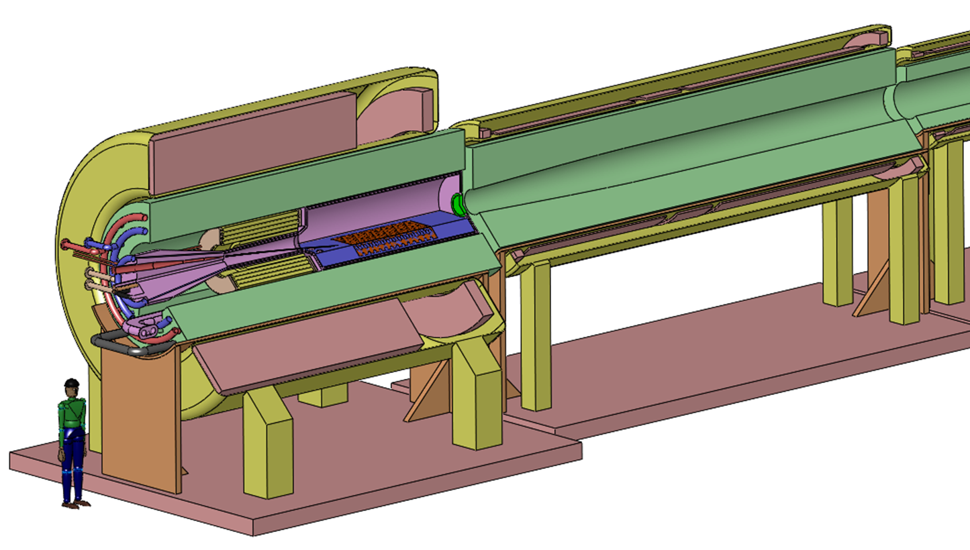
The Capture Solenoid
A Neutrino Factory and/or Muon Collider Facility requires challenging magnet design in several areas:
  Target Capture SC Solenoid (15T with large aperture)
  Stored Energy ~ 3 GJ
  10MW, 5T resistive
  coil in high radiation
  environment
  Liquid Hg Jet
  Possible application
  for High
  Temperature
  Superconducting
  magnet technology

