Slide 1

Design & Simulation:
Summary and Outlook
Robert D Ryne
Center for Beam Physics
Accelerator and Fusion Research Division
Lawrence Berkeley National Laboratory
June 22, 2013

Slide 2
D&S Topics for this Meeting were:
Provide overview of D&S status
Develop D&S plan to account for developments in the Muon Accelerator Staging Study (MASS)
Plan and prepare for Initial Baseline Selections

Slide 3
Many major D&S advances
Front End
325 MHz Front End
chicane design, shielding, energy deposition
taper optimization
engineering constraints
alternatives w/ low B field
particle production/taper optimization
325 MHz design
Realistic coil design for new taper

Slide 4
Cooling
HCC matching
Guggenheim conversion to Rectilinear FOFO (R_FOFO)
Planar snake
Other rectilinear channels
Current density estimates
Final Cooling (PIC, Li Lens)
Beam-plasma effects
6D cooling w/ space charge
R_FOFO

Slide 5
Acceleration
IDS-NF
  linac
  RLA
    arcs, linac, switchyard
  Begun: adapt 10 GeV design to MASS 5 GeV @ 325 MHz
started design of Higgs Factory acceleration chain
initial studies of shared proton-muon linac
write-up for IDS-NF RDR in progress

Slide 6
Collider
Current priority is 126 GeV Higgs Factory:
  FF magnet design
  energy deposition and detector backgrounds simulations
  simulations of fringe field effects and multipole errors
  Beam-beam effect (both transverse and longitudinal) in long bunches
  beam loading effects
Parameter | Unit | Baseline | Upgrade
Beam energy | GeV | 63 | 63
Average luminosity | 10³¹/cm²/s | 1.7 | 8.0
Collision energy spread | MeV | 3 | 4
Circumference, C | m | 300 | 300
Number of IPs | - | 1 | 1
β* | cm | 3.3 | 1.7
Number of muons / bunch | 10¹² | 2 | 4
Number of bunches / beam | - | 1 | 1
Beam energy spread | % | 0.003 | 0.004
Normalized emittance, ε_{⊥N} | π⋅mm⋅rad | 0.4 | 0.2
Longitudinal emittance, ε_{||N} | π⋅mm | 1.0 | 1.5
Bunch length, σ_{s} | cm | 5.6 | 6.3
Beam size at IP, r.m.s. | mm | 0.15 | 0.075
Beam size in IR quads, r.m.s. | cm | 4 | 4
Beam-beam parameter | - | 0.005 | 0.02
Repetition rate | Hz | 30 | 15
Proton driver power | MW | 4 | 4

Slide 7
Machine-Detector Interface
Consistent MARS15 model of Muon Collider HF IR and MDI with large aperture Nb3Sn magnets and SiD lcsim detector built, with results on muon-decay detector backgrounds and heat loads to IRQ calculated.
MDI configuration further optimized matching SiD detector, with new nozzle etc.
Next steps: further improve tracking in strong magnetic fields; extend the MARS IR model to account for all Bethe- Heitler muons; MDI shielding optimization.
Produce background source files and launch HF detector response simulations with the MARS-generated source.
Higgs Factory Interaction Region

Slide 8
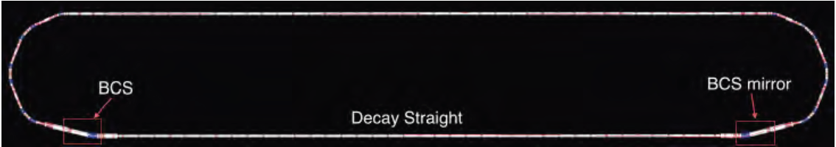
Decay Rings
  nuSTORM ring design: double bend achromat; beam combination section (BCS); chromaticity mitigation; injection/extraction systems; instrumentation studies
IDS-NF ring design: injection insertion scheme adds to the ring circumference but allows realistic injection scenario

Slide 9
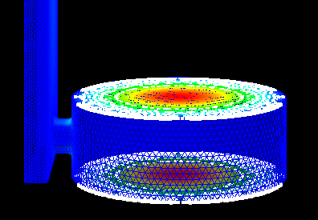
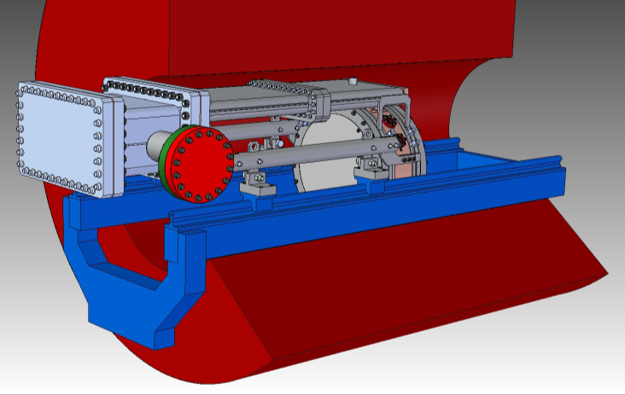
Advanced Computing
Parallel simulations
Parallel optimization
Beam dynamics and Electromagnetics
RF simulation studies with ACE3P

Slide 10
Organizing the Cooling Selection Process
2 basic candidates for 6D channel – Vacuum RF-based (several approaches) and HPRF-based (HCC)
  MAP does not have the time or resources to continue supporting exploration of all vacuum RF approaches
  Vacuum RF efforts need to coalesce around 1 approach
    Need to focus on finalizing lattice designs with realistic simulations
  Engineering support
    HCC is presently receiving design support from FNAL TD
    The same can be provided for for the Snake effort
JPD will form advisory panel to review selection criteria
  Take action on the timescale of MuPAC (Oct 2013)
  Full criteria and detailed process ready for presentation at DOE review (Jan 2013)
Lattice files w/ S2E simulations requested by start of CY 2014 (7 months from now!)

Slide 11
Cooling Selection: Other Issues
Technology:
  HPRF program showing good results
    Dielectric cavity development underway
  Vacuum RF program making progress
    Focus from here out will be on modular cavity demonstration
  Both efforts are strongly supported
Full down-select process for 6D Cooling
  Internal delivery schedule to be determined by end of FY13
  Includes:
    Team deliverable dates
    Review sequence

Slide 12
All L2 areas: Schedule for Initial Baseline Selection
Initial Cooling baseline selection by ~end of FY14; others before end FY15; all documented by end of FY15.
MAP FPII (FY15-18): Paradigm shifts from exploring options to emphasis on strengthening baseline
  Activities strongly tied to results from Tech Dev
  Cooling initial baseline selection strongly impacts 6D demo planning
  support for exploring alternatives significantly reduced
    only mgmt-approved, high-leverage alternatives

Slide 13
MASS requires changes to D&S effort to address staging scenario
There is already significant effort in HF and multi-TeV colliders
  Changes to address staging are mainly in Proton Driver, Target, Front End, Acceleration, and Decay Rings

Slide 14
Action Items/Important Dates
End of July: L2 mgrs provide MAP mgmt w/ any changes to
work plans (personnel/tasks/effort)
    to address MASS
    to refine planning for the Initial Baseline Selection
End of Sept:
  TJR, w/ input from Cooling team, submit draft of cooling selection criteria
  JPD to form advisory panel to review cooling selection criteria
End of Oct: Designers of cooling channel w/ vacuum RF urged to join forces, agree on one approach for which engineering concepts can be developed
Jan 2014: Cooling channel lattice files w/ S2E simulations requested from all teams
Other Important dates:
  Oct: MuPAC review
  Jan 2014: DOE review of MAP
  Sept 2014: 6D Cooling initial baseline selection review underway
  through Sept 2015: other baselines selected
  By Oct 2015: all baseline selections documented

