Slide 1
Coil Configurations for the Target/Front End of a Muon Collider or Neutrino Factory
Bob Weggel
Particle Beam Lasers, Inc.
June 21, 2013

Slide 2
Topics to be Covered
1) Illustrative Target-Magnet geometries
2) B(z): 15-20 T, ramping to 1.5-2.5 T in 5-15 m
3) Coil cross sections; off-axis fields; stresses
4) Operating temperature vs. deposited power

Slide 3
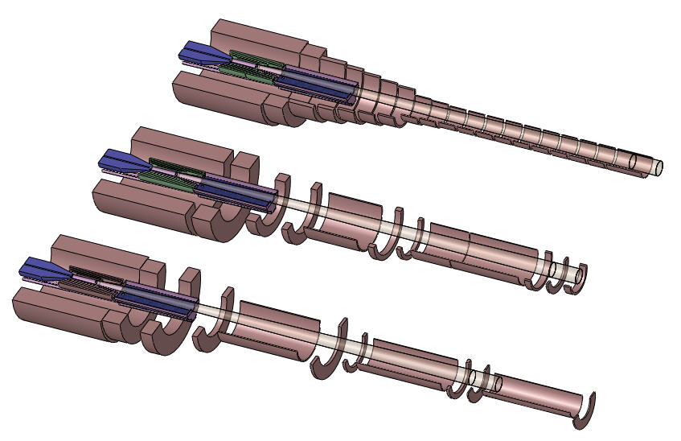
Magnets with B(z) ramping from B₀ to B_{min} as B₀/[1+βζ²(3−2ζ)], where β=B₀/B_{min}−1, ζ=(z+∆)/(L+∆), L=15m, ∆=37.5cm.

Slide 4
Field profiles of resistive, superconducting & total magnet.

Slide 5
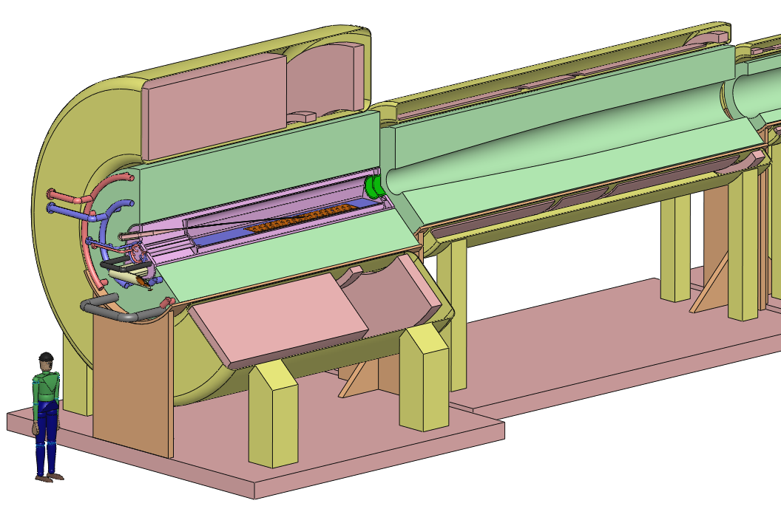
IDS120_15-1.5T7m3+4 Cryo1-2 Iso Cut

Slide 6
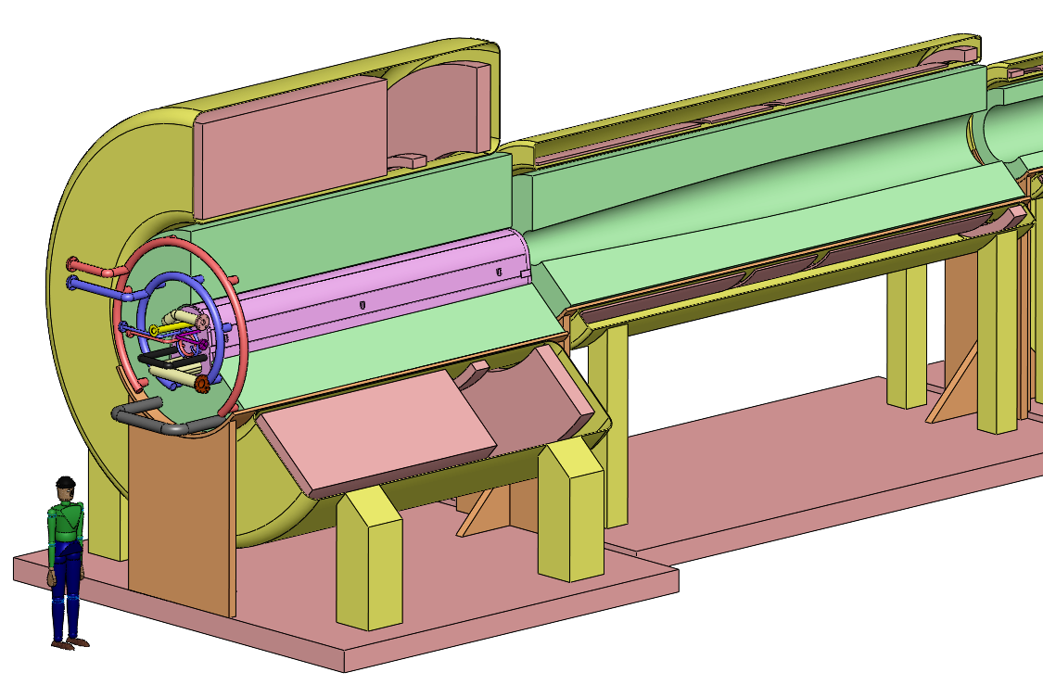
IDS120_15-1.5T7m3+4 Cryo1-2 With Uncut Target Module

Slide 7
Field profiles B(z) that ramp from 15 T to 1.5 T at 700 cm.

Slide 8
B(z) ramps to 1.5 T at 7 m, 2.0 T at 6 m, or 2.5 T at 5.3 m.

Slide 9
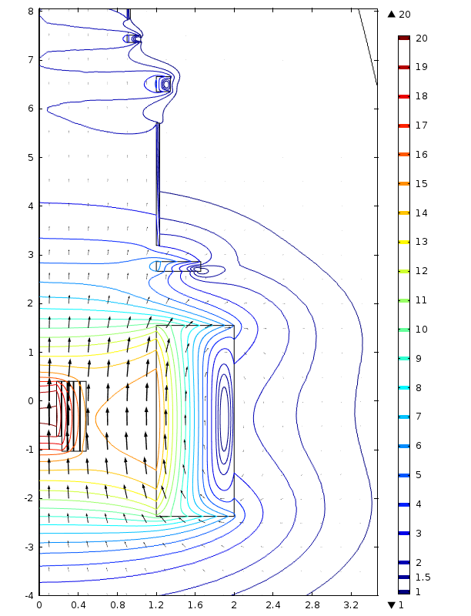
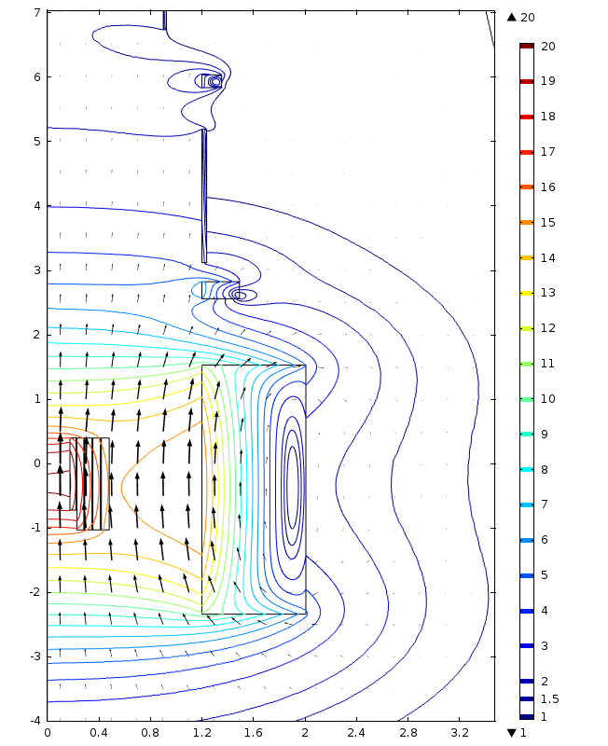
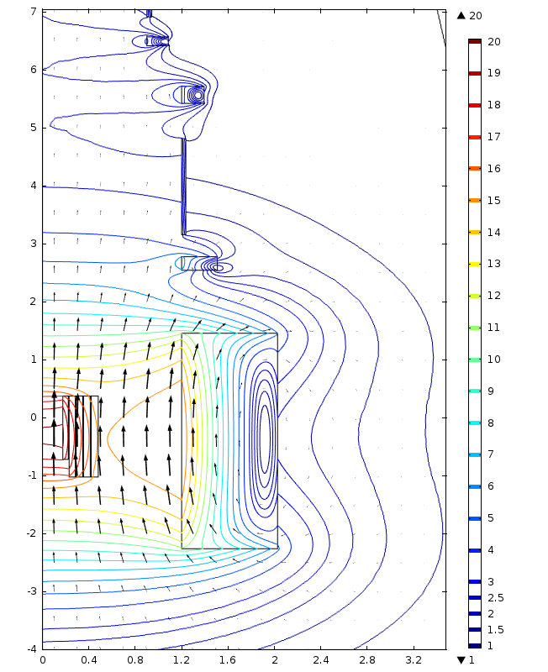
Field direction & magnitude of magnets with field ramp from 20 T to (left to right) 1.5 T at 7 m, 2.0 T at 6 m or 2.5 T at 5 m.

Slide 10
B(z) of IDS120L20to1.5T7m, with 5-T, 9.8-MW resistive magnet; field error ∆B/B is 4.9% at 70 cm & 1.2% at 11.9 m.

Slide 11
B(z) of IDS120L20to1.5T6m: with 9.2-MW resistive magnet. ∆B/B is 4.3% at 60 cm & 1.1% at 12.2 m.

Slide 12
B(z) of IDS120L20to1.5T5m, with 8.5-MW resistive magnet. ∆B/B is 5.0% at 140 cm & 1.4% at 11.2 m.

Slide 13
B(z) ramps from 15 T to 1.5 T at ~5.6 m; 210-cm gap after SC #1.

Slide 14
B(z) ramps from 15 T to 1.5 T at 6 m; 185-cm gap after SC #1.

Slide 15
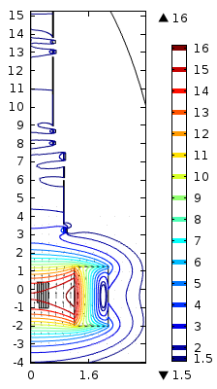
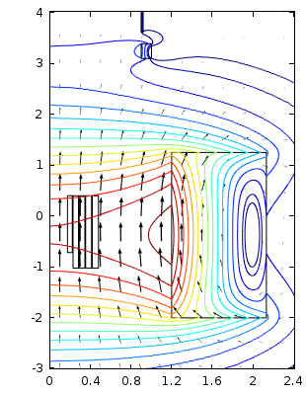
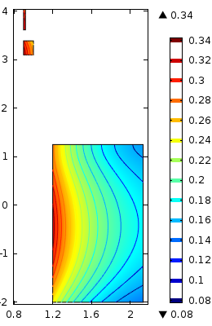
Field direction & magnitude (left & center) and hoop strain (right) of magnet with field that ramps from 15 to 1.5 T in 6 m.

Slide 16
B(z) ramps from 15 T to 1.5 T at 5 m; 189-cm gap after SC #1.

Slide 17
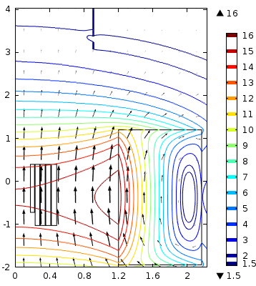
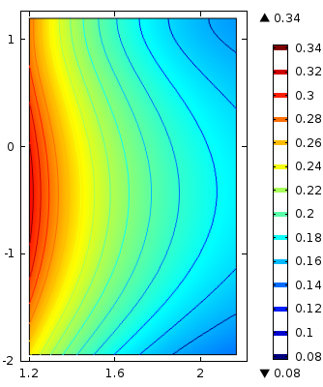
Field direction & magnitude (left) and hoop strain (right) of magnet with field that ramps from 15 to 1.5 T in 5 m.

Slide 18
Mass, power consumption, and amortization, running & total cost of hollow-conductor magnets for 1.5-T chicane 50 m long.

Slide 20
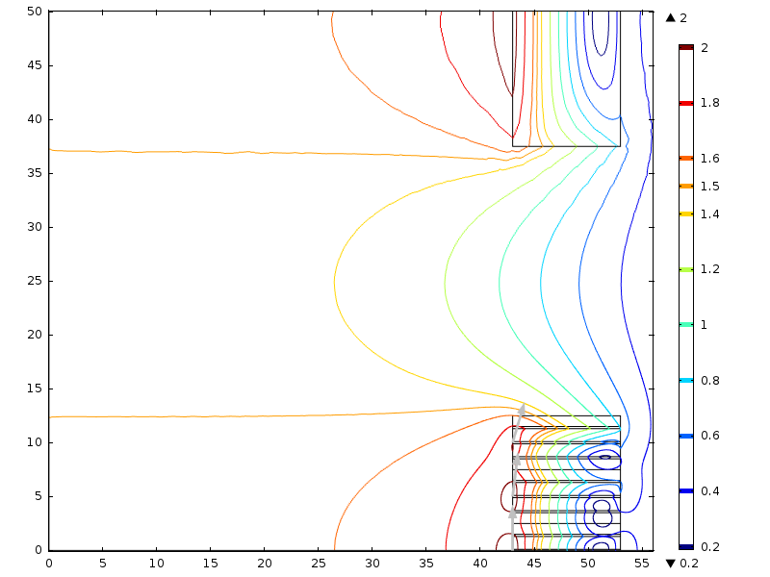
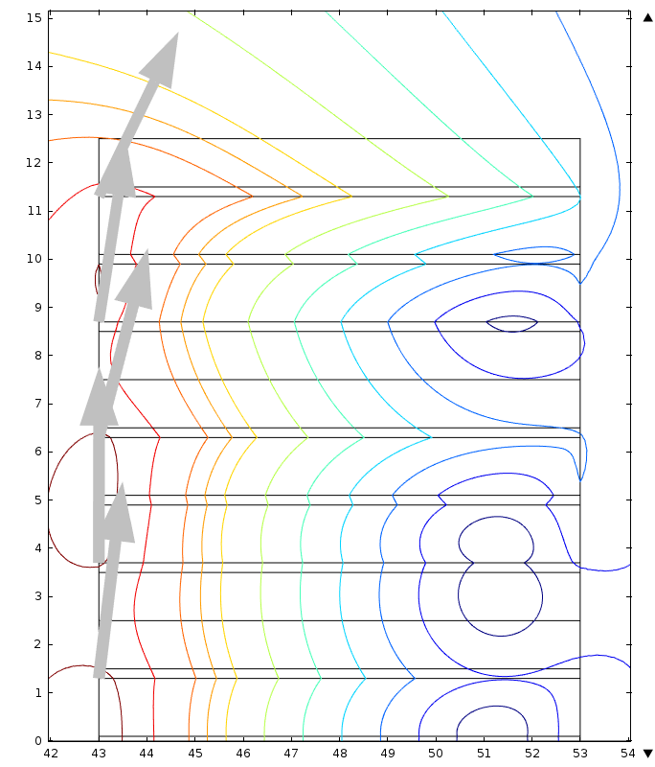
Field magnitude & direction of 50-cm section of 1.5-T chicane. B(0,z) varies only 2% peak-to-peak; B_{max} = 2.17 T.

Slide 21
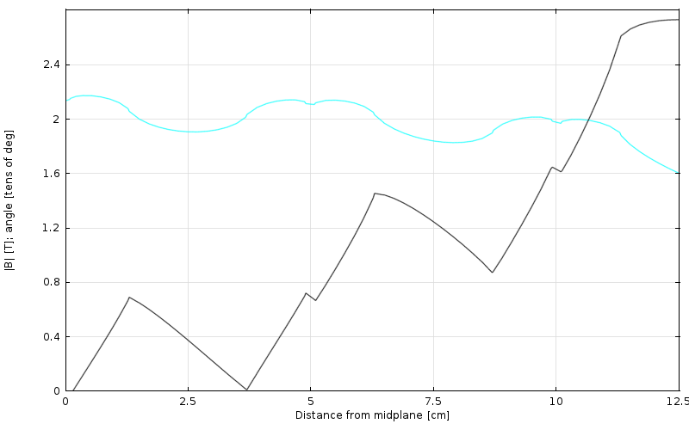
B(r=43cm, z) magnitude & direction. B_{max} = 2.17 T; θ_{max} = 27°.

Slide 22
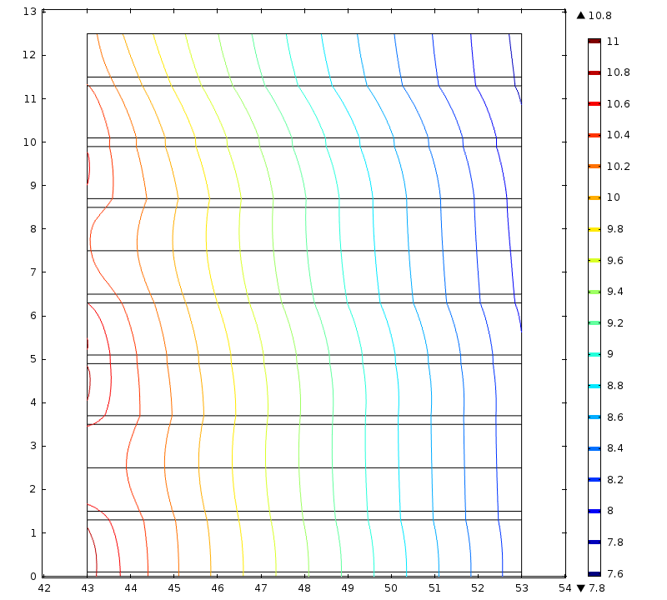
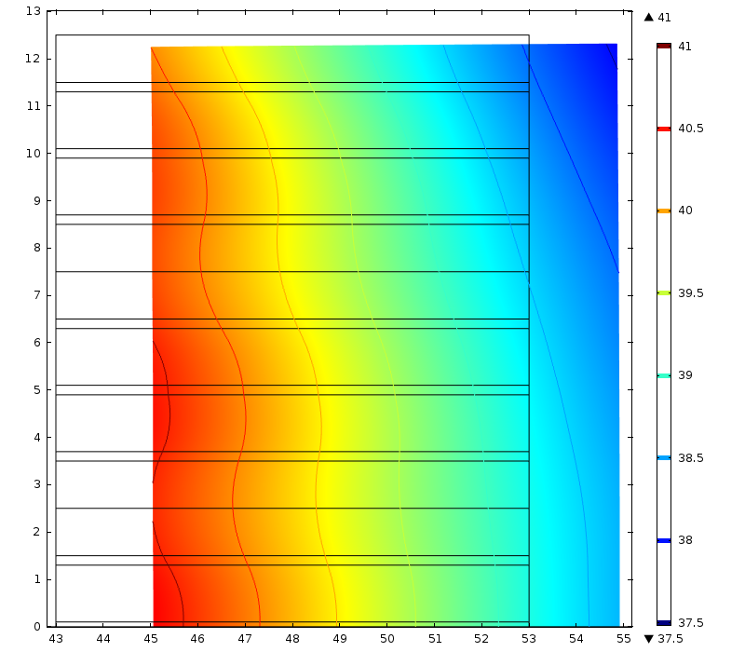
Left: von Mises stress, 7.6 to 11.0 MPa.
Right: Deformation (amplified 500 fold), 37 to 41 μ.m.

Slide 23
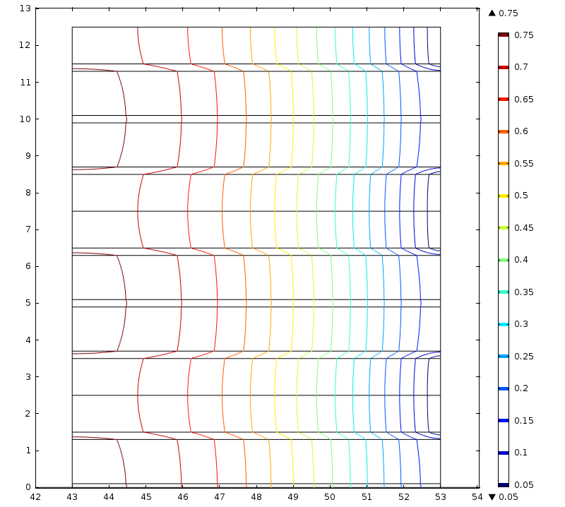
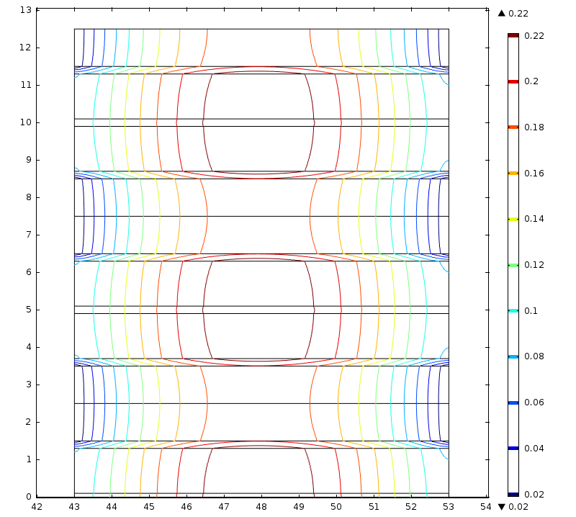
∆T with uniform w_{v} = 500 kW/7.5 m³ = 66 mW/cm³.
Left: Cooled only from outer radius; ∆T_{max} = 0.75 K.
Right: Cooled from inner & outer radii; ∆T_{max} = 0.24 K.

