Slide 1

Design & Simulation Overview
Robert D Ryne
Center for Beam Physics
Accelerator and Fusion Research Division
Lawrence Berkeley National Laboratory
June 08, 2013

Slide 2
The future of accelerator-based, energy-frontier HEP in the USA: It’s not that complicated
Someday…
We will accept that it is extremely unlikely the US gov't will build a new accelerator facility in the USA for energy-frontier HEP
We will decide to explore as far into the energy frontier as possible on our biggest existing site in the USA
We will use the highest accelerating gradients possible
We will collide leptons for maximum energy reach
The facility will be circular to enable multiple passes
We will use the strongest magnets we can build for maximum energy reach within the facility footprint
We will accelerate heavy particles to limit synchrotron radiation

Slide 3
Someday...
We will collide muons
if it is feasible

Slide 4
D&S Goals for this Meeting
Provide overview of D&S status
Develop D&S plan to account for developments in the Muon Accelerator Staging Study (MASS)
Plan and prepare for Initial Baseline Selections

Slide 5
D&S Overview
NEUTRINO FACTORY
2.1 Proton Driver
2.2 Front End
2.3 Cooling
2.4 Acceleration
2.5 Collider
2.6 MDI
2.7 Decay Rings
MUON COLLIDER

Slide 6
D&S Accomplishments : Some Highlights
Front End: chicane design/shielding/energy deposition; taper optimization; engineering constraints; alternatives w/ low B field (< 1T) if needed; 325 MHz buncher/rotator & 4D cooler; particle production @ 1 MW, 3 GeV
Cooling: HCC matching and mechanical design; post-merge Guggenheim; plasma effects in HPRF; half-flip lattices; rectilinear lattices; planar snake
Acceleration: Complete lattices for IDS-NF acceleration; progress on 325 MHz acceleration for 5 GeV neutrino factory; started design of Higgs Factory acceleration chain; write-up for IDS-NF RDR in progress
Project X – MAP Task Force

Slide 7
Major Accomplishments in all Areas
  In addition to 1.5 TeV and 3 TeV collider designs, major progress in Higgs Factory collider design: detector protection from background; fringe fields from IR quads; IR quad vibration analysis; longitudinal studies incl. beam-beam and wakes; beam loading found to be manageable w/ feed-forward/back
  MDI: Unified model of HF detector and near-IP machine components, incl. new nozzle design; lcsim detector model up and running; studies of time-gating techniques; many MARS15 developments incl. mods to model heat loads in SC magnets and to model backgrounds in HF and multi-TeV collider
  nSTORM ring design: double bend achromat; beam combination section (BCS); chromaticity mitigation; injection/extraction systems; instrumentation studies

Slide 8

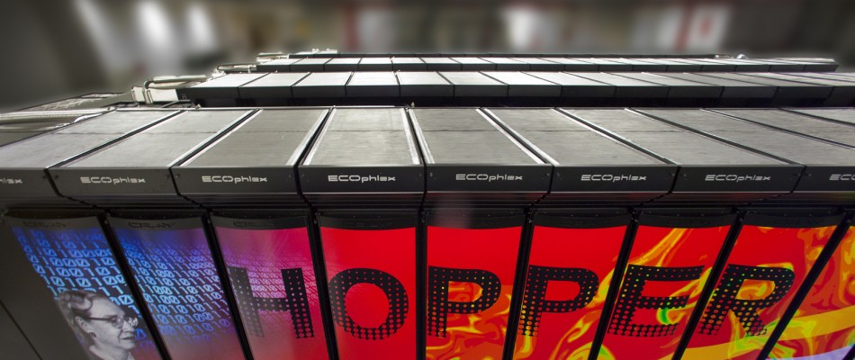
HPC as an Enabling Capability for MAP
FY13 onward
Pre-FY13
Main MAP codes G4Beamline & ICOOL typically run w/ 10K-100K particles using PC’s and clusters
Run times of many hours
“Noisy” simulations due to small # of particles
Not suitable for design optimization
Simplified physics models
G4Beamline & ICOOL parallelized
Ported to 150,000 core supercomputer “Hopper” at NERSC
Simulations now performed with millions of particles
Run times reduced by orders of magnitude
Big impact to MAP D&S effort

Slide 9
Software/High Performance Computing
Key codes: G4beamline (T. Roberts), ICOOL (J.S. Berg), MARS (N. Mokhov)
  numerous enhancements to all these codes
  G4beamline and ICOOL both parallelized
  All codes installed at NERSC
    export control issues preventing full MARS at NERSC
Design optimization
  parallel optimizer / serial code: done
  serial optimizer / parallel code: done
  parallel optimizer / parallel code: looks solvable by running a script on a single core of a support node ("MOM" node) that runs the optimizer and launches simultaneous parallel jobs
    discussion 1-2pm Friday in Rm 1 North

Slide 10
Muon Accelerator Staging Study (MASS)
A sequence of staged muon-based facilities for neutrino physics and collider physics
  each stage does physics and provides a technology testbed for the next stage
MASS Implications for MAP D&S:
  We are not designing just a single neutrino factory and a single collider
  We are designing a series of staged neutrino facilities and staged collider facilities
Discussion on design of MASS stages 8:15-9 Thurs
before Friday 5:30 – L2 managers will identify personnel and tasks. Primarily Proton Driver, Target, Front End, Acceleration

Slide 11
Initial Baseline Selection
From Mark Palmer's talk:
Major Requirements of the Feasibility Assessment
  Initial Baseline Selection Process
  Technology Demonstrations
  MICE Construction Sub-Project a Successful Experimental Effort
  Long-term planning
    MASS
    6DICE
Schedule:
  Metrics for Cooling baseline selection by end of FY13
  Initial Cooling baseline selection by ~end of FY14; others before end FY15; all documented by end of FY15.
  Paradigm shifts from exploring options to emphasis on strengthening baseline in FY15-18, feedback to tech-dev, input to 6D demo planning
    reduction in exploring alternatives (only mgmt-approved, high-leverage alternatives)
Friday 8-9AM: Management Team: Cooling Channel Selection Process

Slide 12
Closing thoughts on the future of USA-based energy frontier HEP
Not in the USA
ILC, TLEP, Super-Tristan, CLIC
Muon collider?
A big, new, green-field US
accelerator facility
HEP accelerator facility with its own accelerator-driven sub-critical system
  uses some power for science, sells the rest and is a money-maker
LPA-based Multi-TeV collider
Muon collider?
MAP will determine where a muon collider fits in regard to feasibility
Politics
Politics + Feasibility
(someday just politics?)
Not feasible?
A long way off for sure
decreasing feasibility
Muons: the "only game in town" or "no game in town"

Slide 13


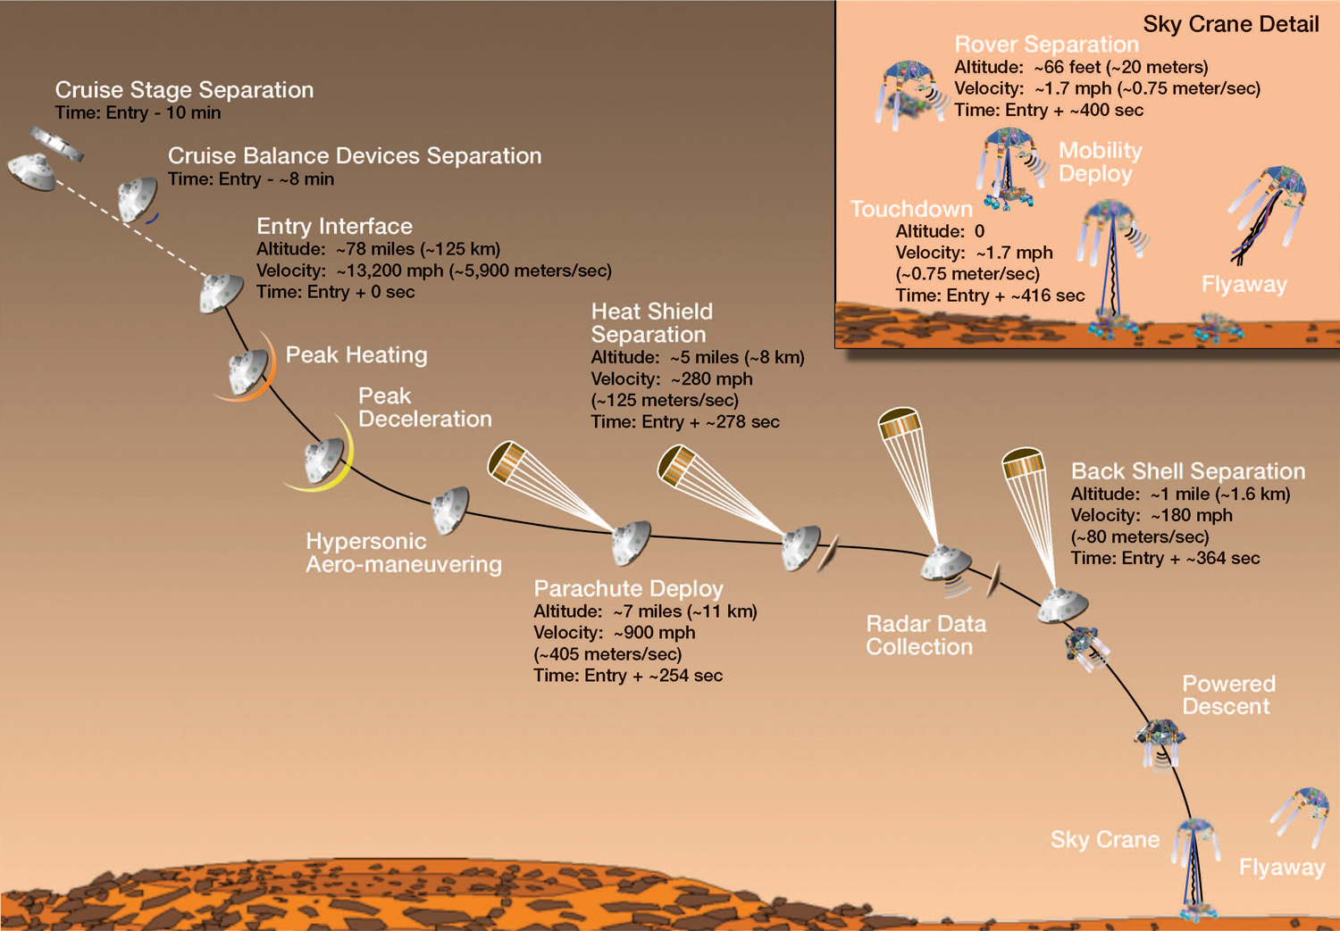
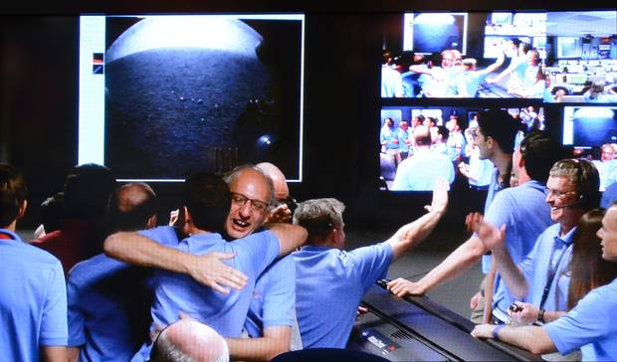
A future with muons is a bold dream
Not just the "next machine," but a new paradigm in accelerator-based HEP that lays the foundation for decades

Slide 14



