Slide 1
Proton Driver
Keith Gollwitzer
Accelerator Division
Fermilab
MAP Collaboration Meeting
June 20, 2013

Slide 2
Outline
Project X
  Goals
  Phases
Project X into Proton Driver
  Phase 4 for 4 MW at 8 GeV
  Phase 2 for 1 to 3 MW at 3 GeV
  Issues

Slide 3
Project X
Mission Goals
Provide a neutrino beam for long baseline neutrino oscillation experiments based on a capability of targeting at least 2 MW on proton beam power at any energy between 60-120 GeV.
Provide MW-class, multi-GeV, proton beams supporting multiple kaon, muon and neutrino based precision experiments. Simultaneous operations of the rare processes and neutrino programs are required.
Provide a path toward a muon source for possible future Neutrino Factory and/or Muon Collider.
Provide Options for implementing a program of Standard Model tests with nuclei and/or nuclear energy applications.

Slide 4
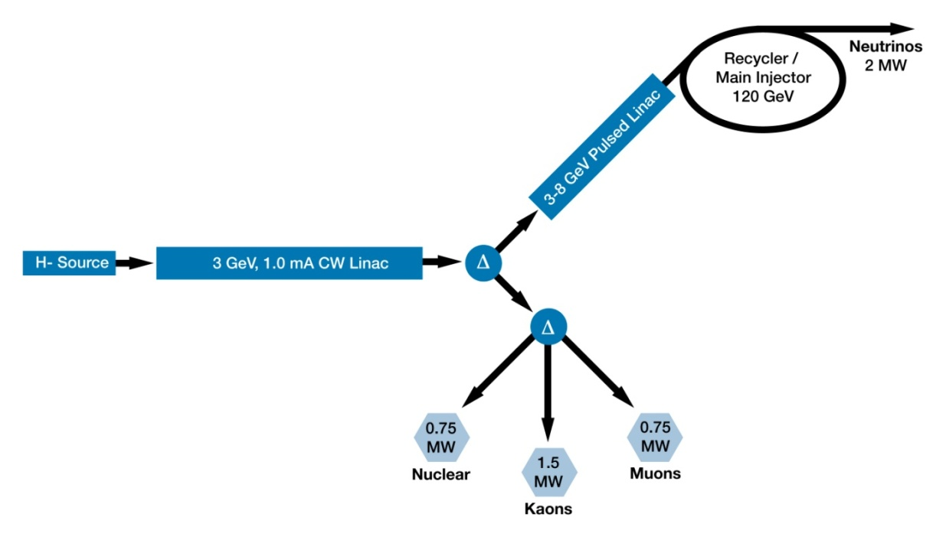
Project X
Reference Design
CW Linac will support average beam current of 1 mA to 3 GeV
Pulsed Linac (3-8 GeV) will have a ~5% duty factor
Possible 8 GeV beam power of 320 kW
Programmable Chopper System (part of H- source) will provide appropriate bunch structure for the linac experiments as well as fill the appropriate part of the RF buckets in the accumulating Recycler Ring

Slide 5

Proton Driver Layout
4MW Target
Accumulator Ring
Compressor Ring

Slide 6
Project X Staging
Recently, DOE requested Fermilab to propose staging of Project X
  Ion Source and CW Linac to 1 GeV; inject into current Booster; possible 1 MW at 1 GeV
  CW Linac 1 to 3 GeV with 3 GeV experiment campus
  Pulsed Linac 3 to 8 GeV; inject into Recycler
  Upgrade Project X to 4 MW at 8 GeV

Slide 7
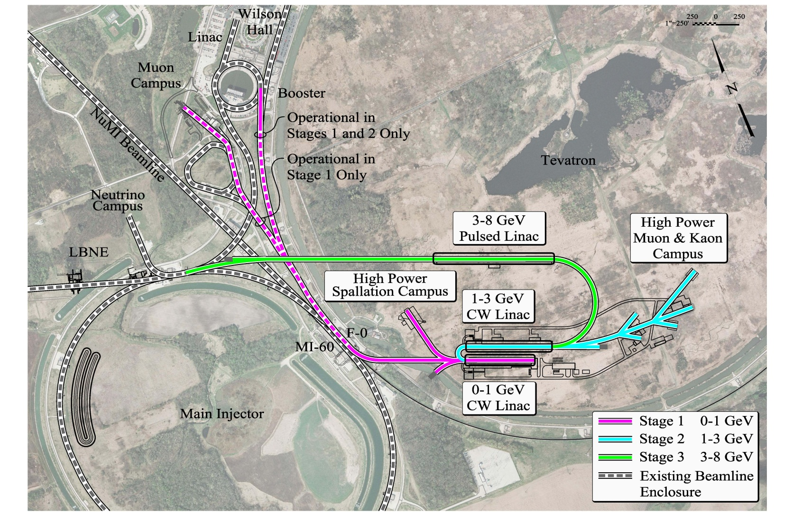
Staging
Site Plan

Slide 8
Project X and 8 GeV Proton Accumulation
Compressor
Accumulation

Slide 9
Project X and 3 GeV Proton Accumulation
Compressor
Accumulation

Slide 10
Project X to 8 GeV
Proton Driver
Upgrade Project X to 4 MW at 8 GeV
  Increase particles
    Doubling particles per linac bunch
    Average beam current increase to 5 mA
  Increase pulsed linac duty factor
    Increase to 10%
    Additional RF power and infrastructure
Beam Reformatting
  Accumulation Ring
  Bunch Compression

Slide 11
Project X to 3 GeV
Proton Driver
1
3
Upgrade Project X to 4 MW at 8 GeV
  Increase particles
    Doubling particles per linac bunch
    Average beam current increase to 5 mA
  Increase pulsed linac duty factor
    Increase to 10%
    Additional RF power and infrastructure
Beam Reformatting
  Accumulation Ring
  Bunch Compression
or 3MW

Slide 12
Possible Operational Schemes - 1
Upgraded Project X
  Run beam to Accumulation Ring 12-20 Hz for few ms intervals
  For 8 GeV, the pulsed linac is used (6.67 ms at 15 Hz)
  Programmable chopper allows half of beam into linac
Accumulation Ring
  Converts ion beam to proton beam
  RF buckets synchronized to chopper
  Results in several bunches

Slide 13
Possible Operational Schemes - 2
Desired frequency to Compressor Ring
  Transfer single bunch at a time
  Transfer all bunches
Compressor Ring bunch rotates beam and extracts into 1 or multiple beam lines to target
  Multiple beam lines are such that all bunches arrive simultaneously

Slide 14
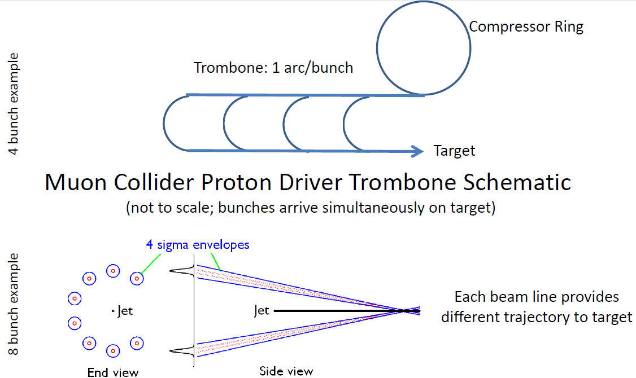
Multiple Beam Lines to Target
Extracted bunches from Compressor Ring are sent into different length beam lines

Slide 15
Multiple Beams onto Target
Each beam line enters the target area with an angle to the solenoid axis and will have a path such that the center of the interaction region is on the solenoid’s axis

Slide 16
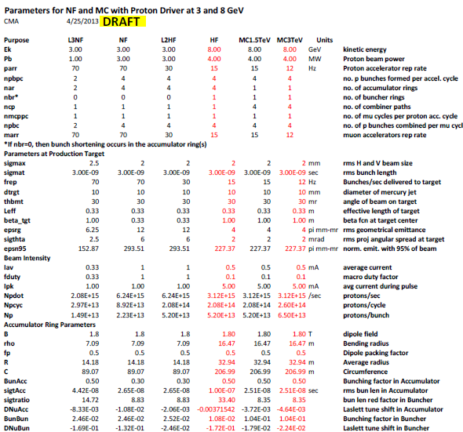
MASS Spreadsheet

Slide 17
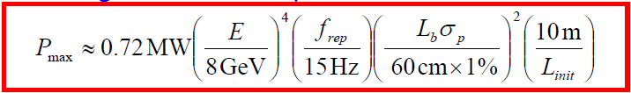
Why Multiple Bunches
Longitudinal Instability
Low frequency running will need to have multiple bunches
  4MW/8GeV/15Hz means 6x720kW bunches
  1MW/3GeV/75Hz means 15x72kW bunches
    How many bunches can be brought to the target?
V. Lebedev: maximum power per bunch
Final Bunch Parameters
(Compressor Ring)
Initial Ring Bunch Parameters
(Accumulator Ring)

Slide 18
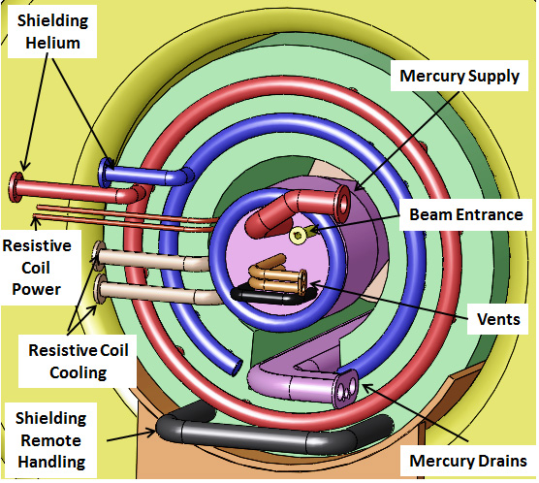
Small Number of Bunches
Target Station
  Infrastructure
  Shielding
Last transfer line magnet(s)
  Multiple beams will be close together
  Focusing the multiple beams
  Steering the multiple beams

Slide 19
Some Rings Concerns
Stripping
  Accumulation of protons from Hminus linac beam
  Handling of unconverted beam
Intense particle bunches
  Instabilities?
    Seen an example of longitudinal
    Space charge

Slide 20
Final Focus
Beam Line(s)
Deliver beam: ring to target
    IDS-NF design shown
Issues (multiple beams)
  Collimation
  Connection to target area is at “angle” since will need to have helical orbit in solenoid
  Last magnetic element location with respect to the target infrastructure
  Window(s)
    Beam vacuum separated from Mercury containment

Slide 21
Summary
We understand an upgrade path for Project X to 8 GeV Proton Driver
Need to work on rings designs and addressing instabilities
Upgrade path for Project X for a 3 GeV Proton Driver is more straight forward
Need lots of work to understand 3 GeV proton accumulation
Limits of number of beams on target need to be investigated

Slide 22
Backup

Slide 23
Phased Project X Physics
Program: | Onset of NOvA operations in 2013 | Stage-1: 1 GeV CW Linac driving Booster & Muon, n/edm programs | Stage-2: Upgrade to 3 GeV CW Linac | Stage-3: Project X RDR | Stage-4: Beyond RDR: 8 GeV power upgrade to 4MW
MI neutrinos | 470-700 kW** | 515-1200 kW** | 1200 kW | 2450 kW | 2450-4000 kW
8 GeV Neutrinos | 15 kW +0-50kW** | 0-42 kW* + 0-90 kW** | 0-84 kW* | 0-172 kW* | 3000 kW
8 GeV Muon program e.g, (g-2), Mu2e-1 | 20 kW | 0-20 kW* | 0-20 kW* | 0-172 kW* | 1000 kW
1-3 GeV Muon program, e.g. Mu2e-2 | ----- | 80 kW | 1000 kW | 1000 kW | 1000 kW
Kaon Program | 0-30 kW** (<30% df from MI) | 0-75 kW** (<45% df from MI) | 1100 kW | 1870 kW | 1870 kW
Nuclear edm ISOL program | none | 0-900 kW | 0-900 kW | 0-1000 kW | 0-1000 kW
Ultra-cold neutron program | none | 0-900 kW | 0-900 kW | 0-1000 kW | 0-1000 kW
Nuclear technology applications | none | 0-900 kW | 0-900 kW | 0-1000 kW | 0-1000 kW
# Programs: | 4 | 8 | 8 | 8 | 8
Total max power: | 735 kW | 2222 kW | 4284 kW | 6492 kW | 11870kW
* Operating point in range depends on MI energy for neutrinos.
** Operating point in range depends on MI injector slow-spill duty factor (df) for kaon program.

Slide 24
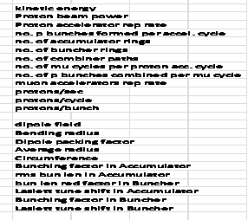
MASS Parameter Sheet

