Slide 1
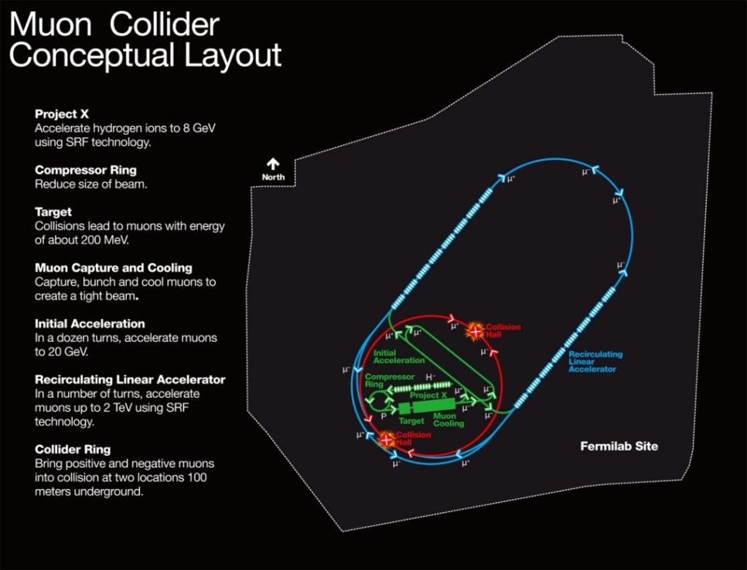
MAP Magnets – Critical Path Technologies
A 4 TeV Muon Collider
fits on the Fermilab Site
MAP Magnets – Critical Path Technologies
J. Tompkins, FNAL
J. Tompkins
for the MAP Magnet Group

Slide 2
MAP Magnets
We concentrate on magnets downstream from the µ production target which are critical for muon cooling and the Collider Ring magnets
Initial focus has concentrated on critical components for design validation
  High field solenoids for cooling => HTS technologies, very high fields, significant departure from ‘classical superconductors’
  Unique geometries – e.g., helical solenoids - for intermediate cooling
  Fast ramping dipoles for beam manipulation
  Collider Ring dipoles and quadrupoles – interfaces w/ detectors, significant heat loads from muon decay backgrounds
Some programmatic changes introduced in the past year by Mark Palmer -
  More detailed planning w/ task definition & milestones
  Monthly progress reporting at teleconferences
Supported by MAP DOE Funding, SBIR Funding, and other DOE funding (e.g., ‘DOE Office of Science Early Career Research Program Award’)
  FY13 funding constrained by other demands on MAP resources

Slide 3
MAP Magnet Group
Ramesh Gupta, BNL
M. Lopes-Lima, FNAL
H. Piekarz, FNAL
T. Shen, FNAL
Don Summers, UMiss
J. Tompkins, FNAL
A. Zlobin, FNAL

Slide 4
MAP Magnets, cont.
Very High Field Magnets
  Required for rapid beam cooling
  Need HTS conductor to obtain highest fields – J_{c} and B_{max}
  Two approaches underway -
    YBCO/ReBCO – ‘tape’ conductors (Ramesh Gupta, BNL)
      Mounted on a substrate
      Best suited for solenoidal geometries
      Some sensitivity to field direction
      Available in commercial quantities
      ‘Ready to use (wind)’
    Bi2212 – ‘wire’ conductor (Tengming Shen, FNAL)
      Can be made into cable
      Recent advances in manufacturing/reaction technology yield high Jc
      Expensive – wire sheath is made of silver
      ‘Wind & React’ technology – requires accurate temperature cycle/controlled conditions to produce the SC material

Slide 5
MAP Magnets, cont.
Fast Pulsed Magnets
  Two approached have been taken:
    Conventional Cu-Fe magnet design
    HTS/YBCo coils
  Conventional design (D. Summers, UMiss)
    Has reached field strength and repetition rate needed in a small magnet
    Pushes magnet parameters near to limits of conventional design
  HTS design (H. Piekarz, UMiss)
    Clever design to use HTS (YBCo) conductor in pulsed mode
    Has made a lower ramp rate (~40Hz) prototype suitable for use in the accelerator front end
    Scaling to ~400Hz MAP ramp rate requirements is challenging and is being investigated

Slide 6
MAP Magnets, cont.
HTS Magnets for Final Cooling
  Field strengths in the range 20T ≤ B_{max} ≤ 40T
  Both ReBCo and 2212 conductors are being investigated
    Ramesh Gupta – ReBCO
    Tengming Shen – Bi2212
General Magnet Development – Sasha Zlobin, FNAL
  Development of designs of high field magnets for the Collider Ring and Interaction Region in support of MC accelerator systems design.
    High heat/radiation loads
    Nb3Sn-based designs
      Benefits from the experience of the LARP program
    Design studies respond to evolution of CR/IR configurations
      Close coupling between machine designers/modelers and magnet designers

Slide 7
Magnet Tasks FY2013
Planning by the individual tasks for FY2013
ReBCO Development BNL Leader: R. Gupta, BNL
Support of ongoing PBL/BNL (SBIR funded) 20+T ReBCO coil development
Prepare the advanced quench detection system for testing 100 mm PBL/BNL solenoid (Q1/Q2)
Complete the construction of 100mm PBL/BNL solenoid consisting of 24 pancakes (Q1/Q2)
Perform the test of quench protection system with 100 mm PBL/BNL solenoid at 77 K (Q2)
Disassemble the 100 mm aperture (midsert) PBL/BNL solenoid to examine individual pancakes (Q3)
Identify the source of degradation in PBL/BNL solenoid during the 77K system tests in Q2 (Q3)
Device a formal procedure for testing a group of pancake coils at ~77K (Q3)
Failure Analysis Report on Coil Autopsy Studies (Q3)
Repair and assemble 100 mm PBL/BNL solenoid for high field test at 4K (Q4)
Integrate the advanced quench protection system for testing above solenoid at 4K (Q4)
Perform high field test of the repaired 100 mm PBL/BNL solenoid at 4K (Q4)
HTS Solenoid Magnets FNAL Leader: T. Shen, FNAL
Development of 2212 conductor, cable, and high field solenoid for final cooling
Conductor development – increase J_{c} by reducing impurities/eliminate ‘bubbles’ (ongoing)
Development/fabrication/procurement of reaction equipment for HT of 2212 (Q3)
Cable development – fabrication and studies of round and flat cables for high current, low inductance solenoids(Q3/Q4)
Development/fabrication/procurement of fixtures and equipment for coil fabrication(Q3/Q4) Assembly, reaction, and test of 2212 coils (FY2014)

Slide 8
Magnet Tasks FY2013, cont.
Fast Pulsed Magnets FNAL Leader: H. Piekarz, FNAL
Support of ongoing FNAL (SBIR supported) YBCO-based fast pulsed magnet development.
Cables and Leads: design/fabricate vacuum pipes to house magnet and leads (Q3)
Cryogenic system for magnet test - design & procurement complete, fabrication (Q3/Q4)
Assembly of test system subcomponents & installation in E4R enclosure (Q4)
Engineering note for the safety review (Q4)
Report on extrapolation to MC repetition rates (~400Hz)
Magnet test at 0.5 T field and up to 16 Hz repetition rate (16 T/s) (Q4, FY2014)
Fast-Pulsed Magnets UMiss Leader: D. Summers, UMiss
Development of fast pulsed conventional (Fe-based) magnets.
  Develop design for next generation magnet beyond the current 1.8T, 1400 Hz dipole. The gap will be wider and the laminations will be more accurately placed for better field quality. (Q3/Q4)
  Work out how to transpose copper conductor strands and try to make observed and calculated losses match. (Q3/Q4)
  Develop parameters for a 1.75 TeV muon synchrotron in a 16 km circumference Fermilab site filler tunnel. (Q4)
HCC Magnets FNAL, Muons, Inc. M. Lopes, FNAL
Development of NbTi, Nb3Sn, and HTS magnets for helical cooling channel concept.
  Develop magnet specifications – Nb₃Sn based, intermediate fields (Q2/Q3)
  Development of magnetic, mechanical, and cryogenic designs for magnet (Q3/Q4)
  Development of conceptual designs for fabrication tooling (Q4)
  Conceptual Design Review (Q4)
General Magnet Development FNAL A. Zlobin, FNAL
Development of designs of high field magnets for the Collider Ring and Interaction Region in support of MC accelerator systems design.
  Design studies of large-aperture quadrupoles and dipoles for a Higgs Factory Storage Ring and IR including magnet operation field and margin, field quality and quench protection (Q1/Q3)
  Studies of effects of HF CR operational conditions (e.g., radiation-induced heat load, backgrounds, etc.) on magnet design and operation.(Q3/Q4)

Slide 9
Magnet Tasks planned for FY14
HTS Solenoid Magnets FNAL Leader: T. Shen
Development of 2212 conductor, cable, and high field solenoid for final cooling.
Conductor development – increase J_{c} by reducing impurities/eliminate ‘bubbles’ (ongoing)
Cable development – fabrication and studies of round and flat cables for high current, low inductance solenoids …continues
Development/fabrication/procurement of fixtures and equipment for coil fabrication …continues
Assembly, reaction, and test of 2212 coils (FY2014)
  ReBCO Development BNL Leader: R. Gupta
  Support of ongoing PBL/BNL (SBIR funded) 20+T ReBCO coil development
  Complete the test of individual pancakes of 25 mm PBL/BNL insert solenoid (Q1)
  Assemble 25 mm (insert) PBL/BNL insert solenoid for high field test at 4K (Q2)
  Integrate insert and midsert HTS solenoids for producing >20 T (Q3)
  Integrate insert and midsert solenoids with the advanced quench protection system (Q3)
  Readiness Review prior to test (Q3)
  Perform conceptual engineering design of >30 T solenoid consisting of HTS and LTS (Q3)
  Initiate mechanical and thermal analysis in support of the above programs (Q3)
  Perform high field (>20 T) test of the combined solenoid at 4K (Q4)
  Write a report (to be followed by a conference paper) on the test results (Q4)

Slide 10
Magnet Tasks planned for FY14, cont.
Fast Pulsed Magnets FNAL Leader: H. Piekarz
Support of ongoing FNAL (SBIR supported) YBCO-based fast pulsed magnet development.
  Completion of 0.5T field, 16Hz, 40 mm gap program & magnet design for 60 Hz Proton Accelerator (Q1)
  Study scaling to +/- 1.8 T, (400 & 550 )Hz, (6 & 5) mm gap magnets for Muon Accelerator (Q2)
  Development of R&D Plan for Muon Accelerator magnets (Q2)
  Engineering design of core, power cable and leads for Muon Accelerator test-magnet (Q3/Q4)
  Design and assembly (components mostly exist) of 4-quadrant (400-550) Hz power supply (Q3/Q4)
  Procurement of long-lead magnet components: e.g. Super-Power HTS strand, etc. (Q3/Q4)
  Fast-Pulsed Magnets UMiss Leader: D. Summers
  Development of fast pulsed conventional (Fe-based) magnets.
Build and test dipoles with a variety of lamination materials for comparison.(Q1-Q4)
Study wider gaps with larger capacitance required; primary focus will be on field quality.(Q3/Q4)

Slide 11
Magnet Tasks planned for FY14, cont.
HCC Magnets FNAL, Muons, Inc. M. Lopes
Development of Nb3Sn magnets for helical cooling channel concept.
  Continued development of magnetic, mechanical, and cryogenic designs for magnet(Q1/Q2)
  Development of designs for fabrication tooling (Q3/Q4)
  Cable design studies and tests with practice cable(Q3/Q4)
  Final Design and Fabrication Readiness Review (Q4)
General Magnet Development FNAL A. Zlobin
Development of designs of high field magnets for the Collider Ring and Interaction Region in support of MC accelerator systems design.(Q1/Q4)
Magnet designs and impact of HF CR operational conditions (e.g., radiation-induced heat load, backgrounds, etc.) on magnet design and operation as needed.

Slide 12
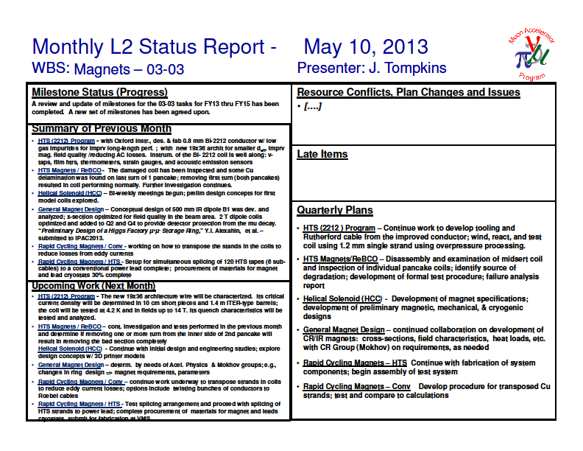
MAP Monthly Reporting
(an example)

Slide 13
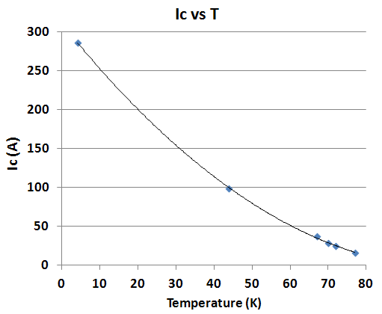
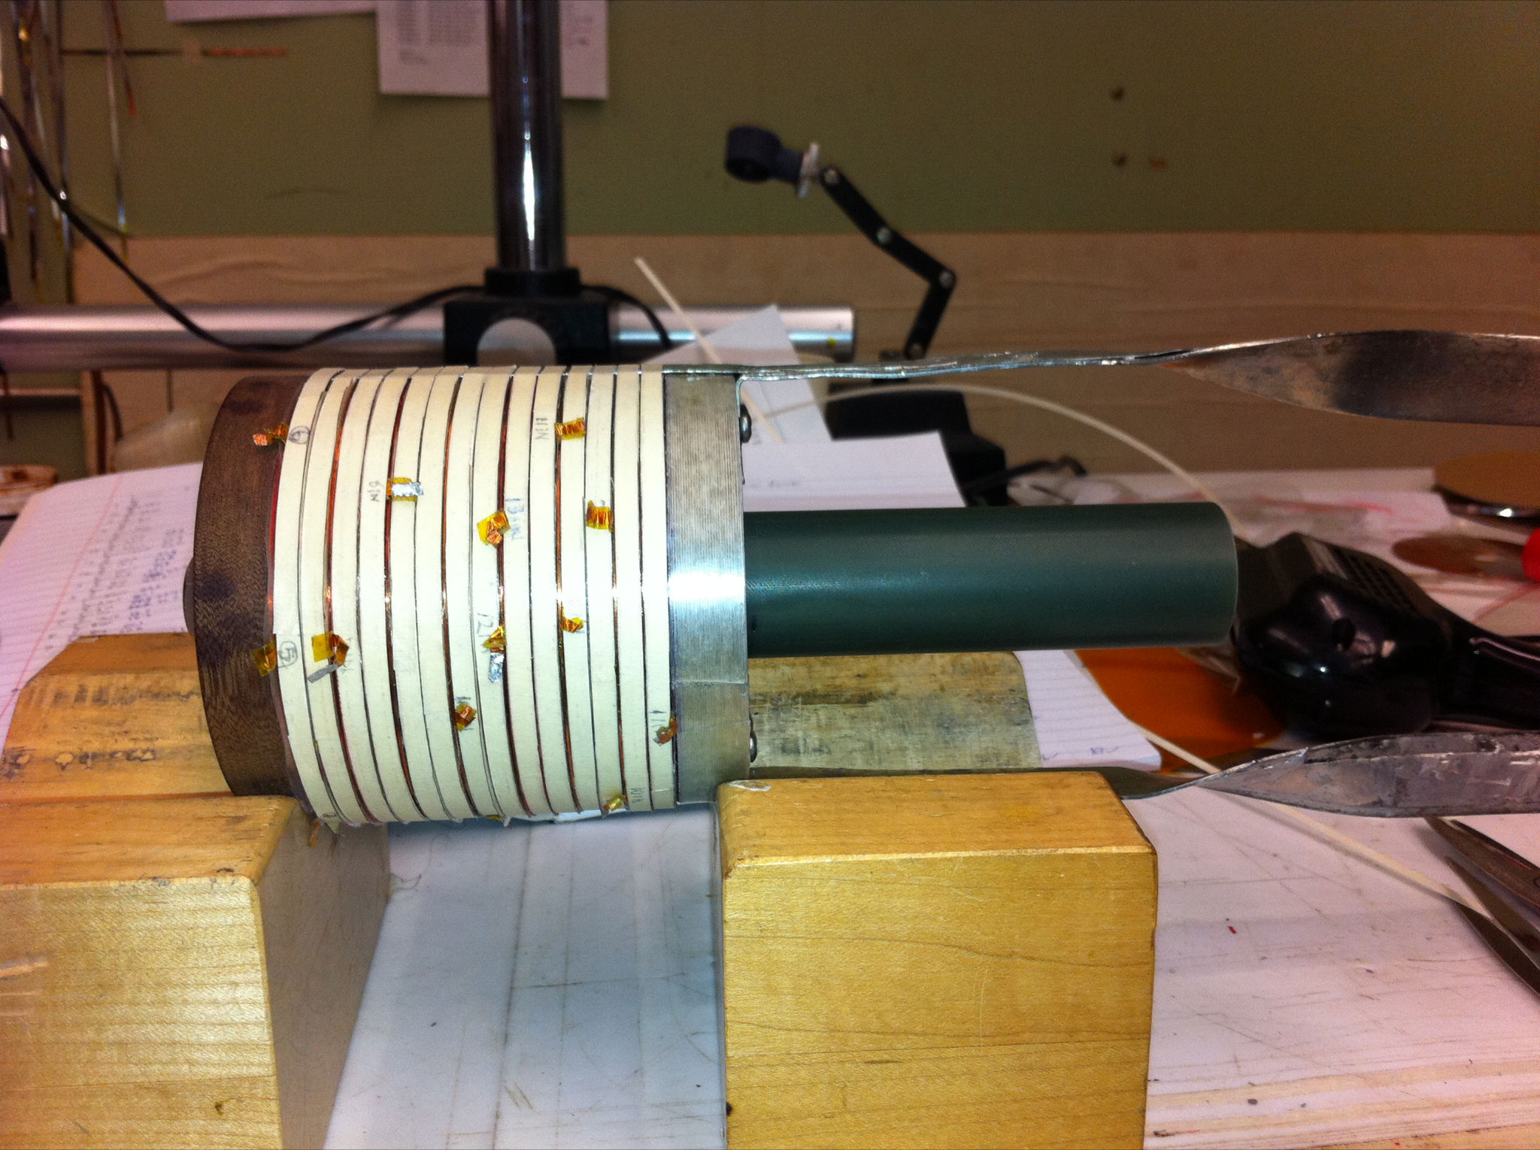
ReBCO Solenoids
Ramesh Gupta, BNL
Ramesh gave a detailed presentation of this work yesterday
High Field HTS Solenoid Test Results (magnet #1 - insert)
Field on axis:
  over 15 T
Field on coil:
  over 16 T
(original target was 10-12 T)
Real demo of 2G HTS to create high field
Highest field in an all HTS solenoid (previous best SP/NHMFL ~10.4 T)
Overall J_{o} in coil:
>500 A/mm² at 16 T
(despite anisotropy)
14 pancake coils with ~25 mm aperture
MAP began supporting the PBL/BNL HTS Solenoid Development in FY2013

Slide 14
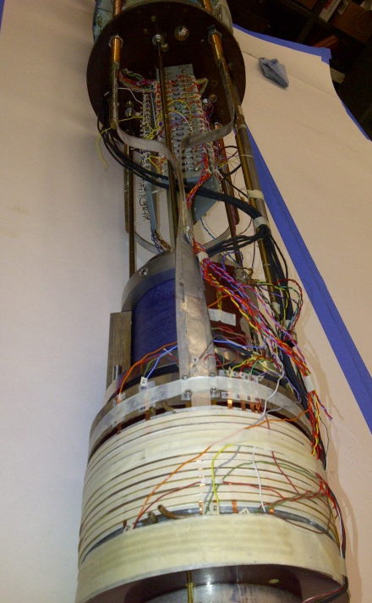
Test Results of HTS Solenoid #2
(½ Midsert, 12 coils instead of 24) - R. Gupta, BNL
250 A ==>
6.4 T on axis
9.2 T peak field on coil
Coil could have reached above 10 T peak (original target), but was not ramped up to protect electronics of that time.
Full solenoid with 24 pancakes should create >10 T on axis.

Slide 15
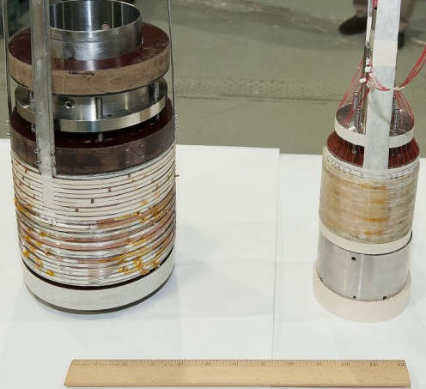
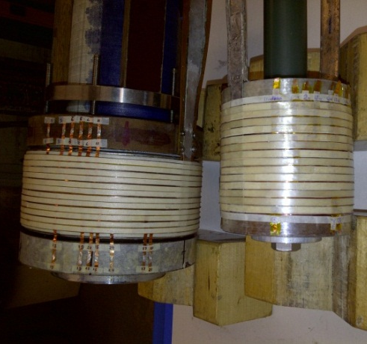
Fully Assembled HTS Solenoids
R. Gupta, BNL
15⁺ T, 25 mm HTS solenoid (insert) with 14 pancakes (each pancake made with 50 m HTS)
10⁺ T,100 mm HTS solenoid (midsert) with 24 pancakes (each pancake made with 100 m HTS)
100 mm HTS solenoids –
half length (12 pancakes) and
full length(24 pancakes)

Slide 16
ReBCO Solenoids, cont.
Ramesh Gupta, BNL
Mid-sert - Review of 77 K Tests (after 4K tests)
(100 mm, 24 pancakes)
During the final 77 K QA test before the scheduled high field 4K run, several pancakes started showing early onset of resistive voltages.
The same assembly has been earlier tested at 77 K and performed well.
No particular order in the location of these now under-performing pancakes
Several 77 K follow-on tests found no further deterioration in performance
Summary:
Several pancakes (4?) in inner (25 mm) found resistive during 77 K test
  Location : all in bottom part of the assembly
Several pancakes (4?) in midsert (100 mm) found resistive during 77 K test
  Location : random
Studies of the affected coils have isolated the problem; damaged turns have been removed. Inspection of all coils has been completed; the problem is being understood, modifications are being made, and procedures are being modified to reduce thermal gradients during cool down.
(Discussed in Ramesh’s presentation yesterday)

Slide 17
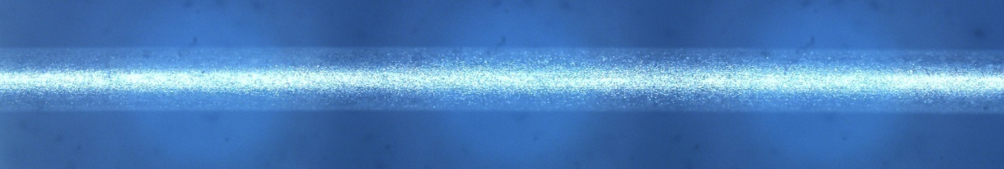
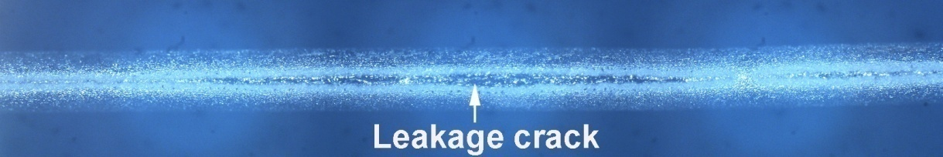
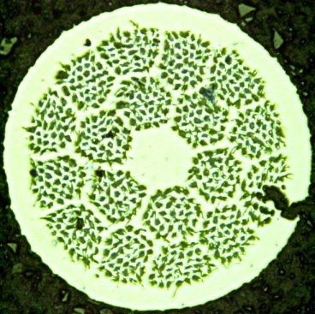
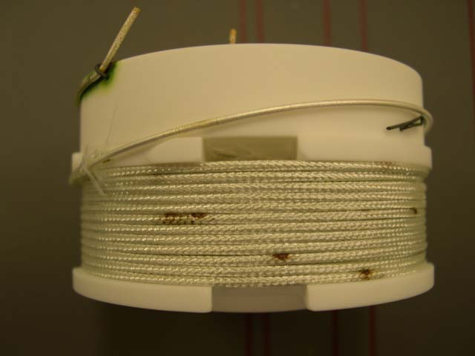
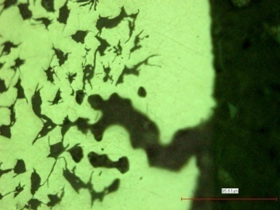
Bi2212 Solenoids
Tengming Shen, FNAL
For 20 years, the performance of long length Bi-2212 wires has been much worse than in short pieces: this problem has been solved in 2012-2013
Short pieces: J_{E}=500 A/mm² at 4.2 K and 20 T
Long pieces: J_{E}<200 A/mm² at 4.2 K and 20 T
Open ends: 180 A, 0.8 mm
Sealed ends: 50 to 140 A, >0.825 mm
Shen, Ghosh, Cooley, Jiang, J. Appl. Phys. 113, 213901 (2013);
The technology also suffered from leakage appearing in long length wires during the forming reaction.

Slide 18
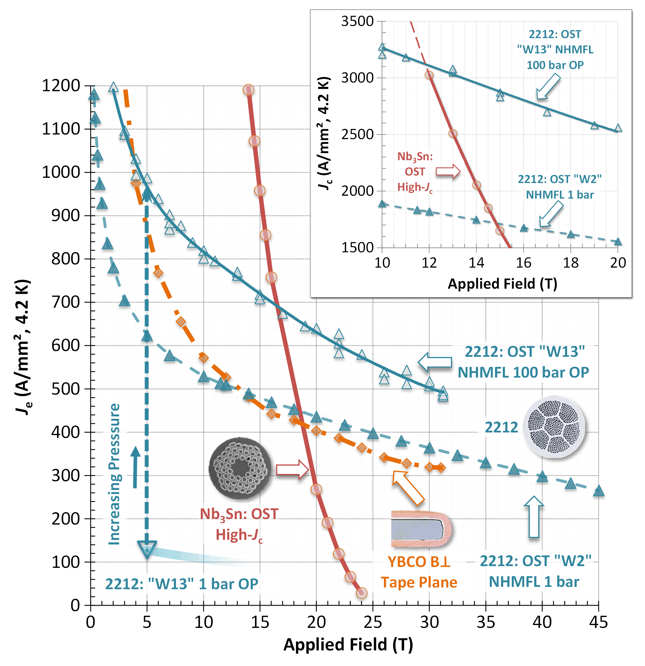
The problem was addressed by applying external gas pressure during heat treatment, resulting in the long length wire achieving J_{E} >600 A/mm² at 4.2 K and 20 T
Bi2212 Solenoids, cont.
Tengming Shen, FNAL
FNAL mass spectroscopy experiments indicated that gases released from wires while they were heated are the problem
Larbalestier et al.
NHMFL/FSU
Results of overpressure processing
P_{o}
P_{o}
P_{o}
Under compressive stresses, Ag creeps inwards, producing denser Bi-2212 core and increasing J_{c}.
P_{o}
P_{i}
P_{o}
P_{o}
P_{o}
P_{o}

Slide 19
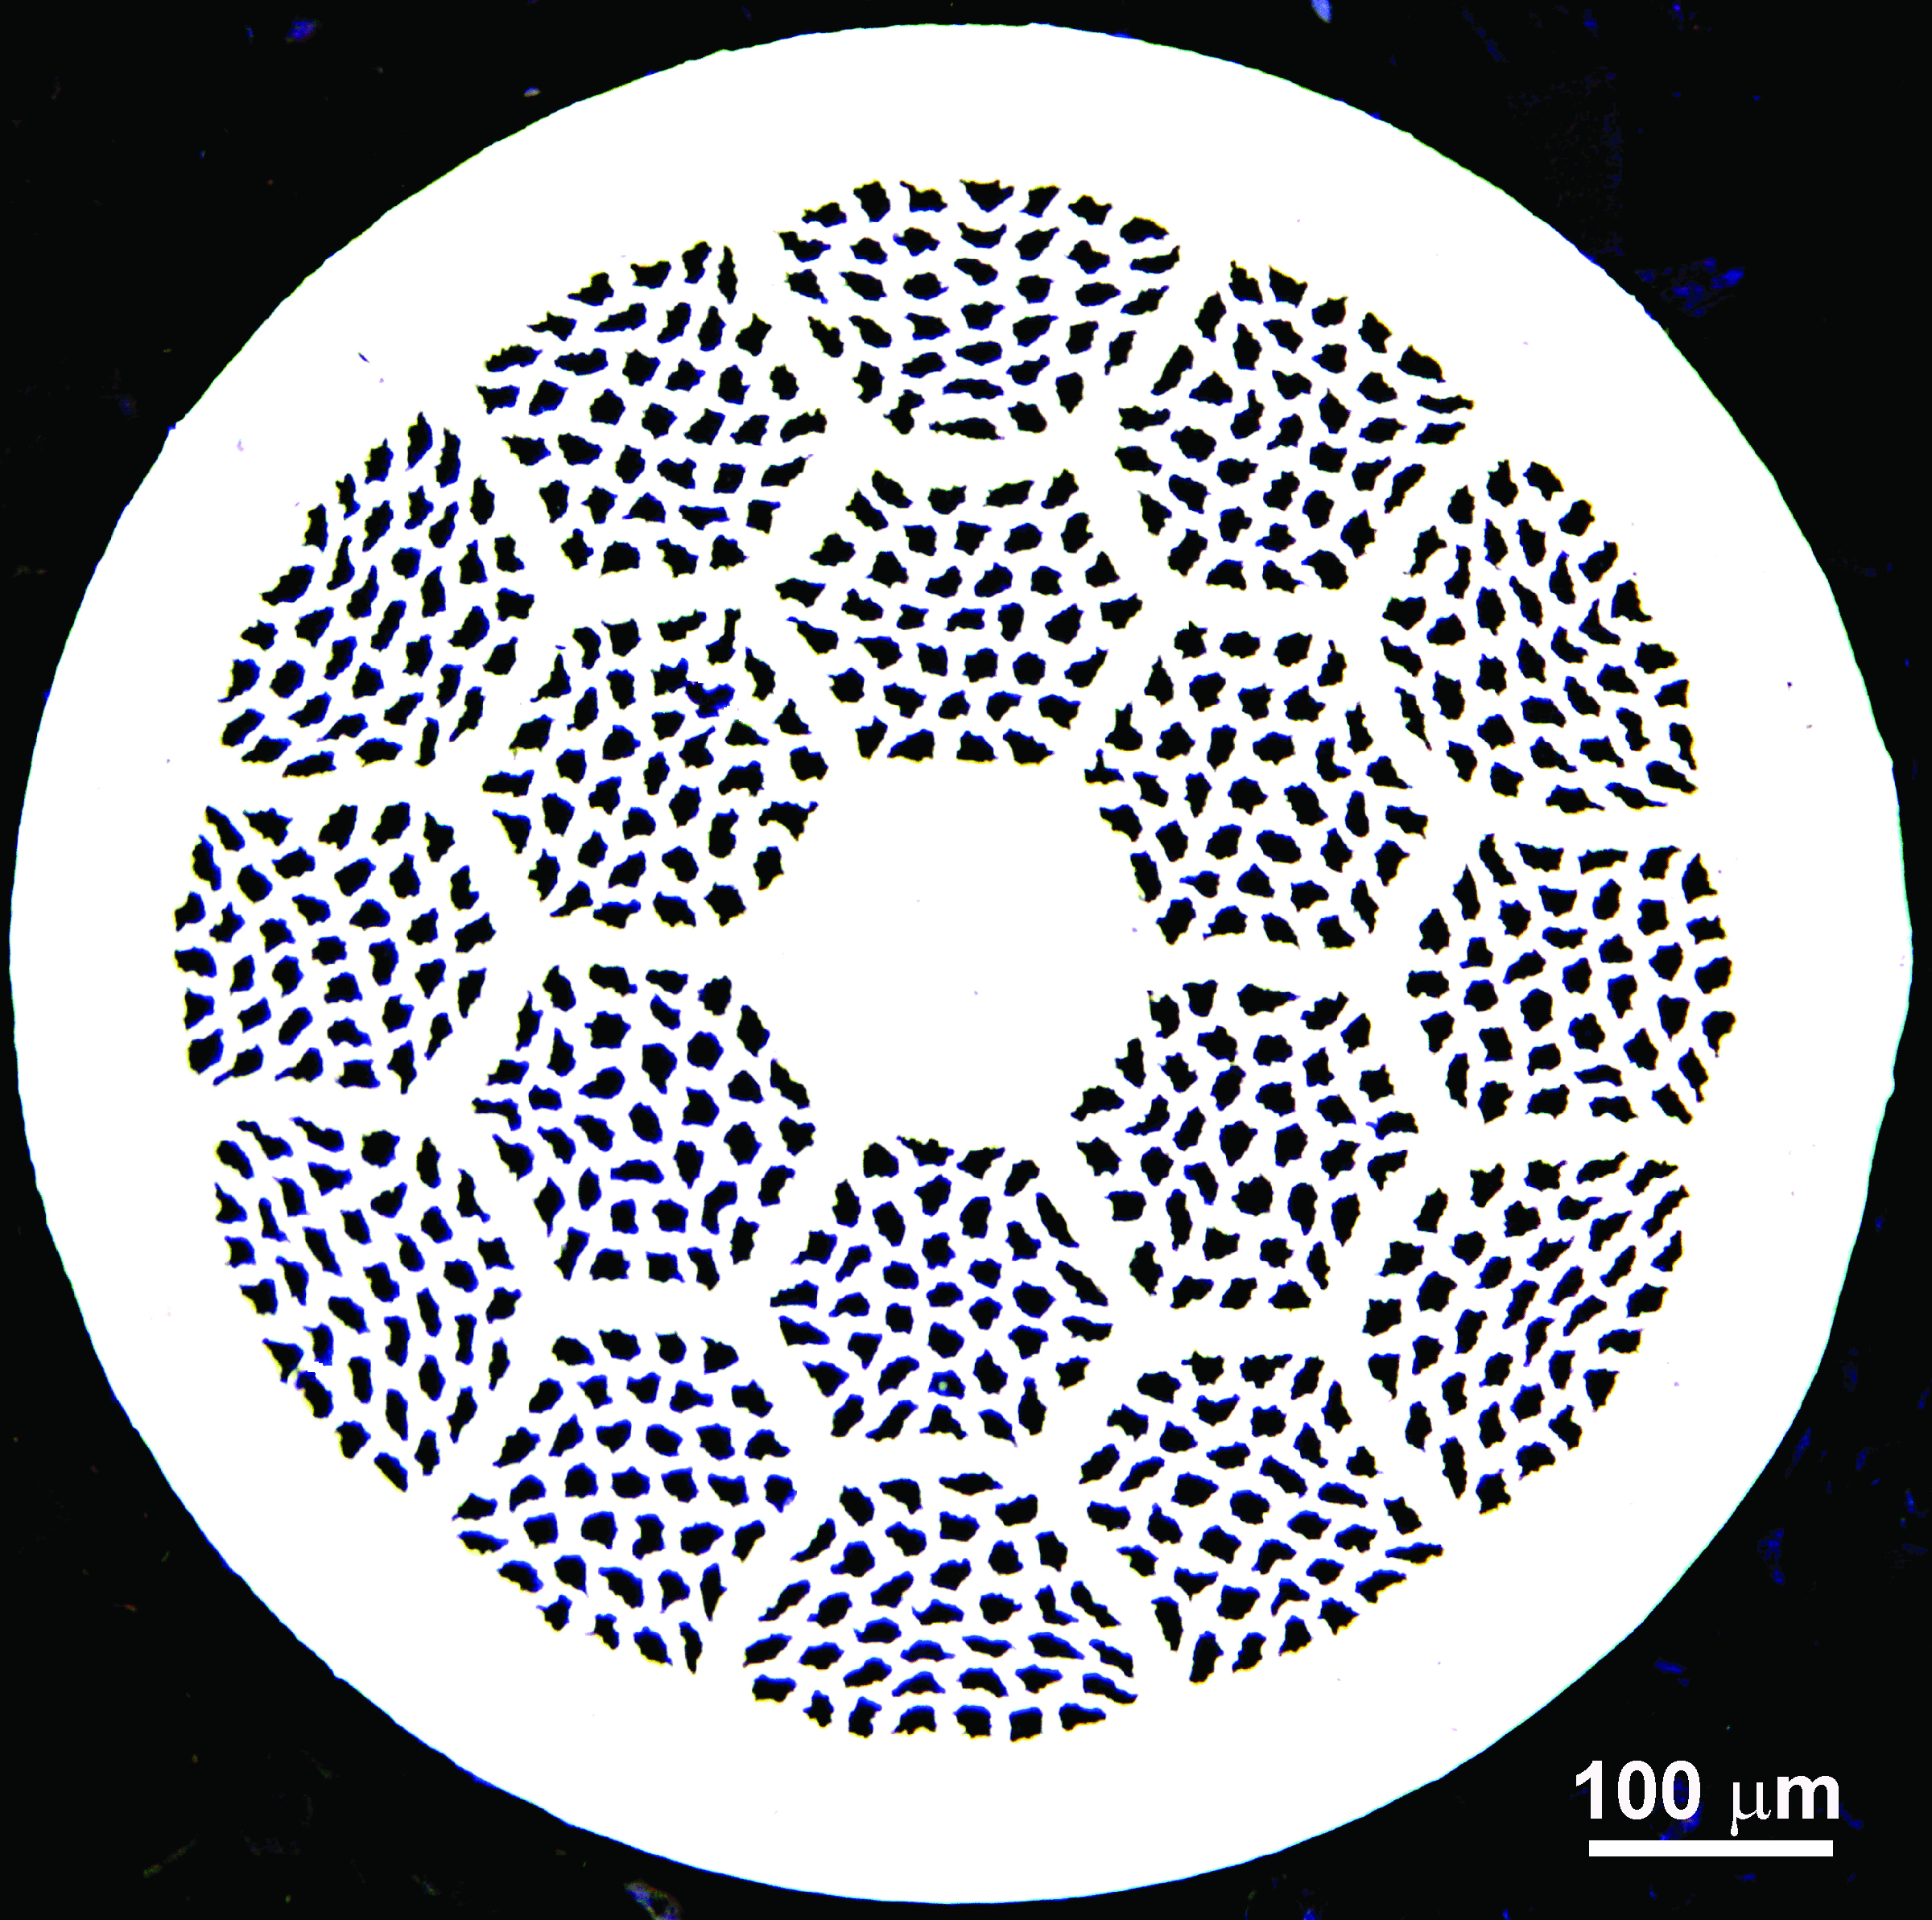
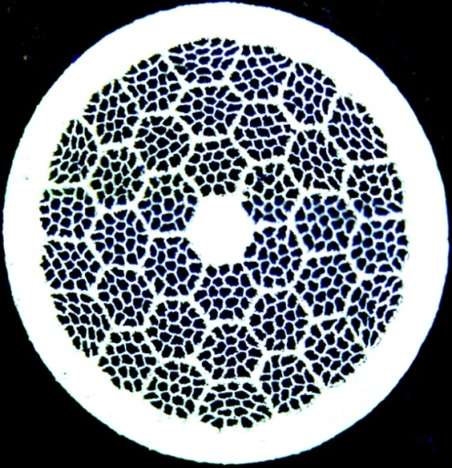
MAP support also helps develop low d_{eff} wires
Bi2212 Solenoids, cont.
Tengming Shen, FNAL
Filament diameter=25 μm
37x18, D_{eff}(12 T)=116.8 μm.
305 m, PMM130411
19x36, 0.8 mm wire
D_{eff}(12 T)=80 μm (estimation)
Filament diameter=25 μm.
D_{eff}(12 T)=174.3 μm.
Liquid
VSM magnetization measurement: Courtesy of NHMFL/FSU

Slide 20
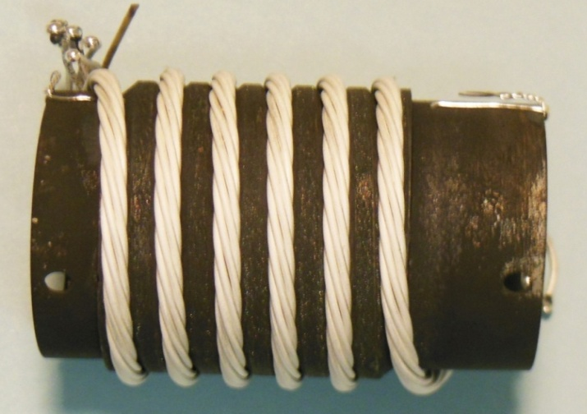
The cable J_{c} was also significantly improved by overpressure processing
Bi2212 Solenoids, cont.
Tengming Shen, FNAL
OP 10 bar
Ends sealed; no leakage
10 bar overpressure processing increased the J_{c} by 4 times, and improved n-values.
Shen (FNAL), Jiang (FSU)

Slide 21
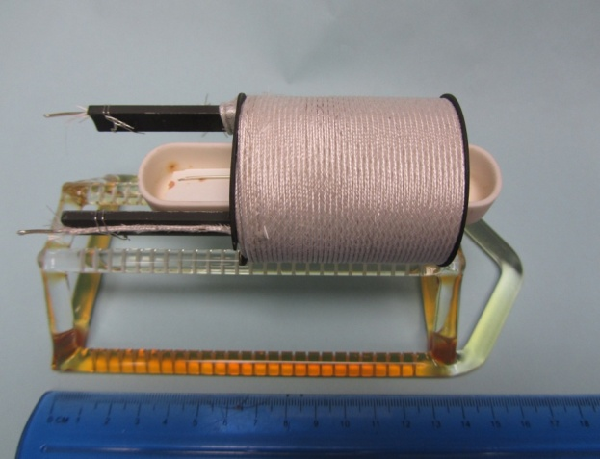
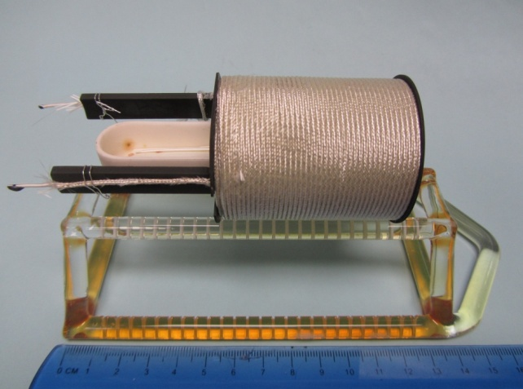
Move forward in 2013-2014
Bi2212 Solenoids, cont.
Tengming Shen, FNAL
(b) After reaction
(a) Before reaction
Work w/ industry to develop cleaner wires
Facility development: design, procurement, and set-up of overpressure reaction facilities for cables and coils (50 bar, 900 °C)
  3 zone, 50 bar, 900 °C, 30 cm homogeneous heating zone, 52 mm bore
  50 bar, 900 °C, 120 cm homogeneous heating zone, 30 mm bore
Conductor development:
  Determine conductor J_{c} as a function of B and T up to 16 T and 50 K
Coil engineering:
  Test five small-scale coils, explore novel quench detection strategies, and design quench protection schemes.
  Test various insulation and mechanical structures.

Slide 22
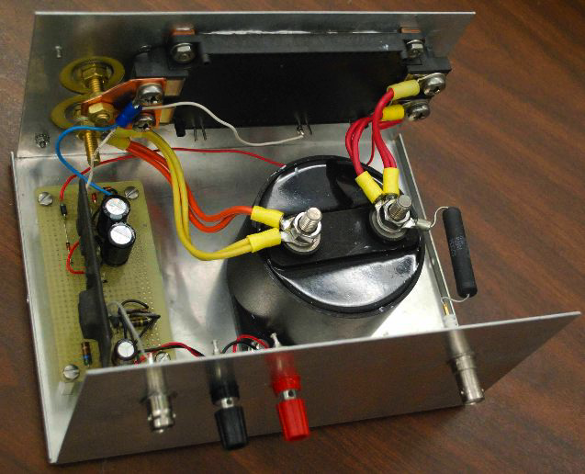
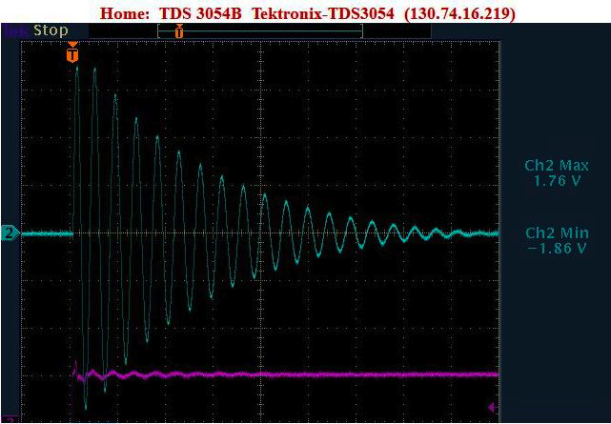
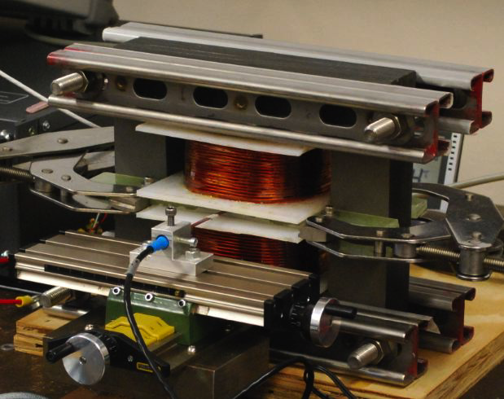
Fast Pulsed Magnets
Don Summers, UMiss
1.8 Tesla, 1410 Hz Dipoles for Muon Synchrotrons
550V, 18 turns of 12 gauge copper wire
0.28 mm thick steel laminations
Bell 5180 Hall Probe
∆E = -15% per half cycle
LC circuit with fast IGBT switch
arXiv:1207.6730

Slide 23
Fast Pulsed Magnets
Don Summers, UMiss
    Next Steps
      Conductor configuration - twisted “Roebel” cable to reduce eddy currents
        “The basic idea is to make sure that the amount of flux going through current loops is the same. Otherwise differential voltages are generated. This means currents will flow if cables are connected outside the magnet. So longitudinal eddy current losses and not just transverse eddy current losses.”
      Pole face eddy current calculation of sextupole strength
      Improved field quality
      Ultra low carbon steel (LEP magnets).

Slide 24
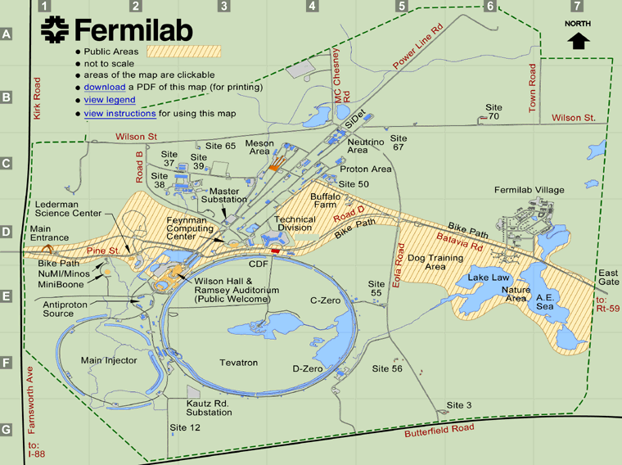

63 to 400 GeV, 200 Hz Synchrotron: FNAL Tevatron Tunnel
Don Summers, UMiss
  63 → 400 GeV in 56 orbits (1.2 ms) Muon survival = 73%
  6 GV of Superconducting RF (can be refilled during orbits)
  Dipoles ramp from 0.28 to 1.8 Tesla.
  Flat top and collide in the Tevatron tunnel: = 0.8 TeV
  mrad/year distance = 5 × 10⁻⁷ E(TeV)1.5 = 3 km
An unpaid advertisement from Don…
Tunnel exits.
Little civil construction.
High γ = 600 injection.
Small magnets.
RF needed similar to LEP200.
arXiv:0707.0302
Dipole energy | 4 MJ | vs. 40 MJ | @Main Ring
RF needed | 6 GV | vs. 3 GV | @LEP200
 | 0.8 TeV | vs. 0.5 TeV | @JLC
24

Slide 25
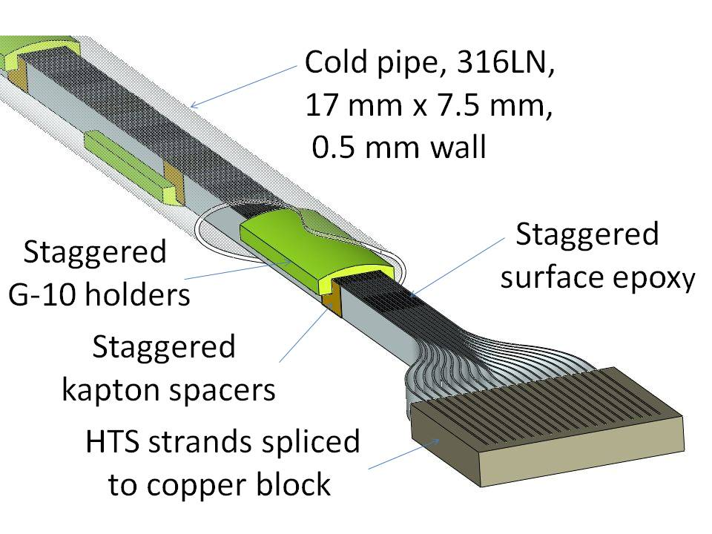
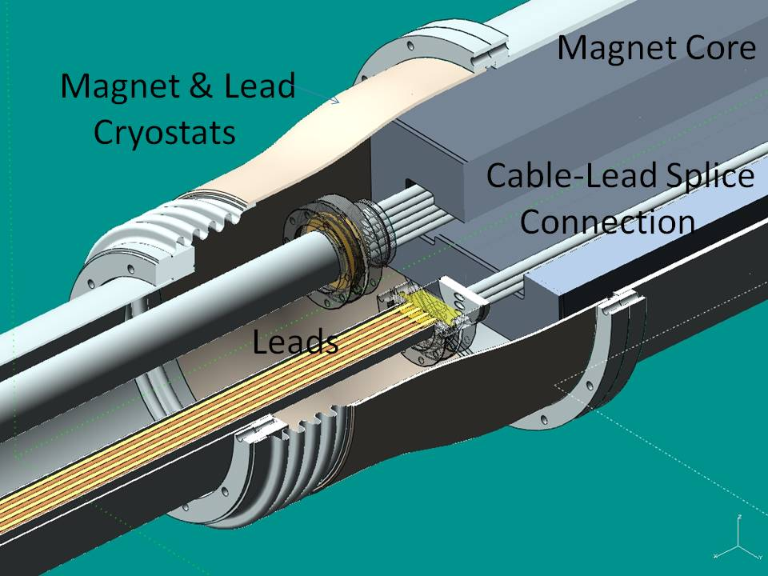
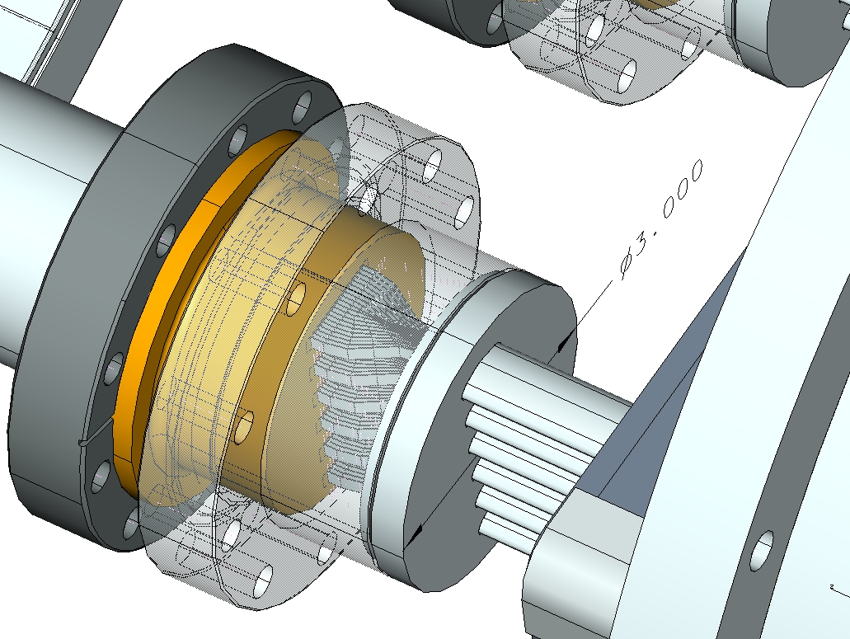
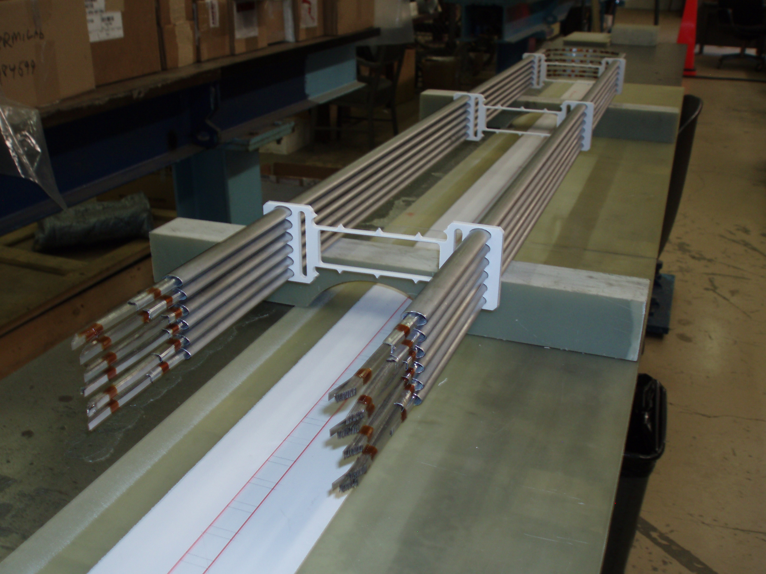
Rapid Cycling HTS Magnet
Henryk Piekarz, FNAL
Purpose: Develop HTS-based rapid-cycling magnet for Proton and Muon Acceleration Synchrotrons (MAP)
Group members: J. Blowers, S. Hays, H. Piekarz, V. Shiltsev
Attributes of magnet power cable based on HTS tape-strand:
Low dynamic power losses due to: (1) parallel orientation of HTS strand wide side to the core induced field, and (2) near total suppression of self-field with Ni5%W magnetic substrates and shields
Wide temperature margin (25 K or more, if desired)
Resilience to radiation (YBCO 344C-2G)
Magnet design:
Cable: 2 x 6 sub-cables with HTS strands stacked vertically
Core: 105 µm laminated, non-oriented Fe3%Si steel
Sub-cable design
HTS sub-cables to lead connection
Sub-cables assembled into a cable
Cross-section view of HTS magnet with leads

Slide 26
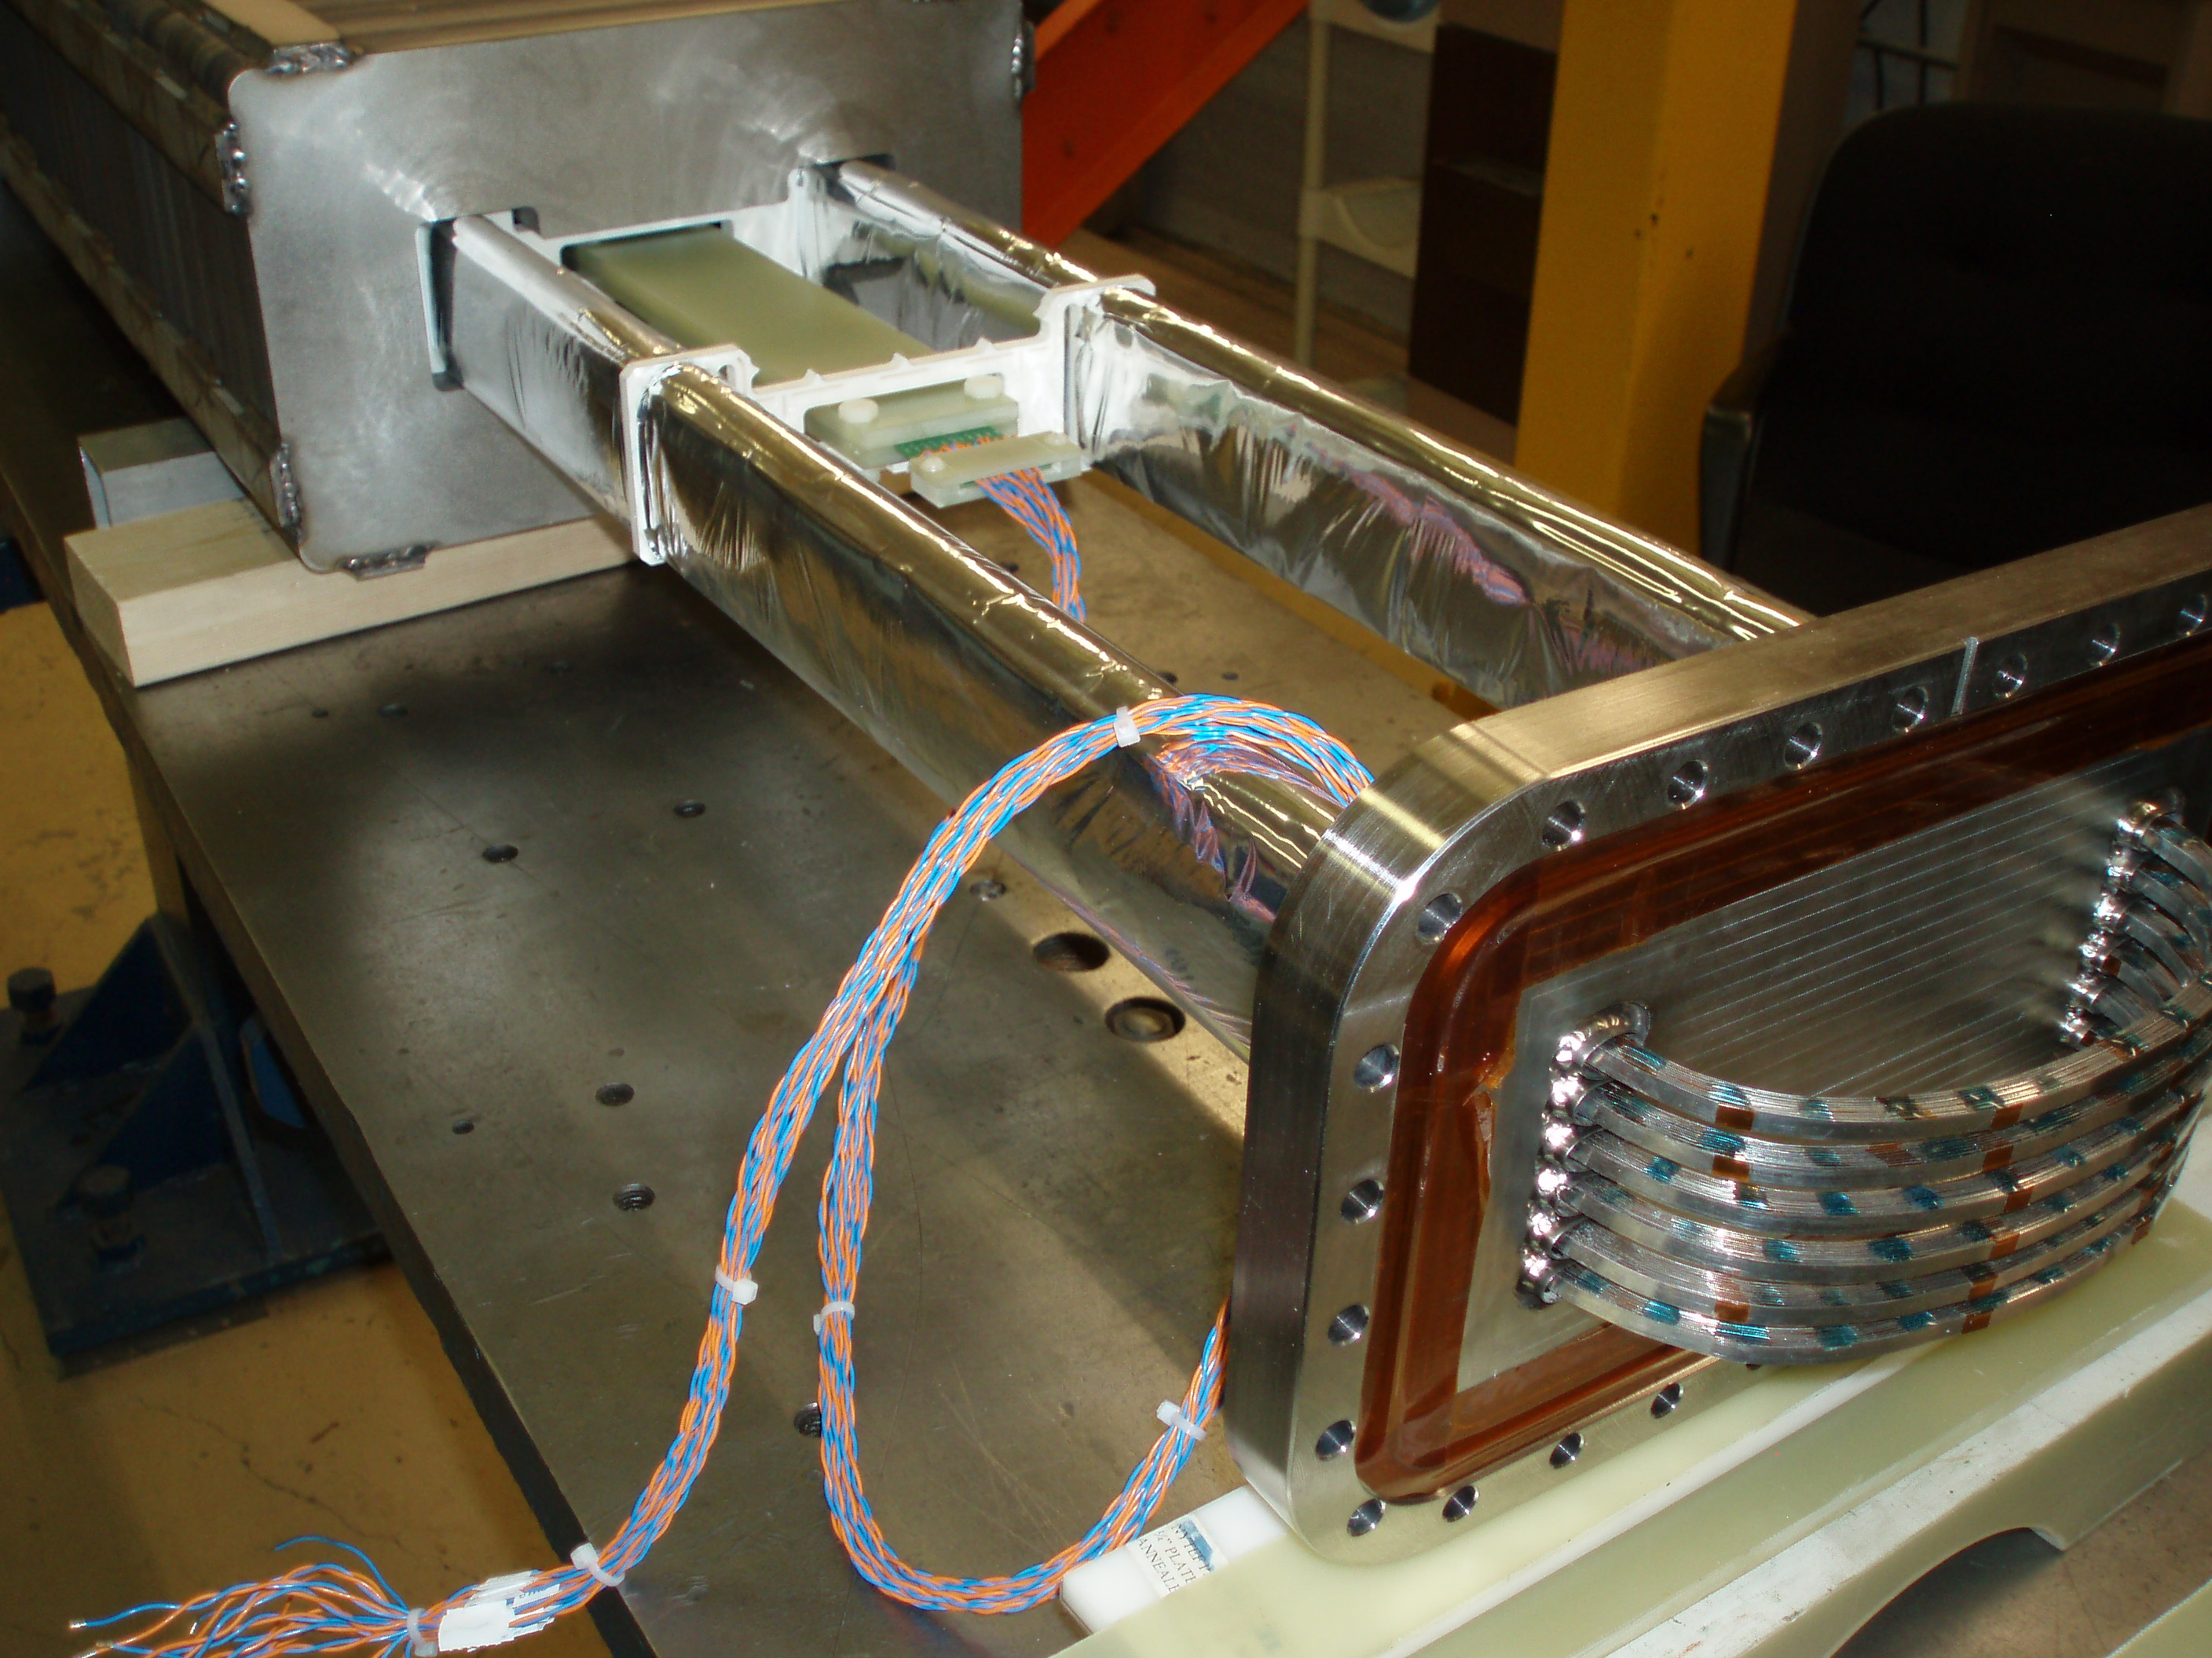
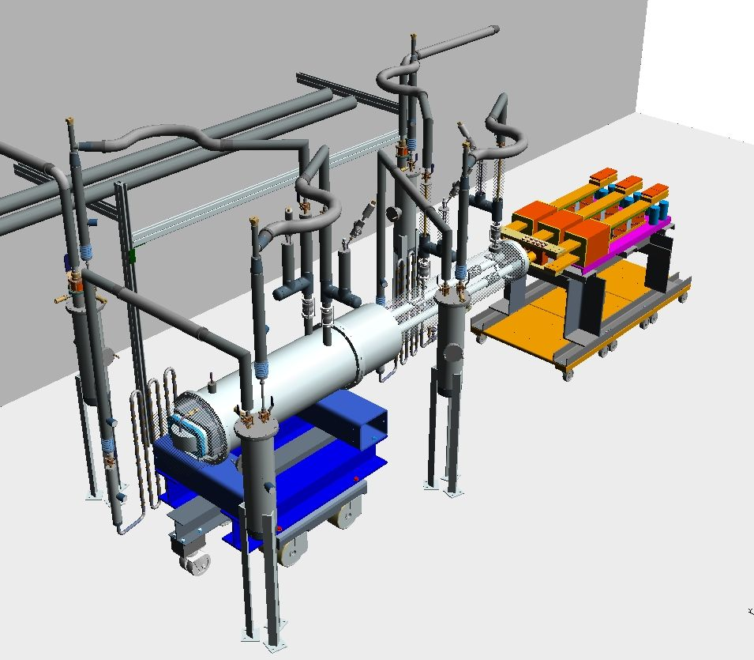
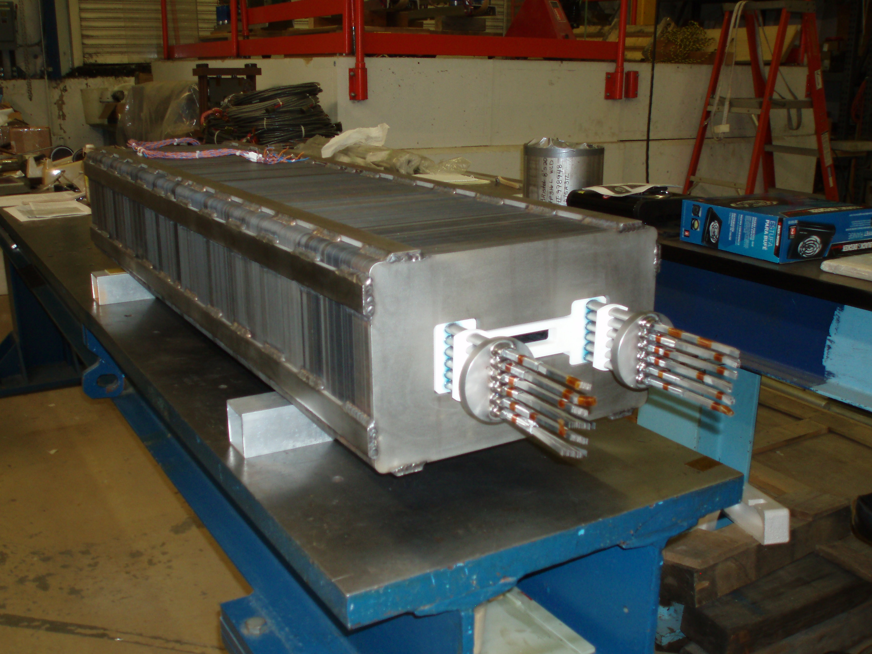
Rapid Cycling HTS Magnet
Henryk Piekarz, FNAL
Test magnet construction status
Ramping PS
Leads
HTS coil being inserted into magnet core
Magnet cryostat
Rapid-cycling HTS magnet test arrangement
Construction status:
Magnetic core [length 1.2 m, gap 40mm (v) x100 mm (h)],
HTS cable, leads and cryogenic support system:
- Design & procurement complete
- Fabrication 80% complete
- Assembly work 50% complete
HTS coil installed in magnet core

Slide 27
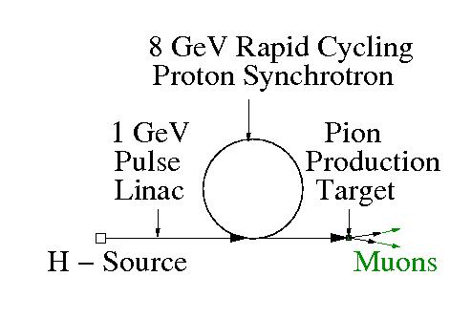
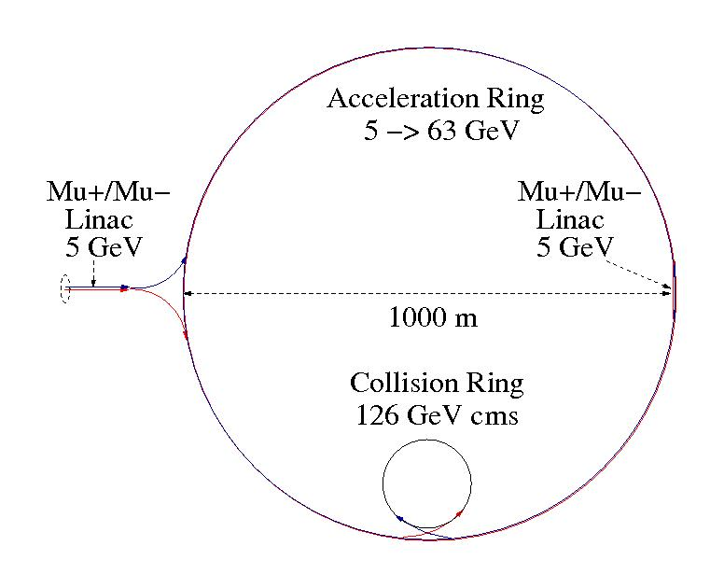
Rapid Cycling HTS Magnet
Rapid Cycling HTS Magnet
Henryk Piekarz, FNAL
Examples of possible application in Muon Accelerator Program
1. High-power proton source, 4 MW
Beam parameter | Proton Acc. | Muon Acc. 63 GeV | Muon Acc. 375 GeV
E _{inj} / E _{extr} [ GeV/GeV] | 1 / 8 | 5 / 63 | 20 / 375
Ring length [m] | 829.9 | 6860 | 6860
Cycle time [µs] | 2.77 | 22.9 | 22.9
Cycles to top energy | 6000 | 12 | 71
Muon survival rate [%] | - | 50 | 50
Time to top energy [ms] | 16.6 | 0.275 | 1.63
Beam pulse rate [Hz] | 60 | 60 | 60
Beam power [MW] | 4 | - | -
2. Muon acceleration, 63 GeV/beam
Magnet parameter | Proton Acc. | Muon Acc. 63 GeV | Muon Acc. 375 GeV
B _{inj} | B _{oper} [T | T] | 0.05 | 0.5 | +/-0.02 | +/-0.24 | +/- 0.08 | +/- 1.45
Beam gap [mm] | 40 | 25 | 25
I _{top} [kA |N _{turns}] | 25 | 1 | 7.5 | 1 | 45 | 1
dB/dt (beam gap) [T/s] | 30 | 840 | 840
dB/dt (cable gap) [T/s] | 0.3 | 8.4 | 8.4
Superconductor HTS | 344C-2G | 344C-2G | 344C-2G
N sub-cables | 2 x 6 | 2 x 6 | 2 x 6
N strands/sub-cable | 6 | 3 | 15
Cable power dynamic loss @ 5 K [W/m] | 1.4 | 30 | 150
Cable power dynamic loss / Acc @ 5K *) [W] | 14 | 2400 | 12000
Dynamic + static cable power loss / Acc.*) @ 5K [W] | 600 | 6500 | 16000
Core power loss / Acc @ RT *) [kW] | 0.005 | 160 | 160
*) includes duty factor of 1.67 %
Conclusion: Proton Source and Muon Acceleration HTS-based Synchrotrons are likely to be feasible.

Slide 28
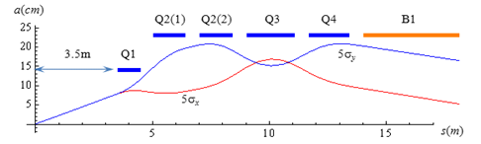
General Magnet Design
Sasha Zlobin, FNAL
FY13 Plans and Progress - focus on:
Conceptual Design Studies of SR and IR Magnets for a Higgs Factory (in collaboration with MAP Collider Ring and MDI groups)
Radiation-hard insulation R&D (supported by FNAL GARD) – important for Collider Magnets
HF IR layout and beam size variations – Y.I. Alexahin

Slide 29
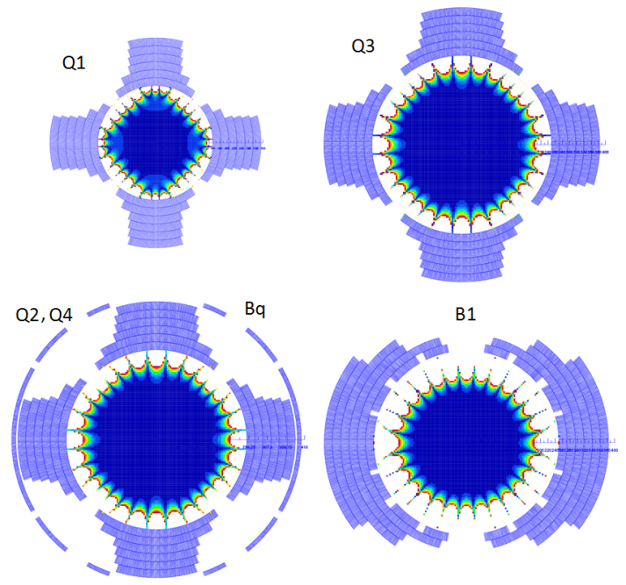
General Magnet Design
HF IR Magnet Designs & Parameters - A. Zlobin, FNAL
A.V. Zlobin et al., IPAC2013, May 2013
Conceptual designs of the HF IR magnets are based on a 1 mm Nb₃Sn strand with J_{c}(12T,4.2K)=2.7 kA/mm² and Cu/nonCu ratio of 1.15.
The Q1-Q4 and B1 coils use a 42-strand Rutherford cable, 21.6 mm wide and 1.85 mm thick.
The cable in the dipole coil Bq (in Q2 and Q4) has 22 strands and is 11.3 mm wide and 1.77 mm thick.
Both cables are insulated with a 0.2 mm thick insulation.

Slide 30
General Magnet Design
Field Quality - A. Zlobin, FNAL
Coil cross-section optimization provided the relative field errors in the area occupied by muon beams on the level of 10⁻⁴ (dark blue area).
Analysis of the Dynamic Aperture (DA) with the MADX PTC code shows that field errors in the straight sections of the IR magnets reduce the DA by a factor of 2 so that it coincides with the good field region.

Slide 31
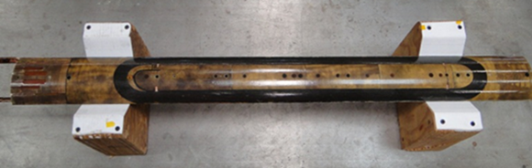
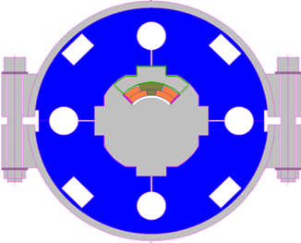
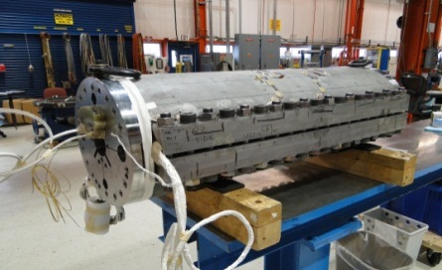
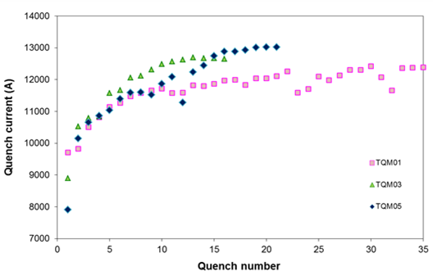
General Magnet Design
Radiation-Hard Insulation Studies - A. Zlobin, FNAL
Epoxy limits magnet radiation life-time
Search for radiation-hard material to replace epoxy started at FNAL 10 years ago (D. Chichili et al, ASC 2002)
  MATRIMID 5292 - a bismaleimide solution
  high radiation resistance
  tolerable viscosity and pot-life
  excellent mechanical, electrical and thermal properties
A 1 m long Nb₃Sn quadrupole coil was impregnated with MATRIMID and tested in 2012
  excellent impregnation quality
  quadrupole mirror structure (FNAL)
  good quench performance
MATRIMID is a potting material for future Nb₃Sn accelerator magnets
  LHC IRQ, ILC BDS, MC-NF-HF
R. Bossert et al., ASC2012, September 2012.
Quadrupole coil impregnated with Matrimid
Coil Test Structure (quadrupole mirror)
Matrimid
CTD101K epoxy
Coil training comparison

Slide 32
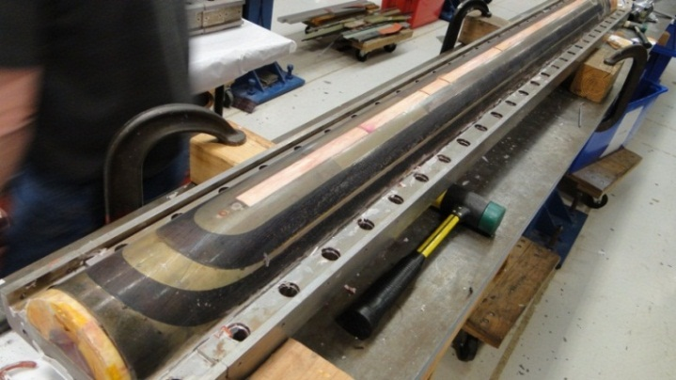
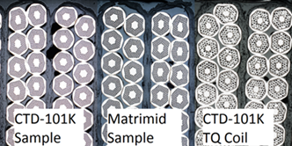
General Magnet Design
MATRIMID Coil Next Steps – A. Zlobin, FNAL
A.V. Zlobin et al., IPAC2013, May 2013.
Technology scale up
  2-m long Nb3Sn dipole coil with 60 mm
  bore and 15 mm wide cable has been
  impregnated with MATRIMID in Feb 2013
  Coil inspection is in progress
When resources allow
  5.5 m long dipole practice coil impregnation with MATRIMID
  1-2 m dipole coil fabrication and test in dipole mirror structure
The test stack program will be completed
  mechanical, thermal and electrical testing
  of stacks at room temperature and 4.5 K
  using cables of various types
Radiation testing of MATRIMID coil samples
is planned in collaboration with CERN
‘Synergistic’ interaction with LARP program
  directly applicable to MAP IR Magnets
R. Bossert et al., CEC/ICMC2013, June 2013.

Slide 33
BISMALEIMIDE (from ASM Handbook)
“BISMALEIMIDE (BMI) RESINS are a relatively young class of thermosetting polymers that are gaining acceptance by industry because they combine a number of unique features including excellent physical property retention at elevated temperatures and in wet environments, almost constant electrical properties over a wide range of temperatures, and nonflammability properties. Bismaleimides have become a leading class of thermosetting polyimides. Their excellent processibility and balance of thermal, mechanical, and electrical properties have made them popular in advanced composites and electronics. Composites of the BMI class are used on some of the most important and complex, high-performance applications ranging from military programs such as the U.S. Air Force's F-22 to Formula-1 race cars. The most important attribute of BMIs is the highest service temperature capability of an addition-cure matrix resin combined with epoxy-like autoclave processing. The BMI matrix composites provide the highest composite mechanical properties available through 177 °C (350 °F)/wet with damage tolerance equivalent to the best epoxies. Certain BMIs are capable of extended service at 230 to 290 °C (450 to 550 °F), approaching the performance of PMR-15 (see the article “Polyimide Resins” in this Volume). BMIs also are suitable for resin transfer molding (RTM) processing.”

Slide 34
Summary
Despite limited funding there has been significant magnet work accomplished:
  HTS Magnets (ReBCO ): significant progress in coil/magnet development Leverage w/SBIR funding – PBL – has been significant
    Significant successes with several coils
    Significant progress in attaining high fields
    Recent setbacks are being understood and modifications/improvements are underway
  HTS Magnets (Bi2212): new records in J_{c} achieved with understanding/control of impurities in
    Overpressure processing, control of impurities result in large gains in J_{c} and elimination of leakage
    Coil development is well underway and testing is expected in the near future (waiting for facility availability)
  Fast Pulsed Magnets - 1.8 Tesla, 1410 Hz Dipoles
    Has reached design goal of 1.8T at 1410 Hz
    Working on twisted Roebel cable-like approach to reduce eddy currents

Slide 35
Summary, cont.
Accomplishments, continued
  Rapid Cycling HTS Magnet
    Successful proof of principle test for 40Hz prototype
    Fabrication of full scale magnet proceeding
    Studies for MAP 400Hz requirement in progress
  General Magnet Design
    Conceptual designs of the HF IR magnets based on a 1 mm Nb₃Sn strand were developed
    Search for radiation-hard material to replace epoxy: Matrimid a bismaleimide solution w/ high radiation resistance, tolerable viscosity and pot-life, and excellent mechanical, electrical and thermal properties is being investigated. Inspection of a 2-m long Nb3Sn dipole coil impregnated with MATRIMID is in progress

