Slide 1
The MAP Staging Study
(MASS)
J.P.Delahaye/SLAC
On behalf of the MASS team

Slide 2
MAP Accelerator Staging Study (MASS) Mandate (August 2012)
Develop an overarching vision for MAP by exploring the feasibility of potential staging scenarios and defining the strategy for moving beyond the feasibility phase of the effort
  Review possible intermediate facilities and physics capabilities in staged approach to NF and/or MC including evaluation of Physics and accelerator R&D at each stage.
  Assessment on how such facilities could be coupled with on-going machine based R&D program?
  Minimum physics performance at each stage?
  Expected physics performance from facilities based on baseline concepts?
  Potential physics performance improvements from alternative concepts?
  Key synergies between NF and MC?
Advisory Working Group to the MAP director on staged Physics and R&D program

Slide 3
Deliverables & Schedule
For 2013 Community Summer Study (“Snowmass”) develop white paper addressing:
  Unique capabilities of muon accelerator based program
  Most useful staging scenarios
  Plausible (technically limited!) timescales
ASAP and by end 2014 at latest:
  Provide set of recommendations on possible staging options, specially at FNAL as only US HEP lab
  evaluation of how staging options may couple to planned R&D for FPII feasibility studies and beyond
By end of FP1 (2015), present conclusions and recommendations as part of final MAP FP1 review

Slide 4
MASS members

Slide 5
MASS task forces
Path towards Neutrino Factory: A.Bocagz
Path towards Higgs Factory and/or Muon Collider: C.Ankenbrandt
Muon-based Test Facilities: P.Snopok

Slide 6
Procedure
Define possible stages of NF and MC with minimum performances based on Physics arguments
Identify design and technical issues of each stage
Estimate necessary timescale of R&D to address each technical issue
From 1 and 3 identify a possible staging scenario for NF and MC separately and/or combined
Revisit 1 to 4 for faster/better staging scenarios

Slide 7
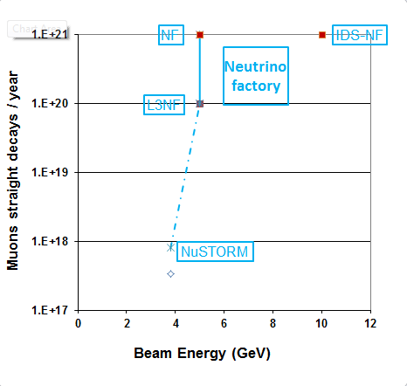
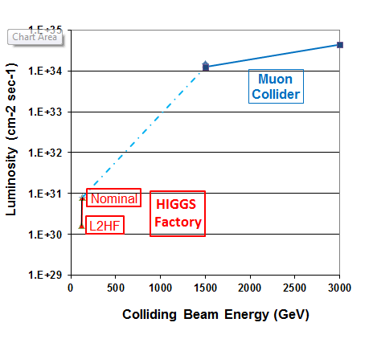
Staged pathway with Physics interest and upgrading technology
Intensity Frontier
Energy Frontier

Slide 8
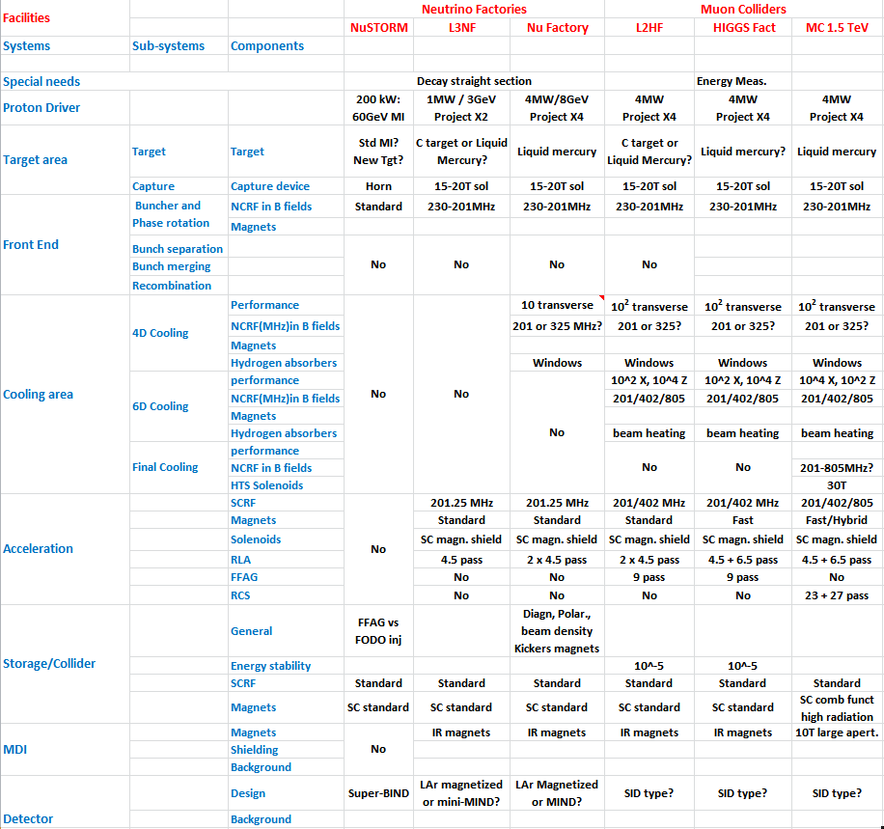
Technical issues

Slide 9
R&D timeline
Best estimate
at the time
Feasibility assessment & principle of cooling
4 MW@8GeV
4D&6D cooling
demonstration
Major issues on critical path
MAP technology feasibility (L3NF)
4D Cooling (NF) & 6D Cooling (MC)
Proton beam power (NF & MC)

Slide 10
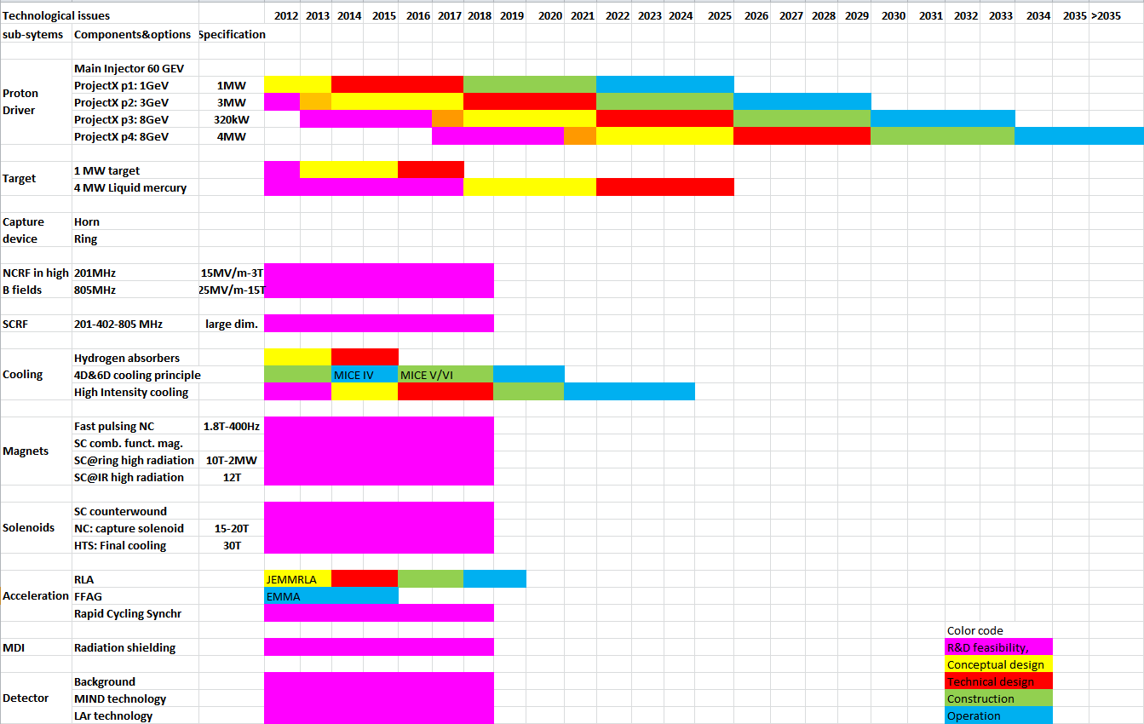
Nominal Neutrino Factory or Muon Collider critical path: proton beam power availability
Feasibility assessment
4D&6D cooling
demonstration
4 MW@ 8GeV
1MW@3GeV
Facility based on nominal 4MW@8GeV Proton Driver
L3NF: 1MW@3GeV, no cooling

Slide 11

Critical paths

Slide 12
The Muon Accelerator Program Timeline

Slide 13
Principles of an ideal staging scenario
Series of facilities
  increasing complexity
  physics interest at each stage
Affordable step (<750M$) from one facility to next
  Stage built-on previous stage with additional systems
  Novel systems validated by R&D on previous stages
Taking advantage of FNAL existing or future facilities
  synergy between present and future FNAL program

Slide 14
Muon based facilities in FNAL context
Taking advantage of and leveraging FNAL future projects:
  NuSTORM, ProjectX, LBNE
NuSTORM an ideal start and an asset for MAP:
  Build-up experience of muon based facilities
  As muon source (10¹⁰/pulse) for R&D platform of a cooling (4D and 6D) test facility with substantial intensity
  Reuse as many components (3.8 GeV) as possible for the neutrino facility (5 GeV)
ProjectX as proton driver
  Starting with ProjectX phase 2 with 1MW @ 3 GeV for an early and more realistic start (beam power, target…..)
  Upgradable to 4MW @ 8 GeV of PX phase4 when available
Sanford laboratory as location of long distance Neutrino detector
  Great synergy with LBNE about detector and facility
  Neutrino Factory energy of 5 GeV compatible with 1300 km distance of FNAL to Sanford

Slide 15
An attractive Neutrino route at the intensity frontier in FNAL context
nuSTORM
  10¹⁷ straight muons decays/year @ 3.8 GeV
  Great interest for Physics: existence of light sterile neutrinos
  Available technology and proton beam power: could (should) be launched now
Low luminosity Neutrino Factory as first stage:
  10²⁰ straight muons decays/year @ 5 GeV
  Great interest for Physics: Precision CP measurements,
  Neutrino ring at 5 GeV pointing towards Sanford
    A magnetized 10kT LAr detector upgraded from LBNE (underground) detector
  No 4D cooling for reduced risk and early start
  Phase 2 project X with 1MW@3 GeV as proton driver
Upgrade to full luminosity NF: 10²¹ straight muons decays/year @ 5 GeV
  Similar Physics performance as IDS-NF
  Add 4D cooling : muons flux X 2
  Upgrade proton driver to 3MW (PX2) and later 4 MW@8GeV of PX4 : muon flux X 5
    Target station upgrade to larger beam power
  Upgrade Sanford detector: Larger magnetized LAr detector (30kT)?

Slide 16

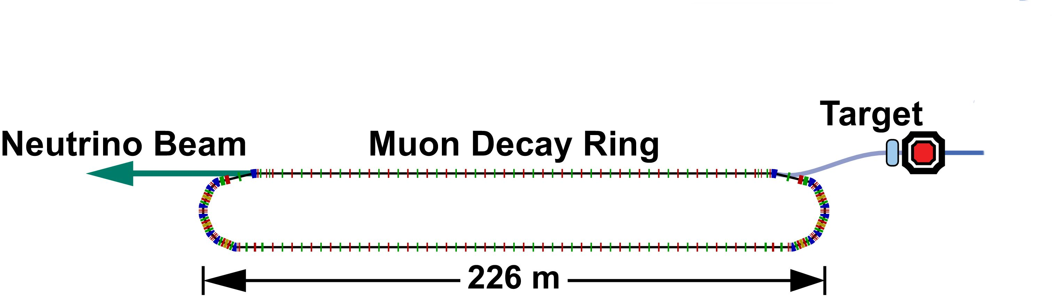
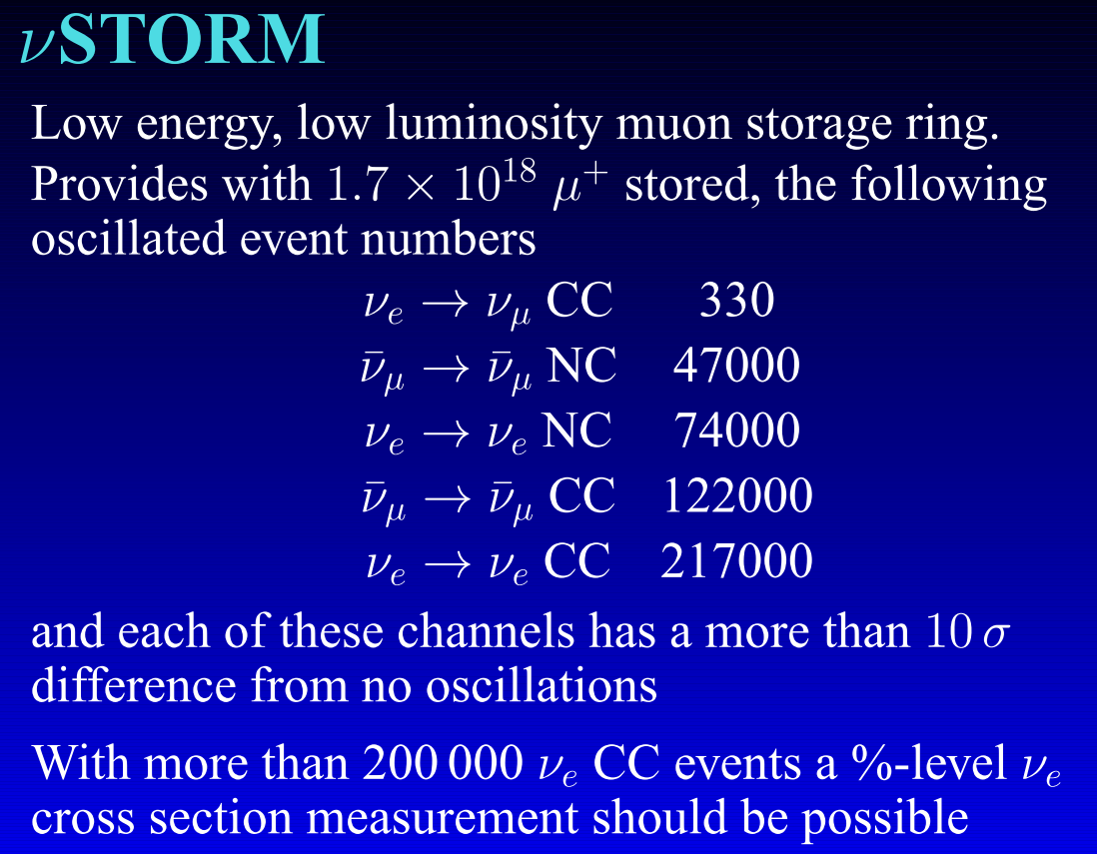
NuSTORM:
Neutrinos from Stored Muons
3.8 GeV/c
stored μ
A.Bross
Fermilab P-1028
An entry-level NF?
200kW
DOES NOT
Require the
Development of
ANY
New Technology
Stage I approval requested at last weeks
Fermilab PAC meeting
NuSTORM Workshop held Sept 21-22 @ FNAL:
(https://indico.fnal.gov/conferenceDisplay.py?confId=5710)

Slide 17
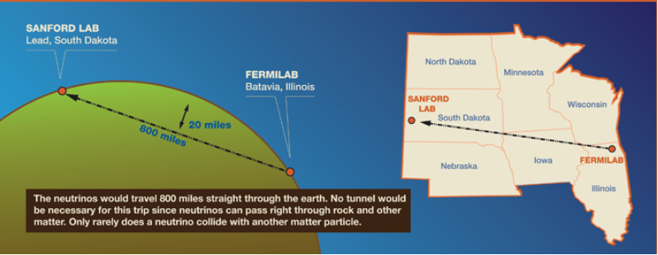

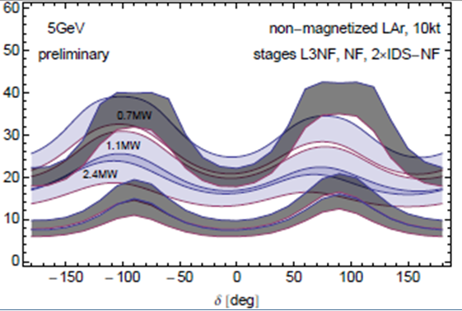
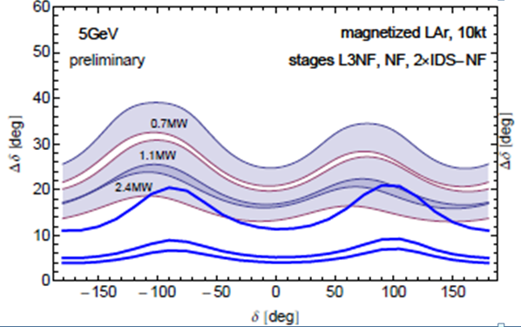
A Staged Neutrino Factory with far detector at SANFORD (LBNE)?
What if we were able to have a magnetized LAr detector?
a 1 MW, no cooling (L3NF)
a 3 MW, with cooling (NF)
a 4 MW, with cooling (NF+)
LBNE
Gray bands represent range of possible
detector performance per arXiv:0805.2019
Neutrino Factory
Plots assume
100 kt-years
Plots courtesy of P. Huber

Slide 18
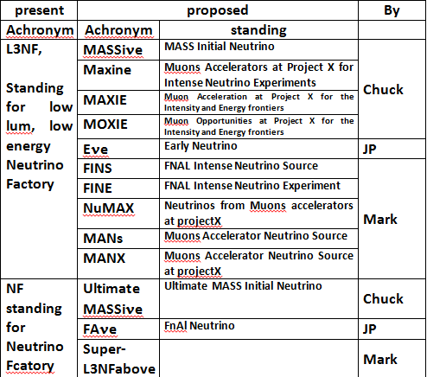
Plea for appealing L3NF name!
Not very
attractive
Preferably
avoid
Neutrino
Factory
to avoid
confusion
with IDS-NF

Slide 19
The Muon Collider path at the energy frontier
Defined by 6D cooling feasibility
  Decision >2025
Low Luminosity, Low Energy Muon Collider (L3MC) as first stage:
  Energy and luminosity defined by Physics at the time.
  Possibly a Low Luminosity Higgs factory (L2HF) if still useful at the time: no final cooling (>30T solenoid)
Upgrade to High Luminosity Low Energy Muon Collider (Higgs Factory)
  More powerful proton driver,
  Final Cooling
Evolving towards High Energy Muon Collider
  More acceleration stages
  High energy collider ring

Slide 20
R&D platform at each Physics stage
P.Snopok
Principle:
  MAP critical & novel technologies to be demonstrated in test facilities
  Dedicated test facilities usually very expensive and not useful for Physics
  Novel concept of test facility integrated into actual Capability stage aiming at development & validation of technology required by next stage
NuSTORM as R&D platform for 6D cooling at moderate intensity
  Source of 10¹⁰ muons per pulse
  6D cooling validation for HIGGS factory and/or Muon Collider
Low Luminosity Neutrino Factory as R&D platform for 4Dcooling
  complementary to 4D cooling @ MICE at (very) low intensity
  4D cooling validation for High Luminosity Neutrino Factory
High Luminosity Neutrino Factory as R&D platform for 6D cooling at high intensity
  6D cooling validation for HIGGS factory and/or Muon Collider
HIGGS factory as R&D platform for final cooling
  Final cooling validation for Muon Collider

Slide 21
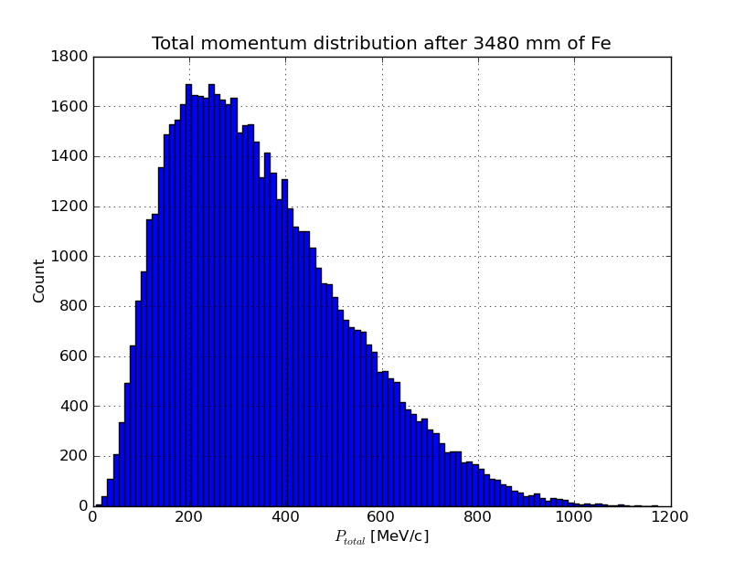
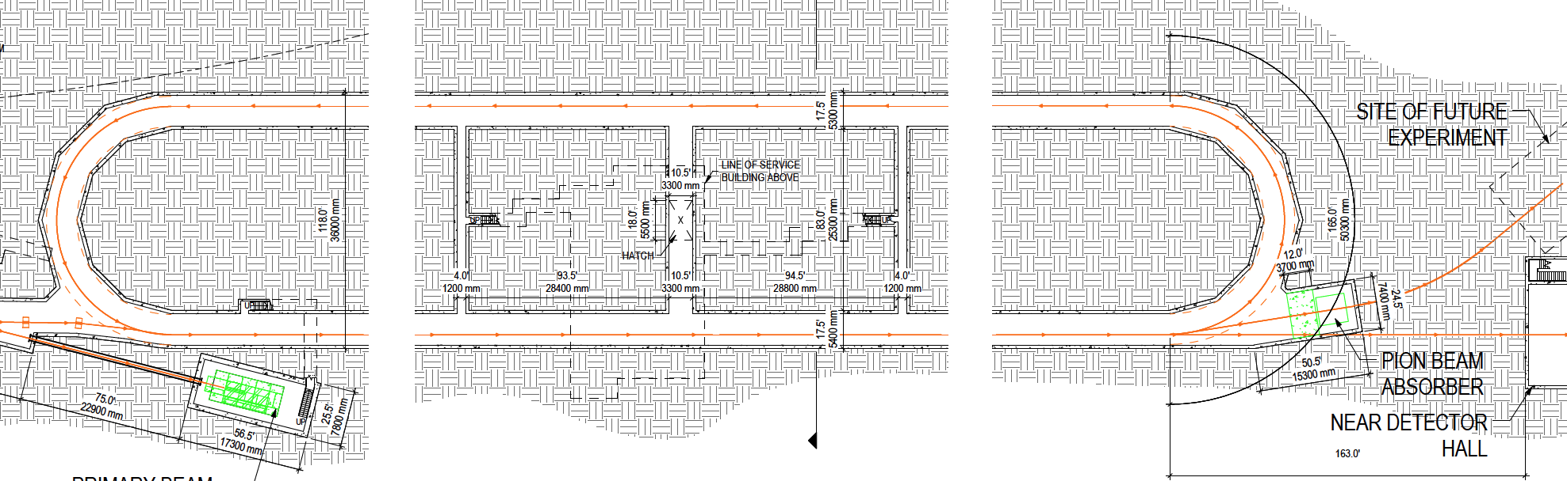
nuSTORM as an R&D platform
High-intensity pulsed muon source
100<p_{μ}<300 MeV/c muons
  Using extracted beam from ring
  10¹⁰ muons per 1 μsec pulse
Beam available simultaneously with
physics operation
  Sterile ν search
  ν cross interaction physics program
nuSTORM provides opportunity
to design, build & test:
  decay ring instrumentation (BCT, momentum spectrometer, polarimeter) to measure & characterize the circulating muon flux
  6D cooling of high intensity muon beam

Slide 22
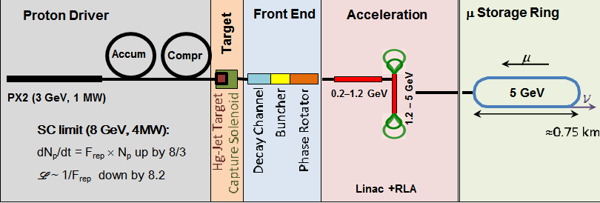

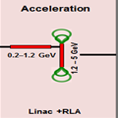


L3NF->NF->HF->MC
L3NF
1 MW@3GeV p+ driver
No cooling
Test facility: 4Dcooling
Neutrino Factory
+ 3 MW@3GeV p+ driver
+ 4D cooling
Test facility: 6D cooling
Higgs Factory
+ 4MW@8GeV p+driver
+ 6D cooling
+ further acceleration
+ Collider ring
Test facility: final cooling
Muon Collider
+ final cooling(40T solenoids)
+ further acceleration
+ high energy Collider Ring
PX2 (3 GeV, 1 MW)
235m
Proton Driver
Front End
Acceleration
μ Storage Ring
Target
Accum
Compr
PX2 (3 GeV, 3 MW)
0.2–0.8 GeV
0.8 – 2.8 GeV
235m
Linac + 2×RLA
PX4
(8 GeV, 4 MW)

Slide 23
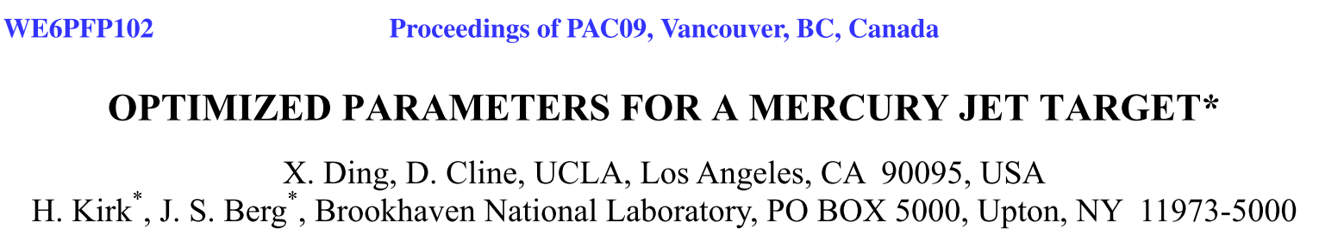
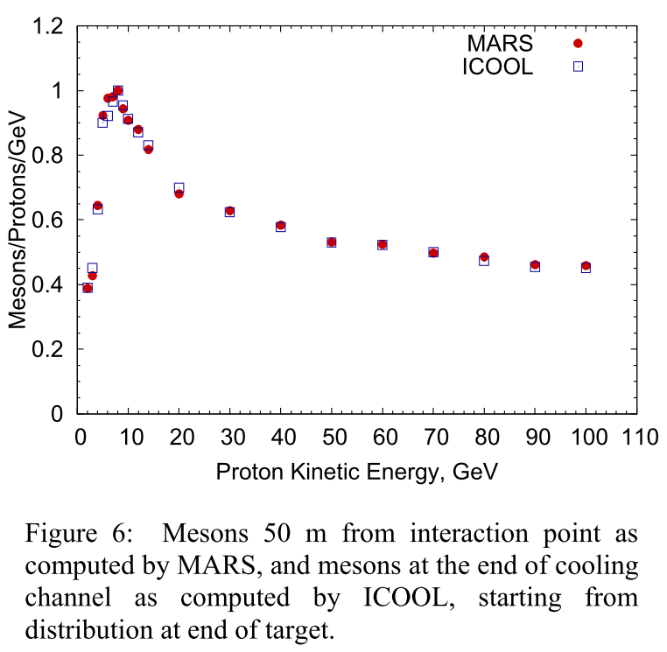
Muon production with low energy p+ driver
Muon production by proton:
@ 8GeV: 0.082
@ 3GeV: 0.014 (5.9 reduction)
Muon production per MW of Proton:
- Reduction by 5.9*3/8 = 2.2
Additional limitations due to space charge (12.3) of proton beam during accumulation before target
Partial compensation by:
number of accumulator rings
Larger repetition frequency
Lower charge per bunch:
Valid for neutrino flux: α Nb
Not for collider: L α Nb^2
Issue: assymetric muon production:
- Mu⁻ =1.56Mu⁺ @ 3GeV?
Ga target?
- 11% more muons

Slide 24
Revisited Design
Work in progress
C.Ankenbrandt
From Excel sheet to real design?
Reflection with D&S experts on June20 at 8:15

Slide 25
Staged Neutrino Factory and Muon Colliders main parameters
Neutrino Factory based on ProjectX ph2
Muon Colliders based on ProjectX ph4

Slide 26
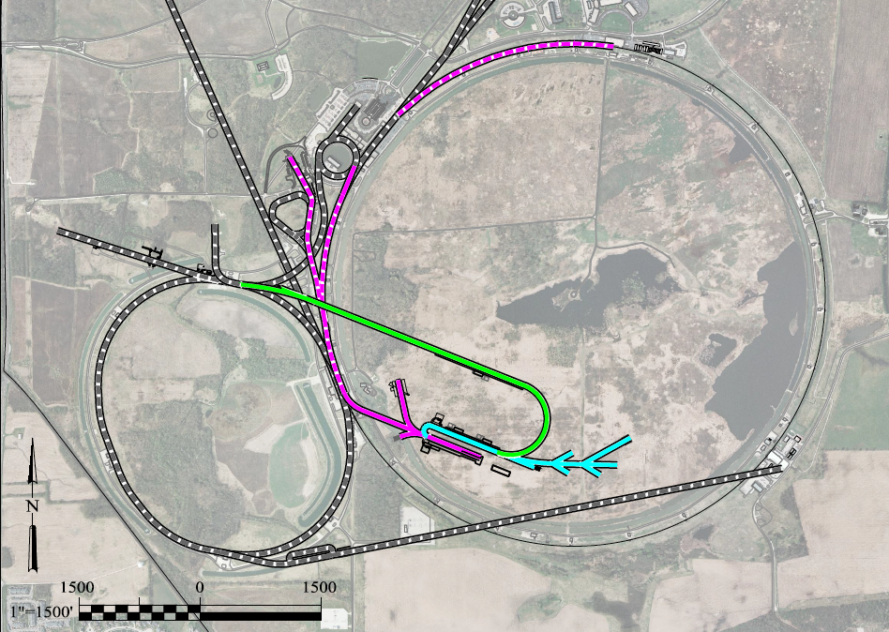
Preliminary
work in progress
(collab. project X)
To Far Detector in
Sanford (1300km)
LBNE
Buncher/
Accumulator
Rings & Target
RLA to 63 GeV +
300m Higgs Factory
5 GeV
NF Decay Ring:
νs to Sanford
Front End+4D+6D
Project X
Stage III
Linac + RLA
SC 325MHz
to ~5 GeV
Project X
Stage II
Project X
Stage I
νSTORM + Muon Beam
R&D Facility

Slide 27
Alternative with additional synergies with Project X
Using phase 3 of PX for p+ and Muons acceleration
Higgs Collider Ring
Nu-Factory
To Sanford
Linac + RLA to 5 GeV
325 MHz linac to 0.9 GeV
6D Cool
4D Cooling
Front End
Acc+Bun
650 MHz linac (0.7 GeV)
target
Decay Ring
νs to LBNE
To LBNE
Maximizing synergies between MAP & ProjectX?
Reflection with PX experts on June21 at 2:30pm
Very, very preliminary
work in progress
(collab. project X)
Initially suggested
by V.Lebedev & others

Slide 28
Conclusion
Critical paths of Muon-based facilities identified
Attractive long term scenario @ FNAL taking advantage of and leveraging envisaged projects
  nuSTORM, Project X, LBNE (Sanford opportunity),
Series of staged capabilities with at each stage:
  great Physics interest
  progressive complexity (&cost) built on previous stages
  Integrated R&D platform and technology validation of following stage
Possible decision on Neutrino Factory program by 2020 and on a Muon Collider program by 2025:
  early and realistic start with initial stage based on reduced beam power (1MW@3GeV) of PX2
White Paper @ CSS2013 in preparation

Slide 29
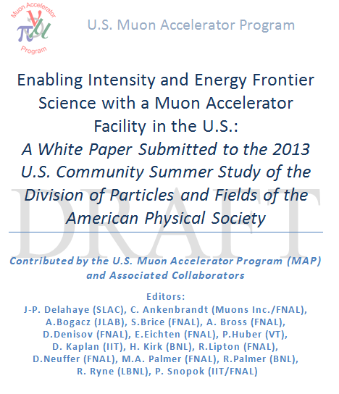
Finalization before submission
on June 21 at 2:00pm
Draft
in preparation

Slide 30
Recommendations- Future work
In parallel with on-going R&D on MAP technology feasibility
Revisit design of initial Muon Facilities based on ProjectX p2 (1to3 MW@3GeV) and 325MHz RF cavities all stages (avoid 201MHz)
  Earlier , less expensive, less challenging,
  Upgradable to 4MW @ 8GeV for full luminosity
  Reserve space compatible with PX on FNAL site
Reconsider ProjectX phase3 in best interest of ProjectX and MAP
  6 or 8 GeV? 3 or 4 MW? 1.3 GHz or 650MHz? Pulsed or CW?
  Multiple use: ProjectX users, MI upgrade, Proton driver, Muon acceleration
Launch design of a staged 5 GeV NF to Sanford
  Performance evaluation of upgraded LBNE detector versus IDS-NF
  Reserve space on FNAL site of decay ring pointing to Sanford
Launch R&D of a magnetized 10kT LAr detector
  Upgraded from LBNE detector reusing parts as much as possible
  Supporting underground LBNE detector (with some additional cost but as an excellent investment for future use and future programs)
Consider using nuStorm as a potential R&D platform providing Muon source for 6D cooling experiment
  Compatibility with Physics program?

