Slide 1



Progress of High-Pressure
Gas-filled RF cavity program
K. Yonehara
APC, Fermilab

Slide 2
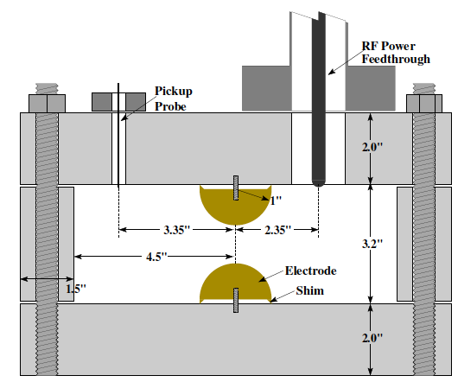

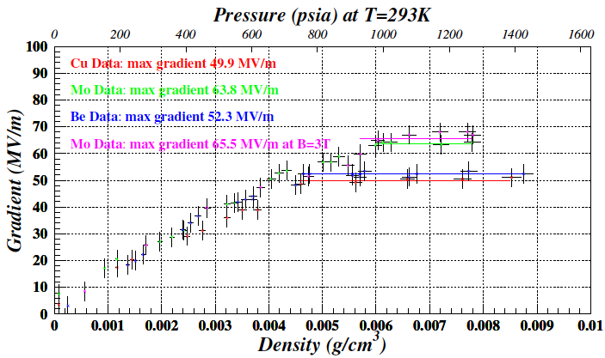
Prologue
~ First result with no beam ~
High Pressure RF (HPRF) cavity has been successfully operated in strong magnetic fields
Use Hydrogen gas to use as ionization cooling material
Maximum electric field gradient in HPRF test cell
Schematic view of HPRF test cell
R.P. Johnson et al., Proceedings of LINAC04
Gas breakdown:
Linear dependence
Governed by electron mean free path
Metallic breakdown
Operation range for muon cooling
Metallic breakdown:
Plateau
Depend on electrode material
No detail study have been made yet
Gas breakdown
P. Hanlet et al., Proceedings of EPAC’06, TUPCH147

Slide 3
Beam-Induced Plasma Loading Effect in Gas Filled RF Cavity
Inject either proton
or muon
Add small amount of
electronegative gas
(SF6, O2, etc)
Beam-induced plasma
Beam-induced plasma
formed in GH2
Positive ion
electron
Muon beam
Ionized electrons
disappear
Plasma is drifted by
RF E field
Still heavy ions
(H_{n}⁺ + O₂⁻)
consume RF power
Absorb RF power
Observed beam-induced plasma loading effect
with 400 MeV proton beam
1% Dry Air (0.2 % O2) in GH2
Dense hydrogen gas
Pure GH2
RF envelope w/o beam
1% Dry Air
(0.2 % O2)
in GH2 at B = 3 T
RF envelope w beam
Beam on
~200 times less
RF dissipation
E₀ = 25 MV/m
E₀ = 25 MV/m

Slide 4
Primary plasma physics process in a gas filled RF cavity
Ionization process
(Produce beam-induced plasma)
Number of electron-ion pairs
RF energy dissipation
(Generate plasma loading)
• RF energy dissipation is modeled
as a resistive motion of plasma in
a matter by an RF field
• Drift velocity of electron & ion ( )
are known from other experiments
• Model predicts
Electron dw >> Ion dw
• Known ionization energy loss
• Known ion pair production
energy (W_{i})
• Easy to estimate total number of
electron-ion pairs
• Same plasma production process
with different incident charged
particles
Linear Theory
No model dependence
Goal:
Experimentally validate
this theory

Slide 5
Ion pair production & Fast thermalizing ionization electrons in dense H₂ gas
H₂ gas (20 ~ 100 atm)
400 MeV protons
RF field (800 MHz, 5 ~ 50 MV/m)
Fast-proton-impact ionizes H₂
and induces electron cascade
# of ion-pairs in ionization process
can be estimated
• # of neutral H₂ molecules in the cavity is ~ 10²¹ cm⁻³
• # of ion-pairs is 10¹³ cm⁻³ in our interesting range
• Frictional collisions between electrons and H₂ are taken place
• Electrons should be thermalized in τ_{th} < 10⁻¹-10⁻² nsec
• 800 MHz RF period (1.2 nsec) >> τ_{th}
• Electron swarm motion should respond to the RF field

Slide 6
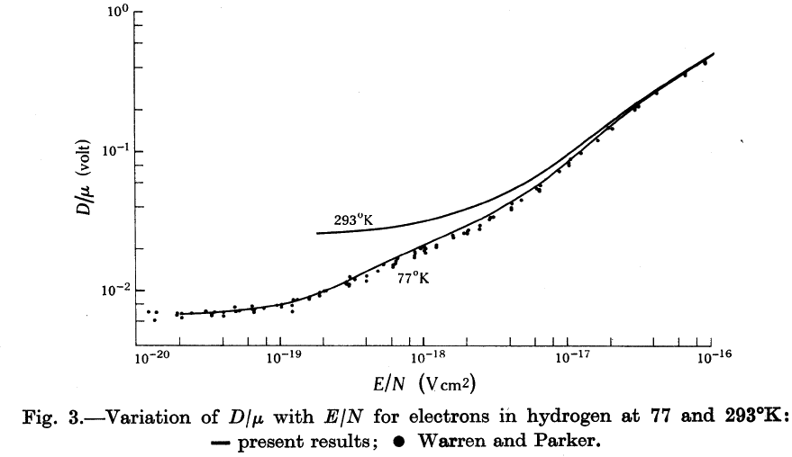
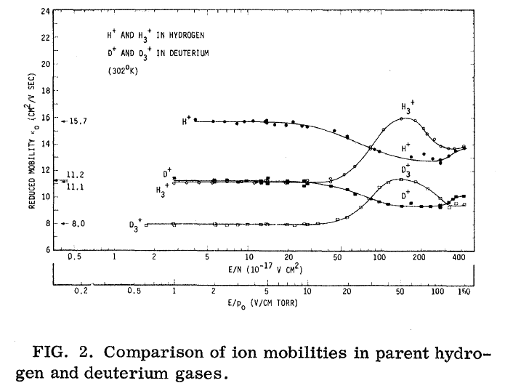
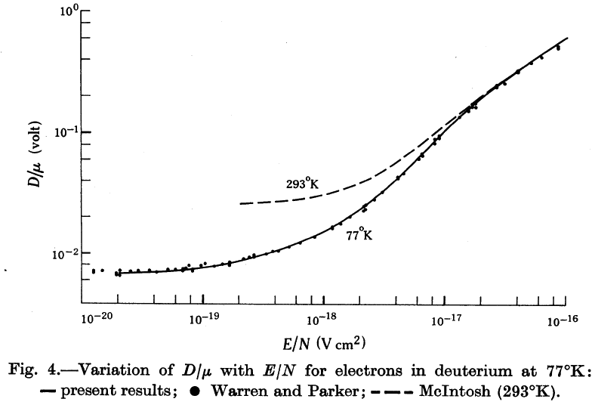
Analytical estimation of plasma loading dw in pure H₂ and D₂ gas
Electron mobility in H₂ and D₂ gases
(R. W. Crompton, 1967)
H⁺, H₃⁺, D⁺, D₃⁺ mobilities in H₂ and D₂ gases
(T. M. Miller, 1968)
• We do not have the D₅⁺ mobility
• Estimate it from Langevin formula

Slide 7
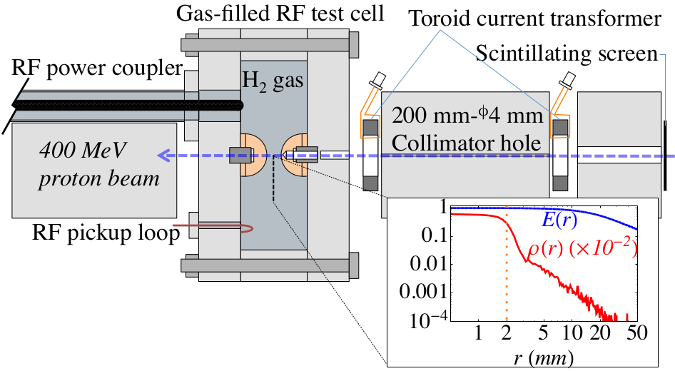
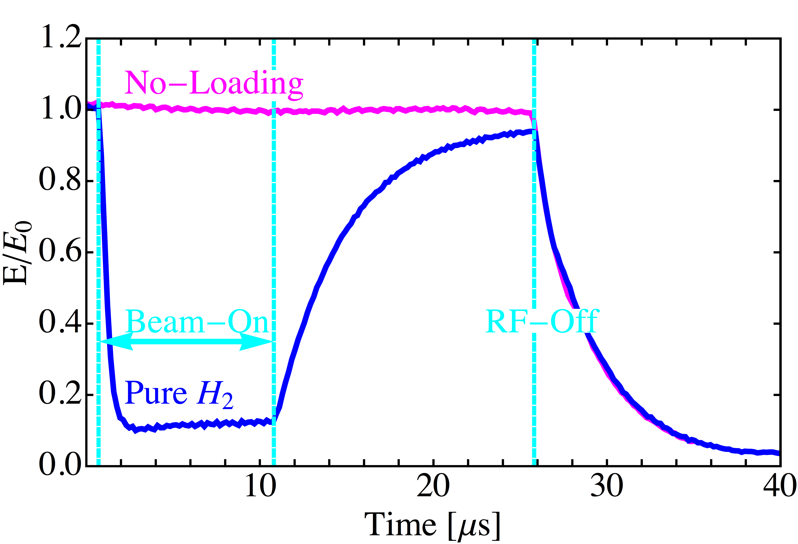
Experimental apparatus
Physics variables:
• H₂ gas pressure
20 to 100 atm at 300 K
• RF frequency
800 - 810 MHz
• RF amplitude
5 to 50 MV/m
• Beam current
10²⁰ protons/s
These apparatuses are located
in a 5-Tesla solenoid
• Observed RF envelops
Magenta: No beam
Blue: With beam during 0 < t < 10 μsec
Cyan: Beam-On & OFF and RF-OFF
• The system is sensitive the plasma physics
that the time scale is from nsec to μsec
M. Chung et al., PRL

Slide 8
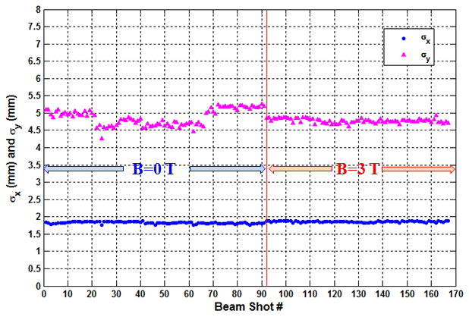
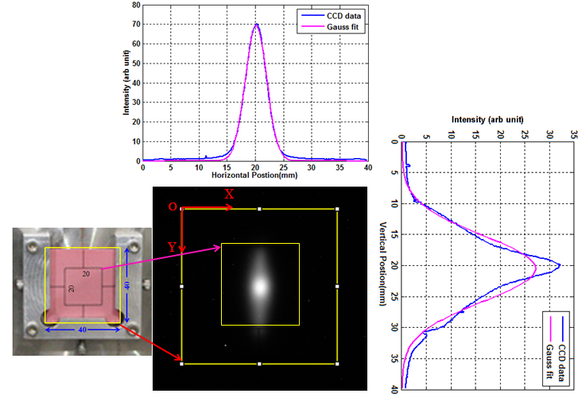
Beam profile measurement by using scintillating screen + CCD
The CCD profile system is insensitive to
an external B field
σ_{x}, σ_{y} vs beam shot plot
Beam profile on CCD Image
B=0 T
σ_{x} = 1.83±0.03 mm
σ_{y} = 4.88±0.23 mm
B = 3 T
σ_{x} =1.86±0.03 mm
σ_{y} = 4.78±0.06 mm
No B field dependence on beam profile
Observed beam profile from CCD image
Beam Center
Beam size
Beam Transmission
M. Jana et al., Rev. Sci. Inst. 84, 063301, 2013
& Poster session

Slide 9
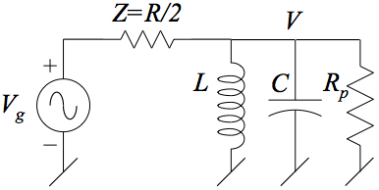
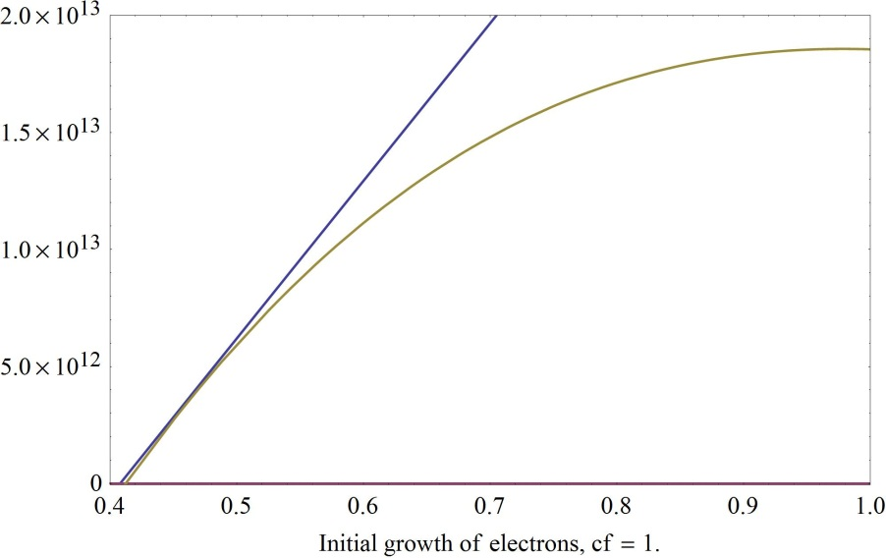
Measured RF power consumption
& Time evolution of plasma
• RF power consumption by ionized plasma
can be given from RF amplitude
V₀: Maximum RF amplitude (flattop)
R: Shunt impedance
R_{p}: Plasma resistance
C: Capacitance
Tollestrup et al.,
“Handbook for gas filled rf cavity aficionados’”
n_{e}
β: Recombination rate
τ⁻¹: Electron capture rate
(τ⁻¹ is negligible in pure H₂)
• # of ion pairs can be estimated from RF
power consumption P/dw
- A blue line in left plot shows the integrated N_{e}
and a yellow one is the estimated # of ion pairs
- Deviation of P/νdw curve in initial state should
match to the total amount of ion pair production
N_{e}
• dw is estimated from this correlation
If hydrogen recombination
rate is small (βn⁺n_{e} ≈ 0),
t (μs)

Slide 10
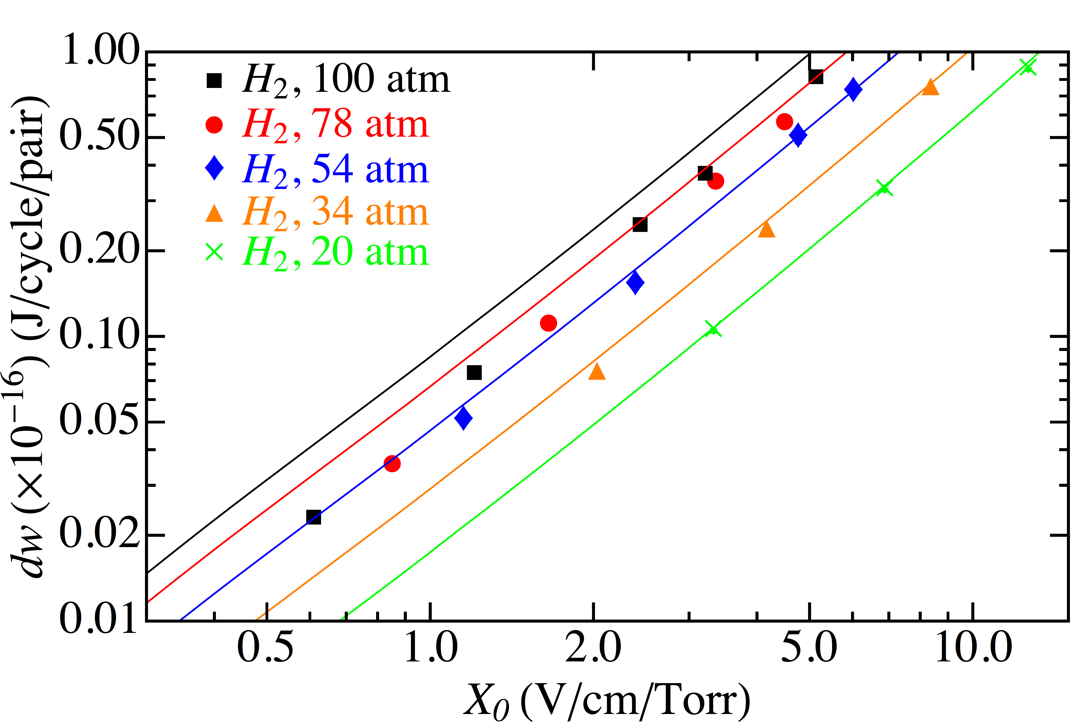
RF energy consumption by beam-induced ion pair in pure GH2
dw : Observed energy consumption per single electron-ion pair
from RF cavity per one RF cycle
Solid line: Prediction from simple model
M. Chung et al., PRL

Slide 11
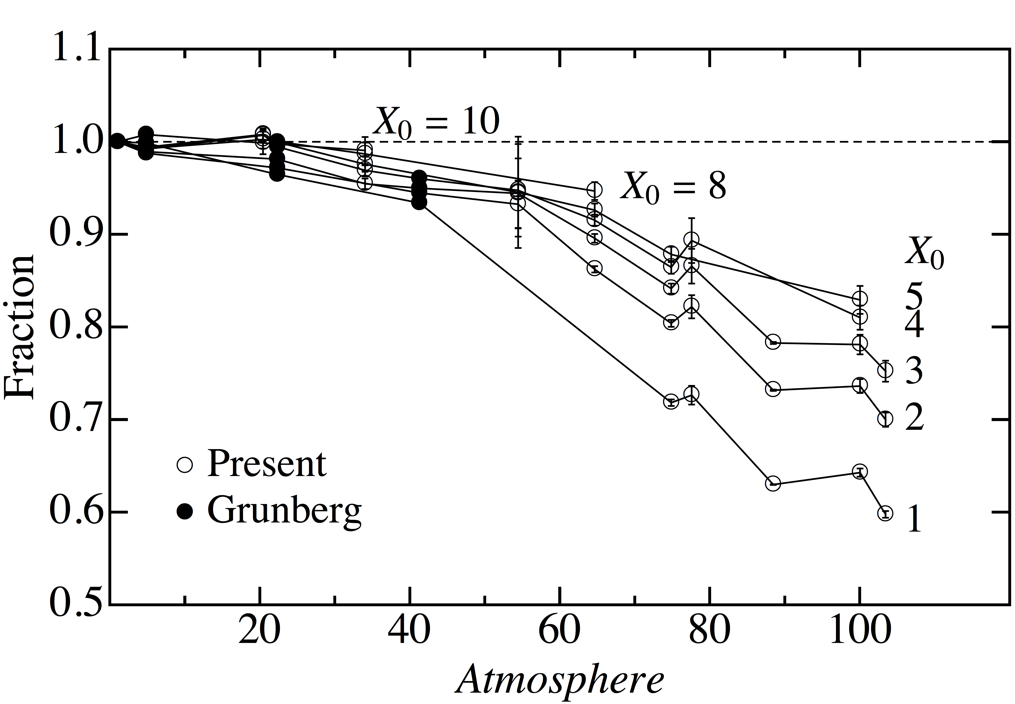
Deviation of experimental result with prediction
Prediction works well at low p
X₀ = E_{RF}/Gas pressure
Large deviation at high p
(Good effect)
K. Yonehara et al., IPAC13, TUPFI059

Slide 12
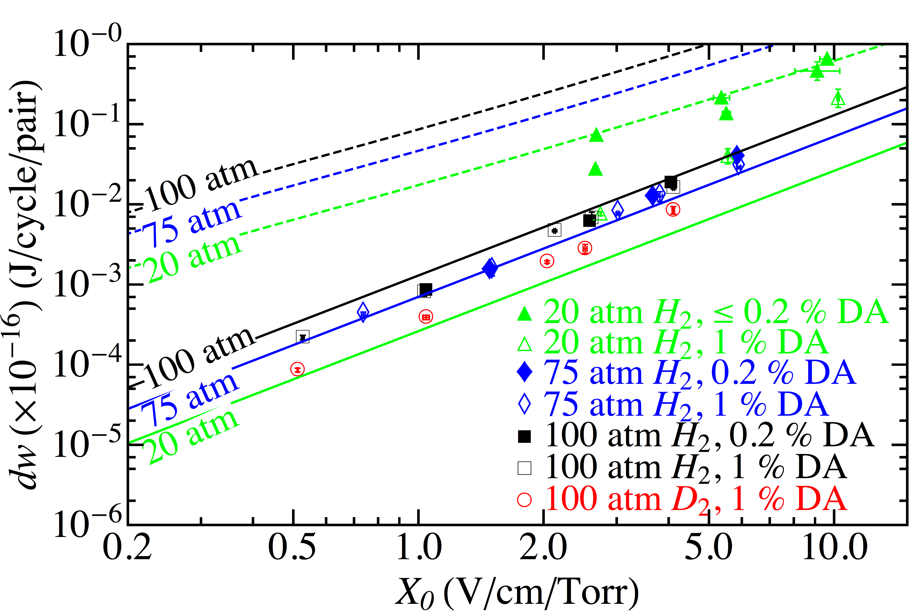
RF energy consumption by beam-induced ion pair in Dry-Air doped GH2
dw : Observed energy consumption per single electron-ion pair
from RF cavity per one RF cycle
Dashed & Solid lines: Prediction from electron-ion pair & only heavy ions
M. Chung et al., PRL

Slide 13
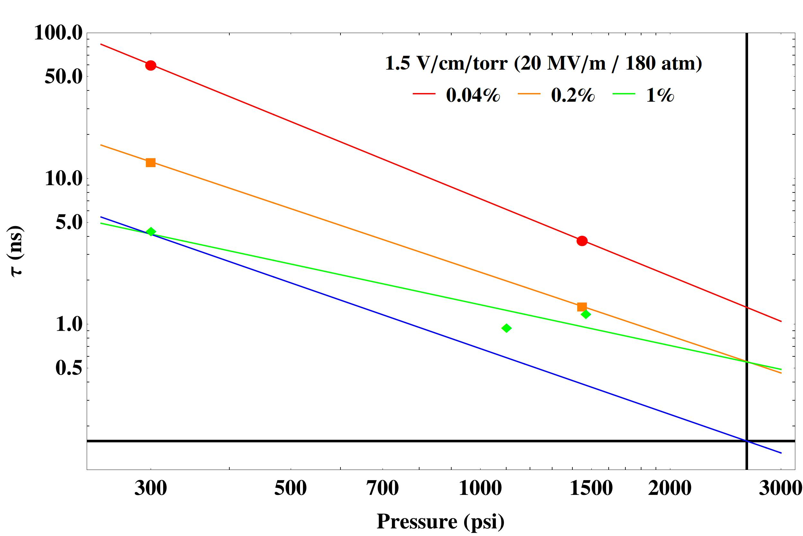
Observed electron capture time by O₂
B. Freemire et al., NA-PAC13
& Poster session
Electrons are captured by O₂ via three body reaction
Theoretical prediction shows electron capture time
Theoretical prediction is τ
~ 0.05 ns@0.2 % of O₂
Observed τ∝p^{-1.5}
Extrapolate 1 % DA line to the MC parameter and found that expected
τ = 0.1 ∼ 0.2 ns
Measurement limit

Slide 14
Interpret experimental result to estimate plasma loading with MC beam
Influence of ionized electron
  Expected electron capture time by dopant: τ ~ 10⁻¹⁰ sec
  Almost all electrons are eliminated in 1 nsec
Influence of heavy ion
  Great amount of heavy ions can be remained
  Ion-ion recombination rate: β_{ii} ~ 10⁻⁸ cm³/s
Influence of dopant
  0.1 % of Oxygen does not change the radiation length of cooling material
Influence of space charge and collective effects
  Formed a working group
R. Samulyak et al., IPAC13,TUPFI059
& Poster session

Slide 15
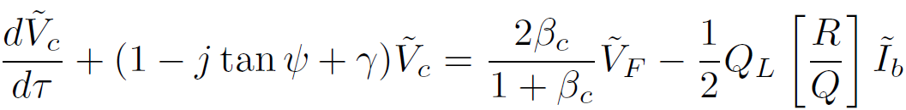
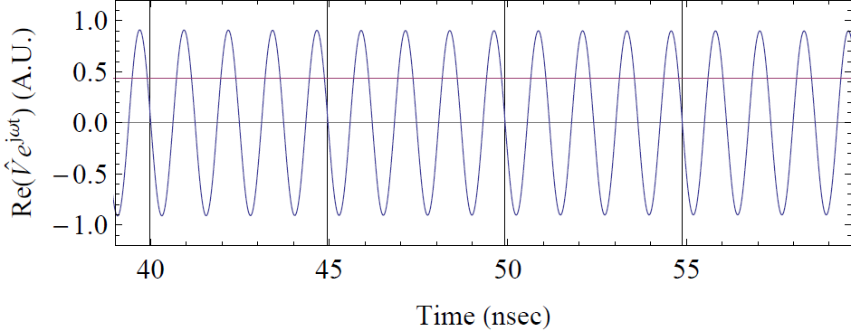
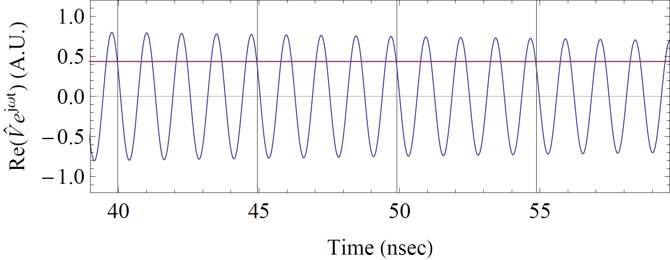
Beam + Plasma loading with MC beam parameter
Model equation with both beam and plasma loading:
Detuning
Plasma
loading
(resistive)
Forward
voltage
Beam loading
(current source)
M. Chung et al., IPAC13,TUPFI053
Example:
10¹³ muons in 12 bunches 5 nsec spacing
Without detuning
With detuning

Slide 16
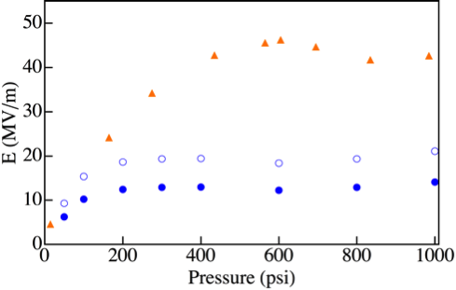
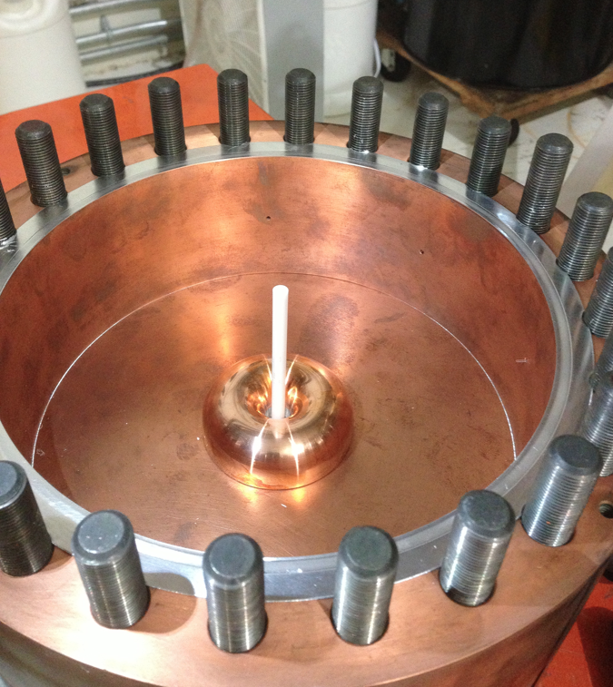
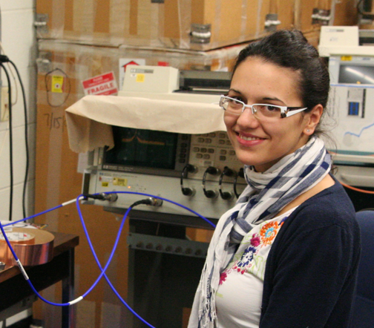
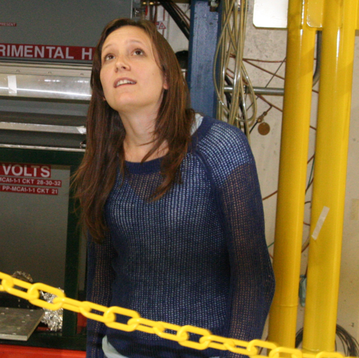
Summary of the first high-power dielectric loaded Gas-Filled RF test
L. Nash et al., IPAC13,TUPFI068
Gas BD slope
Suppressed surface breakdown by N₂ gas
Observed maximum RF gradient ≈ Dielectric strength of ceramic rod
Long run operation (72k RF pulses, 12 MV/m, no BD)
Quickly recovered RF system from severe BD events
Next step: Material search
  High dielectric strength
  Low loss tangent
  High dielectric constant
Metallic BD
Old cavity test
RF gradient at highest point
(convex of electrode)
RF gradient on ceramic rod

Slide 17
Magnetron as RF source
Magnetron is very simple
  Inexpensive
  Widely use for a microwave
Frequency and phase stabilization are an issue to apply for accelerator
Grigory Kazakevich@Muons, Inc. promotes R&D a magnetron to apply for a new RF source of SRF at Project-X
  Experimental result is consistent with the RF theory
  Show a great potential that it could apply for a HCC RF system
Progress further efforts

Slide 18
Tasks in 2013 & 2014
Material search for a dielectric loaded gas-filled RF cavity
Plan for next beam test
Design new RF test cell
  Demonstrate realistic HCC RF cavity
Promote plasma simulation study
Plan & Design for a cooling demonstration test
  Formed working group
Input experimental results to cooling simulation

Slide 19
Summary
Two critical issues in a gas-filled RF cavity applied for muon colliders have been solved
  RF loading due to beam-induced gas plasma in gas-filled RF cavity can be managed by doping a small amount of electronegative gas
  High RF gradient could be generated in a dielectric material loaded gas-filled RF cavity
Remaining issues
  Collective & space charge effects will be studied in simulation
  Design practical gas-filled RF system for cooling channel

Slide 20
Publication in FY13
Beam-induced plasma physics
  “Power Consumption in a Gas-Filled RF Cavity with Ionizing Beams and External Magnetic Fields”, Ready to submit to PRL,
  Plan to submit a full paper to PRSTAB,
  “High Pressure Gas Filled RF Cavity Beam Test At The Fermilab Mucool Test Area”, Doctoral Thesis 2013 at IIT written by B. Freemire,
  “Beam induced plasma dynamics in a high pressure gas-filled RF test cell for use in a muon cooling channel”, Proceedings of IPAC 2013, TUPFI064
  “Simulation of beam-induced gas plasma in high gradient RF field for Muon Colliders”, Proceedings of IPAC 2013, TUPFI058
  “Transient beam loading effects in gas-filled RF cavities for a muon collider”, Proceedings of IPAC 2013, TUPFI053
Analysis
  “Summary of dense hydrogen gas filled RF cavity tests for Muon Acceleration”, Proceedings of IPAC 2013, TUPFI059
Experiment
  “Measurement of Transmission Efficiency for 400 MeV Proton Beam Through Collimator at Fermilab Mucool Test Area Using Chromox-6 Scintillation Screen”, M. Jana et al., Rev. Sci. Instr. 84, 063301, 2013,
  “Beam Test of a High Pressure RF Cavity for the Muon Collider”, Master Thesis 2012 at Politecnico di Torino written by M.J. Collura,
  “High power tests of alumina in high pressure RF cavities for muon ionization cooling channels”, Proceedings of IPAC 2013, TUPFI068.

Slide 21
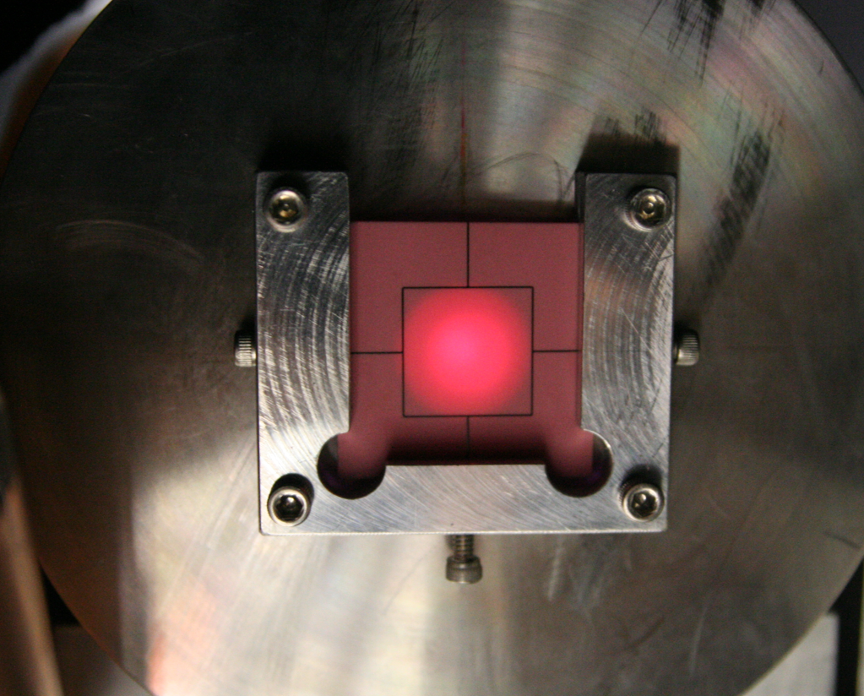
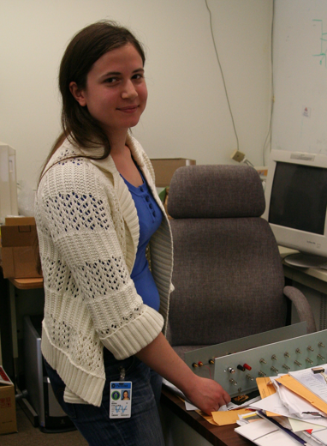
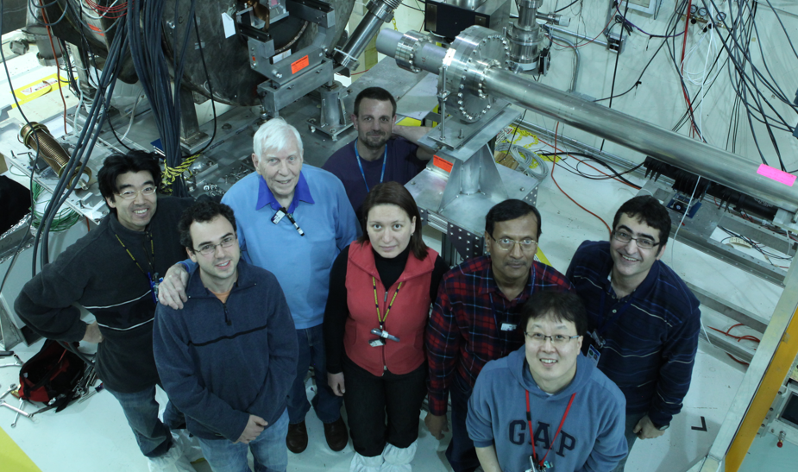
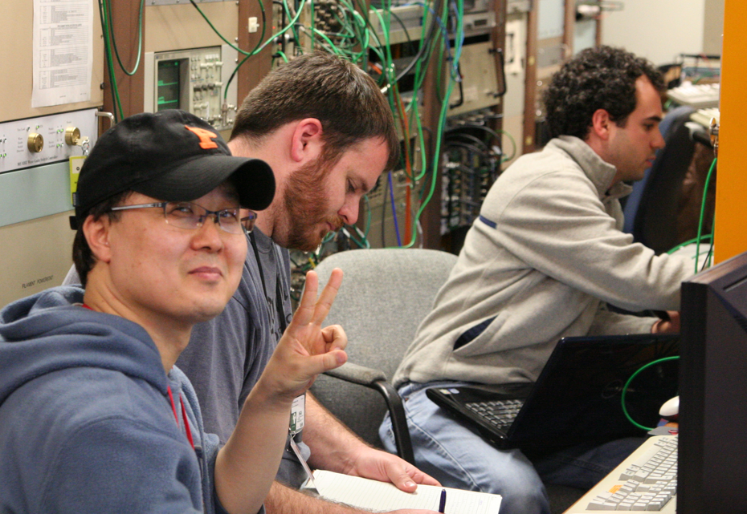

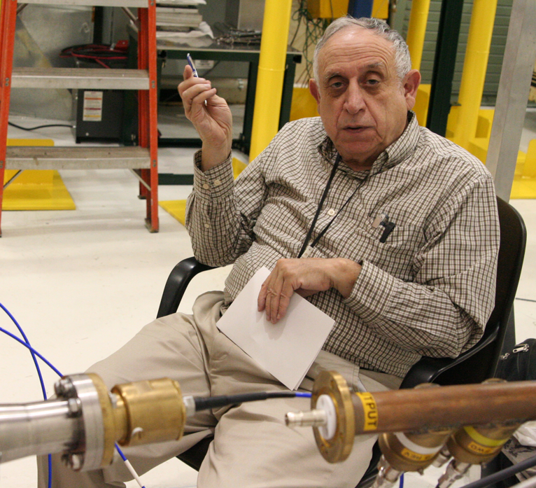
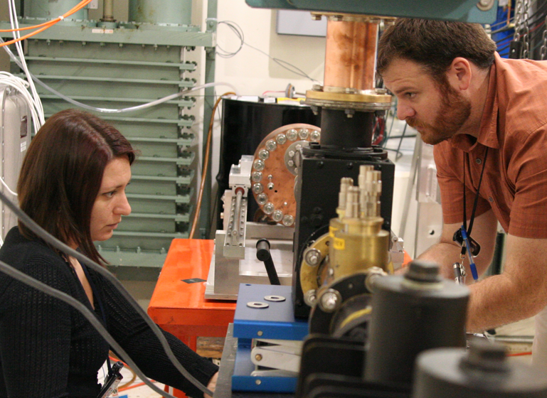
One scene of MTA beam test

