Slide 1
The Normal Conducting RF Program
Derun Li
Center for Beam Physics
Accelerator and Fusion Research Division
Lawrence Berkeley National Laboratory
MAP Collaboration Meeting
Fermilab, June 19-22, 2013

Slide 2
Outline
Introduction and Goals
Brief review of NCRF program
RF R&D Plan
Experimental Studies at 805-MHz
RF gradients (pillbox cavity with and without RF buttons) in multi-Tesla magnetic fields
Modular cavity (Drs. D. Bowring and Z. Li)
All season cavity
High pressure RF cavity + Beam test at the MTA
Dielectric loaded HP cavity
RF breakdown studies (Prof. Y. Torun)
MuCool 201-MHz cavity tests
MuCool prototype cavity: baseline design for MICE
Prototype for MICE
MP studies (Drs. T. Luo and Z. Li)
RF cavities for MICE
Summary
Dr. Y. Yonehara

Slide 3
Introduction I: NCRF Requirements
Muon capture, bunching, phase rotation, ionization cooling require
Low frequency normal conducting RF cavities
High RF gradient operation in a few-T to 10 T magnetic fields
* RF gradients for Guggenheim cooling channels: ~ 25 MV/m at 3-T initially & tapering to ~ 10 MV/m at 18-T

Slide 4
Introduction II: NCRF Cavity Programs
We have learned a great deal about the NCRF for muon acceleration: design/construction/experiments
Cavity design, engineering and construction, and experimental programs at the MTA (Prof. Y. Torun’s talk)
805-MHz open-cell cavity
805-MHz pillbox cavity
Be windows for 805-MHz and 201-MHz cavities
Pillbox cavity with RF buttons
805-MHz HP RF cavity (Muons Inc.)
Two 805-MHz box cavities (ExB studies)
All season cavity
Dielectric loaded cavity (low power prototype)
201-MHz cavity with Be windows for MuCool (baseline for MICE)
201-MHz prototype cavity for MICE using the single cavity vessel

Slide 5
Review: NCRF Vacuum Cavity for Muon Beams
RF cavity options, why and how we got here:
Muon beams are born with large emittance and decay and must be confined by strong magnetic field
Must use NCRF
Pillbox-like cavity with beam irises terminated by thin Be windows (muons can penetrate)
High RF electric field between two “parallel” planes
TiN coating at high electric field region
A factor of 2 higher cavity shunt impedance
Less RF power for a given gradient
Independent cavity phase control
RF heating on thin Be windows could detune the cavity
Two double-curvature windows pointing in the same direction

Slide 6
805 MHz Cavities

Slide 7
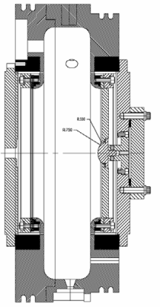
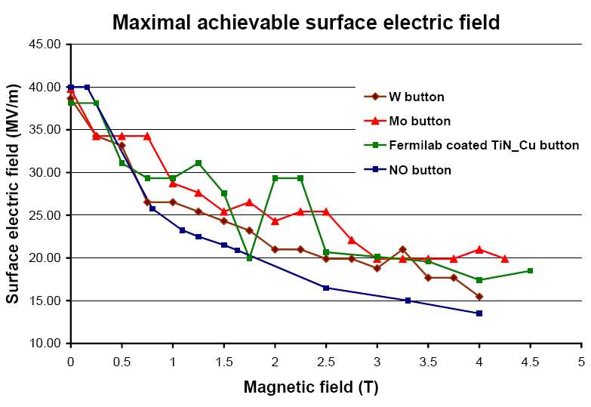
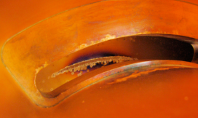
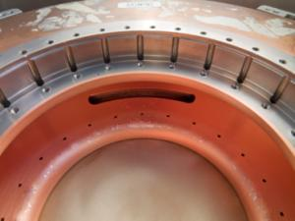
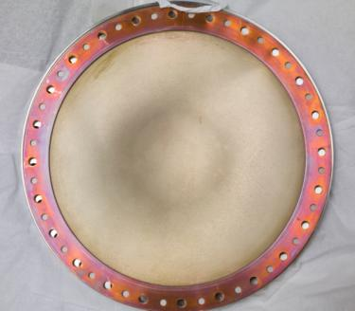
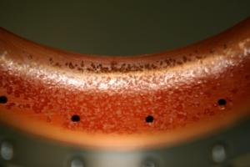
Overview: Pillbox Results - High Gradient in Strong B Field
What we have learned from the high power tests so far
Achievable accelerating gradients degrade due to external magnetic fields (by approximately a factor of 2 at 3-Tesla magnetic field)
Combination of strong magnetic field + RF fields cause damage on cavity surface
Single button test results
Coupling iris
805 MHz Cavity
Scatter in data is due to surface damage on
the iris and the coupling slot
Be window

Slide 8
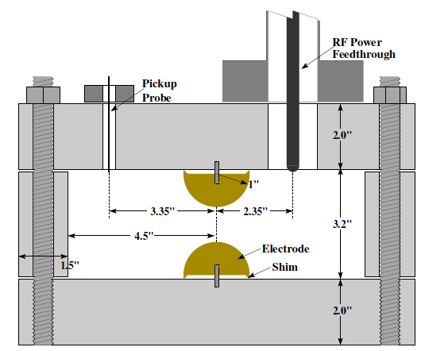
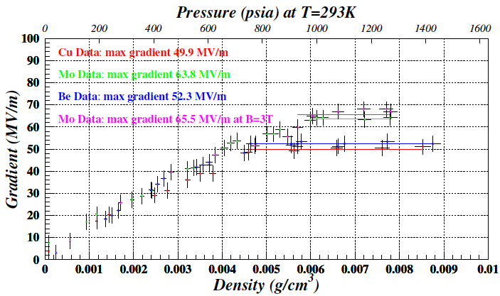
Overview: HPRF Cavity
High Pressure RF (HPRF) cavity has been successfully operated in strong magnetic fields
Use Hydrogen gas as ionization cooling material
Maximum electric field gradient in HPRF test cell
Schematic view of HPRF test cell
Gas breakdown:
Linear dependence
Governed by electron mean free path
Metallic breakdown
Metallic breakdown:
Plateau
Depend on electrode material
No detail study have been made yet
Operation range for muon cooling
Gas breakdown

Slide 9
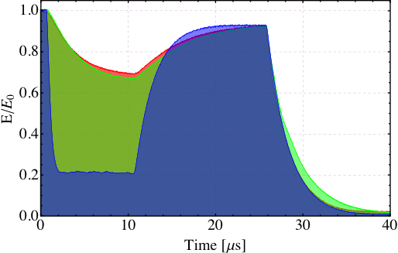
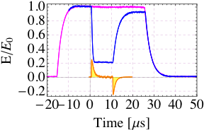
Overview: Beam Test of HPRF Cavity
Inject either proton
or muon
Beam-induced plasma
Add small amount of
electronegative gas
(SF6, O2, etc)
Positive ion
electron
Beam-induced plasma
formed in GH2
Muon beam
Ionized electrons
disappear
Plasma is drifted by
RF E field
Still positive ions (mainly
ionized hydrogen)
consume RF power
Absorb RF power
Observed beam-induced plasma loading effect
with 400 MeV proton beam
1% Dry Air (0.2 % O2) in GH2
Pure GH2
RF envelope w/o beam
1% Dry Air
(0.2 % O2)
in GH2
at B = 3 T
RF envelope w beam
Beam on
~ 50X reduction in
RF power dissipation
E₀ = 25 MV/m
E₀ = 25 MV/m

Slide 10
Summary of HPRF Cavity
What we learned from the HPRF Test Cavity Experiment:
No gradient (50 MV/m) dependent on B field for HPRF for H2 gas pressure above 400 psi
Beam tests showed: introduction of less than 1 % air (negative gas absorbs electron) reduces the HPRF cavity loading greatly
Demonstrate that HPRF cavities can be used in the HCC
Design and build a practical HPRF test cavity (not buttons) with improved diagnostics
Muon beam dynamics associated with plasma, collective and space charge effects

Slide 11
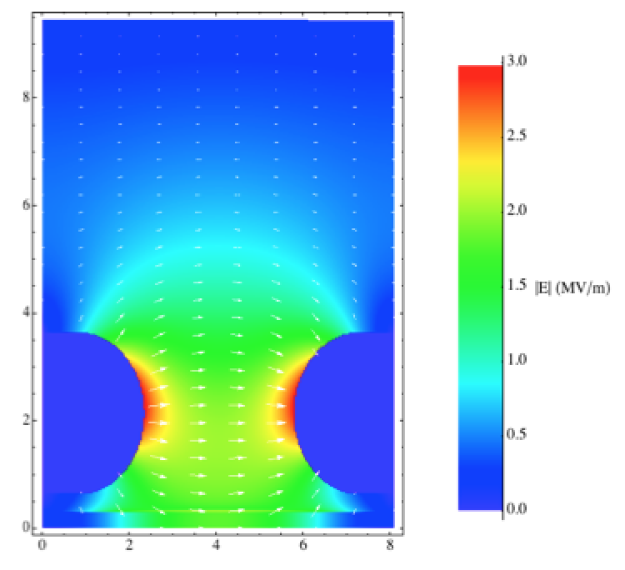
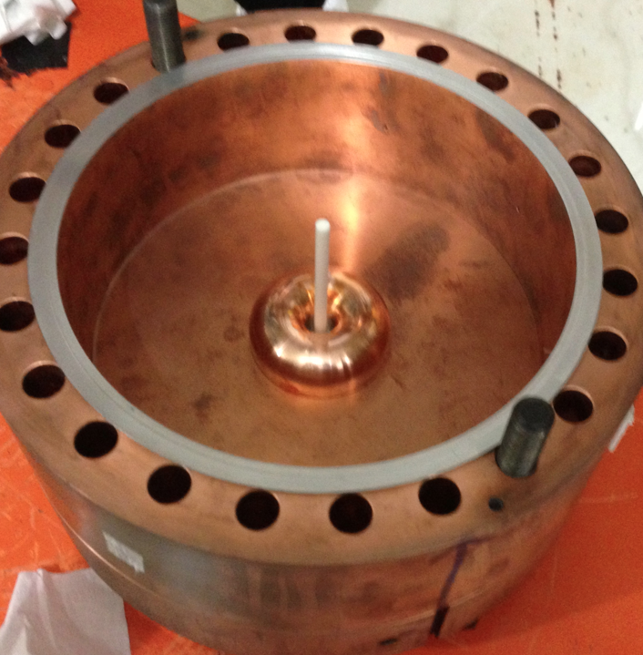
Dielectric Loaded Gas-Filled RF Cavity
Helical Cooling Channel requires small size (radius) RF cavities
A compact RF system loaded by a dielectric material
Design, construction and measurements:
• N₂ gas pressure = 1,000 psi; observed unusual BD event at E_{surface} < 10 MV/m
• Observed usual BD event at E_{surface} > 10 MV/m; Long run at E_{surface} = 12 MV/m,
No more BD during 2 hrs long run; but multiple BD at 14.5 MV/m
Dielectric materials:
Determine breakdown limit, strength, and loss tangent that are suitable for cooling channels.
Design and build a full scale practical dielectric loaded cavity
Measured frequency = 814.544 MHz @ 1 atm, Q_{L} = 4,250

Slide 12
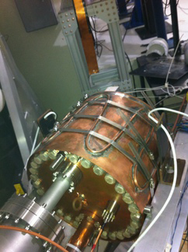
Overview: All Season Cavity
The All-Season Cavity (Muons Inc + Fermilab):
Modular pillbox with replaceable end walls
Designed for both vacuum and high-pressure
Made of 316 SS with 25m Cu-plating
3.9cm-thick center ring, 6.6cm-thick outer
End-plates; 2.7mm-thick inner plates
RF volume 29.1cm x 12.9 cm (Long)
1-5/8" Cu coax coupler
f₀ = 810.375 MHz with vacuum (at upper edge
of RF source power band); Q₀ ∼ 2.8x 10⁴
Successful operation of the All-Seasons Cavity in 3 T magnetic field under vacuum
Reached ∼ 20 MV/m
Detailed data analysis in progress
Operation of RF cavity in strong B field is a challenge
Goal: Find a workable solution through targeted R&D

Slide 13
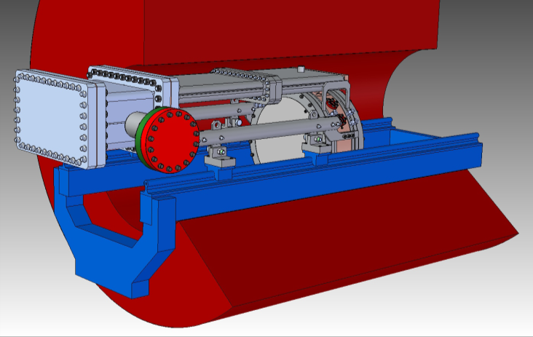
Modular RF Cavity
Modular cavity design and fabrication (Dr. D. Bowring’s Talk)
Require a new RF cavity to replace the damaged 805-MHz LBNL pillbox cavity for normal conducting RF experimental programs at MTA
Complete new cavity complex with waveguide coupler that fits inside the Lab-G magnet at MTA, Fermilab
Cavity fabrication using the state-of-art of normal conducting techniques developed at SLAC
Systematical RF breakdown studies in an external magnetic field
The cavity design allows for testing of different materials (beryllium, copper), surface finish and processing (EP, brite-dip, etc..) end-plates
Different cavity lengths (testing effects from time transit factor)
Modular cavity complex
Cavity support rail
Lab-G magnet

Slide 14
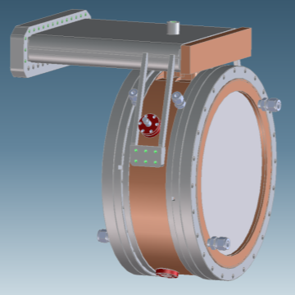
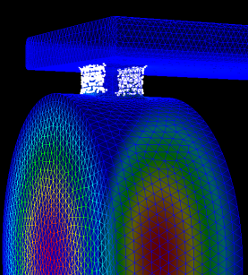
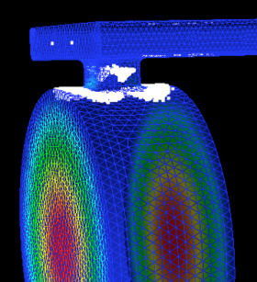
The Modular Cavity Design
Cavity design optimization
Minimize peak surface field at the RF power coupling region
Minimize multipacting at B=0 and B=3 Tesla
Current status
Fabrication in progress
Many parts made
Schedule
A complete modular cavity assembly will be delivered to Fermilab by FY13.
RF experimental programs developed
MP with & without external B field

Slide 15
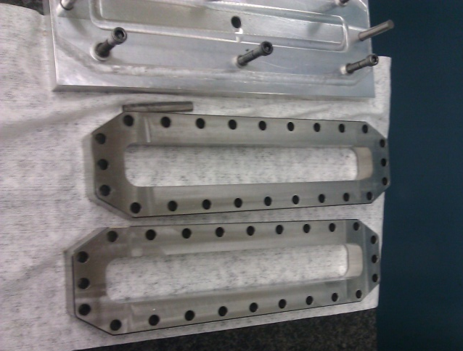
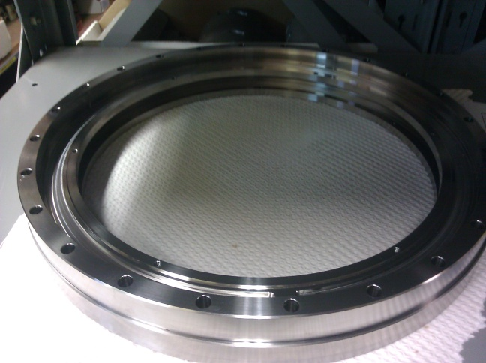
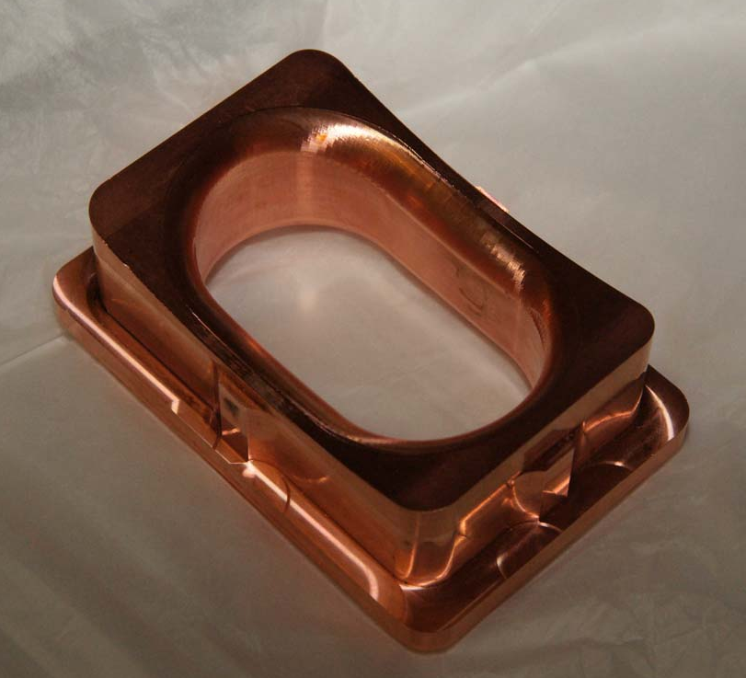
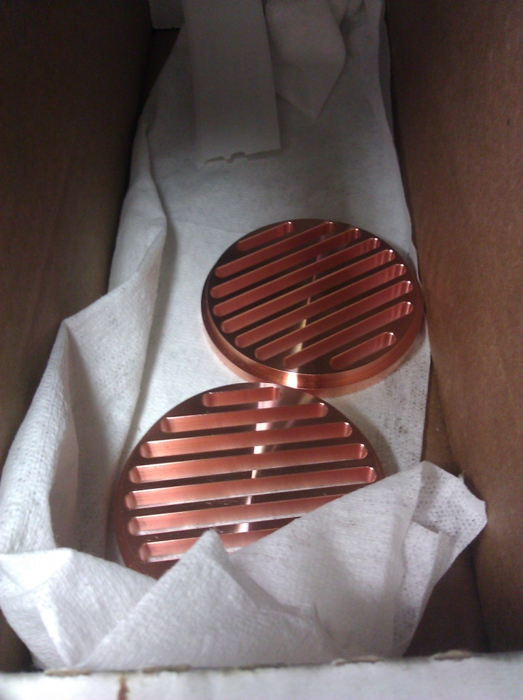
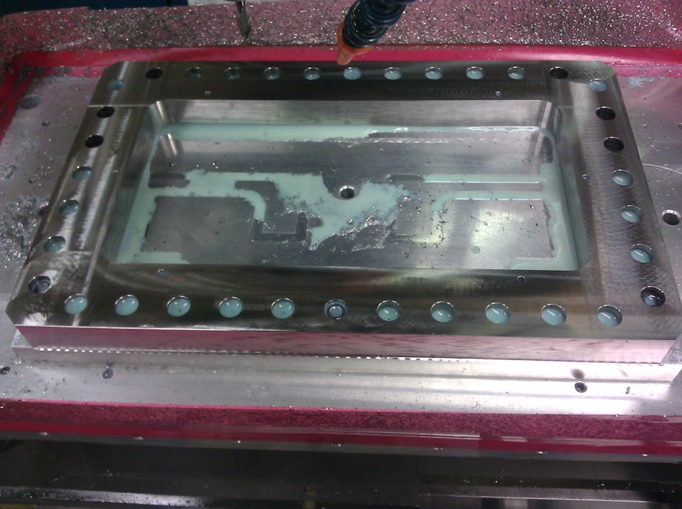
Cavity Fabrication Progress
Photos of parts being fabricated;
Cavity braze at SLAC;
Assembly and low power measurement at SLAC;
To be delivered to the MTA, Fermilab for high power test by end of FY2013

Slide 16
201 MHz Cavities

Slide 17
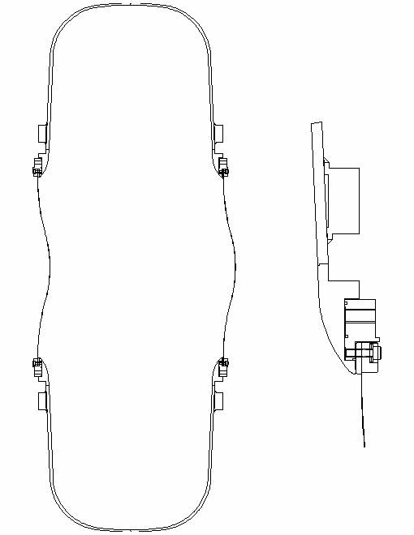
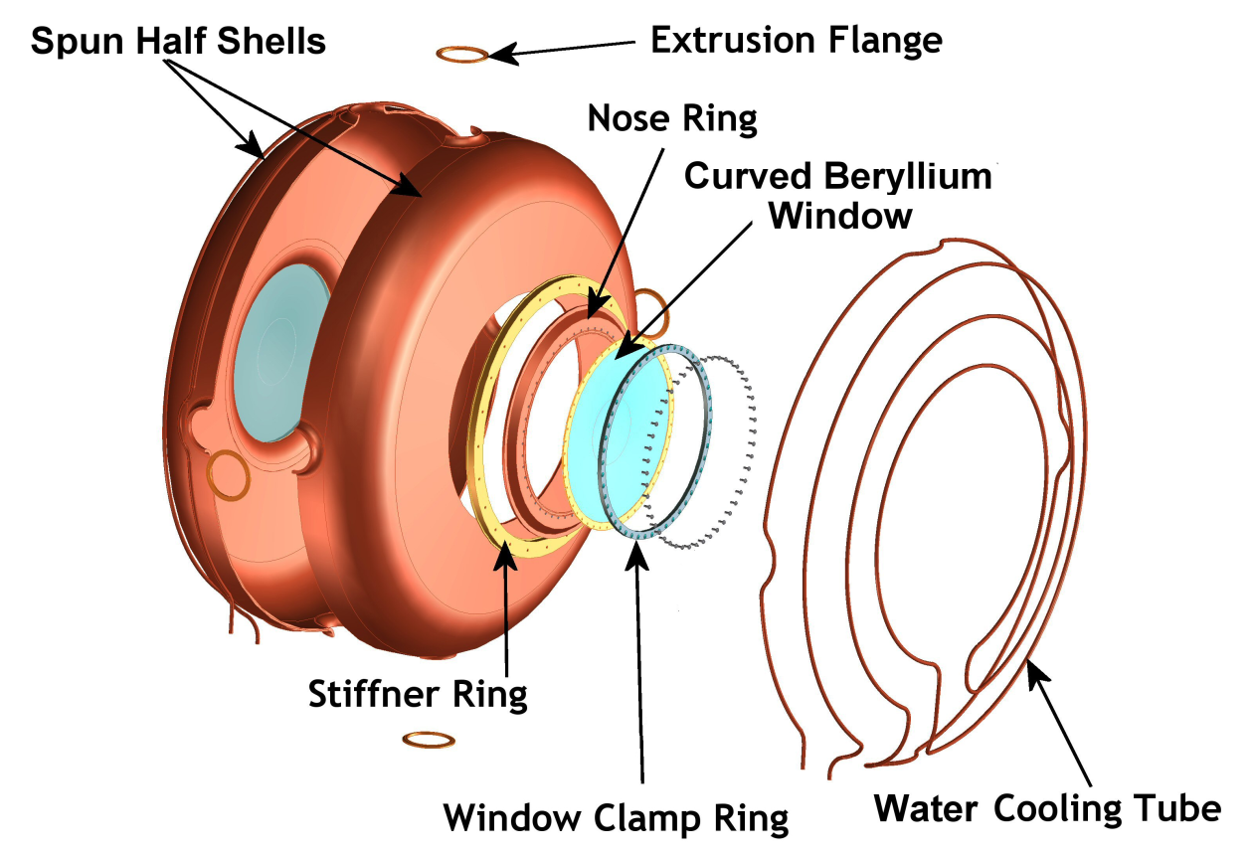
201 MHz Cavity for Muons
Cavity has been tested successfully without magnetic fields
Be windows can withstand high RF power in strong magnetic field without damage
Stiffener ring
42-cm
121.7-cm
Low peak surface
E-field at iris

Slide 18
Cavity Design Parameters
The cavity design parameters
Frequency: 201.25 MHz
β = 0.87
Shunt impedance (VT²/P): ∼ 22 MΩ/m
Quality factor (Q₀): ∼ 53,500
Be window diameter and thickness: 42-cm and 0.38-mm
Nominal parameters for MICE and (cooling channels) in a neutrino factory or muon collider
8 MV/m (∼ 16 MV/m) peak accelerating field
Peak input RF power: 1 MW (∼ 4.6 MW) per cavity
Average power dissipation per cavity: 1 kW (∼ 8.4 kW)
Average power dissipation per Be window: 12 watts (∼ 100 watts)

Slide 19
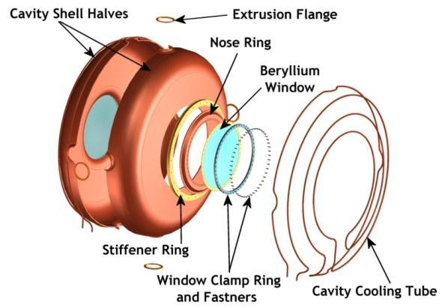
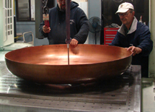
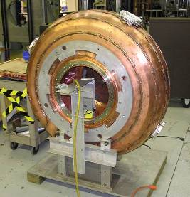
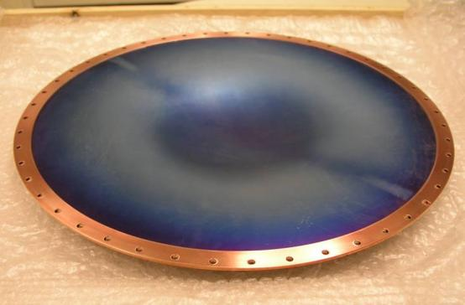
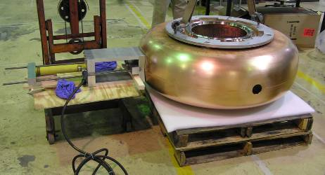
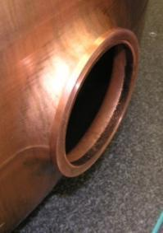
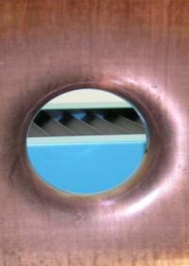
Development of 201 MHz Cavity
Cavity fabrication technique development, in collaboration with JLab; The cavity has been high power tested at MTA, Fermilab
42-cm

Slide 20
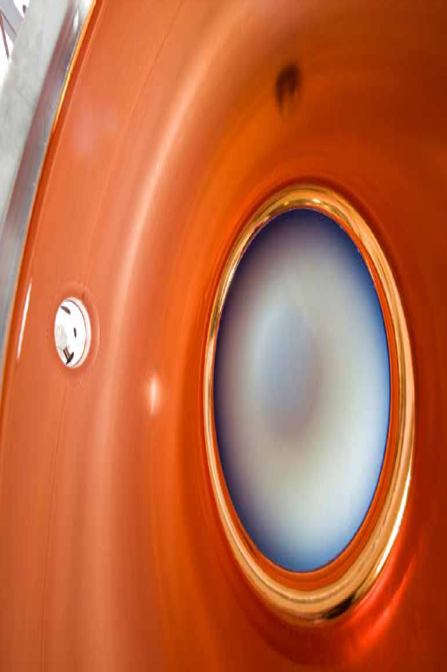
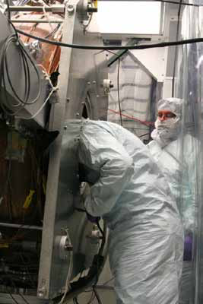
Tests of 201-MHz RF Cavity I
SRF cavity post-processing techniques help NCRF
Fast conditioning, 21 MV/m with no B field, no surface damage found
Tests with fringe fields of Lab G magnet, 12 MV/m
Damage in coupler and coaxial transmission line, Cu sputtering in ceramic windows, more realistic and systematic studies require Coupling Coil magnet

Slide 21
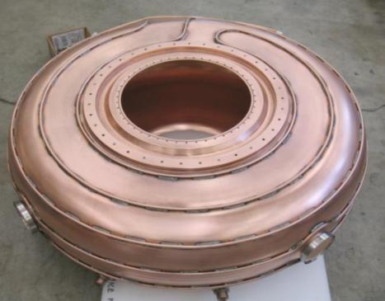
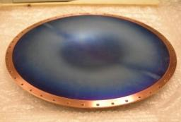
201 MHz MICE Prototype Cavity Test at MTA
Preparation for testing of the first MICE 201 MHz cavity using the single cavity vacuum vessel at the MTA, Fermilab
The cavity
Electro-polishing of the first cavity completed at LBNL (May 2012)
Cavity is at Fermilab now & being prepared for installation at MTA
An RF Workshop held May 28-29, 2013
Status of other accessory components
Beryllium windows received
Tuners: fabrication of tuner arms (FNAL) and actuators (LBNL) complete
Couplers: fabrication started at Fermilab
RF windows (received)
1st 201 MHz MICE Cavity
Curved Be window

Slide 22
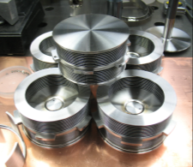
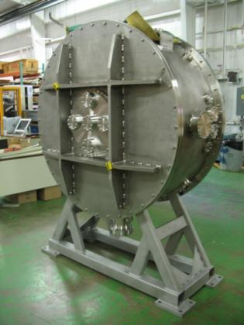
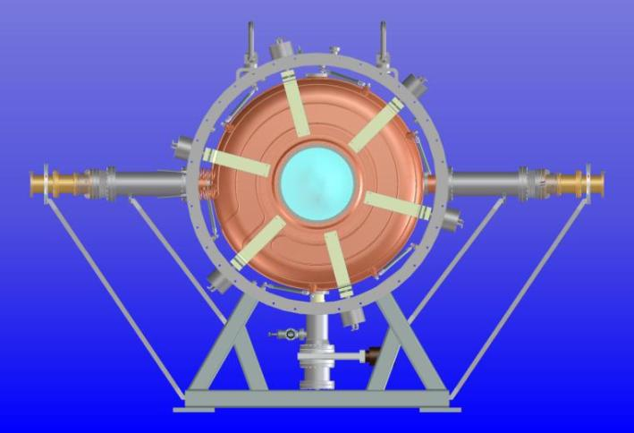
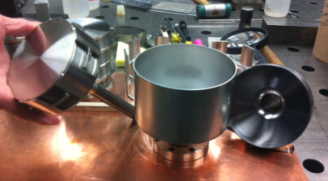
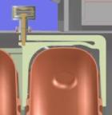
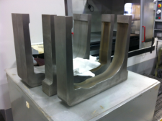
201 MHz MICE Prototype Cavity Test at MTA
Using the single cavity vacuum vessel at Fermilab
Same dimensions and features that a MICE RFCC vacuum vessel would have
Installation fixtures and cavity handling experience
RF commissioning and testing with external magnetic field
Require a coupling coil magnet for testing at MTA
Configuration of cavity and the vessel
Loop coupler
Loop coupler
Tuner actuator
Tuner arms
6 Tuners
Single cavity vessel
Vacuum pump

Slide 23
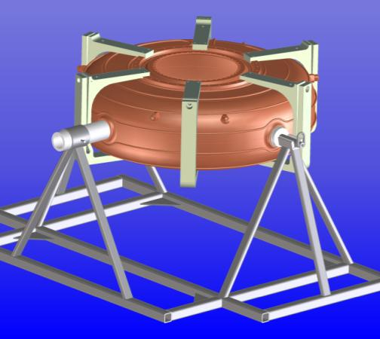
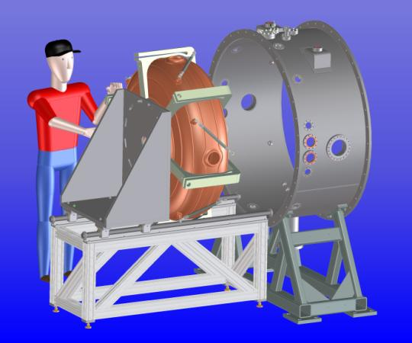
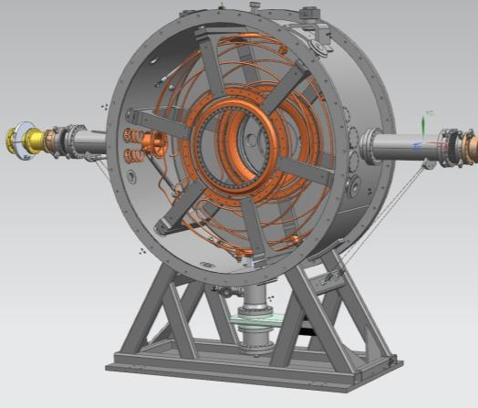
201 MHz MICE Prototype Cavity Test at MTA
Close collaboration between Fermilab and LBNL
Hardware design and fabrication (cavity, vessel, accessory components and etc. ) complete, and most parts are at Fermilab
Development of installation concept
Fixture fabrication
Experimental testing program at MTA, Fermilab
Development of test plan
23

Slide 24
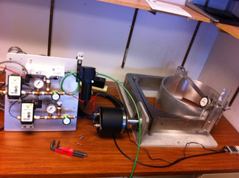
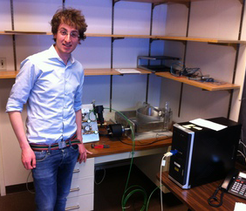
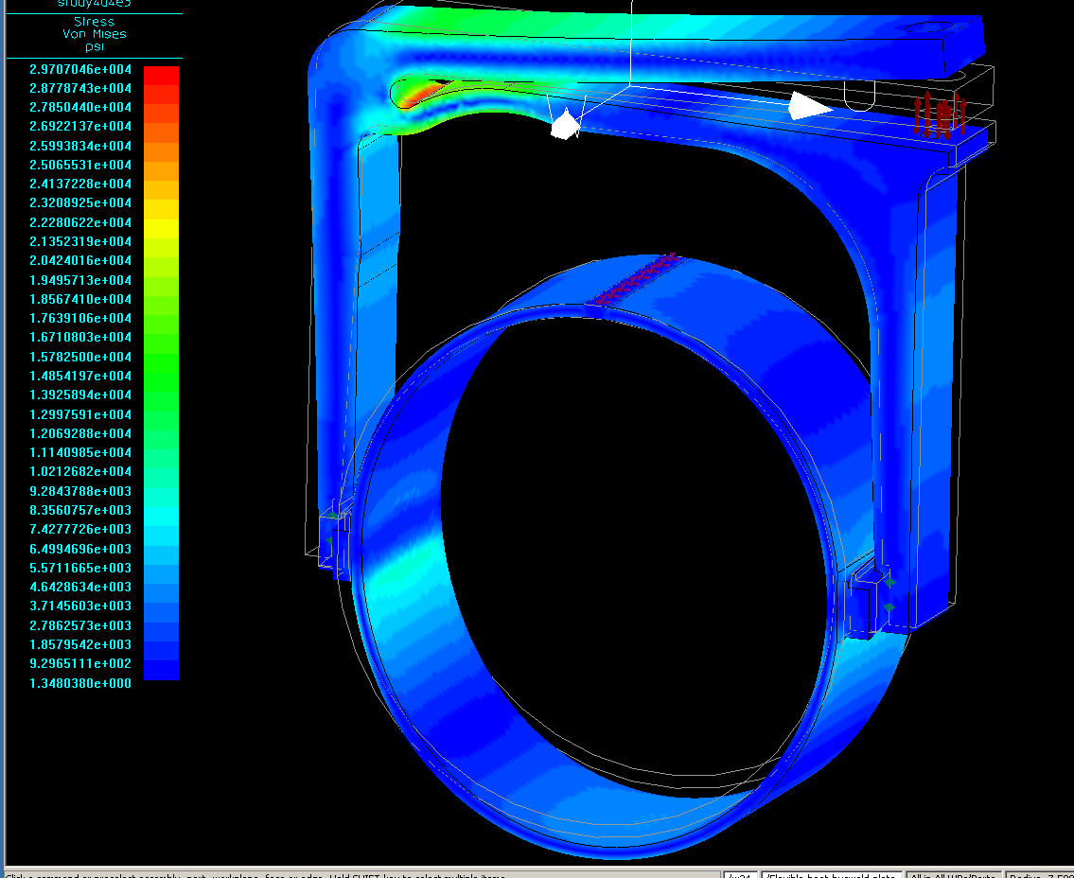
Tuner Test
Tuner assembly has been tested (in air) at Fermilab
Consistent performance of each tuner arm
Measurement agree well with FEA simulations
Push and pull have slight slope difference for pressure versus deflection
Measurements of pressure versus cavity frequency shift will be conducted this summer
Lucas Somaschini

Slide 25
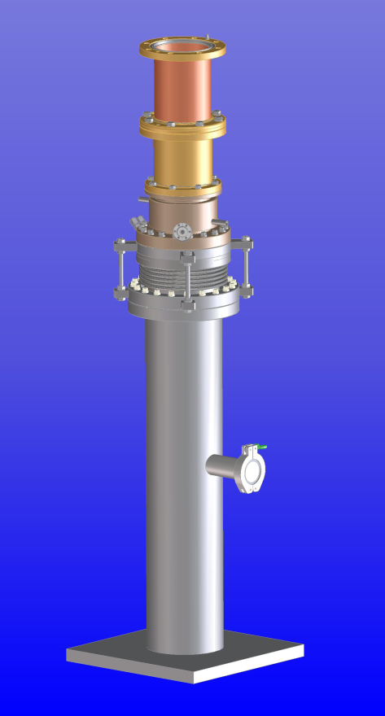
MICE RF Coupler
Updated coupler design
Fabrication drawings complete
Quotes from vendors reviewed
Fabrication start soon at LBNL
Materials ordered
Ti-N coating of the loop region and outer tube of the coaxial transmission line
Need to modify existing vacuum chamber at LBNL
Schedule
Estimated to be ∼ 12 weeks at LBNL machine shop

Slide 26
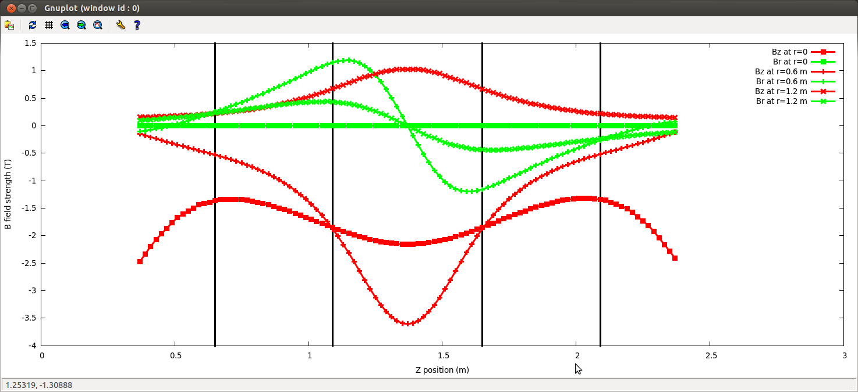
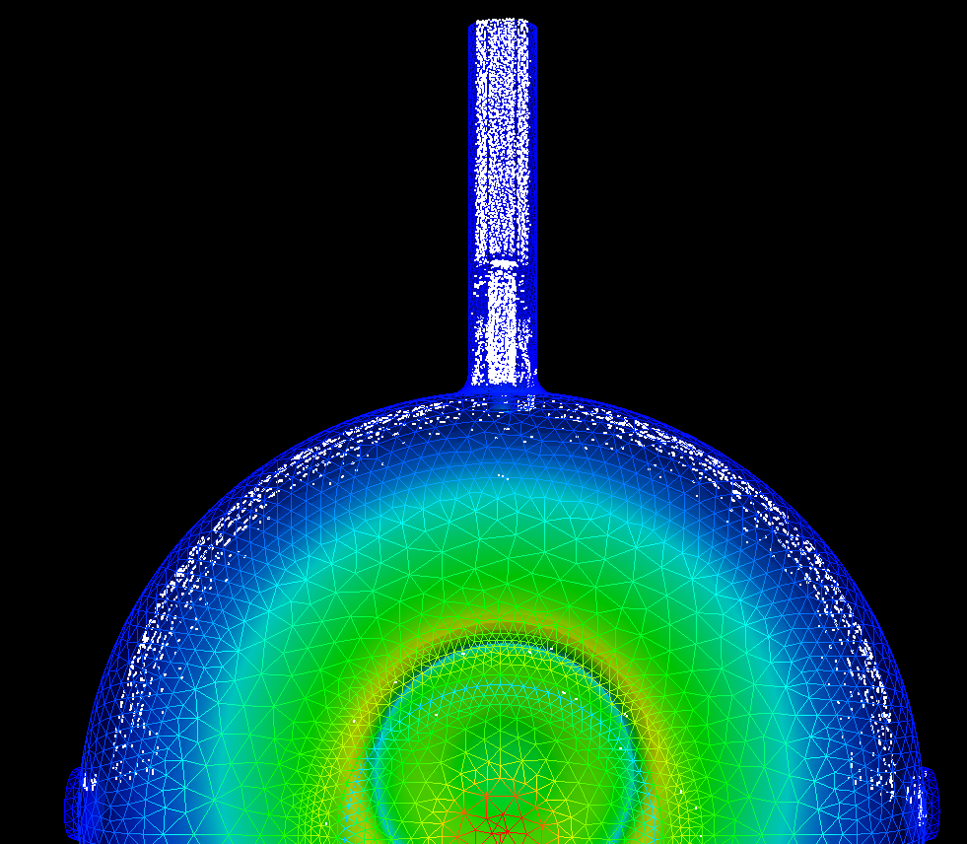
MP Simulation Studies
High power RF tests of MuCool prototype cavity at MTA showed damage in RF couplers and sputtering of Cu on ceramic RF windows
Suggest MP may have happened in the couplers
MP simulation studies (Dr. T. Luo’s talk)
Collaboration with SLAC using ACE3P, including some code development
Simulation studies using MICE B-field map & cavity and coupler geometry

Slide 27
US MICE Responsibility
Hardware responsibility in MICE cooling channel
Two RFCC modules: eight RF cavities
Two spectrometer solenoid magnets
International MICE experiment at RAL
Demonstration of muon ionization cooling

Slide 28
MICE Cavity Status
All ten cavities with brazed water cooling pipes (two spares), nine cavities at LBNL to be EPed and 1st EPed cavity at FNAL
Five cavities measured (low power measurements)
Received 11 beryllium windows
Received 10 ceramic RF windows
Tuner design complete, one set of tuner assembly fabricated and tested offline
PO of 24 tuner arms placed
Updated design of RF power coupler complete, fabrication of two coupler started
Assembly and installation of the 1st EPed MICE prototype cavity in progress at FNAL (Prof. Y. Torun’s presentation)
Sectional view of RFCC module

Slide 29
NCRF R&D Goals
Trying to understand the RF breakdown problems in magnetic fields
Develop a workable solution for high gradient NCRF operating in B fields approximately 3 Tesla (initially) and higher (future).
Support sub-assembly prototyping for the 6D cooling bench test.
Guggenheim
FOFO Snake
HCC

Slide 30
Multi-Institute Collaboration
RF R&D program has been operating successfully in a collaborative effort:
Fermi National Accelerator Laboratory
Lawrence Berkeley National Laboratory
Brookhaven National Laboratory
Jefferson Laboratory
Illinois Institute of Technology
Argonne National Laboratory
University of Mississippi
SLAC National Accelerator Laboratory
Muons Inc.
Tech-X Corp.
RF test facility, MTA at Fermilab

Slide 31
Summary
Muon front-end system requires normal conducting RF cavity operating at high gradient in a few Tesla magnetic field
Remains a challenge
R&D plans developed to find a workable solution
Plans for RF breakdown studies
Vacuum cavities
High pressure RF cavity tests + beam at the MTA
Dielectric loaded cavity
First MICE 201-MHz prototype cavity using the single cavity vessel this fall
We believe our targeted R&D programs will help understand the RF BD and lead to a workable RF cavity solution in a strong magnetic field!

