Slide 1
Status of High Field Solenoid Development (ReBCO)
Ramesh Gupta
(for BNL/PBL Team)
Muon Accelerator Program 2013 Collaboration Meeting (MAP13)

Slide 2
Overview
Goal of the program
Background
Latest test results and other updates
Rapid start of energy extraction with copper discs
Outline of future R&D program under MAP
Schedule and status

Slide 3
Goal of the Program
A 5-year R&D program for feasibility of high field solenoid (30 T or more) based on ReBCO High Temperature Superconductor (HTS)
The target is to demonstrate 30+ T in one (or more) short magnet(s)
Real demonstrations (not just design studies) are necessary since
  these are unprecedented fields for superconducting magnets
  High Temperature Superconductors (HTS), which makes this possible, is a new and challenging conductor and has never been used in such applications
Sub-goal #1: One time demonstration
  to determine if such fields are possible in superconducting solenoids or not?
Sub-goal #2: Protection and Reliability
  if possible, is it practical to use them in a real device or not?
5-year is about the right time frame for a variety of reasons

Slide 4
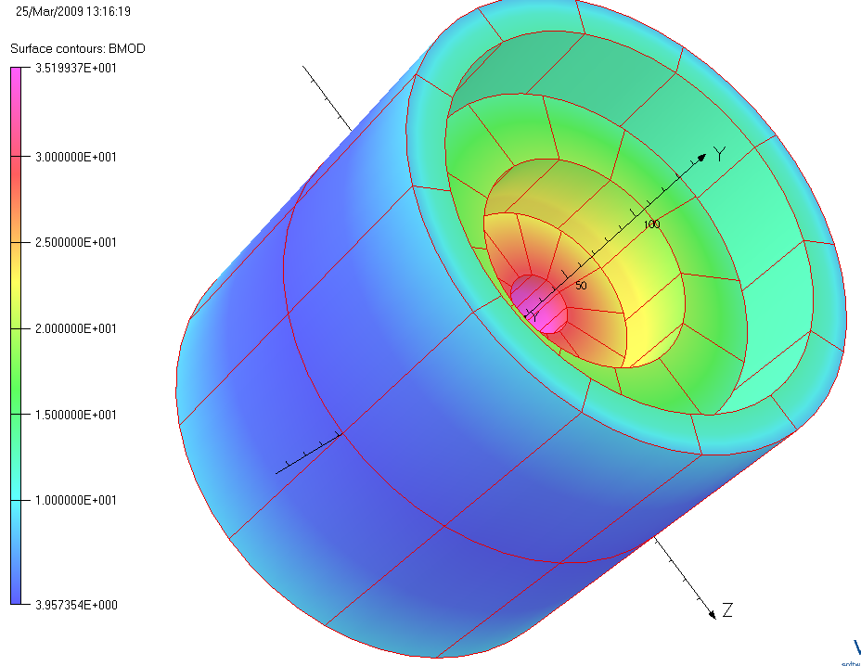
Path to Demonstrate a 30⁺ T Solenoid
Step-by-step R&D approach consisting of three (or more) coils:
>10 T HTS solenoid (midsert): SBIR Phase II with PBL
>12 T HTS (insert): SBIR Phase II with PBL
>8 T LTS (outsert): Not yet started
20⁺ T HTS Solenoid (1 & 2):
  addresses initial challenges with high field HTS magnets
30⁺ T Solenoid (1, 2 and 3):
  addresses challenges with high field superconducting solenoids
1
3
2
Synergy and experience (with coils made ~40 km of 4mm tape equivalent) with other HTS R&D programs at BNL creates a unique opportunity.

Slide 5
Background (1)
PBL (with BNL as a partner) got funded for three Phase 1 and two Phase II SBIRs on high field solenoids for Muon Collider
  First SBIR (Phase I and Phase II) for ~10 T, 100 mm ReBCO midsert
  Second SBIR (Phase I and Phase II) for ~12 T, 25 mm ReBCO insert and for integrating insert and midsert for >20 T all HTS solenoid
  Third SBIR (Phase 1 funded but Phase II was not) for Nb₃Sn outsert
These were presented as bold experimental programs
  Initial results have been impressive (may be too impressive) with record fields generated in HTS coils
  They showed us the potential of the ReBCO high field technology to solve a critical technology challenge for MAP (30 -50 T solenoid)
This should be considered a noteworthy achievement of the SBIR program

Slide 6
Background (2)
Recently we had some surprises
  Murphy strikes (finally) and we get setbacks
  Some pancakes got degraded/damaged during 77 K tests
  This was surprising because
    We had tested all of these coils before (some multiple times) and they were OK. We also thought we had established a good test procedures
    If not for the nature of R&D with new conductor, one would be more prepared to get negative results during high field 4 K tests (not at 77K)
With technology potential demonstrated under SBIR programs, the next phase of development now continues with direct funding from MAP
  This includes moving forward to understand and overcome above setback (significant portion of this presentation is on that)
  This also includes more support for engineering, analysis and related R&D

Slide 7
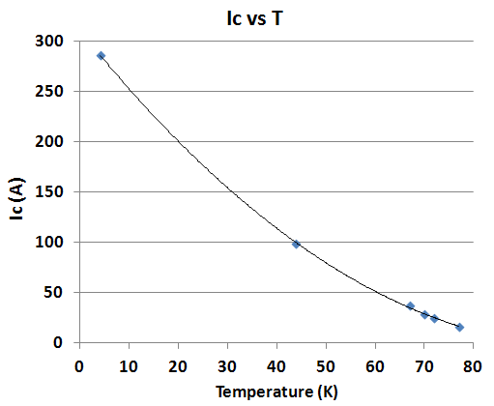
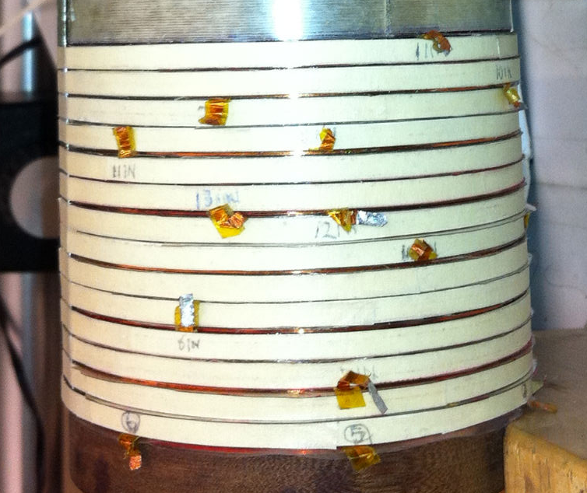
High Field HTS Solenoid Test Results (magnet #1 - insert)
Field on axis:
  over 15 T
Field on coil:
  over 16 T
(original target was 10-12 T)
Real demo of ReBCO (2G) HTS to create high field
Highest field in an all HTS solenoid (previous best SP/NHMFL ~10.4 T)
Overall J_{o} in coil:
>500 A/mm² at 16 T
(despite anisotropy)
14 pancake coils with ~25 mm aperture

Slide 8
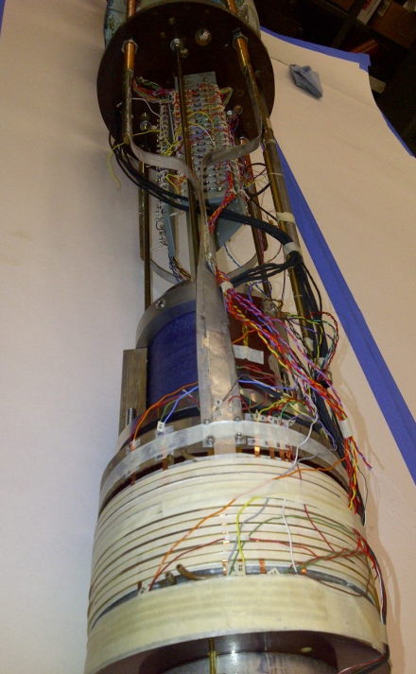
Test Results of HTS Solenoid #2 (½ Midsert, 12 coils instead of 24)
250 A ==>
6.4 T on axis
9.2 T peak field on coil
Coil could have reached above 10 T peak (original target), but was not ramped up to protect electronics of that time.
Full solenoid with 24 pancakes should create >10 T on axis.

Slide 9
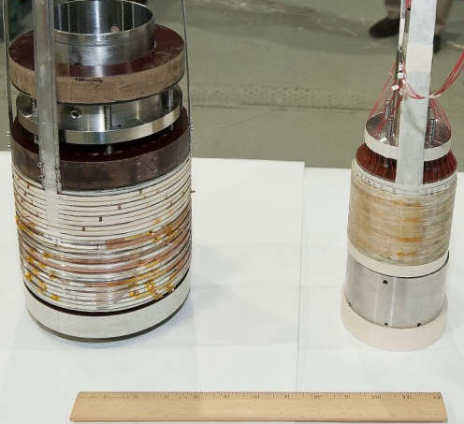
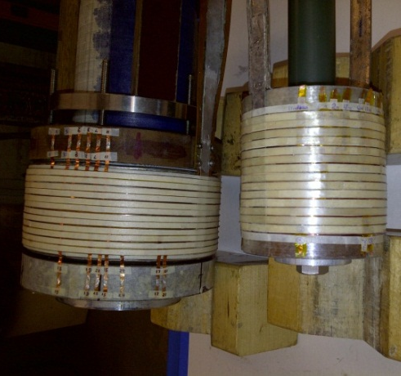
Fully Constructed (insert + midsert) HTS Solenoid for 20+ T Test
15⁺ T, 25 mm HTS solenoid (insert) with 14 pancakes (each pancake made with 50 m HTS)
10⁺ T,100 mm HTS solenoid (midsert) with 24 pancakes (each pancake made with 100 m HTS)
100 mm HTS solenoids –
half length (12 pancakes) and full length(24 pancakes)

Slide 10
77 K Test Results

Slide 11
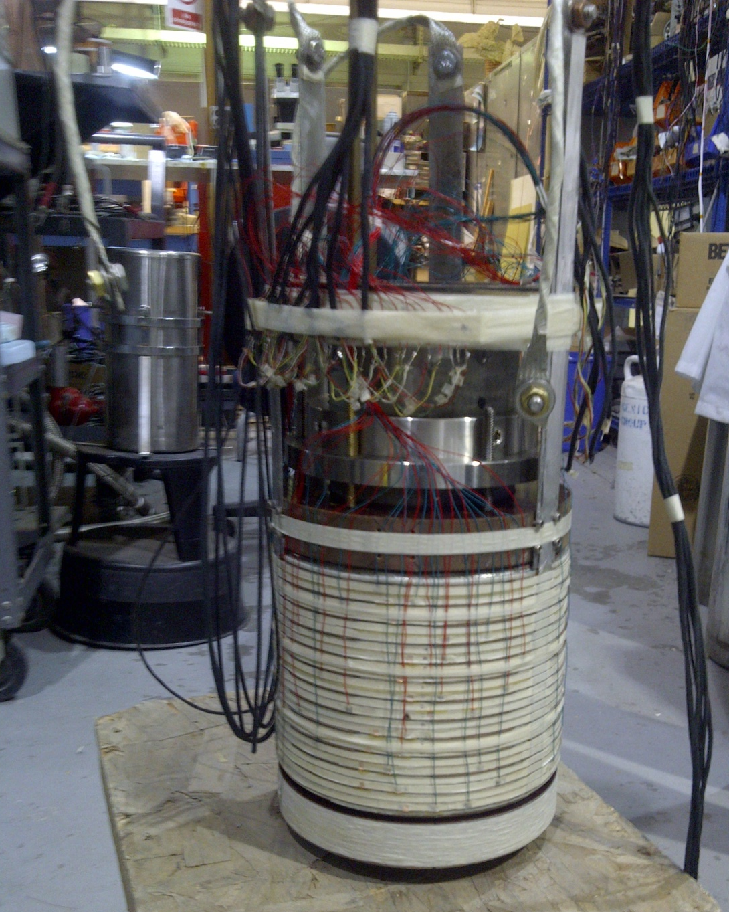
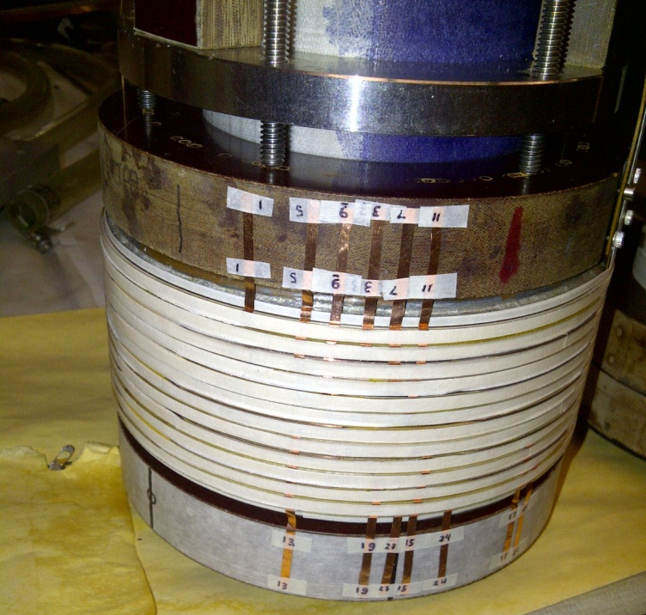
PBL/BNL Midsert Solenoid
Each 100 mm i.d. pancake uses 100 meter of conductor.
Picture on left (half solenoid with 12 pancakes, previously tested at 4 K)
Picture on right (full solenoid with 24 pancakes, recently tested at 77 K) Picture taken in December 2012

Slide 12
Earlier 77 K Test of Half Midsert
(half midsert contains 12 pancakes)
These tests were performed well over a year ago
100 mm aperture solenoid
Each pancake uses 100 m of HTS tape.
All pancakes are powered in series
Critical current of 12 pancake system: ~21 A for 0.1 μV/cm criterion.

Slide 13
77 K Test of Full HTS Midsert
(full midsert contains 24 pancakes)
Tests performed in Nov. 2012
All pancakes are powered in series. Critical current of 24 pancake system: ~20 A for 0.1 μV/cm criterion. It was ~21 A for 12.

Slide 14
Surprise/Setback During the 77 K Test of 100 mm Coil made with 24 Pancakes
During the final 77 K QA test before the scheduled high field 4K run, several pancakes started showing early onset of resistive voltages.
The same assembly has been earlier tested at 77 K and performed well.
Setback despite the fact that the cool-down was the slowest and the most controlled ever to minimize the thermal strain. Furthermore, copper discs were used between the pancakes to provide uniform cooling
Only significant work on the coil
  subject to repeated 77 K tests for debugging quench protection system
  a few layers of wet fiberglass epoxy support over the individual coil
No particular order in the location of these (now) underperforming pancakes
Several 77 K follow-on tests found no further deterioration in performance

Slide 15
77 K and sub-cool tests of 100 mm pancakes (powered in series)
Bad coils
Sub-cool
77 K
Good coils
Note: Several coils show early on-set of resistive voltages
    (next slide – location of bad coils)

Slide 16
Coils of Concern (6 out of 24)
(Varying degree of concern)
16
Coil with the most damage/degradation
15
8
11
5
1
Coil with the smallest noticeable degradation

Slide 17
Good (or almost good) Coils (18 of 24)

Slide 18
Moving Forward
Determine the extent of damage and locate the problem area
  Several pancakes (at least 6 of 24) clearly show a degraded performance by a varying amount
  Essentially all internal splices (between two pancakes) show a large increase in joint resistance
Can we make a repair and move forward?
  There is a significant investment both in terms of time (several years) and conductor (2.4 km). Therefore, there is a strong incentive for repairing
  Splices can be repaired. But how about the pancake coils?
Identify the possible cause(s) and way to avoid them in future

Slide 19
Detailed Study of Individual Coils
Take solenoid apart to critically examine each of twenty four pancakes
  when they are tested in series bad coils limits a critical examination of coils which are not so bad as one can’t push current so high
  compare performance before and after the incident
The goal is to determine how many can be used (either as is or after repair)

Slide 20
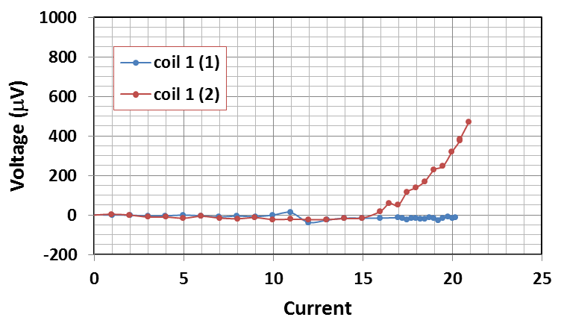
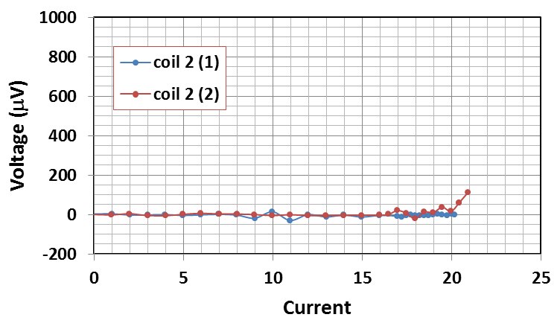
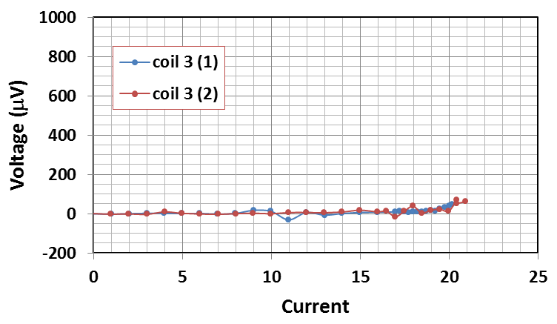
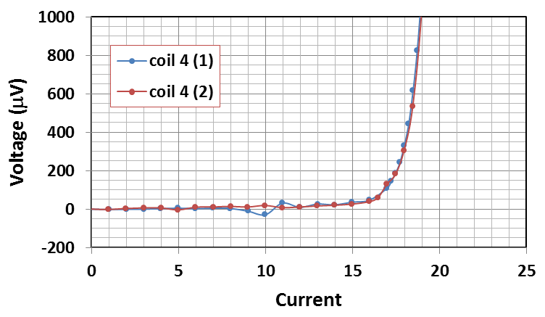
Before (1) and After (2) cooldown
(1 mV is 0.1 μV/cm for 100 meter)
Not so good
(15 Amp)
Good coil
(no change)
Was Good
Good coil
(no change)
Good coil
(no change)
Coil #2, #3 and #4 seem OK. Coil #1 has changed. Is it useable?

Slide 21
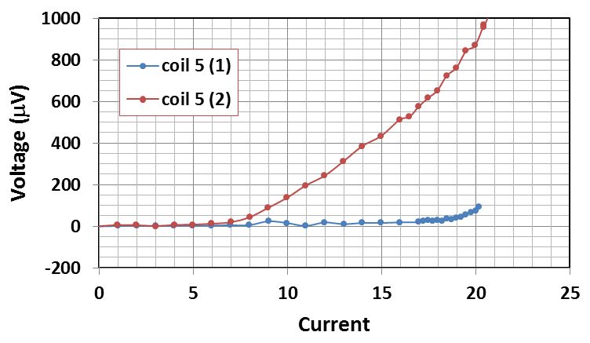
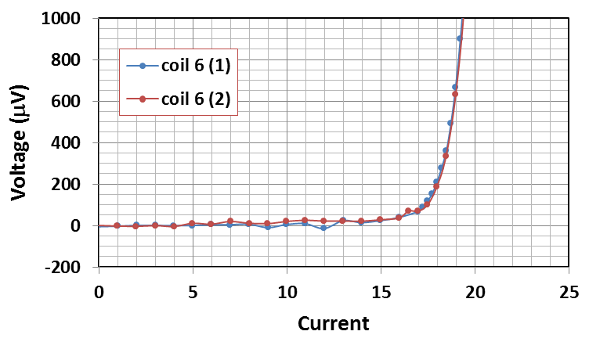
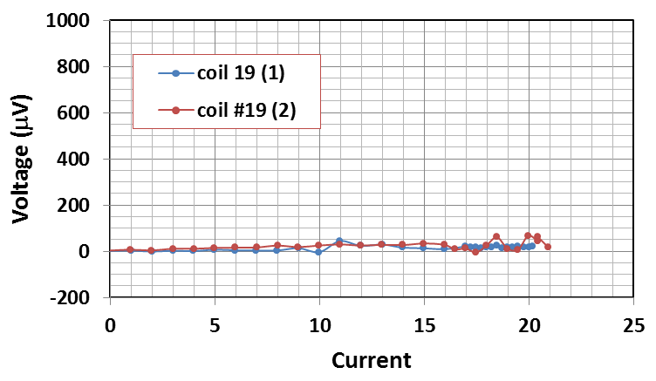
Before (1) and After (2) cooldown
(1 mV is 0.1 μV/cm for 100 meter)
Became Bad
(5th worst coil)
Good coil
(no change)
Was Good
Coil #5 was good initially but became bad after cooldown.
Coil #6 and coil #19 are OK.
Similar analysis on other coils were also performed.
Only the worst (#15 and #16) will be discussed (next few slides).
Good coil
(no change)

Slide 22
Repairing of the Coils
Start with coil #15&#16 (the worst pair).
Splice joint is replaced with a new type of diagonal joint (used in another program)
First turn is removed from each pancake
Coil performance is measured and compared it with that before the repair
Was Bad
Became Good
Was Bad
Became Good
Was Bad
Outcome: Splice joint and coil #15 got fully repaired. However, coil #16, though got better, but did not get fully repaired.
Remove one more turn? Now being done.
Became Better (but not good enough)

Slide 23
Inside turn of Partially Repaired Coil #16
(measured separately @77 K)
Since a v-tap can be put on inside turn easily, we decided to do a 77 K measurement to see if there is a defect there before taking this turn out.
First turn of coil 16 (after 1st repair)
It appears that removing one turn is not sufficient and we may need to remove more.
Where exactly is the defect in first turn and how wide/long is the defect?
Do another run with v-taps placed in small (1 cm) interval.
Remainder of coil 16
Coil 15 (coil became good after repair)

Slide 24
Detailed Analysis of Coil #16
(several v-taps in 1 cm interval)
It seems that the defects in first turn are in the regions 3-4 cm and in 4-5 cm (it could also be one defect spanning in two regions)
Onset of resistive voltage from ~0 A itself means that there is a total break in current path across the conductor width.

Slide 25
Identification of Defect(s) in Coil 16
Resistance: 96 μΩ
Resistance: 94 μΩ
To determine the size of the defect, one needs to know non-sc resistance of the wire (when cold).
To obtained this, we pass 1 A mp and let it warm to non-sc state.
Measured voltage across ~1 cm sections is 0.02 mV (20μV/mm).
Therefore, resistance: 20μΩ/mm.
Thus we have two ~4.7 mm long defects or one 9.5 mm long defect.
Voltage (V) with time @ 1A

Slide 26
Status of the Repair
One more turn of coil #16 has been removed
Visual inspection of the turn removed shows some delimitation of copper that was electro-platted (likely cause of the problem)
The double pancake with coil #15 and #16 will be assembled and tested
One turn of all other 22 pancake coils have also been removed.
They have been spliced together in 11 double-pancakes with new splice joint
All of these will be re-tested to pass 77 K QA test
It is possible some pancakes may require removal of one more turn (coil #15 and #16 were the worst though)
It is also possible that some coils can’t be repaired by removing a couple of turns. In that case, those coils would be removed and the solenoid would have a fewer than 24 coils. We should still be able to achieve the target field.

Slide 27
Updated Design and Test Procedure
Provide better cooling to reduce thermal gradient
Use extended copper discs and expose them to better cooling
Computer modeling and experiments to provide better guidance
Much slower cooling to reduce thermal gradient
  Pre-cool with helium gas
A more controlled test procedure

Slide 28
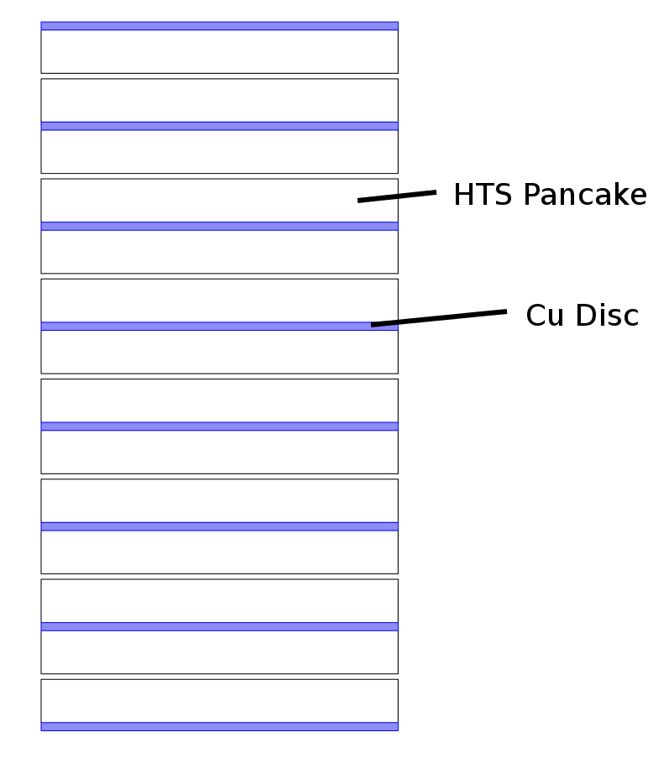
Copper Discs to Minimize Thermal Strain During Cool Down
Excessive thermal strain during cooldown may damage HTS coils
We use copper discs between the double pancakes to provide a more uniform cooling across the coil windings
Schematic: Holger Witte
Next few slides: Another significant benefit of using copper discs.
It was not reported earlier due to possible patent and relationship to other programs.

Slide 29
Another Surprise
(one that is being put to good use)
During the quench protection, we observed a sharp initial drop in coil current as soon as the energy extraction started on external dump resistor.
This was observed both in 25 mm and in 100 mm solenoids.

Slide 30
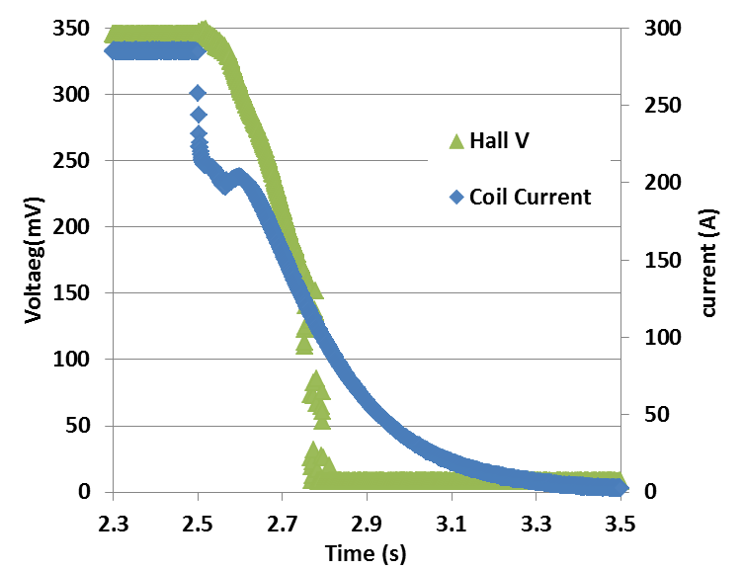
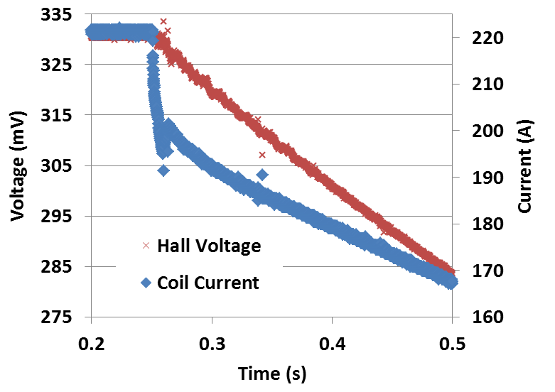
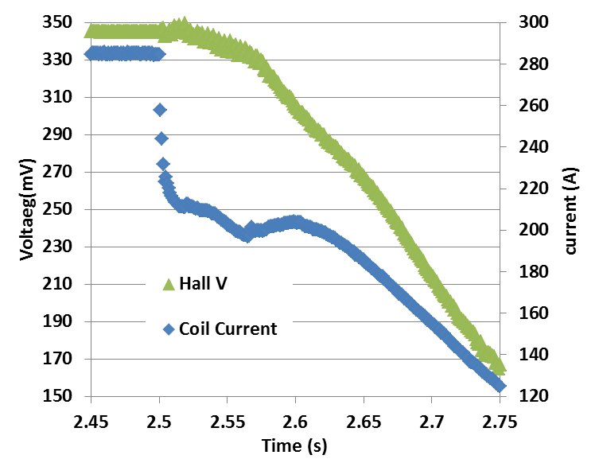
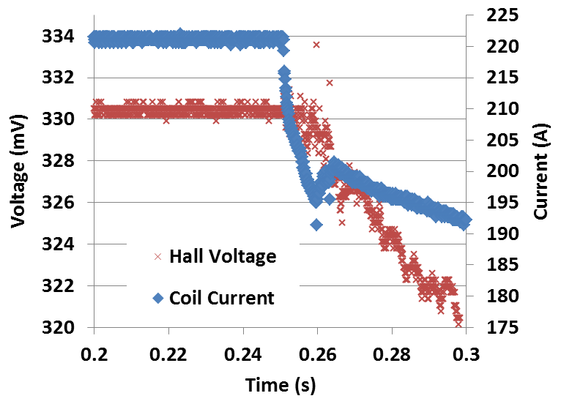
Sharp Drop in Current
(but not such sharp drop in field)
Bo = ~15.6 T
Bo = ~5.3 T
100 mm
12 coils
25 mm
14 coils
Expanded scale
(time)

Slide 31
Possible Sources of Sharp Drop in Current
The following sources were initially attributed to the possible sharp drop in current in coil:
Instrument malfunction
Current transfer to the stainless steel tape (co-wound with HTS tape)
Current transfer to copper discs

Slide 32
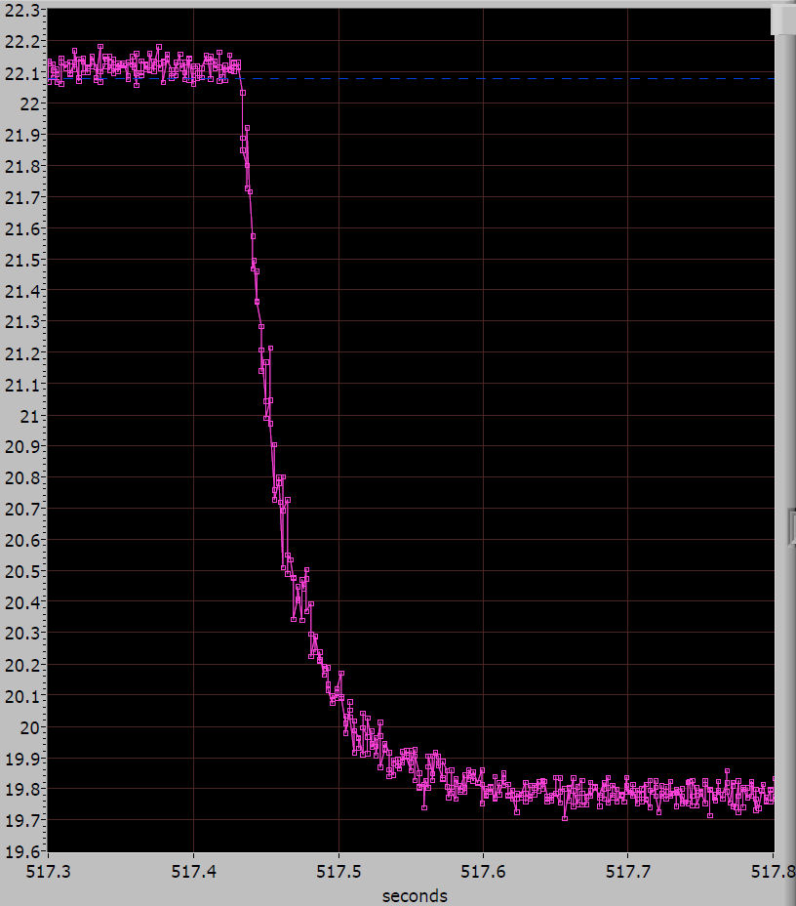
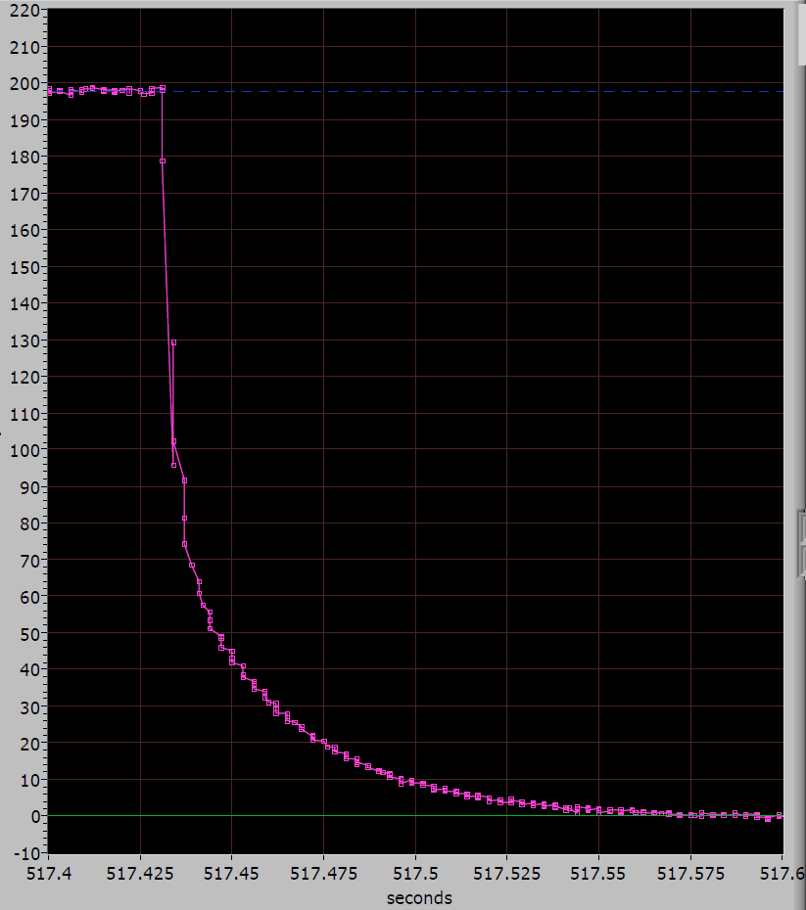
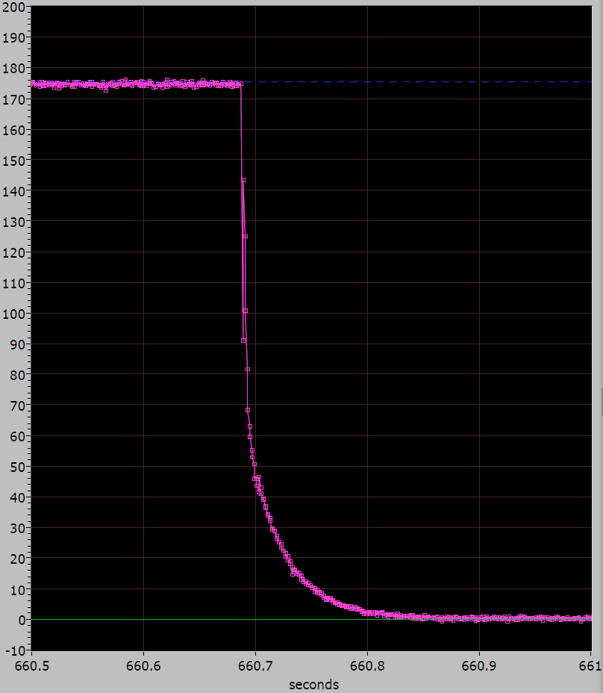
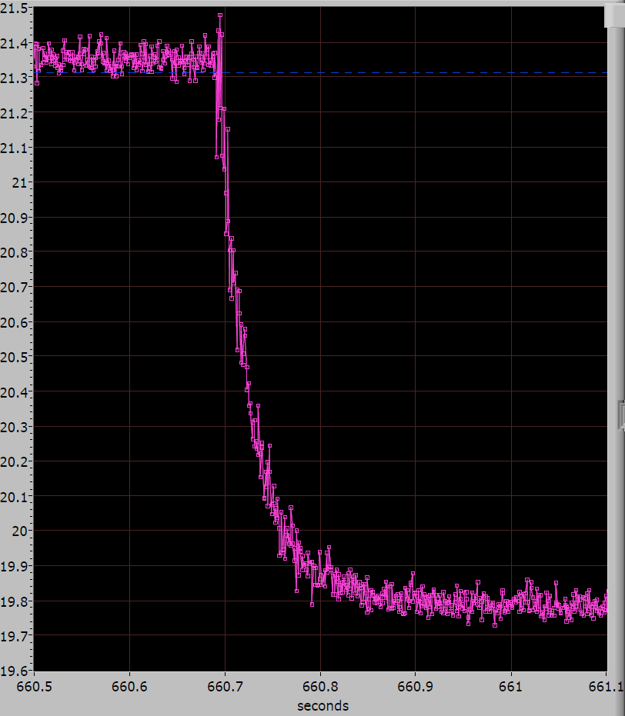
Decay of Current and Field in PBL/BNL Coils for HTS co-wound with SS and Kapton Tape
Discharge of coils made with Kapton and Stainless Steel insulation in 20 T background at NHMFL (total field ~22 T)
Field vs Time (Kapton)
Current vs Time (Kapton)
Current vs Time (SS)
Field vs Time (SS)
Decays after shut-off are similar in both cases (SS and Kapton).
Therefore, stainless steel tape can’t be responsible for this.

Slide 33

Confirmation with Simulation
Initial simulation by Bob Weggel (PBL) showed that inductive transfer of current from HTS coils to copper discs could produce such a behavior.
Since then Holger Witte has done more detailed FEM simulation. That explains the behavior more quantitatively (abstract submitted to MT23).

Slide 34
Role of Copper Discs in Quench Protection
It was quickly realized that such a rapid reduction of current could be used to our advantage in protecting HTS coils
  energy from the coil is instantaneously extracted
  One quickly goes below the danger value of current in coil and that may allow coil to operate safely a bit longer
  Copper discs may help spreading the energy (heating)
Copper discs now play a major role in quench protection of HTS coils in various programs at BNL

Slide 35
Quench Protection Strategies
(continues)

Slide 36
BNL Quench Protection Strategy
Things happen slowly in HTS => quench propagation velocities, increasing coil temperature to quench whole coil , etc., etc.
Use problems (properties) of HTS “of things happening slowly” to our advantage.
In HTS, there is a long pre-quench phase with very small resistive voltage during which the coils can be safely operated.
Detect this pre-quench phase early on and initiate quench protection action.
This requires detecting small resistive voltage in presence of large noise and inductive voltage – challenge in large systems.
BNL has made significant advances in electronics to detect start of this pre-quench phase well below 1 mV rather than 50-100 mV.
Pre-quench phase
Use quench protection heaters as the final line of defense

Slide 37
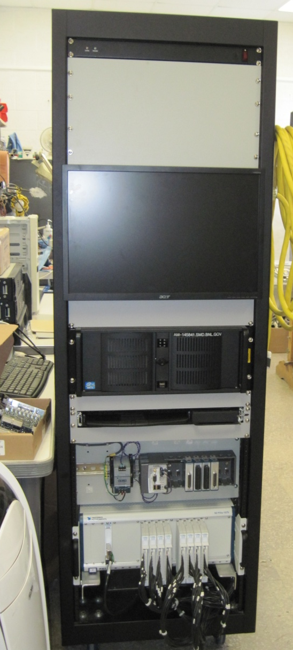
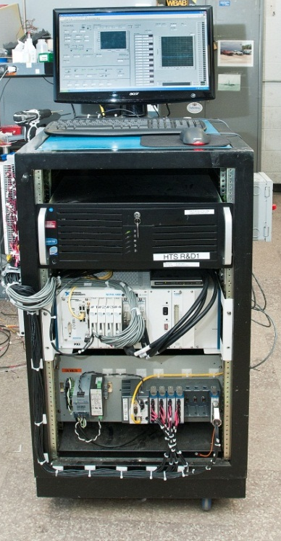
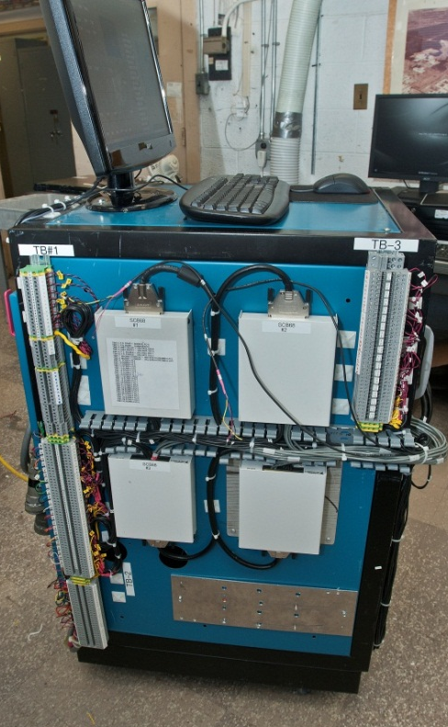
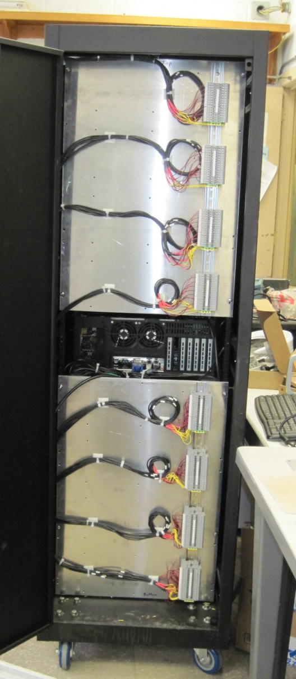
Expansion of Advanced Quench Detection System at BNL
The electronics should be able to withstand high isolation voltage to allow rapid energy extraction (t=L/R; V=I*R)
We need many channels to monitor as many pancakes as possible individually (and rest combined in groups)
Cabinet #2 (32 channels, 1kV)
(expandable to 64 and 3kV)
Cabinet #1 (32 channels, 1kV)

Slide 38
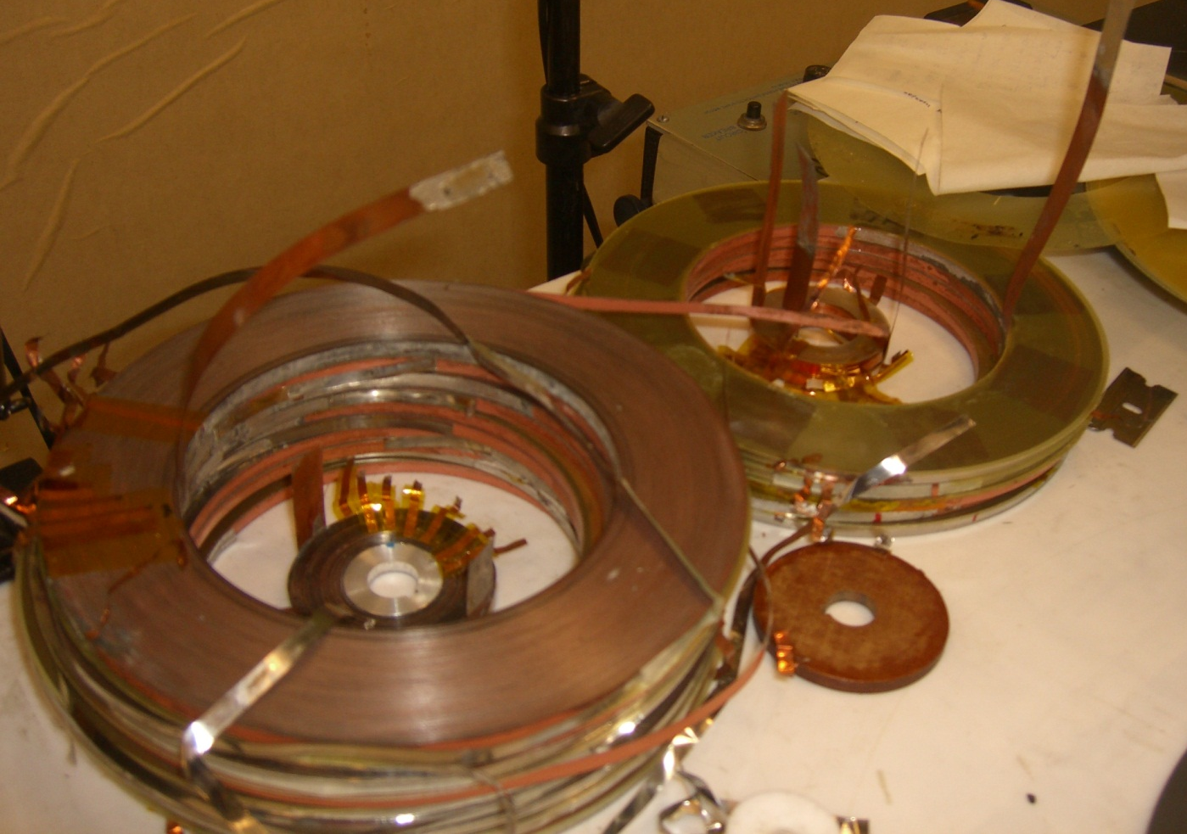
Quench Studies in Small HTS Coils
We want to learn more about quench propagation and quench protection.
We want to examine what HTS coils can tolerate before getting degraded.
We want to try different quench protection ideas in small coils.
Carryout various quench related studies in small single pancake, double pancake and bi-filar coils.
In these studies coils can be operated beyond the safe value (and possibly get destroyed) to find out what the limit is?

Slide 39
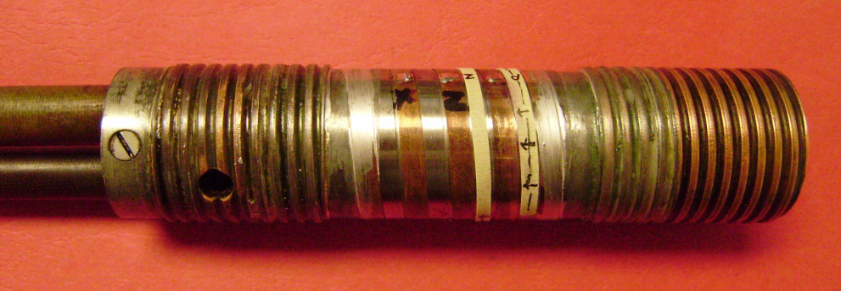
Conductor Performance Measurements
HTS vendor typically measure performance at 77 K, self-field
We find a large variation in scaling between 77 K and 4K, in field
We need to monitor it and know this scaling for the conductor used in making magnet
For measuring performance in field parallel
Measured field perpendicular scaling (Ghosh)
There are also some issues with the mechanical property of the conductor.
This (and other similar studies) is part of R&D that needs to be carried out.

Slide 40
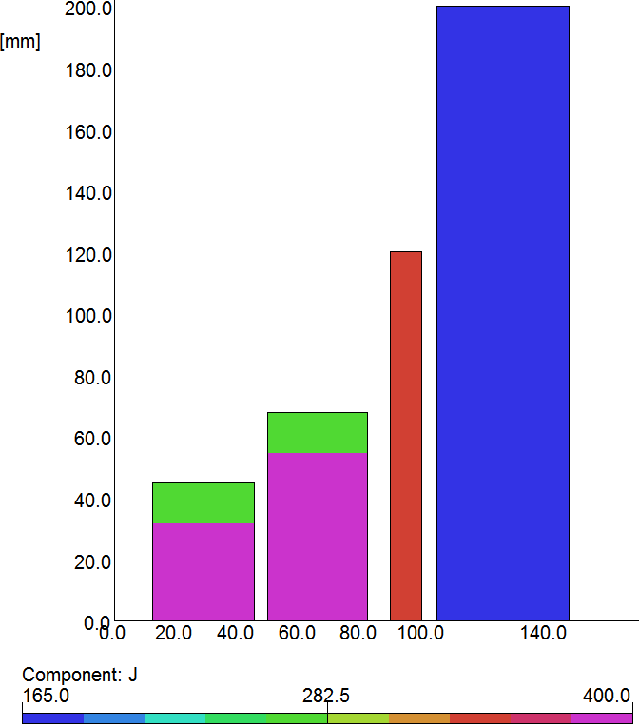
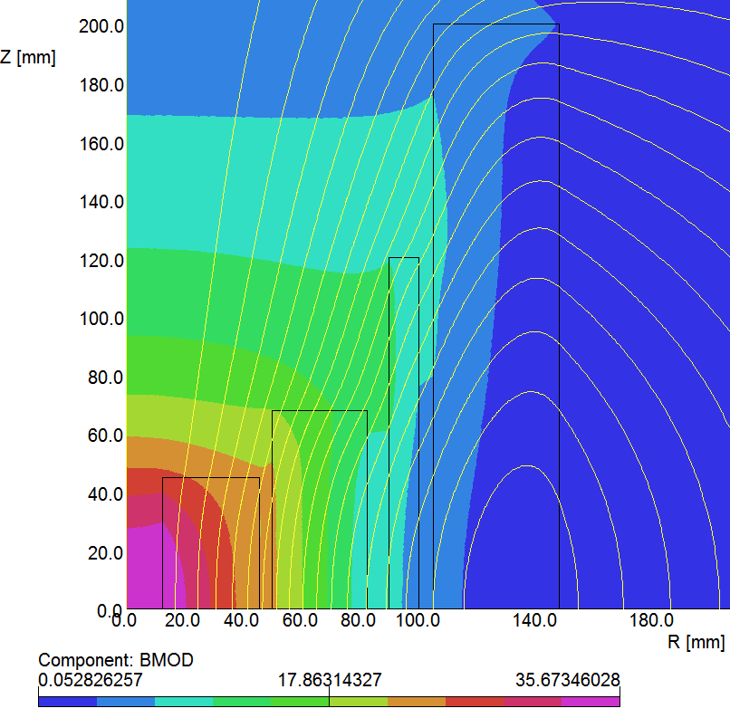
Proposed 35 T Design
Strategy: Leverage existing coils and parts as much as possible to reduce costs.
It is a highly leveraged program.
It is built upon the major progress and coils made with PBL/BNL SBIRs.
z
Construction of LTS outsert is also leveraged.
New HTS coils (graded Je)
LTS outsert
HTS mid-sert
HTS insert
R (mm)

Slide 41
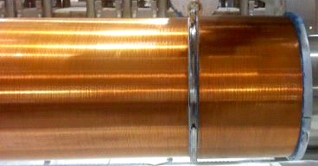
NbTi Solenoid based on Several Existing Components and Proven Design
Two of these solenoids were recently tested to 6.6 T (test stopped 10% above design field)
Design, technology and may be some leftover material available

Slide 42
Status of ReBCO High Field Solenoid Development Tasks (FY2013)
Prepare the advanced quench detection system for testing 100 mm PBL/BNL solenoid (Q1/Q2)
Complete the construction of 100mm PBL/BNL solenoid consisting of 24 pancakes (Q1/Q2)
Perform the test of quench protection system with 100 mm PBL/BNL solenoid at 77 K (Q2)
Disassemble the 100 mm aperture (midsert) PBL/BNL solenoid to examine individual pancakes (Q3)
Identify the source of degradation in PBL/BNL solenoid during the 77K system tests in Q2 (Q3)
Device a formal procedure for testing a group of pancake coils at ~77K (Q3)
Failure Analysis Report on Coil Autopsy Studies (Q3)
Repair and assemble 100 mm PBL/BNL solenoid for high field test at 4K (Q4)
Integrate the advanced quench protection system for testing above solenoid at 4K (Q4)
Perform high field test of the repaired 100 mm PBL/BNL solenoid at 4K (Q4)
On schedule upto Q3. Q4 may get slightly delayed because of conflict in scheduling with other programs

Slide 43
Status of ReBCO High Field Solenoid Development Tasks (FY2014)
Complete the test of individual pancakes of 25 mm PBL/BNL insert solenoid (Q1)
Assemble 25 mm (insert) PBL/BNL insert solenoid for high field test at 4K (Q2)
Integrate insert and midsert HTS solenoids for producing >20 T (Q3)
Integrate insert and midsert solenoids with the advanced quench protection system (Q3)
Readiness Review prior to test (Q3)
Perform conceptual engineering design of >30 T solenoid consisting of HTS and LTS (Q3)
Initiate mechanical and thermal analysis in support of the above programs (Q3)
Perform high field (>20 T) test of the combined solenoid at 4K (Q4)
Write a report (to be followed by a conference paper) on the test results (Q4)
  Wind HTS coils for quench studies which can also be tested to their limit (FY2015 Q1)
FY15 Task
Move to FY14
Some tasks takes advantage of synergy with other ongoing ReBCO programs at BNL (some exhausted). Surprises or reduction in budget may delay tasks listed in red (scope contingency).
Request to move quench studies to FY14 (may be under GARD).

Slide 44
Status of ReBCO High Field Solenoid Development Tasks (FY2015)
Wind HTS coils for quench studies which can also be tested to their limit (Q1)
Perform preliminary engineering design of >30T solenoid consisting of HTS and LTS (Q1/Q2)
Review of >30 T Solenoid Design (Q2)
Perform quench studies and test to limit studies (at 4 K) in specially wound coils (Q2)
Wind additional HTS coils needed to achieve >30 T in a hybrid (HTS + LTS) solenoid (Q2)
Complete mechanical and thermal analysis of >30 T design with ANSYS or similar programs (Q2/Q3)
Perform 77 K tests of new (additional) HTS coils wound at 77 K (Q3)
Production Readiness Review (Q3)
Start construction of the NbTi outsert solenoid (Q4)
Completing tasks listed in FY13 and FY14 will allow 30⁺ T design to be carried out on a stronger technical footing.

Slide 45
Summary
We are optimistic about the viability of HTS (partly by the record fields already created)
  High strength ReBCO is particularly suitable here
We had some setback recently
  Cause primarily understood and a way forward found
  It has been demonstrated that coils can be repaired
  Direct support from MAP is crucial to deal with such setbacks which are hard to avoid during R&D Phase
Copper discs play a unique role in quench protection in addition to minimizing the thermal strain on HTS coils
Even though initial results are encouraging, a series of issues point to the need of a several year R&D program to determine if this technology is really feasible or not

Slide 46
Back-up Slides

Slide 47
Magnet Engineering
Because of limited funds, very little magnet engineering was carried out during SBIR programs.
In SBIR program, we chose an approach where funds were used in most effective way to open and show the possibility.
In MAP program, we have to demonstrate the technology.
Therefore, as we move to the next phase, we have to significantly increase both magnet engineering and magnet analysis.

Slide 48
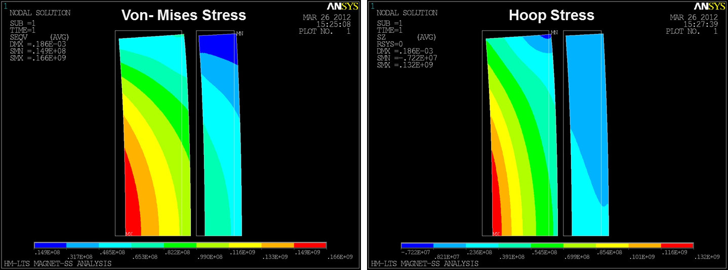
Mechanical Analysis
Von Mises and hoop stress in distribution from ANSYS in an LTS solenoid design
Courtesy:
S. Lakshmi
Von Mises and hoop strain in distribution in an LTS solenoid design from ANSYS

Slide 49
Energy Extraction
After detecting quench, we want to extract energy as fast as system allows
Time constant = L/R : large inductance requires large resistor for this
However, large resistor also creates large voltages : I*R
To avoid a too high voltage, divide coil in sections (reduce inductance)
Each section will have its own dump resistor and would be powered by a separate power supply
      Multiple power supplies also permits a dynamic grading, which in principle should allow higher field tests

Slide 50
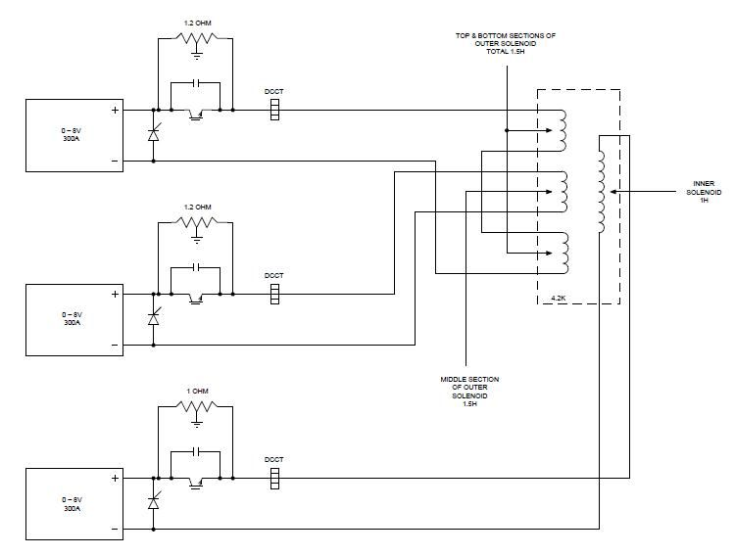
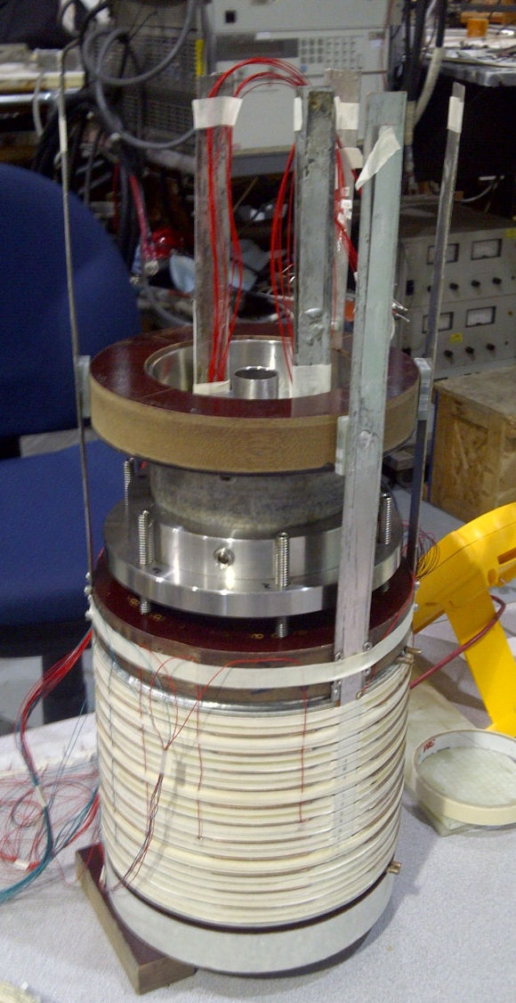
Solenoid with Multiple (3) Sections
(38 pancake coils)
#1 : insert (14 pancakes), #2 and #3 : two half midserts (12 pancakes each)
Solenoid is sectionalized to extract energy fast on external dump resistors while keeping voltage low
Bonus: Can also be used to provide electrical grading

Slide 51
Test of PBL/BNL coils at NHMFL with HTS tape co-wound with SS and Kapton Tape (2)
Discharge of coils made with Kapton and Stainless Steel Insulation in 20 T background (total field ~22 T)
Current vs Time (Kapton)
Field vs Time (Kapton)
Field vs Time (SS)
Current vs Time (SS)
Decays after shut-off are similar in Kapton and SS coils.
Therefore, stainless steel tape can’t be responsible for this.

Slide 52
Variation of Critical Current in Small (1 cm long) Sections
Measure I_{c} by taking advantage of the fact that we have many voltage-taps in small (~1cm) sections.
I_{c} seems to be reasonably uniform. In almost all cases, onset of resistive voltage starts at ~36A
Note: Very small scale (voltages in micro-volts)

