Slide 1
Complete Helical Cooling Channel Design & Simulations*
*Work supported in part by DOE STTR grant DE-SC 0007634.

Slide 2
Outline
Schedule
Expected Cooling Performance
Charge Separation
Summary

Slide 3
Preliminaries
This work was supported under a phase II STTR grant with JLAB announced 3/4/13 with start date 4/22/13.
We have weekly meetings with attendance and/or input by:
Slava Derbenev (JLAB subgrant PI), Vasiliy Morozov, Rol Johnson, Chuck Ankenbrandt, Dave Neuffer, Katsuya Yonehara, Jim Maloney, & Cary Yoshikawa (MuPlus PI)

Slide 4
Abbreviated Schedule (T₀ ≈April 22, 2013)
Six months after start of funding:
Segment and Matching Designs
A matching section out of the Neuffer front end and into an HCC segment that is similar to the first segment in the original design is completed.
Creation of criteria to determine end of a segment and need for the start of the next, most likely driven by cooling rate, is underway.
Lowest Final Emittance
Study of optimal momentum to provide coldest beam underway.
Twelve months after start of funding: (required for 2nd year of funding)
Segment and Matching Designs
Early segments that are maximized for acceptance are designed along with their matching sections.
Lowest Final Emittance
Study of optimal momentum to provide coldest beam completed.

Slide 5
Expected Cooling Performance
The 6D cooling reach of the HCC has not been revisited recently.
Parameters of the 7 HCC cooling channel segments used by Yonehara [IPAC10, MOPD076]. All Z values (except for 0) refer to the end of a segment with segment number designated by unit value.
 | Z | b_{φ} |  | b_{z} | λ_{HCC} | ν | ε_{T} | ε_{L} | ε_{6D} | E
unit | m | T | T/m | T | m | GHz | mm rad | mm | mm3 | Transmission
1 | 0 | 1.3 | -0.5 | -4.2 | 1.0 | 0.325 | 20.4 | 42.8 | 12900
2 | 40 | 1.3 | -0.5 | -4.2 | 1.0 | 0.325 | 5.97 | 19.7 | 415.9 | 0.92
3 | 49 | 1.4 | -0.6 | -4.8 | 0.9 | 0.325 | 4.01 | 15.0 | 108 | 0.86
4 | 129 | 1.7 | -0.8 | -5.2 | 0.8 | 0.325 | 1.02 | 4.8 | 3.2 | 0.73
5 | 219 | 2.6 | -2.0 | -8.5 | 0.5 | 0.65 | 0.58 | 2.1 | 2.0 | 0.66
6 | 243 | 3.2 | -3.1 | -9.8 | 0.4 | 0.65 | 0.42 | 1.3 | 0.14 | 0.64
7 | 273 | 4.3 | -5.6 | -14.1 | 0.3 | 0.65 | 0.32 | 1.0 | 0.08 | 0.62
8 | 303 | 4.3 | -5.6 | -14.1 | 0.3 | 1.3 | 0.32 | 1.0* | 0.07 | 0.60
Finding the 6D cooling reach of the HCC will probe lower momentum to find a configuration that supports a stable system with the lowest ε_{equil}.

Slide 6
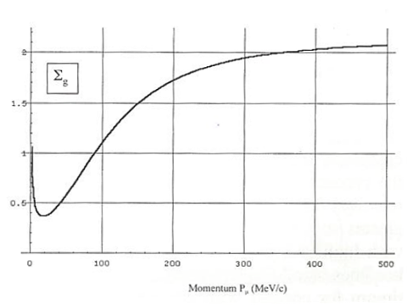
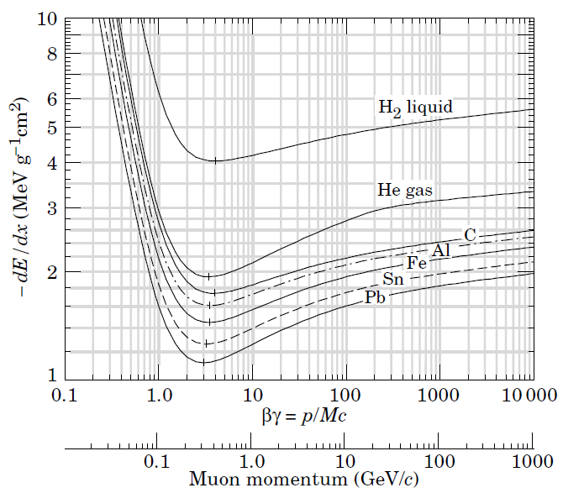
Optimization of Cooling Performance
Balance between operating at:
Large cooling rates → minimizes channel length and decay losses.
Large energy loss rate → to achieve smallest ε_{equil}.
larger
cooling rate
smaller ε_{equil}
smaller ε_{equil}
larger ε_{equil}
smaller
cooling rate
larger ε_{equil}
~cooling rate per dp/p
Sum of cooling partition numbers, Σ_{g}, as a function of muon momentum
Bottom Up Approach: Inject a perfect beam into a long channel and extract the ε_{equil}.
Cooling is possible as long as Σ_{g} > 0, although it will be at a slower rate for smaller Σ_{g}.

Slide 7
Charge Separation
Motivation:
Within the context of the HCC Complete Cooling Channel, our interest is to obtain particle distributions that possess the effects of having gone through a charge splitter, since this is necessary for the HCC.
Our goal is not to design the charge splitter, but rather to extract particle distributions that provide the starting point in designing the complete cooling channel.
A Secondary Benefit:
The resultant particle distributions might serve as a basis upon which the various 6D cooling channels may use as input for performance comparisons between the options that apply to a single charge sign.

Slide 8
Summary of Charge Splitting Work
Started from design using bent solenoids by Palmer & Fernow [PAC11 MOP001] and created a configuration (on spreadsheet) that might work without need for acceleration at 250 MeV/c.
Simulations in ICOOL of the 250 MeV/c design shows promising results.
G4BL was used to validate and determine limits of non-overlapping volumes of reverse bends in splitter.
Discovered limitations in ICOOL that impact study of charge splitter.
Apertures are confined to the horizontal plane and thus are not able to apply its effect on a vertically displaced bunch.
Reference is also confined to the midplane. However, the shorter reference path only leads to a ~0.1 nsec difference in the 250 MeV/c case.
Note that these limitations in ICOOL do not negatively impact the chicane in the front end that is used to clean up the beam.
Implementation of the charge splitter in G4BL revealed some unexpected effects that will be fed back into the design of a real charge splitter.
Have conceptual design of a pseudo charge splitter that will provide the sought after particle distributions.

Slide 9
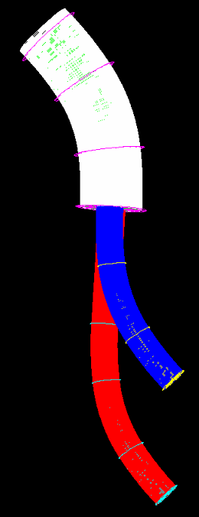
P=Pz | MeV/c | 230[1] | 250 | 300 | 400
B | T | 3 | 2 | 1.9 | 1.9
λ_{L}=(2πP_{z})/(B_{φ}c) | m | 1.61 | 2.62 | 3.31 | 4.41
R_{edge} | m | 2.5 | 7.36 | 6.67 | 12.39
α_{edge}(vert angle) | deg | 5.86 | 3.24 | 4.52 | 3.24
S_{mid sector} | m | 1.6 | 1.7 | 0.45 | 0.8
Δy_{max} | m | 0.165 | 0.340 | 0.332 | 0.340
λ_{L}/2
S_{mid sector}
λ_{L}/2
R_{edge}/2
[1] 230 MeV/c case is a bent solenoid using a single radius. (no matching)
R_{edge}
λ_{L}
R_{edge}
Δy_{max}

Slide 10
Results of Palmer/Fernow Study and Current One at 250 MeV/c using ICOOL
P (MeV/c) | Init | Init | Neg | Pos | <incr> %
230 | ε┴ (mm) | 15.1 | 17.6 | 21.1 | 28%
 | ε|| (mm) | 43.9 | 59.7 | 82.1 | 61%
 | σ_{ct} (mm) | 111 | 151 | 218 | 66%
 | Trans (%) | 100 | 85 | 89 | -13%
250 | ε┴ (mm) | 15.54(-)/15.67(+)* | 15.56 | 15.84 | 0.13(-) / 1.08(+) / 0.61%(avg.)
 | ε|| (mm) | 27.71(-)/30.15(+)* | 33.22 | 41.44 | 19.88(-) / 37.45(+) / 28.67%(avg.)
 | σ_{ct} (mm) | 90.1(-)/94.4(+)* | 141.26 | 171.03 | 56.78(-) / 81.18(+) / /68.98%(avg.)
 | Trans/20kPOT | 4553(-)/4540(+)* | 4371 | 4272 | -4.00(-) / -5.90(+) / -4.95%(avg.)
300 | ε┴ (mm) | 15.1 | 15.4 | 16.7 | 6%
 | ε|| (mm) | 38.1 | 45.8 | 50.3 | 26%
 | σ_{ct} (mm) | 102 | 162 | 187 | 66%
 | Trans (%) | 100 | 95 | 95 | -5%
400 | ε┴ (mm) | 15.1 | 15.2 | 15.3 | 1%
 | ε|| (mm) | 38.1 | 43.8 | 47.8 | 20%
 | σ_{ct} (mm) | 102 | 134 | 162 | 45%
 | Trans (%) | 100 | 98 | 97 | -2.5%
* Initial particle distributions are end of Neuffer 325 MHz Rotator.

Slide 11
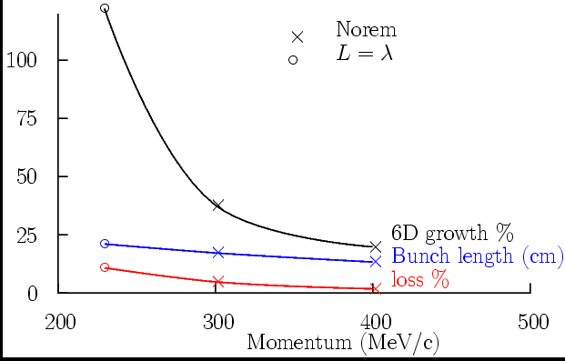
29.8%
x
15.6 cm
17.45 cm
x
x
-5%
-5%
250

Slide 12
Simulations of 250 MeV/c Configuration
 | ε_{T} |  | ε_{L} |  | ε_{6D} |  | N_{survive}
units | mm-rad |  | mm |  | mm³ |  | per 20k POT
Particle Species | µ⁺ | µ─ | µ⁺ | µ─ | µ⁺ | µ─ | µ⁺ | µ─
At End of Rotator | 15.66 | 15.54 | 30.06 | 27.71 | 7368 | 6690 | 4536 | 4553
End of Charge Splitter post Rotator (ICOOL) | 15.84 | 15.56 | 41.44 | 33.22 | 10,360 | 7964 | 4272 | 4371
4D Cooler End | 6.381 | 6.380 | 27.83 | 25.89 | 1133 | 1053 | 3642 | 3697
4D Cooler Match End | 6.673 | 6.730 | 29.56 | 27.98 | 1315 | 1266 | 3586 | 3659
Charge Split End aft 4D Cool Match End (ICOOL) | 7.224 | 7.207 | 65.99 | 62.06 | 3420 | 3210 | 3742 | 3781
Acceptance of Katsuya’s HCC | 20.4 |  | 42.8 |  | 12,900

Slide 13
Muons out of the 250 MeV/c charge splitter following the Rotator should fit into the HCC!
What are the geometric constraints for the downstream segments to not overlap each other?

Slide 14
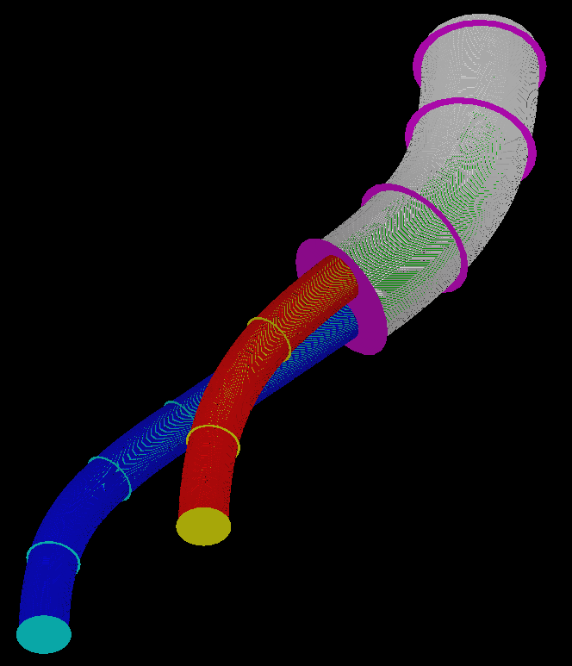
Study in Geometric Constraints
(non-overlapping volumes)
P_{ref} of Bent Solenoid (MeV/c) | R_{outer, max} (cm)
250 (design highlighted in previous slides) | 30
400 (Palmer/Fernow design in PAC11 MOP001) | 29

Slide 15
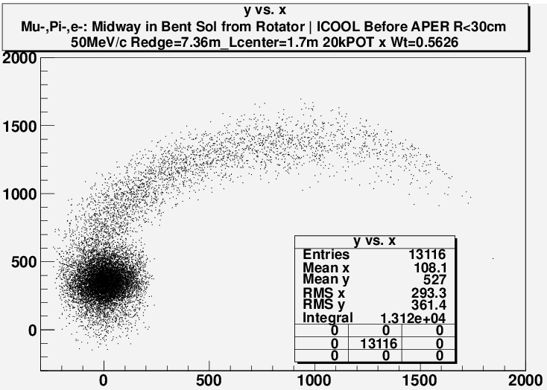
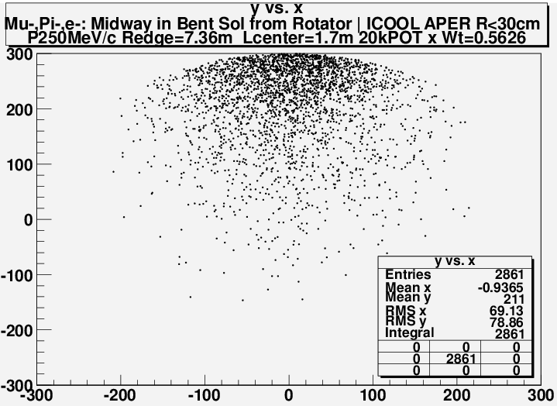
An attempt to apply apertures inside the coils to extract collimation effect of coils revealed an ICOOL feature that constrains its location to the mid-plane.
Midway in Charge Splitter
Before “APER” R=30cm
Midway in Charge Splitter
After “APER” R=30cm
Hence, motivation to use G4beamline.

Slide 16
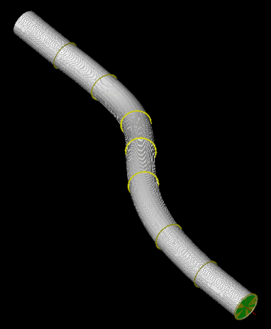
Recall our goal is to obtain distributions indicative of that having gone through a charge splitter.
To avoid complexities of the transition region at end of first bend, we simply simulated a continuous channel for each sign.
Similar strategy as performed in earlier studies by Palmer/Fernow using ICOOL.

Slide 17
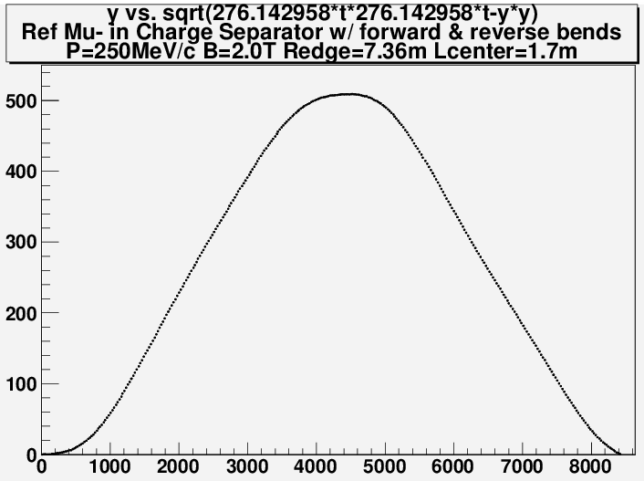
G4bl simulation of reference
x
(3010, 266)
(4320, 340)
Vertical Displacement y (mm)
x
Theoretical expectations
x
(1310, 74)
Path Length along mid-plane S_{x-z}(mm)

Slide 18
Suspect difference is due to coils being vertically displaced which introduces another gradient for the B field. So, we compare simulations to theory for the two configurations:
First sector in first bend is extended to remove effect of multiple radii in bending radius. Coils are still displaced vertically to follow expected trajectory.
First sector in first bend is extended, but are NOT vertically displaced.
The bent solenoid theory is based on this assumption, so it should agree.
Note that the first bend will contain both charge signs, so the first bend in a real design will be confined to the mid-plane.

Slide 19
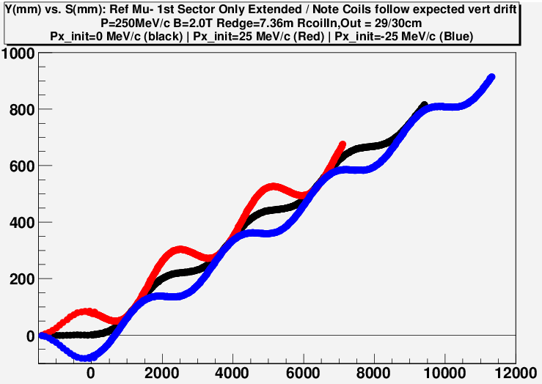
Coils follow expected vertical drift
Vertical Displacement y (mm)
(7860, 445.8)
Expected vertical drift from theory.
(1310, 74.3)
Path Length along mid-plane S_{x-z}(mm)

Slide 20
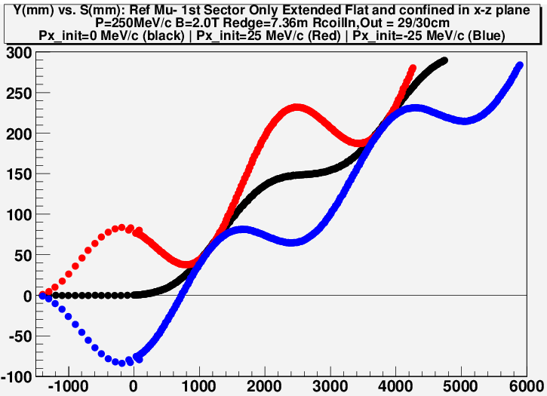
Coils are confined to lie in the horizontal plane
(3930, 222.9)
Vertical Displacement y (mm)
(1310, 74.3)
Expected vertical drift from theory.
Path Length along mid-plane S_{x-z}(mm)

Slide 21
The vertical coil displacement appears to be the culprit in the unexpected behavior.
Ramifications on design of a real charge splitter:
The first bend avoids this effect, since its bend must lie in the horizontal plane to split both charges simultaneously.
The second bend can counter this effect by tilting the coils.
Fastest way to obtain desired distributions:
Use large aperture coils for both bends, which are confined in the mid-plane.
Use cylindrical volumes that follow the trajectory of the reference beyond the first bend to extract the effect of finite apertures in the downstream segments.

Slide 22
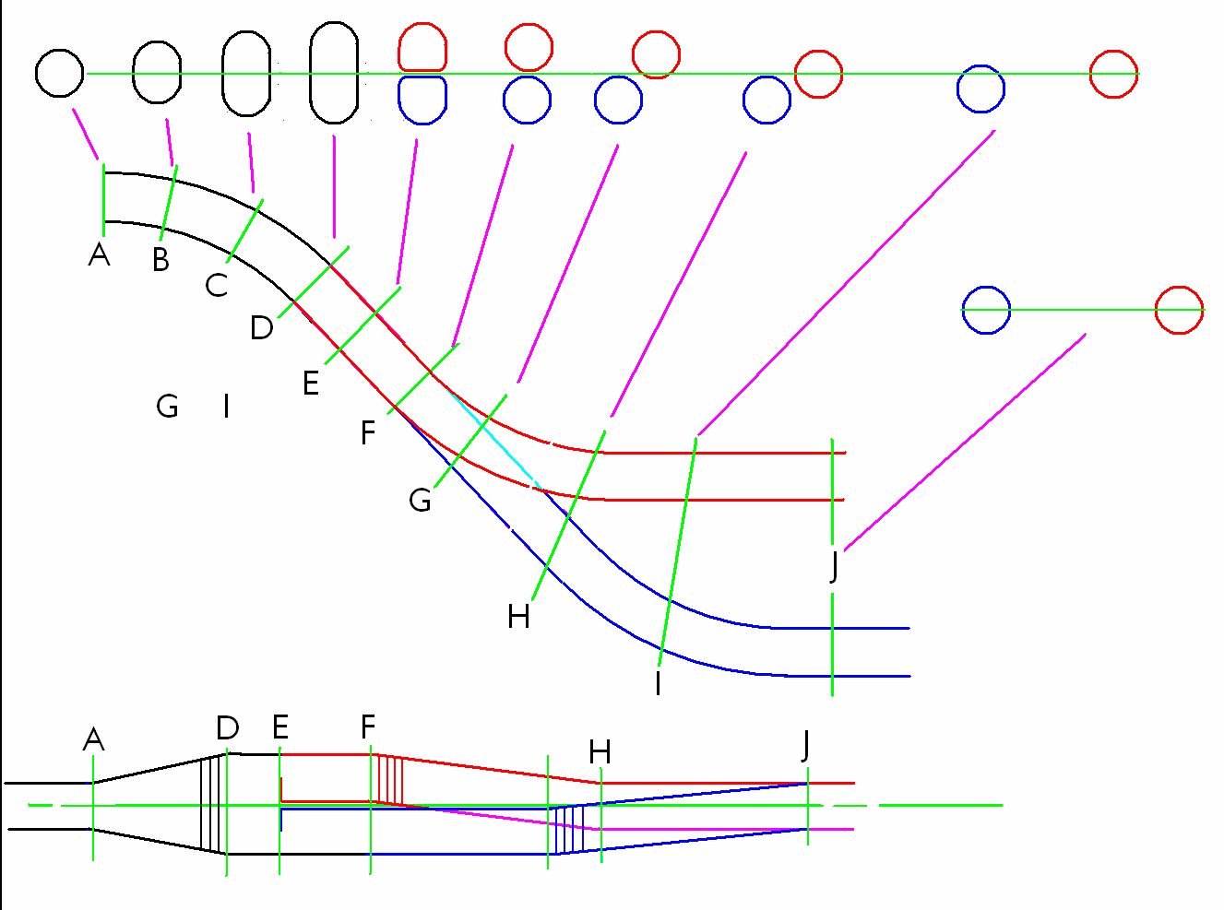
Concepts to Guide Design of a Real Charge Separator
(Bob Palmer originator)
Consider use of D shaped coils at transition at end of first bend.
Tilt coils to control vertical drift. See Comet/Prism Prime for guidance.
G4beamline doesn’t support coils that are not circular.
So, Tosca or some other tool that generates magnetic fields will need to be employed.
Or, G4beamline could be enhanced to expedite the design.

Slide 23
Summary & Future
We have a schedule in place to design a complete Helical Cooling Channel, which may need to be adjusted in light of recent discussions earlier this morning and that to follow this presentation.
We are on the verge of producing particle distributions that possess the effect of traversing a charge splitter, which may also serve as input for performance comparisons between the 6D cooling options that apply to a single charge sign.
Lessons learned were fed into concepts to guide the design of a real charge splitter.

Slide 24
Back up

Slide 25
Performance Schedule (Tasks and Milestones; T₀ ≈April 22, 2013)
Six months after start of funding:
Segment and Matching Designs
A matching section out of the Neuffer front end and into an HCC segment that is similar to the first segment in the original design is completed.
Creation of criteria to determine end of a segment and need for the start of the next, most likely driven by cooling rate, is underway.
Lowest Final Emittance
Study of optimal momentum to provide coldest beam underway.
Space Charge, etc.
Identify effects determining the longitudinal dynamics.
Extend the analytic theory to take these effects into account.
Search the parameter space for the optimal longitudinal dynamics scenario.
Computational Tool Development
G4beamline tracking efficiency improvements implemented.
G4beamline space-charge calculation able to handle a helical reference trajectory.

Slide 26
Twelve months after start of funding: (required for 2nd year of funding)
Segment and Matching Designs
Early segments that are maximized for acceptance are designed along with their matching sections.
Lowest Final Emittance
Study of optimal momentum to provide coldest beam completed.
Space Charge, etc.
Explore space charge compensation mechanisms.
Identify or develop numerical tools to simulate the longitudinal effects.
Computational Tool Development
G4beamline space-charge calculations parallelized efficiently on Hopper at NERSC.
Improved Emittance Calculation

Slide 27
Eighteen months after start of funding:
Segment and Matching Designs
Segments that are maximized for cooling rate are designed along with their matching sections.
If space charge permits, bunch merging and re-cooling would have commenced.
Space Charge, etc.
Identify or develop numerical tools to simulate the longitudinal effects.
Computational Tool Development
Additional physics processes incorporated into our simulations, as appropriate.

Slide 28
24 months after start of funding
Segment and Matching Designs
Segment optimized for the coldest beam possible and its matching section is implemented into the HCC for both:
a Higgs Factory using shared wedge shaped RF windows.
an Energy Frontier machine using shared flat RF windows.
Matching section out of the HCC and into a straight channel that will accelerate the muons is completed .
Measure effect of tolerance of beam elements on performance.
Space Charge, etc.
Optimize and finalize the longitudinal dynamics simulations.
Computational Tool Development
Additional physics processes incorporated into our simulations, as appropriate.

Slide 29
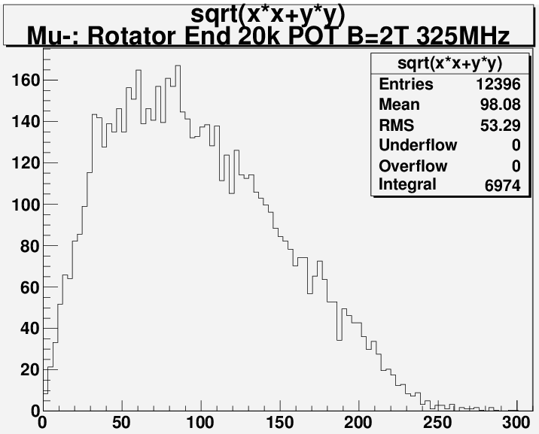
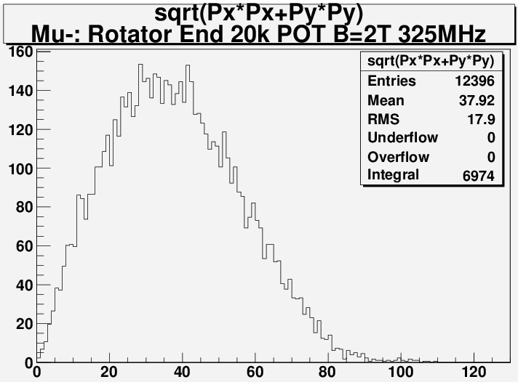
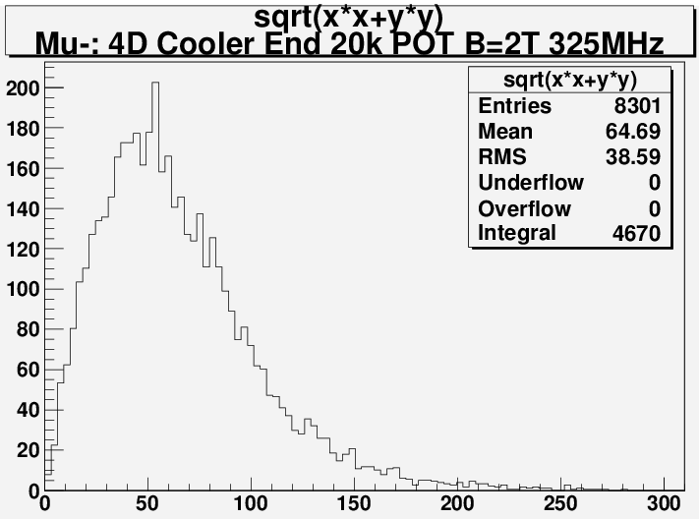
Mu- at End of Rotator and 4D Cooler

Slide 30
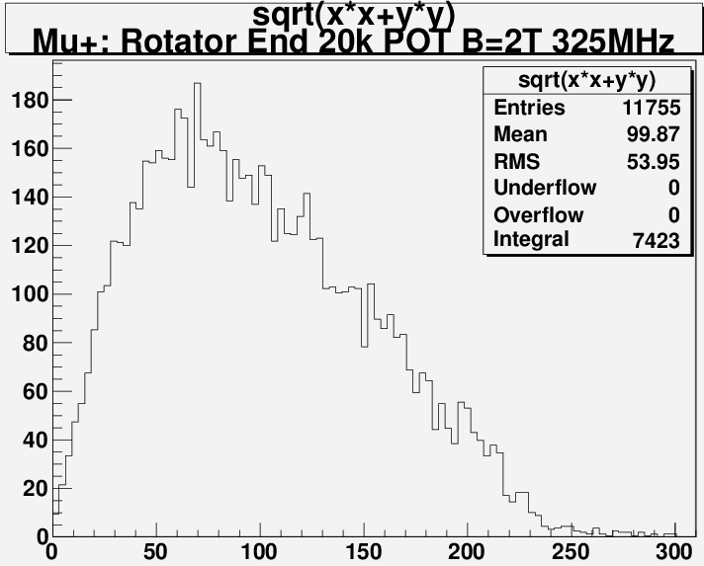
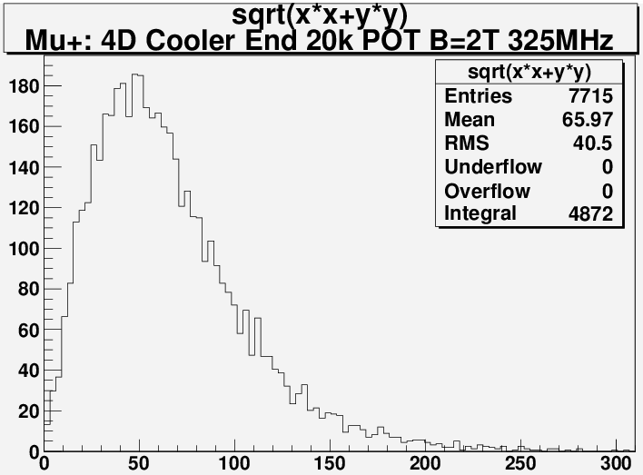
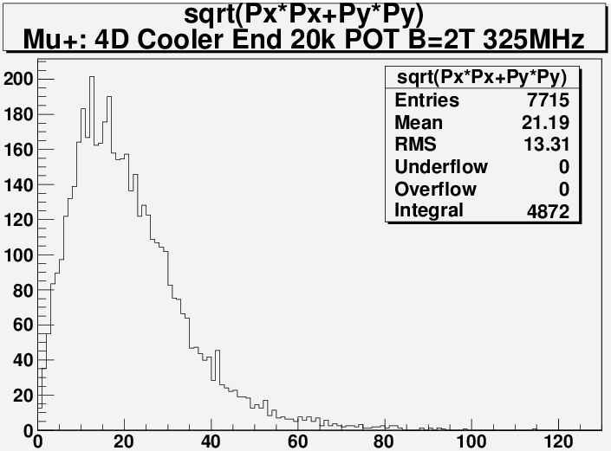
Mu+ at End of Rotator and 4D Cooler

