Slide 1
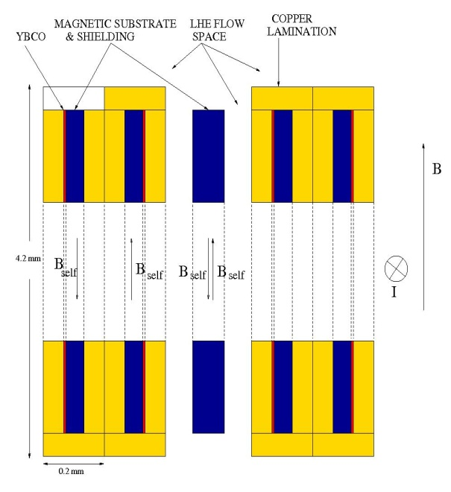
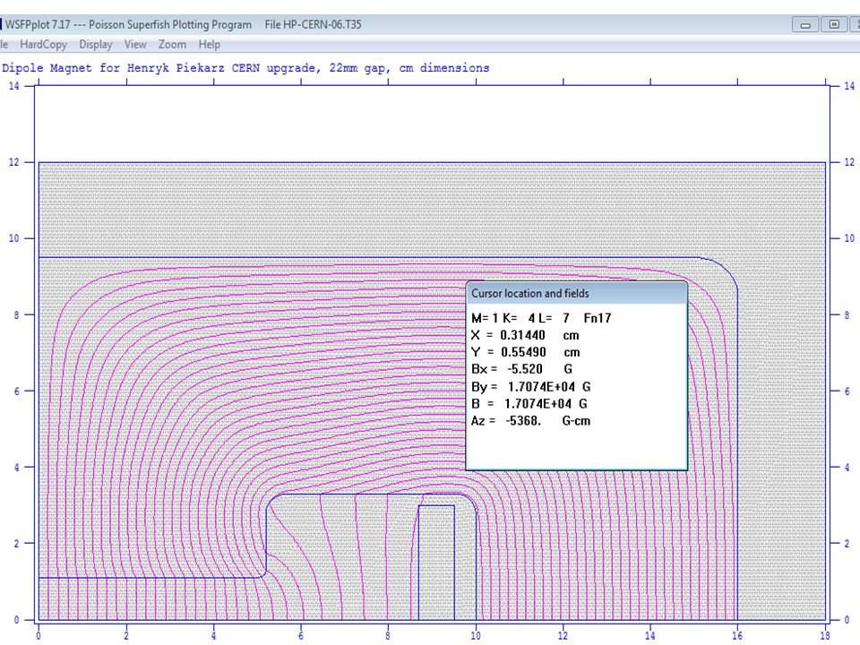
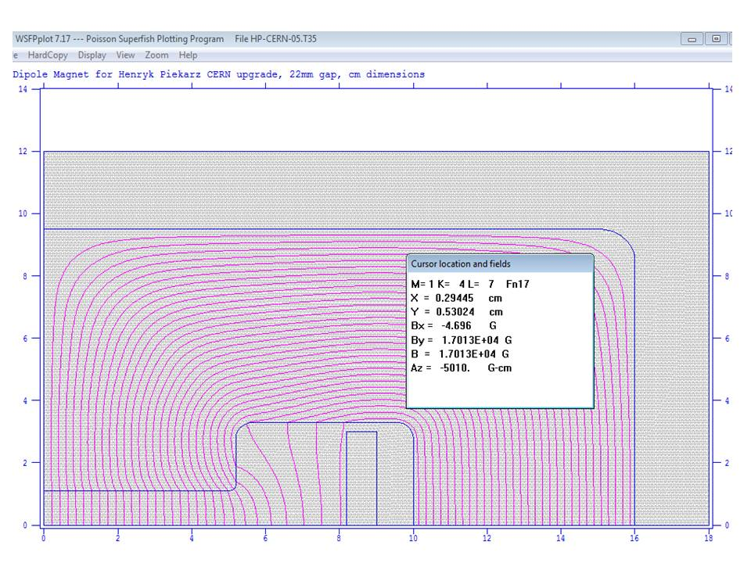
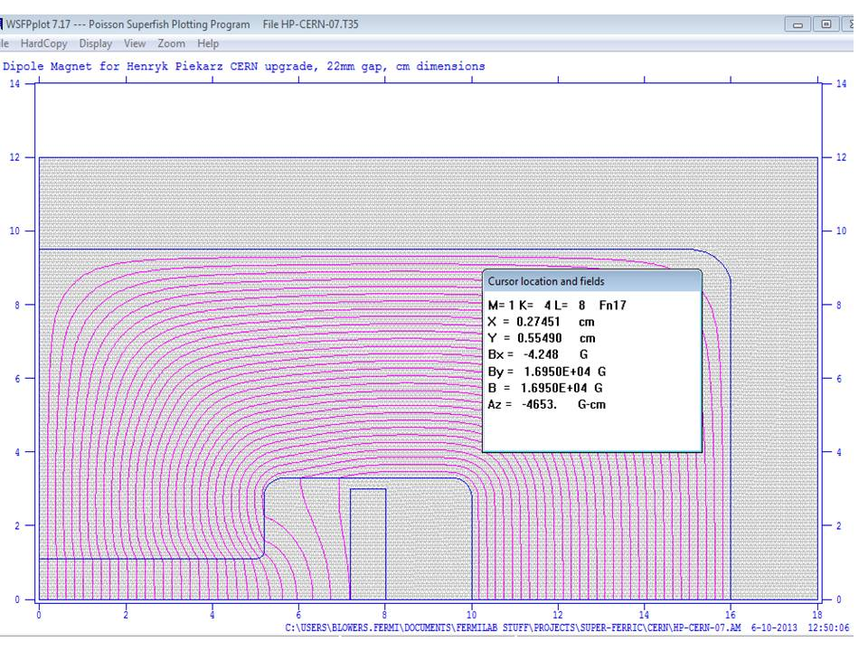
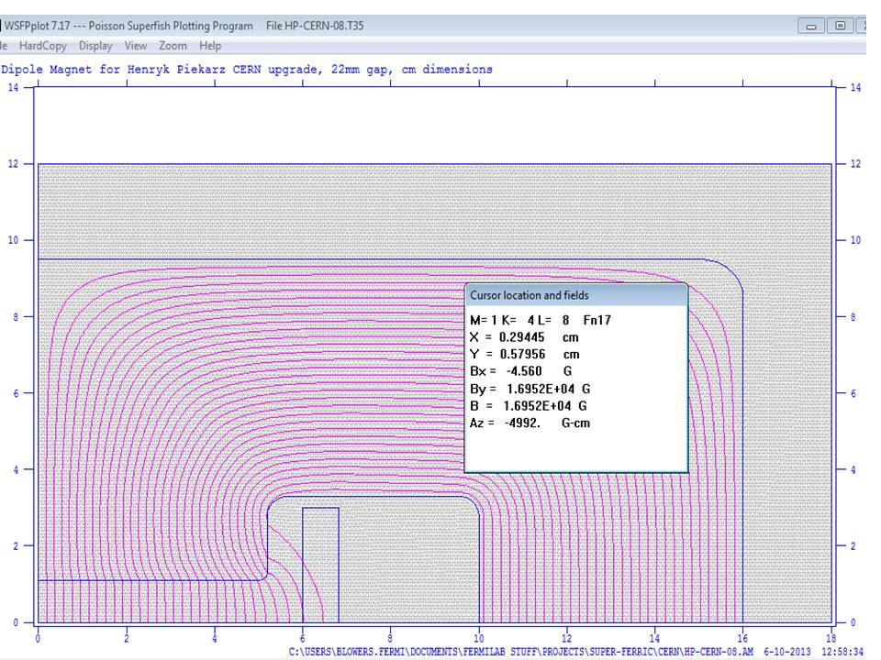
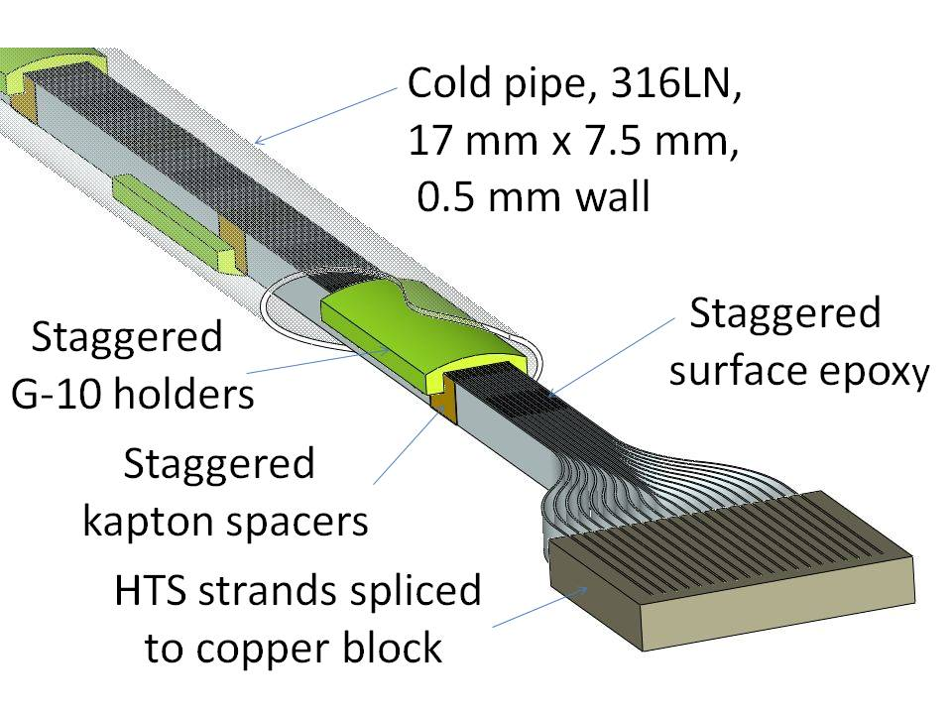
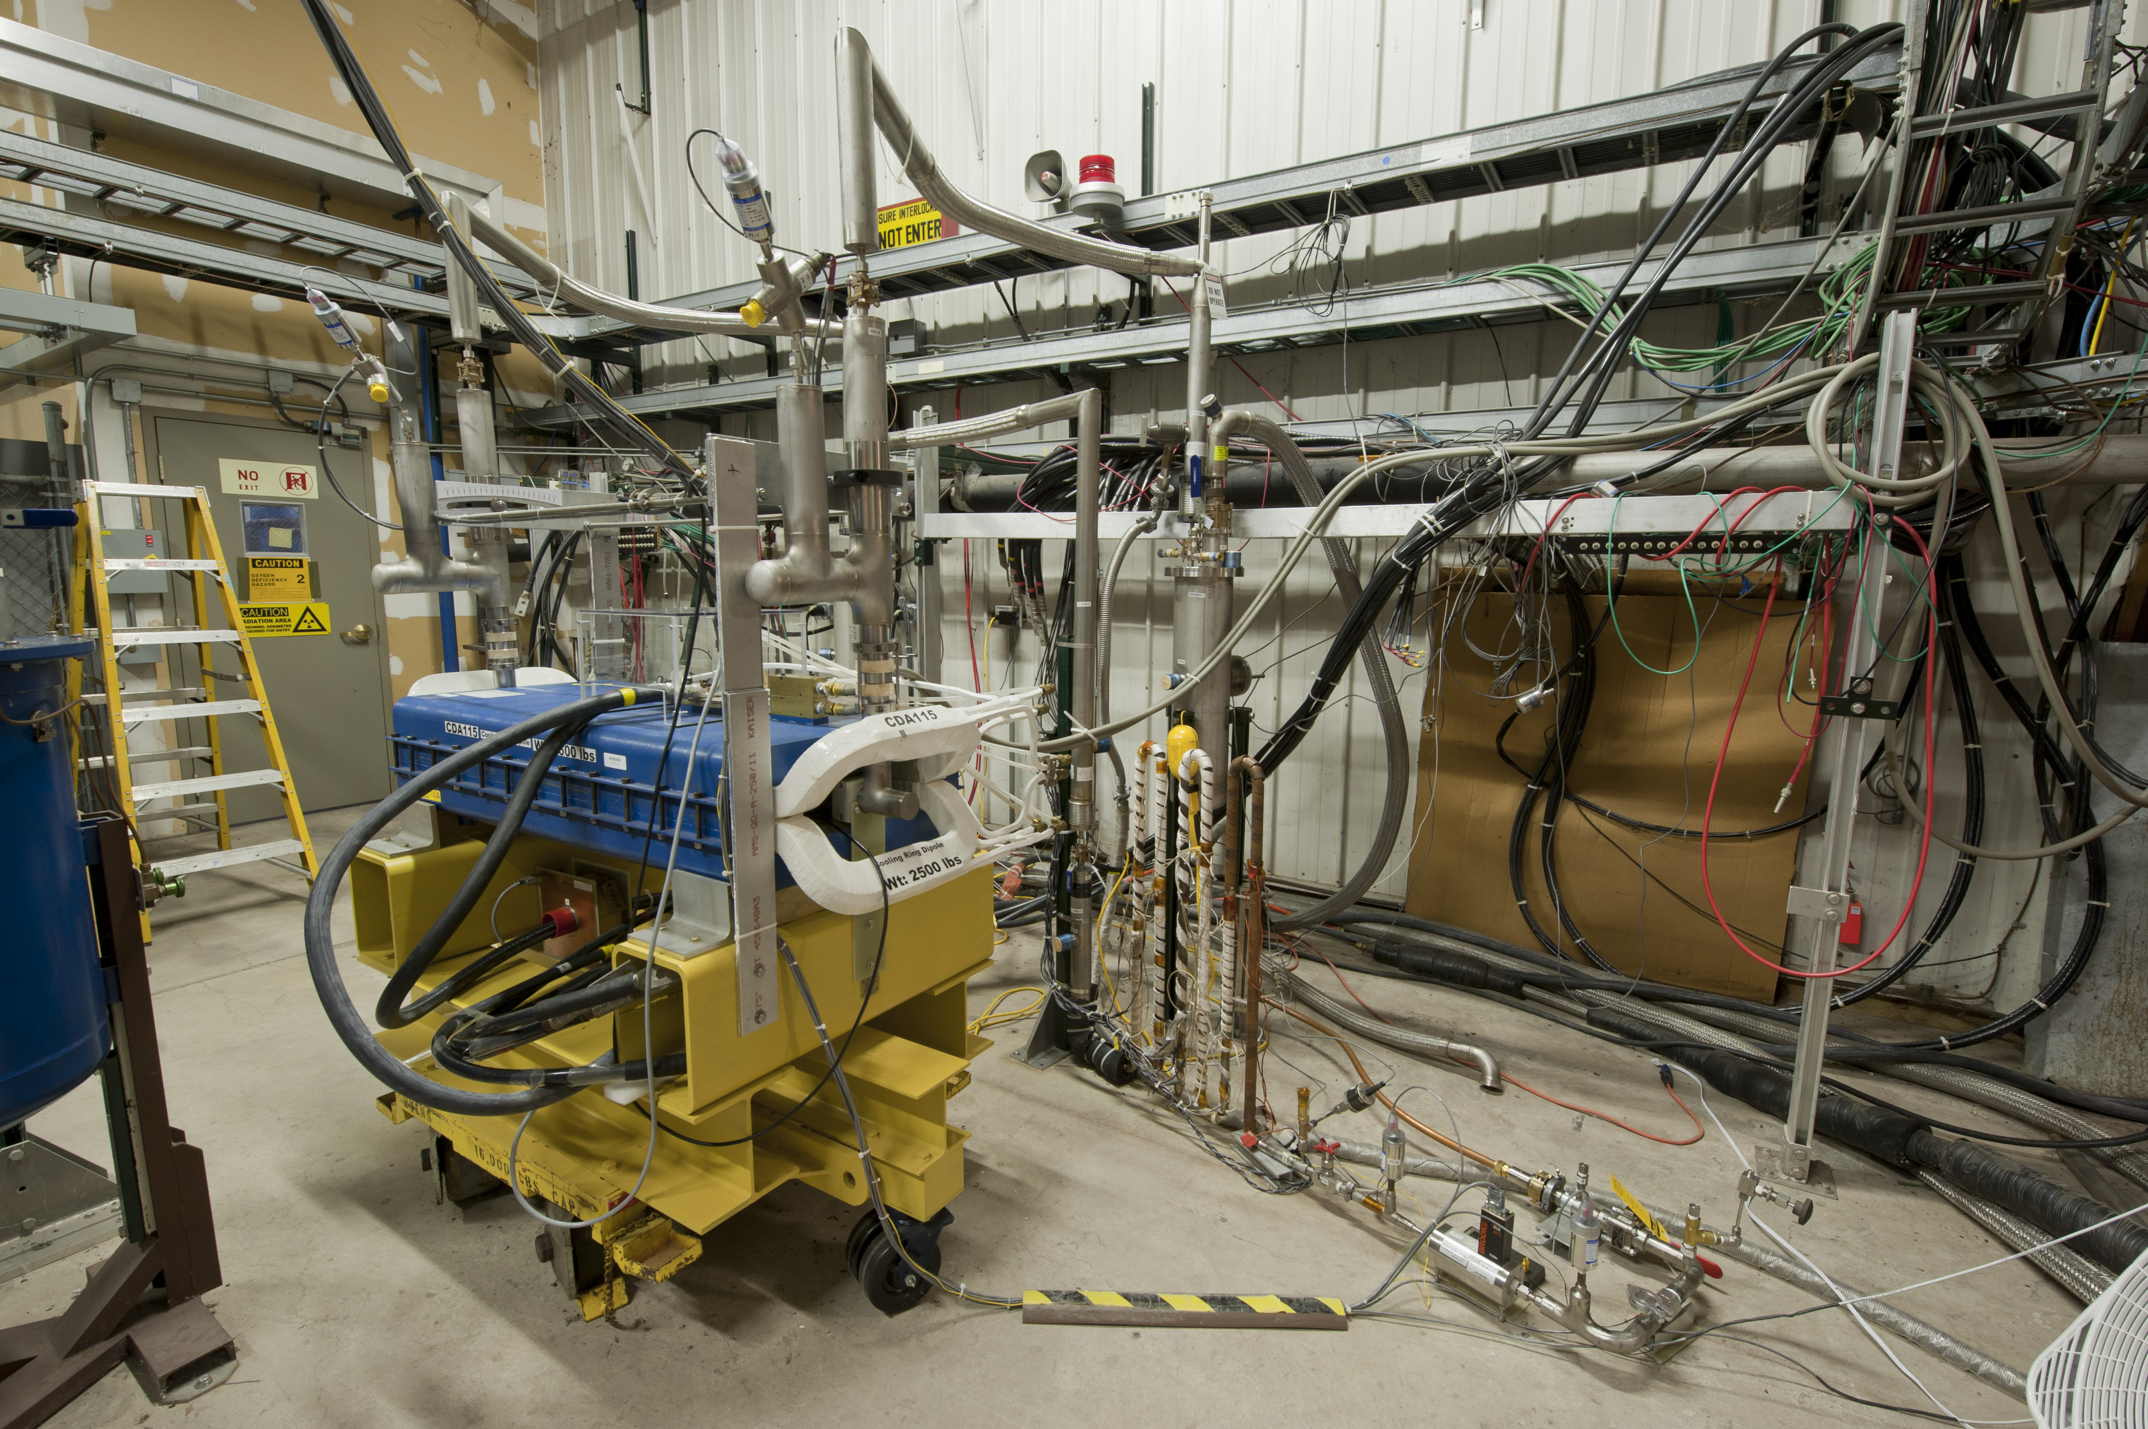
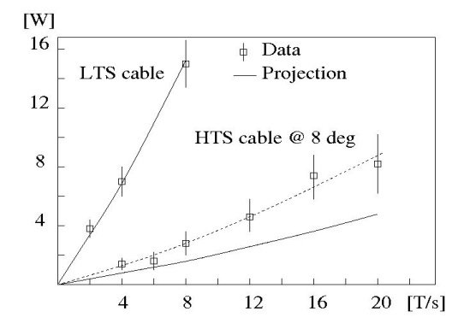
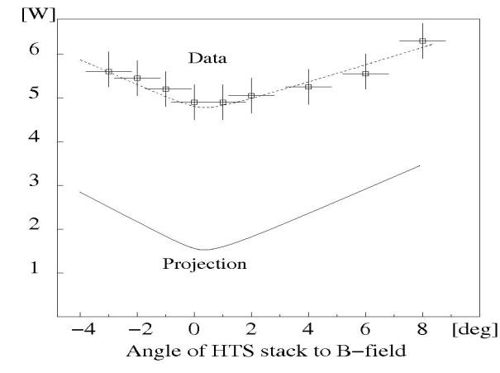
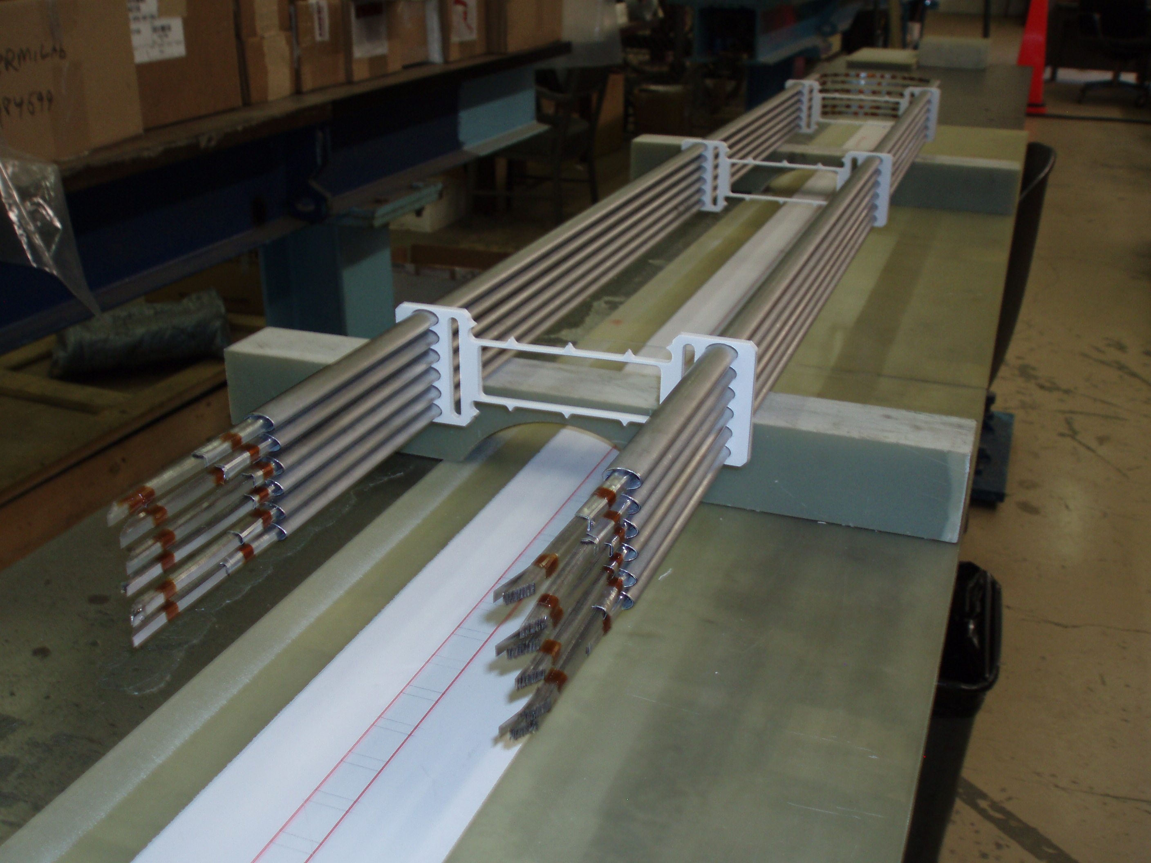
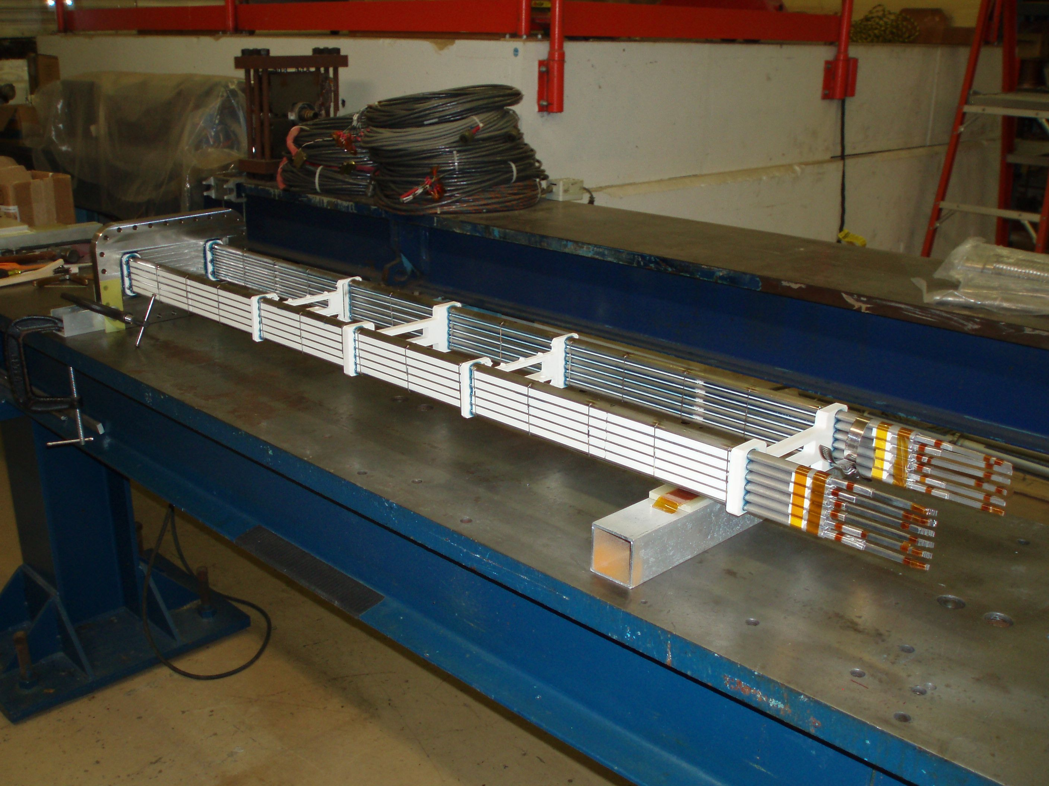
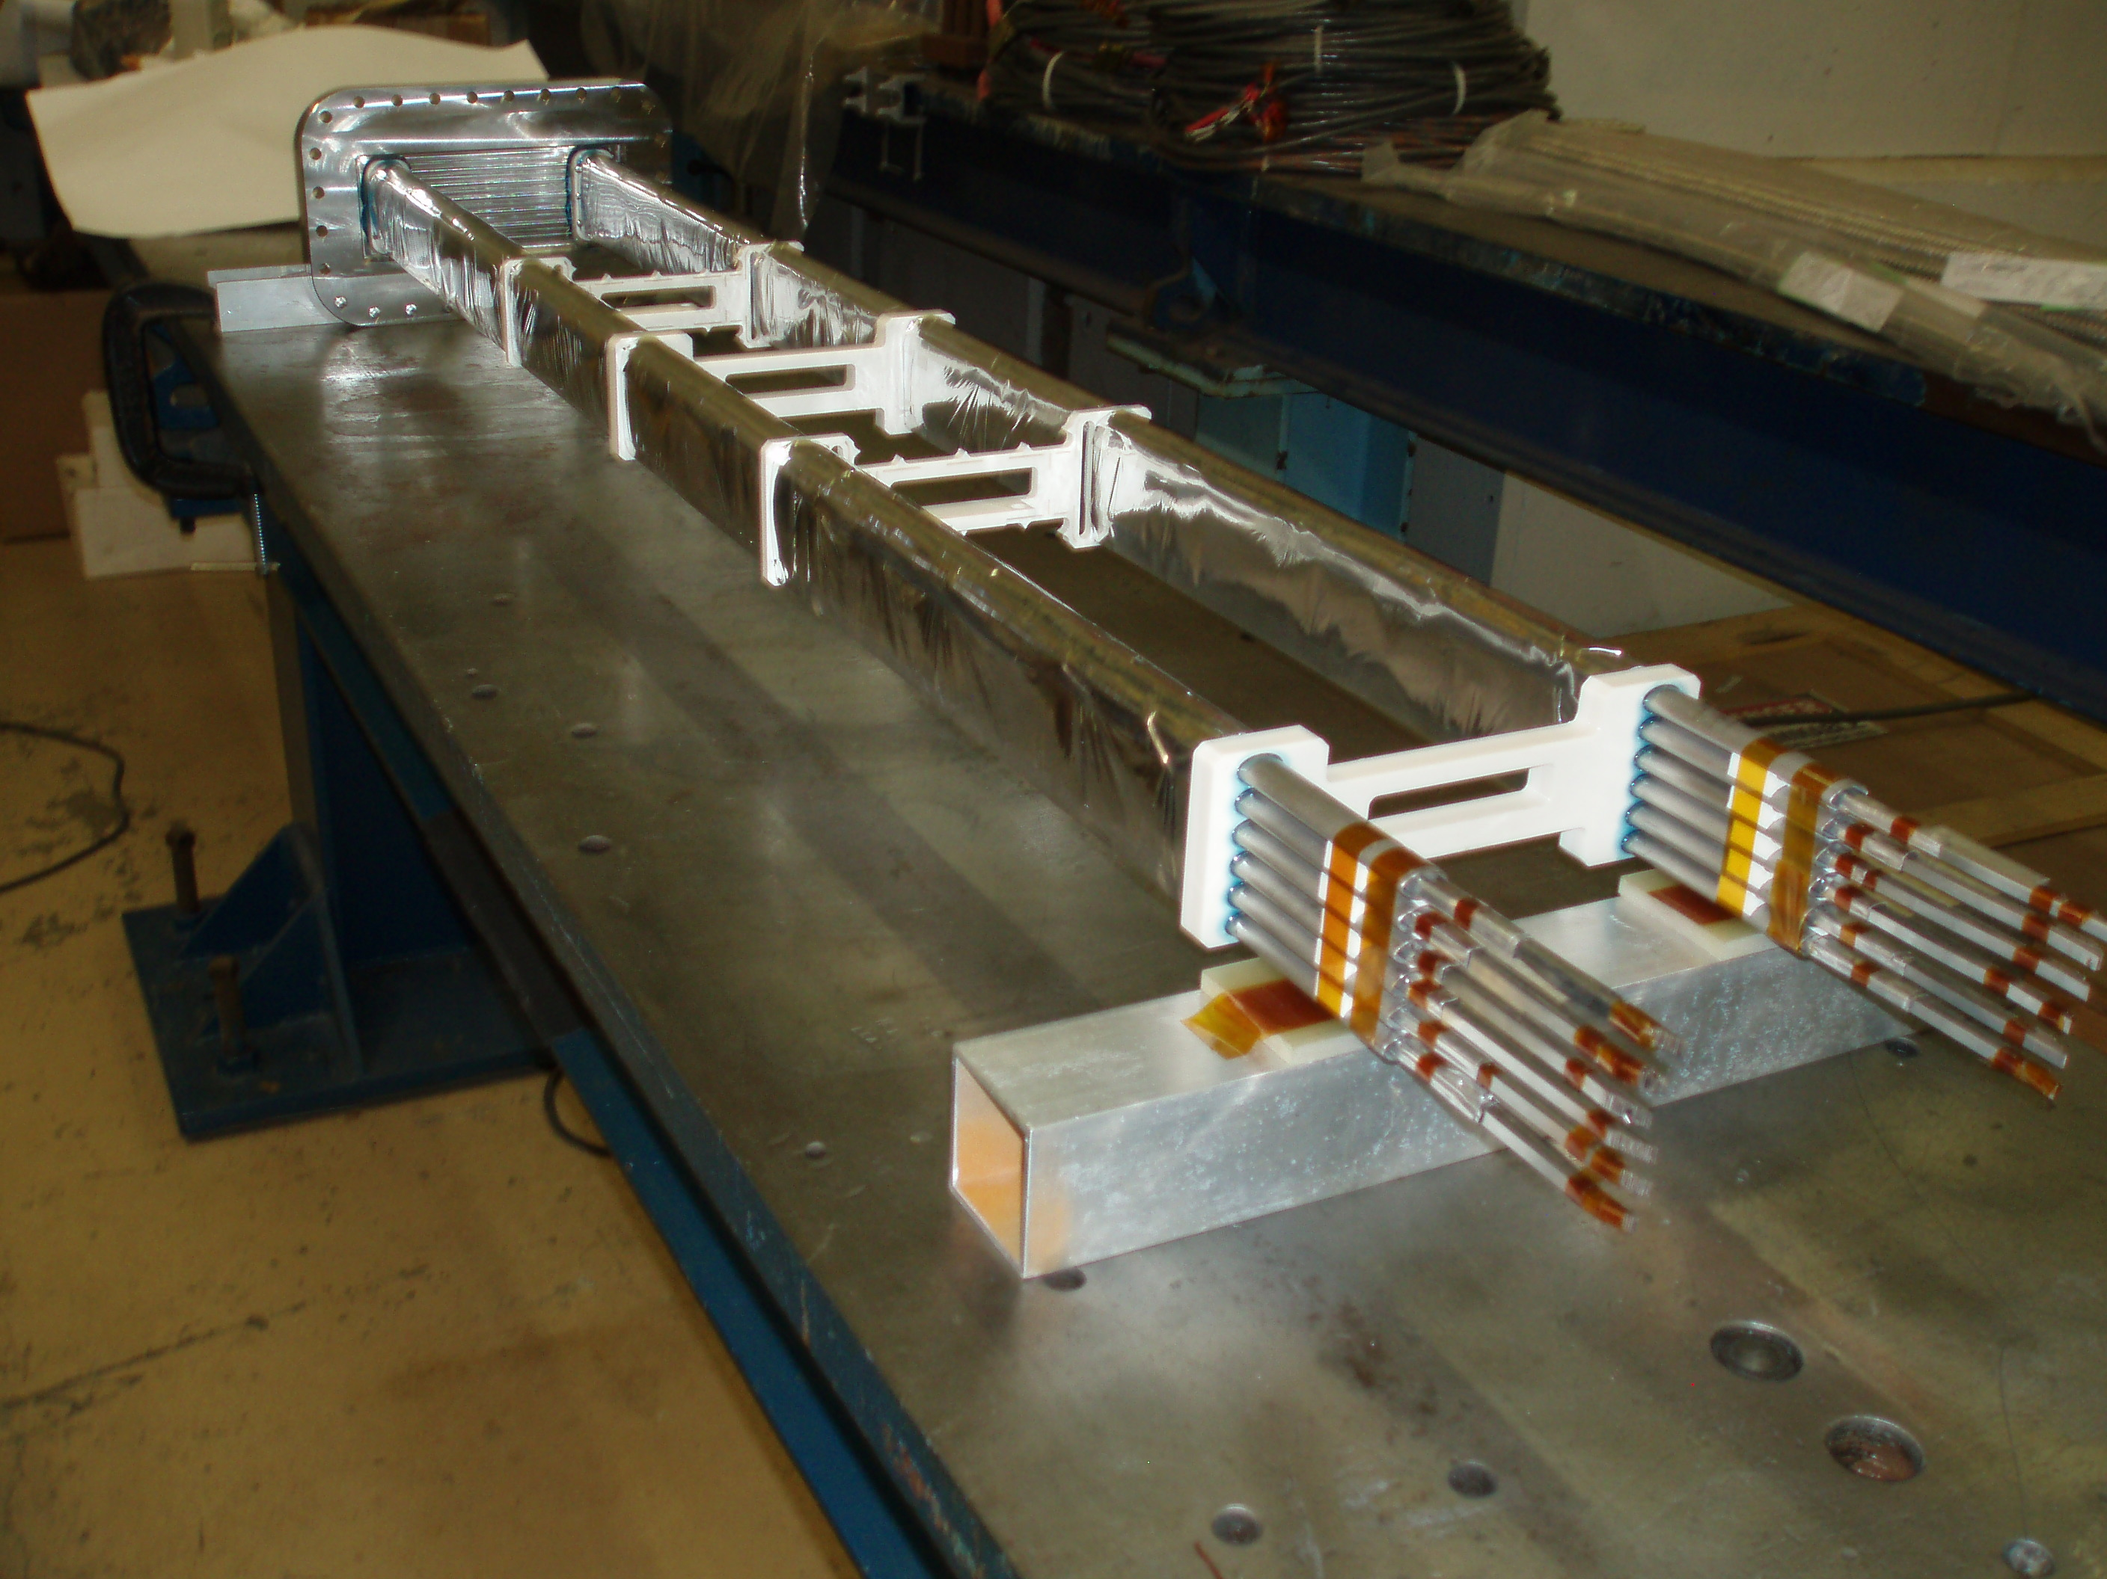
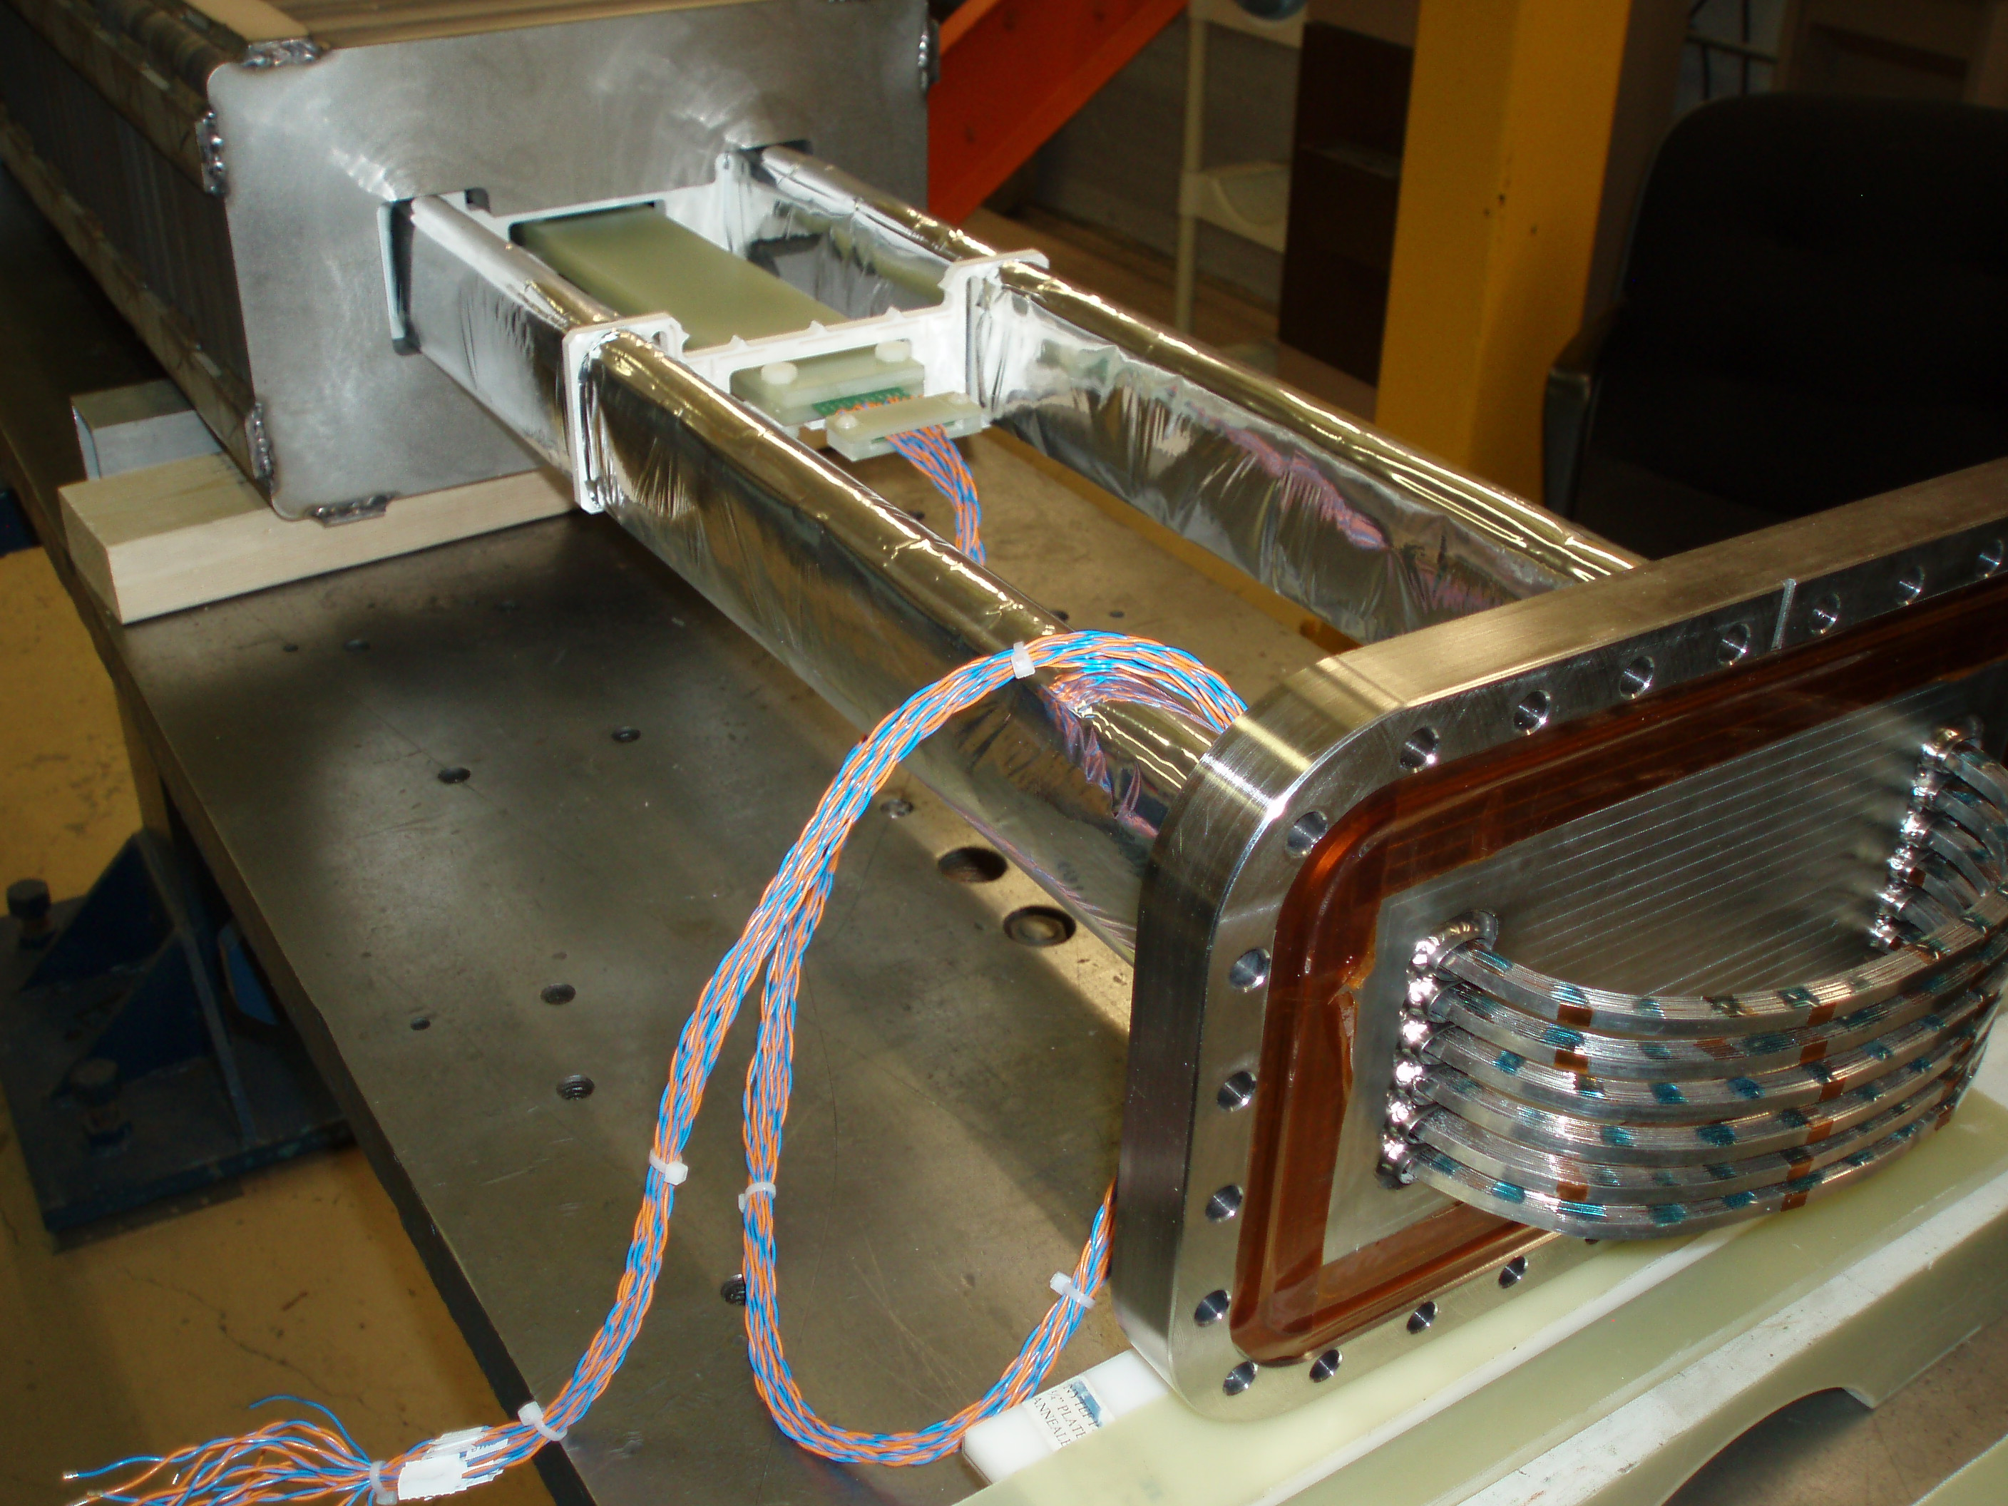
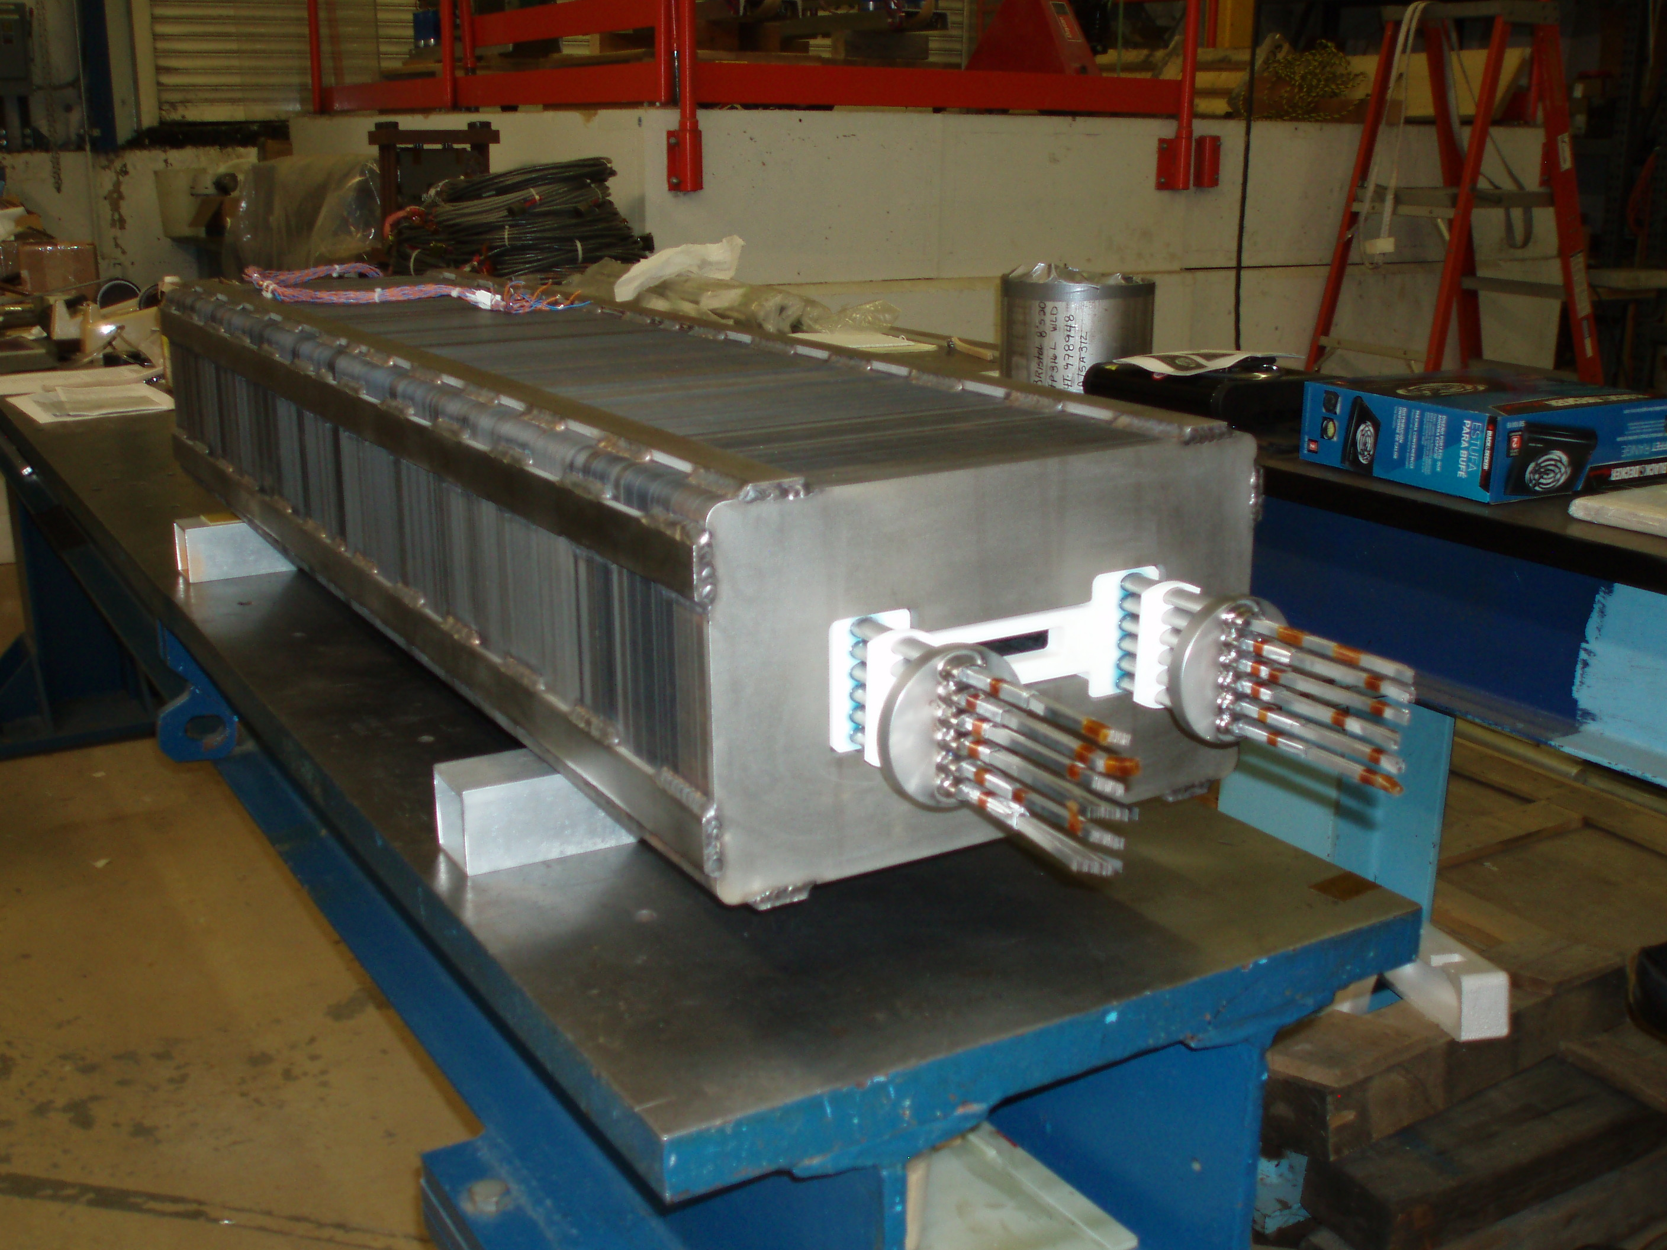
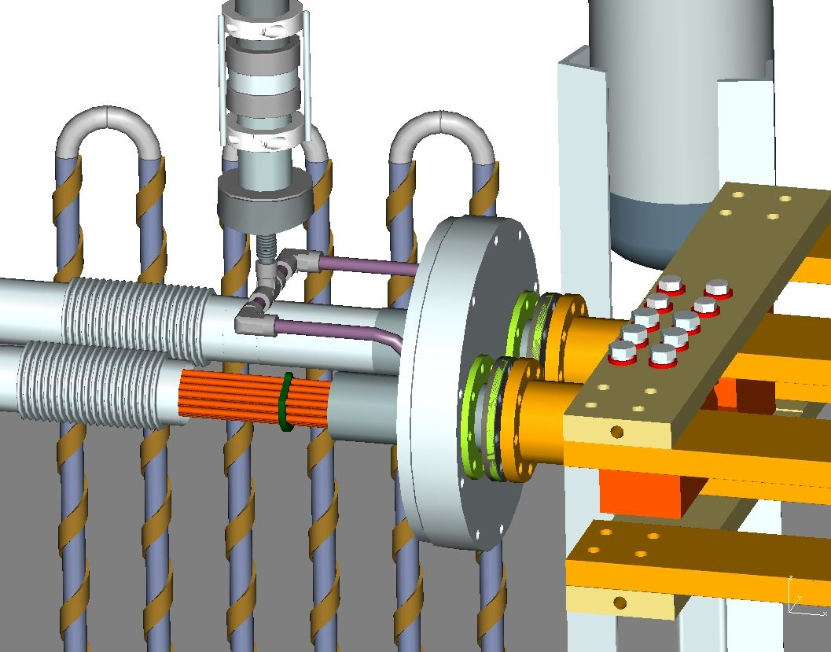
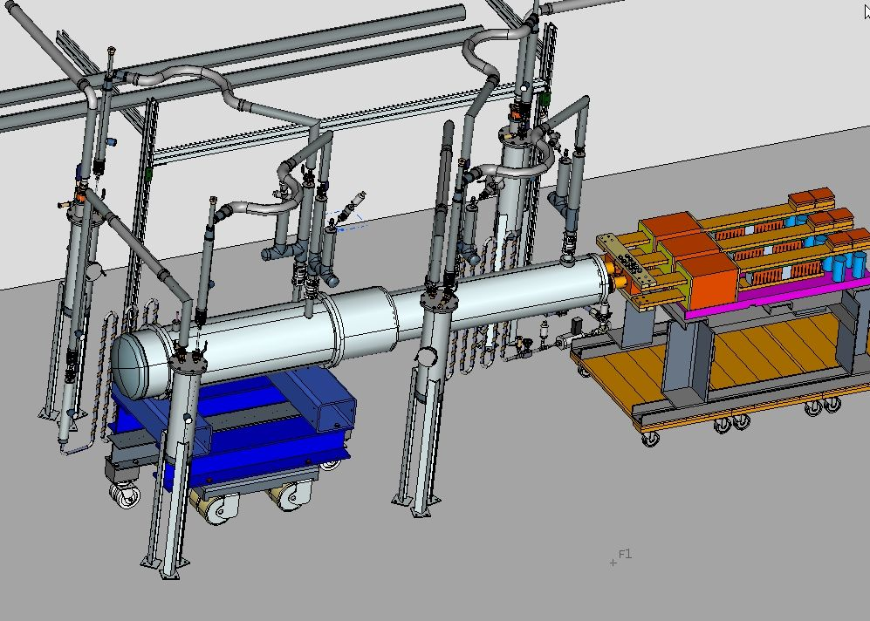
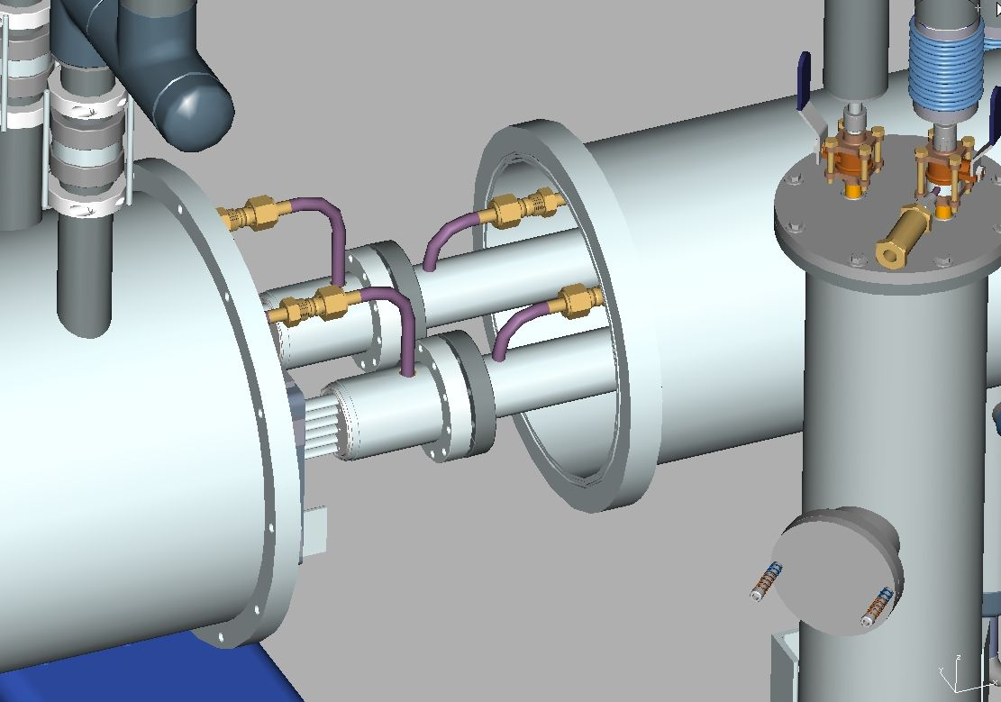
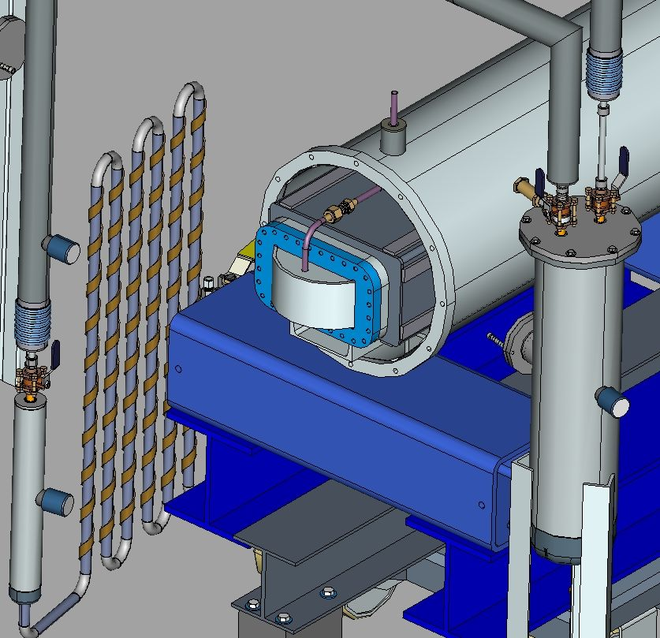
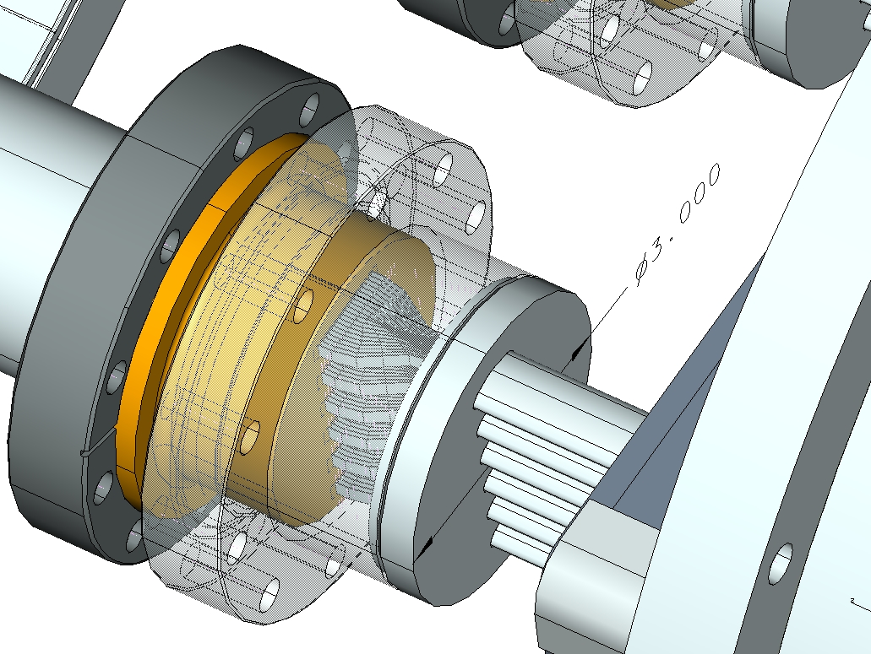
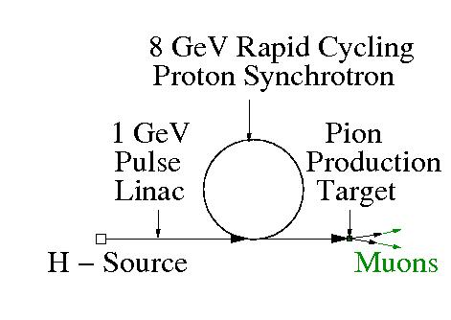
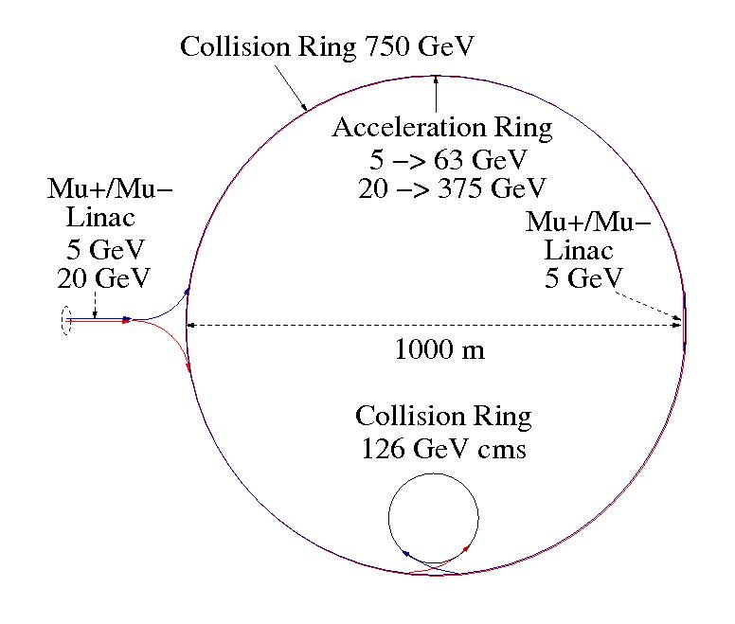
Rapid-Cycling HTS Magnet
J. Blowers, S. Hays, H. Piekarz and V. Shiltsev
Accelerator Physics Center, FNAL, Batavia, Illinois 60510
Purpose: Develop HTS-based Rapid Cycling Magnet for Proton and Muon Acceleration Synchrotrons
Attributes of magnet power cable constructed with HTS tape-strands:
Low dynamic power losses due to near suppression of:
(1) Self-field with Ni5%W substrates and shields
(2) Core-induced field with optimization of cable position within core cavity
(3) Core-induced field with parallel orientation of HTS tape to B-field
Wide temperature margin (20 K or more, as required)
Resilience to radiation (YBCO 344C-2G)
Cable: 2 x 6 sub-cables with HTS strands stacked vertically
Magnet core: 100 µm laminated non-oriented FE3%Si steel
Arrangement of HTS strands
and Ni5%W substrates
Cable design and construction
Field in cable gap versus cable position
Arrangement of HTS sub-cable
Setup for HTS & LTS cable test in rapid-cycling B-Field
Power loss in HTS and LTS cables of equal critical current,
and power loss at various B-> HTS tape inclination angle
Construction of HTS magnet and test arrangement
HTS cable: 6 sub-cables,
20 strands / sub-cable
ABS printed spacers to
immobilize sub-cables
Magnet cable wrapped with MLI
Inserting cable into core
Cable & core assembled
Ramping
power supply
Magnet cable & leads connection
Leads connection to power supply
Magnet cryostat
Leads cryostat
Rapid-cycling HTS magnet test arrangement
Return end of magnet cable
Possible applications of HTS magnet in MAP program
4 MW proton source
Muon accelerator for 126 GeV
& 750 GeV Muon Collider
Magnet parameter | Proton Acc. | Muon Acc. 63 GeV | Muon Acc. 375 GeV
B _{inj} | B _{oper} [T | T] | 0.05 | 0.5 | /+/-0.02 | +/-0.24 | +/- 0.08 | +/- 1.45
Beam gap [mm] | 40 | 25 | 25
I _{top} [ kA |N _{turns}] | 25 | 1 | 7.5 | 1 | 45 | 1
dB/dt (beam gap) [T/s] | 30 | 840 | 840
dB/dt (cable gap) [T/s] | 0.3 | 8.4 | 8.4
Supercondutor HTS | 344C-2G | 344C-2G | 344C-2G
N sub-cables | 2 x 6 | 2 x 6 | 2 x 6
N strands/sub-cable | 6 | 3 | 15
Cable power dynamic loss @ 5 K [W/m] | 1.4 | 30 | 150
Cable power dynamic loss /Acc 5K *) [W] | 14 | 2400 | 12000
Total cable power loss / Acc.*) @ 5K [W] | 600 | 6500 | 16000
Core power loss / Acc @ RT *) [kW] | 0.005 | 160 | 160
Beam parameter | Proton Acc. | Muon Acc. 63 GeV | Muon Acc. #) 375 GeV
E _{inj} / E _{extr} GeV/GeV] | 1 / 8 | 5 / 63 | 20 / 375
Ring length [m] | 829.9 | 6860 | 6860
Cycle time [µs] | 2.77 | 22.9 | 22.9
Cycles to top energy | 6000 | 12 | 71
Muon survival rate [%] | - | 50 | 50
Time to top energy [ms] | 16.6 | 0.275 | 1.63
Beam pulse rate [Hz] | 60 | 60 | 60
Beam power [MW] | 4 | - | -
#) Note: If Fermilab site-filler ring of 16.1 km was assumed for the Muon Accelerator
a collision energy of 2.0 TeV could be achieved with 1.6 T magnets.
*) Assuming 1.67 % duty factor

