Slide 1

MASS – staged facilities
J-P. Delahaye (SLAC), C. Ankenbrandt (Muons Inc./FNAL), A.Bogacz (JLAB), S.Brice (FNAL), A. Bross (FNAL), D.Denisov(FNAL), E.Eichten (FNAL), P.Huber (VT),
D. M. Kaplan (IIT), H. Kirk (BNL), R.Lipton (FNAL),
D.Neuffer (FNAL), M.A. Palmer (FNAL), R.Palmer (BNL),
R. Ryne (LBNL), P. Snopok (IIT/FNAL)
Fermilab
Today

Slide 2
The Muon Accelerator Program Timeline
 | 2010 |  | ~2020 |  | ~2030
Muon Accelerator R&D Phase
Proton Driver Implementation (Project X @ FNAL)
Intensity Frontier
Energy Frontier
MAP Feasibility Assessment
Advanced Systems R&D
Muon Ionization Cooling Experiment (MICE)
Proj X Ph I
Proj X Ph II
Proj X Ph III & IV
IDS-NF RDR
Proposed Muon Storage Ring Facility (νSTORM)
Evolution to Full Spec ν Factory
Collider Conceptual ➔ Technical Design
Collider Construction ➔
Physics Program
Notes:
Yellow diamonds indicate potential start of DOE CD process

Slide 3
A Staged Muon-Based Neutrino and Collider Physics Program
The plan is conceived in four stages.
The “entry point” for the plan is the nuSTORM Facility proposed at Fermilab, which can advance SBL oscillation physics by making the definitive measurements on light sterile neutrinos and ν interaction physics.
  Also an R&D platform for demonstration of accelerator capabilities needed for the later stages.
A stored-muon-beam Neutrino Factory can take advantange of the large value of θ₁₃ to make definitive measurements of neutrino oscillations and their possible violation of CP symmetry.
Thanks to suppression of radiative effects by the muon mass and the m²_{lepton} proportionality of the s-channel Higgs coupling, a Higgs Factory Muon Collider can make uniquely precise measurements of the 126 GeV boson recently discovered at the LHC.
An energy-frontier Muon Collider can perform unique measurements of Terascale physics, offering both precision and discovery reach.

Slide 4
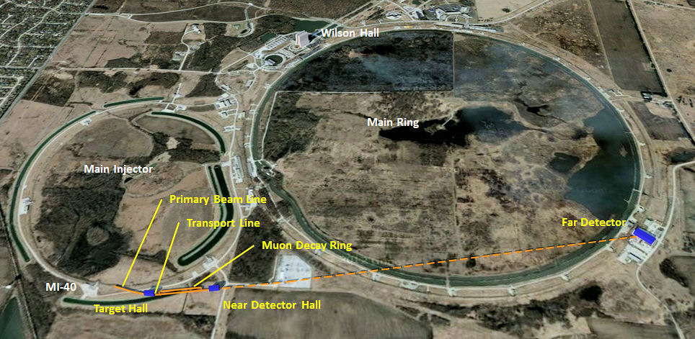
NuSTORM
Physics Motivation
  neutrino cross sections
  “sterile” neutrino search
Muon Based Added value
  electron and muon neutrinos
  sterile neutrino search
  monitored beam
Parameter | Value | Unit
Ring Momentum P_{μ} | 3.8 | GeV/c
Circumference | 400 | m
Intensity
Proton Beam Power | 0.2 | MW
60 GeV protons/year | 2×10²⁰
cycle period | 0.8 | s
stored μ/year | 8×10¹⁷
ν_{e} ν_{μ}* to detectors/yr | 3×10¹⁷

Slide 5
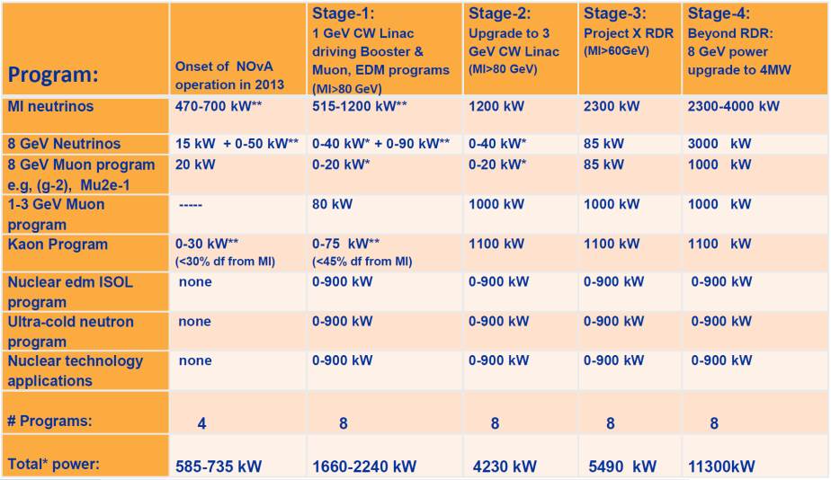
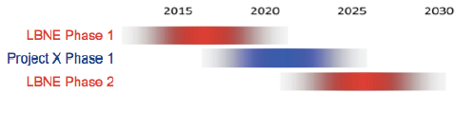
Proton X Driver Stages
    0. Proton improvement plan
        0.7MW – 60/120GeV
PX Stage 1
  1 MW @1 GeV; 1.2MW at 60/120GeV
PX Stage 2
  1—3 MW@3GeV;
  entry level Higgs or nuFact?
PX Stage 3
  1—3MW@3GeV; 8 GeV 0.2MW
    2.3 MW at 60/120GeV
8 GeV; 4MW
  4MW 8GeV; 4 MW at 60/120GeV
  Accumulator/Compressor

Slide 6
3 GeV Proton Driver Stage
3 GeV will make lots of ~200MeV/c μ’s
  μ/MW ~same as 8GeV (?)
Need pulsed bunches to match
target –capture magnet, pulsed rf
Capture and bunch into harmonic 4; C=90m 3GeV ring; 70 Hz (2.5*10¹³/ bunch)
  1→2→ 4 accumulator rings
Accumulate in storage ring
  space charge:
  B_{F} ∝ δz/R , R ∝ βγ

Slide 7
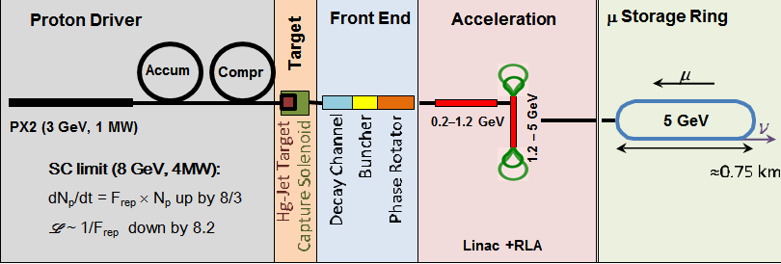
3 GeV Scenarios
C. Ankenbrandt et al.
1 MW
  initially use only 1/3 of PX2
  accumulate in 70 Hz storage ring (42000/3 turns?)
  multiple bunches on target
  enough μ for low-luminosity NF
  2→4 storage rings; 2->4 bunches
    spreadsheet level design
3 MW
  Use full project X2
  High luminosity NF
  Collider ?
    at lower L than baseline?
  Try to do

Slide 8
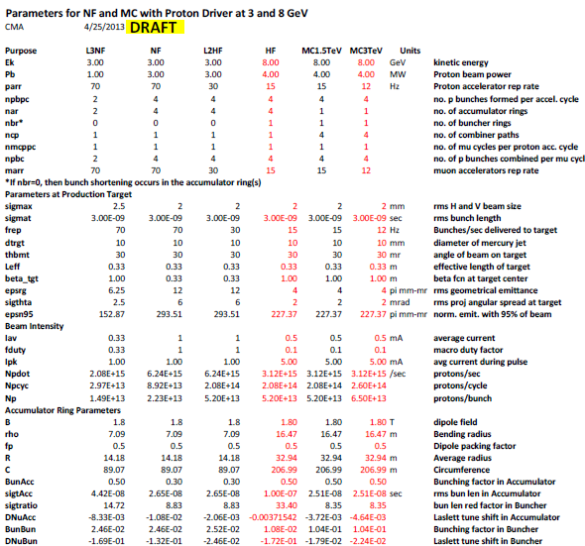

Slide 9
Neutrino Factory Staging (MASS)
Preliminary Staging Plan Based on
Project X Phase 2
* supports multiple detector technologies

Slide 10
A Staged Pathway
A Muon Accelerator Facility provides a
staged route from the Intensity Frontier
to the Energy Frontier via a
Unique Higgs Factory
  Only a low energy Muon Collider can
  directly measure the full width of H(125)
  Offers the most precise measurement of
  the Higgs mass
  σ_{peak} x 10³¹ x (1 SMyr) = 10k Higgs
  Precise energy resolution ΔE/E ≈ few x 10⁻⁵ allows scanning of the line shape
  Preliminary scan studies: ΔE = 2 MeV → 2 fb⁻¹
  Multi-Higgs, H⁰ A⁰, accessible with >500 GeV CoM machine
Represents the 1st step towards a multi-TeV Energy Frontier Lepton Collider

Slide 11
ν Factory and μ⁺μ⁻ Collider
ν Factory design based on IDS neutrino factory
Luminosities in the range of 1-10 x 10³¹ appear feasible for Higgs Factory
The Higgs Factory is one stage in a facility that supports both the Intensity Frontier physics goals (with a ν Factory) and can reach the Energy Frontier with a multi-TeV μ Collider
Luminosities in the range of 1-10 x 10³¹ for Higgs; 10³⁴ for Multi TeV machines
π→μ
ν Factory
π→μ
μ Collider

Slide 12
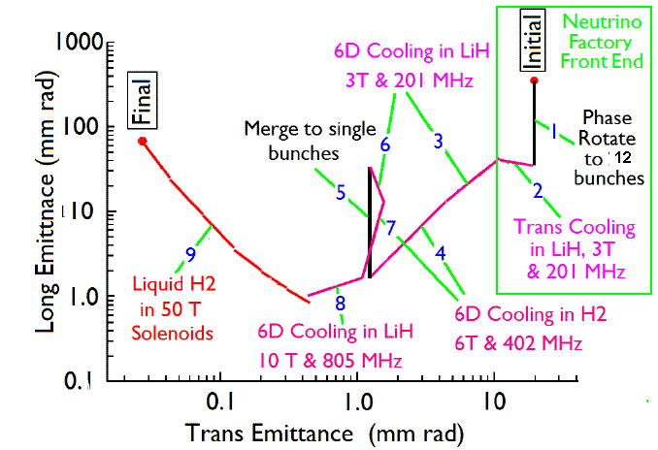
Emittance Evolution
ν Factory ➔ Higgs Factory ➔ Multi-TeV Collider
HE MC
in 40 T
For Higgs Factory stop cooling where the longitudinal emittance is at minimum:
ε_{⊥N} =0.3π⋅mm⋅rad, ε_{||N} =1π⋅mm⋅rad

Slide 13
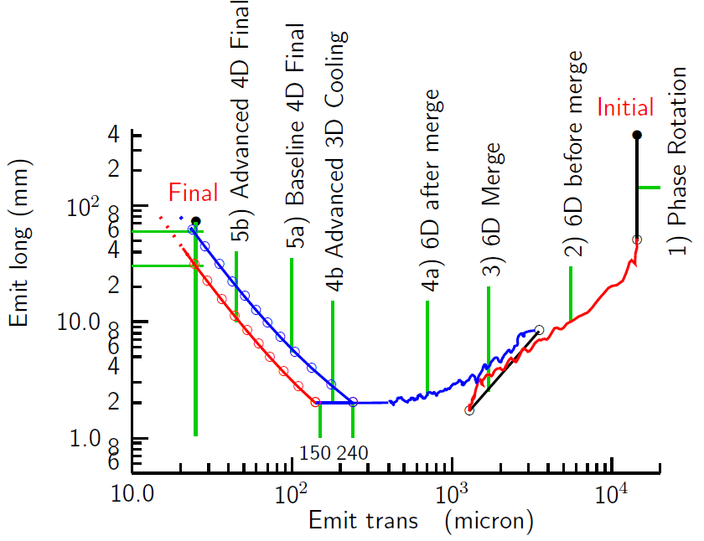
Emittance Evolution
ν Factory ➔ Higgs Factory ➔ Multi-TeV Collider
HE MC
in 40 T
For Higgs Factory stop cooling where the longitudinal emittance is at minimum:
ε_{⊥N} =0.2π⋅mm⋅rad, ε_{||N} =15π⋅mm⋅rad

Slide 14
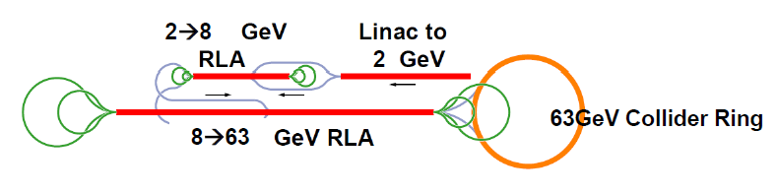
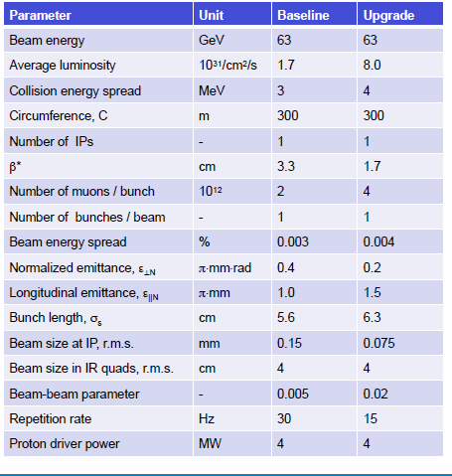
Higgs: 63 x 63 GeV
C=300m
Y. Alexahin

Slide 15
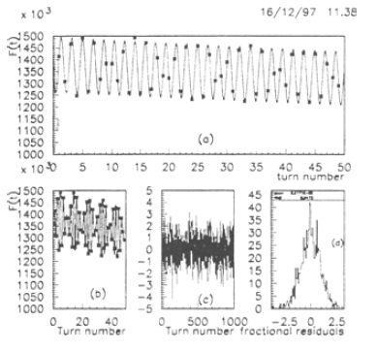


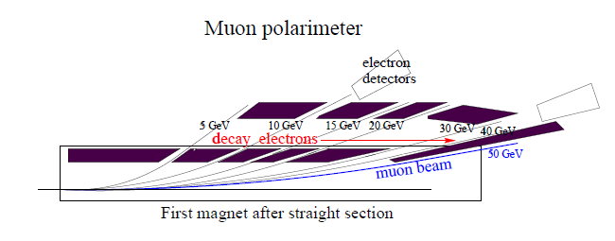
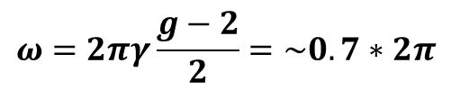
Polarization & Energy measurement
Raja and Tollestrup (1998) Phys. Rev. D 58 013005
Electron energy (from decay) depends on polarization
  polarization is ~25% → 10%
  Measure ω from fluctuations in electron decay energies
    6×10⁶ decays/m
  <E_{μ}> depends on Frequency
  Frequencies can be measured very precisely
  E, δE to 0.1 MeV or better (?)
  need only > ~5% polarization ?
    A. Blondel
$$ω=2πγ\frac{g−2}{2}=\sim 0.7∗2π$$

Slide 16
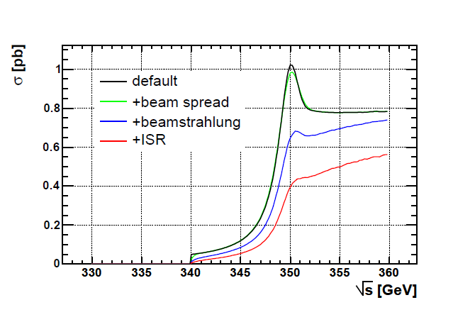
μ⁺μ⁻ Collider at tt* (350 GeV)
σ= ~1pb for tt*
  no beamstrahlung, less ISR
~10⁴ at L=10³³, t =10⁷
  δE/E < 10⁻³ OK (<200 MeV)
    could add some final stage cooling (ε_{t}~10⁻⁴m; ε_{L}~10⁻²m);
Must add acceleration to 175 GeV/beam
~700m circumference ring
  reuse detector, IR quads
(Degraded performance for e⁺e⁻⁾

Slide 17
Higgs to Top Factory Parameters
Parameter | Unit | Baseline 126 GeV | Upgrade 126GeV | Toponium 350 GeV
Beam energy | GeV | 63 | 63 | 175
Average luminosity | 10³¹/cm²/s | 1.7 | 8.0 | 100
Higgs or top/ 10⁷s |  | 7000 | 32000 | 10000
Collision energy spread | MeV | 3 | 4 | 100
Circumference, C | m | 300 | 300 | 700
Number of IPs | - | 1 | 1 | 1
β* | cm | 3.3 | 1.7 | 1
Number of muons / bunch | 10¹² | 2 | 4 | 2.5
Number of bunches / beam | - | 1 | 1 | 1
Beam energy spread | % | 0.003 | 0.004 | 0.07
Normalized emittance, ε_{⊥N} | π⋅mm⋅rad | 0.4 | 0.2 | 0.1
Longitudinal emit., ε_{||N} | π⋅mm | 1.0 | 1.5 | 10
Bunch length, σ_{s} | cm | 5.6 | 6.3 | 1
Beam size at IP, r.m.s. | mm | 0.15 | 0.075 | 0.025
Beam size in IR quads, r.m.s. | cm | 4 | 4 | 2.5
Beam-beam parameter | - | 0.005 | 0.02 | 0.027
Repetition rate | Hz | 30 | 15 | 15
Proton driver power | MW | 4 | 4 | 4

Slide 18
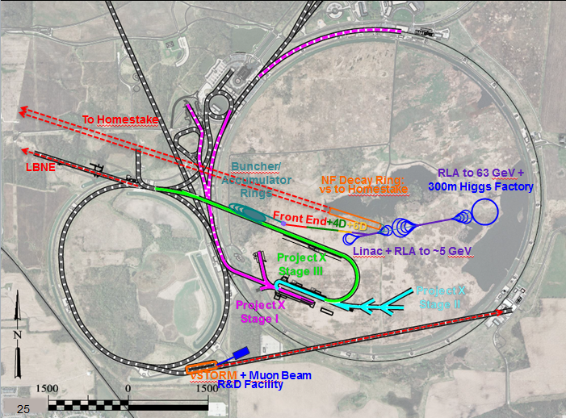
Fermilab Facilities:
ft

Slide 19
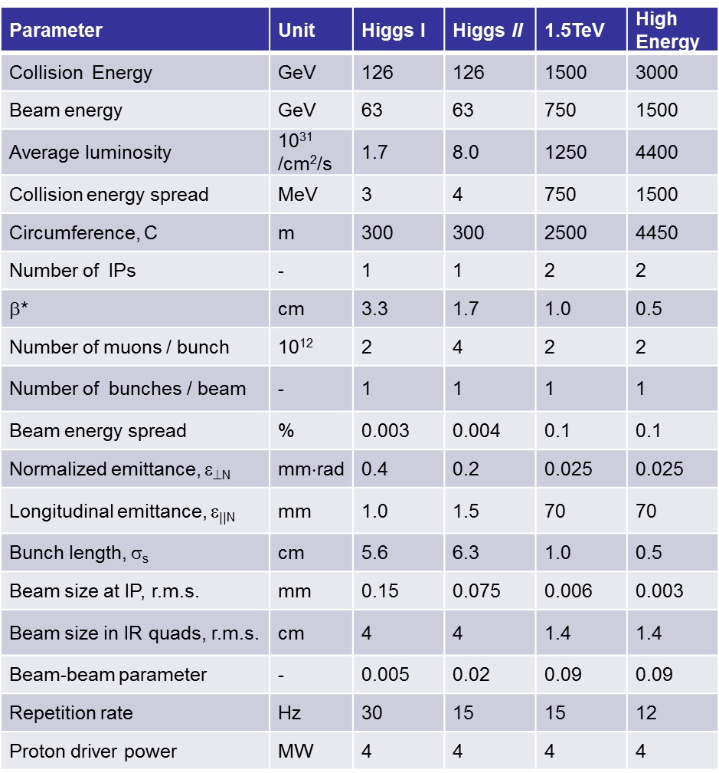
Higgs Factory and TeV-Scale Collider Parameters

Slide 20
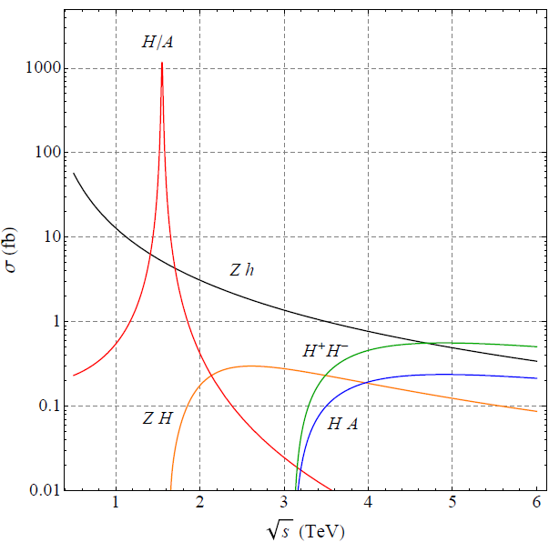
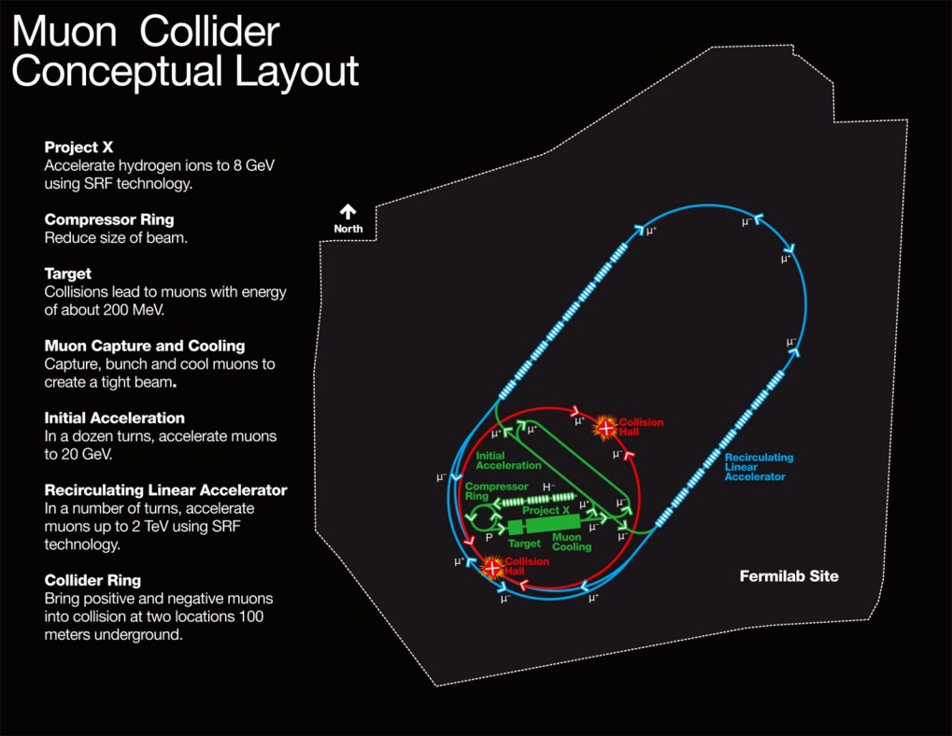
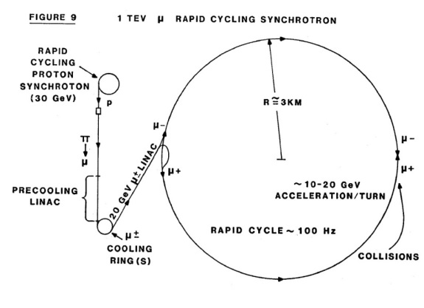
Higher energy?
On to multi TeV !
  Find H/A (10⁵/year)
Acceleration by VRCS
4 TeV

Slide 21
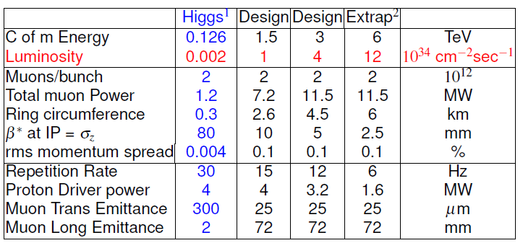
Muon Collider parameters
R.B,Palmer
Depends on cooling scenario:
10³¹a~10³² cm⁻²sec⁻¹

Slide 22

Multiple Projects and Stages…

