Slide 1
Muon Collider Physics and Detectors
R. Lipton, Fermilab
Why contemplate a Muon Collider?
Because of the reduced bremsstrahlung muon rings can be made compact
  Lower cost
  Lower power consumption- 230 (MuC) vs 570 (CLIC) MW for 3 TeV
    20% increase for 6 TeV
  Fits on existing sites
Different cost scaling and lower power consumption mean that one can contemplate collider rings to 6 TeV
A Muon Collider is uniquely capable of producing Higgs bosons in the s channel with beam energy resolution comparable to it’s width

Slide 2
The Standard Model Higgs
The SM Higgs:
  All properties are determined for a given mass.
  Any deviations signal new physics.
Questions:
  Couplings and width SM?
  Scalar self-coupling SM?
  Any additional scalars? EW doublets, triplets or singlets? (e.g. SUSY requires two Higgs doublets)
  Any invisible decay modes?
Branching Fractions
bb = 0.584 W⁺W⁻ = 0.229
ττ = 6.02 x10⁻² Z⁰Z⁰ = 2.82 x 10⁻²
cc = 2.57 x10⁻² gg = 6.81 x 10⁻²
ss = 2.57 x10⁻² γγ = 2.26 x 10⁻³
μ⁺μ⁻ = 2.09 x 10⁻⁴ Z⁰γ = 1.58 x 10⁻³
M(H) = 126 GeV
Γ(H) = 4.21 MeV

Slide 3
Questions
Central Question:
Can we do precision physics in the high background environment of the Muon Collider?
Subsidiary questions
What detectors are needed?
What compromises must be made and what is the physics impact?
What new technologies must be developed?
Identify and study sensitivity to specific processes in the Muon Collider environment

Slide 4
Current Efforts
We have limited manpower (we don’t exist as a funded entity)
Short term goal – provide studies on the plausibility and utility of Muon Collider detectors for Snowmass.
Longer term – Establish a program of studies and detector development to enable experimental studies at a Muon Collider.
Two rather parallel efforts:
Studies of a high energy collider based on existing lattice design and background simulation
Studies of a Higgs factory based on new lattice and background calculations

Slide 5
High Energy Collider
Extension of efforts over the last 3-4 years based on ILCROOT simulation
Background files available
We never fully integrated backgrounds and physics events to evaluate performance – we plan to do that now
First study will be s-channel resonant production of a heavy Higgs (H/A) at 1.5 TeV – discussed by Estia on Wednesday
Infrastructure is ready – we expect initial feedback in the few-week time scale.

Slide 6
Higgs Factory
Using a different software framework – LCSIM
Detector simulation available and has been used for Higgs factory fast simulation studies
Further development of analysis tools – Particle flow jet reconstruction, tracking is underway
We are ready to include HF backgrounds described by Nikolai on Thursday
Will then begin to validate HF fast simulation studies including background rejection algorithms.

Slide 7
Higgs Factory Rates
Cross section
At scan point
Overall rates
Luminosity estimates are in the
10³¹-10³² range
If we fold a 4.2 MeV Breit-
Wigner with a 2.5 MeV
Gaussian beam we get a on-peak
cross section of ~46 pb
This gives us between 3,000 (5 MeV, 10³¹) and 46,000 (2.5 MeV, 10³²) Higgs/year
The physics we can do depends strongly on machine parameters

Slide 8
Higgs Factory vs High Energy Collider Requirements
The unique contributions of a MuC Higgs Factory include precise, model-independent measurements of width and mass. This requires:
Excellent machine energy resolution and stability
g-2 based measurement of energy
Z/γ* background rejection (W/W* signal probably best)
A high energy machine would be used to measure new states (supersymmetric …). The requirements are similar to CLIC, MuC has lower beamstrahlung – more precise fits.
Requires as for CLIC:
Precise, low mass tracking (μμ→Zh)
Vertex Flavor tagging
Calorimetry capable of separating W/Z signals

Slide 9
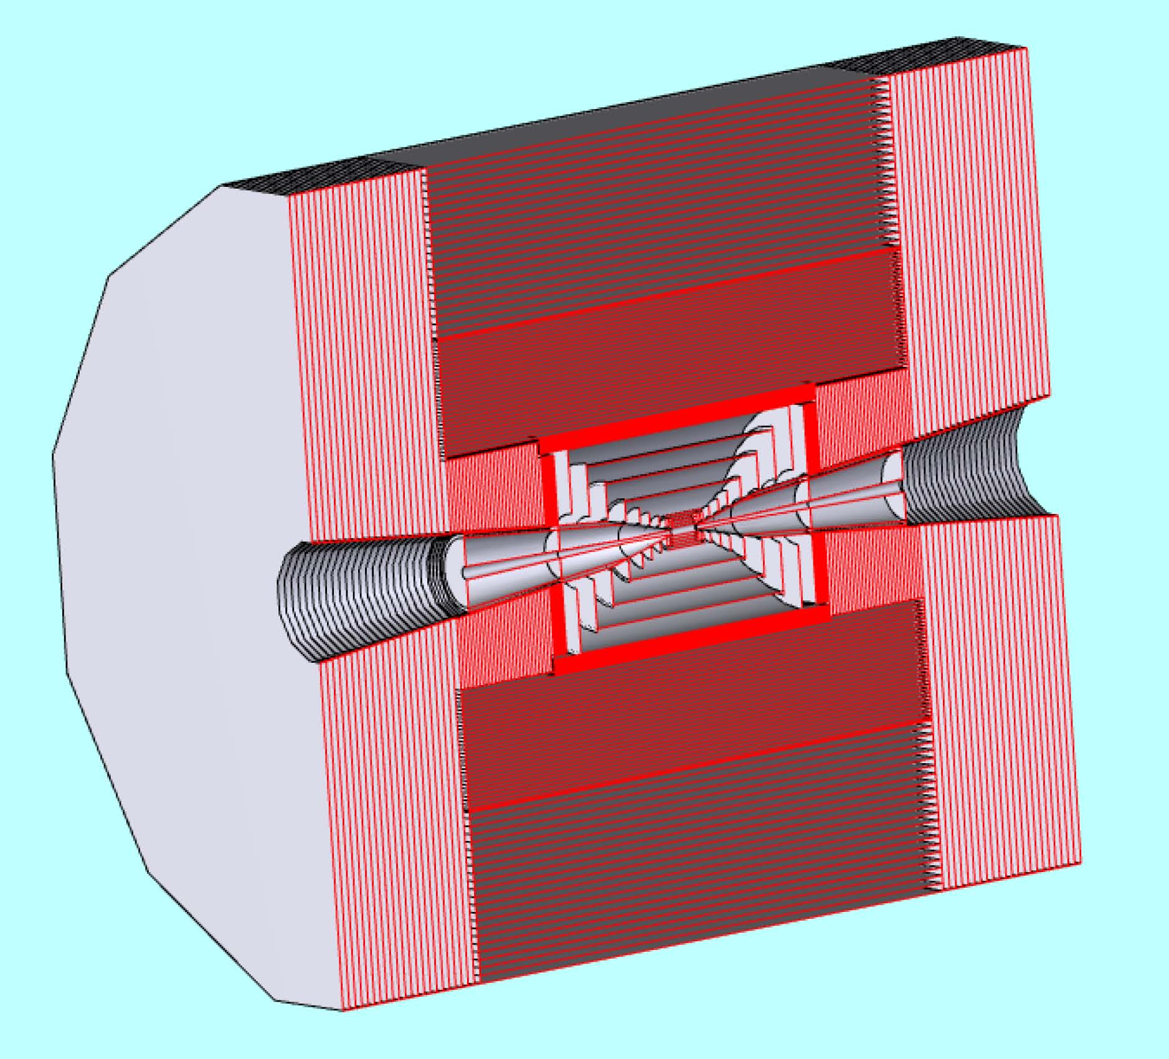
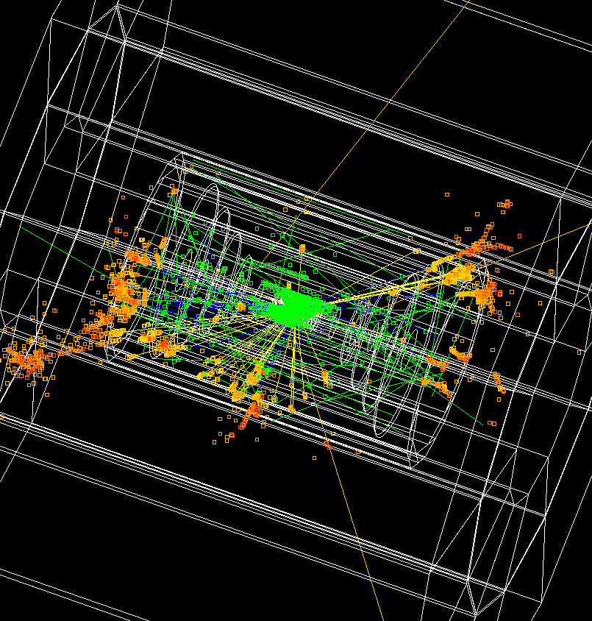
Detector Model based on ILC SiD concept
LCSIM Detector Model
Full Simulation
Absorber cone

Slide 10
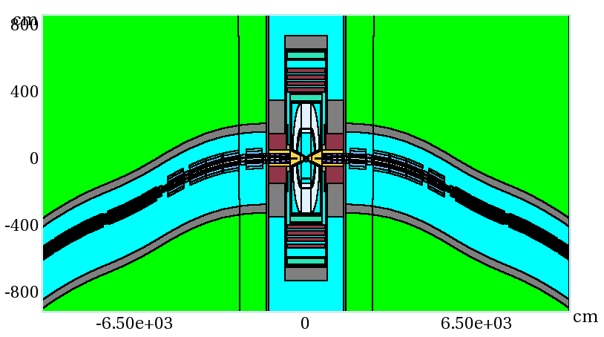
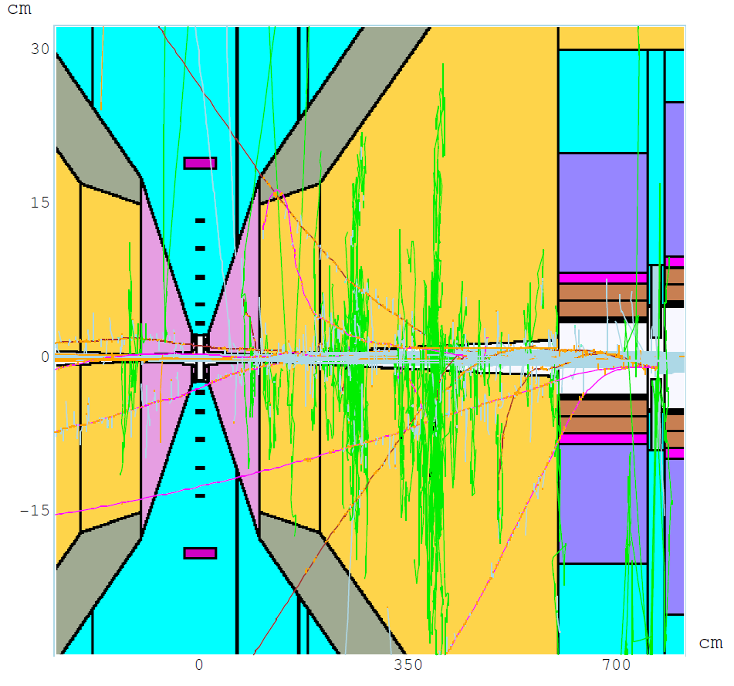
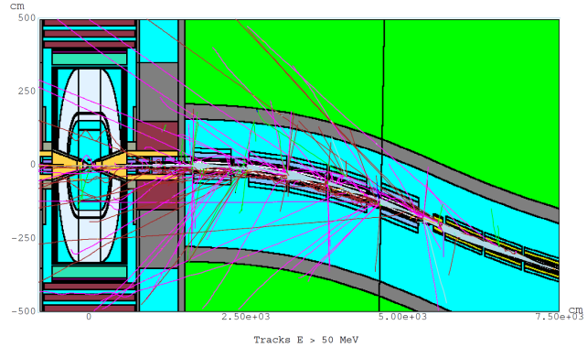
MARS 1.5 TeV
Machine Detector Interface Model
Θ = 10º 6 < z < 600 cm x:z = 1:17
Q1
W
BCH₂

Slide 11
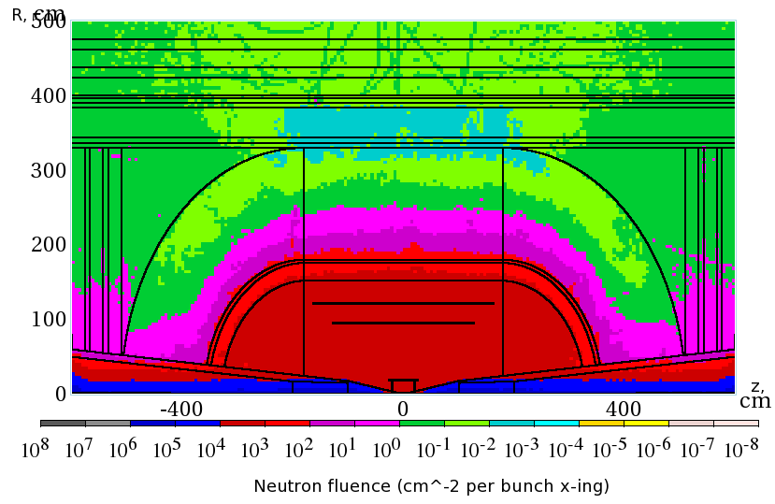
Overall Background – 1.5 TeV
Detectors must be rad hard
Dominated by neutrons –
smaller radial dependence
Non-ionizing background ~ 0.1 x LHC
But crossing interval 10μs/25 ns 400 x

Slide 12
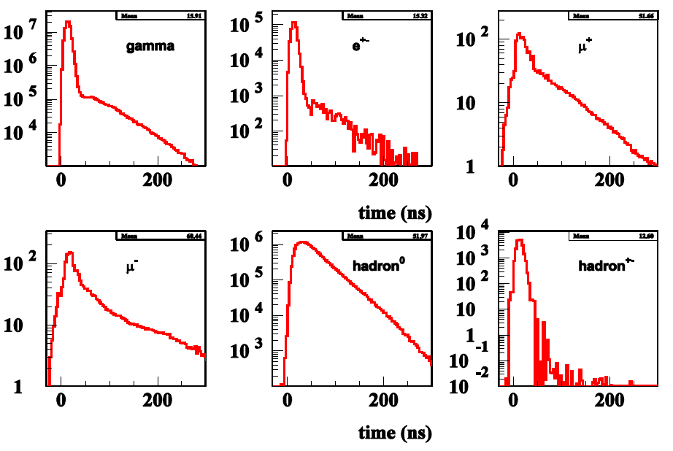
Much of the Background is Soft
γ
e^{+/−}
μ⁺
μ⁻
h⁰
h⁺⁻
γ
e^{+/−}
μ⁺
And Out of Time
μ⁻
h⁰
h⁺⁻
(Striganov)

Slide 13
Attacking the Background
It is clear that timing and energy discrimination will be crucial in limiting the background in a Muon Collider
We have concentrated on understanding the time resolution required and how it may affect the detector mass and resolution for physics objects
The R&D is synergistic with CLIC, which requires ns level resolutions, LHC which is looking at fast timing for background reduction, and intensity frontier experiments, which may require 100’s of ps resolutions

Slide 14
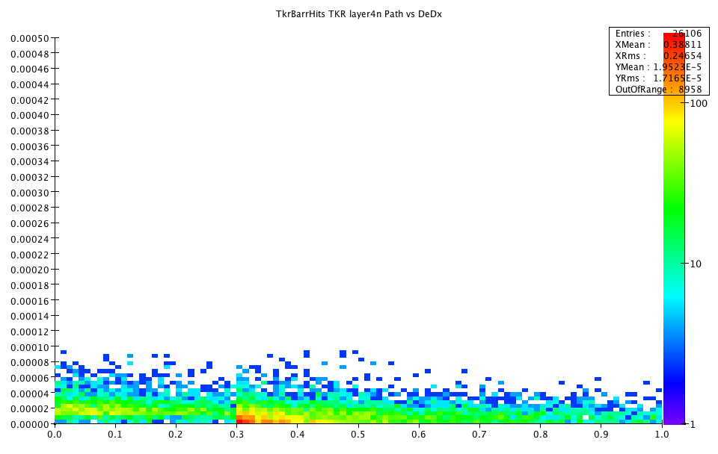
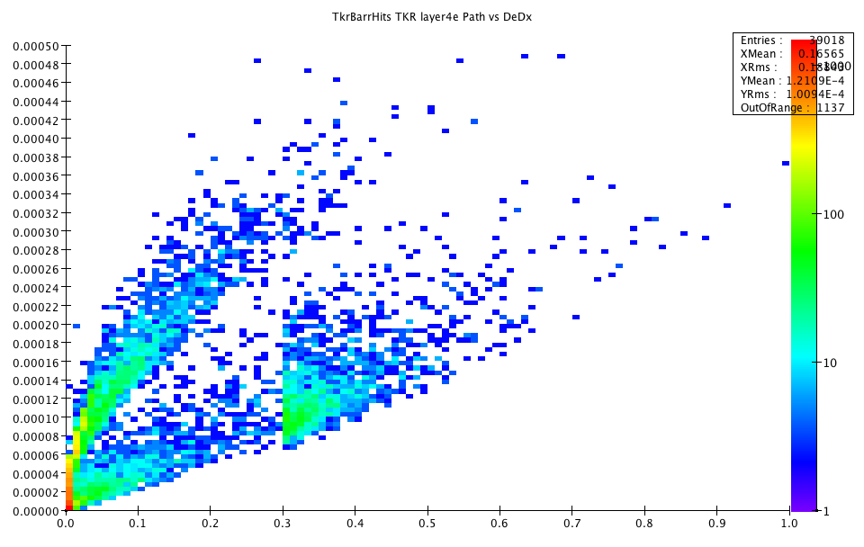
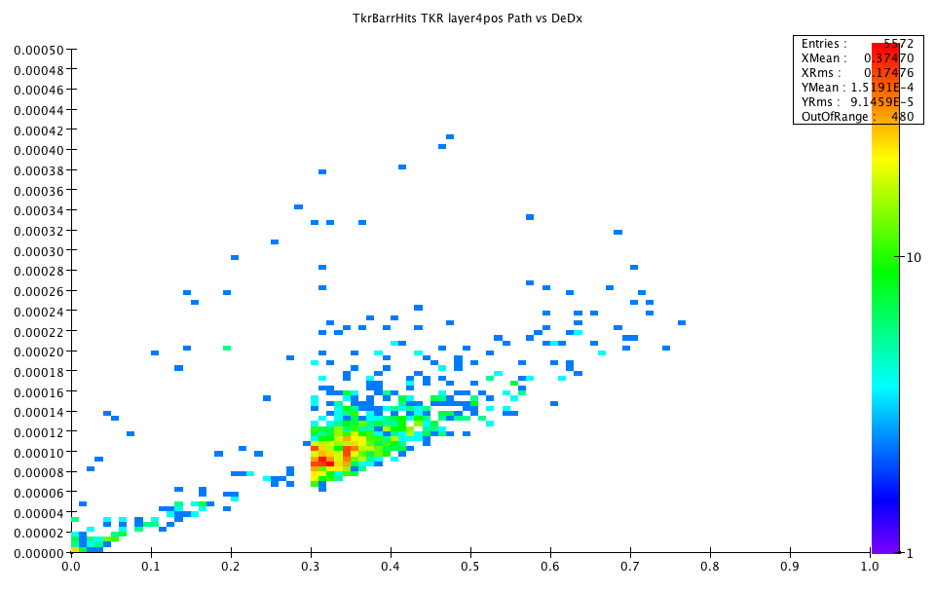
Time of energy deposit with respect to TOF from IP
Neutrons
electrons
positrons
Compton
High energy
conversions
soft
conversions

Slide 15
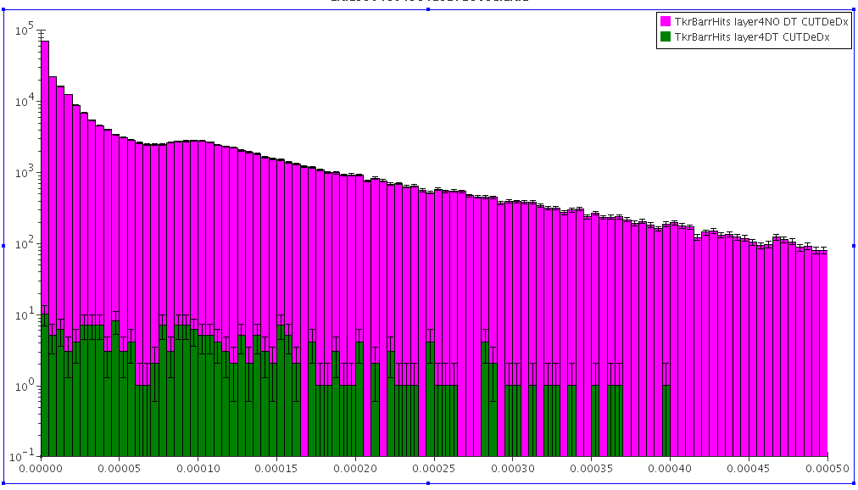
Effects of Cuts on Tracker Background
Tracker Layer 4
Background, no time cut
Timing is the most
important
  Reduces backgrounds by 3 orders of magnitude
De/dx also is also important
  We need pulse height information anyway since our timing accuracy will depend on signal/noise and time walk corrections
Background, 1ns time cut
de/dx
Radius | DT Cut | DT & rphi & dedx
20 | 0.0012 | 0.0009
46.2 | 0.0008 | 0.0006
71.7 | 0.0011 | 0.0007
97.3 | 0.0006 | 0.0004
122.9 | 0.0009 | 0.0006
Background Hit rejection

Slide 16
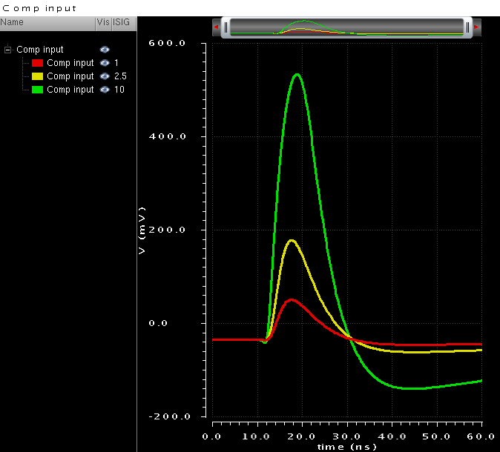
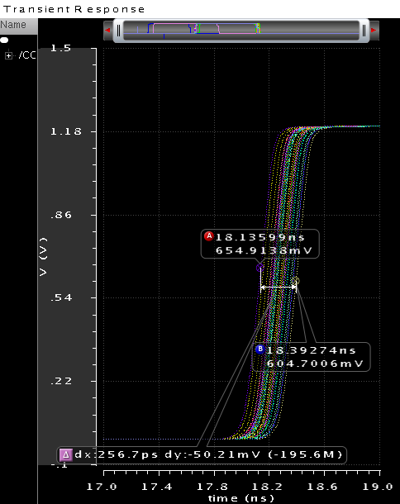
Timing In a Tracker
There is already an example of a fast timing IC design at CERN for CMS upgrades
Intent is to use fast timing to reject “loopers”
65 nm process
  Pixel ~ 1mm x 100 μ x 200 μ thick
  Peaking time: 6 ns
  220 e- ENC for 260 fF input capacitance
  Consumption for nominal bias: 65 uA
Jitter for 0.6fC V_{th} and 2.5fC signal; ~50 ps rms
Jitter for 1 fC signal; ~100 ps rms.
Time resolution defined by time walk (~3 ns) → without correction the resolution will be ~500 ps RMS
Time walk for signals 1 to 10 fC (0.6 fC threshold); <3 ns

Slide 17
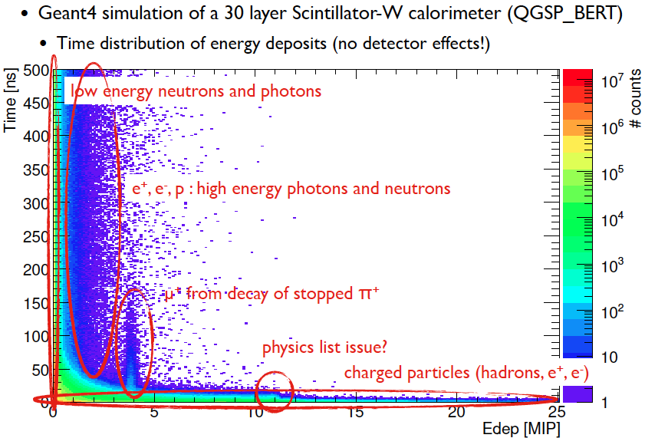
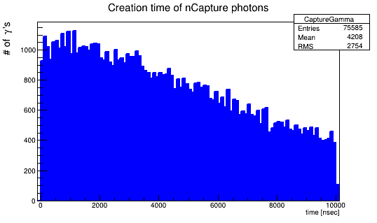
Time Development of Hadron Showers
(F. Simon CALICE)
The problem of hadron calorimetry at CLIC and a Muon Collider is interesting…
Hadron showers take time to develop – nuclear processes can take more than the ns time scale we would like for μC
(H. Wenzel)
n→ thermalize → neutron Capture
→ γ → visible Energy
(mean Time: 4.2 μ sec)

Slide 18
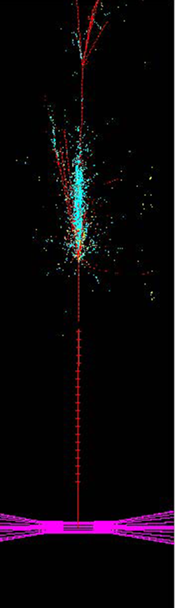
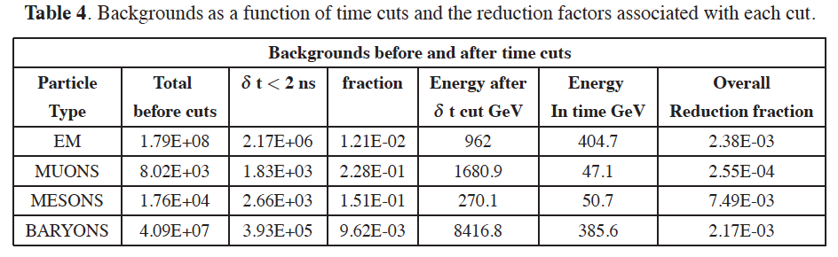
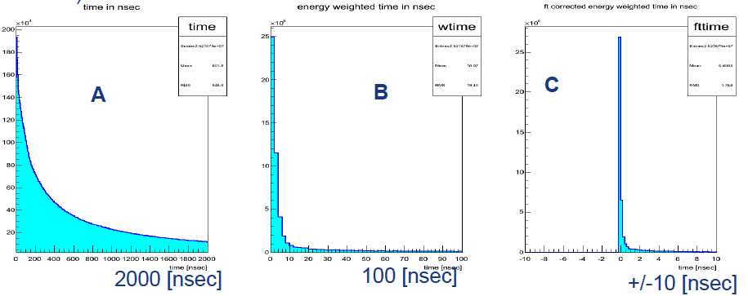
Two approaches
Software compensation
Based on nuclear int. vertices
Pixelated digital calorimeter with 2ns gate
[R Raja 2012 JINST 7 P04010]
Hadron shower time development
Dual readout calorimetry with fast timing

Slide 19
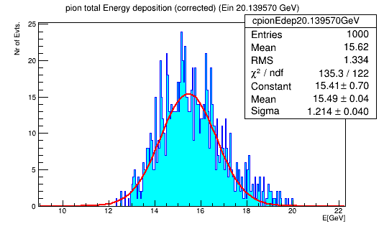
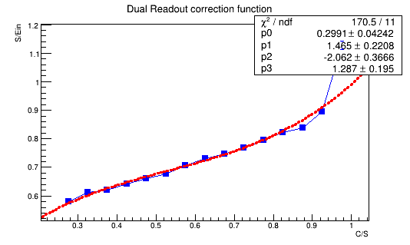
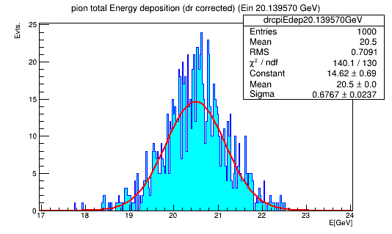
Effect of dual read out correction: γ ‘s from neutron Capture discarded
20 GeV π⁻
No DR
correction
Before Dual Read out correction:
Mean: 15.5 GeV
(reduced by 13.6 %)
σ: 1.21+/-0.04 GeV
After DR correction:
Mean: 20.5 GeV
σ: 0.68+/-0.02 GeV
20 GeV π⁻
With DR
correction
H. Wenzel, Preliminary

Slide 20
Summary of Detector Requirements
Much of the HE collider physics is similar to e⁺e⁻ (ILC, CLIC), low mass tracking, good calorimetery w/z discrimination
But with the additional challenges of:
  Radiation hardness
  Nanosecond (or better) time resolution
Requirements are relaxed for Higgs Factory if we aim primarily at measuring the width
  Use bb pairs (higher background)
  W*W has almost no physics background

Slide 21
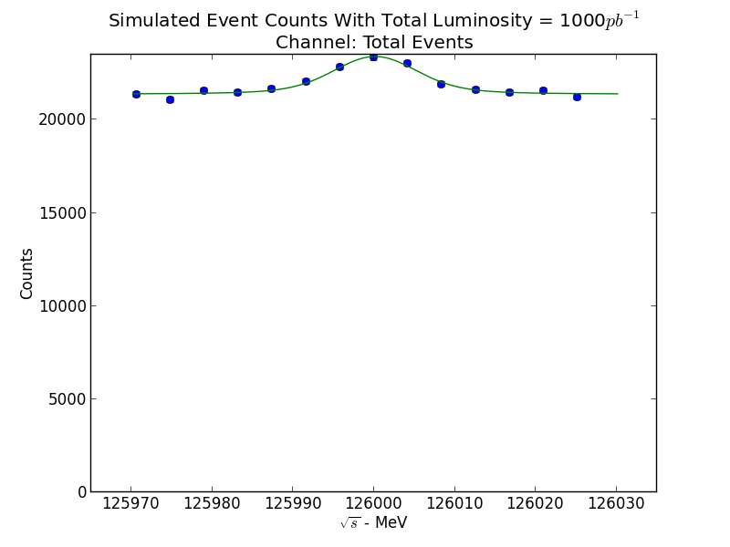
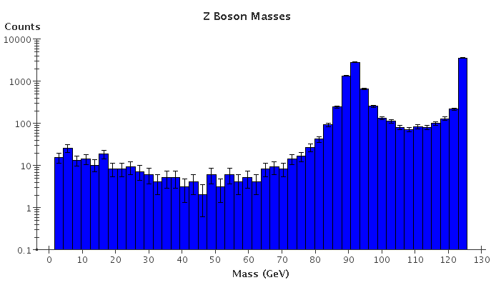
Higgs Measurements
Initial (draft) study by A. Conway, H Wenzel
1 fb⁻¹ at Higgs resonance, peak σ=28 pb
Physics background Z/γ*-> X
bb background can be reduced by event cuts that remove μμ-> Zγ events
WW* physics background very small

Slide 22
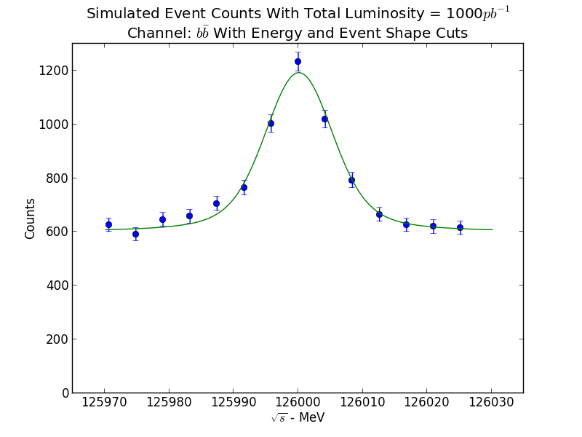
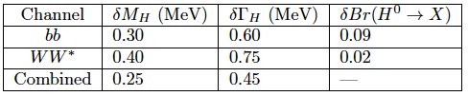
Event Yields
Based on counting experiment stepping the beam across the Higgs resonance
I expect that detector efficiencies and analysis cuts will reduce yields by 10-20%
These results will have to be confirmed with full simulation including background

Slide 23
Conclusions
The Muon Collider is a “poster child” for a technically ambitious project with high risks and rewards.
The central themes are fast and radiation-hard
Low mass tracking and vertexing with ns resolution
  Cooling, power delivery, and support are central issues in making a low mass tracker
Fast, high resolution calorimetry
  Pixelated? Digital?
  PFA?
  Dual readout?
We need to understand the detector possibilities and tradeoffs to access the physics reach of a Muon Coliider.
Next step – integrate physics and background studies.

