Slide 1
IDS-NF: overview

Slide 2
Contents:
Origins
What we know now
IDS-NF baseline
Preparing the RDR
Politix, conclusions, looking ahead

Slide 3
Origins

Slide 4
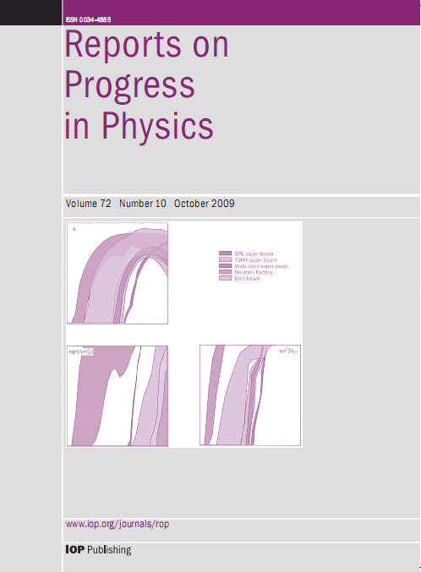
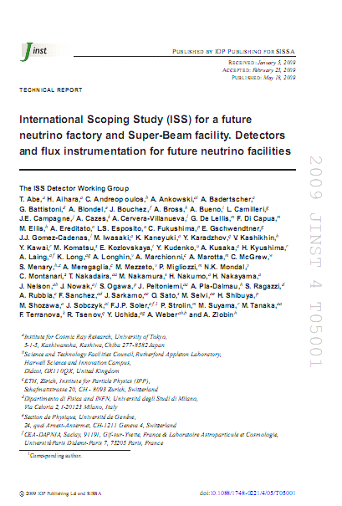
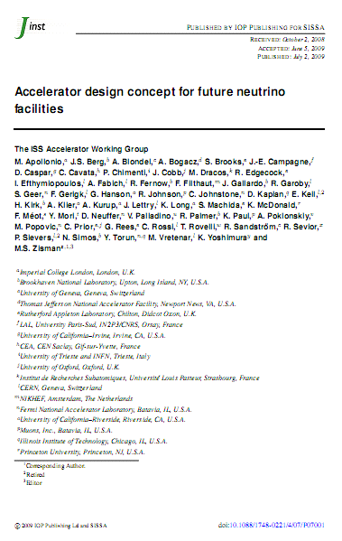

History:
Conclusions of the International Scoping Study presented at NuFact06:
  Publications:
287 citations to date
87 citations to date
148 citations to date
•
Published, a substantial achievement!
–
Physics Report: Rept.Prog.Phys.72:106201,2009.
–
Accelerator Report: JINST 4:P07001,2009.
–
Detector Report: JINST 4:T05001,2009

Slide 5

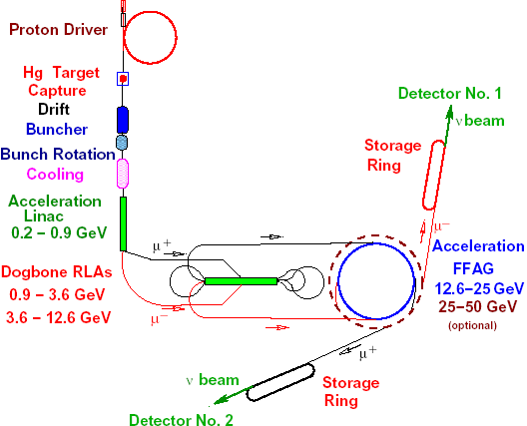
The ISS baseline:
100 (50) kT magnetised iron detector
Two baselines:
  3000 – 5000 km
  7000 – 8000 km
Store μ⁺ & μ⁻ simultaneously
  10²¹ muon decays/yr
  E_{μ} ~ 25 GeV

Slide 6
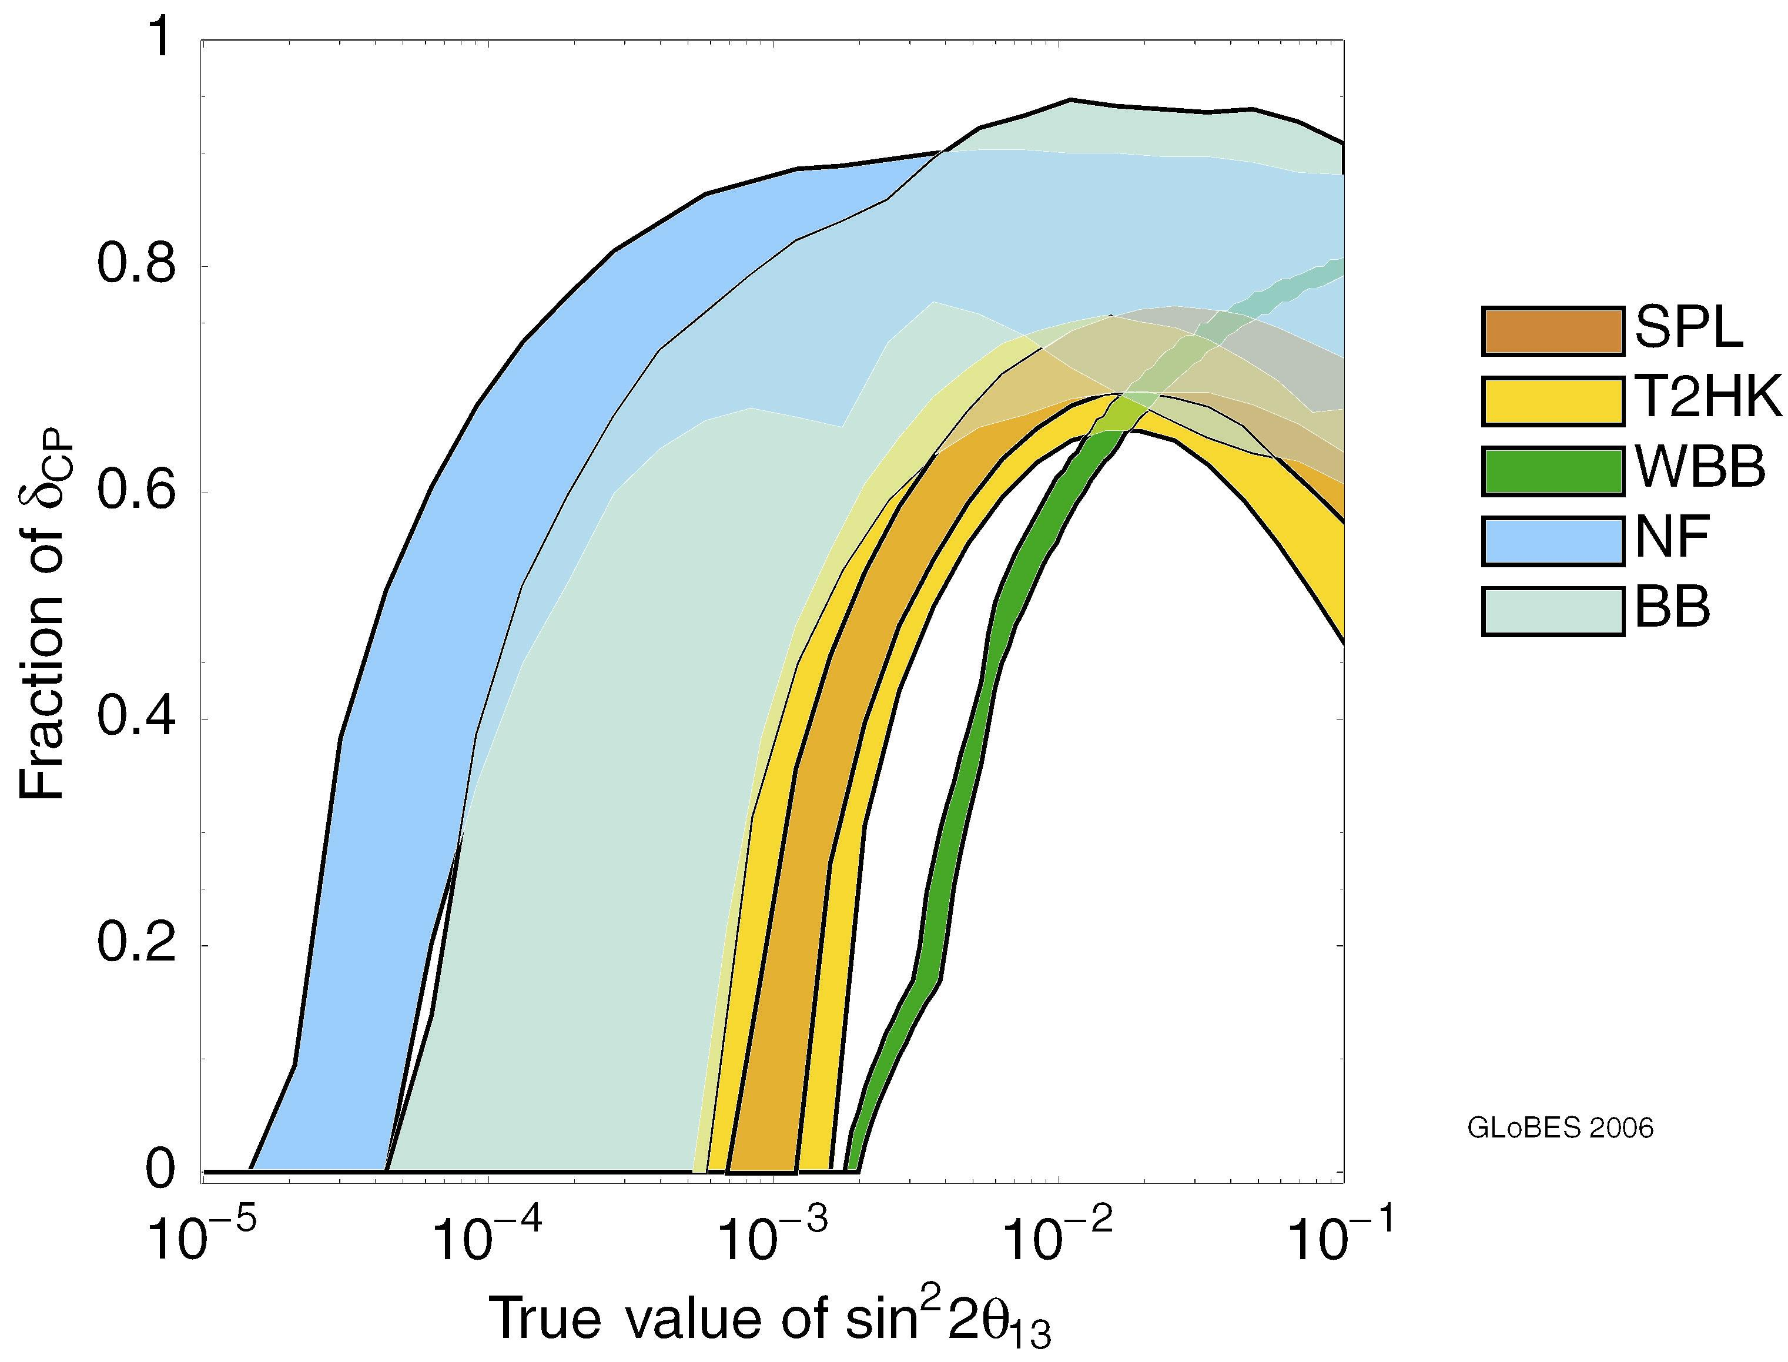
Comparison: CP violation
SPL
Systematics: 2% – 5%
T2HK
Systematics: 2% – 5%
WBB
Systematics from
proposal
Beta beam
γ = 100
500 kT H₂O Ç (130 km)
γ = 350
500 kT H₂O Ç (730 km)
Neutrino Factory
Golden, 4000,
E_{μ} = 50 GeV
Golden* (4000 km), Golden* (7500 km)
E_{μ} = 20 GeV

Slide 7
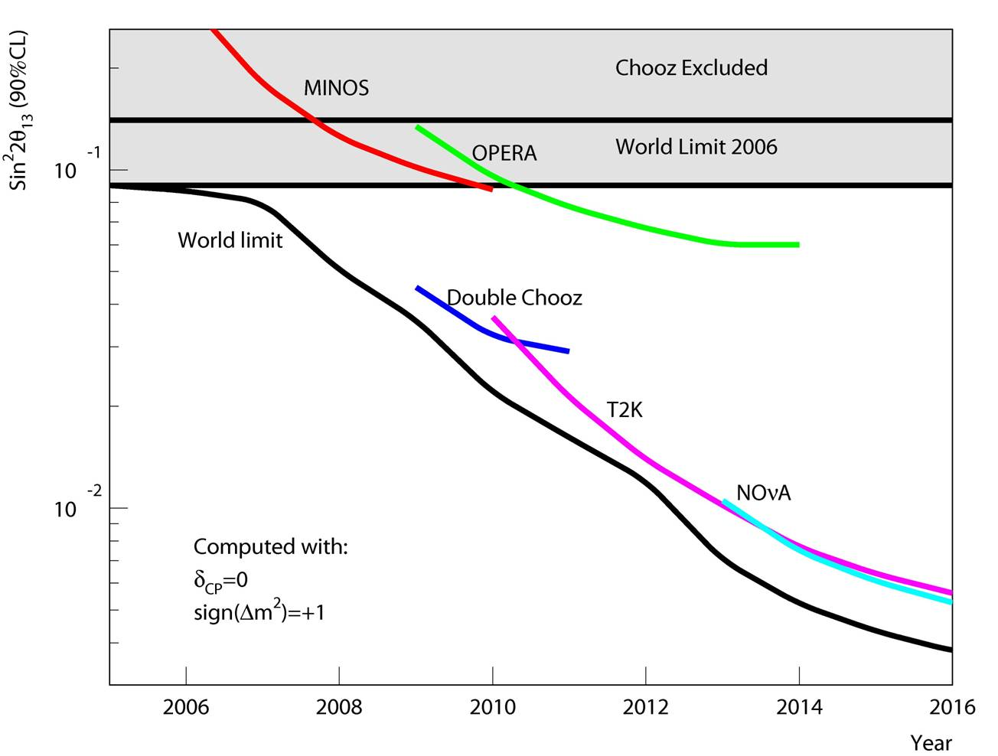
Motivation: θ₁₃
Mezzetto

Slide 8
Strategic review conclusions:
Reviews of particle-physics strategy in Europe and the US concluded that:
  Future neutrino programme be developed as an internationally coordinated programme
  Goal to define the ‘optimal’ programme around 2012
NuFact community aspiration matches this

Slide 9
IDS goals:
Goal of NF IDS:
  Neutrino Factory RDR (~2012):
    Engineering designs for most components
  Neutrino Factory IDR (~2010):
    Marks transition from:
      Concept development/R&D with engineering support … to …
      Significant engineering effort with concept-development/R&D programmes to mitigate risks

Slide 11
What we know now

Slide 12
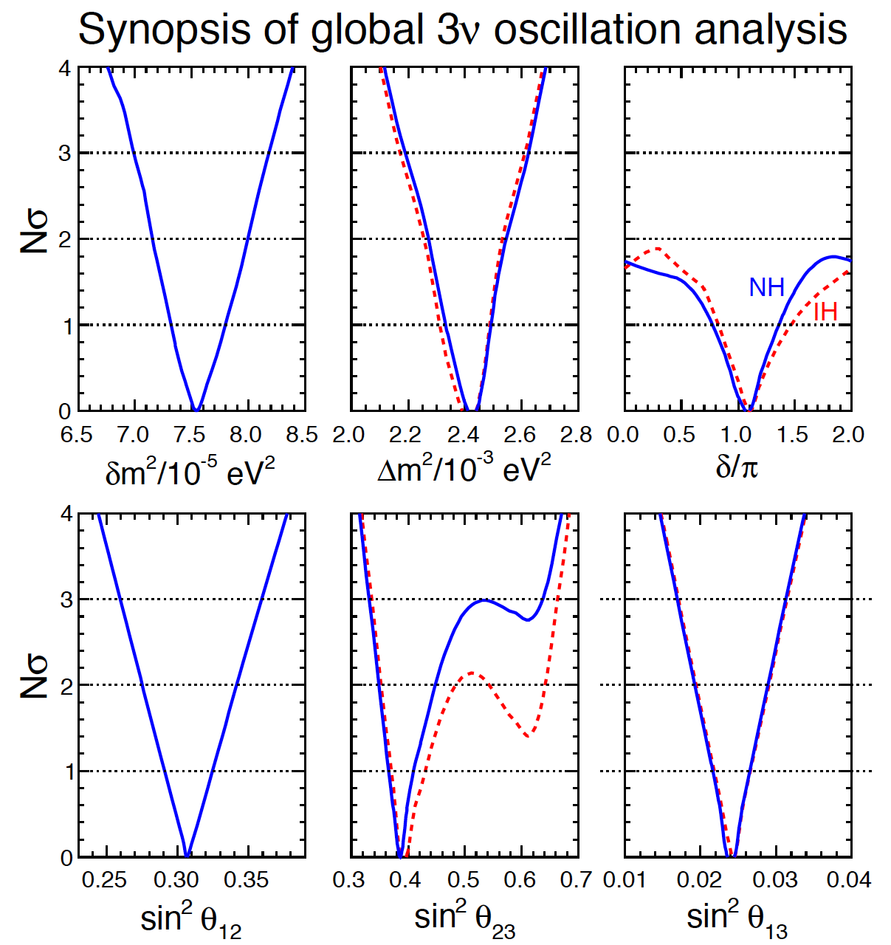
Standard Neutrino Model:
Exciting new data!
Discovery of leptonic
CP-violation is possible
Increases motivation for precision determination of the parameters and search for “non-standard effects”
Fogli, Lisi, Marrone,
Montanino, Palazzo,
Rotunno
arXiv:1205.5254v3
Notes:
The Double Chooz collaboration, by measuring the "disappearance" of electron antineutrinos, presents hints for oscillation also involving the third angle with the following value: sin^2(2theta_13) = 0.085 +/- 0.051. The probability given by preliminary results that there is no oscillation is only 7.9%.

Slide 13
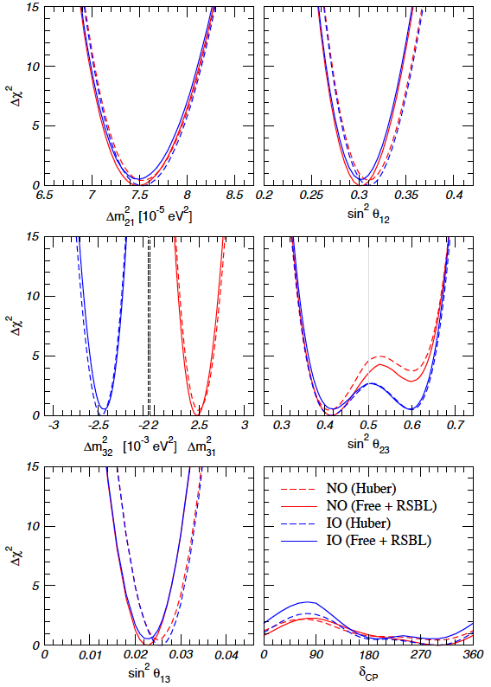

Standard Neutrino Model:
Exciting new data!
Discovery of leptonic
CP-violation is possible
Increases motivation for precision determination of the parameters and search for “non-standard effects”
Goncalez-Garcia,
Maltoni, Salvado,
Schwetz
arXiv:1209.3023v2
Notes:
The Double Chooz collaboration, by measuring the "disappearance" of electron antineutrinos, presents hints for oscillation also involving the third angle with the following value: sin^2(2theta_13) = 0.085 +/- 0.051. The probability given by preliminary results that there is no oscillation is only 7.9%.

Slide 14
Effect of systematic uncertainties:
Winter
NuInt12

Slide 15
Effect of systematic uncertainties:
Winter
NuInt12

Slide 16
Neutrino Factory:
Optimise discovery potential for CP and MH:
  Requirements:
    Large ν_{e} (ν_{e}) flux
      Detailed study of
      sub-leading effects
Unique:
    (Large) high-energy
    ν_{e} (ν_{e}) flux
      Optimise event rate at
      fixed L/E
      Optimise MH sensitivity
      Optimise CP sensitivity

Slide 17
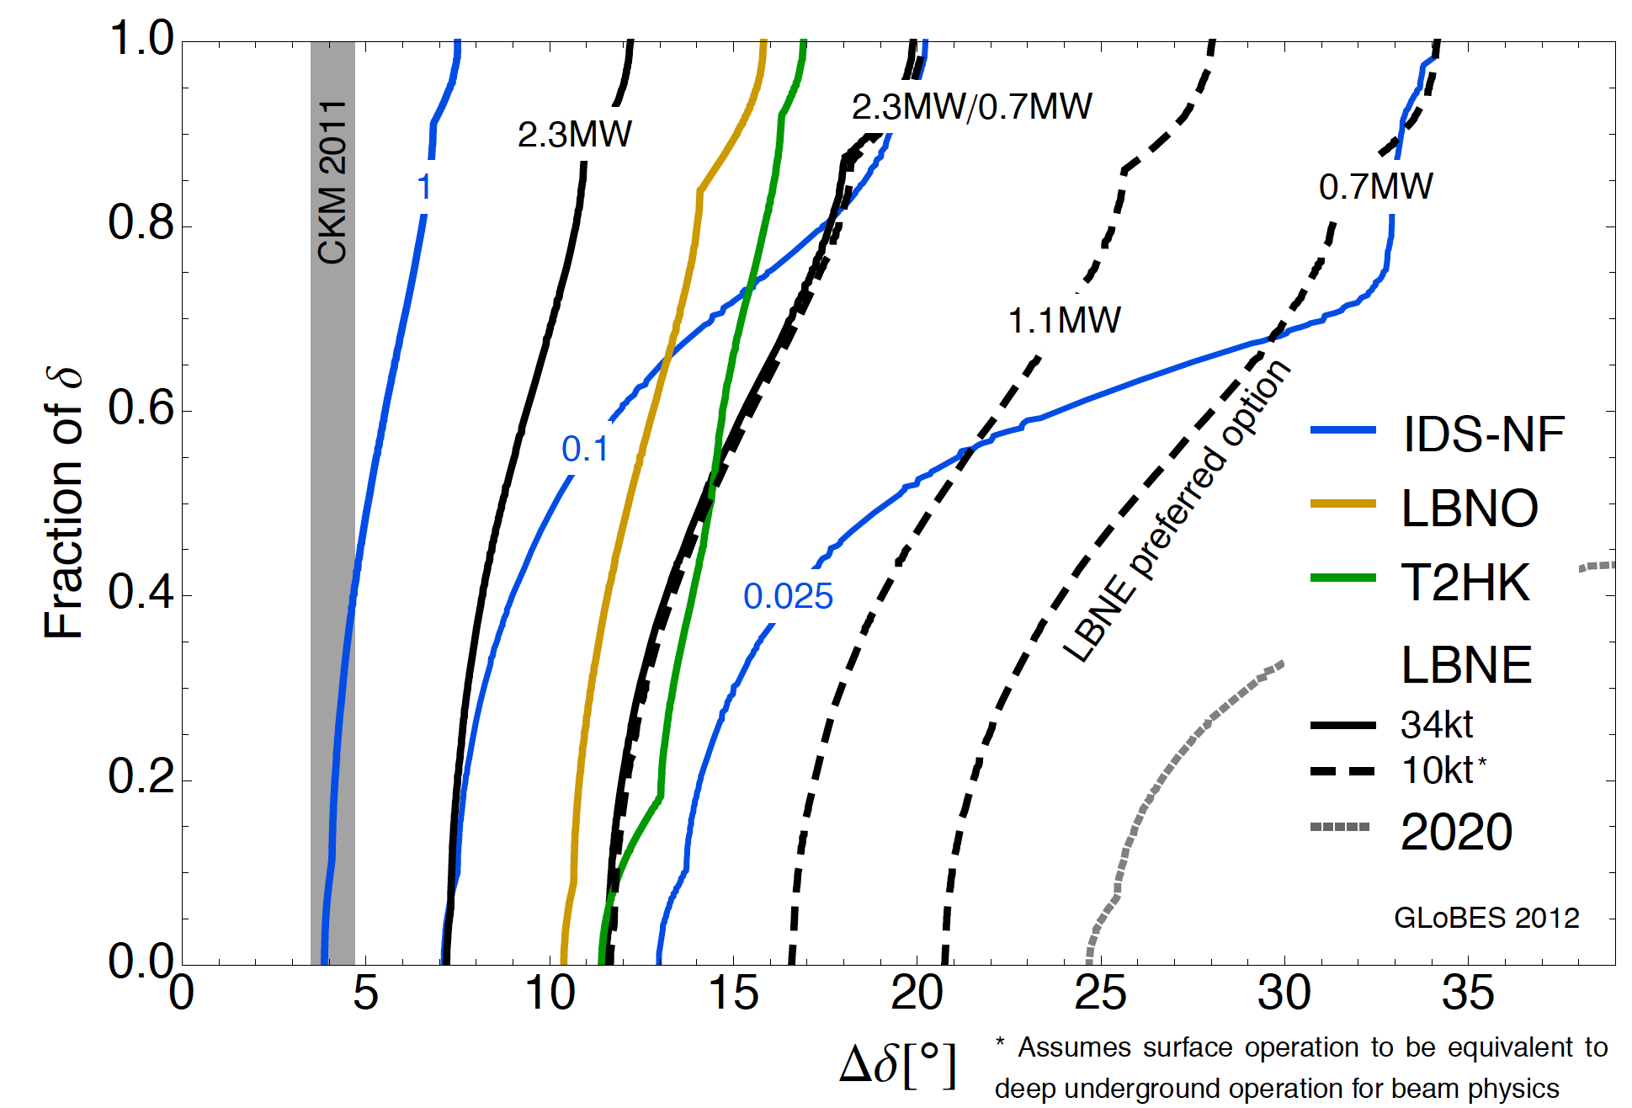
Comparison:
Coloma, Huber, Kopp, Winter
arXiv:1209.5973
Benefit of luminosity:
  Solid blue lines show effect on precision of scaling luminosity from baseline 10²¹ decays per year
  Potential for definition of staged upgrade programme

Slide 19
IDS-NF baseline

Slide 20
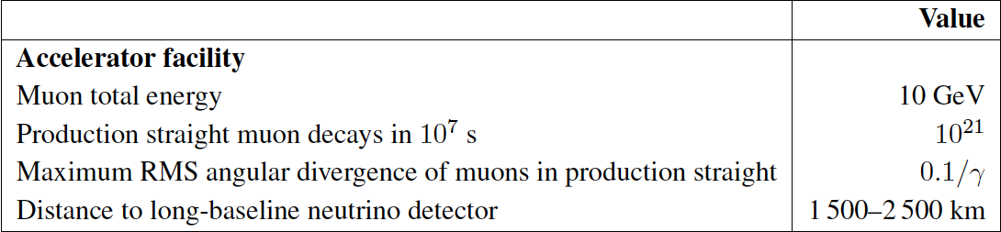

Slide 21
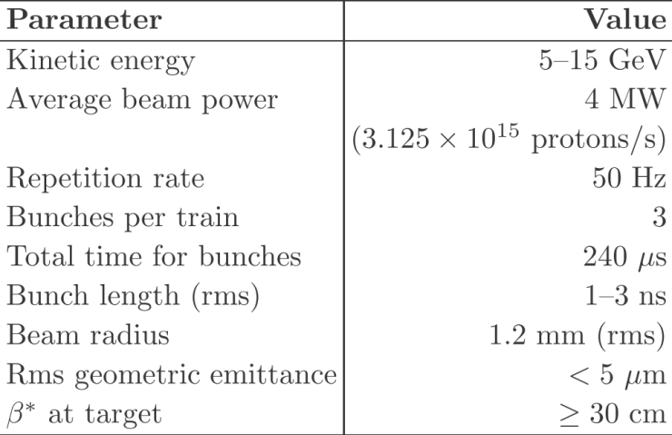
Proton driver:
Garoby, Gollwitzer, Pasternak, Thomason
Challenges:
  High power; short
  proton-bunch length
  at ~10 GeV
IDS-NF approach:
  Consider two
  ‘generic’ options:
    LINAC:
      Possible development
      option for SPL (CERN)
      or Project-X (FNAL)
      Requires accumulator &
      compressor rings
    Rings:
      Development option for J-PARC or RAL or possible ‘green-field’ option
      Requires bunch compression

Slide 22
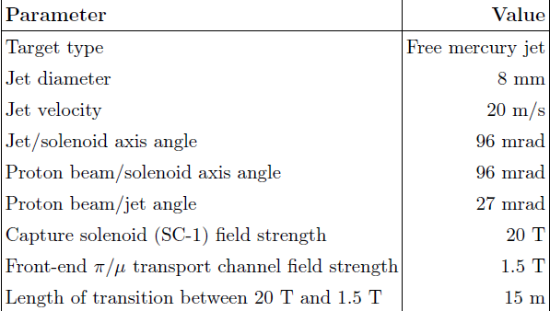
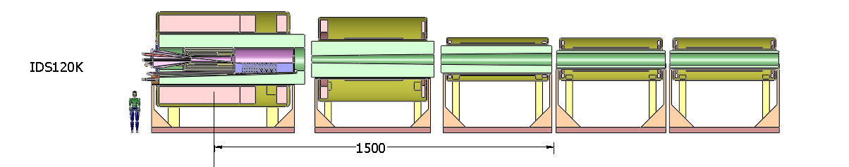
Target/capture:
McDonald, Kirk,
Back, Graves,
et al
Several variants of “IDS120k” under discussion:
  Shielding of super conductor; normal-conducting insert, stored energy, implementation of mercury loop and services are all issues

Slide 23
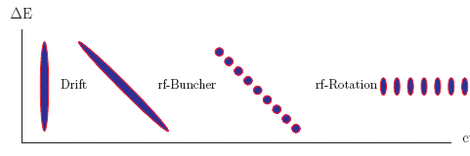
Muon front-end:

Slide 24
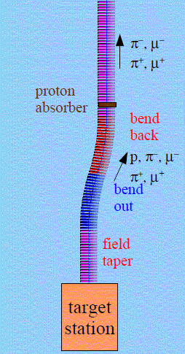
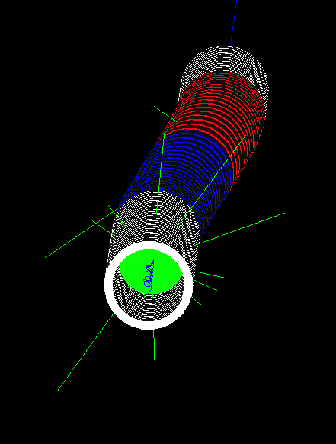
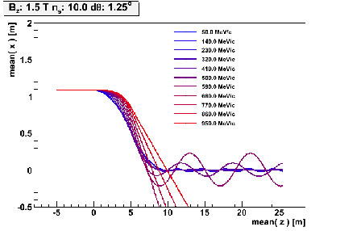
Particle losses in front-end:
Rogers
“Unmanaged”:
  ~50kW μ+ + μ-
    plus p, e, π, …
    ~20W/m μ-decay
    ~0.5MW losses along transport
    >0.1MW at z>50m
  Too large for hands-on maintenance
“Managed”:
  Chicane plus shielding:

Slide 25
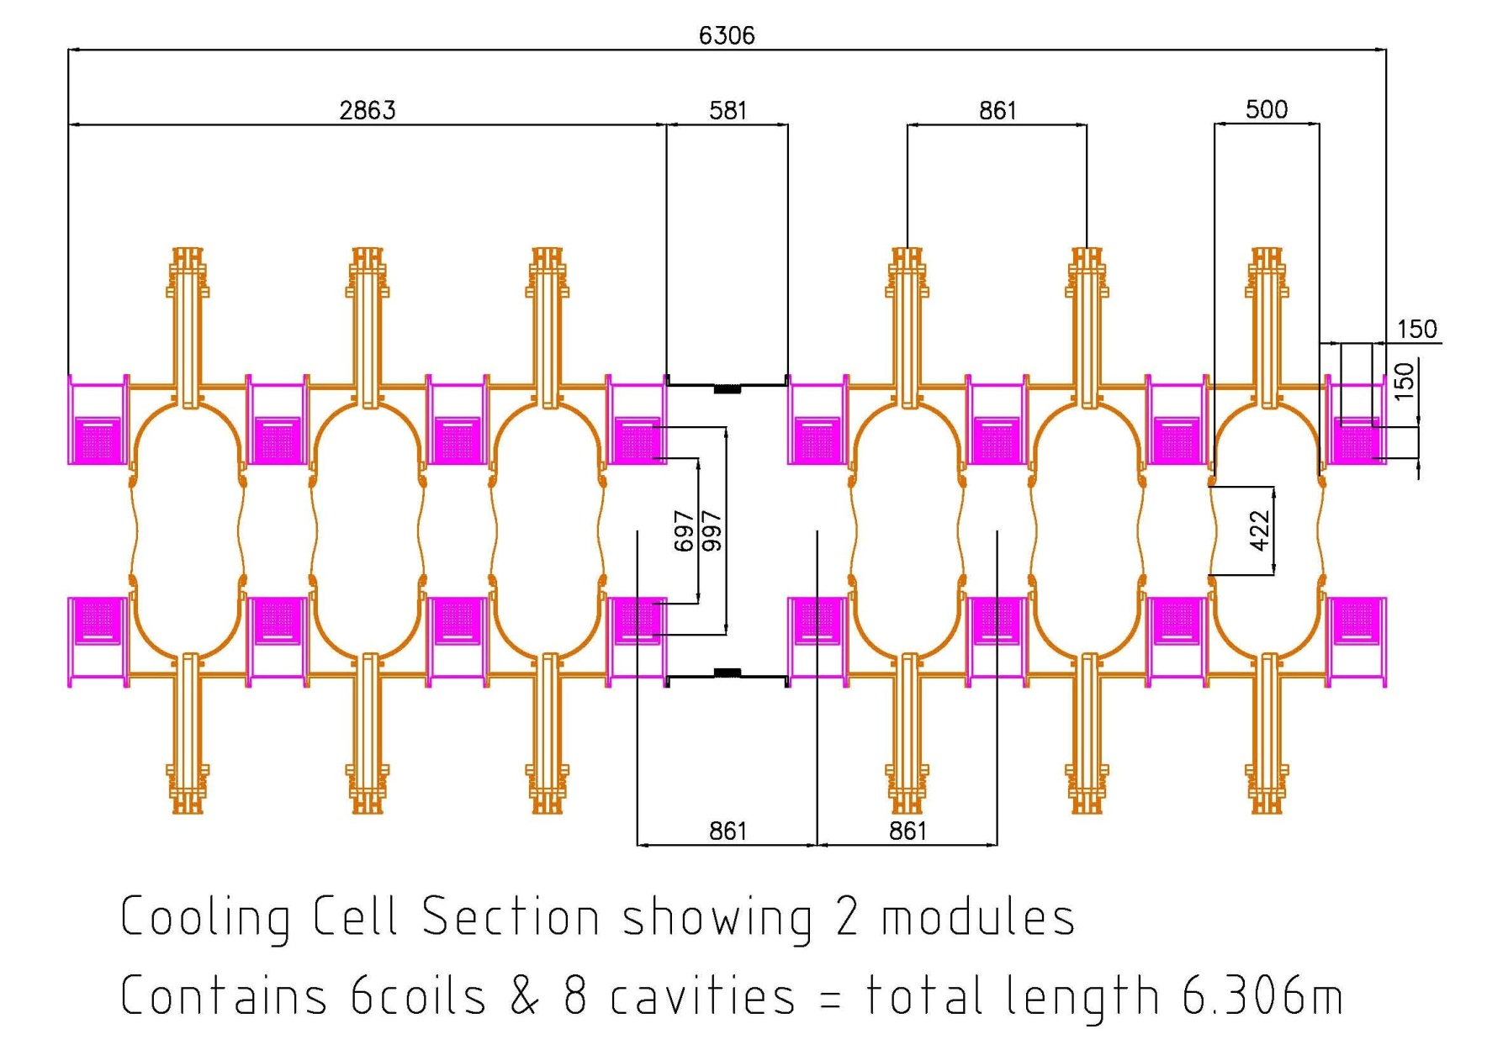
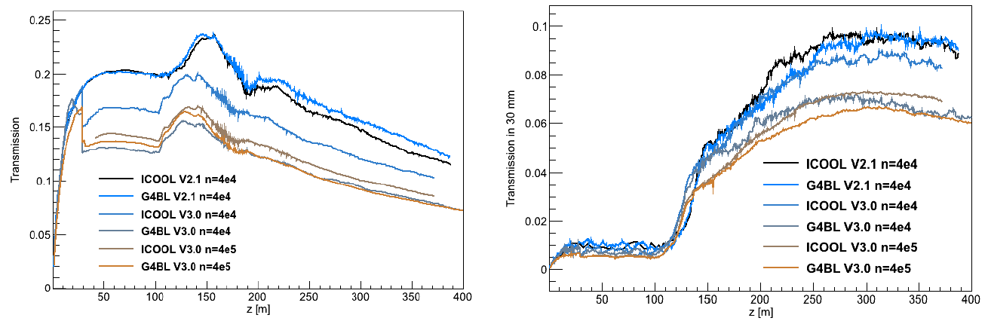
Transmission:
Rogers, Neuffer, Grant et al.
Engineering concepts for buncher, phase rotator and cooling channel produced
Iteration of lattice in response to engineering and chicane:
  Performance maintained, modulo “high-statistics issue”

Slide 26
Muon acceleration:
Bogacz, Collomb, Berg, et al.
Layout of RLAs crystalises congestion in switchyards:
  Excellent progress;
    Clearly requires careful attention

Slide 27

Decay ring:
Kelliher, Pasternak
10 GeV lattice;
Realistic insertions for injection/extraction

Slide 28
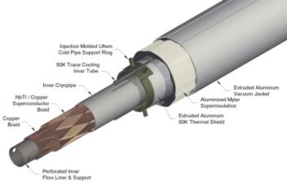
Magnetized Iron Neutrino Detector (MIND):
IDS-NF baseline:
  Intermediate baseline detector:
    100 kton at 2500—5000 km
  Magic baseline detector:
    50 kton at 7000—8000 km
  Appearance of “wrong-sign” muons
  Toroidal magnetic field > 1 T
    Excited with “superconducting transmission line”
  Segmentation: 3 cm Fe + 2 cm scintillator
  50-100 m long
  Octagonal shape
  Welded double-sheet
    Width 2m; 3mm slots between plates
Bross, Soler

Slide 29
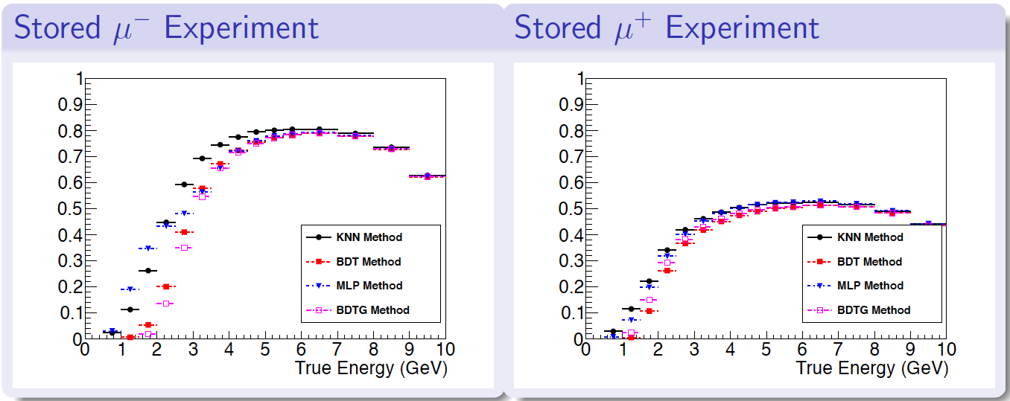
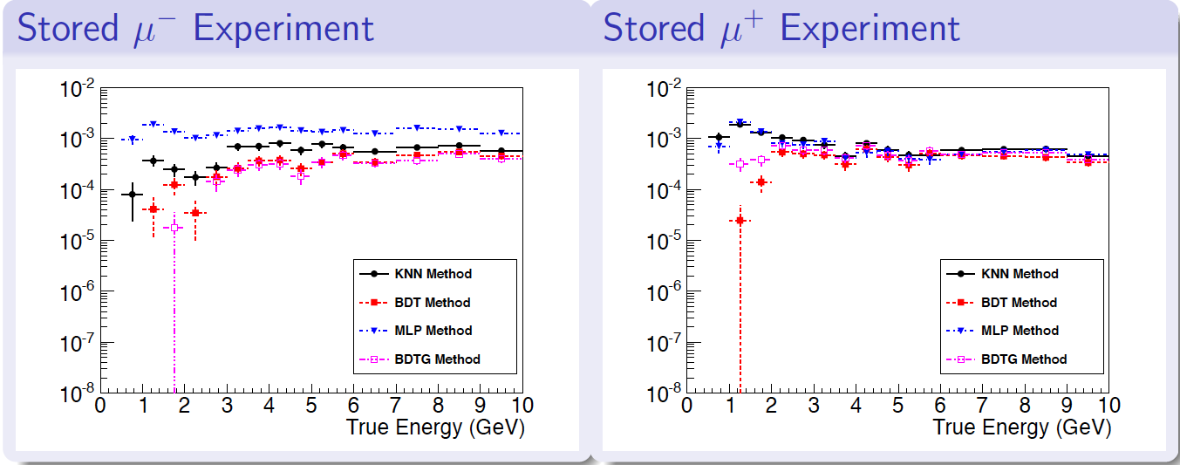
MIND: performance of improved analysis:
Bayes

Slide 30
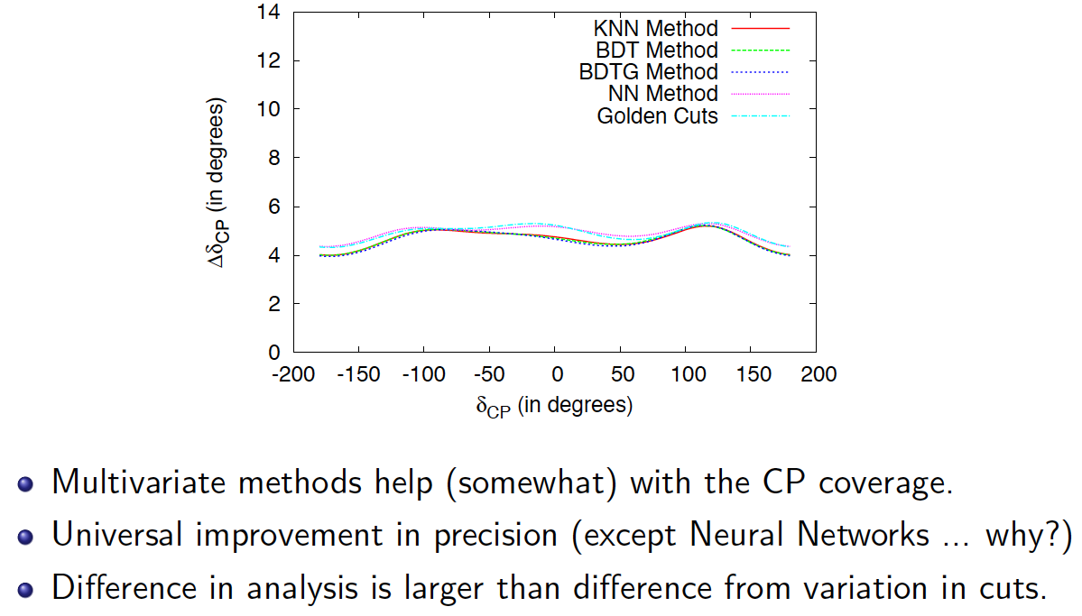
Precision:
Bayes

Slide 31
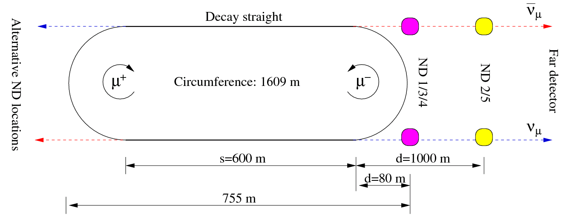
Near detectors:
Morfin, Tsenov
Near detector missions:
  Neutrino flux (<1% precision) and extrapolation to far detector
  Charm production (main background) and taus for Non Standard Interactions (NSI) searches
  Cross-sections and other measurements (ie PDFs, sin²θ_{W})

Slide 32
Costing exercise:
Bross, Soler
Long-baseline detectors:
  PBS developed based on MINOS;
  CBS being completed; again based on MINOS
Near detector:
  Strong connection/synergy with LBNE near detector being exploited to develop PBS and CBS

Slide 33
Preparing the RDR

Slide 34
Costing exercise and RDR timeline:
Ammendments:
  Text deadline 23Jun13;
  First writing w/s first week of July
S1: submit to arXiv
S2: submit to journal

Slide 35
RDR:
The RDR:
  ~50-page document with appendices
  Published in full or with appendices posted in arXiv and referenced in published 50-page document
Mechanics:
  Develop through svn:
    Top-level structure:
      Top matter Lead author: KL
      Section 1: Introduction Lead author: KL
      Section 2: PPEG Lead author: PH
      Section 3: Accelerator Lead authors: SB, JPa
      Section 4: Detector Lead author: PS
      Section 5: Conclusions Lead author: KL
      Bottom matter Lead author: KL
      Appendices:
        A: PPEG Lead author: PH
        B: Accel Lead author: SB, JPa
        C: Detector Lead author: PS
        D: “Progect”:
          Costing Lead author: AK
          Risk and its mitigation Lead author: JPa, NC, AK
          Incremental development Lead author: CR
    Top-level lead-authors are asked to develop structure for the section(s) for which they are responsible and define lead authors
      In place by: 16Apr13
Deadlines:
  Text deadline: 23Jun13
  First complete version [for first writing workshop]: 01-05 July 13

Slide 36
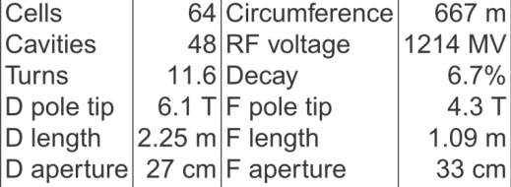
Risk mitigation: example:
Berg, Machida, Kelliher, Pasternak

Slide 37
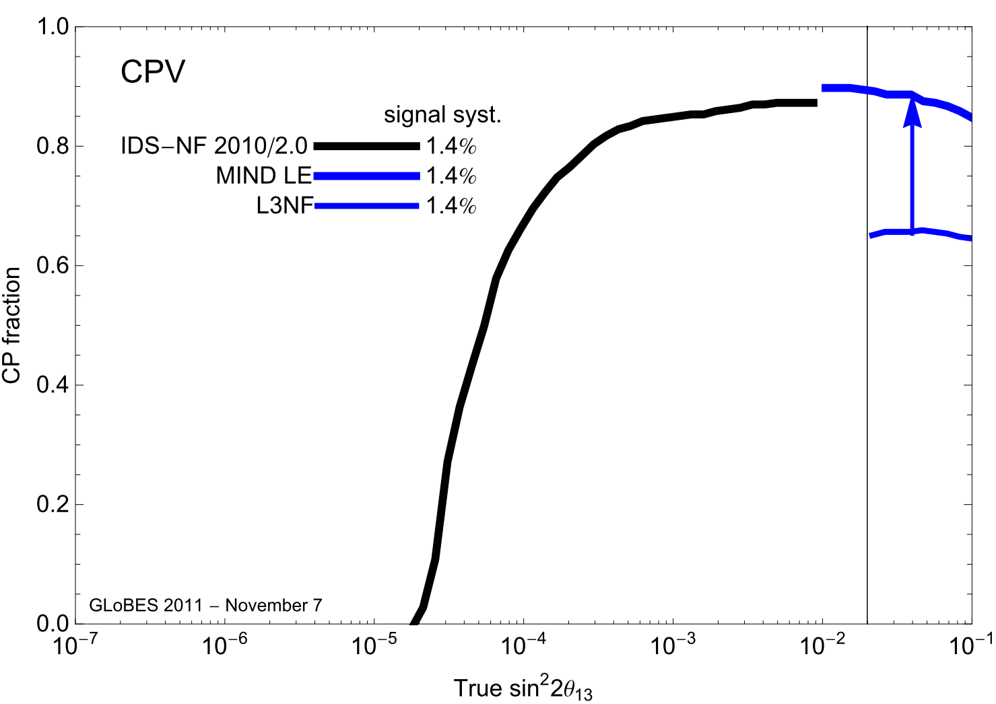
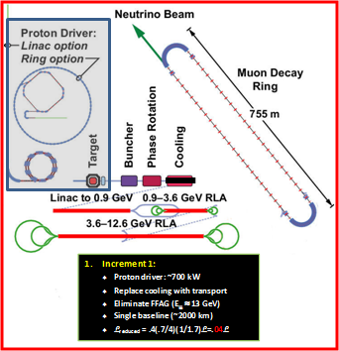

Slide 38
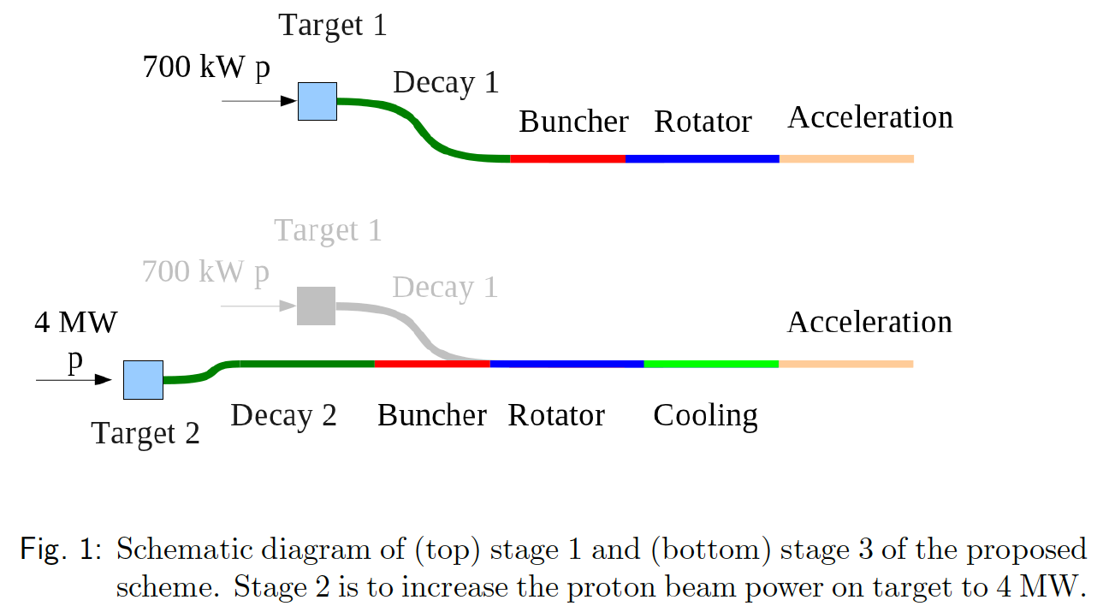
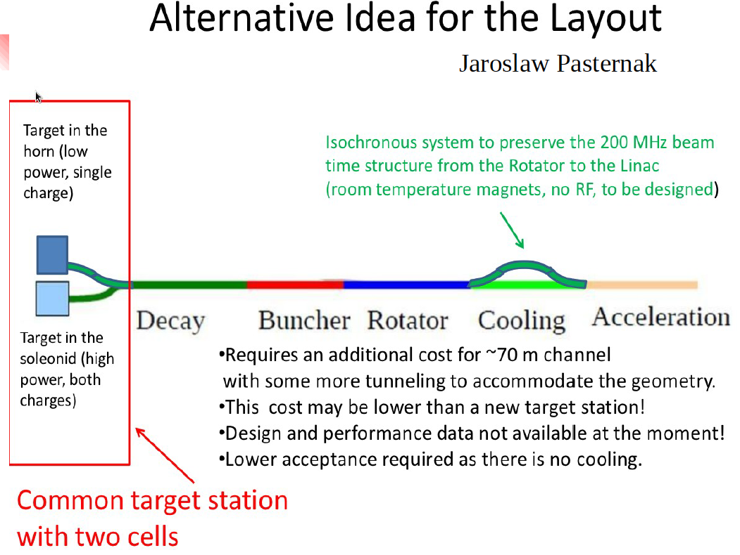
Staging the IDS-NF accelerator facility:
Rogers, Pasternak
Options to reduce cost while maintaining performance at a level competitive with/superior to conventional super-beam approach

Slide 39
Politix, conclusions, looking ahead

Slide 40
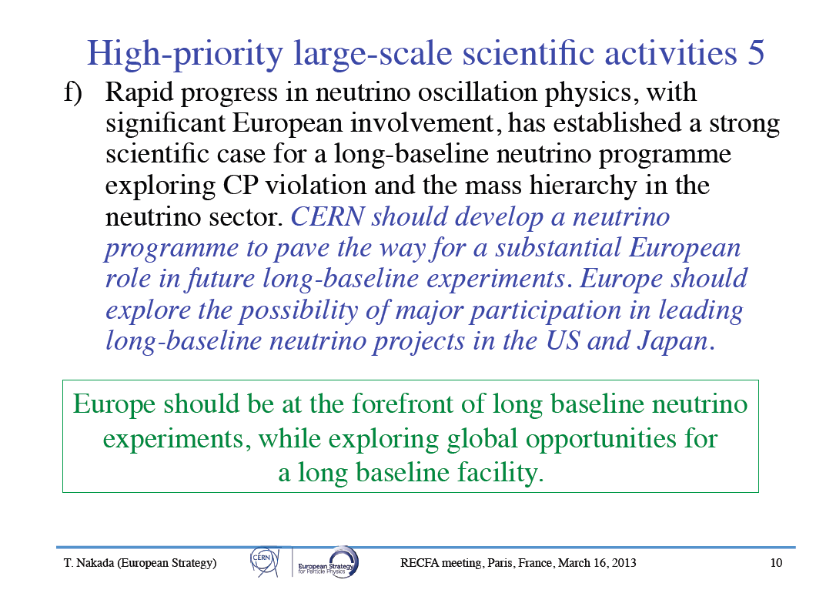
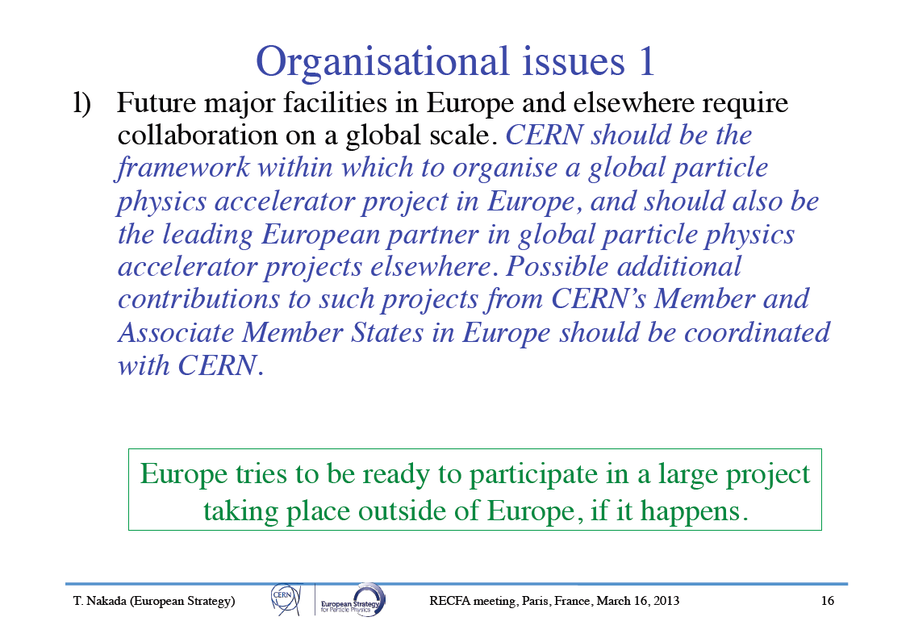
European strategy update:

Slide 41
ICFA neutrino panel:
ICFA has mandated a neutrino panel:
To promote international cooperation in the development of the accelerator-based neutrino-oscillation program and to promote international collaboration in the development a neutrino factory as a future intense source of neutrinos for particle physics experiments.
Neutrino Panel membership appointed for an initial three-year term

Slide 42
nuSTORM?

Slide 43
Conclusions, looking ahead:
The IDS-NF RDR will be a step on the way to the realisation of muon accelerators for the study of the neutrino:
  Excellent progress from IDR in terms of:
    Clarification of physics goals and the role of the Neutrino Factory in the neutrino-physics programme;
    Accelerator conceptual design and “first pass conceptual engineering”:
      Cost estimation delicate, but based on a non-trivial analysis
    Understanding of MIND, and improvements in analysis, now advanced:
      Sensitivity estimates robust and have withstood critical investigation
The RDR will be an excellent document and a major milestone
Going forward:
  Emphasis of IDS-NF (and ISS before):
    Holistic approach to consideration of accelerator facility and neutrino detector systems
    International collaboration:
      Strength: consensus, once established, has broad support
      Sometimes consensus takes time to reach
  Taking the programme beyond the IDS-NF requires that we:
    Exploit opportunities to best effect; while
    Maintaining as far as possible the strengths of international collaboration

Slide 44
Looking ahead:
The elements of an exciting programme are in place:
  The Muon Accelerator Programme has the mandate to establish muon accelerators at the Intensity and Energy Frontier:
    We must engage with MAP (and MAP must engage with us) to deliver first-rate, international contributions to an excellent and effective national programme
  The international MICE experiment is critical system-level proof-of-principal demonstration:
    Embodies the strengths of international collaboration
  nuSTORM:
    First-rate, neutrino physics from stored muon beams and the vehicle to carry out the R&D for the next step in the programme
      Has the potential to deliver an international “user community” …
        The author list has grown by ~×3 since submission of LOI to FNAL
          And representation added from Canada, Spain, France, Germany, Czech Republic: still more is possible if CERN responds warmly to the EoI
A fantastic programme … everything to play for!

