Slide 1
Multipacting simulation of MICE 201 MHz cavity
Tianhuan Luo, University of Mississippi
with Derun Li, LBNL and Lixin Ge, SLAC

Slide 2
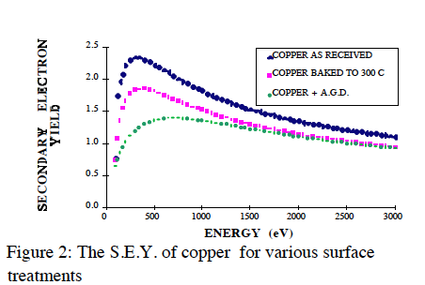
Multipacting
Multipacting: a phenomenon in RF device when secondary electron emission in resonance with an alternating electric field leads to exponential electron multiplication.
Secondary emission yield (SEY): the number of secondary electrons emitted per incident particle, strongly depends on the surface material and treatment.
The secondary electron yield of thechnical materials and its variation with surface treatments, V.Baglin etc

Slide 3
Possible Damage from MP
Heating.
Out gassing: vacuum loss.
Change the coupling: power reflection.
Energy absorption: can’t increase the voltage.
Sparking, RF breakdown.
Severe damage of cavity, unrecoverable.
MICE operation: long pulse of 1 ms, corresponding to 2e5 RF cycle at 200 MHz frequency, thus MP is an important issue.

Slide 4
SLAC ACE3P for Multipacting Simulation
Omega3P/S3P: calculate the EM field in the cavity with very high resolution.
Track3P: launch electrons from the cavity surface, track their motion in RF field & external E/B field, and identify MP electrons for given SEY information input.
Already bench marked with theory and experiment results
ICHIRO Cavity
Coaxial Waveguide
Track3P MP simulation |  | ICHIRO #0 (K. Saito,KEK)
Impact Energy (eV) | Gradient (MV/m) | X-ray Barriers (MV/m)
300-400(6 order) | 12 | 11-29.3 12-18
200-500 (5 order) | 14 | 13, 14, 14-18, 13-27
300-500( 3 order) | 17 | (17, 18)
300-900( 3 order) | 21.2 | 20.8
600-1000(1.5 order) | 29.4 | 28.7, 29.0, 29.3, 29.4
MP in coaxial waveguide, which can be solved analytically.
Multipacting simulation Using Parallel code Track3p, Lixin Ge

Slide 5
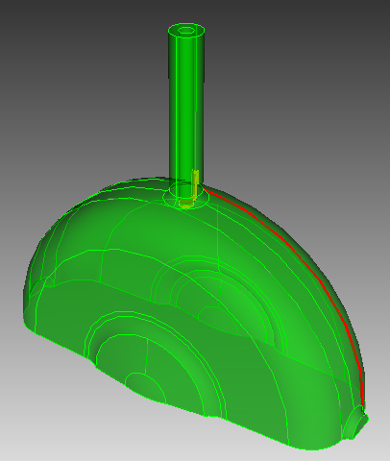
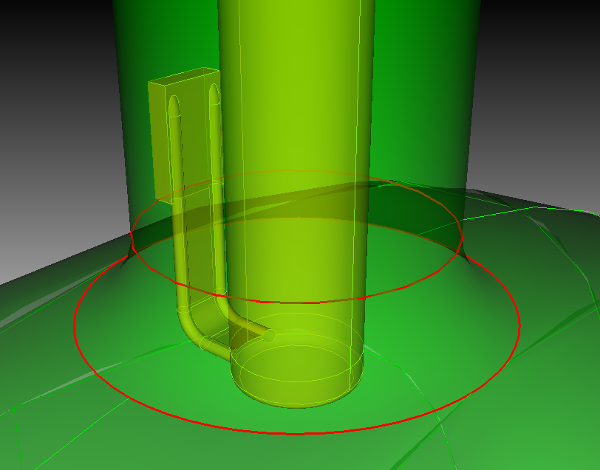
MICE 201 MHz Cavity
The model is derived from as-built CAD drawing provided by Allan DeMello.
Include the extrusion ports, RF coupler, coaxial waveguide and curved Beryllium windows.

Slide 6
Omega3P simulation results
Ez on the cavity surface
B magnitude on the RF coupler surface
f0=201.901 MHz, Q0=51656, R/Q=389 ohm
Critical coupling is achieved with 15 degree coupling angle ( 90 degree corresponds to maximum coupling).
Ez along the beam axis
Ez along the cavity radial direction

Slide 7
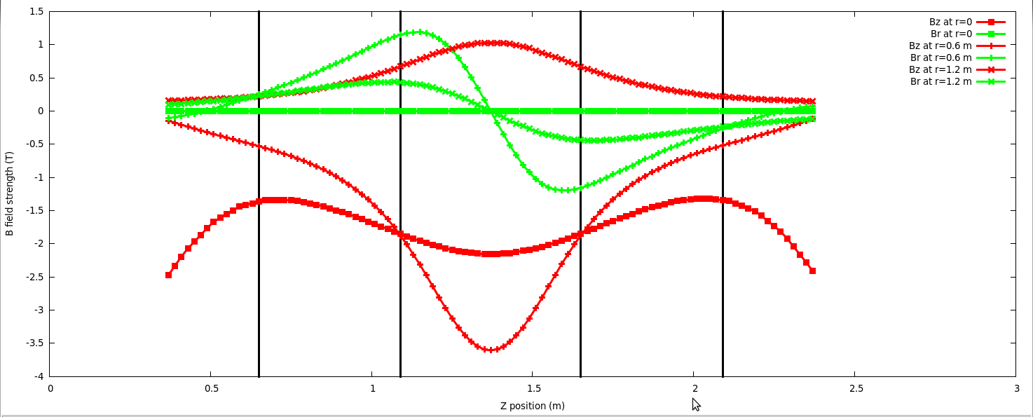
External B field Map
The MICE Cavities are operated in a series of superconducting solenoids. Strong external magnetic field change the MP significantly.
The external B field mapping is provided by Dr. Heng Pan, which includes all the coils in RFCC, AFC modules and SSs. Four different B field configurations for MICE operation.
Four Cavities in a RFCC module
B field plot at r=0 (center), r=0.6 m (RF coupler) and r=1.2 m (RF window).

Slide 8
MP results: coaxial waveguide (1)
Impact Position: green without B field, magenta with B field.
Without external B
MP Order
With external B

Slide 9
MP results: coaxial waveguide(2)
Without B field: MP barrier is found to happen from about 1.75 MV/m to about 2.75 MV/m. Simulation assumed Q = 51000, this corresponds to the input peak power from 46 kW to 354 kW.
With MICE RFCC B field: we expect a wider MP barrier expanding to both lower and higher power region.

Slide 10
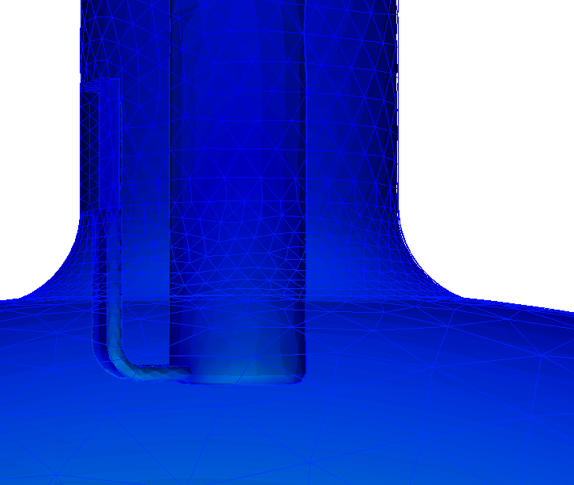
MP results: RF coupler region (1)
Due to the complexity of the geometry at the coupler region, the meshing is too dense to calculate the MP for the whole area with reasonable machine time on NERSC. Thus it is divided into three part: upper, middle and lower part.
Upper part: start of the extrusion.
Middle part: end of the extrusion.
Lower part: the cavity surface slightly lower than coupler.
Upper part
Middle part
Lower part

Slide 11
MP results: RF coupler region (1)
MP Order
Without B field: MP barrier at low power.

Slide 12
MP results: RF coupler region (2)
MP Order
Expect a stronger MP effect than no B field situation:
The MP at the peak SEY impact energy has much wider power range.
More low order MP.

Slide 13
MP results: RF coupler region (3)
The resonant impacting position of MP electrons.
Green: without external B; magenta: with external B.
Observe many secondary electrons traveling backwards into RF coupler.
Similar to the MP in the cavity body.
lower of coupler
middle of coupler
upper of coupler

Slide 14
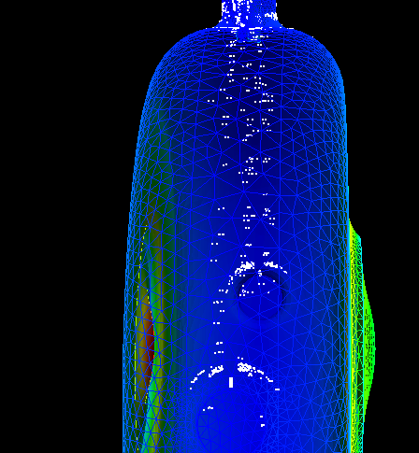
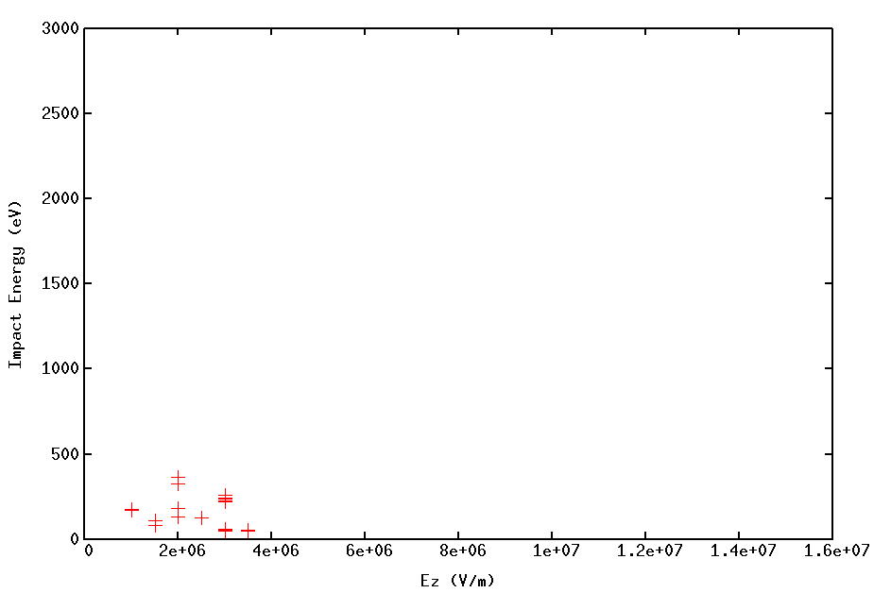
MP results: Cavity Body (1)
Without B field
By Lixin Ge (SLAC)
Should be no MP problem

Slide 15
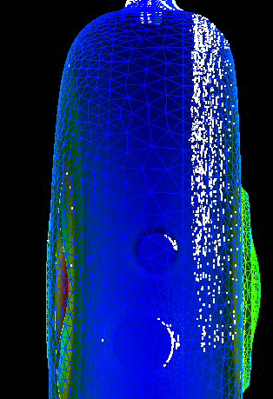
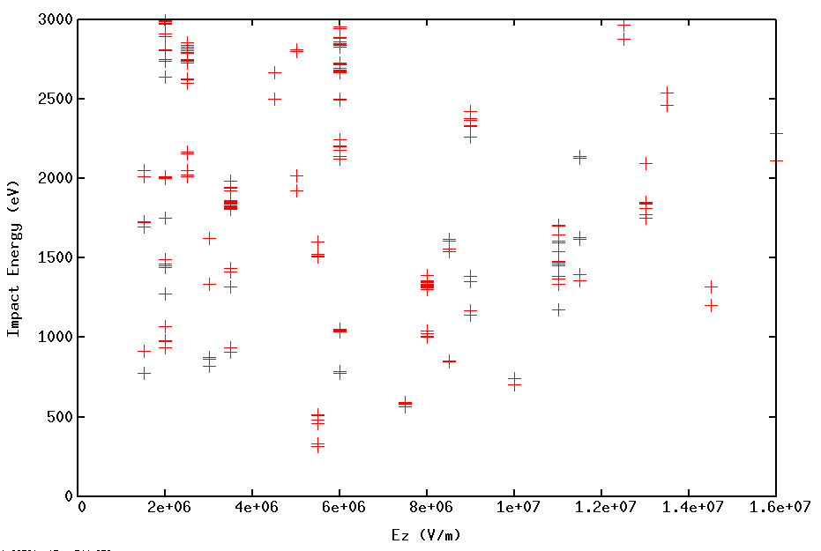
MP results: Cavity Body (2)
With B field
By Lixin Ge (SLAC)
Some narrow MP barrier show up at different power level but should not be serious.

Slide 16
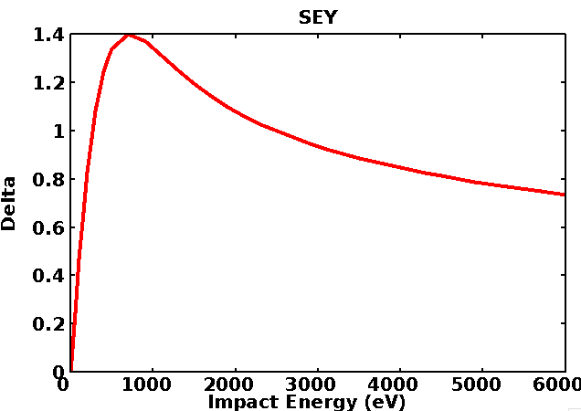
Enhancement Counter
By Lixin Ge (SLAC)
Enhancement Counter: Total number of secondary electrons
Estimated according to the SEY at each impact.
Emitted from one single primary electron
During n RF cycles.
EC >1, potential MP.
The bigger ec, the harder of MP barrier
(E, )

Slide 18
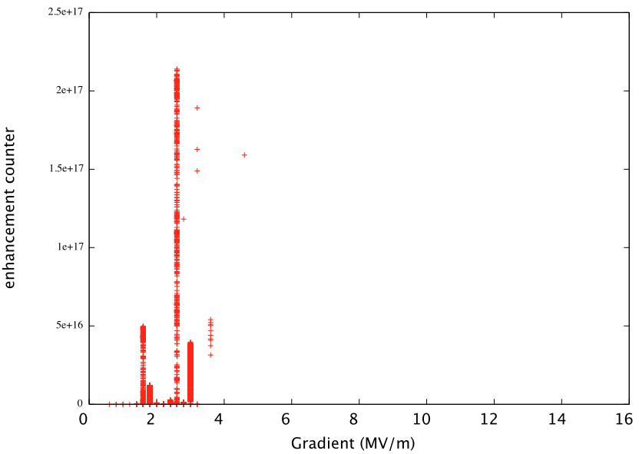
Enhancement counter for SEY of Copper as received
By Lixin Ge (SLAC)
peak EC E^17

Slide 19
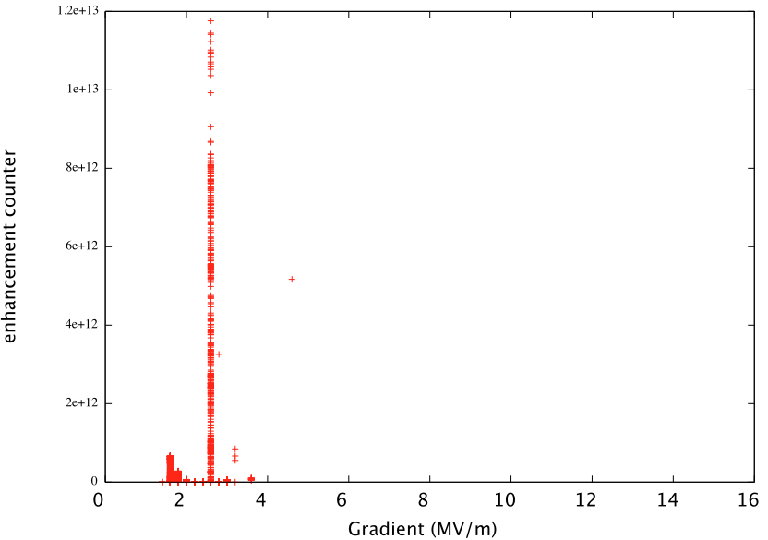
Enhancement counter for SEY of Copper baked to 300C
By Lixin Ge (SLAC)
peak EC E^13

Slide 20
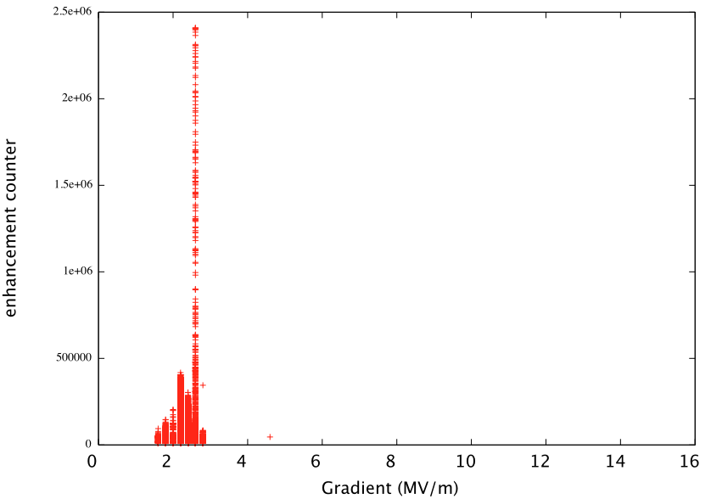
Enhancement counter for SEY of Copper + A.G.D
By Lixin Ge (SLAC)
peak EC E^6
Reduce surface SEY can suppress MP significantly.

Slide 21
Summary
RF simulation of MICE 201 MHz cavity, with curved beryllium windows, RF couplers and coaxial waveguide.
Study the MP in the coaxial waveguide, coupler region and cavity body.
Without external B field, there is narrow MP barrier at low energy in both waveguide and coupler region. A considerable among of electron emitted at coupler region drifts back into waveguide.
With the B field of MICE cooling channel, more resonant pattern shows up and MP barrier becomes wider. MP is strongly affect by the external B field.
RF cavity body doesn’t show MP issue with and without B.
Suggestion: TiN the coupler and coaxial waveguide to suppress the possible MP in different B field configurations.

