Slide 1

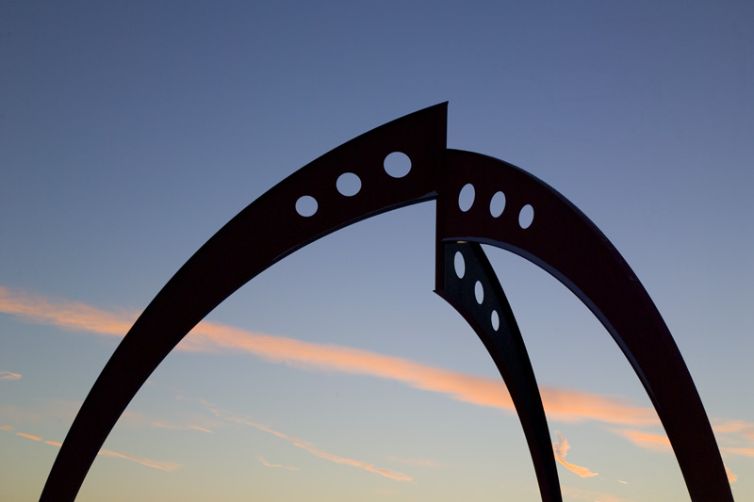

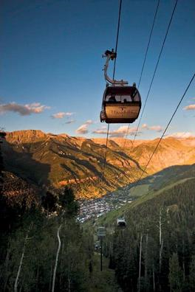

Detector Computing
Muon Collider simulation status and plans
Hans Wenzel, Norman Graf, Ron Lipton, Alex Conway, Jeremy McCormick, Mary Anne Cummings, Nikolai Terentiev,…
MAP13
June 21st , 2013
Hans Wenzel
Fermilab
Feb. 22nd 2012

Slide 2
Software framework
Used for ILC and CLIC physics studies:
Many reconstruction modules available e.g.
PandoraPFA (Mary Ann)
Tracking, Vertexing, B-tagging (Alex)
Good relations with SLAC group provide support, contribute to the tutorial, e.g. changes specific to the muon collider

Slide 3
MCDRD (Muon Collider Detector R&D): computing resources
Virtual Organization (VO): mcdrd
  Sign up at: https://voms.fnal.gov:8443/voms/mcdrd
  (we have 250 dedicated slots + opportunistic on fermigrid and we are part of OSG)
  Resources at NERSC (thanks to Robert D Ryne)
reference machine on the fermicloud: mcdrd.fnal.gov
  To get an account contact service desk and request a fermicloud account and request access to mcdrd.
1 TB of dedicated disk space on bluearc: /grid/data/mcdrd
  software installed in: /grid/data/mcdrd/sw
  detectors jas-assembly-0.9.9 jdk1.7.0_21 mac slic
  data available in: /grid/data/mcdrd/data

Slide 4
MCDRD: computing resources (cont.)
100TB in fermilab mass storage system (dcache, enstore)
/pnfs/mcdrd/Higgsfactory/
--> software(dccp) installed on mcdrd to move data in and out of mass storage
Right now resources are limited but we can probably ask for more when we need it (easier to extend than start from scratch)
Many thanks to the FermiGrid team!!!!!

Slide 5
Muon Collider Documentation
Created Confluence page:
https://confluence.slac.stanford.edu/display/MCPDS/Home
Look for:
Documentation for Accessing MCD R&D Computing Resources.
Tutorial:
https://confluence.slac.stanford.edu/display/ilc/Installing+lcsim+software+for+the+Winter+2012+tutorial
You can sign up here:
https://jira.slac.stanford.edu/signup/

Slide 6
Changes to slic and Geomconverter
Slic now uses version of geant 4 (4.9.6.p01) and new build system (cmake).
Now optical properties can be specified in compact.xml and propagate to .lcdd and .gdml files.
Optical dual readout (scint. And Cerenkov) calorimeter now available.
Now we have the chance to kill particles entering a specific volume (e.g. the tungsten cone)

Slide 7
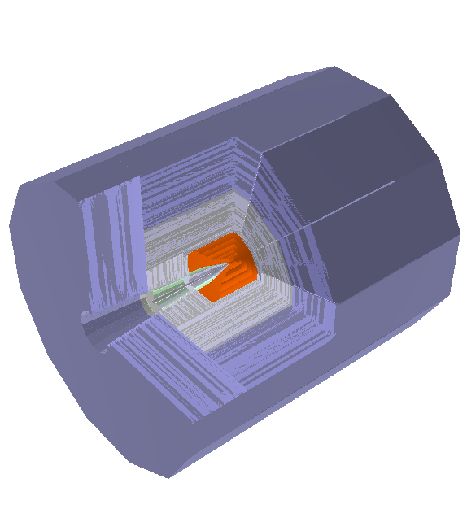
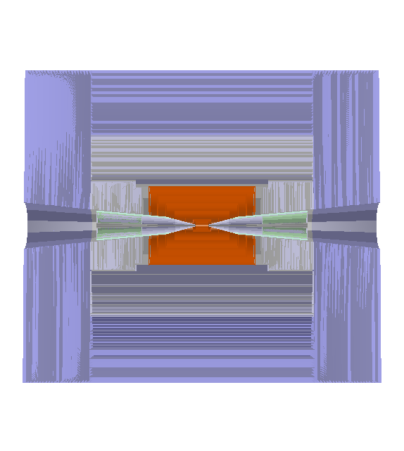
The mcdrcal01 detector in org.lcsim
5T solenoidal field,
radius=3.075m
Calorimeter dimensions:
Rmin: 1.36 m
Rmax: 3.07 m
Length: 2x3.702 m
Good relation with accelerator group,
Easy to change detector design if e.g.
shielding/MDI changes. Declared DMZ.

Slide 8
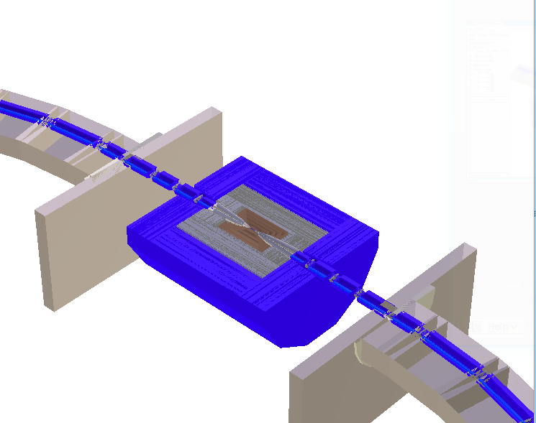
HF IR MARS15 Model: 3D View

Slide 9
Motivation for calorimeter choice
Precise:
  total absorption (no sampling fluctuations),
  dual readout correction,
  Homogeneous;(no difference in ECAL and HCAL response) → results in excellent energy resolution and linearity.
Fast:
  Cerenkov light is prompt, new photon detectors like SiPM show excellent timing capabilities → provides handle to get muon decay backgrounds under control.
Finely granulated:
  Improve reconstruction even further with PFA algorithms.

Slide 10
Calorimeter Properties for Barrel and Endcaps
 | EM | Hadron | Muon
Material | BGO/PbF₂/PbWO₄ | BGO/PbF₂/PbWO₄ | Iron
Density [g/cm^3] | 7.13/7.77/8.29 | 7.13/7.77/8.29 | 7.85
Cell size [cm^3] | 1x1x2 | 2x2x5 | 10x10x10
Layers | 10 | 30 | 22
Detector Depth [cm] | 20 | 150 | 220
Radiation Length [cm] | 1.1/0.93/0.89 | 1.1/0.93/0.89 | 1.76
Nuclear Interaction Length [cm] | 22.7/22.4/20.7 | 22.7/22.4/20.7 | 16.8
Total Nr of IA length (em+had) | 7.5 /7.6/8.2

Slide 11
Motivation for tracker choice
Precise:
  To achieve the tracking goals while keeping the tracker compact we require a high solenoidal magnetic field of 5 Tesla and use silicon tracking paired with a pixel vertex detector for high precision low mass tracking.
  Fast timing and fast readout requires extra power and cooling and R&D will be necessary to achieve this while keeping detectors and support at the required low mass. (more CMS than ILC like)

Slide 12
Mcdrcal01: Tracker
Simplified geometry: cylinders and disk no segmentation
(virtual segmentation used in reconstruction)

Slide 13
Mcdrcal01: Tracker Parameters

Slide 14
Predicted momentum resolution

Slide 15
Predicted: Impact Parameter resolution

Slide 16
Caveats
New detector description still needs to be copied to .lcsim/cache by hand!
No Material for coil included
Not enough iron to return flux of 5T solenoidal field
But list gets smaller!!

Slide 17
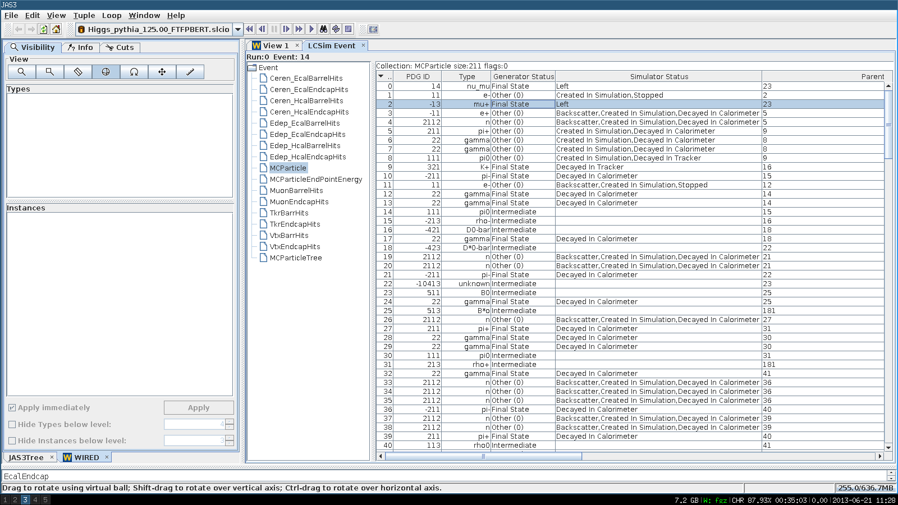
JAS3 – Event Browser

Slide 18
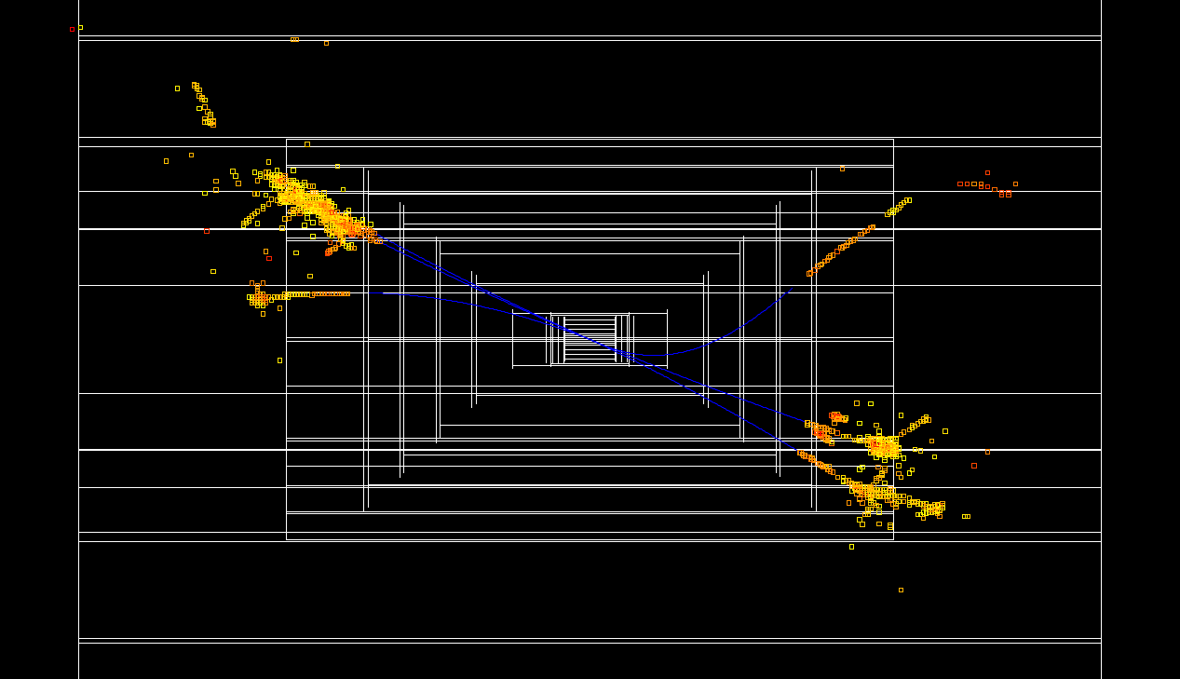
H⁰→ τ⁺τ⁻ event

Slide 19
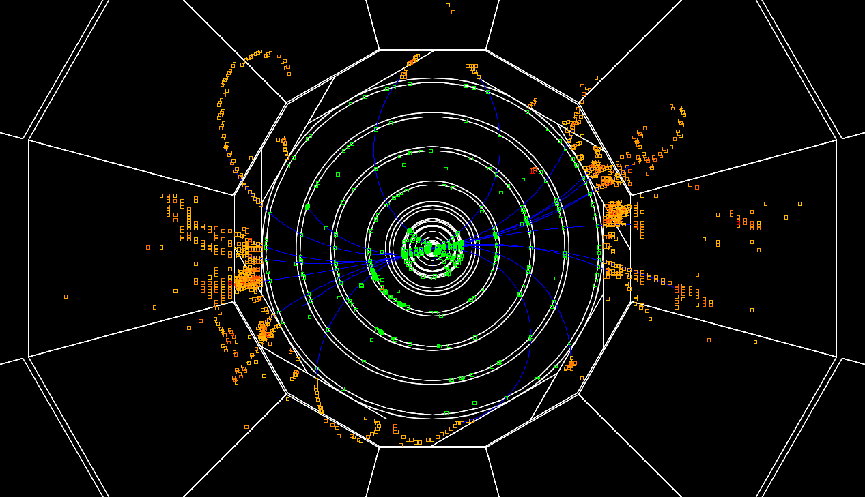
H⁰→ bb event

Slide 20
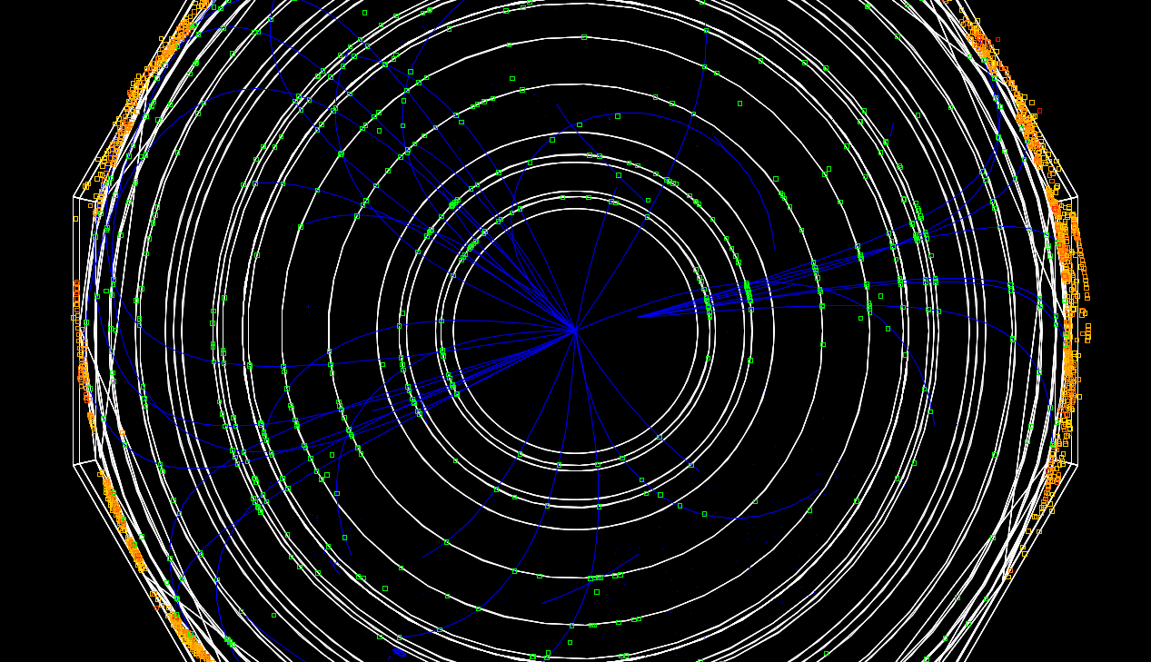
H⁰→ bb event

Slide 21
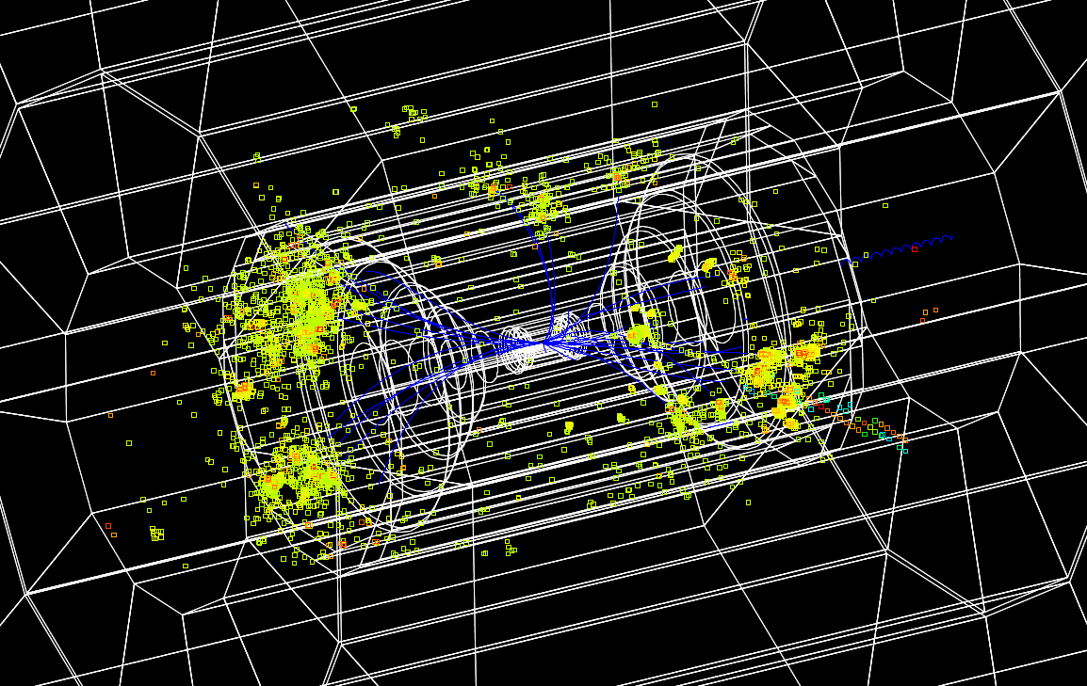
H⁰→ bb event (Edep Hits)

Slide 22
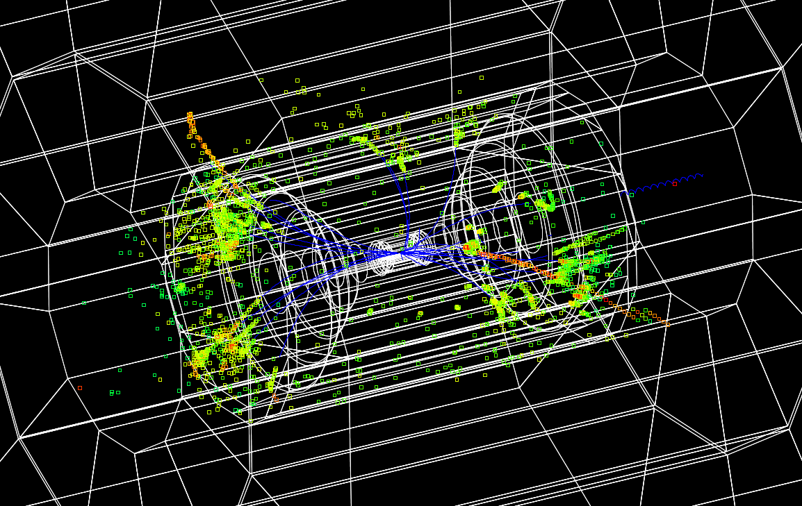
H⁰→ bb event (cerenkov Hits)

Slide 23
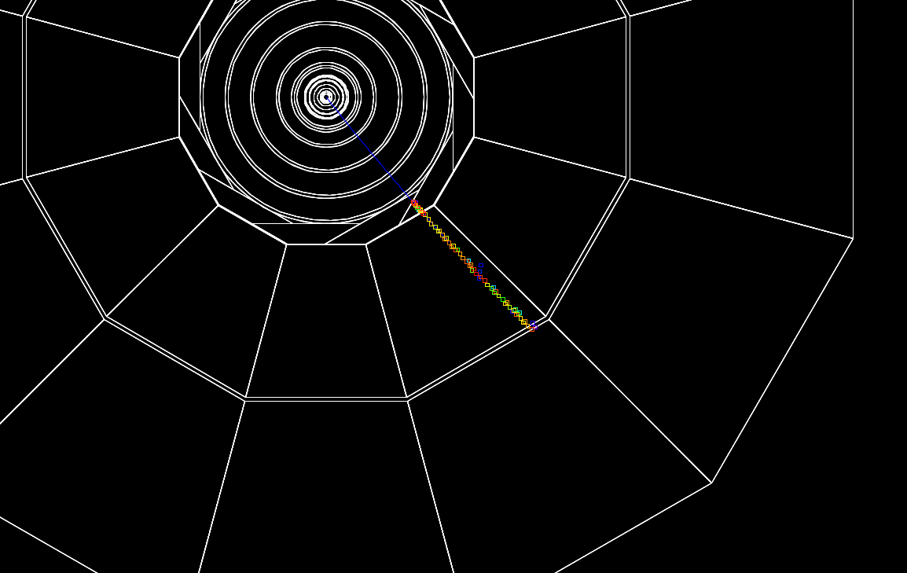
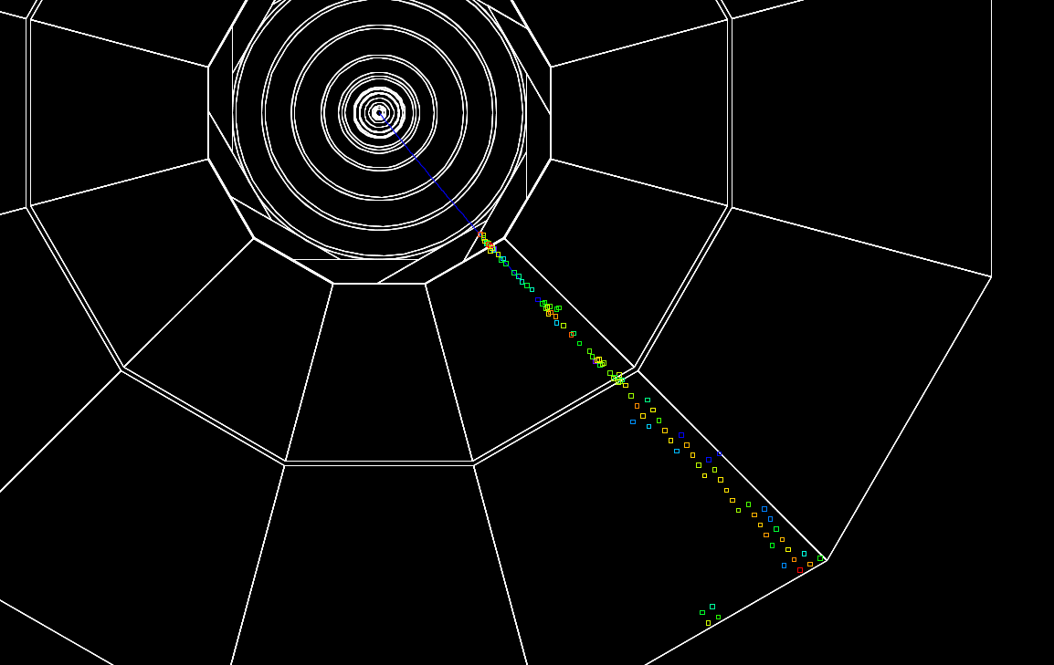
Single Muon
Cerenkov
Edep

Slide 24
Near term plan
Check the detector description!
Get simulation running on the Grid.
Then generate single particle, Higgs, SM bgr. and machine bgr. once available.
Find out how to modify and run: tracking, vertexing, jet reconstruction, b-tagging, PFA…
Many fun studies where people can contribute, join the fun.

