Slide 1
Muon Accelerator Program:
Overview & Directions
Mark Palmer
June 19, 2013

Slide 2
Outline
Introduction
Organizational Thrusts
R&D Effort
Snowmass Process
Concluding Remarks

Slide 3
Introduction

Slide 4
Welcome
Today is a joint MAP and MICE day
  Welcome to all!
  I hope that today provides an opportunity for both groups to mingle and enhance connections
I would like to say thanks in advance to Alan Bross and Pavel Snopok who handled the local organization along with:
  The Fermilab Conference Office
    Cynthia Sazama
    Suzanne Weber

Slide 5
MAP’s Near Term Picture
Significant program reorganization over the last year:
Project-like reorganization of the program
  Updated Program Management Plan
  Implementation of project planning/tracking tools
  Development of a more detailed Program Execution Plan
  Detailed assessment of likely costs and schedules
Major Requirements of the Feasibility Assessment
  Initial Baseline Selection Process
  Technology Demonstrations
  MICE Construction Sub-Project a Successful Experimental Effort
  Long-term planning
    MASS
    6DICE
Some things have gone smoothly. And some less so…

Slide 6
The Muon Accelerator Program Timeline
At Fermilab, critical physics production could build on Phase II of Project X

Slide 7
Organizational Thrusts

Slide 8
MAP Top Level Organization

Slide 9
Updated Management Plan
Program Scientists:
Strategic Connections with Community
Program Feedback
Advisory Panels:
Program Guidance (eg, MASS)
Technology and Baseline Reviews
Physics and Detector:
Operational Connection to Physics & Detector Group
Close Coordination
Executive Committee:
Overall Program Coordination
Program Strategy
Central Planning and Tracking

Slide 10
New Elements in the Program
Fermilab has appointed Program Scientists to support MAP
Steve Brice will help coordinate the strategic connections of MAP to the Intensity Frontier physics effort
Dmitri Denisov will help coordinate the strategic connections of MAP to the Energy Frontier physics effort
They have an important role to play as we move through the Snowmass and P5 process…
MAP R&D Advisory Panels
Jean-Pierre Delahaye
First instance is MASS, which is working towards a staging plan and is coordinating our Snowmass White Paper
MAP Program Management Office
Peter Garbincius
Program planning, budget and interfaces between institutions

Slide 11
MAP L1 & L2 Organization

Slide 13
R&D Effort

Slide 14
Some Highlights of the R&D Effort
Design & Simulation
High Performance Computing Initiative
Setting up the Initial Baseline Selection Process
Technology Development
Expanded support for the MTA
HTS Conductor & Magnet Development
Systems Demonstrations
Contributions to the MICE Online, DAQ, and Analysis Efforts
6DICE Options Study
Modular 805 MHz Cavity Effort
New NF & MC Design Options and MC Backgrounds
MICE Construction
Magnet Progress
Preparing for RF Cavity Tests in the MTA
Partial Yoke Magnetic Shielding for the Cooling Channel
MASS
A Fermilab Staging Plan
Possibility of Launching a Facility on Project X Stage II (2020’s)
Truly a 2 Frontier Plan

Slide 15
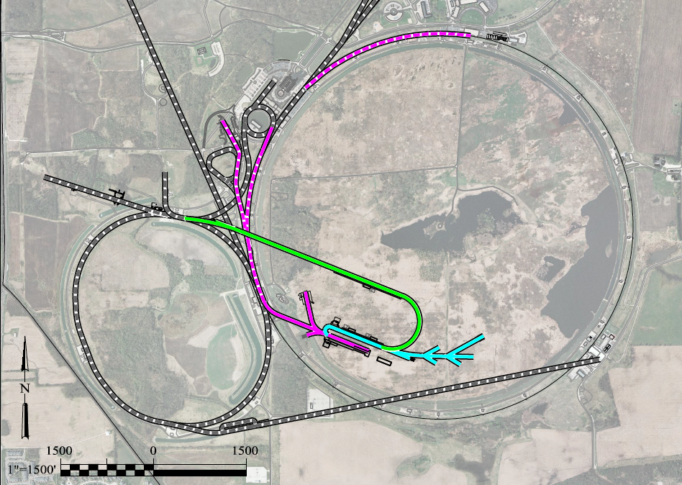
A Muon Accelerator Facility for Cutting Edge Physics on the Intensity and Energy Frontiers
Based on Project X Stage II
To Homestake
LBNE
Buncher/
Accumulator
Rings
RLA to 63 GeV +
300m Higgs Factory
NF Decay Ring:
νs to Homestake
Front End+4D+6D
Project X
Stage III
Linac + RLA to ~5 GeV
Project X
Stage II
Project X
Stage I
A 1.5 TeV collider
would fit within the
Tevatron ring
νSTORM + Muon Beam
R&D Facility

Slide 16
How Could the Staged NF to Homestake Perform?
What if we send beam to LBNE?
1 MW, no muon cooling
a 3 MW, w/cooling
a 4 MW, w/cooling
What if we were able to have a magnetized LAr detector?
Gray bands represent range of possible
detector performance per arXiv:0805.2019
Plots courtesy of P. Huber
Plots assume
100 kt-years

Slide 17
Neutrino Factory Staging (MASS)
Preliminary Staging Plan Based on
Project X Phase 2
* supports multiple detector technologies

Slide 18
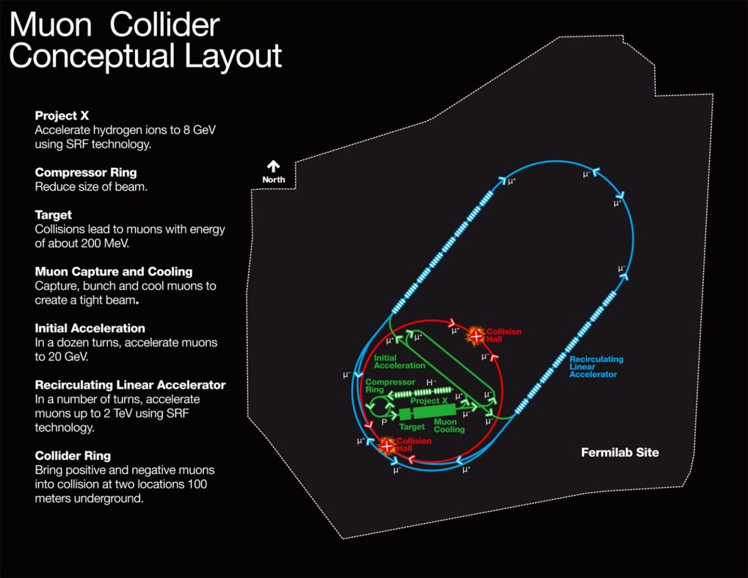
MAP Designs for a Muon-Based Higgs Factory and Energy Frontier Collider
Exquisite Energy
Resolution
Allows Direct
Measurement
of Higgs Width
Site Radiation mitigation with depth and lattice design: ≤ 10 TeV

Slide 19
Snowmass

Slide 20
White Papers
Two Primary White Papers are Being Prepared
  MAP Accelerator Capabilities
    Produced by MASS
    J-P. Delahaye lead editor
  Higgs Factory
    Report based on UCLA Muon Collider Higgs Factory Workshop
    D. Cline and G. Hanson leading the effort
Inputs for
  Intensity Frontier Reports
  Project X Reports
  Energy Frontier Reports
  Capabilities Frontier Reports

Slide 21
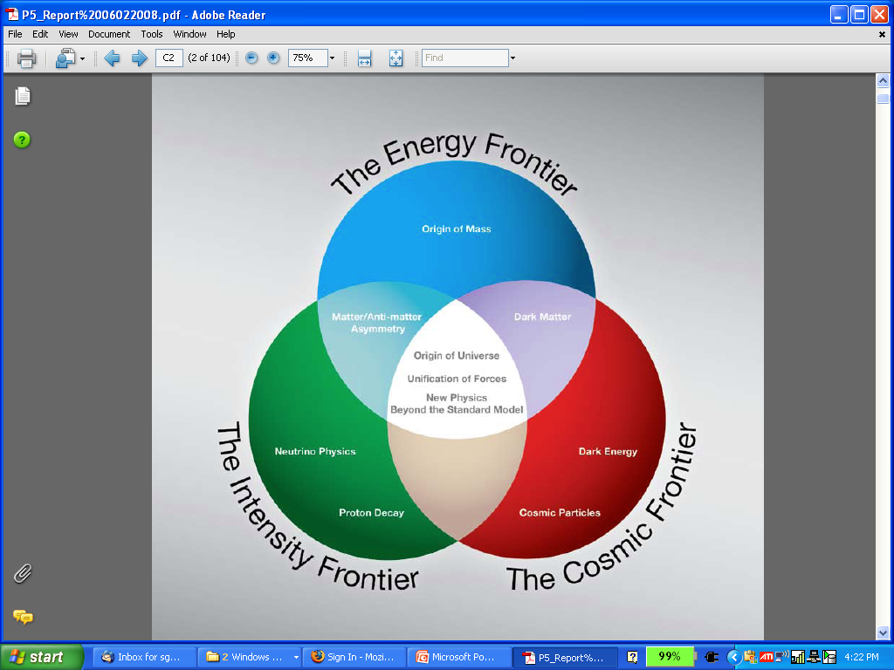
The Aims of the Muon Accelerator Program
  Muon accelerator R&D is focused on developing a facility that can address critical questions spanning two frontiers…
  The Intensity Frontier:
  with a Neutrino Factory producing well-characterized ν beams for precise, high sensitivity studies
  The Energy Frontier:
  with a Muon Collider capable of reaching multi-TeV CoM energies
  and
  a Higgs Factory on the border between these Frontiers
We must make the case at Snowmass for a continued robust R&D program to fully develop one of the most promising and comprehensive options for a U.S. Facility!
The unique potential of a facility based on muon accelerators is physics reach that SPANS 2 FRONTIERS

Slide 22
Conclusion

Slide 23
Concluding Remarks
The last year has seen many developments
  Significant progress on the technology and design efforts
  Program re-organization
  Clear guidance on our budget profile
  Clarification of the program goals
However, there is a great deal of work remaining…
  The Initial Baseline Selection
  Integrating the Staging Plan with our D&S Effort
  Increasing our rate of progress on technology demonstrations
  Clearing major R&D risks from the MICE Construction Effort
The potential of a Muon Accelerator Facility is tremendous
  It is our responsibility to ensure that a clear assessment of the required technologies is completed in timely fashion
  I’m looking forward to completing that process with everyone here

