Slide 1
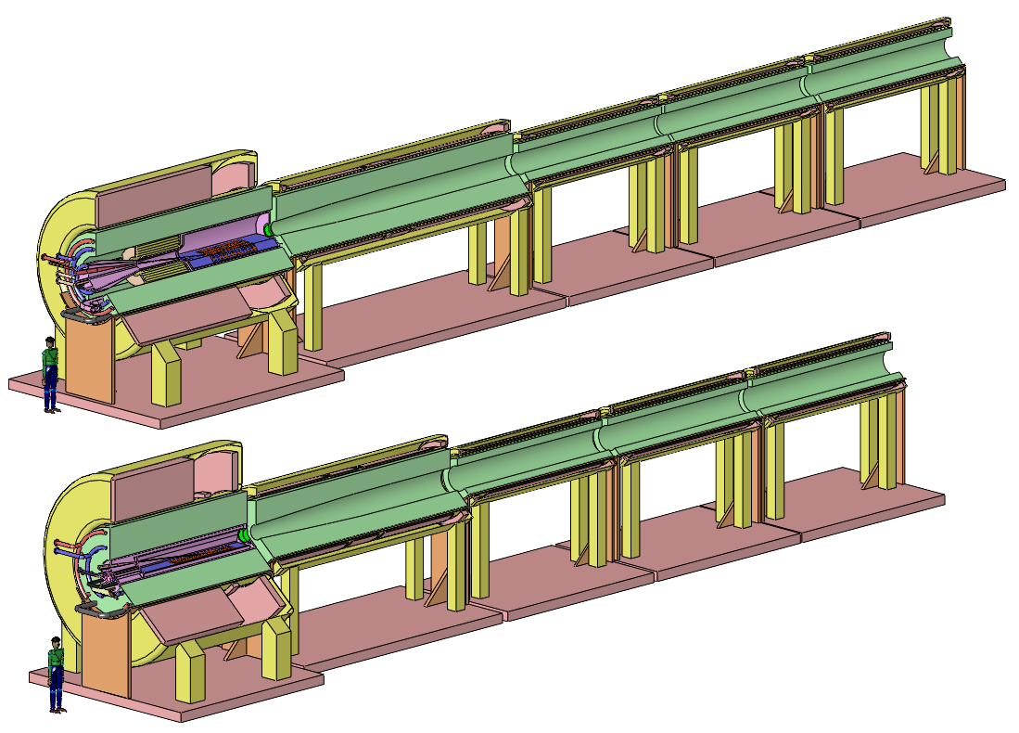
The High-Power-Target System of a Muon Collider or Neutrino Factory
K. McDonald
Princeton U.
(June 20, 2012)
Muon Accelerator Program Collaboration Meeting
FNAL

Slide 2
History of Target & Capture Options for a Muon Collider
Early thoughts by Dave Neuffer in 1981,
http://puhep1.princeton.edu/~mcdonald/examples/accel/neuffer_ieeetns_28_2034_81.pdf
Considered (toroidal-field) Li lenses, ⇒ 2 target stations to collect both signs.
Fernow et al. reviewed options in March 1995,
http://puhep1.princeton.edu/~mcdonald/examples/accel/fernow_aipcp_352_134_95.pdf
Li lenses, plasma lenses, toroidal horns, and solenoidal capture.
All of the pulsed, toroidal systems would be well beyond present technology, so the solenoid capture system began to be favored.
The advantage of transverse-longitudinal emittance exchange (a kind of transverse cooling) via use of a high-field capture solenoid with downstream field tapering to a lower value was appreciated from the beginning.
The option of a mercury jet target may have been first considered by Palmer et al. in late 1995,
http://puhep1.princeton.edu/~mcdonald/examples/accel/palmer_aipcp_372_3_96.pdf
  The issue of radiation damage to superconductors was appreciated early on, but MARS without the MCNP data significantly underestimated damage due to low-energy neutrons.

Slide 3
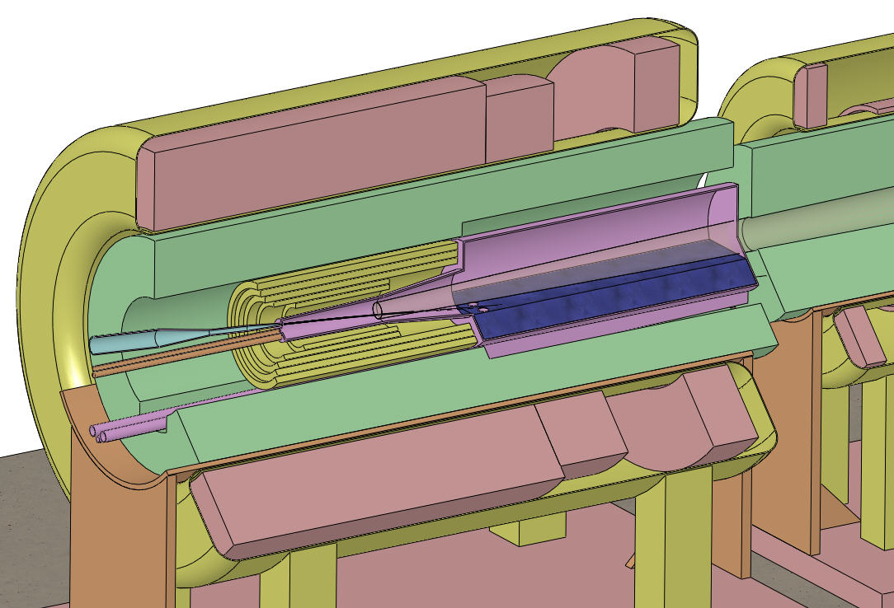
Target and Capture Topology: Solenoid
Desire ≈ 10¹⁴ μ/s from ≈ 10¹⁵ p/s (≈ 4 MW proton beam)
R.B. Palmer (BNL, 1994) proposed a 20-T solenoidal capture system.
Low-energy π's collected from side of long, thin cylindrical target.
Solenoid coils can be some distance from proton beam.
≥ 10-year life against radiation damage at 4 MW.
Liquid mercury jet target replaced every pulse.
Proton beam readily tilted with respect to magnetic axis.
⇒ Beam dump (mercury pool) out of the way of secondary π's and μ's.
Superconducting magnets
IDS-NF Target Concept:
Tungsten beads,
He gas cooled
Proton beam and
Mercury jet
Be window
Mercury collection pool
With splash mitigator
Resistive magnets
Shielding of the superconducting magnets from radiation is a major issue.
Magnet stored energy ~ 3 GJ!
5-T copper magnet insert; 15-T Nb₃Sn coil + 5-T NbTi outsert.
Desirable to replace the copper magnet by a 20-T HTC insert (or 15-T Nb coil).

Slide 4
Large Cable-in-Conduit Superconducting Magnets
The high heat load of the target magnet requires Nb₃Sn cable-in-conduit technology, more familiar in the fusion energy community than in high energy physics.
The conductor is stabilized by copper,
as the temperatures during conductor fabrication comes close to the melting point of aluminum.
The conductor jacket is stainless steel, due to the high magnetic stresses.
A high-temperature superconducting insert of 6+ T is appealing – but its inner radius would also have to be large to permit shielding against radiation damage.

Slide 5
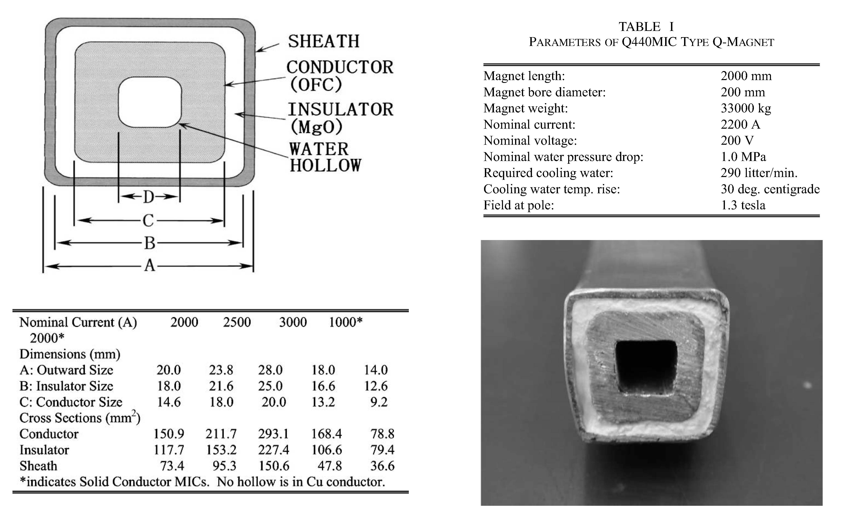
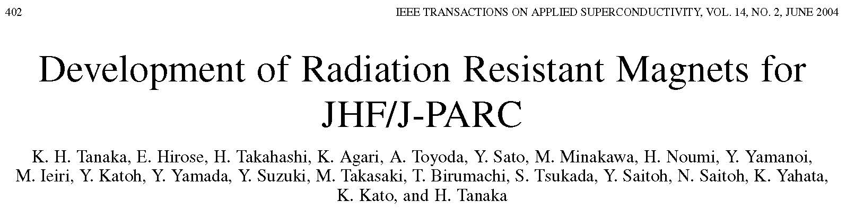
Copper Conductor for Radiation-Resistant Magnets
Organic insulation cannot be used in copper coils in the Target System.
Radiation-resistant conductor with MgO insulation has been developed at KEK/JHF.

Slide 6
Recent Targetry Efforts
Jaroslav Pasternak (IC, London) Proton-beam final focus
Xiaoping Ding (UCLA) Particle-Production Simulations (including comparison of Ga with Hg)
Ole Hansen (CERN) Jet Target Optimization
Hisham Sayed (BNL) Configurations with shorter taper (matched to phase rotator)
Bob Weggel (MORE/PBL) Magnet and Shielding Configurations
Nicholas Souchlas (PBL) Energy-deposition simulations for the Target System (to determine whether the superconducting magnets are sufficiently well shielded from the 4-MW beam power)
Pavel Snopok (IIT) Energy-deposition simulations for the Decay Channel
Van Graves (ORNL) Mercury module design + overall Target System layout
Yan Zhan (Stony Brook) Nozzle and Jet Studies (towards improving the jet quality)
Roman Samulyak (Stony Brook) MHD Simulations (including beam-jet interactions)

Slide 7
Proton-Beam Final Focus
Jaroslav Pasternak (IC, London) [IPAC13, TUPFI074]
The ~ 8-GeV, 4-MW proton beam that drives a Neutrino Factory has a nominal 50-Hz macropulse structure with 2-3 micropulses ~ 100 ns apart.
The nominal geometric beam emittance is 5 μm, and the desired rms beam radius at the liquid-metal-jet target is 1.2 mm.
A quadrupole-triplet focusing system to deliver this beam spot is described.
Proton-beam transport from Compressor Ring to the Target System:
The ~ 250-m-long arc system maintains the 2-ns proton-bunch length without RF cavities:
β-Function and Dispersion of a 17-m-long cell of the arc system:
β-Function of the last 70 m of a Final-Focus system with 5-m gap between last quad and target (which is at s = 70 m):
σ_{x} = σ_{y} = 1.2 mm
at target

Slide 8
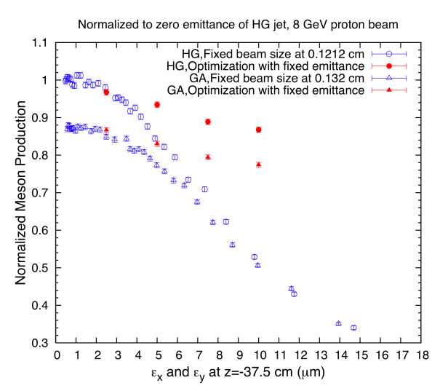
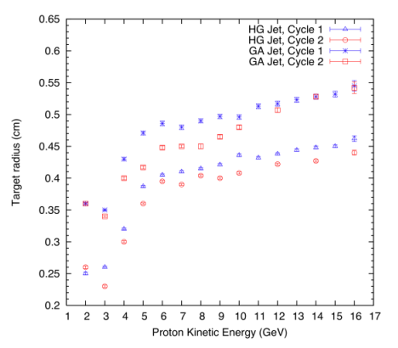
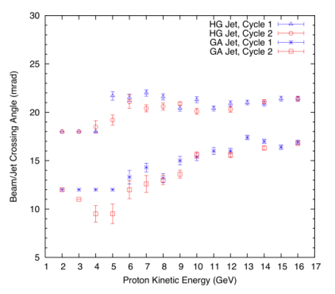
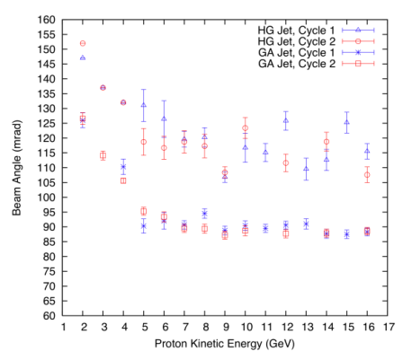
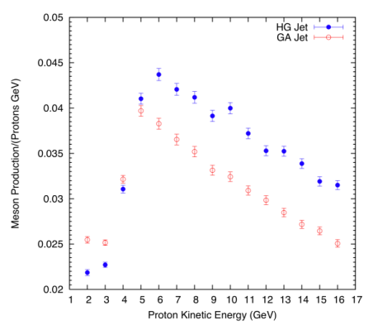
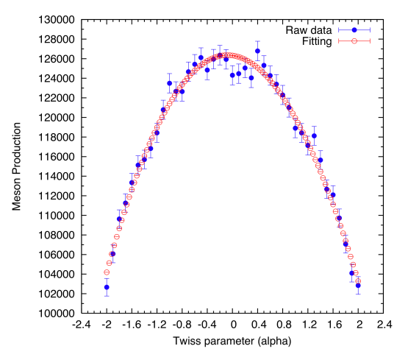
Particle Production Simulations
Xiaoping Ding (UCLA) [IPAC13, TUPFI069]
The geometric parameters of a free Hg or Ga jet target for a Muon Collider or Neutrino Factory were optimized to maximize particle production by an incident, parallel proton beam with kinetic energies (KE) between 2 and 16 GeV using the MARS15 code.
The optimized parameters were: the radius of the proton beam, the radius of the liquid jet, the crossing angle between the jet and the proton beam, and the incoming proton beam angle.
We extended our optimization to focused proton beams for special cases of transverse emittances of 2.5, 5 or 10 μm-rad at a KE of 8 GeV.
We also studied the effect of a shift of the beam focal point relative to the intersection point of the beam and the jet.
1. Optimized target parameters and meson production for incoming proton beam with zero emittance
2. Influence of proton beam emittance on particle production
Meson production decreases with increasing proton beam emittance, but careful optimization keeps this decrease to 7% for a Hg-jet target and 4% for a Ga-jet target for a proton beam of 8 GeV kinetic energy and transverse emittance ε = 5 μm-rad, compared to the case of zero emittance beams. The optimized meson production a Ga-jet target is then about 88% of that for a Hg-jet target.
3. Effect of shift of the beam focal point
Meson production peaks when the beam focal point is about 5 cm upstream of the beam/jet interaction point, but the increase compared to focal point at the interaction point is negligible.
Meson production at low proton KE (below 4 GeV) may be higher for Ga than for Hg.

Slide 9
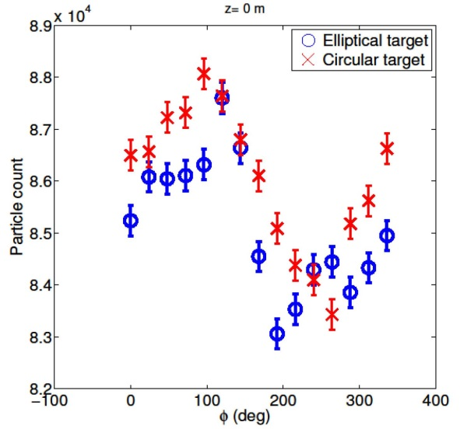
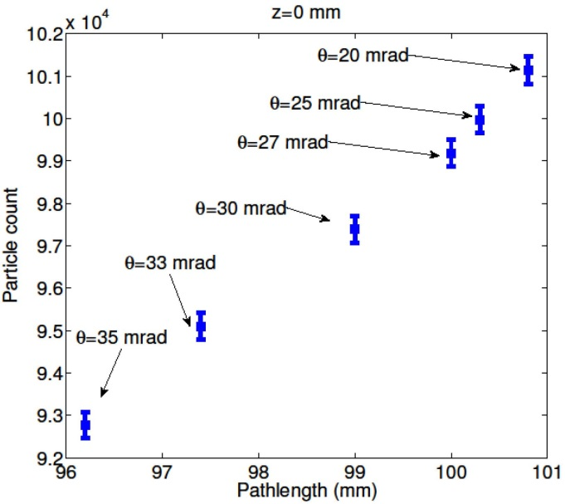
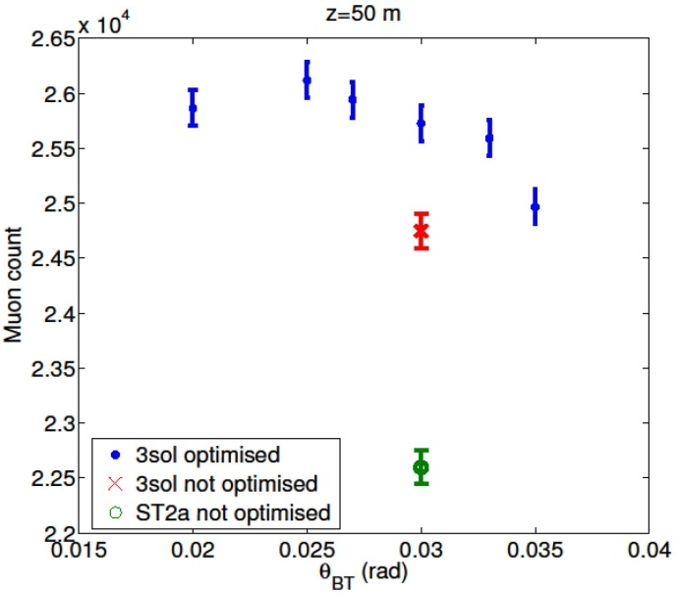
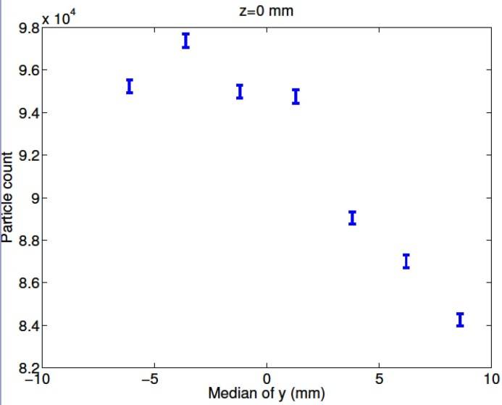
Jet Target Optimization
Ole Hansen (CERN) [IPAC13, TUPFI018]
Little change in particle production if jet is elliptical rather than circular:
[Confirms old result of H Kirk that a “waterfall” target would be fine.]
Small shifts in the target position relative to the nominal can improve the particle production:
H Sayed: Similar effects if shift time of proton beam.

Slide 10
Configurations with a Shorter Taper
Hisham Sayed (BNL) [IPAC13, TUPFI075]
Following a hint from O. Hansen, the yield of useful muons out of the Phase Rotator (Front End), is improved by shifting the timing of the proton beam, and shortening the length of the taper between 20 T and 1.5 T.
It seems favorable to increase the field in the Front End above the baseline of 1.5 T.
The baseline taper length of 15 m could be reduced to ~ 5 m.
Reducing the peak field from 20 T to 15 T is viable.
A short proton bunch continues to be favored:
The shorter taper results in a denser distribution in longitudinal phase space, which is preferable for the ^{Buncher/Phase Rotator.}

Slide 11
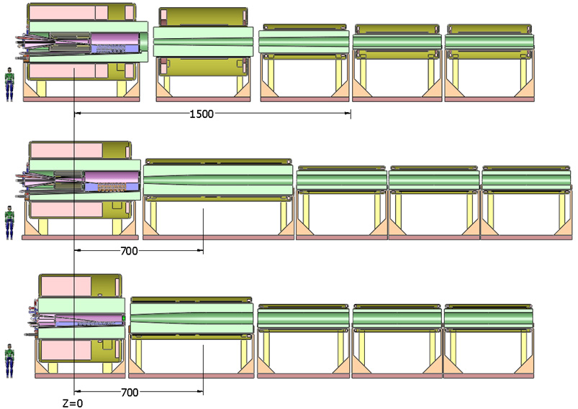
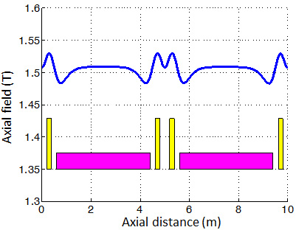
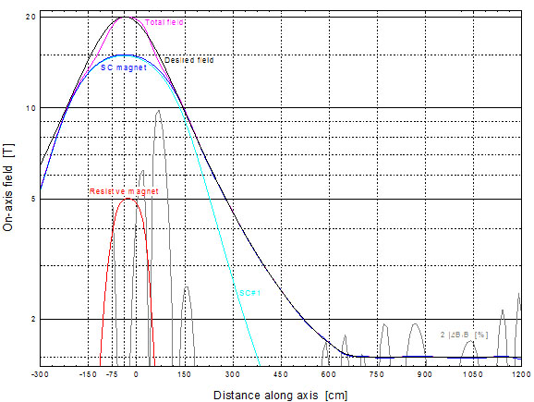
Magnet Coil Configurations
Bob Weggel (MORE/PBL) [IPAC13, TUPFI073]
Baseline (IDS-NF)
Field perturbations at the ends of the 5-m-long Decay channel magnets can lead to “stop bands.”
2 configurations with 7-m taper and 15-T peak
Revised coil configuration has essentially no ``stops bands (H. Sayed):
Axial field profile for a 7-m taper:

Slide 12
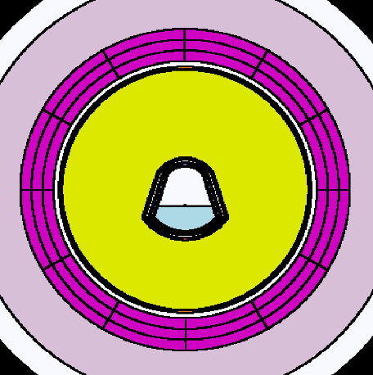
Energy-Deposition Simulations
Nicholas Souchlas (PBL)
Possibly noncircular mercury target module could lead to “hot spots” in downstream coils.
z = 0
z = 4.7 m
MARS15 simulations (with MCNP data files) are used to suggests changes in the W-bead shielding to keep the power deposition below 0.1 mW/g in superconducting coils, as needed to provide a 10-year operation lifetime against radiation damage.
These simulations are very time consuming, ⇒ Run MARS at NERSC (R. Ryne).

Slide 13
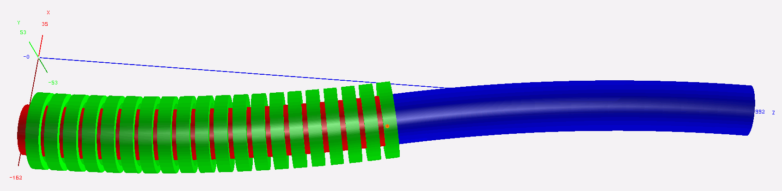
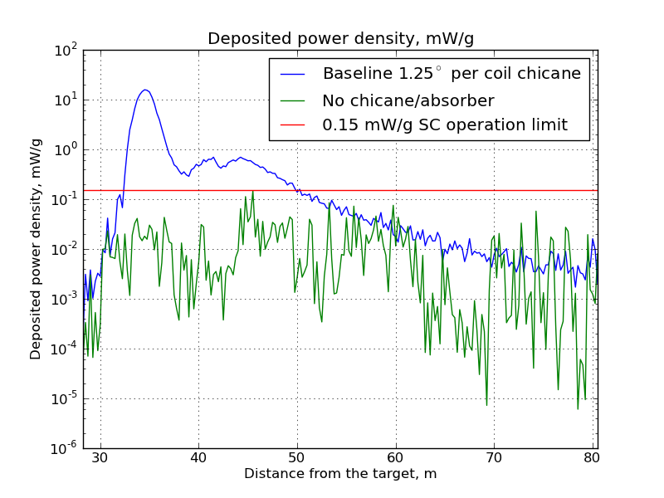
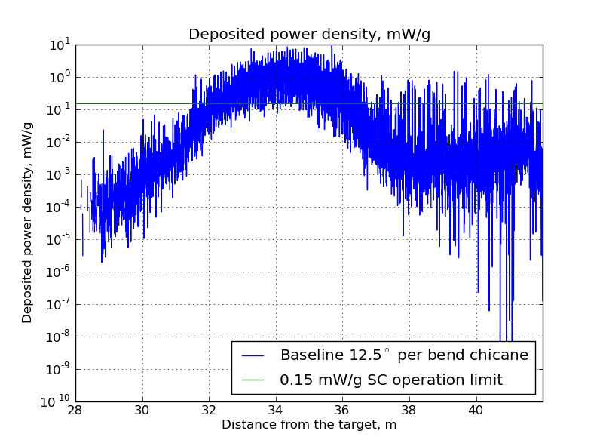
Energy Deposition in the Chicane
Pavel Snopok (IIT) [IPAC13, TUPFI067]
A chicane in the Decay Channel could mitigate the 500-kW power in scattered protons which otherwise would impact on the Buncher/Phase Rotator (C. Rogers).
MARS input geometry derived from a G4Beamline model.
MARS15 simulations showsthat a 10-cm-thick sleeve of pure W helps, but the “hot spot” is still a factor of 50 too “hot.”
No shielding
10-cm W sleeve

Slide 14
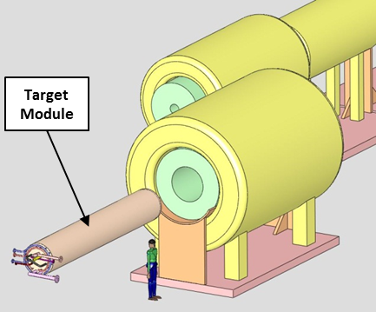
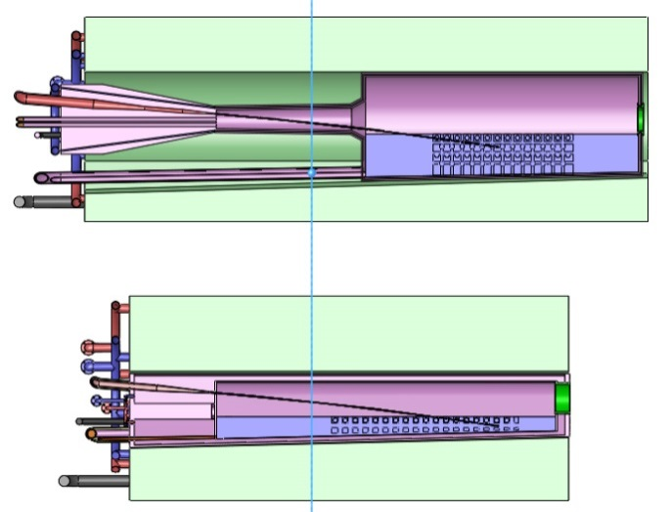
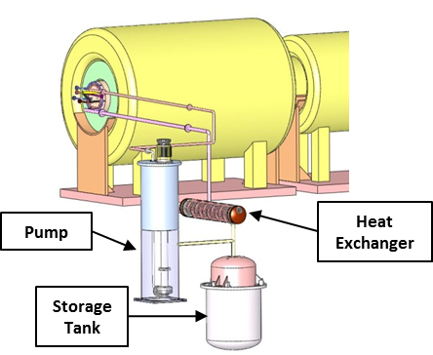
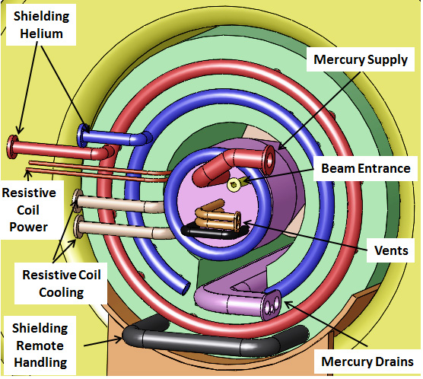
Mercury Target Module Design
Van Graves (ORNL) [IPAC13, THPFI092]
IDS120_20-1.5T7m2+5
Cross
sections
of the
Mercury
Modules for 20 T and 15 T:
Insertion/
extraction
of the
Mercury
Module:
IDS120_15-1.5T7m3+4
Services
for the
Mercury
Module and the Shielding Module:
The mercury
flow loop:

Slide 15
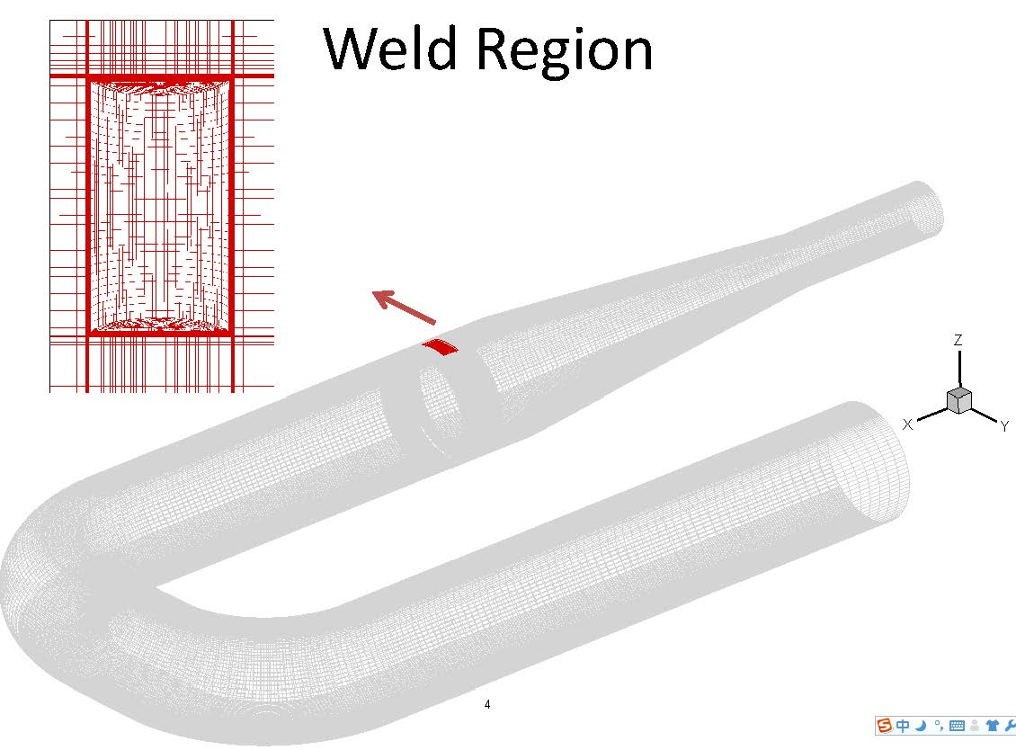
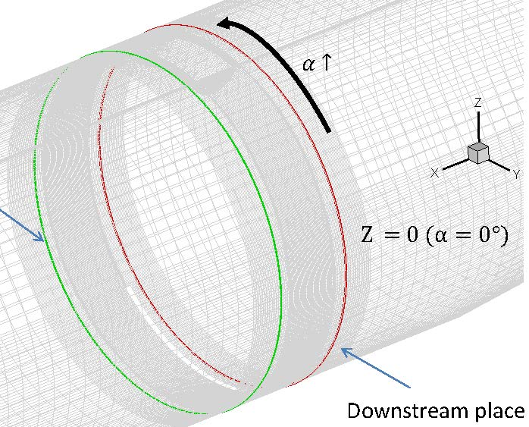
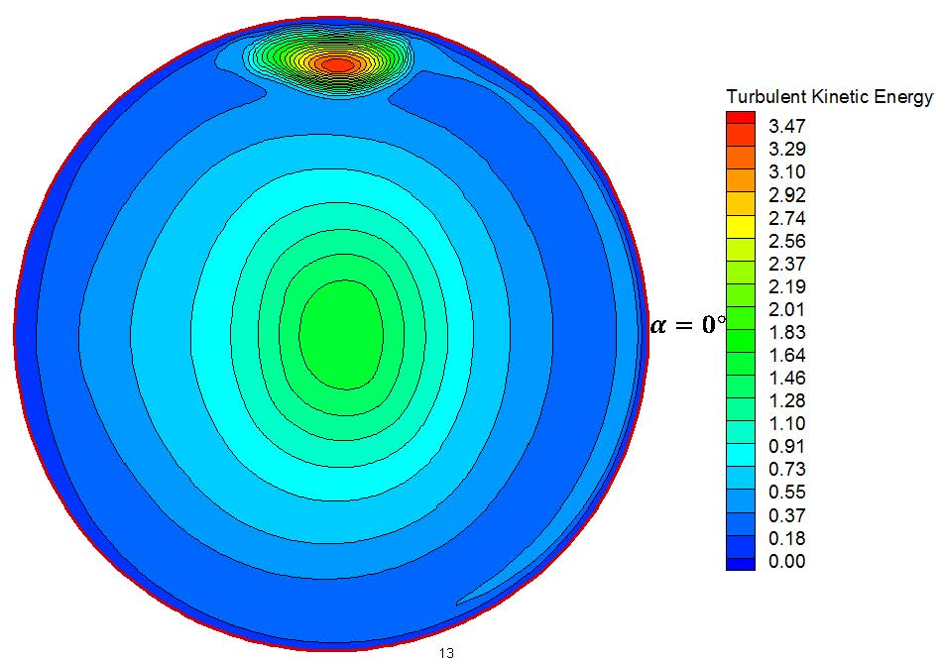
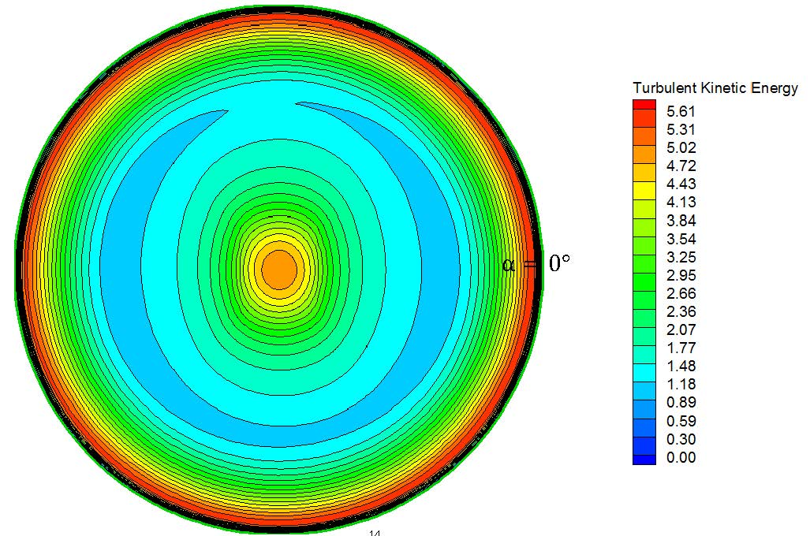
Mercury Nozzle Simulations
Yan Zhan (SUNY Stony Brook)
MERIT mercury jet was “elliptical,” possibly due to weld beads inside the Ti nozzle.
Turbulence profile just downstream of nozzle:
At nozzle exit:
ANSYS FLUENT simulation suggests that weld-bead effect is damped at nozzle exit. Next step: model free jet outside nozzle.

Slide 16
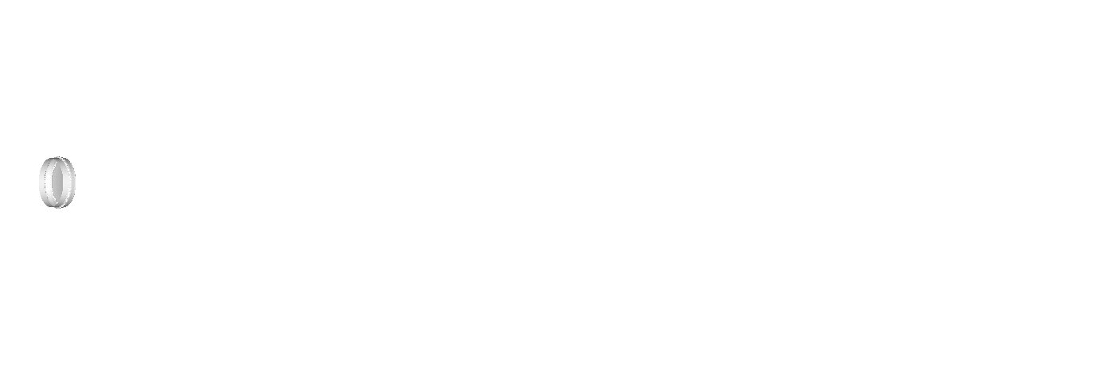
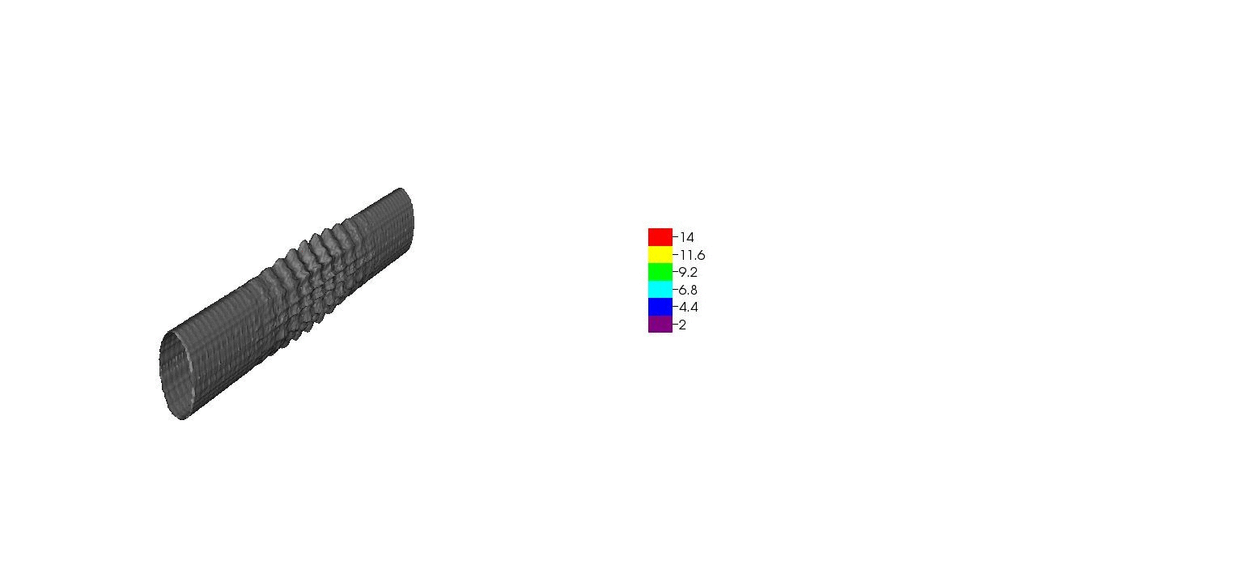
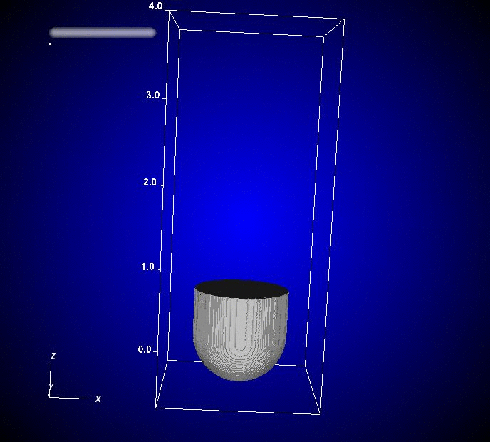

Beam-Jet Interaction Simulations
Roman Samulyak (SUNY Stony Brook)
FronTier simulation of high-speed-jet cavitation and breakup:
Simulation of mercury thimble experiments
(2001) using the Lagrangian particle code:
Smoothed-Particle-Hydrodynamics
simulation of MERIT beam-jet interaction:

Slide 17
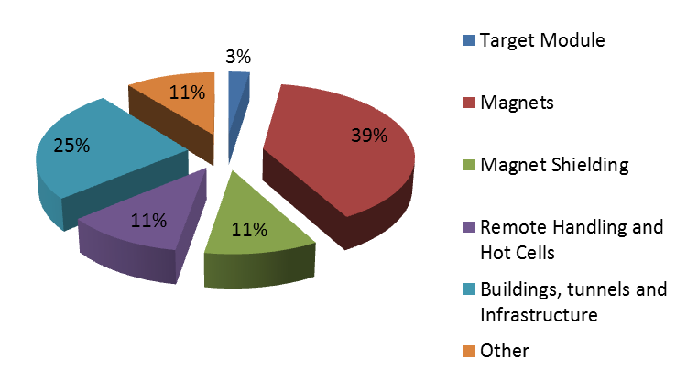
Preliminary Costing of a 4-MW Target System
The nominal target costs only a few % of the Target System.
Infrastructure costs are ~ 50%.
(A. Kurup, International Design Study for a Neutrino Factory)

Slide 18
Staging Scenarios for the Target System
Easy to start with a graphite target for a 1-MW proton beam power, but only saves ~3%.
Could reduce capture field from 15-20 T to ~ 5 T, but would save only 20-25% and would reduce the muon yield.
Could build target station with infrastructure only for 1-MW, which might save 20%, but no upgrade path to 4-MW (except total new build).
Could eliminate the solenoid capture scheme, and consider a toriodal horn, but operation of a horn at 50 Hz (or higher, as per J.-P. Delahaye) is beyond present technology.
Bottom line: A staging scenario for the Target System that maintains an upgrade path to 4 MW with substantial initial cost savings is challenging.
  [Starting with 3 GeV rather than 8 GeV makes little difference in the
  cost of the Target System, but reduces performance considerably.]

Slide 19
Target System Effort in FY14-15
MAP L1 Task: | Technology Development
MAP L1 Manager: | Harold Kirk
MAP L2 Task: | Targets and Absorbers
MAP L2 Manager: | Kirk McDonald
MAP L2 WBS ID: | 3.04
 |  |  |  |  |  |  | Totals: | 10.25 | 970
Work Package* (See Notes) | Start Date | End Date | Brief Description | Investigators (List Institution PI first) | Institution | Milestones/Deliverables |  | Effort (FTE-yrs) | M&S Budget (K$)
 |  |  |  |  |  | Qtr | Type
 | Q1 FY14 | Q4 FY15 | Management of 3.04 | K McDonald | Princeton |  | reports, PAC papers | 0.4 | 80
 | Q1 FY14 | Q4 FY15 | Target System/Front End Global Optimization | H Kirk, H Sayed +? | BNL |  | reports, PAC papers | 3 | 300
 | Q1 FY14 | Q4 FY15 | Energy deposition simulations | J Kolonko, N SouchalsPBL |  |  | reports, PAC papers | 1.5 | 150
 | Q1 FY14 | Q4 FY15 | Magnet design (conceptual) | J Kolonkn, R Weggel | PBL |  | reports, PAC papers | 1.1 | 110
 | Q1 FY14 | Q4 FY15 | Beam/Target optimization | D Cline, X Ding | UCLA |  | reports, PAC papers | 0.75 | 80
 | Q1 FY14 | Q4 FY15 | Mercury handling system design | V Graves | ORNL |  | drawings, reports, PAC papers | 0.5 | 100
 | Q1 FY14 | Q4 FY15 | Beam/jet interaction simulations | R Samulyak | SUNY Stony Brook |  | PhD thesis, paper | 2 | 100
 | Q1 FY14 | Q4 FY15 | Nozzle/jet simulations | F Ladience, Y Zhan | SUNY Stony Brook |  | PhD thesis, paper | 1 | 50

