Slide 1
October 25, 2013
05 01: MICE RF Fabrication & Testing
Derun Li
201 MHz cavity
Installation activities of the MICE prototype cavity at MTA using the single cavity vessel
Tuner arms installed
Cavity support assembly (inside the vessel) tested
Two RF couplers fabrication continues at LBNL
Parts made
Outside vendor for TiN coating
EP of the remaining 9 MICE cavities at LBNL
To be completed in FY14
1st Cryostat fabrication on hold due to budget shortage
Measurements and tuning of all MICE RF cavities
Delivery of the first MICE CC cryostat vessel
Lucas visited LBNL
ANSYS simulations of the prototype cavity
Cryostat fabrication
Currently on hold due to budget situation
Four more weeks of work to complete
Lots progress on the 201-MHz cavity installation
Tuners and tests
Cavity support
Water cooling line connections
Cavity assembly procedures
Continue MP simulation studies of the MICE cavity and coupler with external magnetic fields
Complete fabrication of two 201 MHz RF couplers for the MICE prototype cavity
Support the MICE prototype cavity installation and testing at MTA, Fermilab
Complete cryostat vessel fabrication at LBNL
Continue updating cryostat drawings and cooling circuits
Continue the 201 MHz installation at MTA, Fermilab
Complete two RF couplers fabrication at LBNL and deliver to MTA, Fermilab for installation
Resume the cryostat fabrication at LBNL once the funding is in place
Continue update/finalize the design of MICE CC cryostat and accessory components

Slide 2
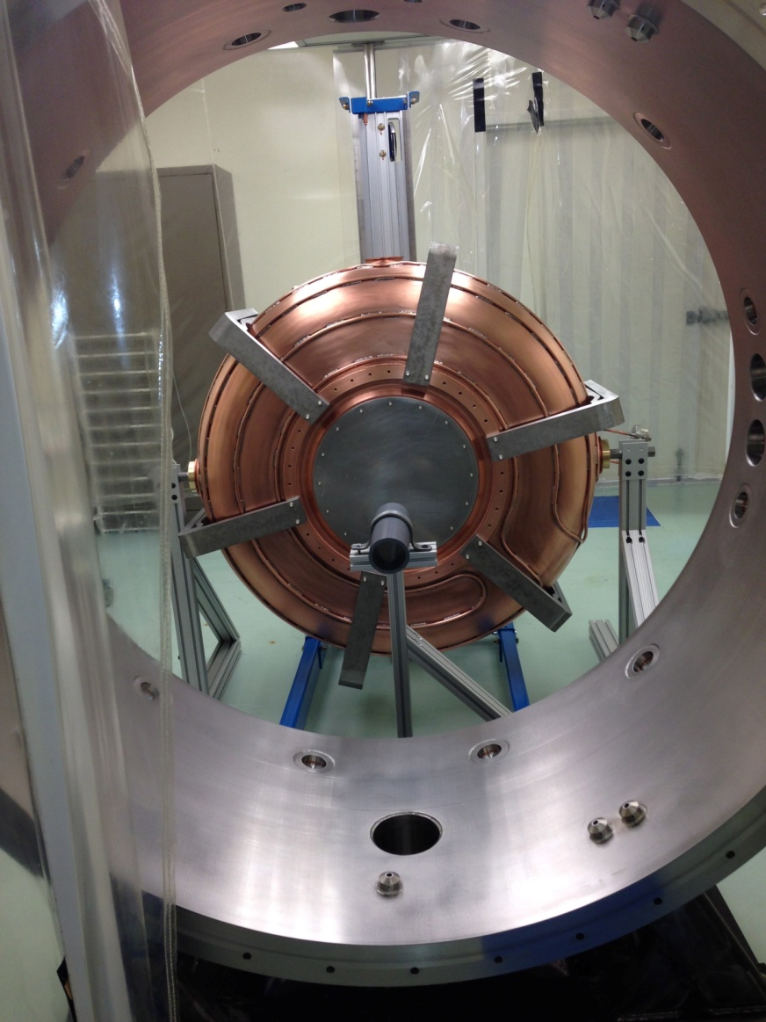
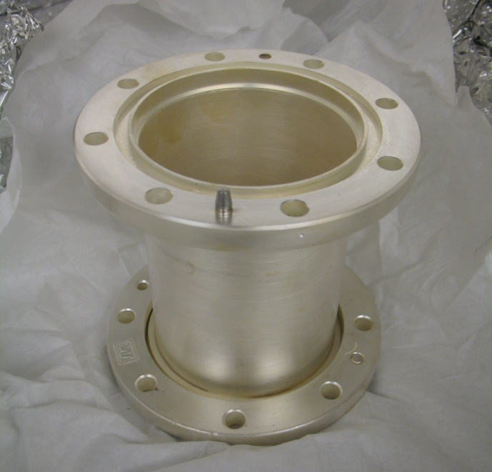
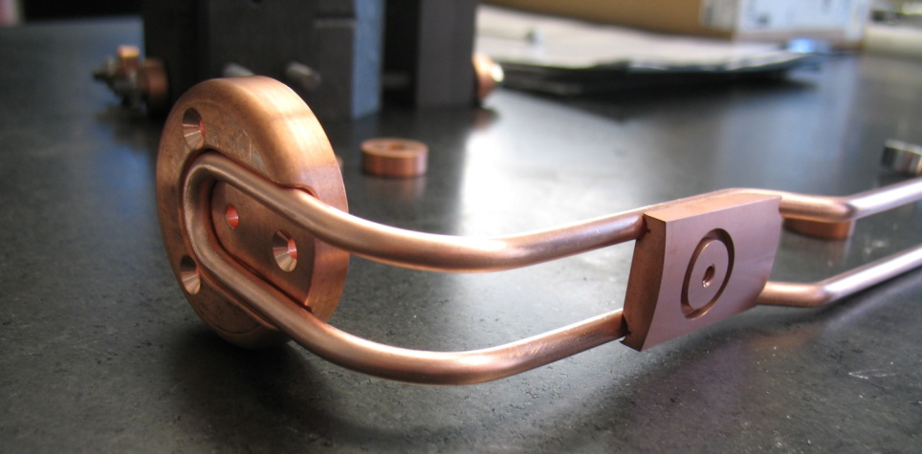
MICE Construction
First MICE RF cavity installation in a single cavity vessel at Fermilab
Coupler loop fabrication

