Slide 1
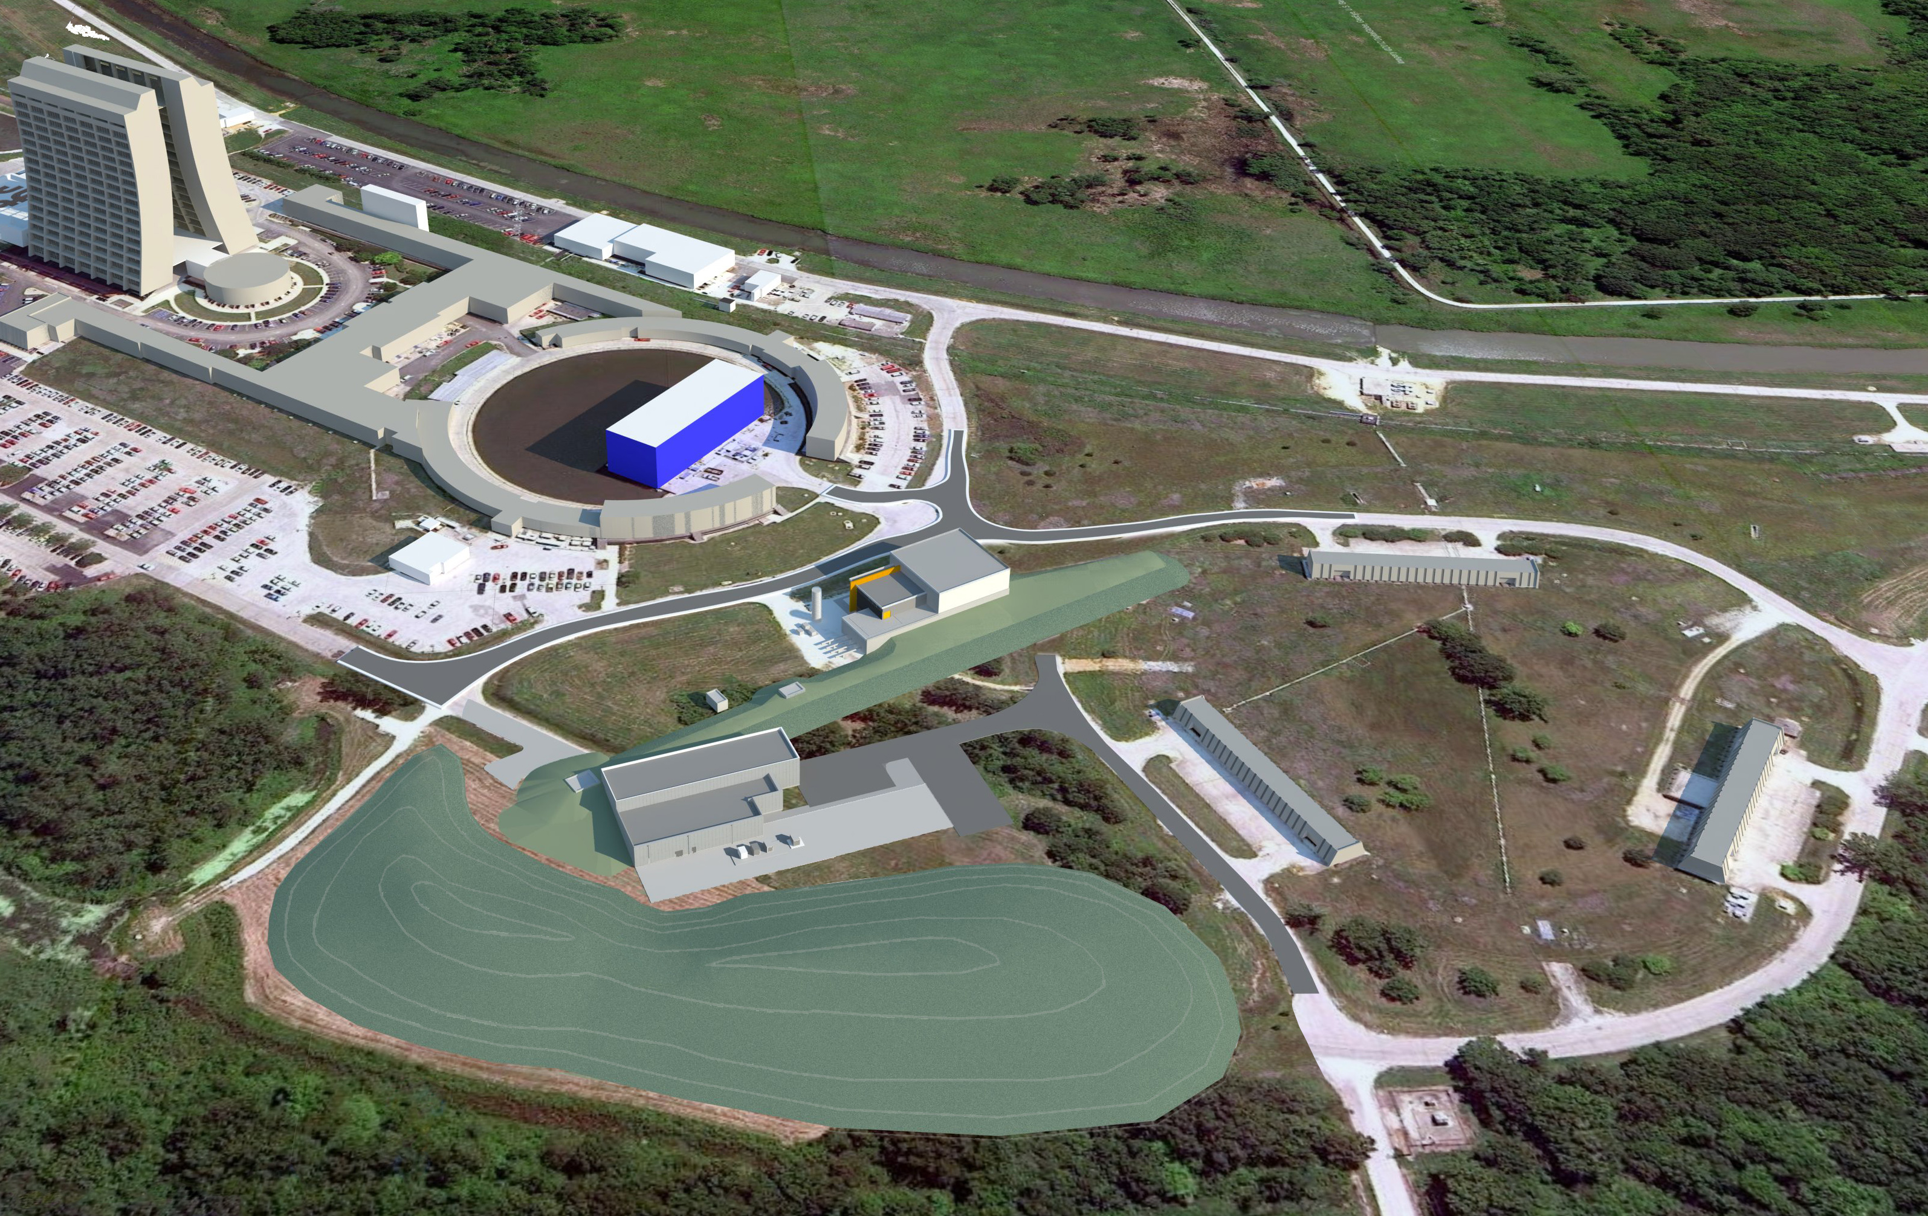
Muon Campus Installation Travelers Cons Gattuso 8/28/13

Slide 2
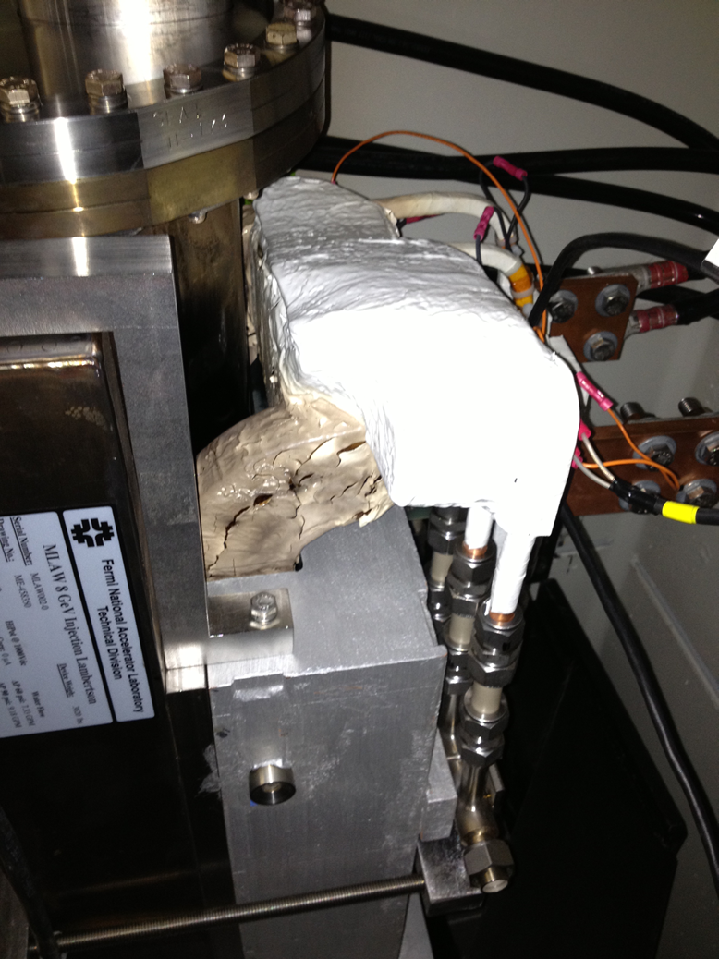
Why do we need such thing???
What went wrong?
RR LAM 232
Water connection did not
made hidden behind magnet
Klixons cables were connected and tested
Cable damage and replaced but never retested
Connected to wrong power supply
Several walk through missed it
Configuration Change RR never had power Lambertson, thus no need for H2O

Slide 3
Installation Travelers
What is an Installation Traveler ?
Road map for the installation for that location
Where will these Travelers be kept ?
A the tunnel location where the work is located.
Gives the Techs and inspectors a road map as to what needs to be done at this location.
Paper copies will be collected and stored, Electronic copies will just exist on line
What will these Installation Travelers look like?
Keep it simple, concise and to the point
Not looking for formal procedures
Who is responsible for filling out Installation Travelers ?
Techs doing the work

Slide 4
1st Traveler used on the RR LAM 232

Slide 5
The process
Machine/Enclosure
Beam line/Quad location/Period
Generate the Traveler
Fine Tune add-remove items if needed

Slide 6
Creating a Data Base and Algorithm to Generate Traveler
Data Base (Needs to be cross checked by Machines)
Magnet
Instrumentation
Vacuum
*Alignment
Algorithm
Set by the support Dept (ownership, responsibility)
Risks based driven
Flag
Water/power/interlocks/ceramics/ect
Use after installation usage
Magnet replacement

