Slide 1
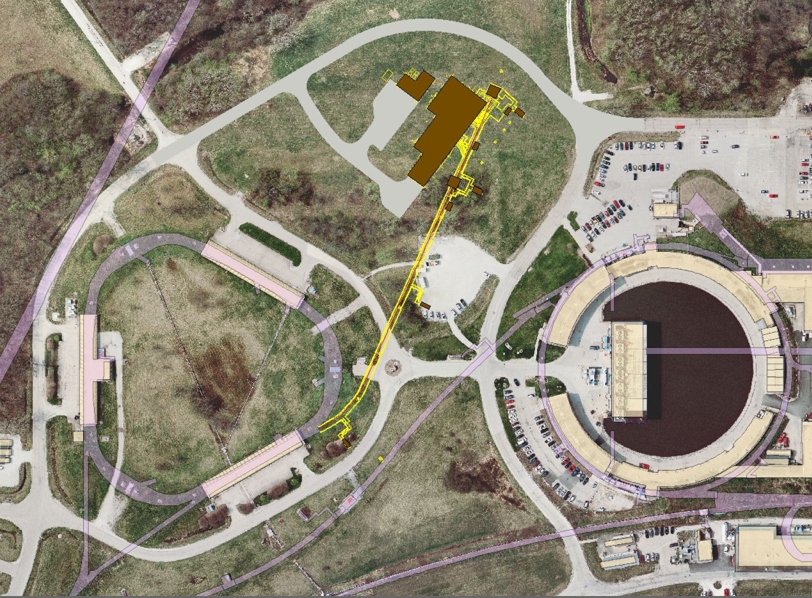
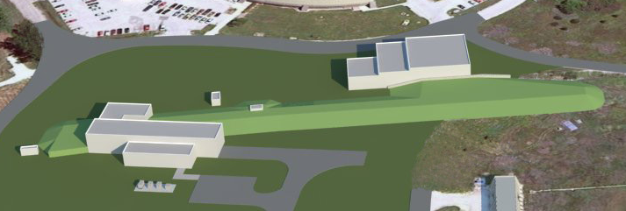
Operations Preparation
Brian Drendel
October 31, 2013
MC-1
Building
Mu2e Building

Slide 2
Operations Preparation
This talk
  Beams-doc-4474 - https://beamdocs.fnal.gov/AD-private/DocDB/ShowDocument?docid=4474
Old Mu2e BoE
  Mu2e-doc-1639 - http://mu2e-docdb.fnal.gov:8080/cgi-bin/ShowDocument?docid=1639
Acnet Application Upgrades
  Mu2e-doc-1640 - http://mu2e-docdb.fnal.gov:8080/cgi-bin/ShowDocument?docid=1640
    Acnet Application Costing: Estimate on Software Costs
    Operations Preparation: Word Document outlining overall needs
    Pbar Applications Inventory: Excel file outline work done to inventiry existing applications.
Beam Abort System moved to controls portion of Mu2e project.

Slide 3
Controls Software Development
Significant controls software development will need to be undertaken prior to Mu2e operations.
  For systems that go unchanged, the existing applications and parameters will be reused when possible.
  In systems that are upgraded, we will upgrade existing applications and parameters when possible.
  For new systems, we will need to develop new applications and parameters. It will need to be determined what platform new applications are developed on (Java application, C application, Sequencer, ACL script, OAC, etc…).

Slide 4
Software
There are a number of software issues to be addressed with the implementation of the machine protection scheme.
  An ACNET interface will need to be written for the beam abort, similar to the current Pbar interface page P67. Controls experts have written a generic template page for aborts, which will minimize programming time.
  The beam line auto-tune application will need to be upgraded for Mu2e operations to include the correct beam line path, beam energies and cycle times. It has become the norm at Fermilab for beam line tuners to be written as Open Access Clients (OACs) which run in the background, so additional programming time may be required to migrate this application to an OAC platform.

Slide 5
Console Applications
    Existing Applications that can be used or upgraded
      Parameter Pages (P8, P12, P36, P38, P57, P69, P66, P75, P202, etc…)
      Sequencer (Need to determine how many sequencers we need)
      Beam Permit and Camac 204 pages
      Vacuum plot and params
      RF curve loading and graphics apps
      Switch tree
      Spectrum analyzer applications (?)
      BPM display and model pages
      BLM display and plot pages
      SEM grid and multiwire pages
      Camac ramp card control
      Cycle busses
      Power supply transient recorder
      Accumulator TBT
      Debuncher TBT
    New Console Applications
      New RF control
      Resonant extraction monitoring and control

Slide 6
How much effort is required?
A rough rule of thumb for console development time is:
  Modify a program---1 month
  Write a new one--4 months
Overall effort was estimated at 2 to 3 FTE’s over several years!!!

Slide 7
Application Inventory Part 1

Slide 8
Application Inventory Part 2

Slide 9
Application Inventory Part 3

Slide 10
Applications Inventory Totals

Slide 11
More Controls Software
  Dabble parameter creation and updates
    Many ACNET parameters for upgraded systems will need to have their database entries updated.
    Many ACNET parameters will need to be created for systems new to Mu2e.
  Acnet & Java Index Pages
    Will need to be reorganized reflecting the Mu2e applications and parameter pages.
  Parameter Page
    Existing parameter pages will need to be restructured to reflect Mu2e operations. Parameter subpage names will need to be renamed in some cases. New parameter pages may need to be added.

Slide 12
Yet More Controls Software
  Open Access client (OAC)
    Software tasks requiring automation via OAC clients will need to be determined and developed.
  Alarms
    Appropriate analog, digital and acknowledgeable alarms will need to be setup for Mu2e devices.
  Studies:
    Machine and beam study time will be required to commission new and upgraded applications.

Slide 13
Training & Commissioning
A training plan will be developed to facilitate the training of operations personnel in g-2 and Mu2e operations.
Training will include:
  Tunnel device locations
  Service Building Equipment location and operation.
  Software operation of all new and modified devices.
Machine and beam study time will be needed to commission new and upgraded applications.
System checkout plan will be developed to verify operational readiness of hardware systems such as power supplies and instrumentation.

