Slide 1
Chicane at 325
David Neuffer
November 2013

Slide 2
Outline
Front End for Muon collider/ IDS Neutrino Factory
  Redesign for 325 MHz
    “Muon Collider” / Neutrino Factory version
  Variations
    8GeV → 3GeV
Add Chicane/ Absorber
  rematch
Incorporate New Front End variants
  8 GeV or 3 GeV protons
  20T or 15T
  shorter taper to X T (→ 3.5)

Slide 3
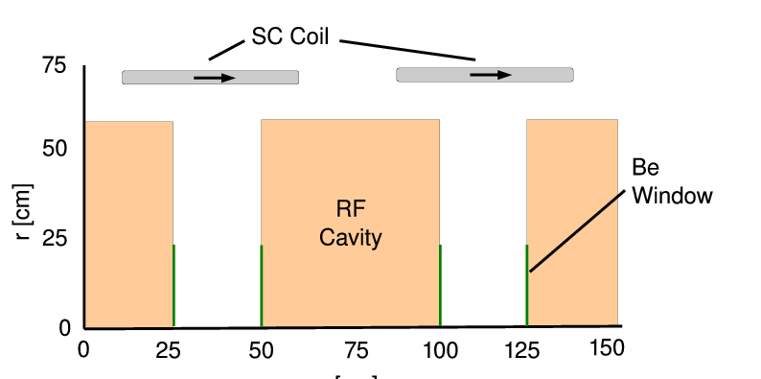
325MHz System “Collider”
Drift
  20T→ 2T
Buncher
  P_{o}=250MeV/c
  P_{N}=154 MeV/c; N=12
  V_{rf} : 0→ 15 MV/m
    (2/3 occupied)
  f_{RF} : 490→ 365MHz
Rotator
  V_{rf} : 20MV/m
    (2/3 occupied)
  f_{RF} : 364→ 326MHz
  N=12.045
  P_{0,} P_{N}→245 MeV/c
Cooler
  245 MeV/c
  325 MHz
  25 MV/m
  2 1.5 cm LiH absorbers
  /0.75m

Slide 4
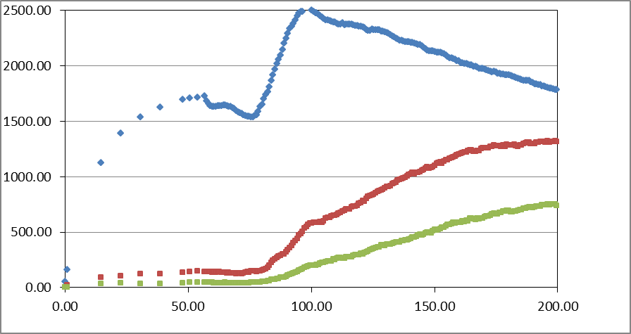
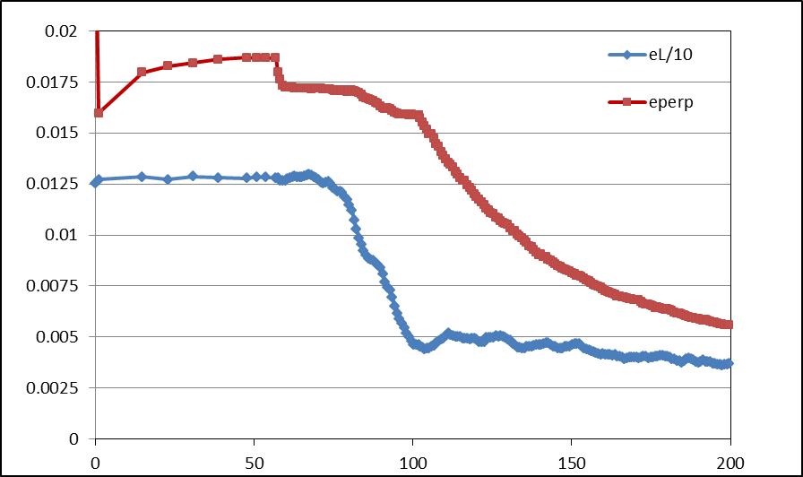
Simulation Results
Simulation obtains
  ~0.125 μ/p within acceptances
  with ~60m Cooler
  shorter than baseline NF
But
  uses higher gradient
  shorter than baseline NF
  325 MHz – less power
  more bunches in bunch train
N :0.15<P<0.35 GeV/c
N: ε_{T}<0.03; A_{L}<0.2
N: ε_{T}<0.015; A_{L}<0.2
Useful
cooling

Slide 5
“Neutrino Factory” 325MHz System
Drift
  20T→ 2T
Buncher
  P_{o}=250MeV/c
  P_{N}=154 MeV/c; N=16
  V_{rf} : 0→ 13 MV/m
    (2/3 occupied)
  f_{RF} : 466→ 362MHz
Rotator
  V_{rf} : 17MV/m
    (2/3 occupied)
  f_{RF} : 361→ 326MHz
  N=16.05
  P_{0,} P_{N}→245 MeV/c
Cooler
  325 MHz
  20 MV/m
  2 1.3 cm LiH absorbers/0.75m

Slide 6
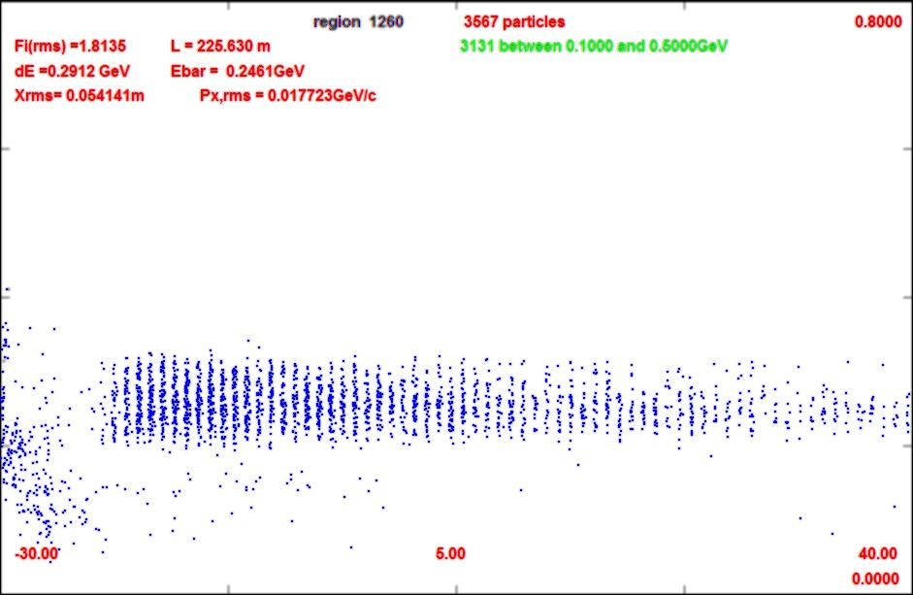
Simulation for “neutrino factory”
Neutrino factory- like parameters
  (N=16)
  ~0.12 μ/p at z=200m
  V_{rf} = 13, 17, 20 MV/m
rf power less than 200 MHz
  (V₂/ V₁)² (f₁/f₂)² L₂/ L₁
  ~60% in MW (peak)
  number of cavities increased (1/2 length …)
  B field higher 1.5T → 2T
N :0.15<P<0.35 MeV/c
N: ε_{T}<0.03; A_{L}<0.2
N: ε_{T}<0.015; A_{L}<0.2
ε_{t}
-30
40

Slide 7
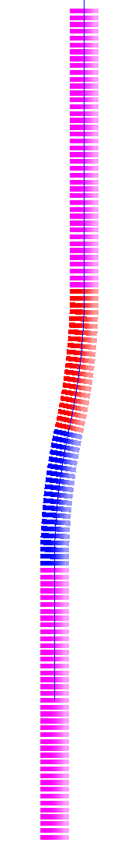
Chicane/Absorber Design Concept
Bent solenoid chicane induces vertical dispersion in beam
  bend out – 5m, 12.5°
  Single chicane will contain both signs
    Opposite signs have dispersion in opposite sense
  Little disruption to the central beam
  High momentum particles scrape
Subsequent proton absorber to remove low momentum protons
  Non-relativistic protons don't have much energy, even for relatively
  large momenta
  (~10cm Be)
π⁻, μ⁻
π⁺, μ⁺
proton
absorber
bend
back
p, π⁻, μ⁻
π⁺, μ⁺
bend
out
field
taper
target
station

Slide 8
Add chicane to absorber
ICOOL version
  2 Bent Solenoids – 10m
  5m, 1.5T, 12.5º,0.27GeV/c
  5m, 1.5T, -12.5º ,0.27GeV/c
    bend radius is 22.92m (1/r=0.043636)
    B_{y}=0
Match to channel
  add ~1m drift
ICOOL BSOL element:
π⁻, μ⁻
π⁺, μ⁺
proton
absorber
bend
back
p, π⁻, μ⁻
π⁺, μ⁺
bend
out
SREGION ! bentsol
5.0 1 1e-2
1 0. 1.0
BSOL
1 2.0 0.0 1 0.27 0.0 0.043636 0.0 0.0 0.0 0. 0. 0. 0. 0.
VAC
NONE
0. 0. 0. 0. 0. 0. 0. 0. 0. 0.
field
taper
target
station
B → 2T

Slide 9
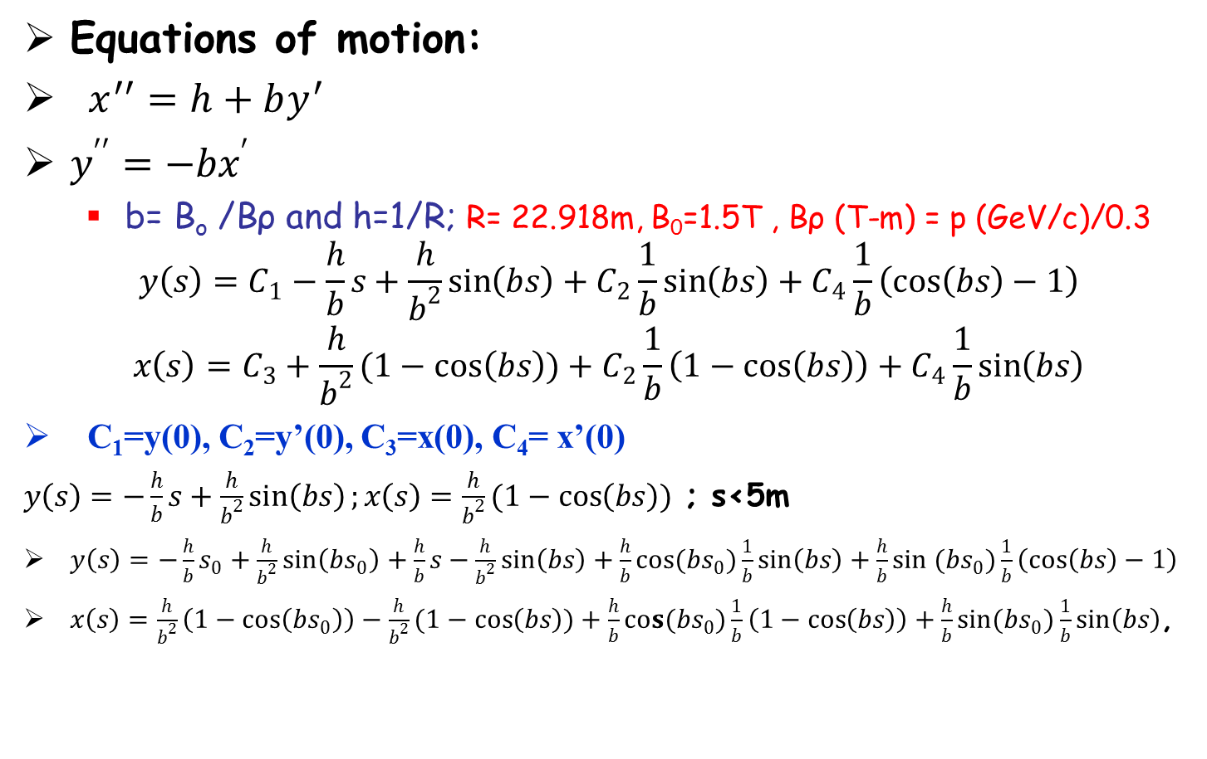
Equations of motion and solution
π⁻, μ⁻
π⁺, μ⁺
proton
absorber
bend
back
Equations of motion:
$x^{′′}=h+by^{′}$
$y^{′′}=−bx^{′}$
  b= B_{o} /Bρ and h=1/R; R= 22.918m, B₀=1.5T , Bρ (T-m) = p (GeV/c)/0.3
$$y\left(s\right)=C_{1}−\frac{h}{b}s+\frac{h}{b^{2}}\sin\left(bs\right)+C_{2}\frac{1}{b}\sin\left(bs\right)+C_{4}\frac{1}{b}\left(\cos\left(bs\right)−1\right)$$
$$x\left(s\right)=C_{3}+\frac{h}{b^{2}}(1−\cos\left(bs\right))+C_{2}\frac{1}{b}\left(1−\cos\left(bs\right)\right)+C_{4}\frac{1}{b}\sin\left(bs\right)$$
C₁=y(0), C₂=y’(0), C₃=x(0), C₄= x’(0)
$y\left(s\right)=−\frac{h}{b}s+\frac{h}{b^{2}}\sin\left(bs\right);x\left(s\right)=\frac{h}{b^{2}}(1−\cos\left(bs\right))$ ; s<5m
$y\left(s\right)=−\frac{h}{b}s_{0}+\frac{h}{b^{2}}\sin\left(bs_{0}\right)+\frac{h}{b}s−\frac{h}{b^{2}}\sin\left(bs\right)+\frac{h}{b}cos(bs_{0})\frac{1}{b}\sin\left(bs\right)+\frac{h}{b}sin (bs_{0})\frac{1}{b}\left(\cos\left(bs\right)−1\right)$
$x\left(s\right)=\frac{h}{b^{2}}\left(1−\cos\left(bs_{0}\right)\right)−\frac{h}{b^{2}}(1−\cos\left(bs\right))+\frac{h}{b}cos(bs_{0})\frac{1}{b}\left(1−\cos\left(bs\right)\right)+\frac{h}{b}sin(bs_{0})\frac{1}{b}\sin\left(bs\right)$,
p, π⁻, μ⁻
π⁺, μ⁺
bend
out
field
taper
target
station
5<s+s₀<10m; s₀=5m

Slide 10
reference particles in chicane
x deviation
  p=0.2, 0.3, 0.4, 0.5, 0.6, 0.7,0.8 ,0.9
y deviation
  p=0.2, 0.3, 0.4, 0.5, 0.6, 0.7, 0.8, 0.9

Slide 11
reference particles in 2Tchicane
x deviation
  p=0.2, 0.3, 0.4, 0.5, 0.6, 0.7,0.8 ,0.9
y deviation
  p=0.2, 0.3, 0.4, 0.5, 0.6, 0.7, 0.8, 0.9

Slide 12
More reference particles
x motion
  p=0.05, 0.1, 0.15, 0.2, 0.25, 0.3, 0.35 ,0.4
y motion
  p=0.05, 0.1, 0.15, 0.2, 0.25, 0.3, 0.35 ,0.4

Slide 13
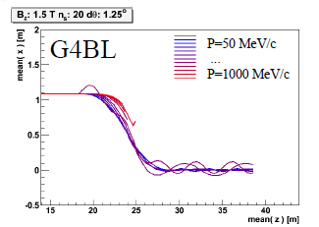
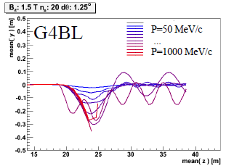
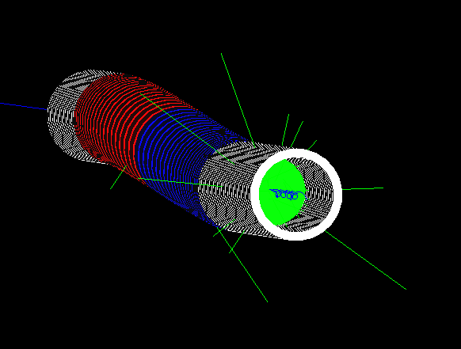

Chicane + absorber
Chicane effect:
  P > ~500MeV/c are lost
  P < ~500MeV pass through
    displaced by ~1.1m
  Nominal Path length increased by only 8cm
    orbits perturbed
absorber effect
  removes low energy particles
    designed to remove protons
  distorts energy distribution
    energy phase-rotation distorted; must be rematched

Slide 14
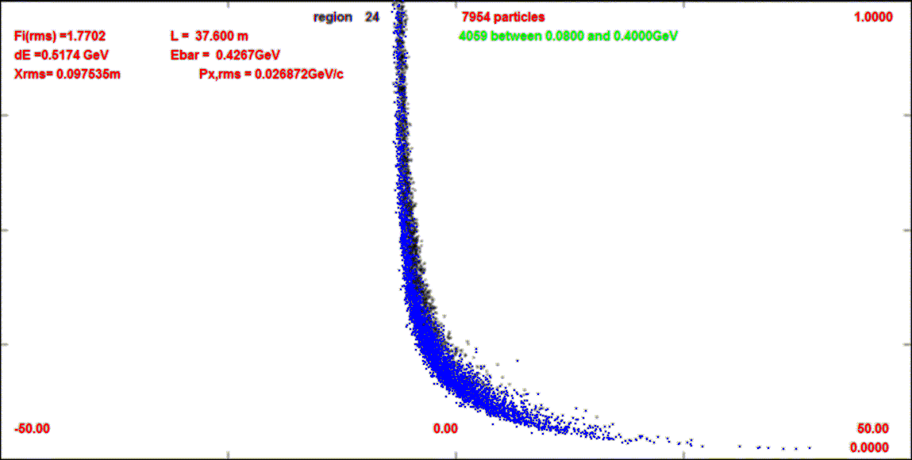
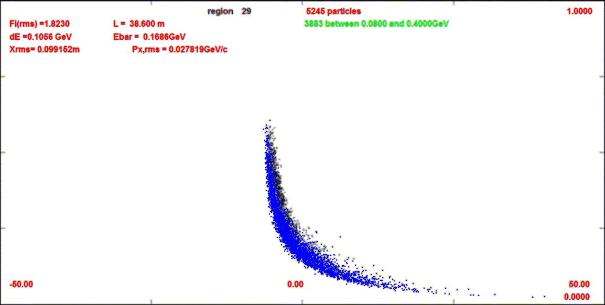
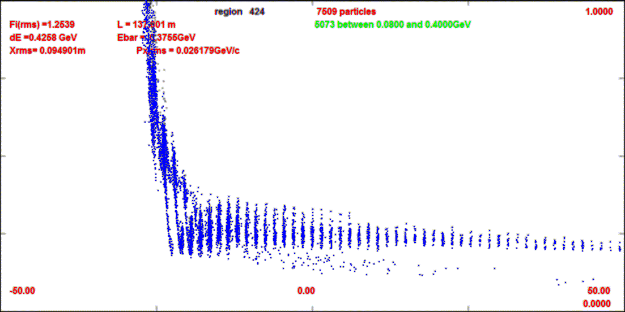
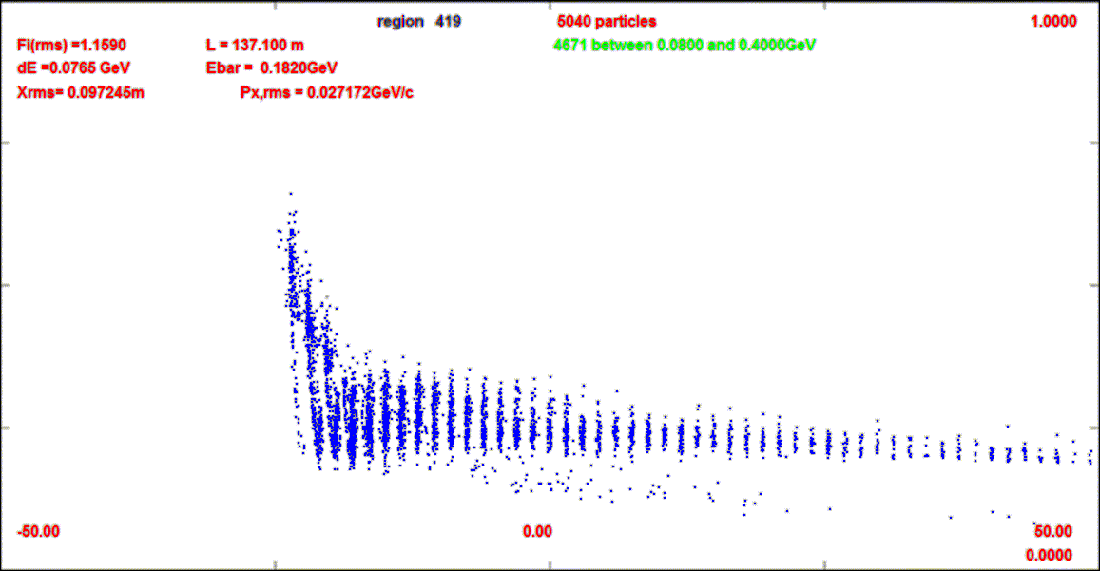
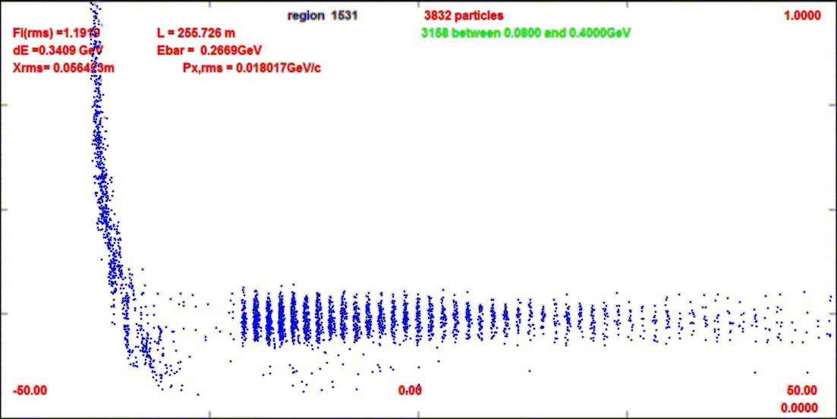
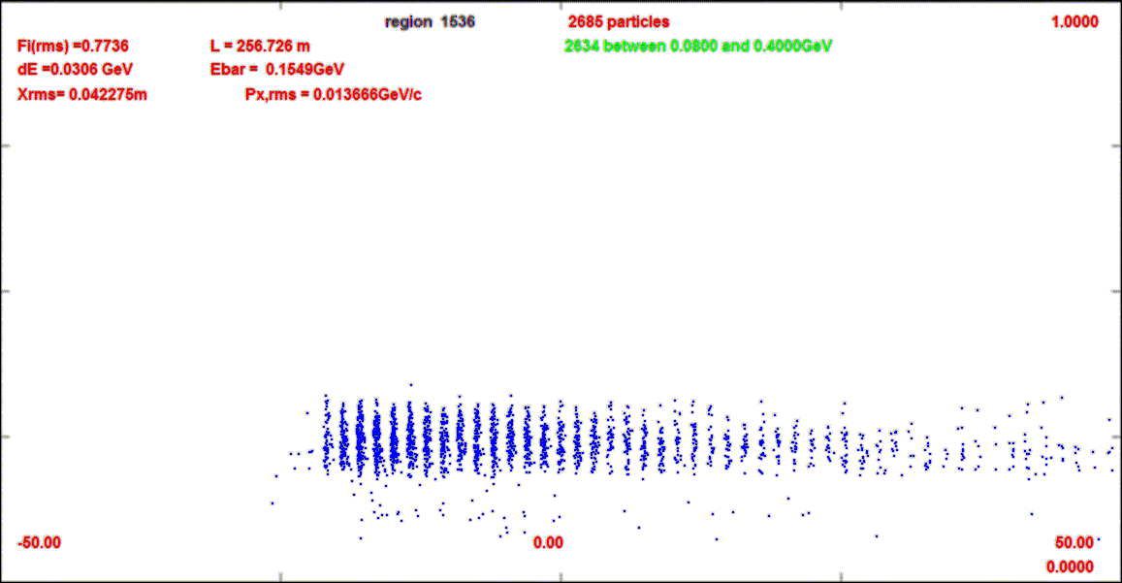
Compare-absorber vs absorber+chicane
This compares absorber only (10cm Be) to chicane (BSOL) + absorber
1.0 GeV/c
z=38m
z=38m
0
z=137m
z=137m
z=255m
z=255m

Slide 15
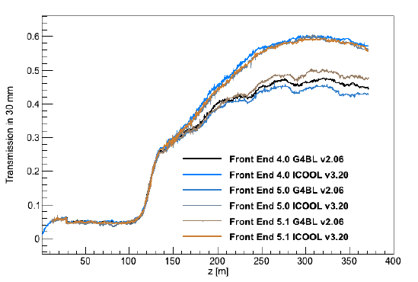
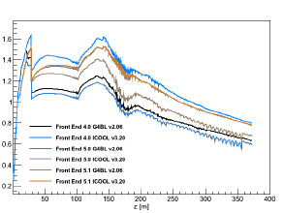
Chicane Anomaly (Rogers)
G4BL version does not work as well as ICOOL version
Comparison
  same mu/p after rotator
  less gain from cooling
  more loss of beam in chicane / absorber
Design differences
  ICOOL model idealized
    no fringe fields
  G4BL coils
    smaller aperture cuts ?
  design matched within ICOOL
    not rematched for G4bl
scraping of larger amplitudes would give this behavior

Slide 16
Anomaly meaning ?
Appears to start at chicane/ absorber region – with greater loss ???
  could be (?) from more restricted apertures
Tried restricting ICOOL aperture
  1.0m →0.4m → 0.3m → 0.25
  0.0975 → 0.096→0.0804 → 0.068 at end
  0.038 → 0.038 →0.038 start of cooling ….
  0.208→0.202→0.160 → 0.136
  Some loss but not quite as much (?)
  ε_{t} ~0.017 → 0.0123m
Pattern is consistent with aperture restriction + some mismatch
  Can deficit be removed with a bit larger aperture in G4BL (?)

Slide 17
Front End with Absorber-Rematch
Chicane
p
π →μ
FE Target
Solenoid
Drift
Buncher
Rotator
Cooler
4+10.1 m
0.1 m Be
14.75 m
~39.5m
~21m
24 m
~80 m
“Muon collider” version
Add chicane + absorber
    particle 1-283 MeV/c
    particle 2-194 MeV/c
  absorber at 29m
    10cm Be
    particle 1-250 MeV/c
    particle 2-154 MeV/c
  Bunch N=12 0→15 MV/m :496→ 365 MHz
  Rotate N=12.045 – 20MV/m : 365 → 326.5 MHz
  Cool -325MHz -25 MV/m
    p_{ref}=245 MeV/c
SREGION ! bentsol
5.0 1 1e-2
1 0. 1.0
BSOL
1 2.0 0.0 1 0.283 0.0 0.043636 0.0 0.0 0.0 0. 0. 0. 0. 0.
VAC
NONE
0. 0. 0. 0. 0. 0. 0. 0. 0. 0.

Slide 18
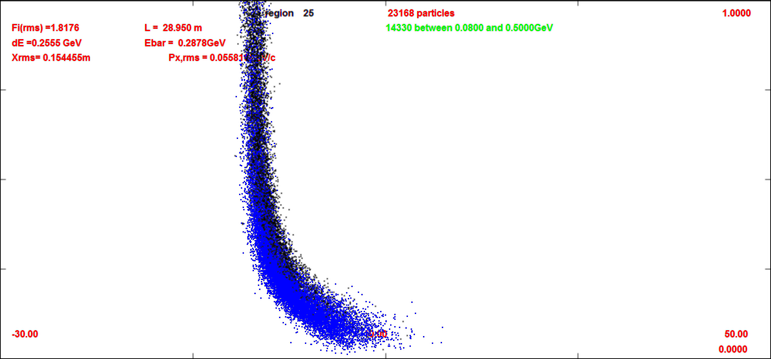
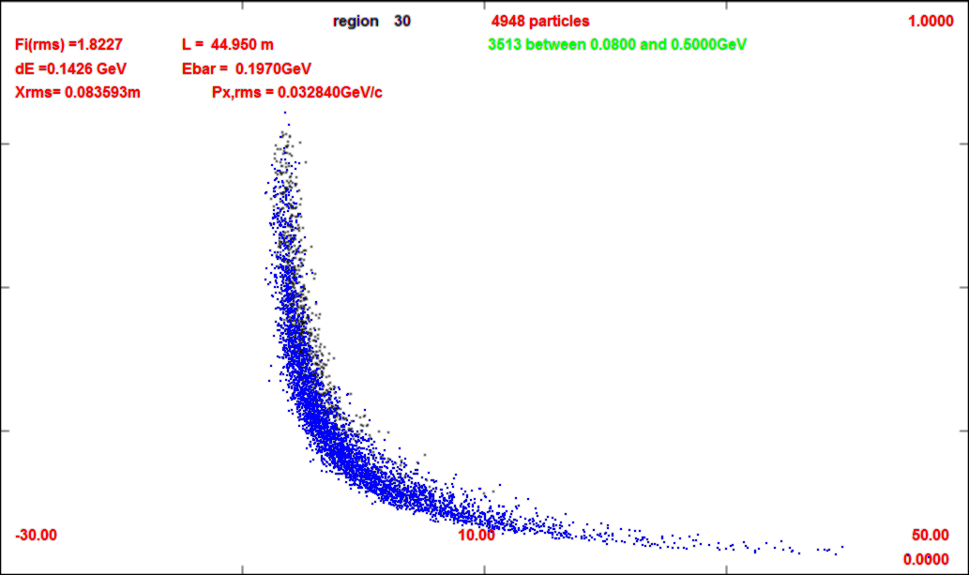
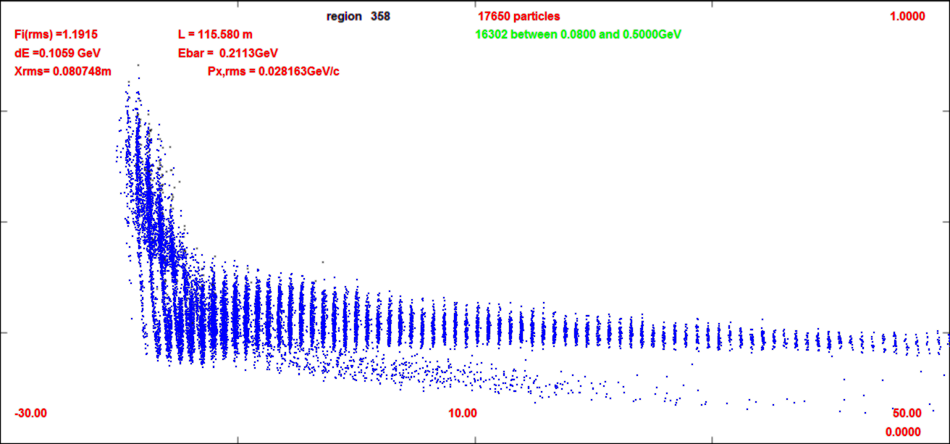
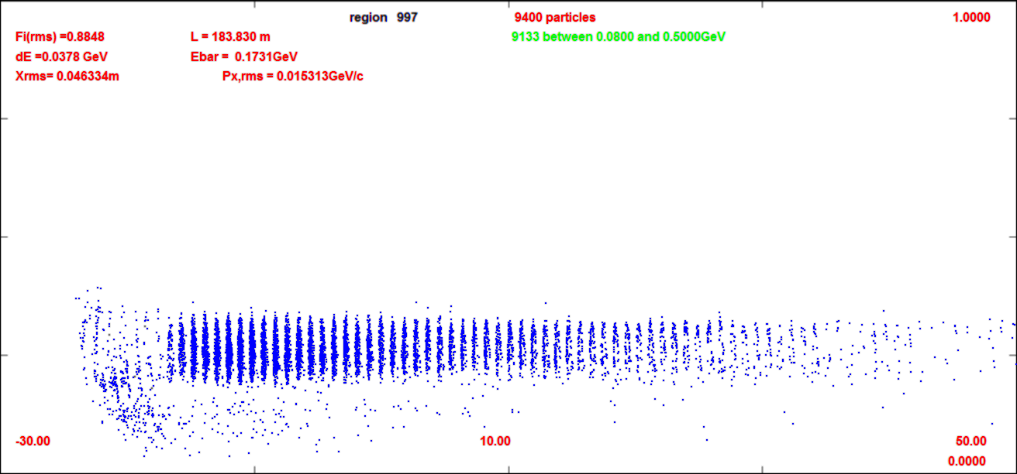
Simulation through chicane + absorber + >>
1.0GeV
29m
0
45m
29m
115m
180m

Slide 19
“Neutrino factory” Chicane
Chicane
p
π →μ
FE Target
Solenoid
Drift
Buncher
Rotator
Cooler
4+10.1 m
0.1 m Be
14.75 m
~64m
~24m
30 m
~80 m
with absorber
    particle 1-284 MeV/c
    particle 2-194 MeV/c
  absorber at 29m
    10cm Be
    particle 1-250 MeV/c
    particle 2-154 MeV/c
  Bunch N=16 0→15 MV/m 468 → 363 MHZ
  Rotate N=16.05 17 MV/m 362→ 326 MHz
  Cool -325MHz
    p_{ref}=245 MeV/c

Slide 20
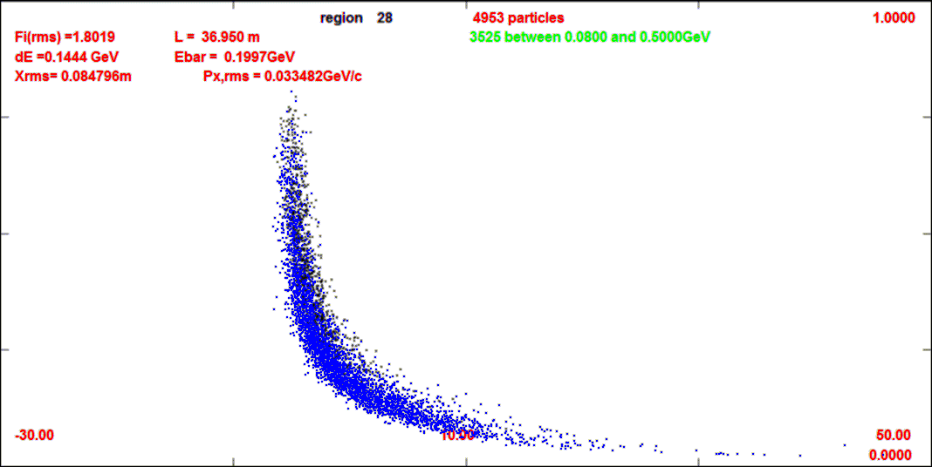
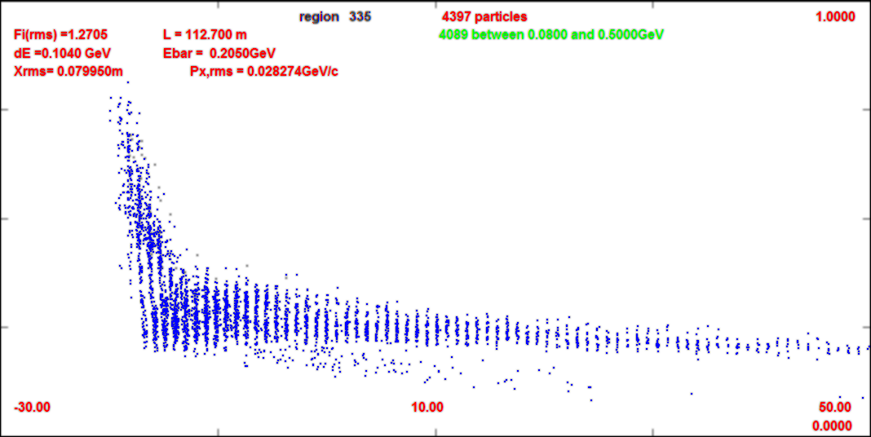
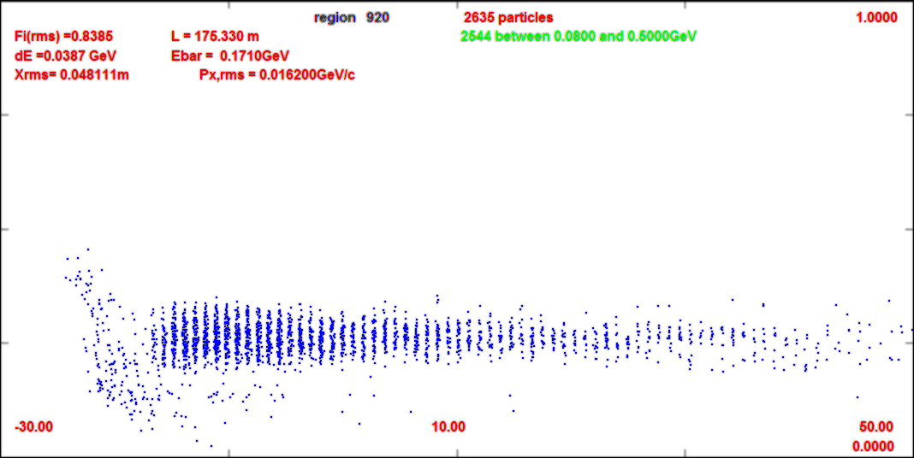
Compare 325 w chicane vs 200
This compares 325 to 200 chicane (BSOL) + absorber
1.0 GeV/c
z=37m
z=38m
0
z=113m
z=137m
z=175m
z=255m

Slide 21
Chicane performance
~Muon Collider version
  ~0.13 → 0.105 μ/p
    more loss than 200 MHz case
  Not as good in removing beam as previous 200 MHz example
    need longer or stronger chicane ?
~Neutrino Factory version
  ~0.12 → 0.10 μ/p
    a bit worse than 200 MHz case
But …
  ecalc9 transverse emittance smaller
    ~0.0062 → 0.0056
  longitudinal emittance much smaller
    ~0.036 → 0.027

Slide 22
Optimum Chicane ???
How to change parameters toward optimum ??

Slide 23
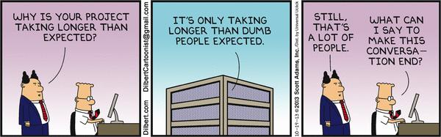
Current Status

