Slide 1
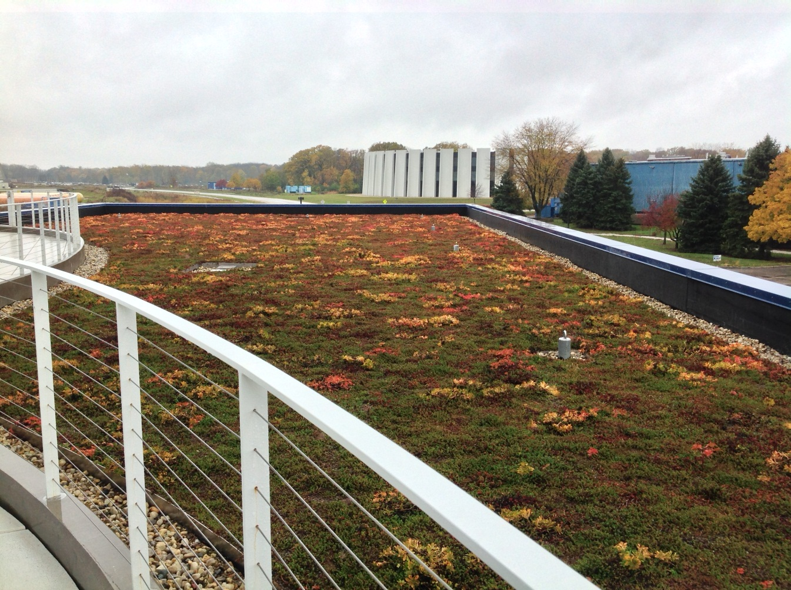
OTE Building PMG Report November 11, 2013
Rhonda Merchut

Slide 2
Agenda
OTE Project:
Coordination
Outfitting
IGPP
CDF
Building Construction Status
State Activities
Schedule
Fiscal
Summary Action Items

Slide 3
OTE Outfitting GPP G13-211
FY 13: $2M for VoIP/networking & Contingency.
Continuing layout studies.
Development of reoccurring module to maximize tenant flexibility & growth.
Evaluating private office/intellectual property integration impact on building utility systems & LEED credits.
Re-balancing of building mechanical system will be req’d.
Relocation & add’l light fixtures & sprinklers will be req’d
LEED daylighting & views credits are challenging
Working with vendors to develop details & pricing for Office of IARC concept

Slide 4
Tenant Module
6-8 private offices, various sizes
4 cubes
2 four-person offices

Slide 5
OTE Outfitting GPP G13-211
Evaluating Johnson Controls proposal for building security.
Planning for future key card needs
Networking/VoIP planning underway.
Moving ahead with permanent connection for Metasys to monitor building systems.
Network & VoIP throughout after substantial completion of OTE Building Construction.

Slide 6
IASU Update (IGPP)
OTE Construction Project Phase 2 scope approximately 85% complete.
Add’l scope added for Road B & Road D paving & gas shed removal.
All work must be fully costed Dec-13

Slide 7
CDF Coordination
Temporary power disconnect will require shut-down of one CDF panel. (Tentative 11/20/13)

Slide 8
OTE Project Status:
Construction Coordination
Pre-punchlist documentation & coordination
Safety oversight continues
RFI’s continue.
Schedule Oversight on-going.
Contractor has targeted 11/20/13 Substantial Completion.
Contractual Substantial Completion 12/09/13.
Financial Oversight on-going.
Change orders continue
Retention reduced to 5% ($900K remains)

Slide 9
OTE Project Status:
LEED
Contractor reporting 97% construction waste has been diverted from landfill.
On track to meet goal of 20% (by cost) of regionally manufactured materials (~37%).
On track to meet goal of 20% (by cost) of recycled content in materials used (~50%).
Commissioning activities well underway. Functional Testing started 11/6/13.
LEED Gold still remains viable.

Slide 10
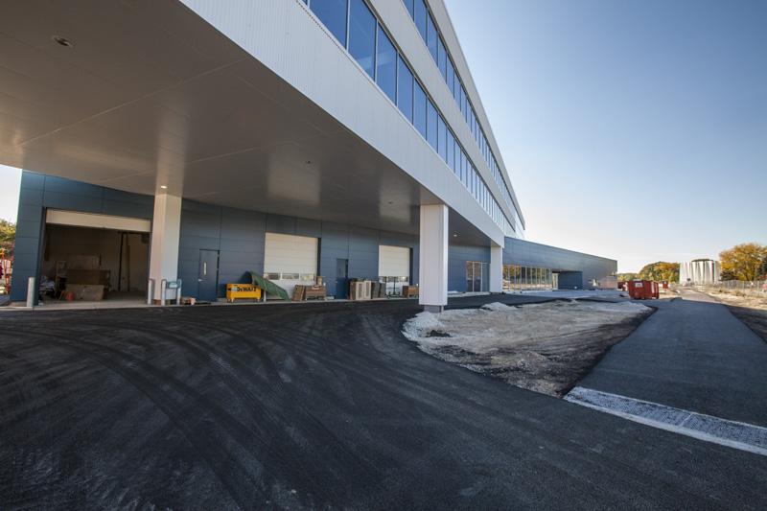

Slide 11
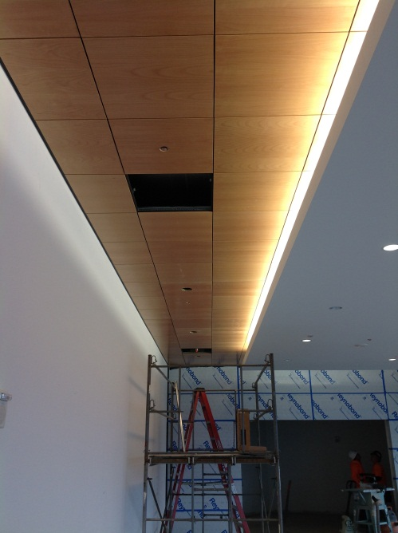
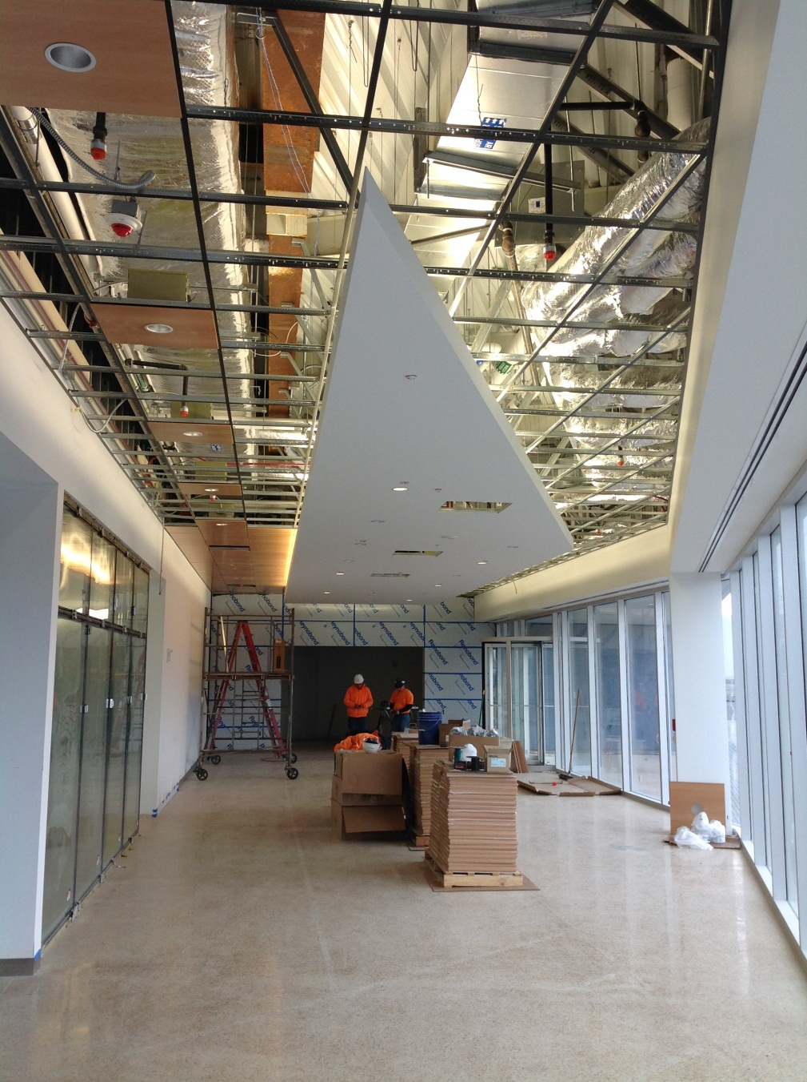
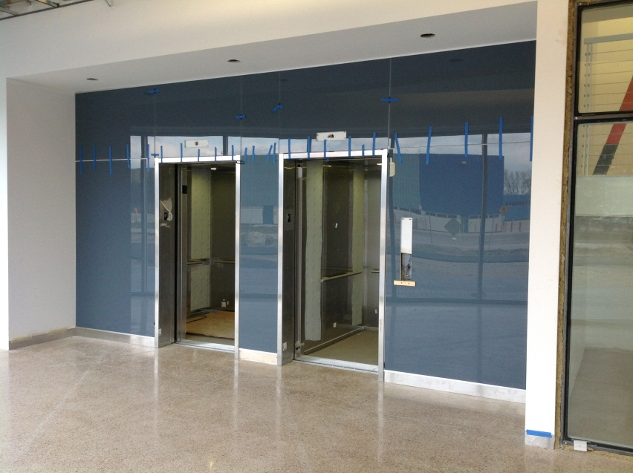
West Lobby

Slide 12
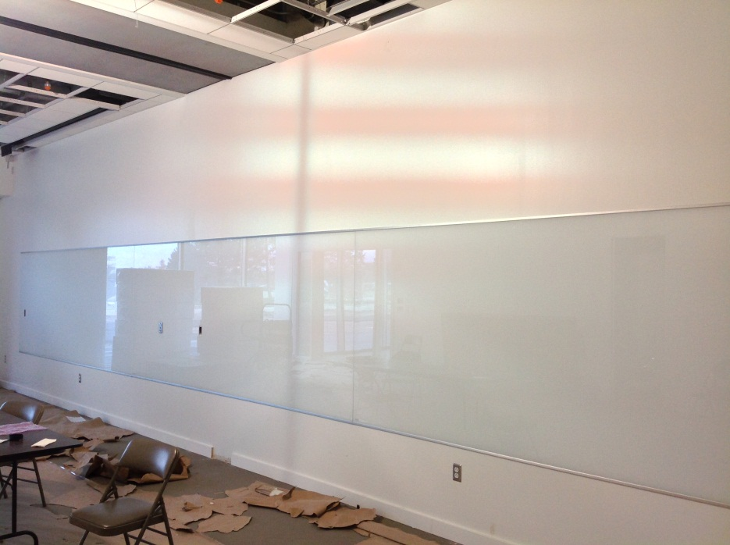
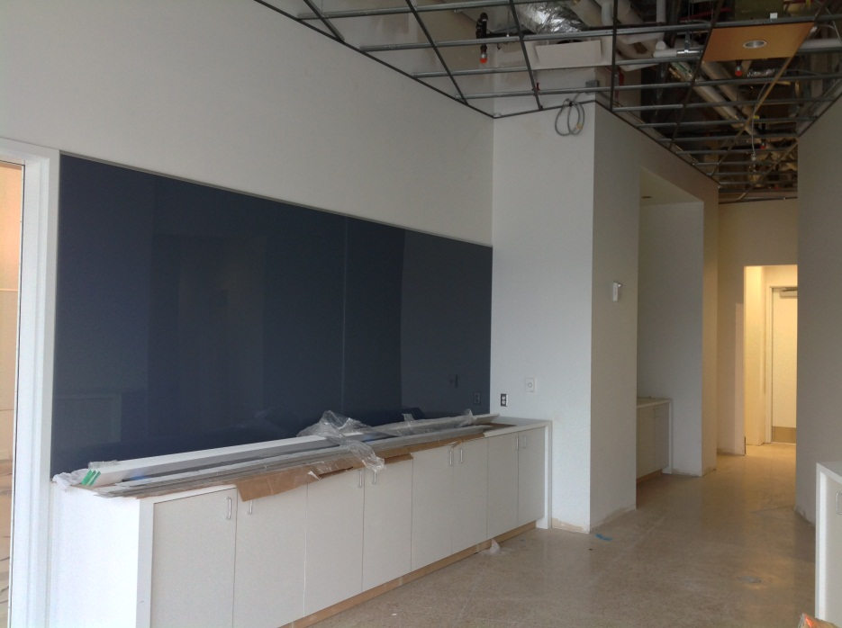
Interior Finish Work

Slide 13
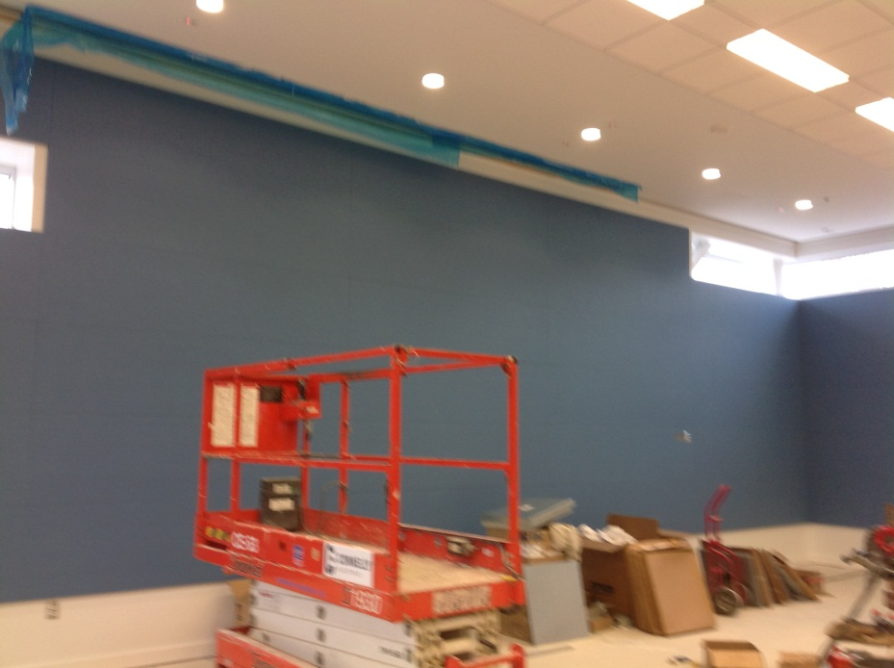
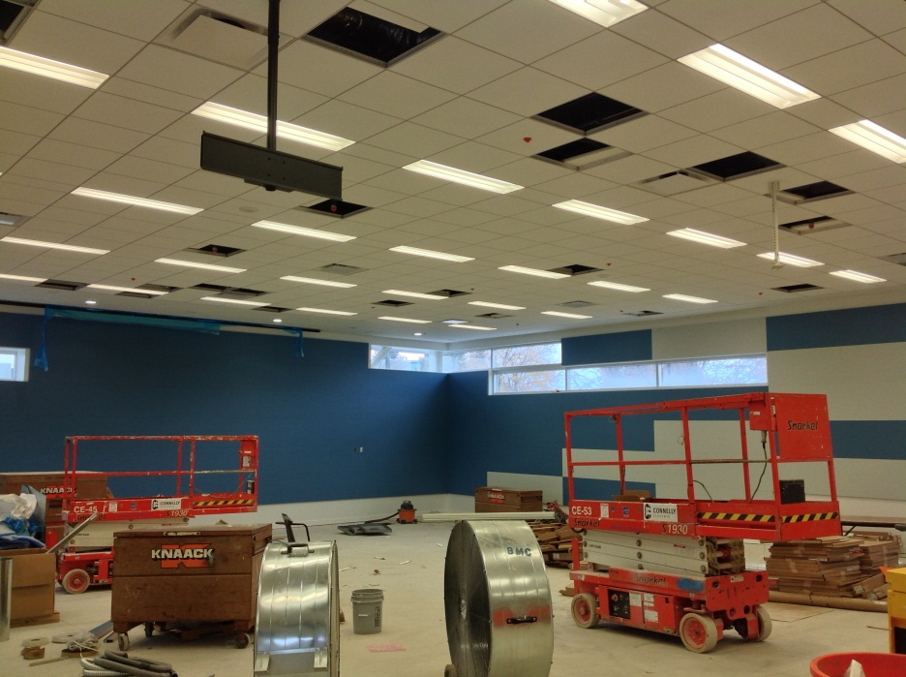
Lecture Hall

Slide 14
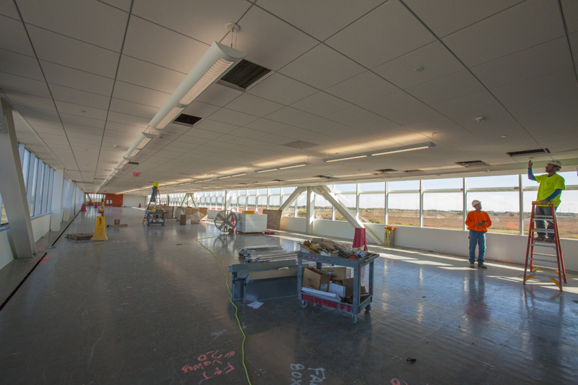
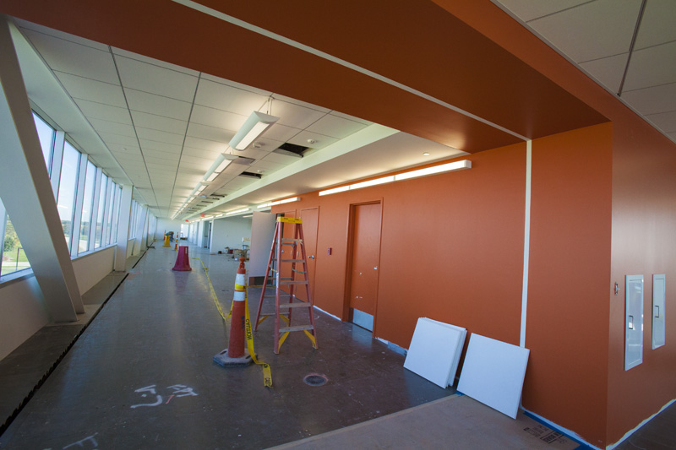
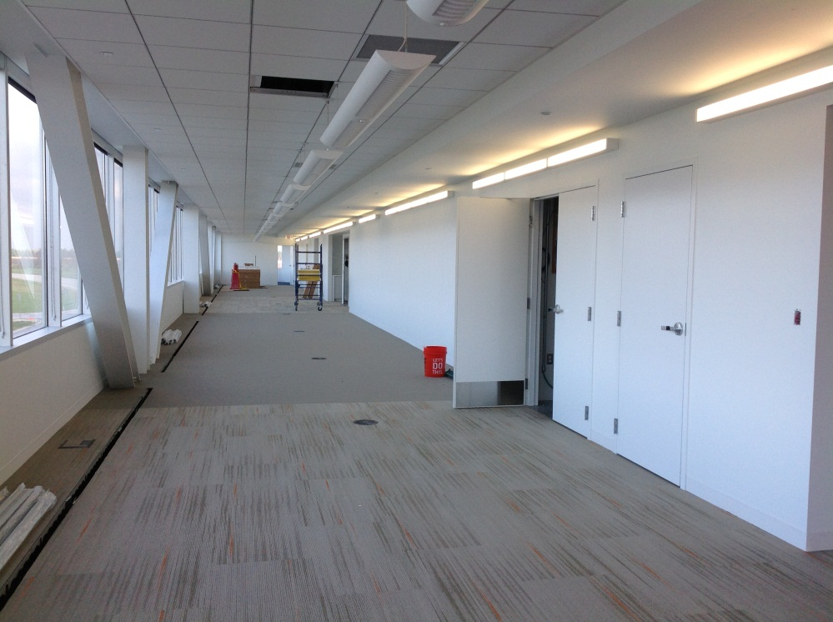
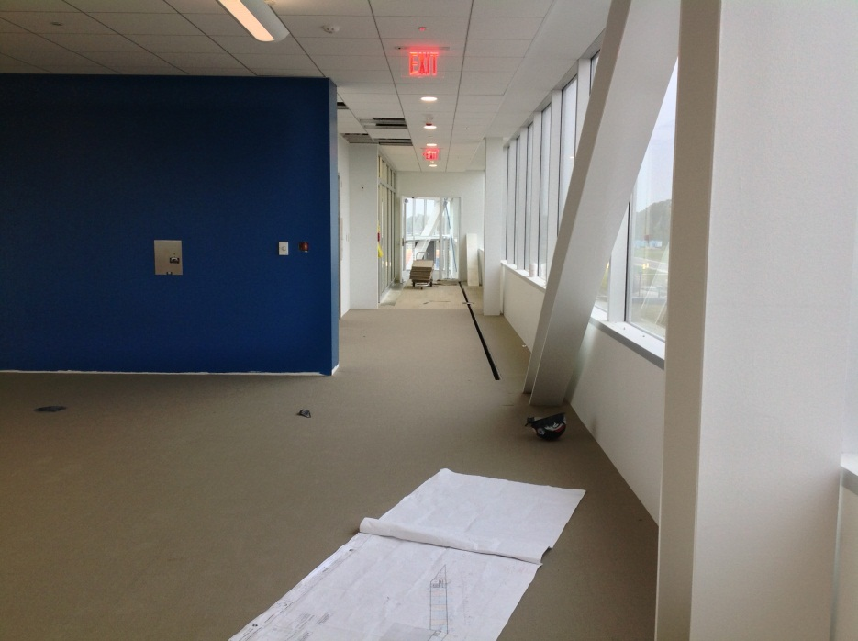
Interior Finish Work

Slide 15
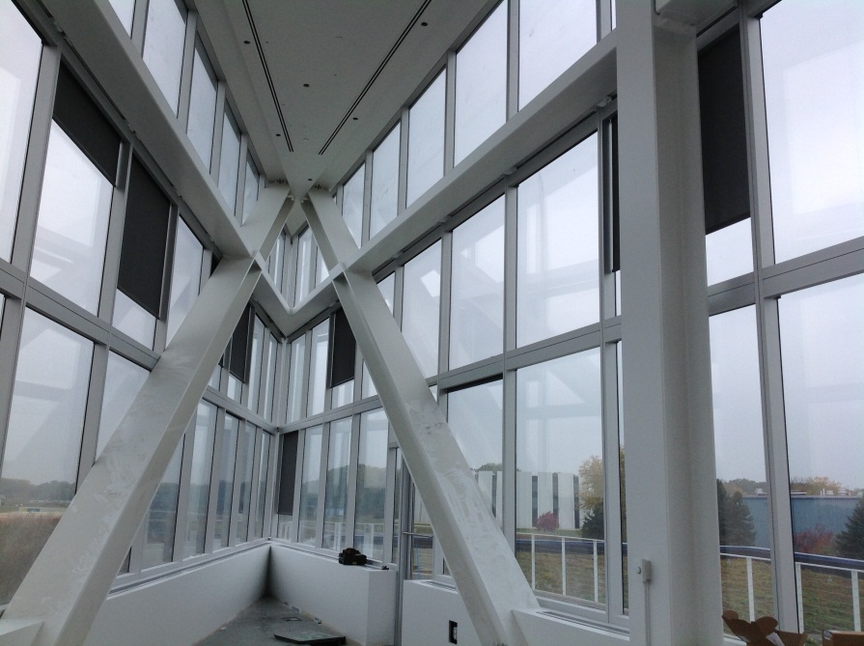
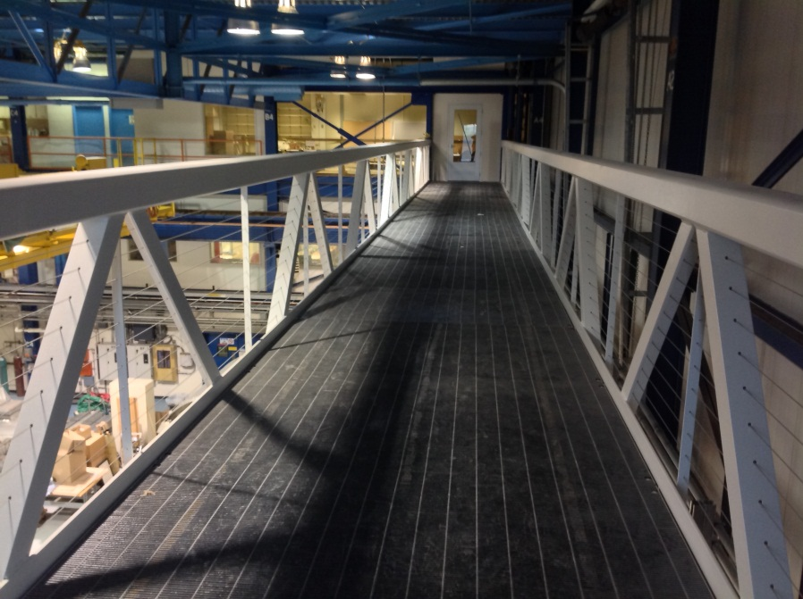

Slide 16
State DCEO Activities
DCEO quarterly report to State for quarter ending 11/30/13 to be submitted by 12/31/13.
Anticipate reporting 99% costed to date.
Project on schedule for grants to be 100% costed by 5/31/14 grant requirement.

Slide 17
Contractual Schedule Adjustments
Schedule Adjustments per SA 27:
MS 1 Bldg Shell Complete: 6/19/13
MS 2 Substantial Completion: 12/9/13
(Project is fully costed at MS 2, retention remains)
MS 3, Project Complete: 3/4/14
Anticipated Schedule Adjustment per SA 29:
MS 2 Substantial Completion: 12/27/13
MS 3, Project Complete: 3/21/14

Slide 18
Oct 2013 BMC Schedule

Slide 19
Oct 2013 BMC Schedule

Slide 20
Oct 2013 BMC Schedule
Anticipated change to Dec 27, 2013
Anticipated change to March 21, 2014

Slide 21
OTE Construction Status:
20-30 workers daily
Major categories of work complete subject to final detailing:
Exterior
East Side grading, paving,
Native planting beds
Base flashing, detailing
Interior
1st floor final finishes
Mech start-up & testing (underway)
Fire Rated Glazing at 1st floor stairs
Millwork & wood panels & doors (underway)
Hand/guardrail detailing
Miscellaneous detailing throughout

Slide 22
Project Plan Tracking Milestones
Project is fully costed at MS 2, retention remains

Slide 23
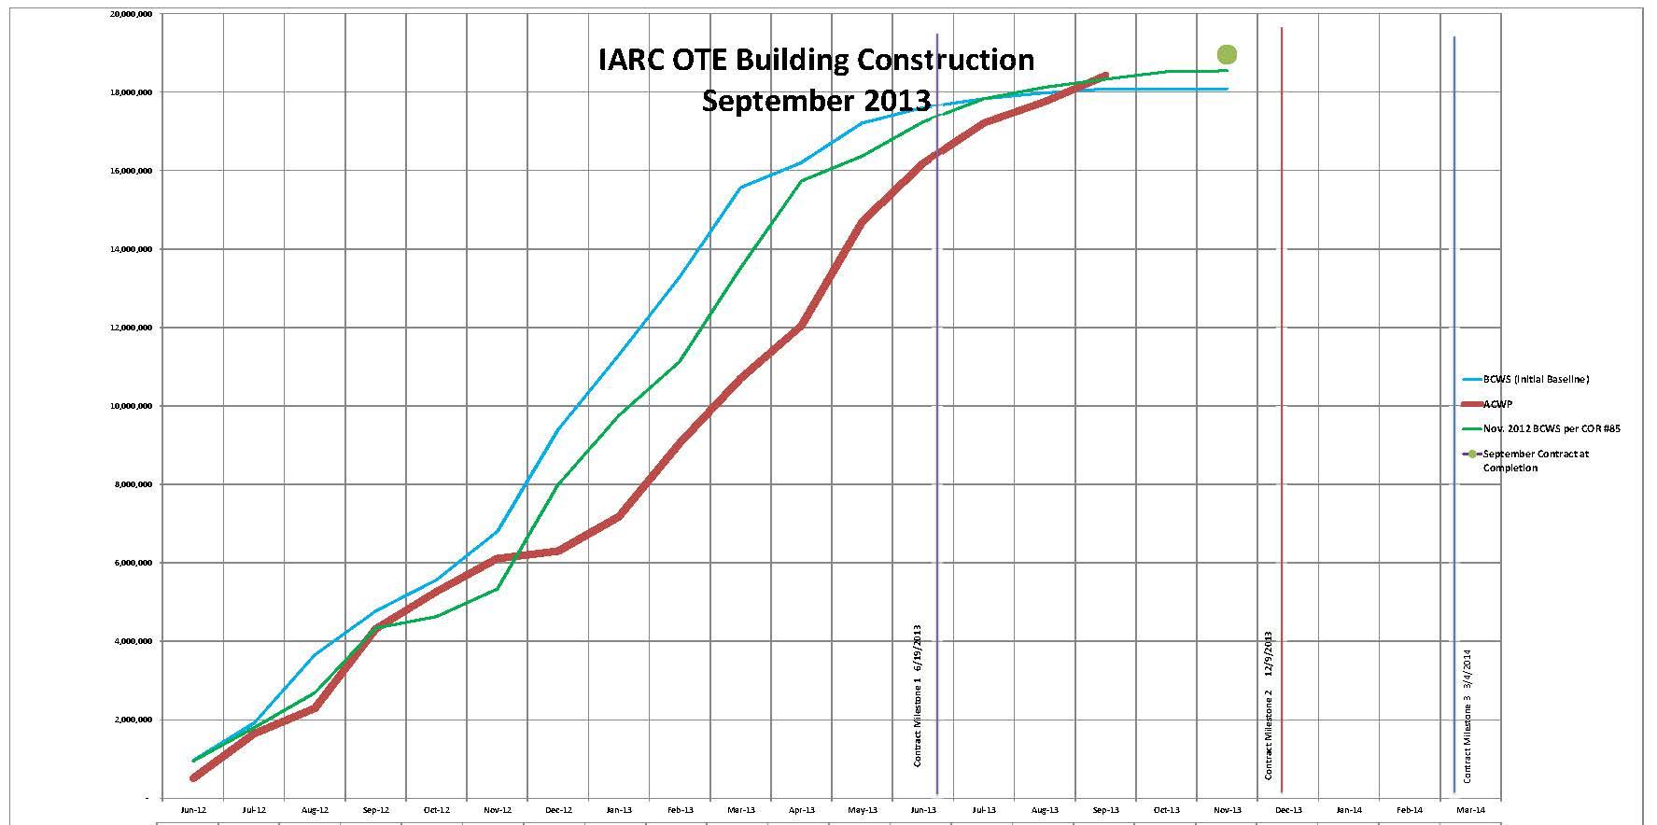
BMC Construction BCWS & ACWP
Based on 9/20/13 Update:
97% Complete based on cost
91% Complete based on time

Slide 24
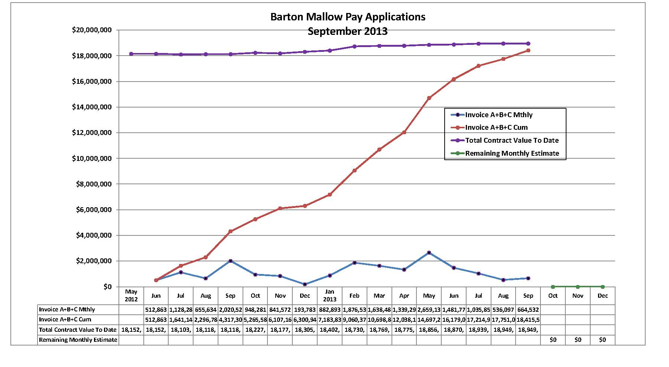
BMC Monthly Costing
Monthly Average to date: $1,184,363
Required Monthly Average to complete: $270,000 (MS2: 11/5/2013)

Slide 25
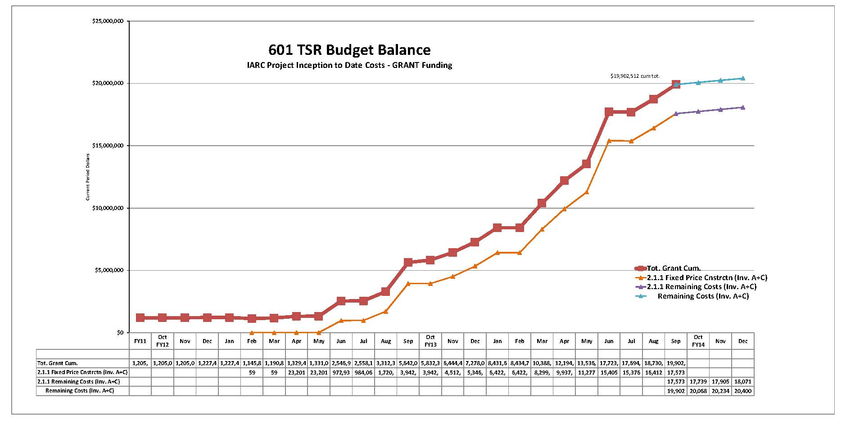
601 TSR Budget Balance
ALL Grant Costing w/ BMC Projection

Slide 26
Financial

Slide 27
Financial – Estimated at Completion 601 + G13221 Funding

Slide 28
Financial – Available Contingency 601 + G13221 Funding
c

Slide 29
Supplemental Agreements by Funding
28 SA’s for 200+ EC’s (change orders) = $19.3M Total Construction Contract

Slide 30
Contingency Management
Sources available to fund change orders:
IGPP;
DOE backstop (GPP Outfitting project);

Slide 31
Summary Action Items
Building Construction:
shop drawing & change order review, RFI responses
construction coordination & oversight.
Safety & SWPPP
Punch List
Commissioning
LEED Documentation – receive BMC final doc’s, upload to USGBC
schedule oversight
financial oversight
Landline phones
Programing & Space Layouts
Finalize typical office layouts
Identify Scope Contingency Items
Finalize Office of IARC
Details
Utility Impact
Design document development
Costs
VoIP, networking
Space Layouts needed
Security
Finalize requirements
Procure
IGPP
Finalize

