Slide 1
MAP Friday Meeting: Systems Demonstrations
Dan Kaplan
IIT
Nov. 15, 2013

Slide 2
Outline
Summary of SD Activities
L2 Summary reports
Topical Report
Summary of MICE CM37, Dan Kaplan, IIT, et al.

Slide 3
Systems Demonstrations: Current Activities
MICE:
(Spectrometer Solenoid 2 – delivered, 1 – cooldown)
Software development (on- and off-line)
Controls & Monitoring development
Data analysis and paper preparation (Step I Emitt. paper published, PID paper in prep)
Planning for MICE NSF proposal
Briefing at NSF HQ Tuesday
6DICE:
Simulate emittance exchange study in MICE (dormant for now)
Define requirements for 6D cooling bench test
Evaluate muon sources for 6D cooling demonstration (nuSTORM, Milorad’s AP0 idea)
Identify venues for collective-effects studies
Design matching section and detectors for 6D ICE

Slide 4
15 November 2013
04 01 – MICE
SS2 delivered to RAL R9
FC2 in cooldown
C&M Integration Plan document & Integrated QPS document
TIARA installation (including UMiss RF gear)
SW: Kalman track reconstruction now available
CAD-based beamline geometry under test
Batch reconstruction: reconstructed all data on the grid
Project plan with detailed task breakdown being developed
EMR run successfully completed, took data for 4 “weekends”
completes MICE Step I
QP for FC tested
FC1 training suspended
SS1 HTS lead failures
TIARA installation
“Emittance” paper published
Complete SS1 training & mapping
Complete FC2 training & mapping
Complete TIARA tests
Get geometry into CDB
Complete PRY design, review, and procure
DS repair and QP commissioning
Integrate EMR reconstruction with MAUS
Ckov analysis and simulation
Complete C&M Integration Plan document
Complete Integrated QPS document
C&M tasks: HV, PA, UPSMon
TIARA test – goal: power by Dec 20
Repair Decay Solenoid leads
Train SS1
Install tracker in SS2

Slide 5
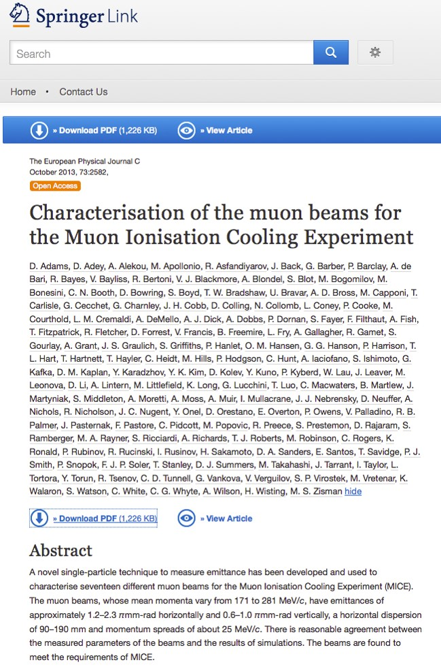

Slide 6
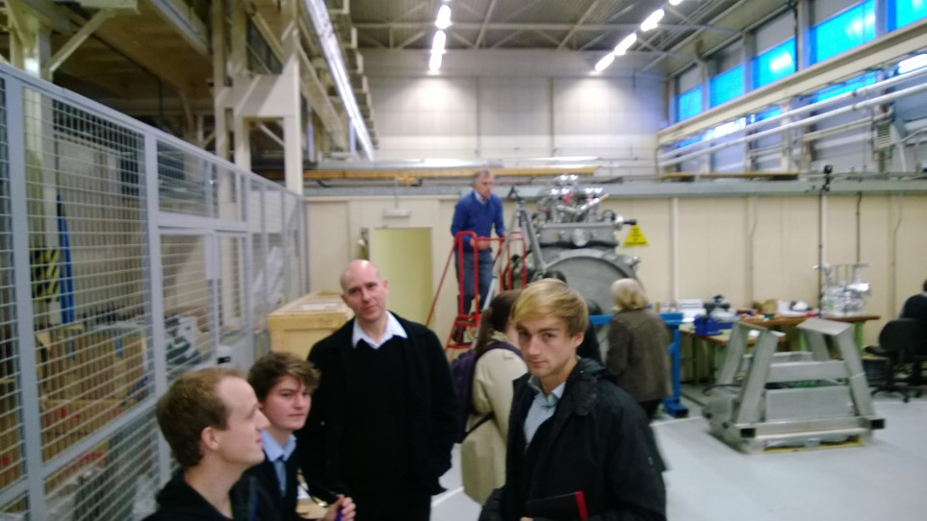
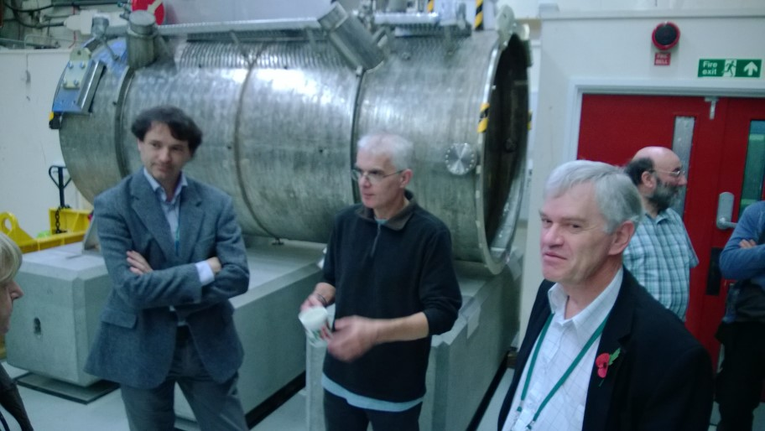

Slide 7
15 November 2013
04.02 – 6D Cooling Demonstration
Pavel Snopok
Feasibility Phase I through FY15:
Development of a plan for a MAP 6D cooling bench test.
Close coordination with D&S and TD activities.
Development of a suite of experimental options.
Report during FY15.
Milorad presented his idea on how to get a muon beam at AP0 with minimal disruption to the g-2 program providing 10⁸ muons/s with momentum centered at 300 MeV/c
6D ICE design discussion is ongoing
Continue exploring muon/proton beam options
Have a first draft detector design and simulation running based on the nuSTORM beam
Continue matching section and detector design/simulation work

