Slide 1
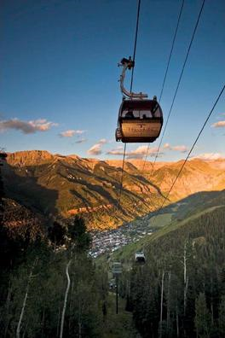
Art 4 CaTS
Muon Collider simulation status and plans
Hans Wenzel
November 21st 2013
Hans Wenzel
November 21st 2013
Hans Wenzel
Fermilab
Feb. 22nd 2012

Slide 2
Outline
Motivation
art/artg4
The gdml detector description language and extensions thereof
Flow control (fcl file)
How is the data stored and how do we access it.
Plan
Acknowledgement

Slide 3
Charge
Extension of geant 4 validation effort but geared specifically towards the needs of the intensity frontier community.
develop an ART based package for monitoring of all identified physics plots relevant to intensity frontier experiments at the model and physics list level.
port elements of Julia’s (stand alone) tests to ART and in addition integrate both EM and HAD plots into this package.
explore the possibility to use the G4-ART interface.
Develop tools to facilitate tests and customization of physics lists.
The plots to monitor in this package will be associated with individual models (compared with thin target experiments aka first interaction) or physics lists, as well as with quantities to be validated with results from test beam and real experiments.
For more complex validation, simplified geometry may be used or real configurations from the experiments could be imported to this ART application.

Slide 4
Motivation
Fast prototyping → make working with geant4 easy without obstructing its functionality.
Avoid specialized application, changes to the detector don’t require compilation → modular system.
Don’t reinvent the wheel (artG4, noνa, LArSoft have solutions so art and Geant4 play together ), CaTS provides example of modular system. GDML is a language to describe geometries….
Make use of the components of CaTS → allow calorimeter R&D and other detector R&D projects to migrate to the new system.
Grid: does relocate able UPS make life easier?
Easier packaging, installation?
Develop art expertise
make use of software developed for art?

Slide 5
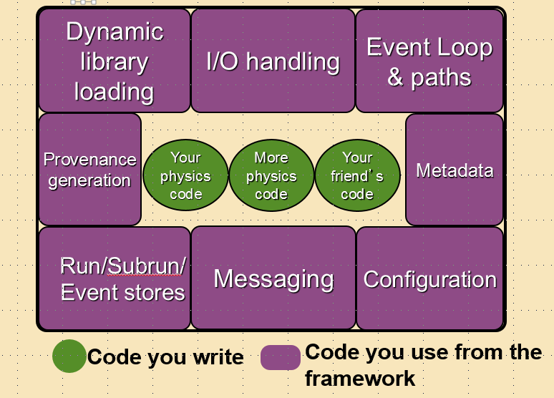
What does art do?
A “lite” forked version of the CMS framework
Supplies all expected framework services as well as links between data objects (Ptr’s and Assn’s)
Used by many Fermilab Intensity Frontier Experiments: (NOvA, g-2, Mu2e, MicroBoone,LBNE) and some others (e.g. DS50)
Written by SCD/CET department
Currently being adapted for multi-processing and DAQ

Slide 8
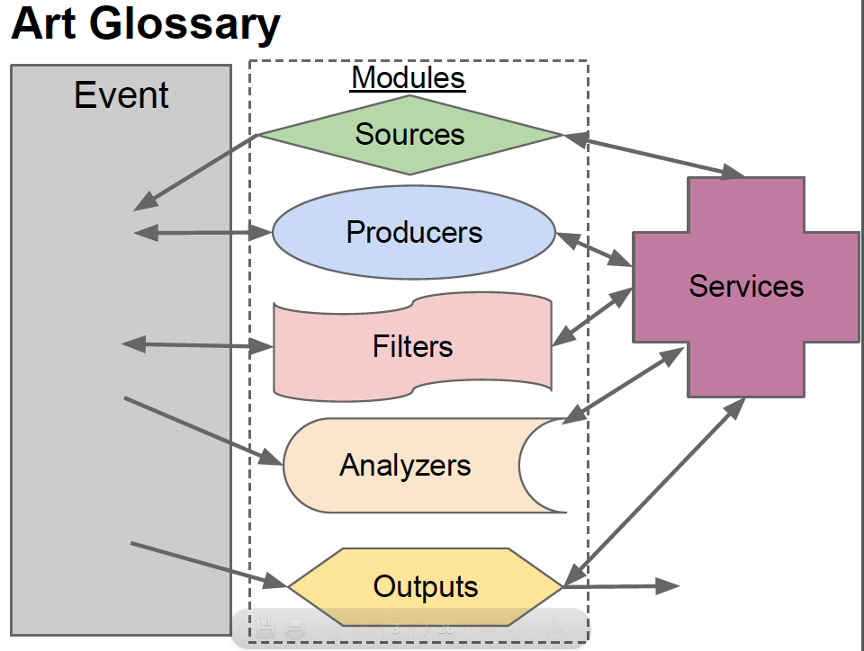

Slide 9
artg4
One producer that handles Geant: ArtG4Main
To make it generic, ArtG4Main delegates lots of responsibilities to
SERVICES that are ONLY used by ArtG4Main.
The configuration files says what Services to load
GDML_Detector_Service
(creates the World and SD’s)
MyEventAction
ArtG4Main
Producer
SteppingAction
MyPhysicsList

Slide 10
Modular system:
build detector from predefined components
μ
BeamDump
BaseArtHit
EM
Hadronic
ArtTrackerHits ArtPhotonHits ArtCalorimeterHits …
Tracker
Particle ID
Cerenkov Radiator
PhotonSD
produces ArtPhotonHits
CalorimeterSD
produces ArtCalorimeterHits
TrackerSD
produces ArtTrackerHits
StoppingCalorimeterSD
Pro. ArtCalorimeterHit

Slide 11
GDML
Gdml developed to completely describe geometries, matched to the
corresponding geant 4 C++ classes.
Supported by geant 4 collaboration.
Easily extendable to include e.g. sensitive detectors (done),
visualization attributes (available), segmentation (not done).
Several browsers exist that allow to visualize (debug) the Geometry.
Converters available to change into different formats.
clear separation of detector description (gdml) and run time configuration
Sensitive Detector:
Knows how to create Hits and how to add hitlist to the event.
Is attached to a logical volume
( as specified in gdml file)
To retain provenance gdml file is stored in run record.
But: no scheme for segmentation/readout geometry (needed?)

Slide 12
Gdml file (1: schema and definitions)
<?xml version="1.0" encoding="UTF-8" ?>
<gdml xmlns:xsi="http://www.w3.org/2001 XMLSchema-instance"
xsi:noNamespaceSchemaLocation=
"http://service-spi.web.cern.ch/service-spi/app/releases/GDML/schema/gdml.xsd">
<define>
<variable name="i" value="0"/>
<variable name="j" value="0"/>
<variable name="k" value="0"/>
<constant name="numlay" value="2"/>
<constant name="numcol" value="2"/>
<constant name="numrow" value="2"/>
<constant name="scalex" value="300"/>
<constant name="scaley" value="300"/>
<constant name="scalez" value="5"/>
<constant name="absoffsetz" value="-0.5"/>
<constant name="szoffsetz" value="2.0"/>
</define>

Slide 13
gdml file (2: materials)
<materials>
<element name="Oxygen" formula="O" Z="8."> <atom value="16.0"/> </element>
<element name="Nitrogen" formula="N" Z="7."> <atom value="14.01"/> </element>
<element name="Lead" formula="Pb" Z="82."> <atom value="207.20"/> </element>
<element name="Carbon" formula="C" Z="6."> <atom value="12.01" unit="g/mole"/> </element>
<element name="Hydrogen" formula="H" Z="1."> <atom value="1.01" unit="g/mole"/> </element>
<material name="Air">
<D value="1.290" unit="mg/cm3"/>
<fraction n="0.7" ref="Nitrogen"/>
<fraction n="0.3" ref="Oxygen"/>
</material>
<material name="Scintillator">
<D value="1.032" unit="g/cm3"/>
<composite n="9" ref="Carbon"/>
<composite n="10" ref="Hydrogen"/>
</material>
<material name="metalPb">
<D value="11.340" unit="g/cm3"/>
<composite n="1" ref="Lead"/>
</material>
</materials>

Slide 14
Gdml(3: solids, logical volumes)
<solids>
<box name="WorldBox" lunit="mm" x="5000" y="5000" z="5000"/>
<box name="CalorimeterCell" lunit="mm" x="300" y="300" z="4"/>
<box name="ScintillatorCell" lunit="mm" x="300" y="300" z="1"/>
</solids>

Slide 15
Gdml (4: placing the physical Volumes)
<structure>
<volume name="CaloVol">
<materialref ref="metalPb"/>
<solidref ref="CalorimeterCell"/>
<auxiliary auxtype="SensDet" auxvalue="Calorimeter"/>
</volume>
<volume name="ScintVol">
<materialref ref="Scintillator"/>
<solidref ref="ScintillatorCell"/>
<auxiliary auxtype="SensDet" auxvalue="Calorimeter"/>
</volume>
<volume name="TOP">
<materialref ref="Air"/>
<solidref ref="WorldBox"/>
<loop for="i" from="0" to="numrow" step="1">
<loop for="j" from="0" to="numcol" step="1">
<loop for="k" from="0" to="numlay" step="1">
<physvol>
<volumeref ref="CaloVol"/>
<position name="posijk" x="scalex*(i-numrow/2)" y="scaley*(j-numcol/2)" z="absoffsetz+scalez*(k-numlay/2)"/>
</physvol>
<physvol>
<volumeref ref="ScintVol"/>
<position name="posijk2" x="scalex*(i-numrow/2)" y="scaley*(j-numcol/2)" z="szoffsetz+scalez*(k-numlay/2)"/>
</physvol>
</loop>
</loop>
</loop>
</volume>
</structure>

Slide 16
Gdml (5: define the world)
<setup version="1.0" name="Default">
<world ref="TOP"/>
</setup>
</gdml>

Slide 17
process_name:processA
source: {
module_type: EmptyEvent
maxEvents: 100
}
services: {
message : {
debugModules : ["*"]
suppressInfo : []
destinations : {
LogToConsole : {
type : "cout"
threshold : "DEBUG"
categories : {
default : { limit : 50 }
}
}
}
}

Slide 18
TFileService :
{
fileName : "CheckHits.root"
}
user: {
DetectorHolder: {}
ActionHolder: {}
RandomNumberGenerator: {}
PhysicsListHolder: {}
PhysicsList: {
PhysicsListName: "FTFP_BERT"
DumpList: false
enableCerenkov: false
enableScintillation: false
enableAbsorption: false
enableRayleigh: false
enableMieHG: false
enableBoundary: false
enableWLS: false
}

Slide 19
// Detector(s) for the simulation
GDMLDetector :
{
category: "world"
gdmlFileName_ : "tiledsamplingcal4mmpb1mmSz.gdml"
}
// Action(s) for the simulation
ClockAction: {}
ExampleGeneralAction: {
name: "exampleGeneral"
}
ExampleParticleGunAction: {
name: "exampleParticleGun"
use_HEP_event: true
}
}
}// end of services!!!

Slide 20
outputs: {
out1: {
module_type: RootOutput
fileName: "exampleTestingout.root"
}
}
physics: {
producers: {
artg4Main: {
module_type: artg4Main
enableVisualization: false
macroPath: ".:./macros"
visMacro: "vis.mac"
//afterEvent: pause
}
}
analyzers: {
CheckHits: { module_type: CheckHits
hist_dir: "HistoDir"}
}

Slide 21
path1: [ artg4Main ]
stream1: [ out1, CheckHits ]
trigger_paths: [ path1 ]
end_paths: [ stream1 ]
}

Slide 22
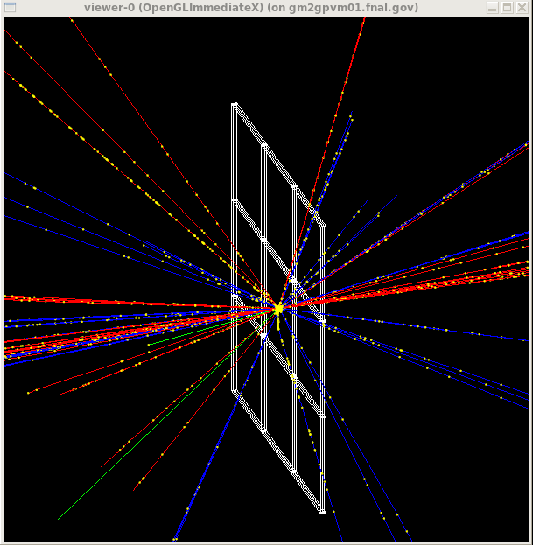
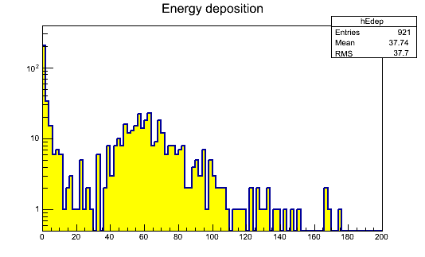
Example tiled PB/scintillator calorimeter
No visual Attributes?
4mm x 30cm x 30 cm Pb,
1mm x 30cm x 30 cm Sz
Pb Absorbers
Szintillator

Slide 23
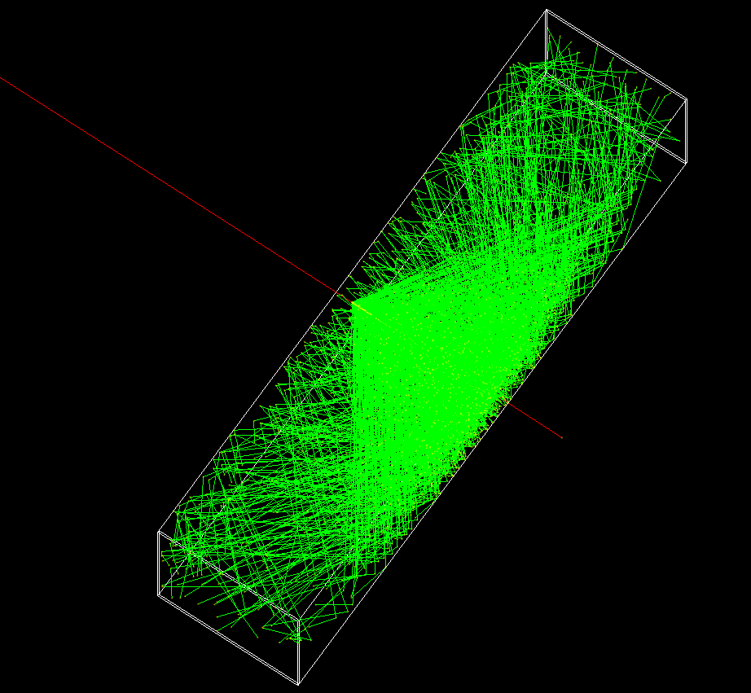
Example PbF2 Crystal
Cosmic ray Muon (red)
producing Cerenkov radiation
in PbF2 Crystal. Photons are
read out at the narrow end of
the Crystal

Slide 24
Components
Detector Description: | GDML_Detector_service used to build G4 geometry and SD. Xml based gdml input file, with extensions for SD’s and visual attributes (e.g. crystalcal.gdml) (Geometry, Materials, optical properties, sensitive detector), we provide working examples, no recompilation necessary. Added mechanism to add gdml file to the run record to retain provenance.
Persistency | Provided by art, uses Root reflexion (gccxml) to automatically, create dictionaries for all classes we want to write out (e.g. Hits)
Input modules: | GPS, Particle Gun, HEPMC (Pythia)
Physics Lists: | choice of all Reference Physics Lists which can be extended to include optical physics processes (Cerenkov, Rayleigh, Scintillation etc.) → make more modular, add numi-beamline (Julia)
Sensitive Detectors and Hits: | TrackerSD, CalorimeterSD, DRCalorimeterSD (also registers Cerenkov photons), DRTSCalorimeterSD (DR+time slices), StoppingCalorimeterSD, PhotonSD: sensitive detector that registers optical photons.
User Actions: | Art Service: examples of user actions (EventAction, RunAction, StackingAction,SteppingAction...) will be provided
Code repository, Redmine project & Instructions: | Use artg4/artg4examples git repository/redmine project.
Histogram manager | Art analyzer, examples provided for various SD.

Slide 25
How to store retrieve the data
BaseArtHit
ArtTrackerHits ArtPhotonHits ArtCalorimeterHits …
Collect all Hit collection in a map:
std::map< std::string, vector<BaseArtHit*> >
String encodes:
Logical Volume that the SD is attached so
Class name of specific Hit class
ArtCalorimeterHit* DRHit = dynamic_cast<ArtCalorimeterHit*> (hits[ii]);

Slide 26
Plan
Clean up code and put int artg4/artg4example git repository→ code
available for others
Document netbeans (IDE) configuraton
Import all SD/Hits classes from Cats. Make sure we can do detector R&D
Implement a geant 4 test.
Integrate numi beamline physics list (Julia)
Implement scheme to store/retrieve/analyze the data (Hits)
……

Slide 27
Acknowledgement
Thanks to:
Paul, Marc, Chris, Rob, Krzysztof, Daniel, Adam

Slide 28
backup

Slide 29
Technical
Framework: Art → worked with it in the past
Code Repository: Redmine and Git since this is used by ART and artg4 → requested to create the project (CaTS). artg4: https://cdcvs.fnal.gov/redmine/projects/artg4
Detector description: options gdml e.g. used by noνa/CaTS extension of Geant4., fhicl: used by artg4, custom: used by mu2e
release management: relocatable ups???
build system: cmake (used by Geant 4, CaTS….)
environment setup: custom shell script
development machine: (something with art and artg4 installed) gm2gpvm → got an account still waiting for instructions to set up the environment.
Execution: for now use Geant 4 VO and (limited) grid resources to execute jobs

Slide 30
Technical (cont.)
Display of results: use geant 4 web application and database hosted here at fermilab (just create a new category)
Configuration of physics lists/ processes: → discuss with Robert, look how it’s done in G4

Slide 31
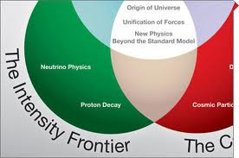
ART based package to
monitor physics relevant to
intensity frontier physics experiments
Muon Collider simulation status and plans
Hans Wenzel
November 21st 2013
Hans Wenzel
Fermilab
Feb. 22nd 2012

Slide 32
CaTS: Calorimeter and Tracker Simulation
CaTS is a flexible and extend-able framework (based on geant4 and ROOT) for the general simulation of calorimeter and tracking detectors.
In the following look at CaTS to:
identify the features that we want,
features that should be replaced by services of Art,
extensions ??

