Slide 1
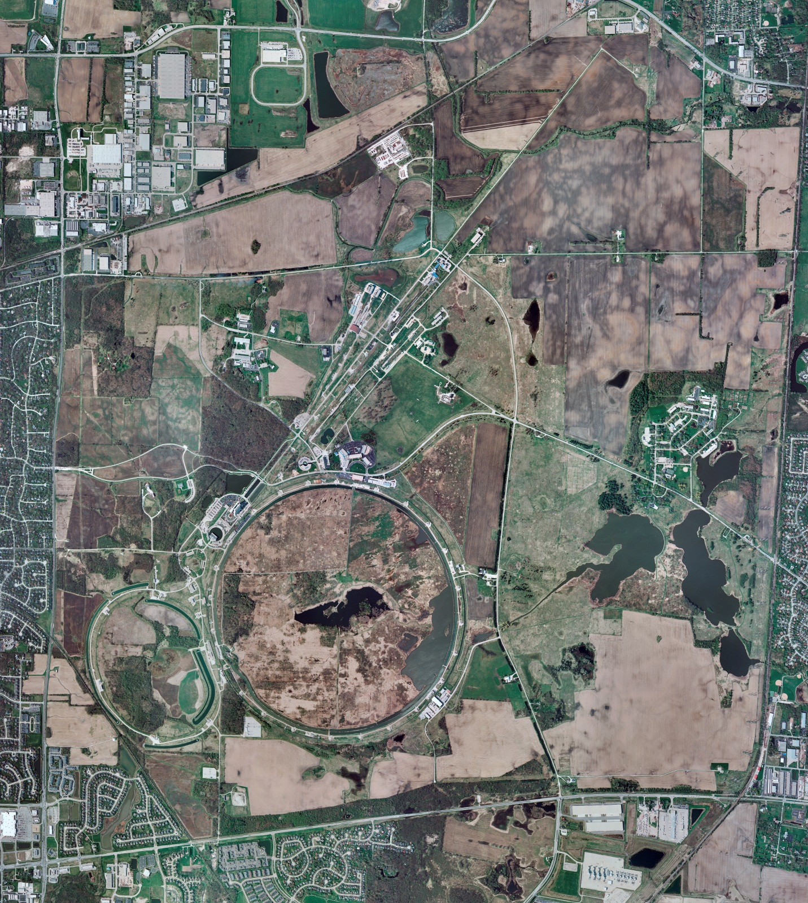
AD/Cryogenics
Status 12/6/2013 J.Makara
CMTF: Linde SCP commissioning continued with testing of CC, WVC, and 3kL Lhe dewar; shut down for several weeks for modifications.
MCTF: Red/Purifier-Comprs online to Brown-FRIG and running fine.
MDB/HTS: at 2K operations.
MDB/STC: 2K upgrade in progress
NML: System ops on Lab-B comprs with N/S-FRIGs online.
CM at 2 K operations.
CC2 at 2 K operations.
CHL: Compr-C/CB-1 shut down; Helium mgmt system (Purifier) online to TF/10kgal Lhe dewar.
MTA: running fine at 4 K.
A0 TEST AREA: South Cave 5-Cell at RT; North Cave vertical test dewar at RT.
Muon Campus: TF (A3 tanks 3&4) and MC subcontracted piping work completed (more TF piping radiography in future; more A0/TF piping pressure tests in future). A0 Compr system retrofit continues; oil removal skid regeneration heating to begin at CMTF.

