Slide 1
Chicane simulation update
Pavel Snopok
Front end phone meeting
December 10, 2013

Slide 2
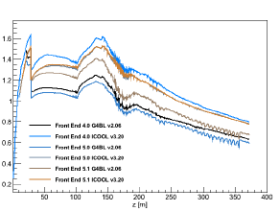
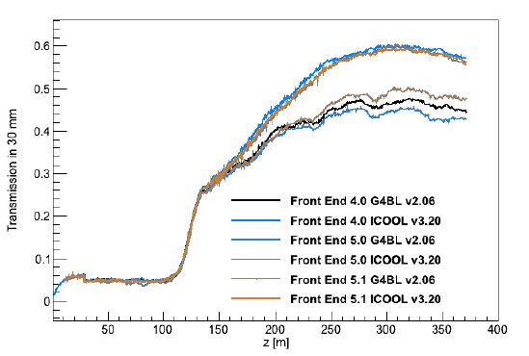
FE simulation discrepancy
It was indicated that there is a discrepancy in the FE simulation results between ICOOL and G4beamline.
It was suggested that the chicane model in ICOOL (two bent solenoids as opposed to the individual coils in G4beamline) is the source of the issue.
It was suggested that the issue is investigated by generating a field map of the chicane in G4beamline and using this map in ICOOL instead of the bent solenoids.

Slide 3
Field map generation
Field map is generated for the chicane only using the G4beamline deck as is (v5.1).
Coordinates of the map are modified accordingly to match the ICOOL region:
z = 19 m => 0,
x = 1.086 m => 0.
This way the only changes in the ICOOL deck are
remove the bent solenoids;
add DVAR command at the downstream end of the map to compensate for the horizontal beam offset.
A word of caution: ICOOL guide suggests max grid size is 501x101x101, while in the code it is 500x100x100, larger numbers generate a subtle error message. Fixed by Scott, but be careful when using the older version of ICOOL.

Slide 4
Field map as imported into ICOOL
As exported from G4beamline
As imported into ICOOL

Slide 5
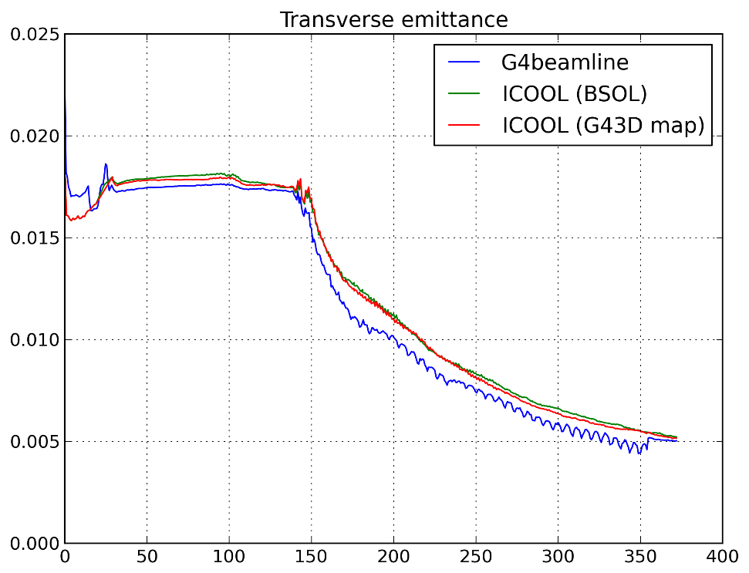
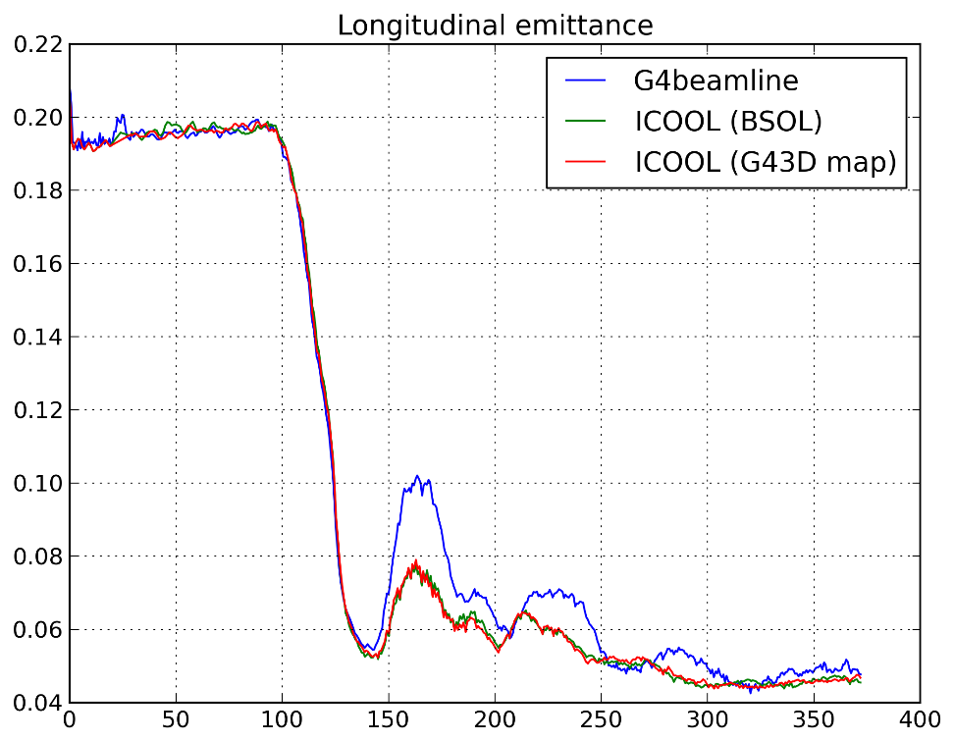
ICOOL with BSOL vs G43D map
Transverse emittance
Longitudinal emittance

Slide 6
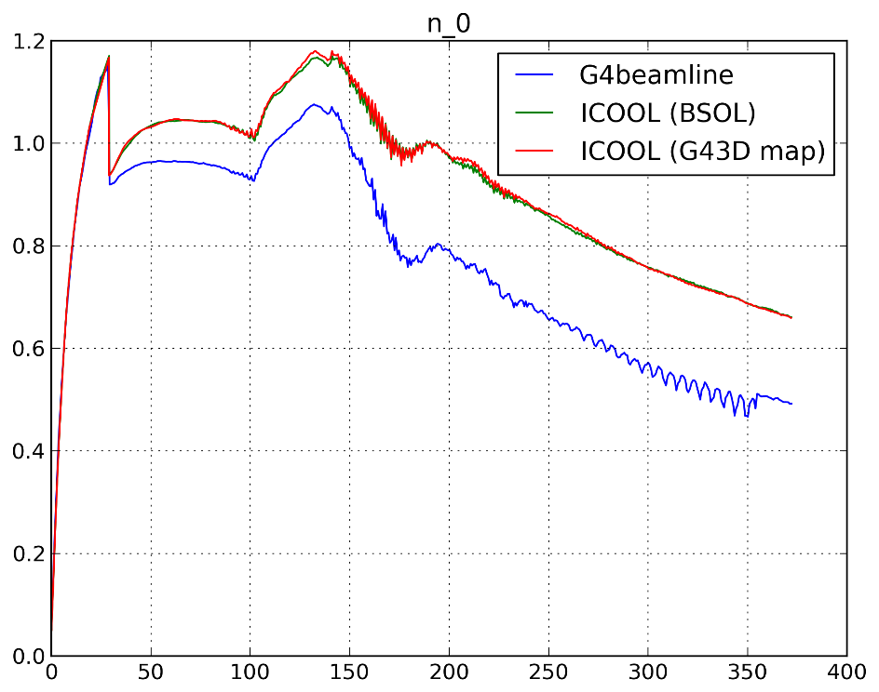
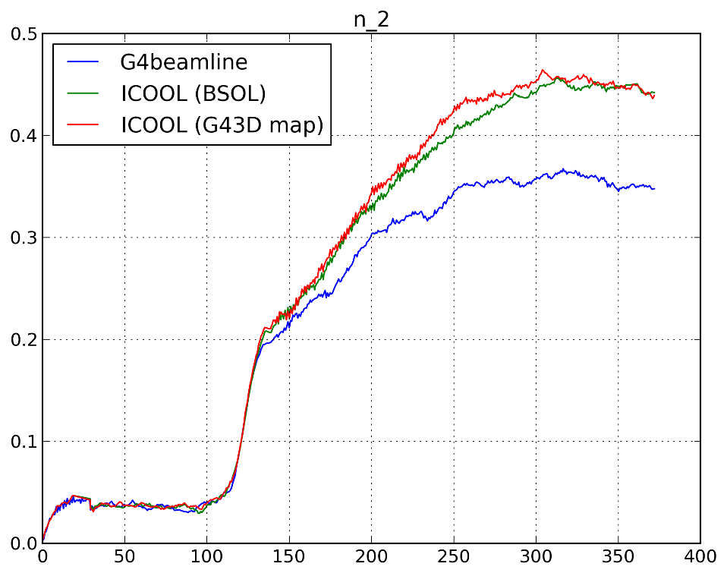
ICOOL with BSOL vs G43D map
Number of muons
Number of useful muons
within canonical cuts
Relatively large statistics: 300k incident particles, correct distribution
(wrong distribution sent earlier by email, no 2 ns correction to time)

Slide 7
Conclusions
ICOOL simulation with bent solenoids and 3D field map for the chicane generated by G4beamline produce the same result.
Bent solenoid approximation is adequate.
Chicane is not the source of discrepancy.
Haven’t taken into account the Be proton absorber, but it is unlikely that the absorber is responsible for such a difference in transmission.
I will continue comparing the elements of the channel downstream of the chicane.

