Slide 1
Technology Development
MAP Friday Meeting
Harold Kirk
Brookhaven National Laboratory
December 13, 2013

Slide 2
Outline
TD Highlights
L2 Summary reports
Topical Report – Recent MARS15 Developments, Nikolai Mokhov, FNAL

Slide 3
Technology Development Highlights for November, 2013
RF Studies
  “Patch Ring” approach chosen for 805MHz Modular Cavity repair
  Mechanical Assembly of 201 MHz Cavity
  Testing of Cu onto Nb electroforming started
Targets
  New short taper (5m) coil design.
Numerous abstracts to IPAC2014

Slide 4
December 13, 2013
03 01: Normal Conducting RF
Derun Li
Modular cavity (collaboration with SLAC)
  Developed the plan for fixing the damaged region
    Braze a copper “patch ring”; braze test at Fermilab in progress
201 MHz MICE prototype cavity
  Significant progress in the single cavity-vessel assembly:
    Installed: water cooling connection; cavity support struts , six tuner arms and actuators (issues)
  Tuner transfer function measurements
  Coupler fabrication continues at LBNL: delay in TiN coating
The modular cavity fabrication at SLAC and repair plan
Oversight of the fabrication of RF couplers for the MICE prototype cavity
  Delay in TiN coating on the coupler
PO of Be plates for the modular cavity
Delay in modular cavity fabrication at SLAC due to bad copper plating
Delay in the 201 MHz coupler fabrication due to TiN coating
Modular cavity
  Fabrication at SLAC continues, delays in fixing the damaged region
  Copper plating quality un-acceptable, plan to braze a copper ring
Good progress in the single cavity installation at MTA, Fermilab
  Accessory components (cavity support struts, tuner arms and water cooling line connections) installed
  Issue with the actuator installation: measurements done and Allan DeMello from LBNL will be at Fermilab on Monday to assist with the installation
  Tuner measurements at Fermilab completed
Fabrication the 201-MHz coupler continues at LBNL, delay in TiN coating
Continue the modular cavity fabrication
EP of the remaining MICE cavities at LBNL
Development of the modular cavity testing plan
Data analysis of previous 805 MHz testing results
MP simulation studies of the MICE cavity and coupler with external magnetic fields and explore other possible solutions
Fabrication of two 201 MHz RF couplers for the first MICE prototype cavity
Support MTA RF testing programs
Support and participate RF design studies of MAP D&S.
Continue the fabrication of the modular cavity with the proposed fix, and low power RF measurement of the cavity at SLAC
Continue the 201 MHz installation at MTA, Fermilab
Oversight of the 201-MHz cavity coupler fabrication at LBNL
TiN-coating on the copper areas of the RF windows at LBNL
Oversight of the CC cryostat fabrication at LBNL
Continue MP simulation studies of the MuCool/MICE 201 MHz cavities with MICE magnetic field map

Slide 5
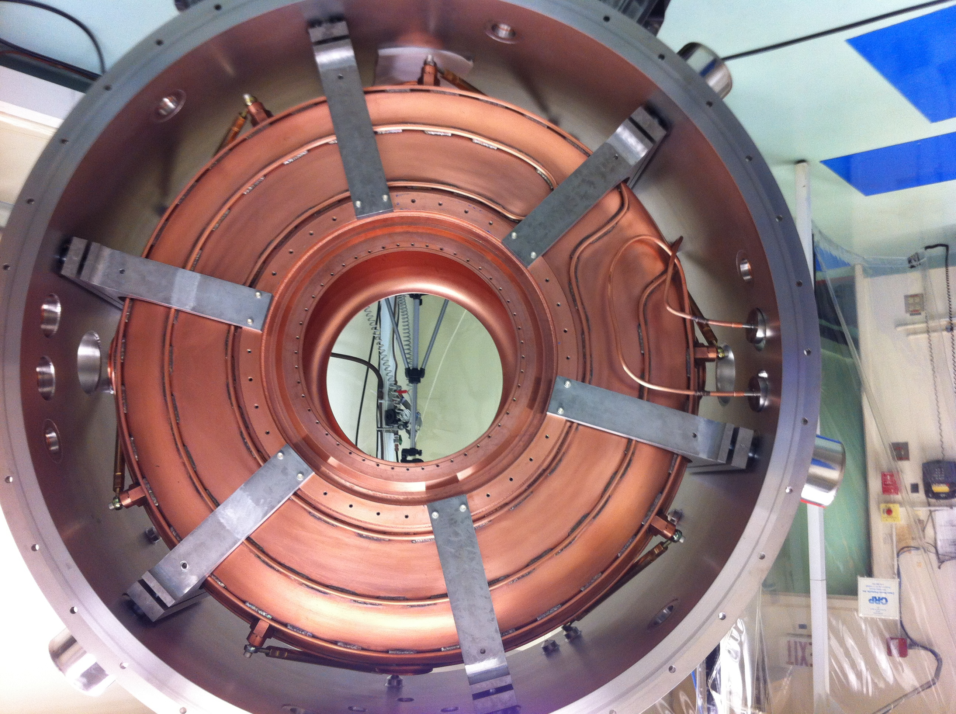
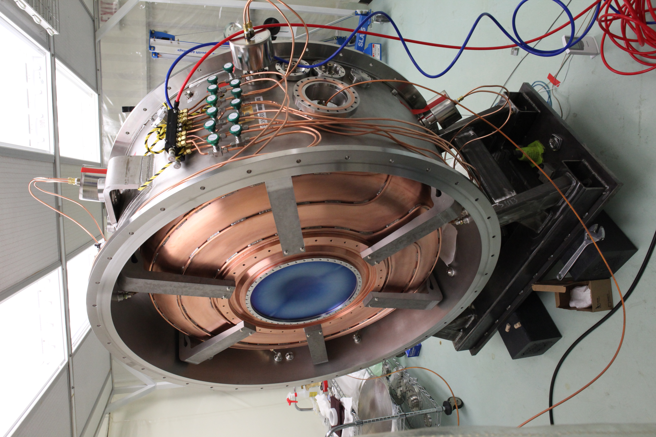
Modular Cavity and MICE Coupler
Measurements:
f = 201.17 MHz with copper windows
Tuning range: 300 kHz @ 100 PSI (Pull);
400 kHz @ 100 PSI (Push)
1/8 gap

Slide 6
December 13, 2013
3.2 – Superconducting RF
Don Hartill
.
Research Instruments shipment of 500 MHz cavities
Electroforming Cu on 1.3GHz Nb cavity
Work continues for welding the beam tubes onto the 500MHz cavities (Research Instruments)
Work started on establishing a viable technique for electroforming Cu on Nb coupons at Epner Technologies.
Testing of 500 MHz explosion-bonded cavities expected in late summer.
Preparation of Cu on Nb electroformed 1.3GHz cavity by end of FY13
Continued work by Research Instruments toward welding of the 500 MHz SRF cavity
Continue studies of techniques for electroforming Cu on Nb

Slide 7
December 13, 2013
03.04 Targets and Absorbers
Kirk McDonald
Ding: Particle production optimization for 3 GeV beam with C target largely complete
Weggel: New target coil designs for more uniform field at target + short taper. Next: field maps for Ding, Sayed.
Souchlas: Tidied up loose ends in energy deposition studies at 8 GeV. Next: 3 GeV studies, including chicane.
Zhan: ANSYS-FLUENT code modifications for free jets seem to be working well. Next: apply to MERIT configuration.
Extend target system conceptual design up to start of buncher (including chicane in decay/drift region).
Begin studies of Staging Scenarios that start with a 3-GeV beam @ 1MW. Need more coordination with Proton Driver team to specify possible multiple beams on target.

Slide 8
December 13, 2013
3.5 – MuCool Test Area
Yağmur Torun
201-MHz vacuum RF: initial mechanical assembly done
805-MHz vacuum RF: ASC run close to completion; modular cavity ETA delayed
Infrastructure: installation prep in hall continuing
Data analysis:
  HPRF beam test PRL published, data analysis continuing (M. Chung, B. Freemire, A. Tollestrup, K. Yonehara)
  all-season cavity data under review
ASC run, hall infrastructure work, MICE cavity assembly, modular cavity prep in parallel
Design/drafting backlog
Too much progress to fit into this template with legible fonts
Single-Cavity Module installation, commissioning
Pillbox with grid windows
Beamline commissioning
All-season cavity: running in solenoid, operating points established: ~30 MV/m @ B=0, ~20-22 MV/m in B=1-5T (A. Moretti, D. Peterson, YT)
Modular cavity: progress on repair plan, instrumentation (D. Bowring, M. Chung, YT)
201-MHz Single-Cavity Module: progress on instrumentation (L. Somaschini, D. Peterson, R. Pasquinelli, M. Chung, A. Moretti, P. Lane, P. Snopok, YT); new struts built (R. Schultz), cavity/actuators installed in/on vessel, tuner response measured (L. Somaschini, D. Peterson, R. Pasquinelli, R. Schultz)
DL-HPRF: material test config designed (A. Moretti), draft plan for next year (B. Freemire, K. Yonehara, A. Tollestrup)
Hall: old MICE prototype removed, services for new cavity installed, crane installation plan advanced (R. Schultz, R. Pasquinelli, YT)
IPAC 2014: 10 MTA abstracts submitted (D. Bowring, M. Chung, B. Freemire, P. Lane, A. Moretti, R. Pasquinelli, L. Somaschini, YT)
Data analysis/publication
  all-season cavity
  HPRF beam test
  magnetic insulation
  Be-Cu buttons
Current program
  ASC
  DL-HPRF
Next on the list
  Grid windows on pillbox cavity?
  201-MHz Single-Cavity Module
  New 805-MHz modular cavity
Other
  Beamline commissioning?
805-MHz all-season cavity: complete run, inspect surface
DL-HPRF cavity: finalize material test config design, fab parts
Old pillbox cavity: install/run with grid windows?
201-MHz Single-Cavity module: instrumentation tests
Modular cavity: instrumentation and inspection setup
Hall infrastructure: overhead crane installation
Planning: detailed schedule for next year

Slide 9
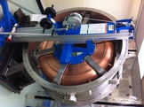
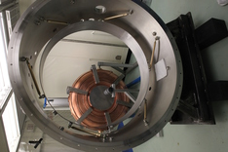

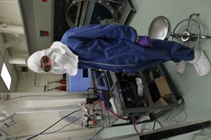
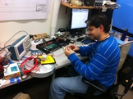
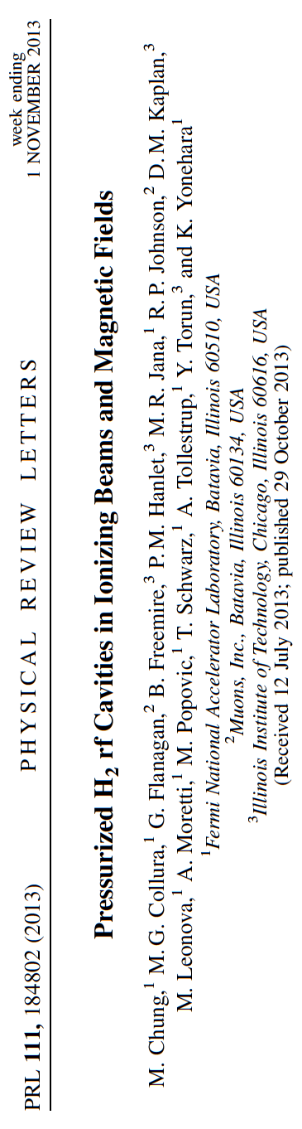
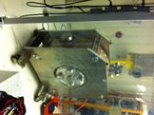
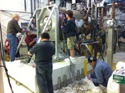
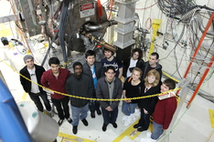
MuCool Test Area − Nov-Dec 2013
MICE Single-Cavity Module Assembly in Lab-6
Acoustic sensor prototypes
Next generation in training
Making space in MTA Hall

Slide 10


