Slide 1






$Z^{′}$ @ 100 TeV Collider
Next steps in the Energy Frontier
---- Hadron Colliders
Workshop at LPC@FNAL
Zhen Liu (PITT PACC, University of Pittsburgh)
Study with Tao Han, Paul Langacker and Lian-Tao Wang, to appear
For $Z′$ at the LHC and ILC, see our Snowmass work arXiv:1308.2738

Slide 2
100 TeV Collider
See Further
Understand Deeper
See many talks in this workshop from different perspectives
We pick $Z′$ for our study

Slide 3
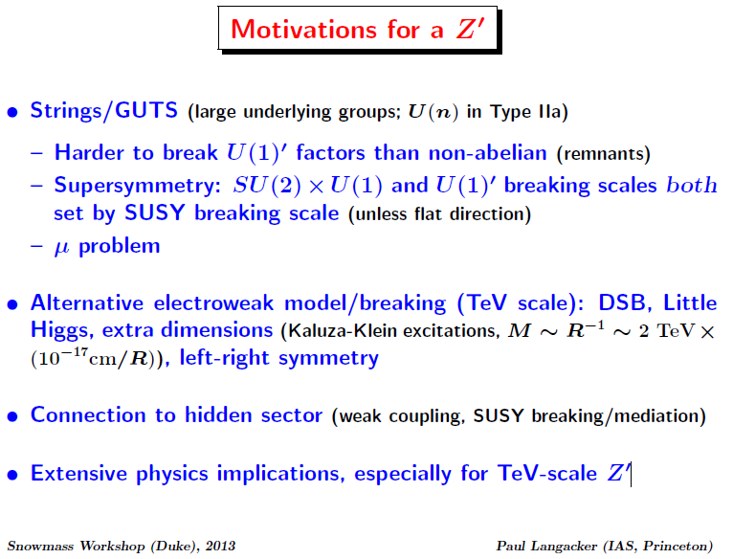

Slide 4
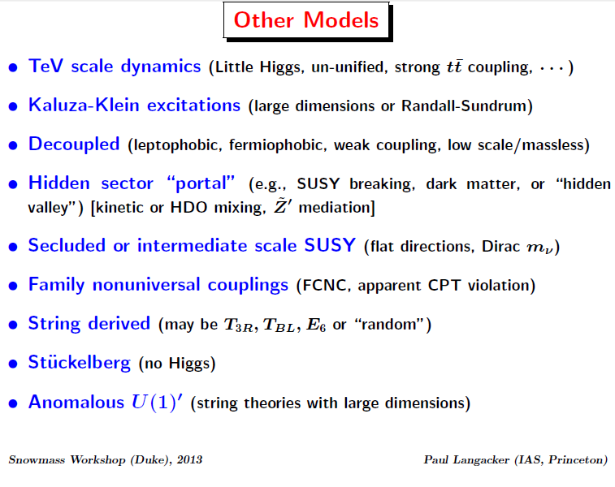

Slide 5
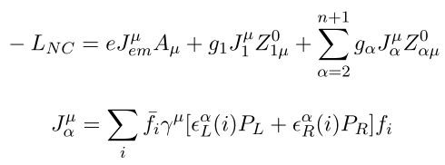
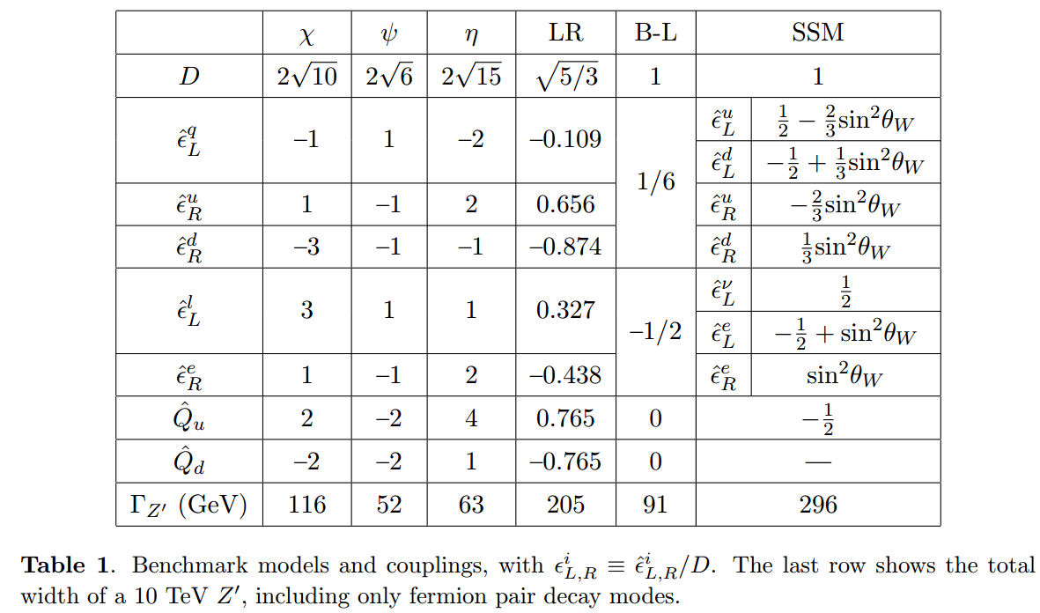


Additional $U(1)′$
Assuming flavor universality, negligible mixing with Z, $Q′$charge commutes with $SU{\left(2\right)}_{L}$ charge
7 (6) Parameters: mass, (total width,) and 5 couplings:

Slide 6
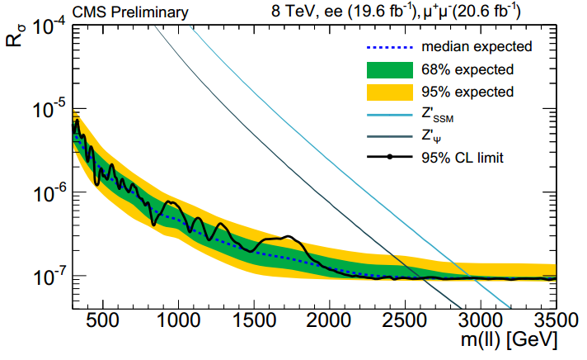
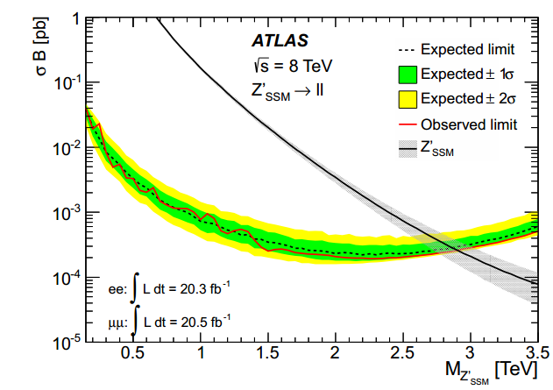
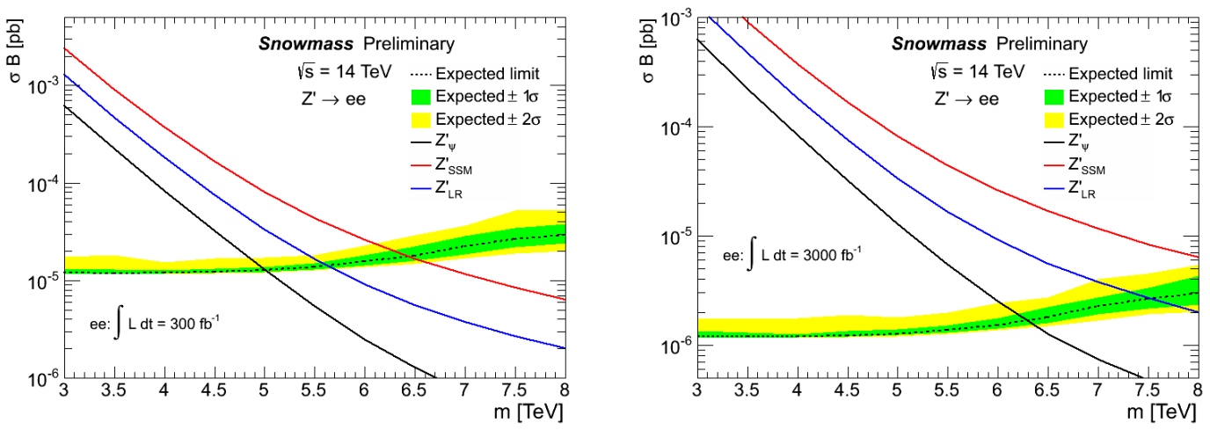
LHC Limits and Projections
D. Hayden, C. Willis, and R. Brock arXiv:1308.5874

Slide 7
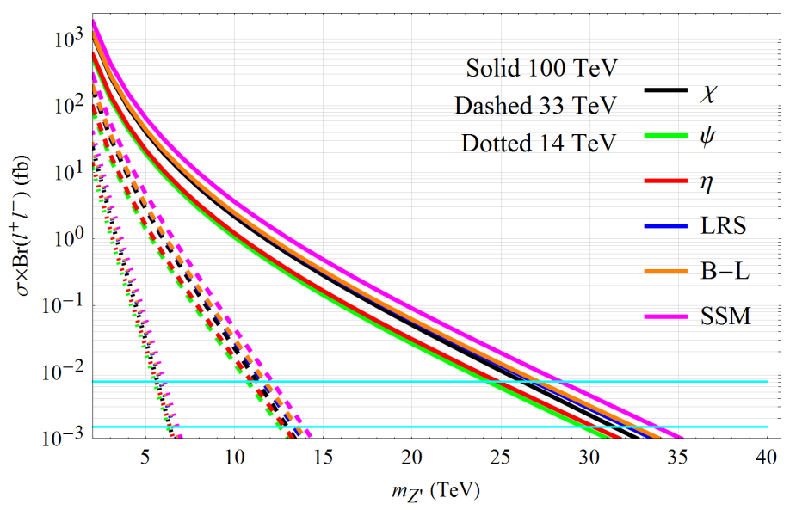
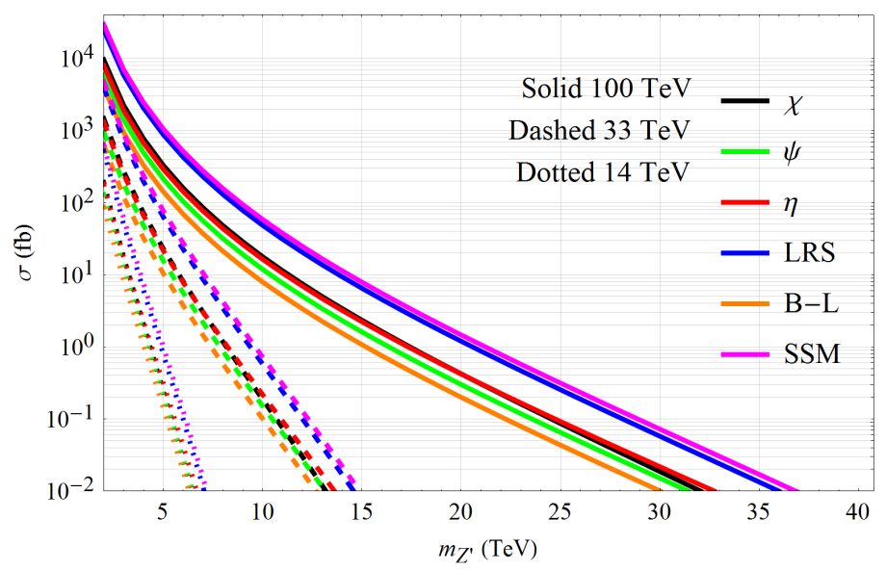
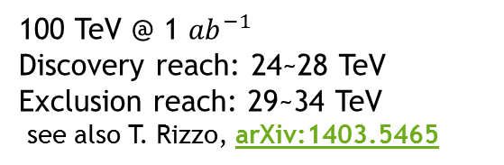
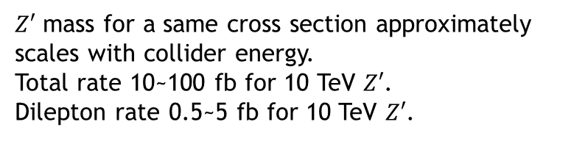

$Z′$ at 100 TeV Collider
Dilepton Production Rate
$Z′$ mass for a same cross section approximately scales with collider energy.
Total rate 10~100 fb for 10 TeV $Z′$.
Dilepton rate 0.5~5 fb for 10 TeV $Z′$.
Total Production Rate
100 TeV @ 1 ${ab}^{−1}$
Discovery reach: 24~28 TeV
Exclusion reach: 29~34 TeV
see also T. Rizzo, arXiv:1403.5465

Slide 8
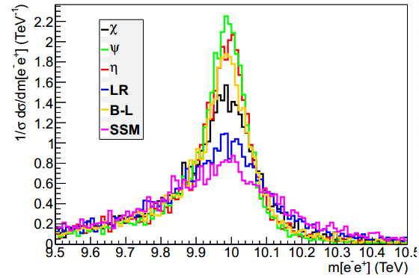
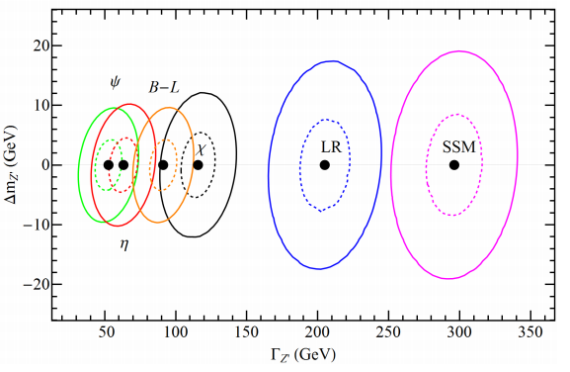

Dilepton Golden Channel
7 (6) Parameters: mass, (total width,) and 5 couplings
$Z′$ widths are narrow, 0.5~3%
Require good knowledge on lepton energy resolution. This can be viewed as the width fit with lepton energy spread subtracted; errors on lepton energy resolution propagate almost fully into width determination.
Study done with MG5+Pythia6+Delphes3,
with the Snowmass 100 TeV collider delphes card.

Slide 9
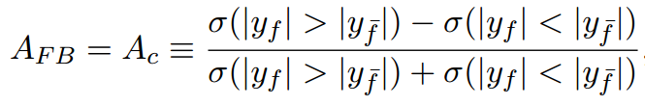
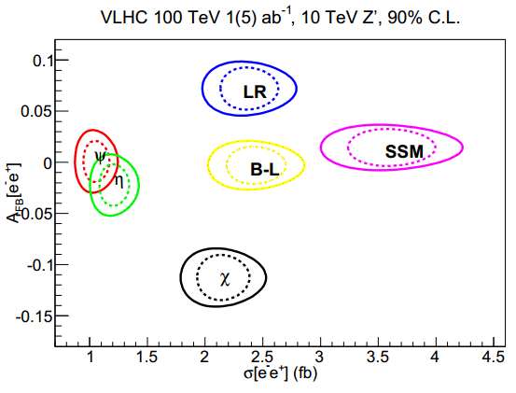
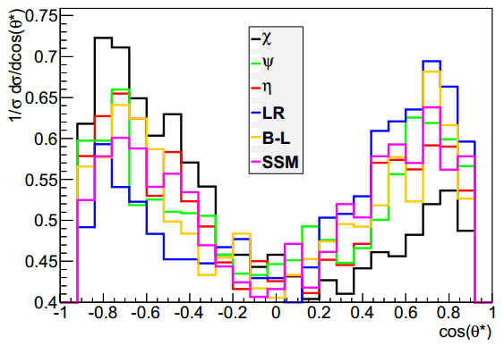
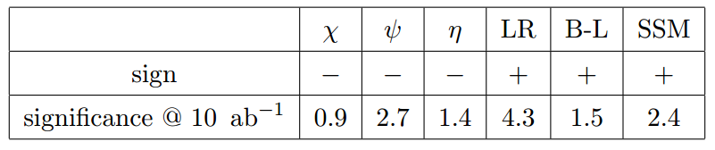

Forward-Backward Asymmetry
Many systematics cancelled;
A good example of ratio observable.
Also emphasized in D. Curtin’s talk
Choose the $Z^{′}$ boosting direction as positive, usually the valence quark direction. Contaminated with sea quark initial state contributions and cases with sea quark more energetic than the valence quark, especially for lighter $Z′$ in the central region.
May make use of the rapidity distribution of the $Z′$ to extract the relative strength of $Z^{′}$ to up- and down-type quarks; need precise knowledge about the PDF.
Extra information to resolve the signs of the couplings by comparing $A_{FB}$ before and after $Z^{′}$ peak. This reveals constructive/destructive interferences with the SM.

Slide 10
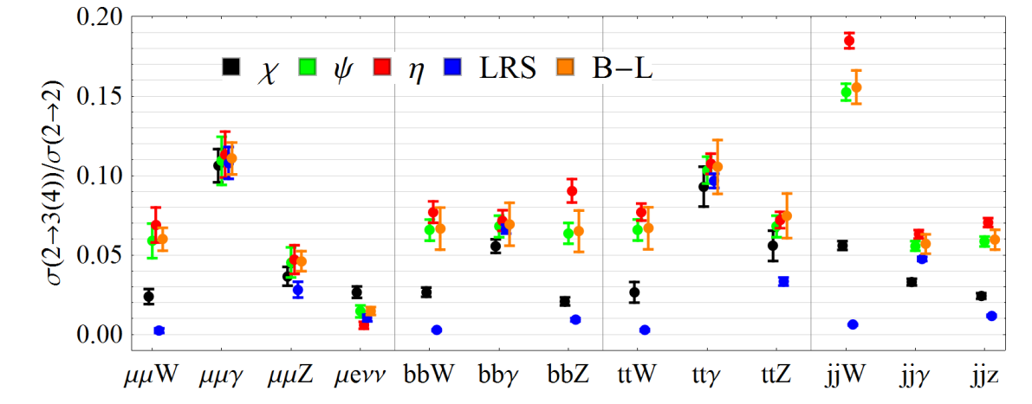
(Electro)Weak Radiation
100 TeV Collider is also the Arena of EW Radiation
Specifically, EW ISR/FSR for DY process:
Photons probe electric charge
W bosons probe chiral-L charge
Z bosons probe Weak charge
(Higgs bosons probe the Yukawas, since assuming family universality, ignored here.)
What can we learn for $Z^{′}$? Ratio of the process with EW ISR/FSR to corresponding DY process to demonstrate the Maximal(bkg free) information on could extract for Z’.
An interesting option (to extract more information) is to use kinematics to differentiate ISR and FSR, especially for Z, and W (for light jets)
ISR
ISR+FSR
FSR
FSR W a bit tricky
Large statistics
Huge background

Slide 11
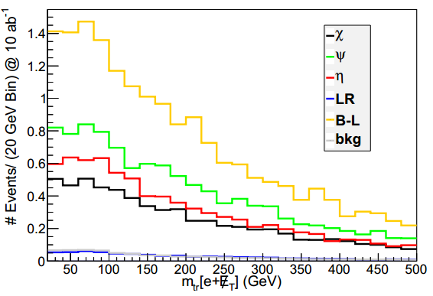
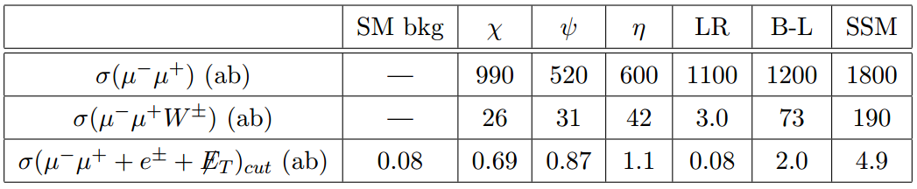
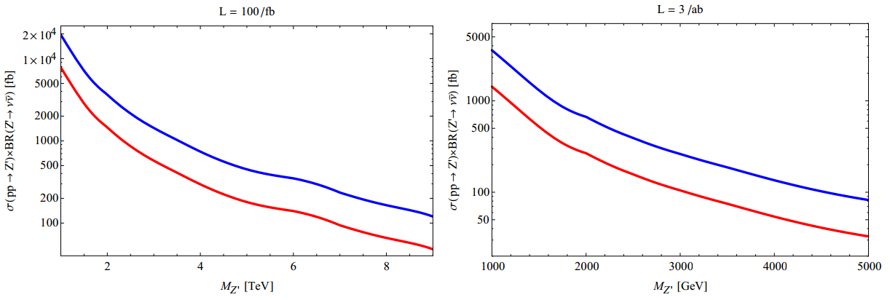
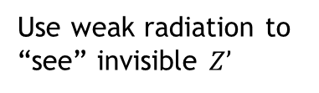
(Electro)Weak Radiation
Left: Transverse mass distribution of the lepton+MET system.
Dipleton golden channel with ISR W;
ISR hadronic W tagging could be very challenging, as it is in the hadronic activity rich region.
We thus choose the leptonic W and pay the price of statistically being limited.
Use weak radiation to “see” invisible $Z’$
A. Hook and A. Katz, arXiv:1407.2607

Slide 12
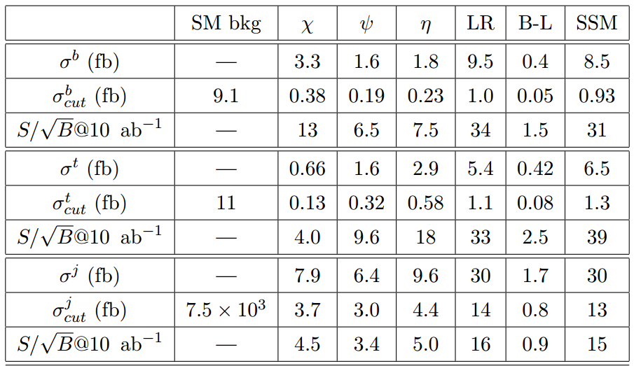

Hadronic Cross Sections:
Crucial for coupling determination
Assuming flavor universality, negligible mixing with Z, $Q′$charge commutes with $SU{\left(2\right)}_{L}$ charge
7 (6) Parameters: mass, (total width,) and 5 couplings:
Mass, total width through dilepton invariant mass fit;
Need at least 5 linearly independent observables to fully determine the 5 couplings:
dilepton rate, dipleton $A_{FB}$, (limited info from) dilepton ISR W, Rapidity Distribution, need more!
Hadronic difficult,
mainly use hard jet pT cut (3 TeV)
Invariant mass cut
Assume “reasonable” b-tagging, fake rate
(high demand on detector design, tagging development)
Rely on b-tagging to reject QCD background for heavy flavor channels.
Possible improvement:
Singlet dipole
For b-tagging, top tagging, see also talk by B. Tweedie and S. Chekanov
10 $ab^{−1}$, Hadronic modes useful

Slide 13
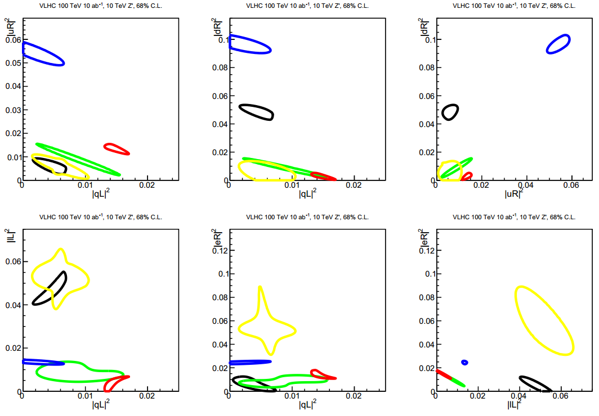
Determination of 5 Couplings through previous mentioned observables
68% C.L. contour at 100 TeV 10 $ab^{−1}$.
Demonstrating Diagnosis Power!
See further, understand better.
Instead of Hypothesis Test, Coupling fitting, e.g. emphasized in Ian Low’s talk

Slide 14
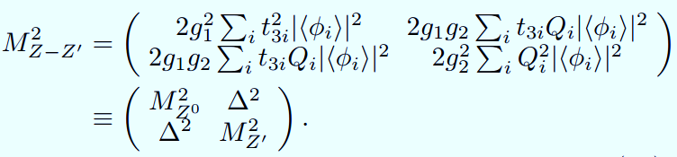
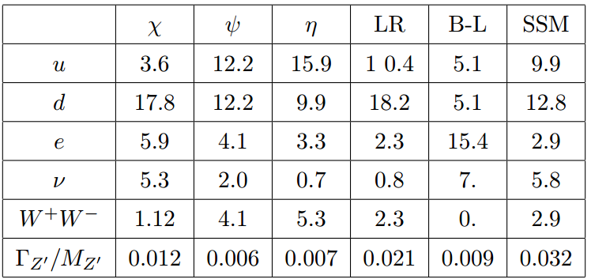
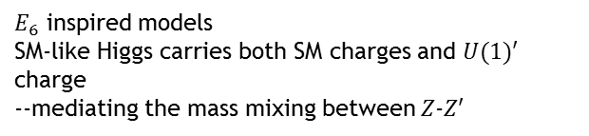
In Presents of Z-Z’ Mixing
$E_{6}$ inspired models
SM-like Higgs carries both SM charges and $U(1)′$ charge
--mediating the mass mixing between $Z$-$Z′$
For simplicity, assume other Higgs bosons are heavier and not considered.
In case of mass mixing, goldstone equivalence theorem applies and WW and Zh decay Branching fractions are equal.

Slide 15
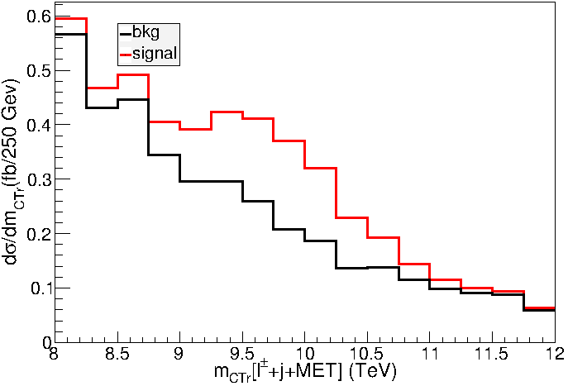
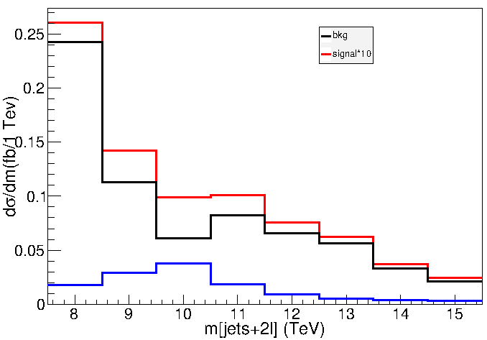
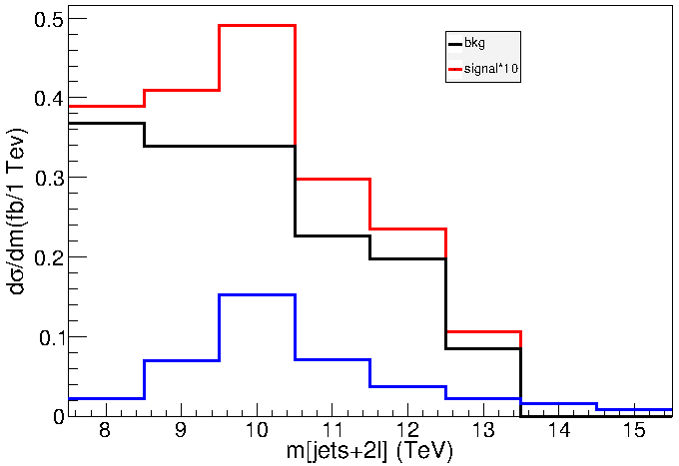
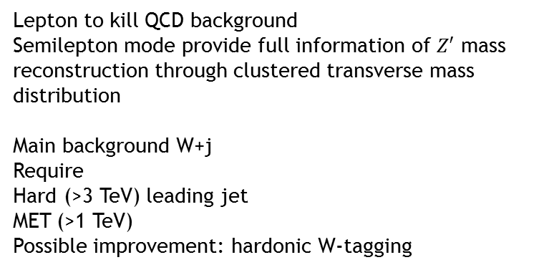
WW—semileptonic mode
Lepton to kill QCD background
Semilepton mode provide full information of $Z′$ mass reconstruction through clustered transverse mass distribution
Main background W+j
Require
Hard (>3 TeV) leading jet
MET (>1 TeV)
Possible improvement: hardonic W-tagging
Zh—Invisible, leptonic Z+ hadronic h
Boosted Hadronic Higgs:
Challenging and lots of potential. Here we conservatively view it as a “jet”
Main background Z+j
Require MET (>2 TeV)
Typically separation between leptons,
R=0.04

Slide 16



Summary $\&$ Outlook
100 TeV Collider Discovery ~30 TeV
(1 ${ ab}^{−1}$ through dileptons)
Dilepton observables:
  Mass, Width
  $A_{FB}$
  Weak Radiation
Hadronic cross sections
Coupling Fit @ 10 ${ fb}^{−1}$
(minimal assumptions/model dependence)
$Z$-$Z’$ mixing induced $Z’$ decays
More to explore: Hadronic W-tagger, Z-tagger, Higgs-tagger, Jet with weak radiation, lepton with weak radiation, tau-tagging and polarization
The future collider IS the intellectual Olympics of Human being,
experimentally, theoretically, and even world peace-wise.
Absolutely INSPIRING!

Slide 17
Thank You!

Slide 18
Backup

Slide 19
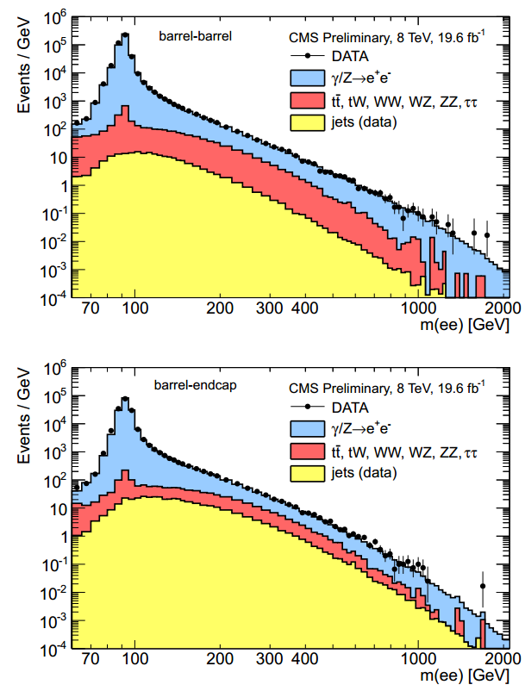
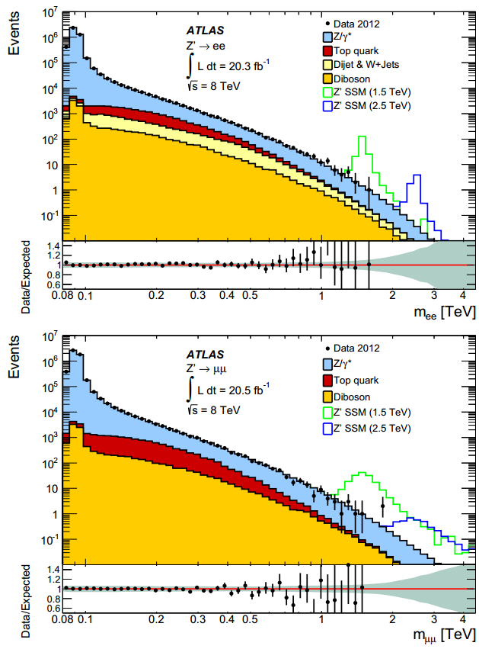

Slide 20
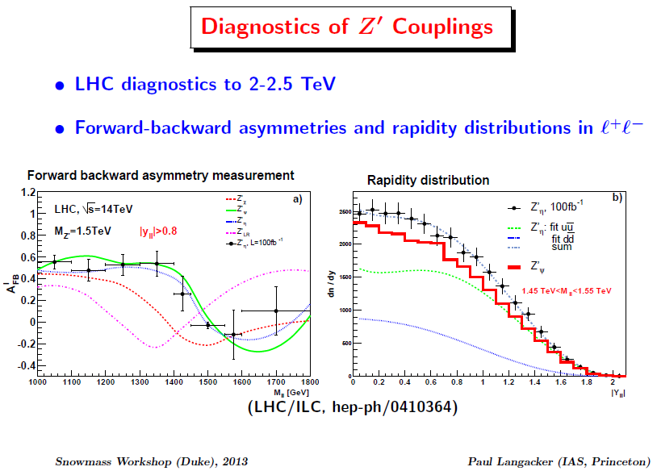
Backup

Slide 21
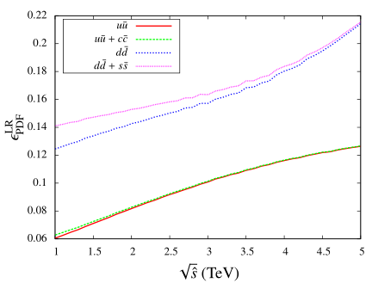
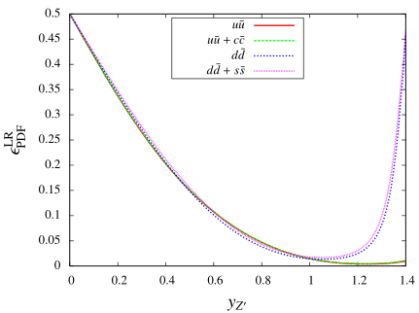
Leptonic mode
(Dimuon final state)
The percentage of events with the quark (anti-quark) direction opposite to (same as) the boost direction.
As a function of rapidity;
As a function of partonic center of mass energy.
Correction: the y-axis should be
\epsilon^{q_{FB}}_{PDF}

Slide 22
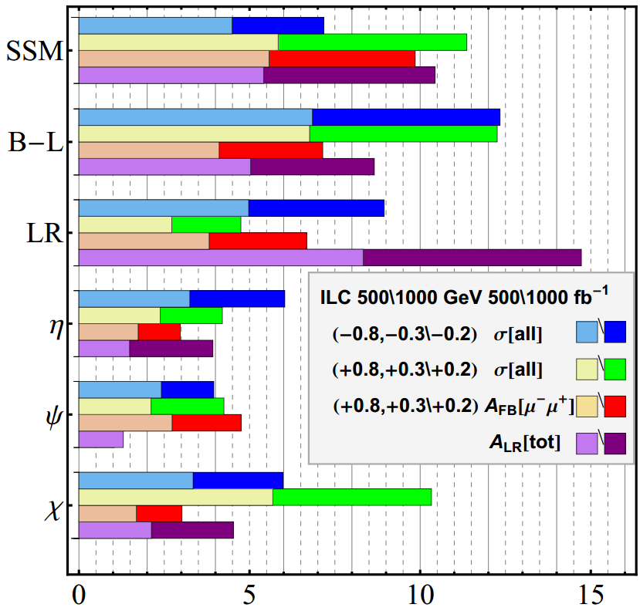

Slide 23
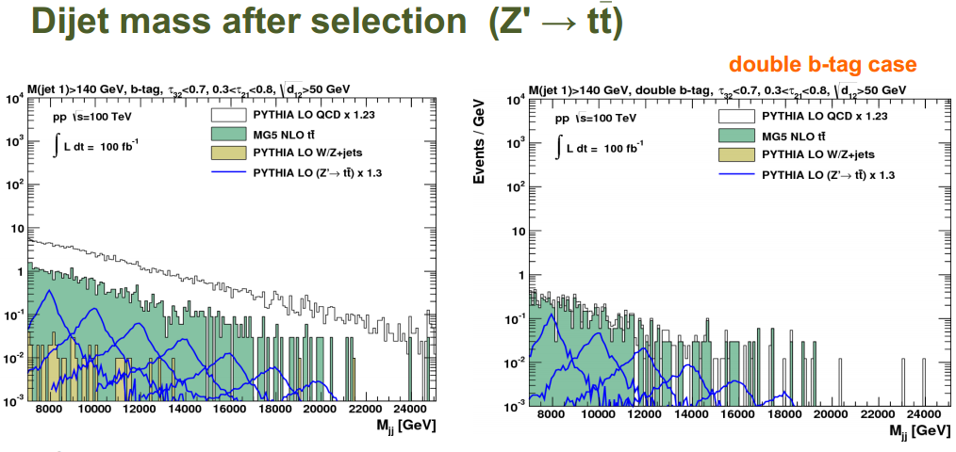

Slide 24
Real Particles
Anti Particles
Bosons
Particles

Slide 25
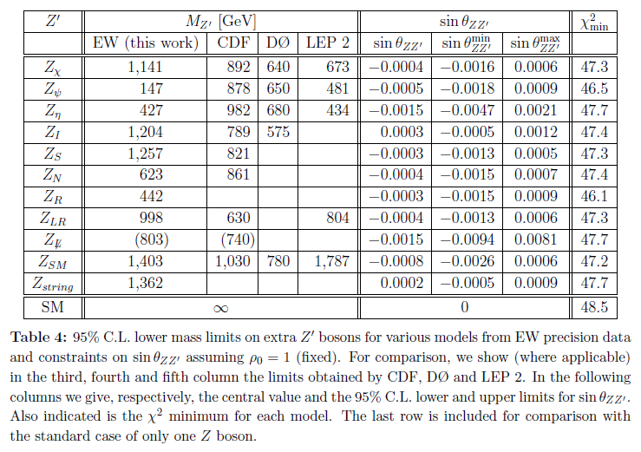
Current Limits (before LHC)

Slide 26
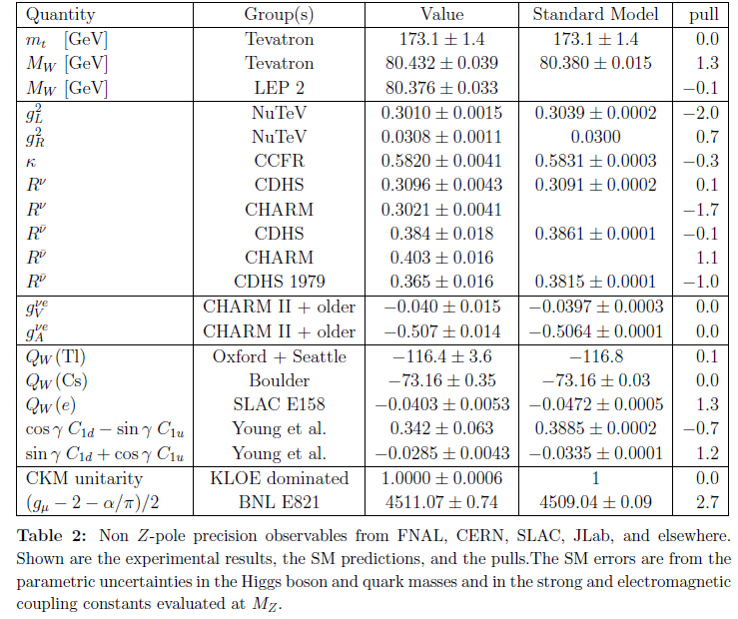

Slide 27
