Slide 1
Comparison of Conclusions from Snowmass, European Strategy Study, and Japanese Planning Study
For the ICFA Neutrino Panel Mini-Workshop
Fermilab, Illinois
Maury Goodman
Argonne National Laboratory
31 January 2014

Slide 2
Charge for this talk
My Charge: “…a 30+5 minute presentation comparing and contrasting the extent to which the conclusions from the various regional studies (Japanese Subcommittee, European Strategy, and Snowmass) agree on the future priorities for neutrino physics. “
Opinion Alerts

Slide 3
Is this talk worthless?
Dwight D. Eisenhower
“I tell this story to illustrate the truth of the statement I heard long ago in the Army:
Plans are worthless, but planning is everything.“
From a speech to the National Defense Executive Reserve Conference in Washington, D.C. (November 14, 1957) ; in Public Papers of the Presidents of the United States, Dwight D. Eisenhower, 1957, National Archives and Records Service, Government Printing Office, p. 818 : ISBN 0160588510, 9780160588518

Slide 4
OUTLINE
Context, Documents, Conclusions for
Europe
Japan
U.S.
The need for considering costs & accounting
My thoughts on how the ν conclusions cohere

Slide 5
Studies
US – Snowmass Process 2012-2013
Last Snowmass 2005
1000 contributors, 700 attended Minneapolis
Input to P5 process
Europe – Strategy for Particle Physics 2013
First & previous strategy from 2006 meetings
Japan – “The Final Report of the Subcommittee on Future Projects of High Energy Physics1”
February 2012
China, India – no comparable documents
https://indico.fnal.gov/getFile.py/access?contribId=21&sessionId=6&resId=0&materialId=slides&confId=7485 (China) & http://www.ino.tifr.res.in/ino/Talks/2013/Sanjib-NNN2013.pdf (India)

Slide 6
Europe-Context
What to do after the LHC.
(The discovery of the Higgs.)
(The non-discovery of some other new physics expected by some.)
Increases in Luminosity(x100) and Energy(x2) are foreseen.

Slide 7
Preamble
Since the adoption of the European Strategy for Particle Physics in 2006, the field has made impressive progress in the pursuit of its core mission, elucidating the laws of nature at the most fundamental level. A giant leap, the discovery of the Higgs boson, has been accompanied by many experimental results confirming the Standard Model beyond the previously explored energy scales. These results raise further questions on the origin of elementary particle masses and on the role of the Higgs boson in the more fundamental theory underlying the Standard Model, which may involve additional particles to be discovered around the TeV scale. Significant progress is being made towards solving long-standing puzzles such as the matter-antimatter asymmetry of the Universe and the nature of the mysterious dark matter. The observation of a new type of neutrino oscillation has opened the way for future investigations of matter-antimatter asymmetry in the neutrino sector. Intriguing prospects are emerging for experiments at the overlap with astroparticle physics and cosmology. Against the backdrop of dramatic developments in our understanding of the science landscape, Europe is updating its Strategy for Particle Physics in order to define the community’s direction for the coming years and to prepare for the long-term future of the field.

Slide 8
Europe-documents/meetings
CERN Council Open Symposium on European Strategy for Particle Physics, Kraków, Poland 10 - 12 Sep 2012 and Satellite Closed Meetings 9, 12, 13 Sep 2012
Book of Abstracts – 177 of them
15 Preparatory Meetings, 1 Editorial Meeting, & 1 Follow-Up Meeting
“The mass-hierarchy and CP-violation discovery reach of the LBNO long-baseline neutrino experiment”, http://arxiv.org/abs/1312.6520

Slide 9
Europe Conclusions General Issues & Other essential scientific activities
Europe should preserve this (CERN) model in order to keep its leading role, sustaining the success of particle physics and the benefits it brings to the wider society.
The European Strategy takes into account the worldwide particle physics landscape and developments in related fields and should continue to do so.
--
Europe should support a diverse, vibrant theoretical physics program, ranging from abstract to applied topics, in close collaboration with experiments and extending to neighboring fields such as astroparticle physics and cosmology. Such support should extend also to high-performance computing and software development.
(Flavor) Experiments in Europe with unique reach should be supported, as well as participation in experiments in other regions, especially Japan and the US.
In the coming years, CERN should seek a closer collaboration with ApPEC on detector R&D with a view to maintaining the community’s capability for unique projects in this field.
The CERN Laboratory should maintain its capability to perform unique experiments. CERN should continue to work with NuPECC on topics of mutual interest.

Slide 10
Europe organizational, wider impact & concluding recs
CERN should be the framework within which to organize a global particle physics accelerator project in Europe, and should also be the leading European partner in global particle physics accelerator projects elsewhere. Possible additional contributions to such projects from CERN’s Member and Associate Member States should be coordinated with CERN.
CERN and the particle physics community should strengthen their relations with the European Commission in order to be further integrated in the development of the European Research Area and to benefit from future instruments in Horizon 2020 and the Structural Funds.
Outreach and communication in particle physics should receive adequate funding and be recognized as a central component of the scientific activity. EPPCN and IPPOG should both report regularly to the Council.
HEPTech should pursue and amplify its efforts and continue reporting regularly ...
CERN, together with national funding agencies, institutes, laboratories and universities, should continue supporting and further develop coordinated programs for education and training.
Updates should continue to be undertaken according to the principles applied on the present occasion. The organizational framework for the Council Sessions dealing with European Strategy matters and the mechanism for implementation and follow-up of the Strategy should be revisited in the light of the experience gained since 2006.

Slide 11
Europe Conclusions High-priority large-scale scientific activities
Europe’s top priority should be the exploitation of the full potential of the LHC, including the high-luminosity upgrade of the machine and detectors with a view to collecting ten times more data than in the initial design, by around 2030. This upgrade program will also provide further exciting opportunities for the study of flavor physics and the quark-gluon plasma.
CERN should undertake design studies for accelerator projects in a global context, with emphasis on proton-proton and electron-positron high-energy frontier machines. These design studies should be coupled to a vigorous accelerator R&D program, including high-field magnets and high-gradient accelerating structures, in collaboration with national institutes, laboratories and universities worldwide.
Europe looks forward to a (ILC) proposal from Japan to discuss a possible participation.
Rapid progress in neutrino oscillation physics, with significant European involvement, has established a strong scientific case for a long-baseline neutrino program exploring CP violation and the mass hierarchy in the neutrino sector. CERN should develop a neutrino program to pave the way for a substantial European role in future long-baseline experiments. Europe should explore the possibility of major participation in leading neutrino projects in the US and Japan

Slide 12
Japan-Context
Dated 11 February 2012
While we already knew the mass of the Higgs and the value of θ₁₃ then, both “discoveries” came later.
The tragic 11 Mar 2011 Sendai tsunami has motivated plans for reconstruction money, some of which might be available for the ILC.

Slide 13
Japan-planning
(from http://newsline.linearcollider.org/2012/08/23/)
The subcommittee was set up about three years ago. Most of the members are not specialized in ILC studies, and many young scientists were selected as subcommittee members. So, the subcommittee organized numerous study sessions to learn not only about linear colliders, but also high-energy physics research at large.
Some of the subcommittee members were doubtful whether the accelerator technologies are mature enough to realize the ILC. “On this question, the subcommittee asked the specialists at KEK to explain the status of development blow by blow. Now we know that the degree of the maturity of the accelerator design is much higher than any accelerator built in the past at the time of the approval,” said Mori.
The original recommendation report was discussed by its umbrella organization, Japan Association of High Energy Physicists, at their meeting held in March (2012) and officially approved.

Slide 14
Japan Documents
“The Final Report of the Subcommittee on Future Projects of High Energy Physics”. 11 February 2012,
English version published 8 Aug 2012 by the Japan Association of High Energy Physics
Reports of this sort have been published twice in the past, at intervals of about ten years.

Slide 15
Japan Recommendations
Should a new particle such as a Higgs boson with a mass below approximately 1 TeV be confirmed at LHC, Japan should take the leadership role in an early realization of an e⁺e⁻ linear collider. In particular, if the particle is light, experiments at low collision energy should be started at the earliest possible time. In parallel, continuous studies on new physics should be pursued for both LHC and the upgraded LHC version. Should the energy scale of new particles/physics be higher, accelerator R&D should be strengthened in order to realize the necessary collision energy.
Should the neutrino mixing angle θ₁₃ be confirmed as large, Japan should aim to realize a large-scale neutrino detector through international cooperation, accompanied by the necessary reinforcement of accelerator intensity, so allowing studies on CP symmetry through neutrino oscillations. This new large-scale neutrino detector should have sufficient sensitivity to allow the search for proton decays, which would be direct evidence of Grand Unified Theories.

Slide 16
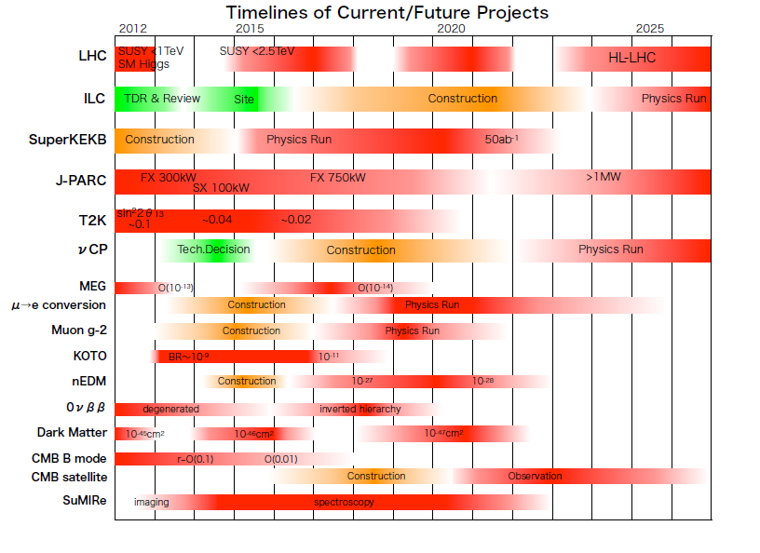
Japan Roadmap
Hyper-K

Slide 17
USA-Context
Snowmass study initiated by American Phyiscal Society Division of Particles & Fields (DPF)
DOE requested that “Snowmass” (aka CSS) delineate opportunities without focusing on priorities.
A HEPAP P5 subpanel (currently deliberating) will use the physics opportunities + budget guidance to create priorities

Slide 18
USA Documents
Executive Summary 49 pages
Intensity Frontier 41 + 84(ν) +221
Energy Frontier 43 + 299
Cosmic Frontier 57 + 320
Accelerator Capabilities 22 + 168
Computing 32 + 143
Detectors 44 + 110
Theory + Outreach +UG 56 + 99
+ >200 contributed papers + 86 1-page ν “white papers”

Slide 19
USA Conclusions from executive summary
Focused more on opportunities than recommendations
LBNE will measure the mass hierarchy and is uniquely positioned to determine whether leptons violate CP.
An upgrade of IceCube...could...measure the mass hierarchy.
Next-generation 0νββ experiments...are a critical component of a strong ν program

Slide 20
USA “goals” from conclusion of executive summary
Probe the highest possible energies and distance scales with the existing and upgraded LHC and reach for even higher precision with a lepton collider; study the properties of the Higgs boson in full detail
Develop technologies for the long-term future to build multi-TeV lepton colliders and 100 TeV hadron colliders
Execute a program with the U.S. as host that provides precision test of the neutrino sector with an underground detector; search for new physics in quark and lepton decays in conjunction with precision measurements of electric dipole and anomolous magnetic moments.
Identify the particles that make up dark matter with complementary experiments deep underground, on the earth’s surface, and in space and determine the properties of the dark sector.
Map the evolution of the Universe to reveal the origin of cosmic inflation, unravel the mystery of dark energy, and determine the ultimate fate of the cosmos
Instrumentation  Theory  Training  Computing  Outreach

Slide 21
Intensity Frontier Summary on ν
There is a clear experimental path forward
Comprehensive test of the 3-flavor paradigm, via long-baseline, precision n oscillation experiments.
Searches for neutrinoless double beta decay
Determination of the absolute values of m_{ν}.
Precision measurement of ν cross sections and a detailed understanding of the ν flux from pion-decay-in-flight ν beams
Definite resolution of the current short-baseline anomalies
Vigorous pursuit of R&D projects related to the development of next-next generation ν-beam experiments.

Slide 22
Neutrino report sections
2. Introduction: physics of νs
2.1 Overview ν oscillations
2.2 Experiments: sources & detectors
The standard oscillation paradigm
3.1 Towards the determination of the ν mass hierarchy
3.2 Towards the detrmination of CP violation in νs
The nature of ns – Majorana versus Dirac
Absolute ν mass
Neutrino Scattering
Beyond the standard paradigm – anomalies and new physics
Neutrinos in cosmology and astrophysics
Neutrinos and society

Slide 23
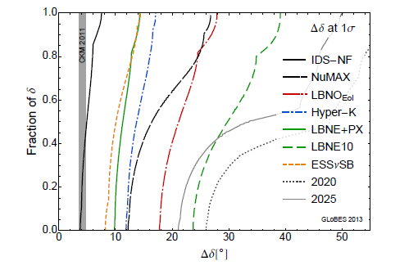
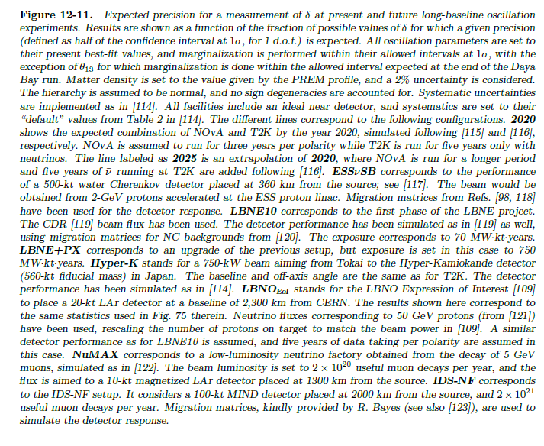
Projected Error on δ

Slide 24
ILC cost?
2007 Reference Design Report
RDR value cost $4.8B + $1.82B (site) + 14.1K FTE-yr
1 Feb 2008, P5 requested a “Lehman cost”, provided by M. Harrison with caveats.
http://www.fnal.gov/directorate/program_planning/P5/P5_Jan2008/Talks/ART_P5_V3.ppt
$14.9 B TEC
$21.9 B with escalation (3.5%) based on Schedule
$25 B with inflation 2007-2013
$17 B scaling 75%* from 500-500 to 250-250 GeV
* private communication M. Nozaki /KEK, August 2013

Slide 25
Opinion Alert
Many high energy physicists didn’t believe me when I told them that Barish’s $6.6B ILC would cost $21.9B
Costs matter. (Something that may be worth $7B may not be worth $21B.)
Accounting matters, particularly for big projects.
When we advocate large projects, we need to understand cost estimates and accounting methodology.

Slide 26
Why talk about ILC costs?
We shouldn’t use cost numbers that fool ourselves.
We shouldn’t treat loaded and unloaded numbers the same.
We shouldn’t treat reviewed and unreviewed numbers the same.
We shouldn’t treat costed and uncosted future facilities the same.

Slide 27
Money What’s the point?
Question: Why was MINOS built?
Answer: Because the SSC was cancelled.
As a neutrino physicist, if we can afford an ILC, it would be nice to have one.
If we can’t afford one, it won’t get built
Whether or not we have an ILC will certainly affect what ν physics we can afford in Europe, US and Asia.

Slide 28
Comparison of Main ν Conclusions
USA – Build LBNE underground
Japan – Build Hyper-Kamiokande
Europe – Support R&D for ν physicists to work on LBNE &/or Hyper-K
Execute a program with the U.S. as host that provides precision test of the neutrino sector with an underground detector; search for new physics in quark and lepton decays in conjunction with precision measurements of electric dipole and anomalous magnetic moments.
Should the neutrino mixing angle θ₁₃ be confirmed as large, Japan should aim to realize a large-scale neutrino detector through international cooperation, accompanied by the necessary reinforcement of accelerator intensity, so allowing studies on CP symmetry through neutrino oscillations. This new large-scale neutrino detector should have sufficient sensitivity to allow the search for proton decays, which would be direct evidence of Grand Unified Theories.
Rapid progress in neutrino oscillation physics, with significant European involvement, has established a strong scientific case for a long-baseline neutrino program exploring CP violation and the mass hierarchy in the neutrino sector. CERN should develop a neutrino program to pave the way for a substantial European role in future long-baseline experiments. Europe should explore the possibility of major participation in leading neutrino projects in the US and Japan

Slide 29
Comparison of Main ν Conclusions
USA – Build LBNE underground
Japan – Build Hyper-Kamiokande
Europe – Support R&D for ν physicists to work on LBNE &/or Hyper-K
Apparent consensus of everyone who said anything at Minneapolis.
Unclear if there is (anti) correlation or not with the ILC decision
Not a clear consensus among neutrino physicists

Slide 30
The World Neutrino Experimental Program
remaining
Paradigm testing
Sterile neutrinos?
Non standard Interactions?
Lorentz violation?
CPT violation?
Non-Unitarity of MNS matrix?
velocity
Questions which might or might not have answers
Parameter Measurement
θ₂₃ Octant (>, < 45°)
Mass hierarchy
Mass scale
CP violation δ
Dirac or Majorana?
More accuracy for θ₁₂, θ₂₃, θ₁₃, Δm²₃₂, Δm²₂₁
Questions with answers
30
30

Slide 31
Some thoughts
The perception of the important issues in neutrino physics seem consistent.
The top goal is to measure δ ≠ 0, π.
There are many other interesting opportunities for measurements and new physics.
These documents didn’t clearly address how much is possible.
Costs and cost sharing issues affect planning.
Regional institutional and facility issues affect planning.

Slide 32
Last Slide
There are no national or continental boundaries to scientific challenges.
Planning for large projects is still mostly done on a regional basis.
International cooperation in planning for our future neutrino facilities is difficult but is possible
This meeting is a step towards the possible.

