Slide 1
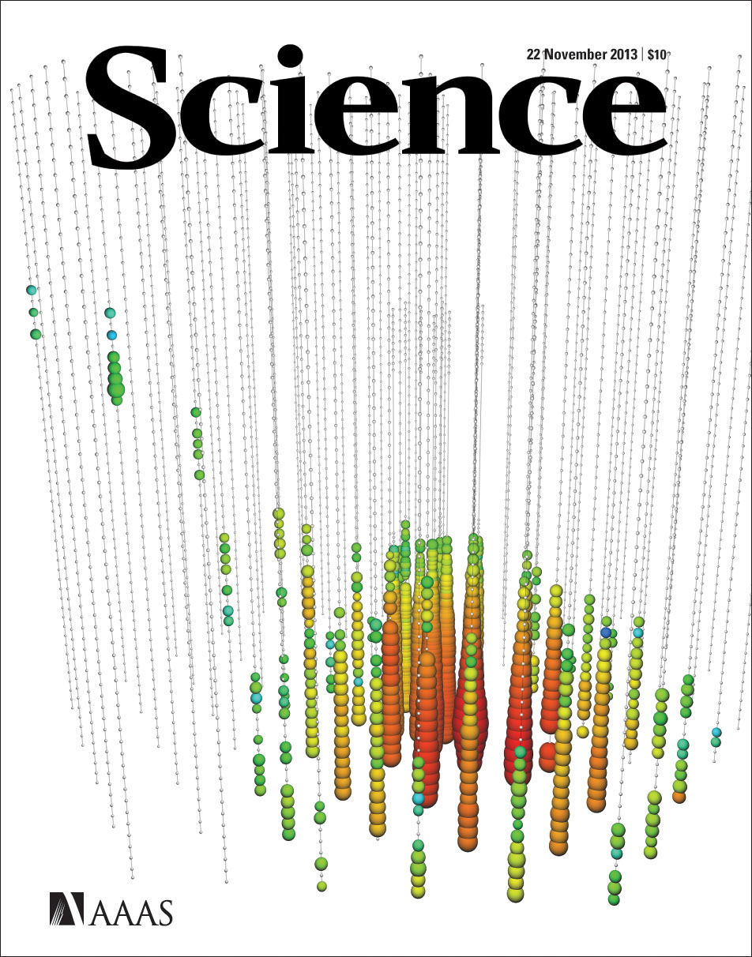
IceCube
Francis Halzen
250 TeV

Slide 2
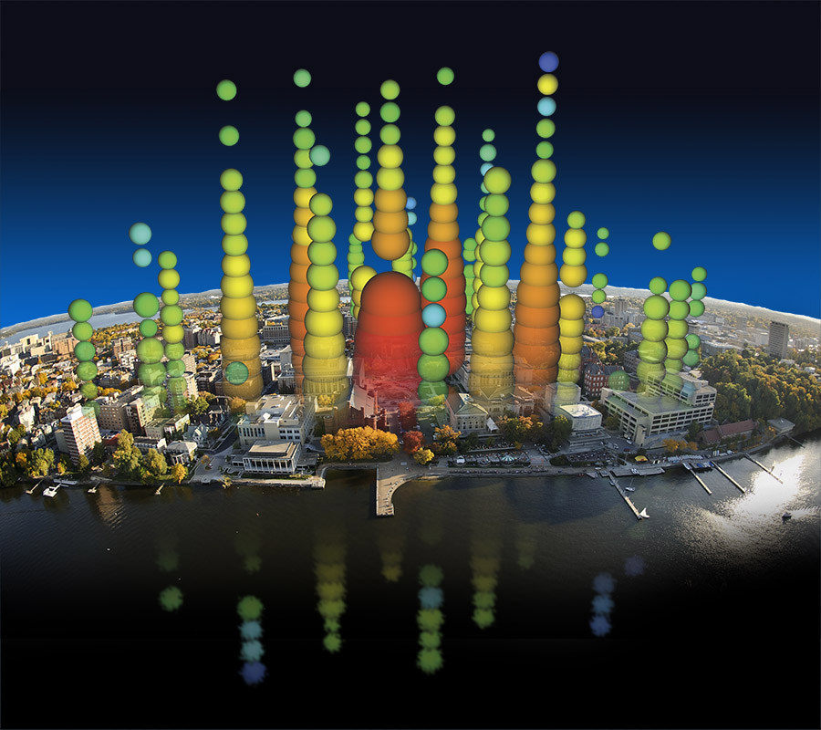
Notes:
IceCube has allowed scientists to launch a hunt for some of the most elusive particles in our universe, neutrinos. These high-energy neutrinos give us an exclusive way to study powerful cosmic engines like exploding stars and black holes. This illustration shows one of the highest energy neutrino events ever measured super-imposed on the Mendota lakefront to give a sense of the enormous size of the IceCube detector.

Slide 3
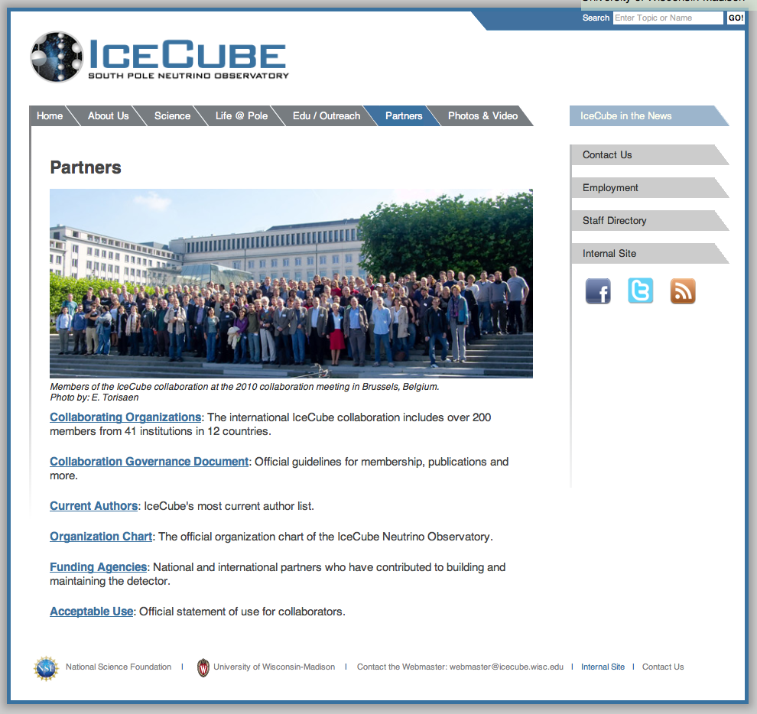

Slide 4
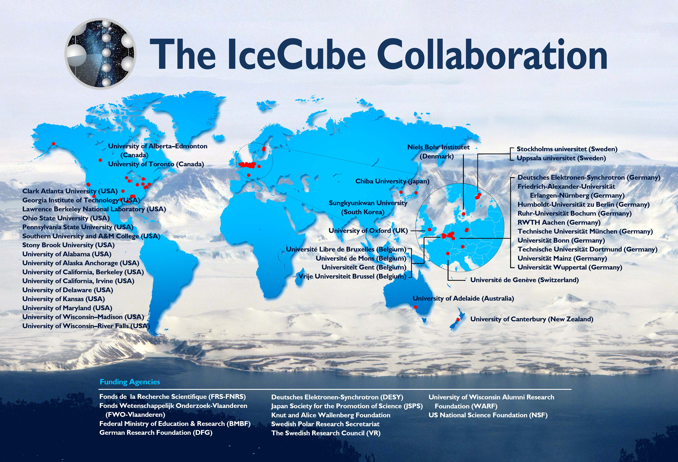
IceCube & PINGU collaborations

Slide 6
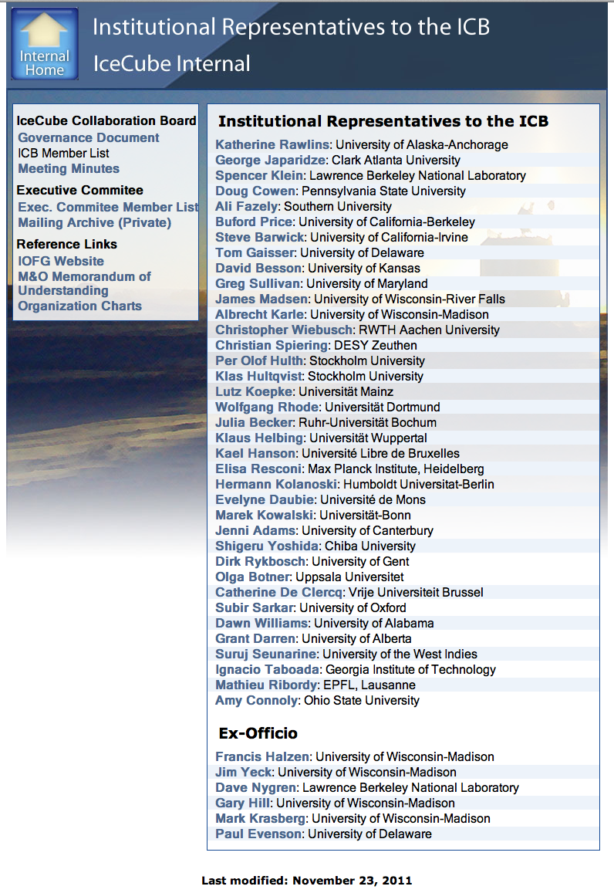
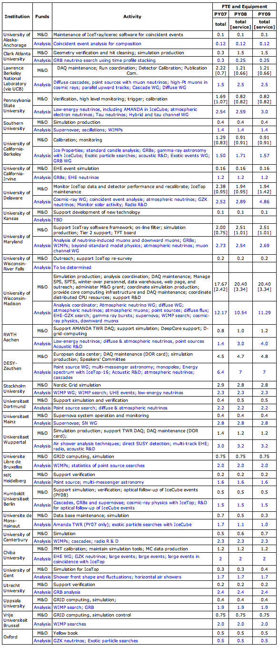
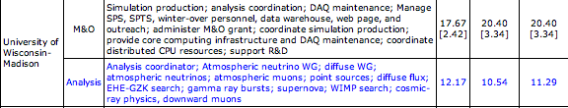
collaboration-wide MOU

Slide 7
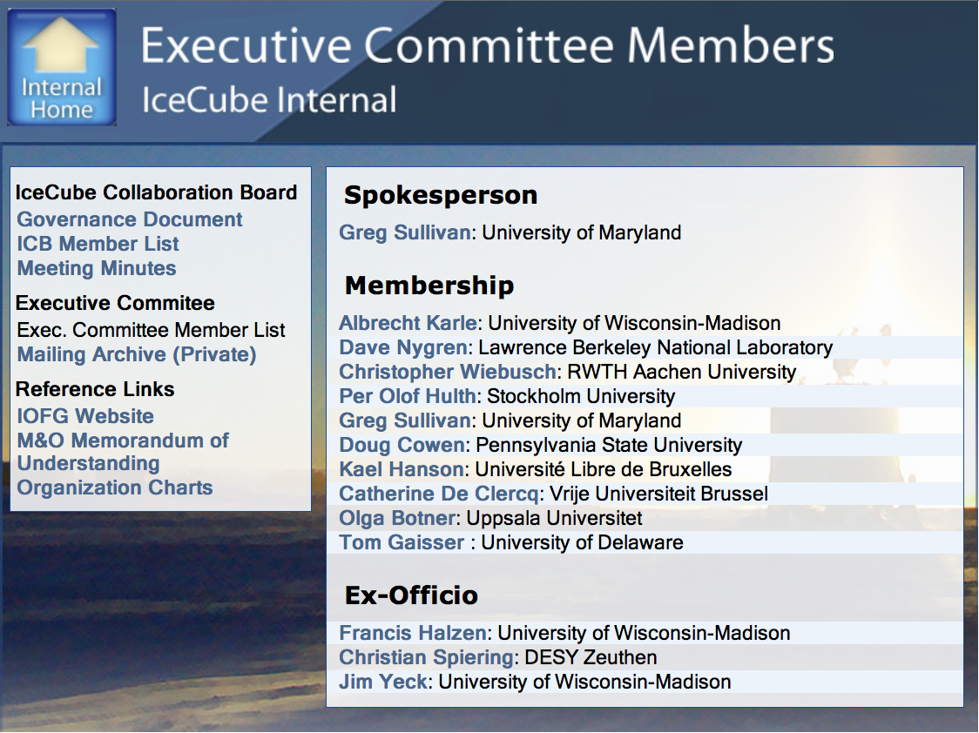

Slide 8
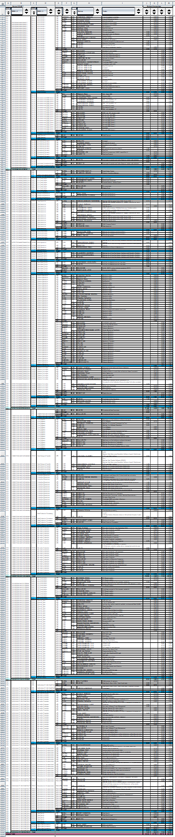
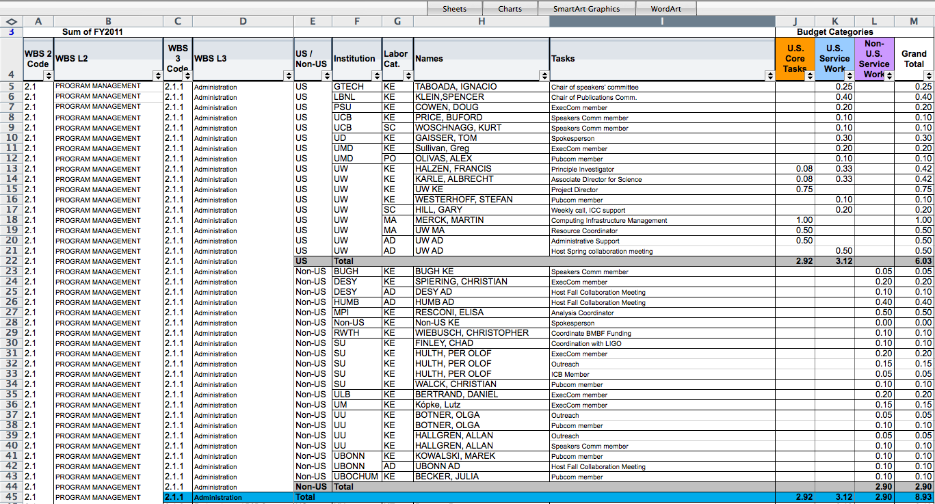
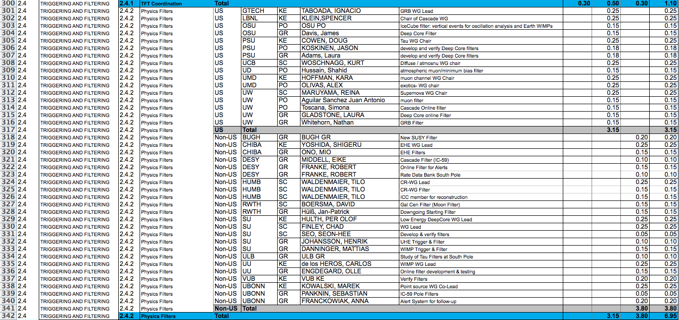
IceCube operation
from hardware to publication

Slide 9
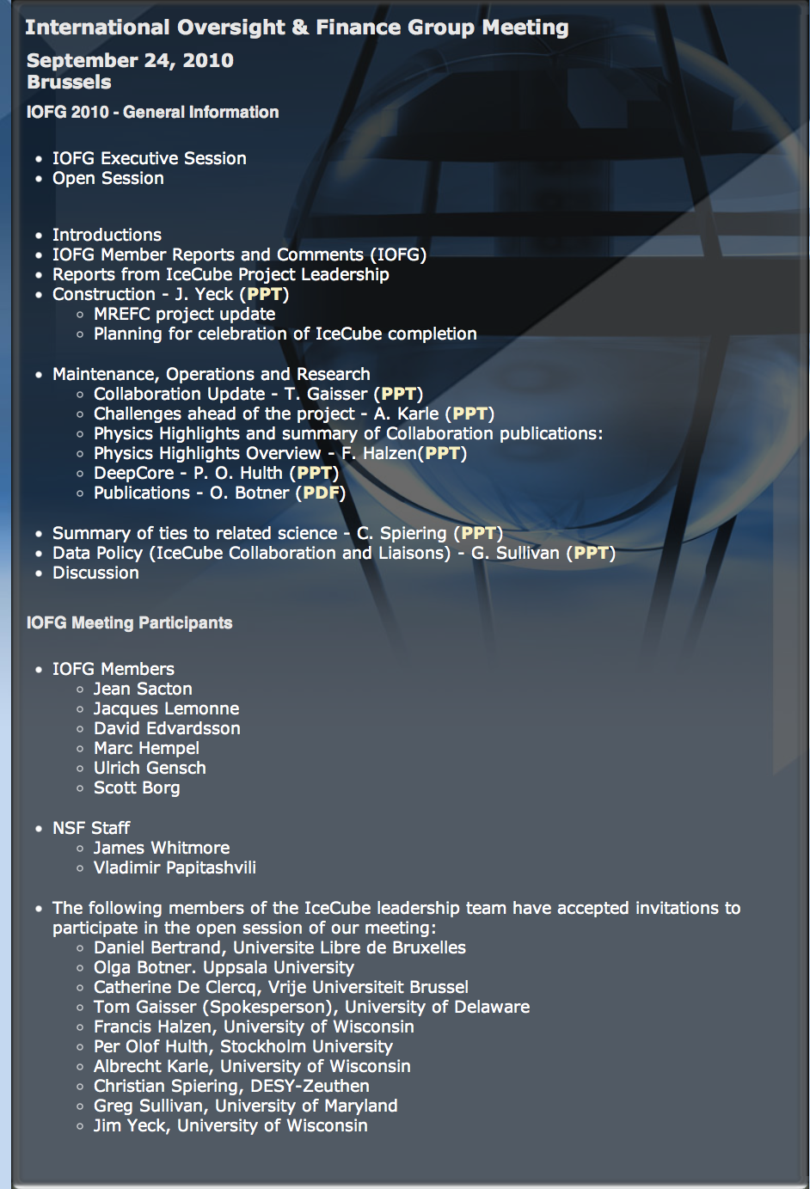

Slide 10
what was helpful?
developed the techniques and designed the final detector within a totally integrated international effort
even though construction and operations was mostly funded by the NSF, the execution is distributed over the international collaboration
construction was distributed over the collaboration (3750 DOM constructed at UW-Madison and 2231 at European sites)

