Slide 1
The Radiochemical Detector Robert Zwaska Fermilab May 22, 2014 High Power Targetry Workshop

Slide 2
Thanks for Discussion and Input
Moses Chung
Nathan Eddy
Ben Freemire
Nikolai Mokhov
Igor Rakhno
Gianni Tassotto
Randy Thurman-Keup
Alvin Tollestrup
Katsuya Yonehara
Jim Zagel

Slide 3
Introduction
Instrumentation for the beam resulting from the target
Secondary Beam Instrumentation
Target Hall Instrumentation
Target & Horns Instrumentation
Beam Monitoring
Neutrino beams, particularly, need a beam of consistent composition
Within a few % over the exposure period
Challenges for the instrumentation:
Measurement quality (precision, stability, etc.)
Survivability

Slide 4
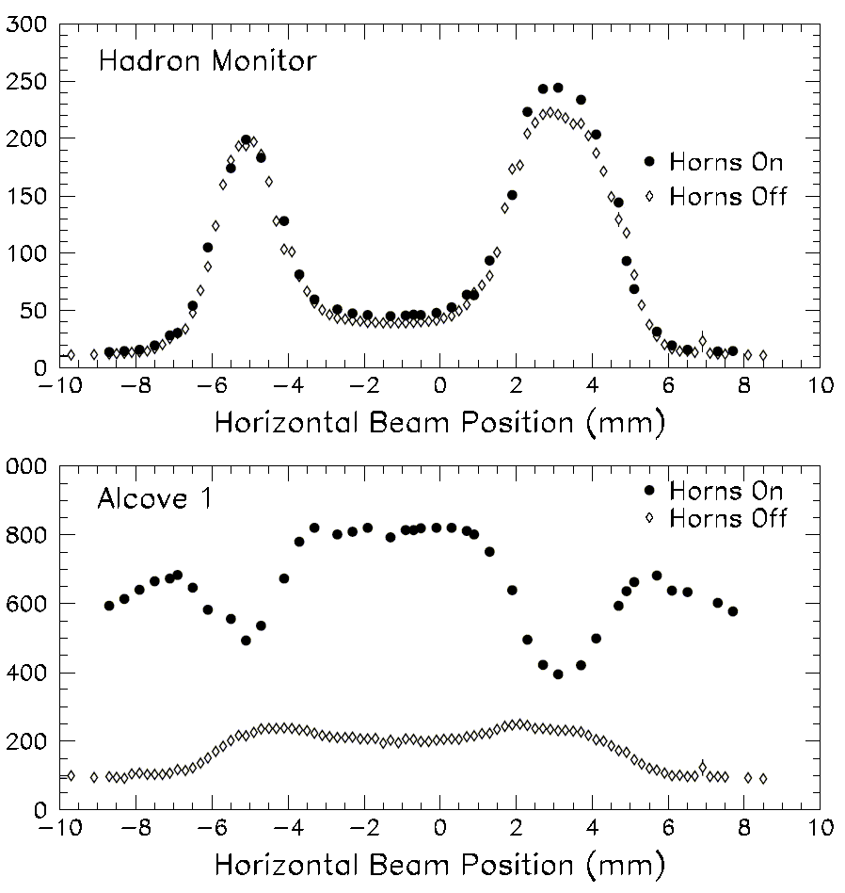
Example: NuMI Target Alignment
Proton beam scanned horizontally across target and protection baffle
Hadron Monitor used to find the edges
Measured a small (~1.2 mm) offset of target relative to primary beam instrumentation.
Systematic effect of this misalignment would exceed statistical uncertainties
Baffle
Horn
p
Target
π
baffle
baffle
target
Graphite protection baffle
Water cooling line
Pulse Height in Chamber (arb.)
Horizontal Fin
21.4 mm
15.0 mm
11.0 mm
baffle
baffle
target
6.4 mm
Graphite target
Notes:
Harp on implementation

Slide 5
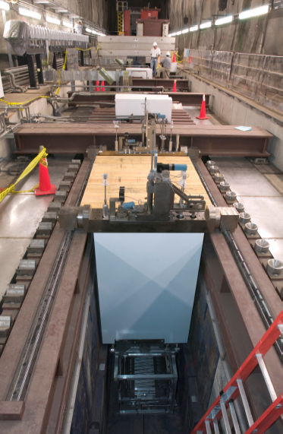
Why was the Target Misaligned?
Aimed at the target by using correctors and 2 BPMs, 10 & 20 m upstream
BPM precision better than 0.1 mm
Everything aligned optically to few tenths of a mm
Loading of the target hall
Shielding piled on top after the optical survey – this can be corrected
Thermal deviation
Stations are fixed at different locations, move relative to eachother as temperatures change
Can we design these out? Were we just unlucky?

Slide 6
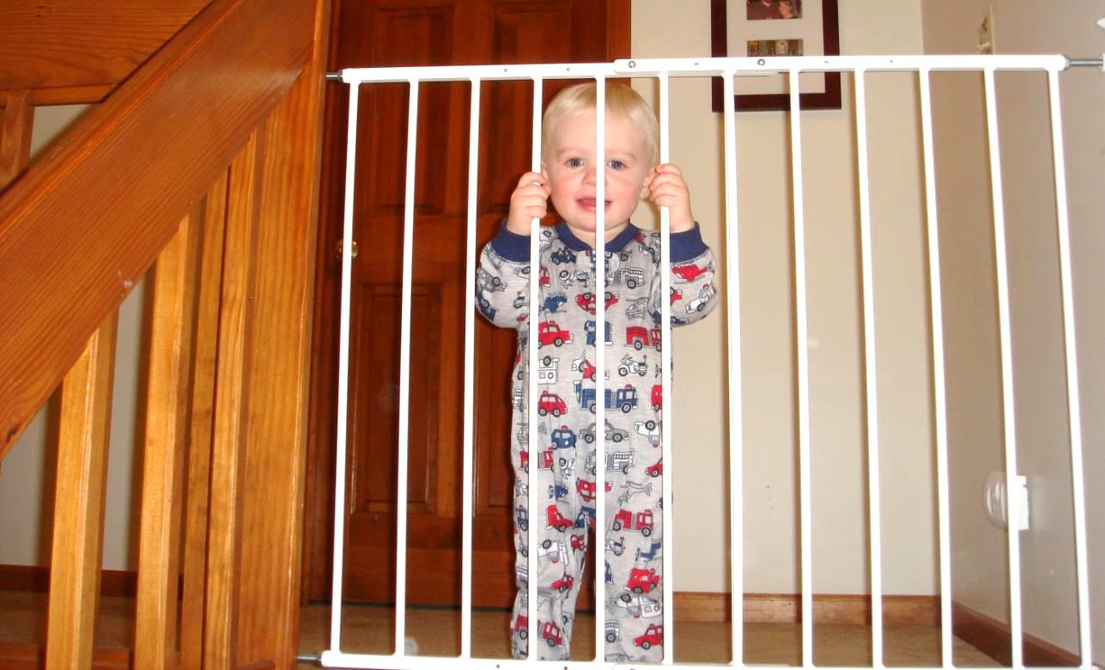
These Issues are Everywhere
Gate at the top of my stairs, installed in summer

Slide 7
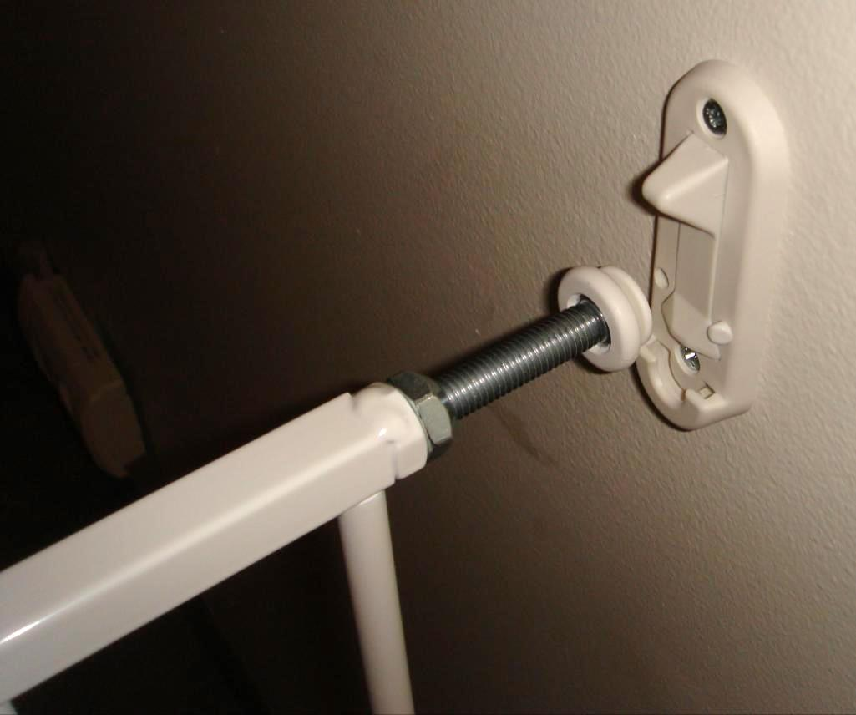
Tight Closure

Slide 8
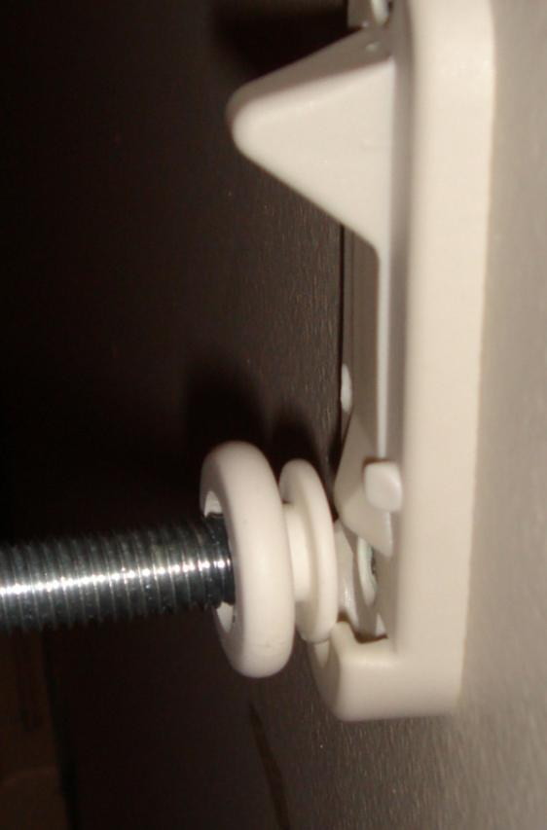
Misaligned by ~ 2 mm
Change of seasons in a temperature-controlled building caused a misalignment of 2 mm
This difference accumulated over only 1 m of span
Here, it is a safety issue!
We are fortunate we only had ~ 1 mm to deal with in NuMI

Slide 9
Approach to Tolerances
Minimize
Model
Measure

Slide 10
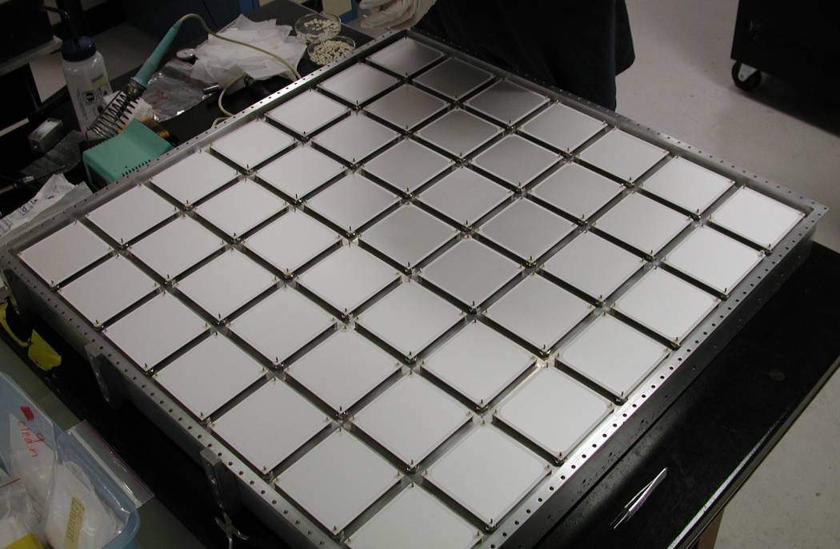
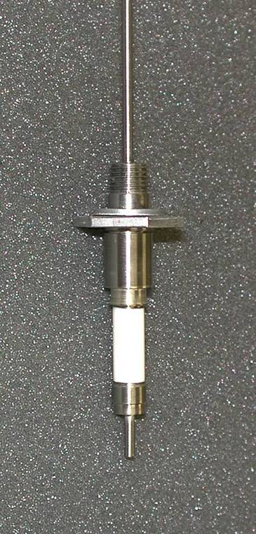
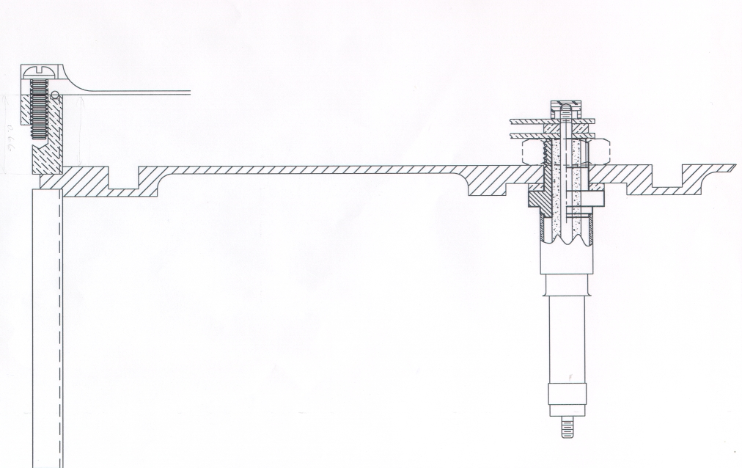
Measure: NuMI Hadron Monitor
This is what we want to replace:
Array of helium ionization chambers
Sits in the beam at the end of the decay pipe
Measures remaining proton beam and larger secondary beam
Needed for operation and alignment
Degrades with exposure
Radiation damage of components or cables
Sensitive to gas composition
Lid
Ceramic
Washer
Stainless
Nut
Ceramic
Plates
PEEK
Cap
Aluminum
Gasket
Stainless
Bulkhead
Ceramic
Feedthrough

Slide 11
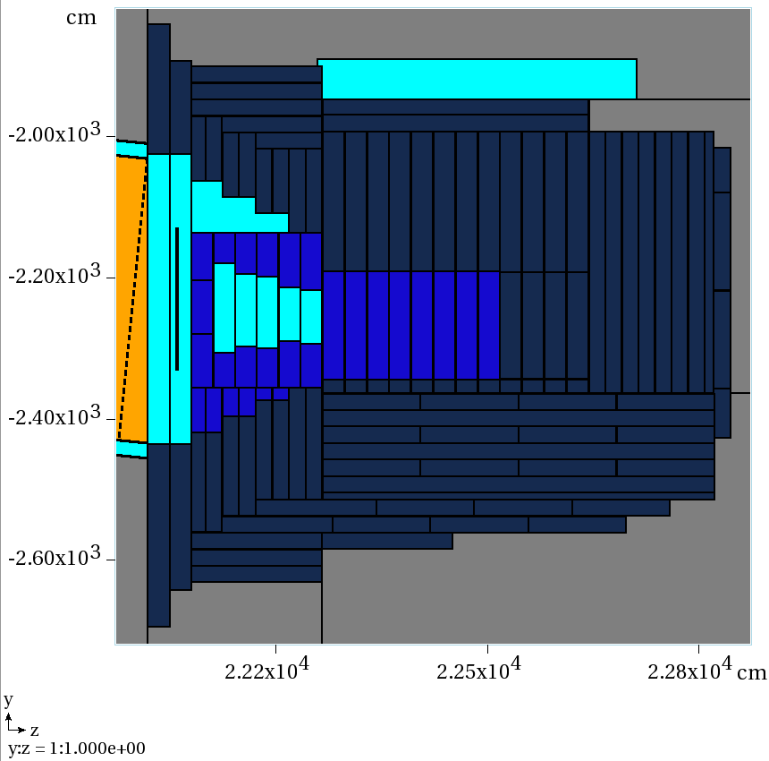
LBNE Hadron Monitor Placement
Air
HM
He
N. Mokhov

Slide 12
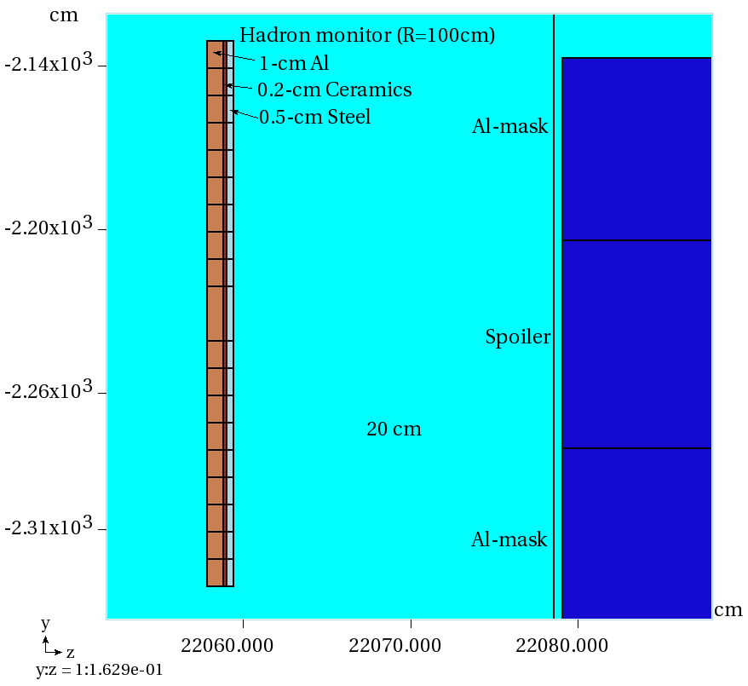
Hadron Monitor Model in MARS
N. Mokhov

Slide 13
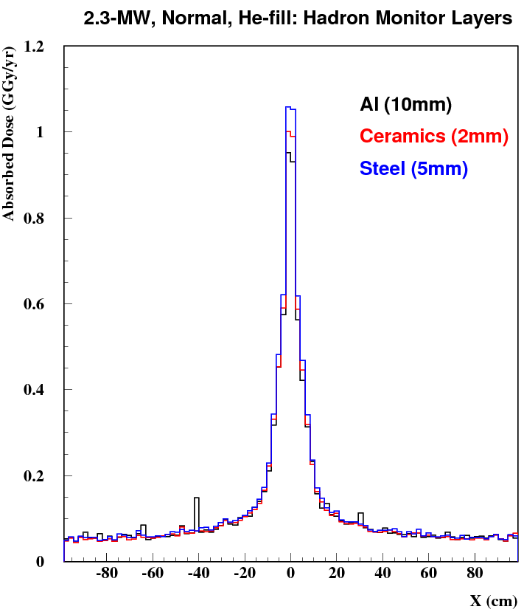
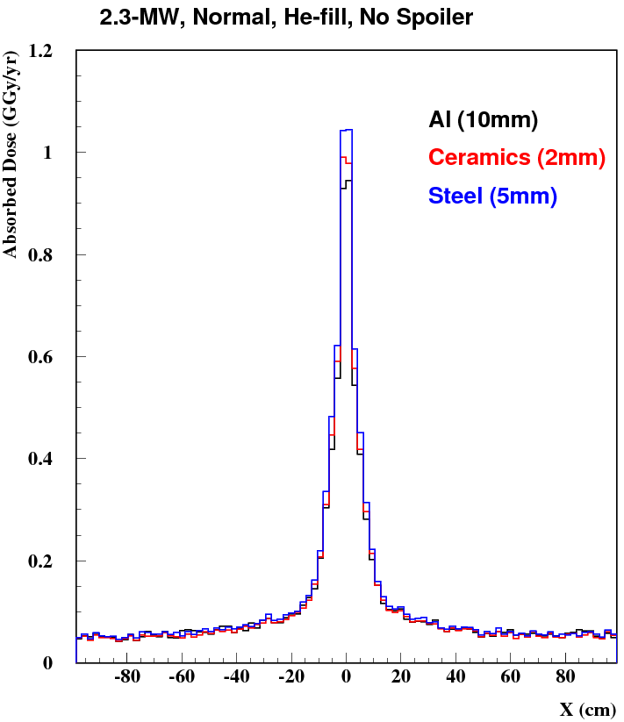
Absorbed Dose
N. Mokhov

Slide 14
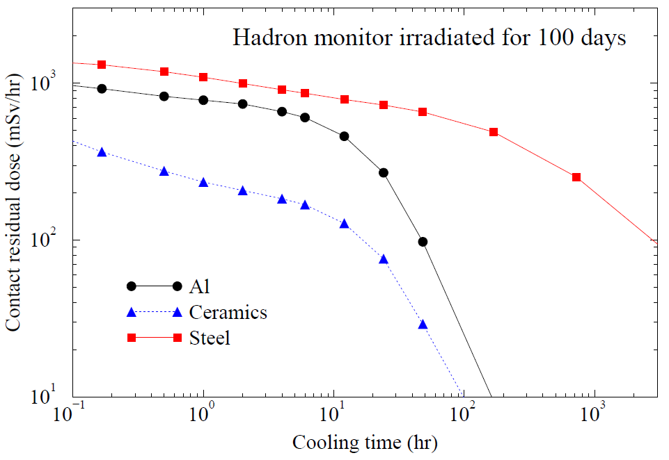
Residual Dose on Contact
N. Mokhov

Slide 15
Summary of Environmental Issues
Dose to components: 500 MGray / yr.
0.02 DPA/yr
Residual activation after a few days:
0.5 Sv/hr for steel
10-100x less for Al and Ceramic (advantage grows with time)
Particle Flux:
10¹² charged particles / cm² in center of monitor
Drops off fast
10¹¹ neutron / cm² background
Heating
Max density: 0.2 W / cm³ in steel

Slide 16
Detector Options
LBNE detector will be subject to ~ 20x greater flux than NuMI
Shorter decay pipe
Higher beam power
Extension of the ionization chamber technology is difficult and risky
Chambers themselves, but also electrical cables and feedthroughs
Some conventional options:
SEMs
OTR
…

Slide 17
New Concept: Flowing Gas Detector
Actively flow reactants through the region.
Beam ionizes the gas and produces reaction products
Products are measured outside of the radiation field
Time series measurement can give spatial information

Slide 18
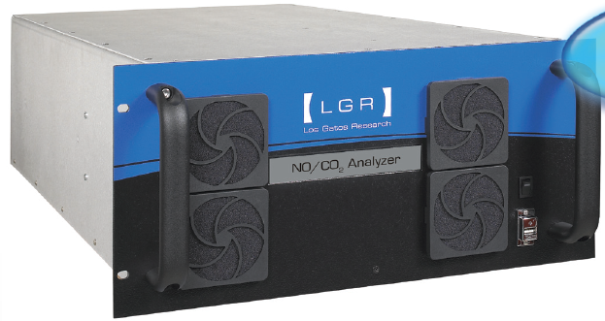
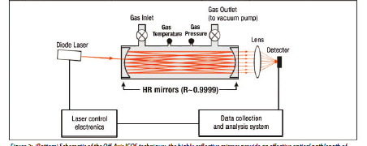
Choice of Reactants
E.g. aN₂ + bO₂ -> NOX
Ionize few parts in 10⁵ each spill
Commercial, flowing detectors available
1 ppb NO sensitivity
Up to 10 Hz rate
“Cavity-Enhanced Laser Absorption Spectrometry”
Numerous other options (chemistry)
Electrical conductivity of water is a great proxy, but water is not so desirable
Would need to calibrate the approach and understand linearity
Seriously considering a prototype of this for LBNE

Slide 19
Bonus Concept: Microwaves
Passage of microwaves through a plasma induces a phase shift proportional to plasma density:
Fusion community uses laser interferometry to interrogate plasmas
Optical paths into the shielding not so desirable
Microwaves can be transported with waveguides

Slide 20
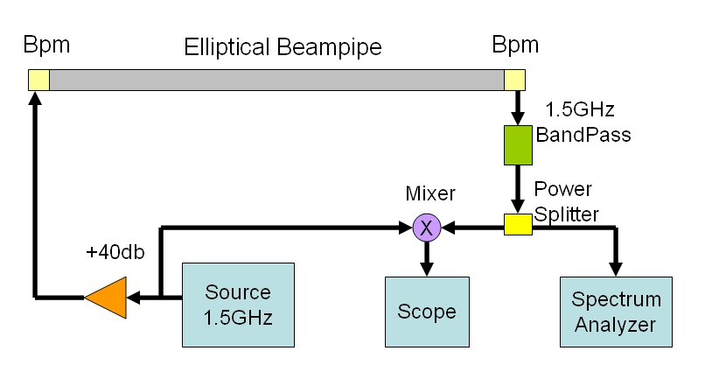
Existing Experiment: ECloud Measurement with Microwaves
ECloud induced phase shift
Carrier is injected with BPMs at just above the cutoff for the elliptical beam pipe
Beam modulates the ECloud
ECloud cause PM of carrier
PM accumulates over the distance
Sideband, zero-span, and direct phase measurements
Sidebands come from modulation, give intensity (convolved with harmonic information)
Zero-span gives a cycle-wide measurement of intensity
Direct phase gives excellent time resolution
Issue is getting enough transmission
FERMILAB-CONF-09-168-AD
inspirehep.net/record/820122

Slide 21
Microwave Detector
Effect would integrate along path length
Time resolution would be very good
Requires tricky/expensive electronics
Need to understand normalization of the plasma to ionization and linearity

Slide 22
Conclusion
Need for secondary instrumentation in neutrino beams
Needed for operation and alignment
Subject to enormous particle fluxes and radiation damage
Existing technology from NuMI is questionable for LBNE
Gaseous ionization chambers
Uncertain gas linearity issues
Problem of electrical connections and cables
Considering novel approaches that do not involve wires or electrodes
Radiochemical detector uses the beam to react gasses, the products are detected outside
Time-series can give spatial information
Microwave detector uses the plasma from ionization to induce a phase shift in a passing microwave
Proven concept, enormous signal
An affordable, stable system may be out of reach

Slide 23
The Radiochemical Detector Robert Zwaska Fermilab May 22, 2014 High Power Targetry Workshop

