Slide 1
Design and Development of a High Temperature Radiatively Cooled Tungsten Target for Mu2e
Chris Densham, Peter Loveridge, Joseph O’Dell, Roger Bennett
(Rutherford Appleton Laboratory, UK)
Rick Coleman, Steve Werkema, Mike Campbell, Vitaly Pronskikh,
(Fermilab)
and the Mu2e Collaboration

Slide 2
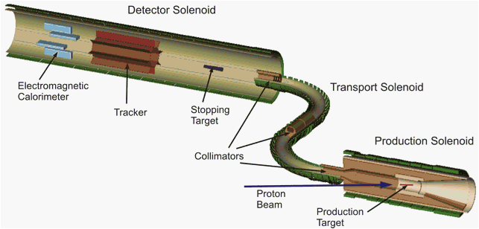
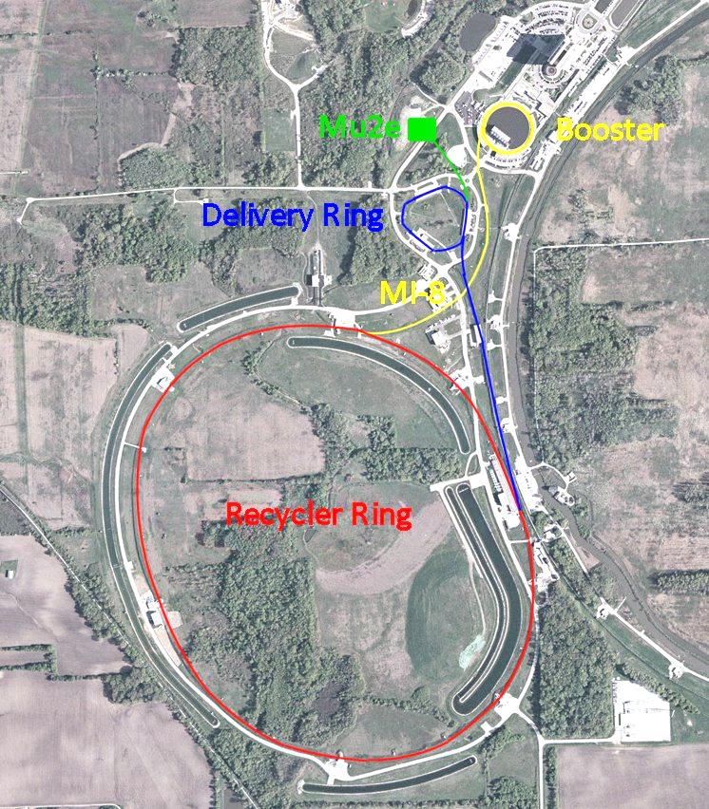
The Mu2e Experiment
Beam kinetic energy | 8 GeV
Beam spot shape | Gaussian
Beam spot size | σx = σy = 1 mm
Main Injector cycle time | 1.333 sec
Number of spills per MI cycle | 8
Instantaneous spill rate | 18.5 Tp/sec
Average spill rate | 6 Tp/sec
Duration of Spill | 54 msec
Average Beam Power | 7.7 kW
Average Power in Production Target | 0.6 kW

Slide 3
Why a Radiation Cooled Target?
A tungsten target rod directly radiates the beam induced heat load to its surroundings without the need for an active coolant.
Advantages Over Forced Convection Cooling:
The cost of an active cooling circuit is avoided
- no plant room, circulation plant, or maintenance required
the remote target exchange process is greatly simplified
- fewer operations = lower risk, smaller assembly
Disposal of spent targets is simplified
- e.g. no active water, smaller target assembly/cask
The potential for coolant leaks in the high-radiation target environment is eliminated

Slide 4
Target Challenges
A feasibility study of this radiation cooled target concept was previously carried out in the CD1 phase. Following on directly from that study a programme of design, development and testing was launched in order to address the key technical issues identified:
High Temperature Operation
- How hot will the target get?
- Are its material properties adequate at this temperature?
- Will it suffer from chemical attack?
Beam-induced Thermal Cycling
- Can we rule out failure by fatigue?
Support Structure
- Can we design a support structure that is able to cope with the target temperature?
- What material / manufacturing options are available?

Slide 5
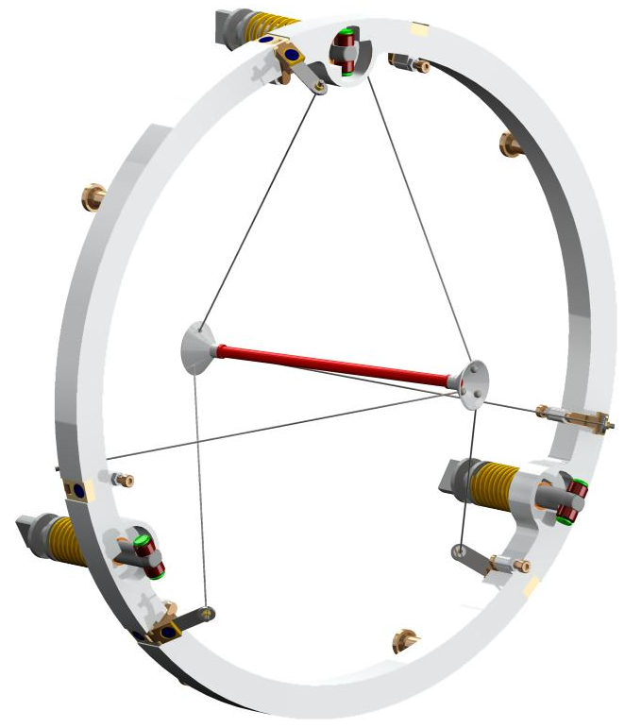
Target conceptual design
Titanium mounting ring
Refractory metal spokes
Radiatively cooled Tungsten target
Refractory metal hubs
Mounting wheel to HRS remotely operable locking mechanism (Fermilab concept)
Spoke tensioners

Slide 6
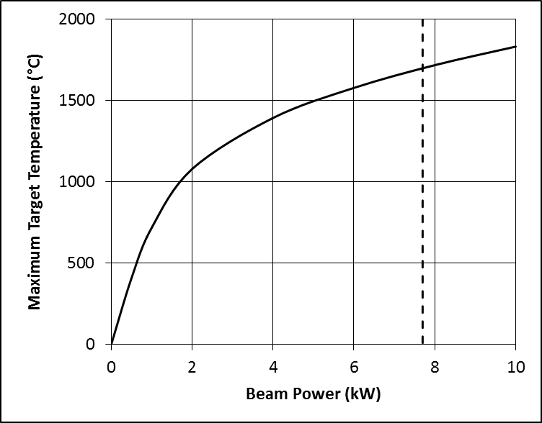
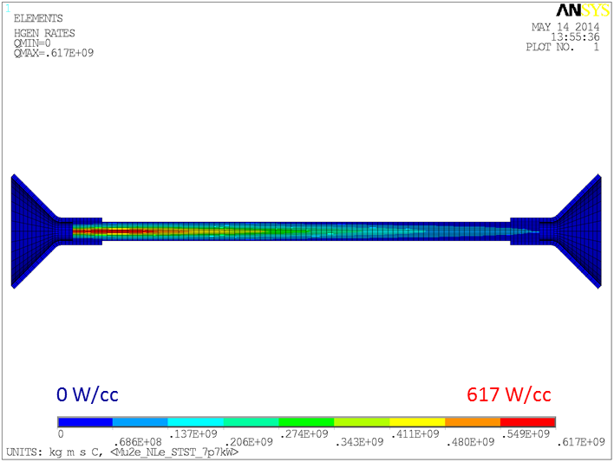
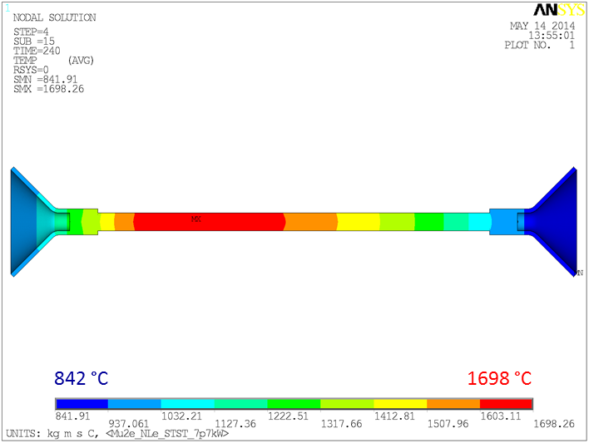
Beam Power Distribution and resultant target heating
600W deposited in the target
7.7kW Mu2e beam power
beam
Peak steady-state temperature around 1700°C
50°C pulsed temperature rise @ 0.75 Hz

Slide 7
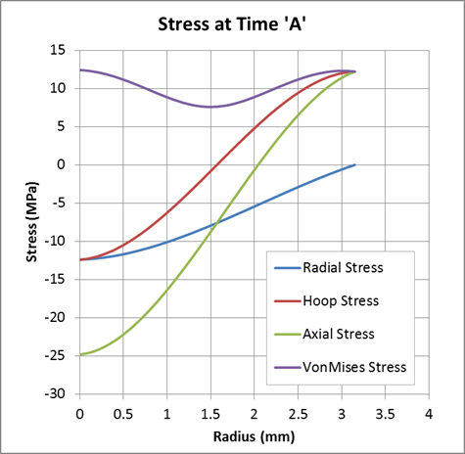
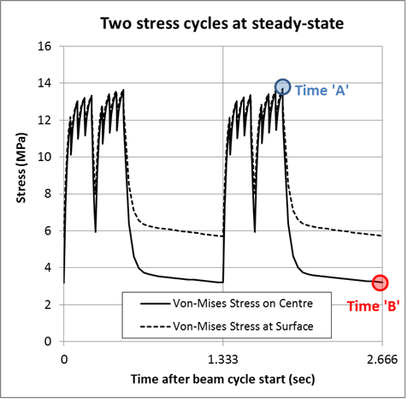
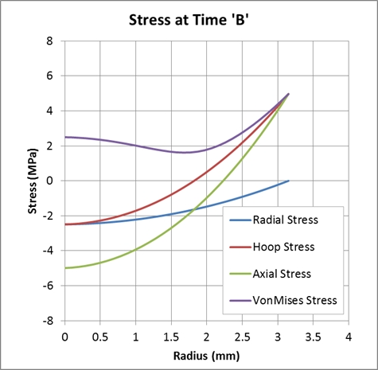
Thermal Stress Cycling in the target
Beam pulses set up transient stresses in the target
Compressive at core, tensile at surface
Long spill (54 msec) = quasi-static stress

Slide 8
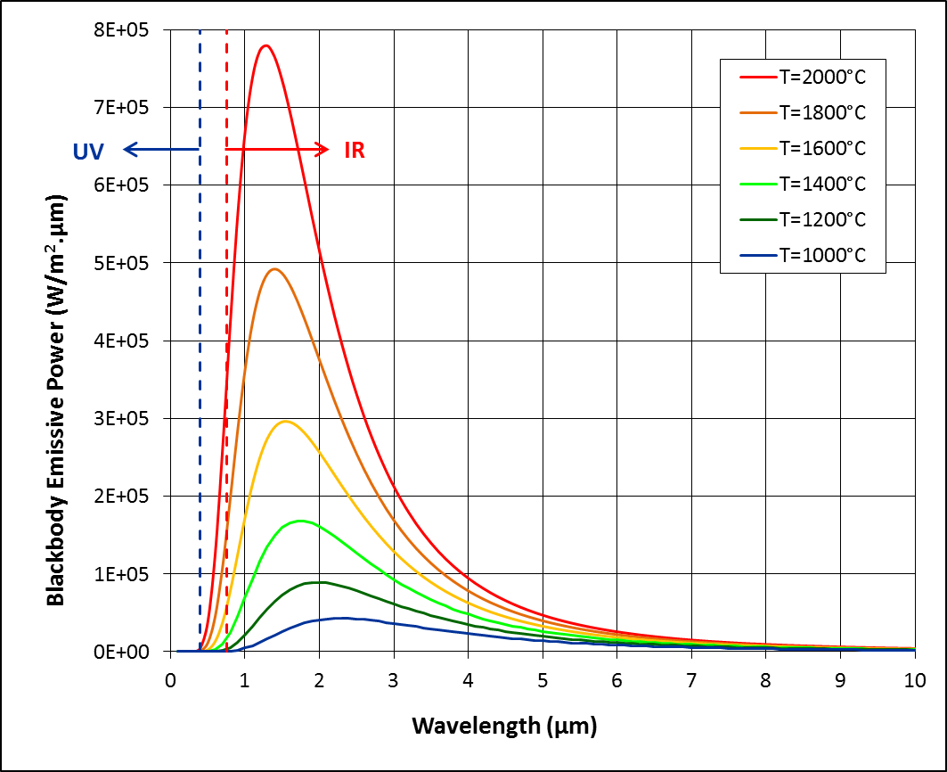
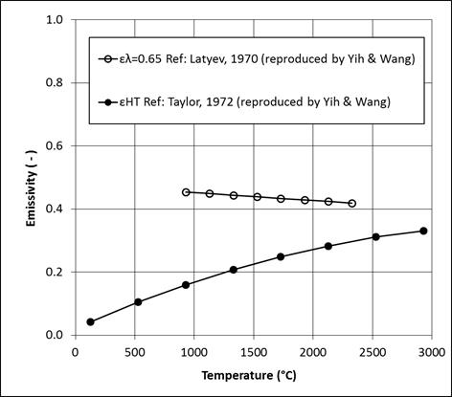
Rationale for Emissivity Measurements
Target operating temperature depends on heat load, surface area, thermal emissivity
Literature data for polished (smooth) tungsten surfaces. Are they valid for real engineering surfaces?
‘Monochromatic emissivity’ – needed to determine pyrometer temperature corrections
‘Total hemispherical emissivity’ – needed to determine radiative heat transfer

Slide 9
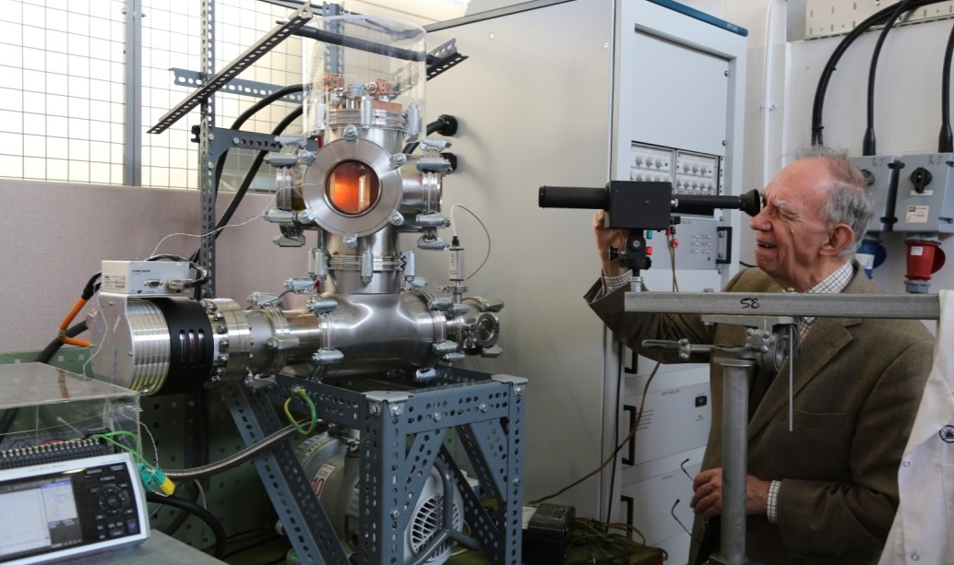
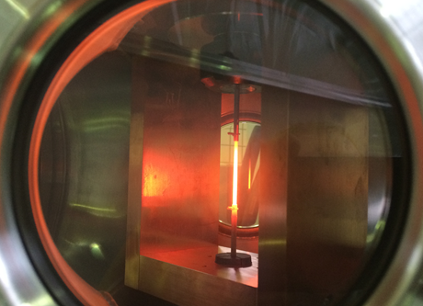
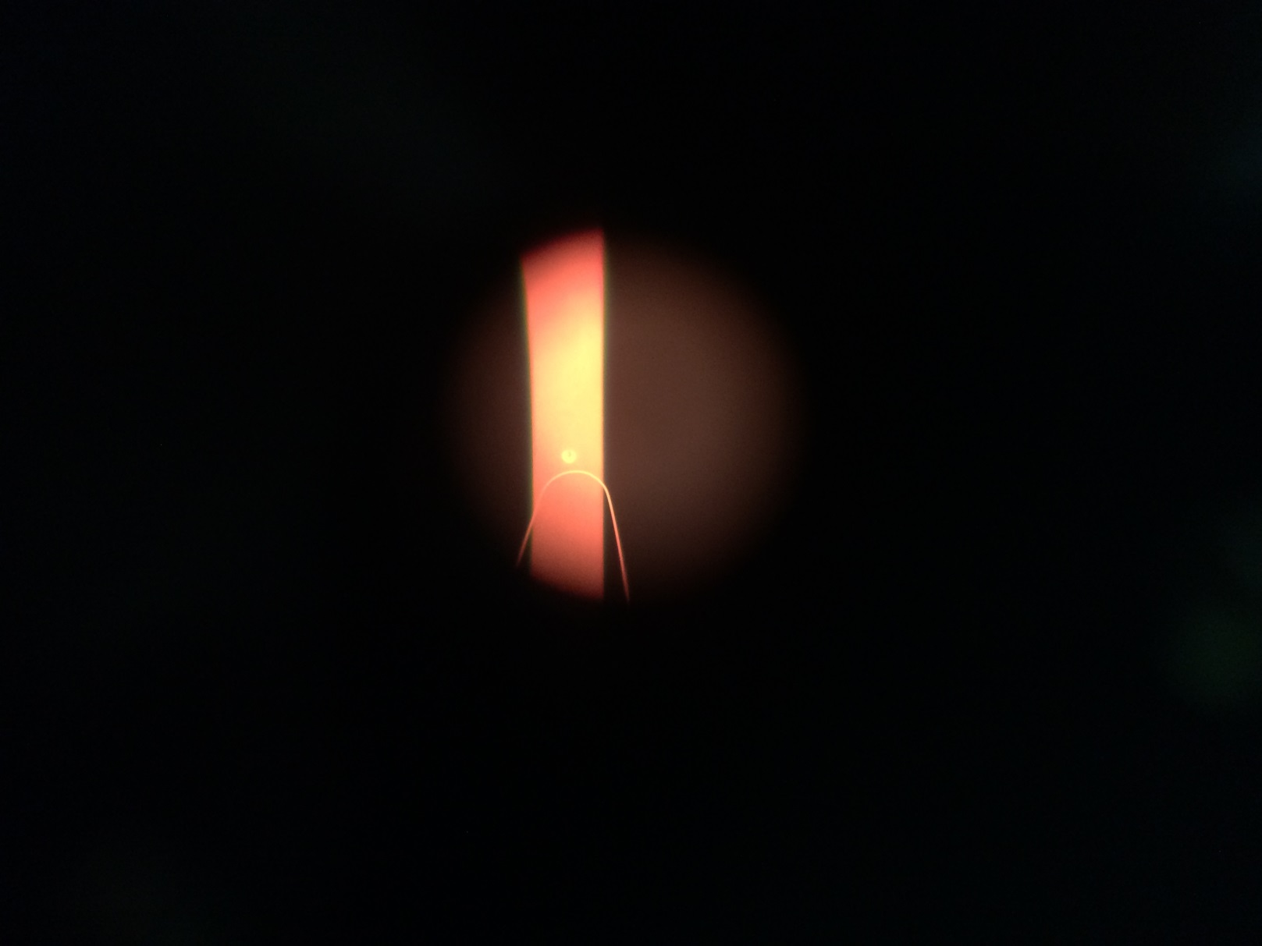
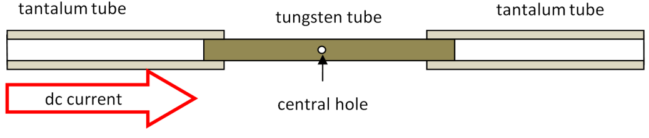
Measuring Monochromatic Emissivity
Operating the disappearing filament pyrometer
A tungsten sample under test
View down the pyrometer telescope
The little hole forms a quasi black-body cavity

Slide 10
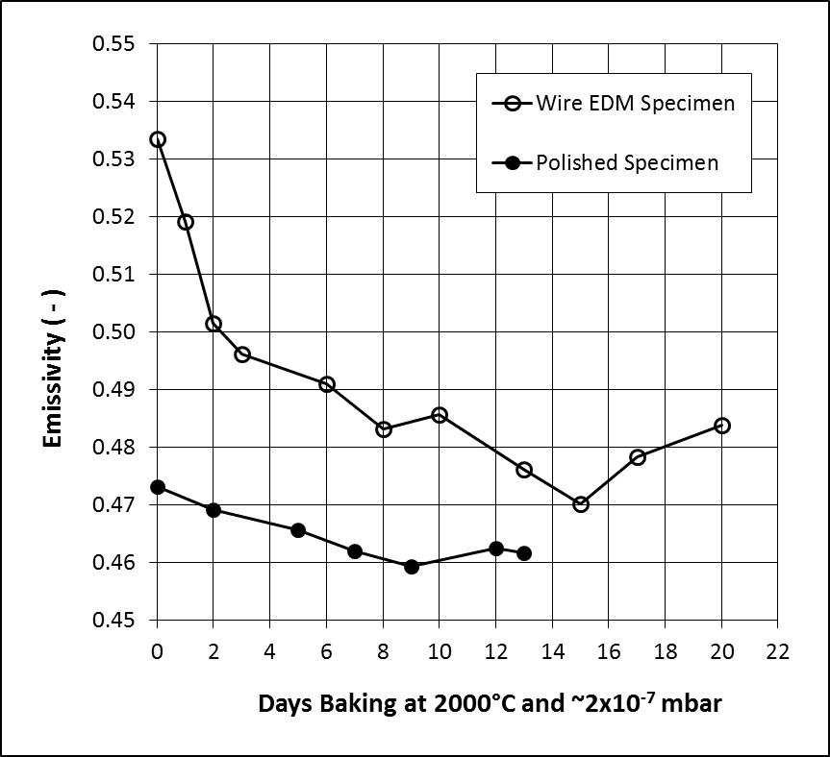
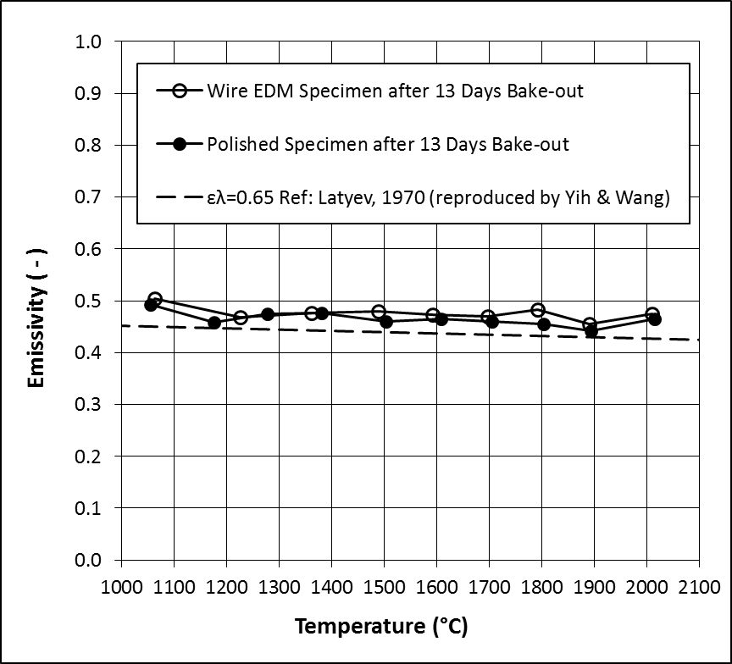
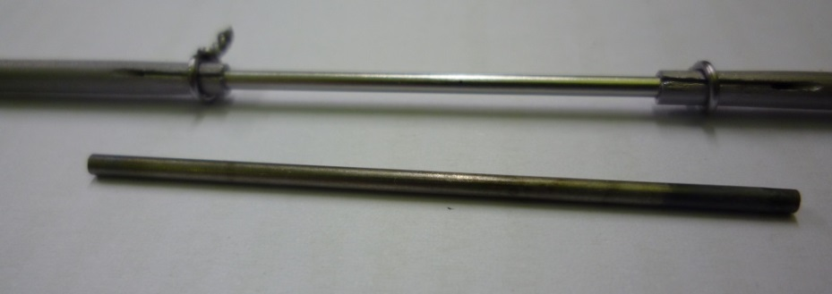
Monochromatic Emissivity Measurement Results
Little difference observed in emissivity between rough (EDM machined) and smooth (polished) surfaces.
Indicates that we can apply literature data on polished material to designs using real engineering surfaces.
Ground tungsten Samples were dull/grey in appearance before testing
They became shiny in appearance after the test

Slide 11
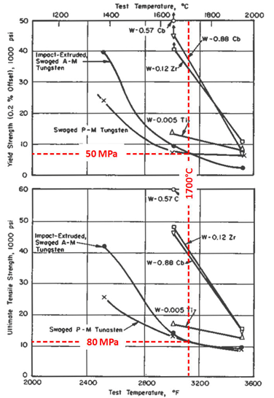
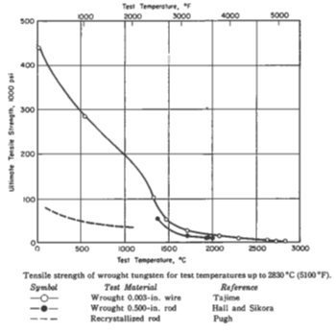
High Temperature Tensile Properties of Tungsten

Slide 12
Rationale for Thermal Fatigue Measurements
There is a scarcity of data available in the literature to predict the fatigue life of tungsten at the relevant temperature (~2000K) , and number of cycles to failure (10⁷ - 10⁸)
Conventional fatigue machines typically operate at room temperature. There are commercially available fatigue machines that can go up to 1000°C using split furnace heaters. Need higher temperature.
High strain-rate lifetime measurements have been made by Skoro and Bennett at temperatures up to 2000°C. But the long beam spill at Mu2e will generate low strain rate effects.
The target is a critical component. Testing the proposed target material under representative load conditions is necessary to quantify the expected lifetime.

Slide 13
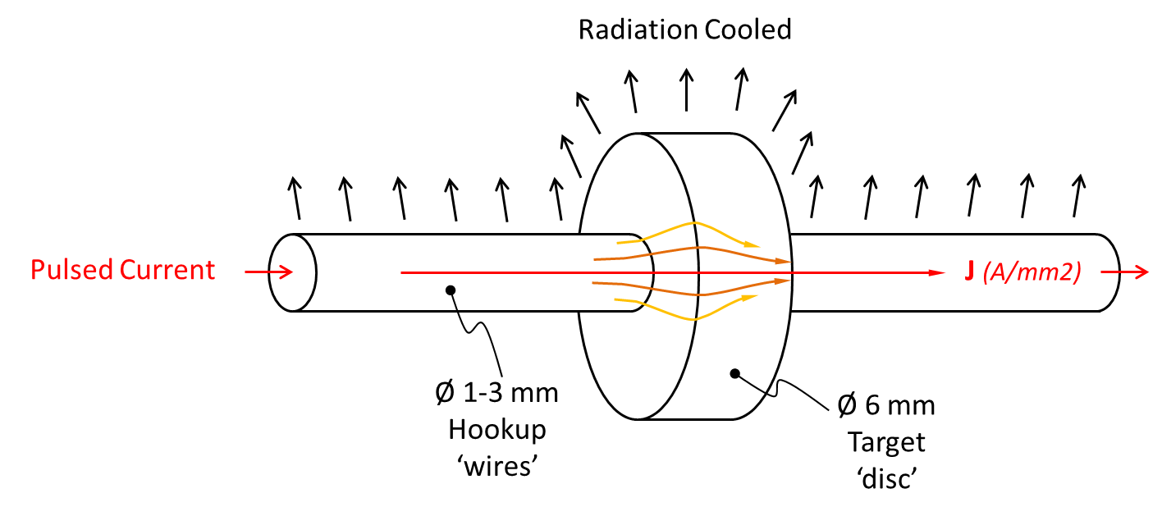
A Novel Lifetime Pulsed Heating Test
Operating Principle:
Use resistive (Joule) heating from an electric current pulse to preferentially heat the centre of a disk
Pulse length long enough to give ‘static’ stress field
(do not want inertial stresses)
Inter pulse gap long enough for transient stress component to decay
(on the timescale of thermal conduction)
Rep rate of 10’s of Hz
(to allow accelerated testing of target lifetime cycles)
RMS current tuned to achieve desired operating temperature
Reproducing the target conditions
Samples cut from representative stock material
Realistic engineering surface finish
Correct elevated temperature regime
Similar temperature jump
Correct strain-rate regime
Correct pressure (vacuum) regime
Thermally induced stress
Possibility to superimpose target self weight bending load

Slide 14
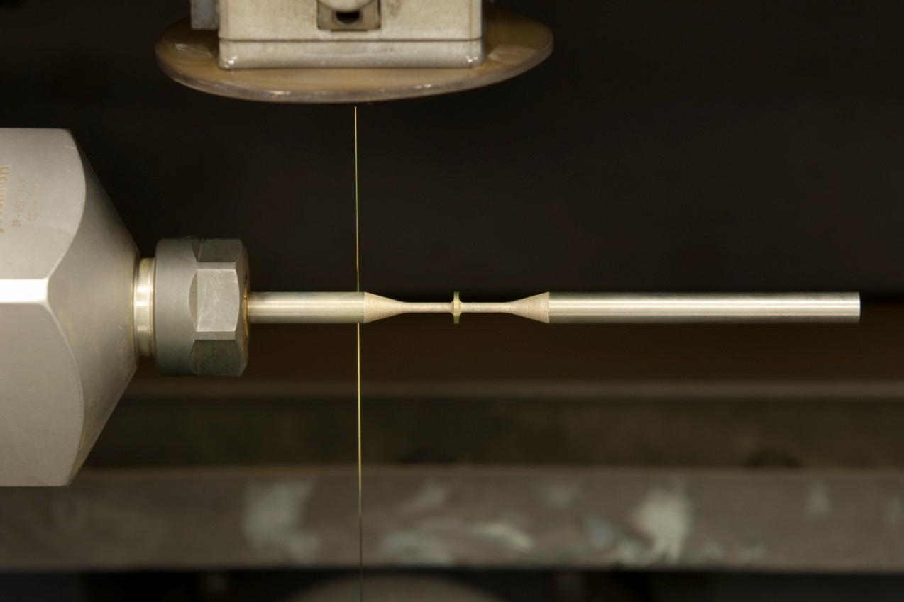
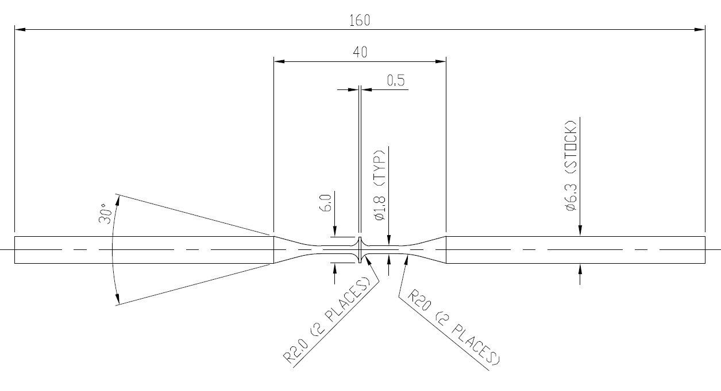
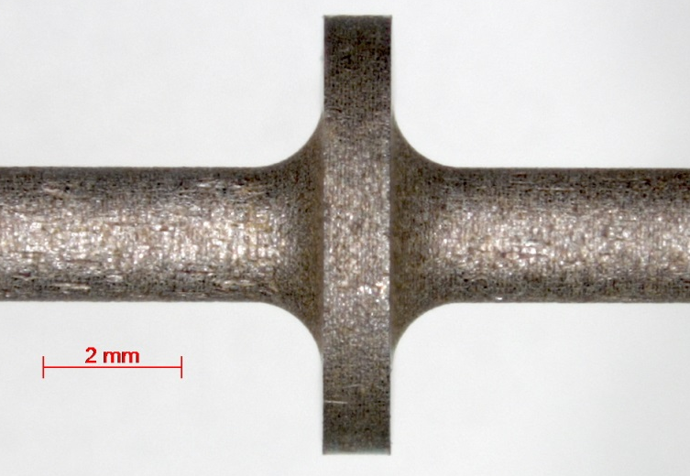
Tungsten Lifetime Test Samples
Stress-free ‘Turn and Burn’ wire EDM machining at RAL precision development facility

Slide 15
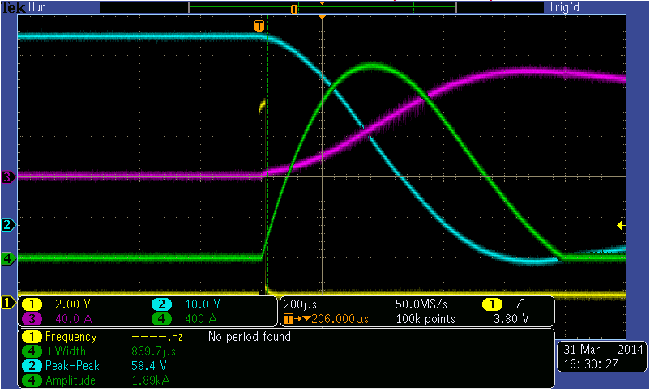
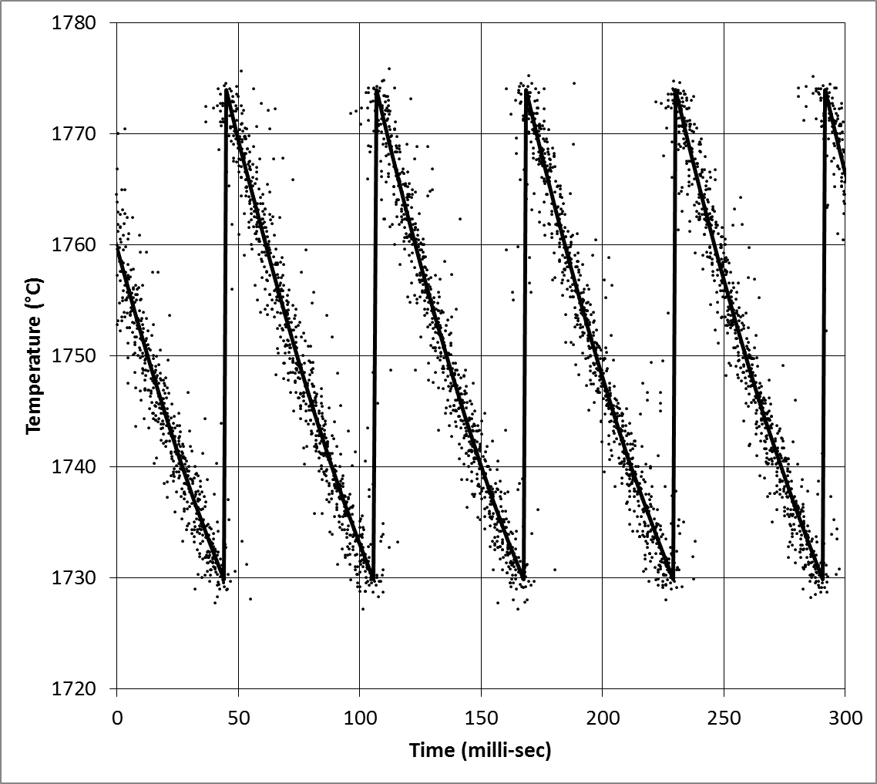
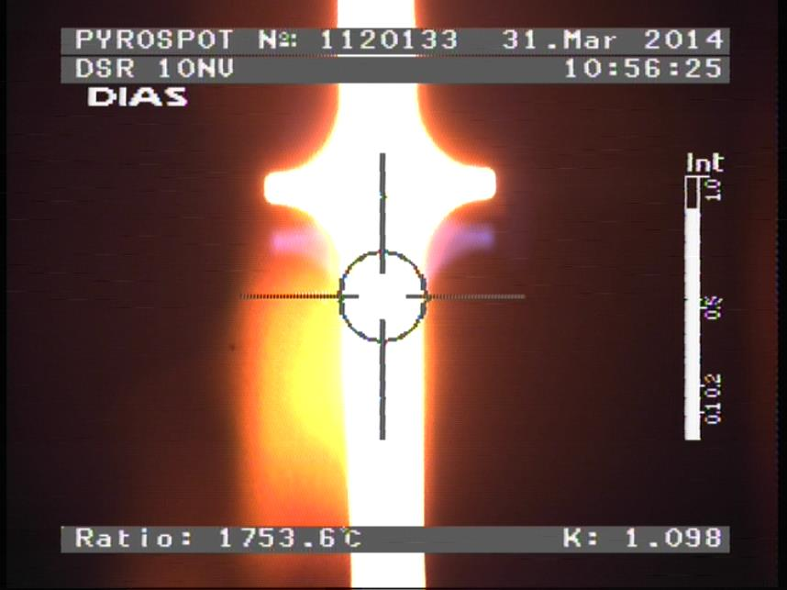
Diagnostics
Measurement Strategy
Cannot measure stress directly…
Simulate the test using multiphysics Finite Element Analyses
Current pulse shape measured and used in the simulations
Stress calculated from the predicted temperature distribution
Verify by measuring pulsed temperature rise in the test
Digital oscilloscope monitors the pulse parameters
Digital pyrometer screen plot

Slide 16
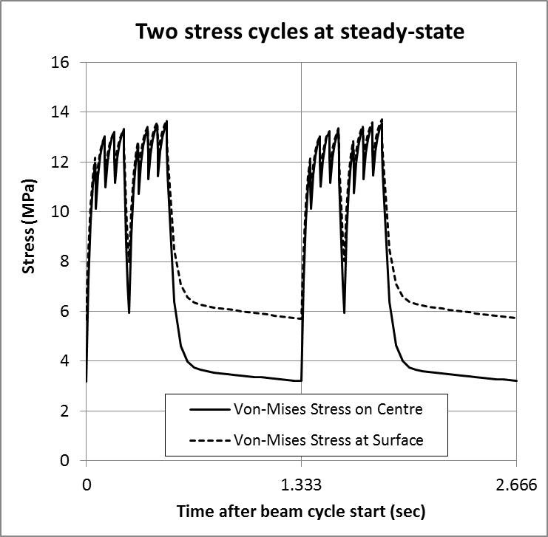
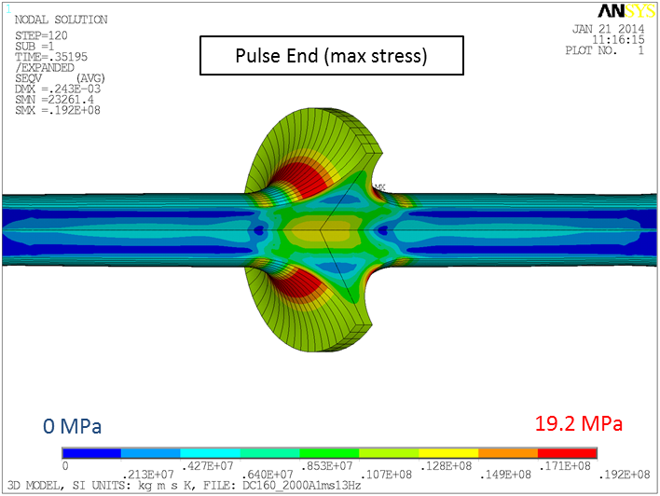
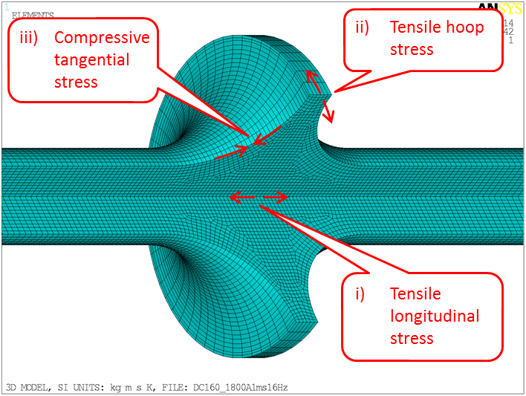
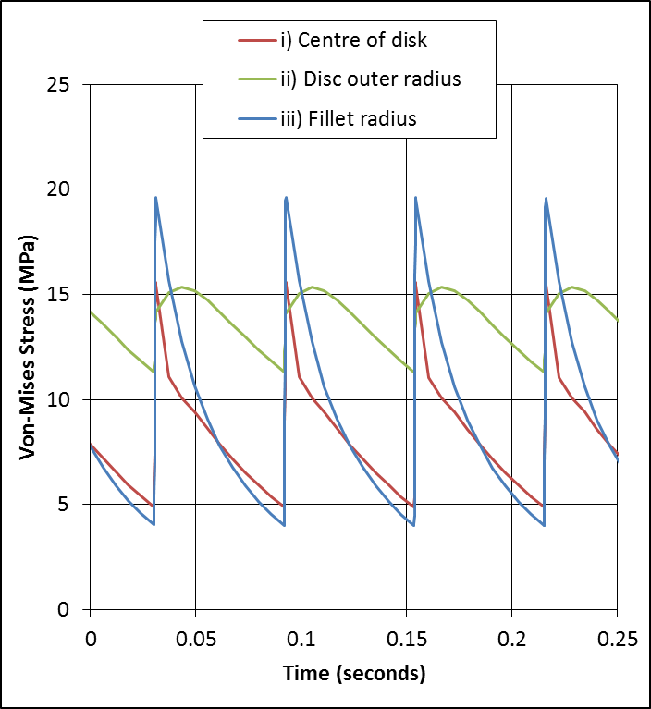
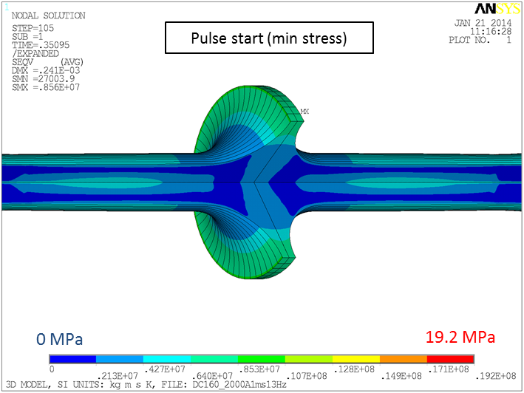
Replicating the Target Thermal Stress Cycle
Von-Mises stress in the specimen after a current pulse
Mu2e Target Stress Cycle
Von-Mises stress in the specimen before a current pulse
Test Specimen Stress Cycle

Slide 17
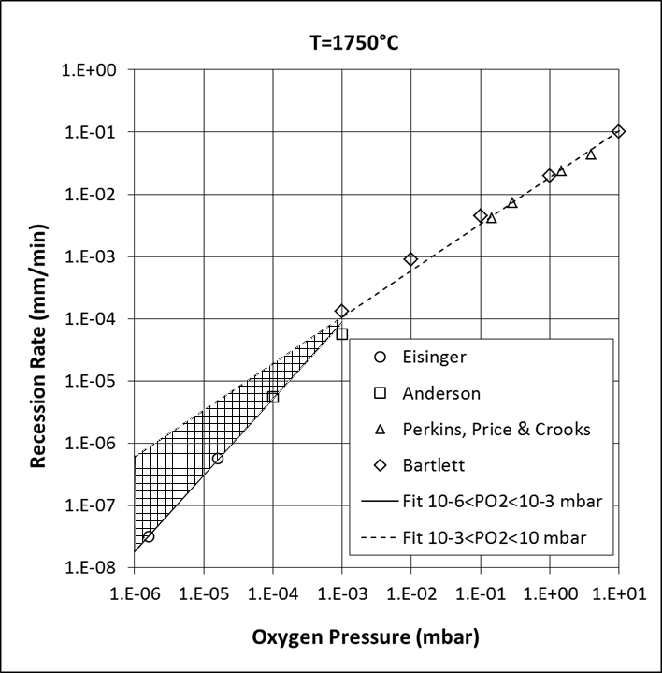
Rationale for Chemical Erosion Tests
At temperatures exceeding ~1300°C in vacuum, tungsten oxide will evaporate faster than it is formed. In this regime oxidation is realised as a surface recession, the rate of which depends strongly on temperature and oxygen pressure.
Surface recession of initially cylindrical tungsten rods heated in a low oxygen pressure
Literature data on recession rate as a function of oxygen pressure

Slide 18
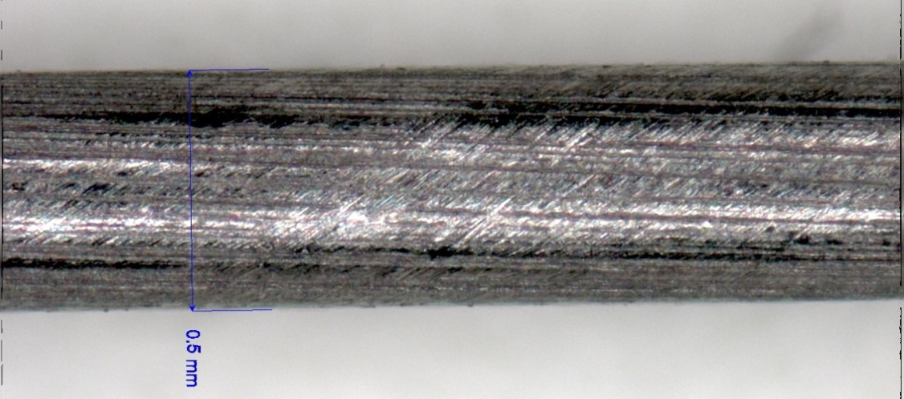
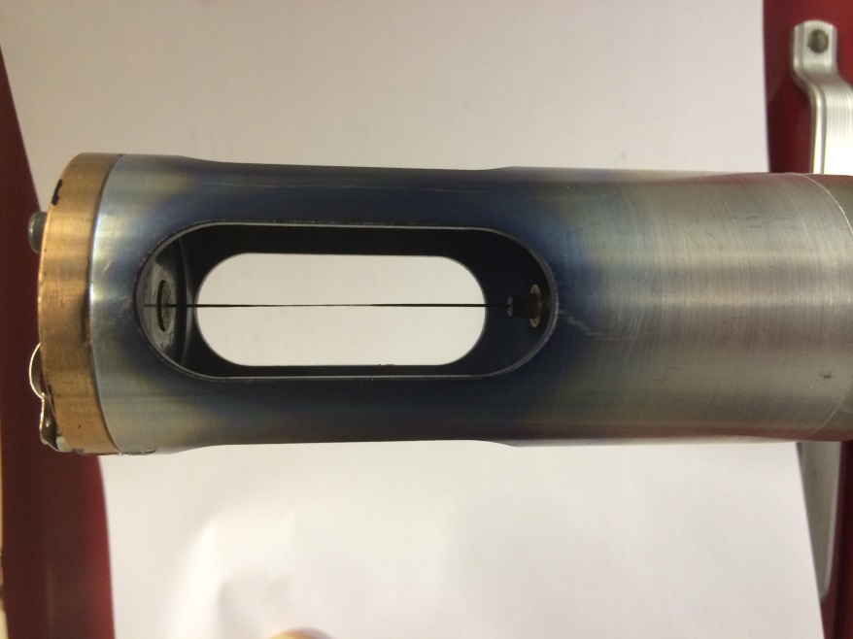
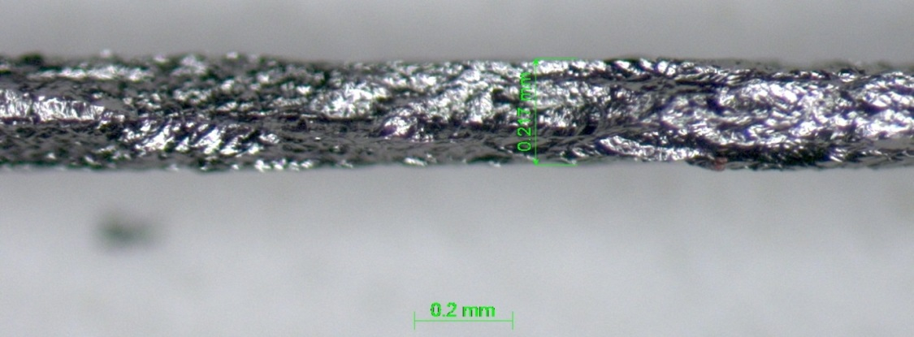
Chemical Erosion Study
Polythene Outgassing Test
Mu2e target environment will not be Ultra High Vacuum
A 0.5 mm diameter tungsten wire was heated in a vacuum of a few Torr
The ultimate pressure was limited by outgassing from a large surface area of polythene inside the vessel
The temperature varied between 1500 and 2300°C
The average surface recession rate was 0.13 mm/day
The wire before the test
The wire after the test
The apparatus post test. Note the thinning of the wire in the hottest (central) region

Slide 19
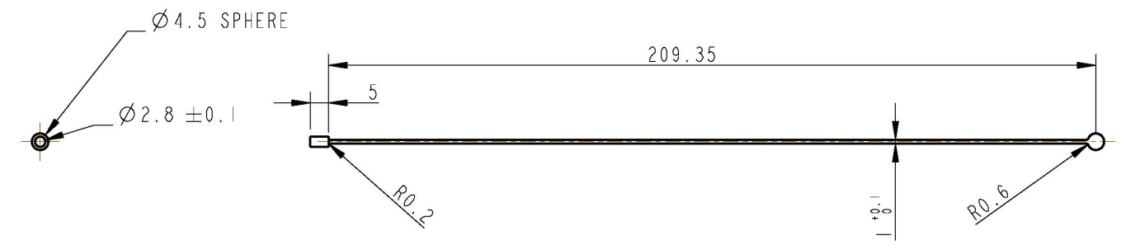
Spoke Manufacturing Challenges
Tungsten Material
  Difficult to process by conventional machining methods
  Not malleable enough to use wire with stamped/formed end features
Application
  Too high temperature for most brazes, and high temperature brazes can alter Tungsten chemistry around the joint
  Too weight/strength critical to use diffusion bonding with axial compression force, and geometry not suitable for radial compression joint
Geometry
  Difficult to achieve by grinding from solid

Slide 20
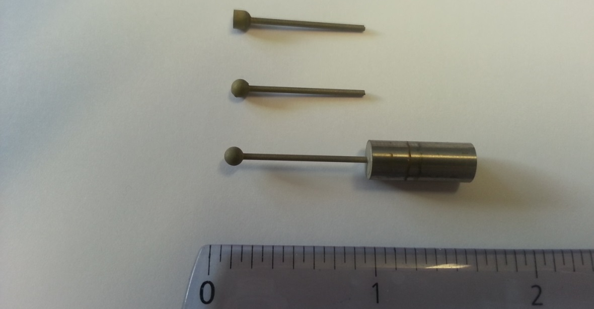
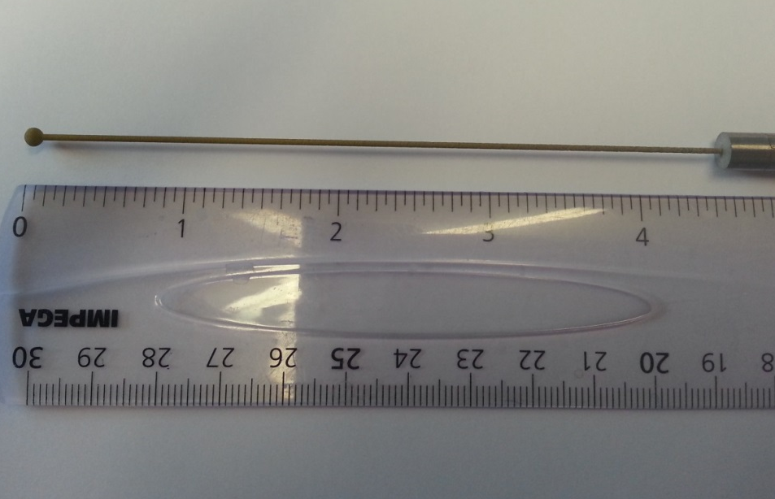
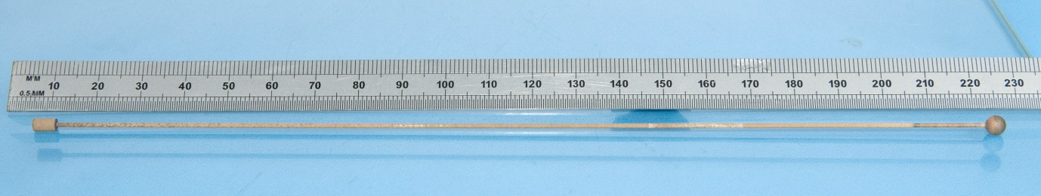
EDM Manufacturing trials
Preliminary trials – End features
Intermediate trial – short 1mm spoke and end feature
Complete spoke trial – Manufacture of full length 1mm spoke with end features
A 220 mm long (full length) prototype tungsten spoke

Slide 21
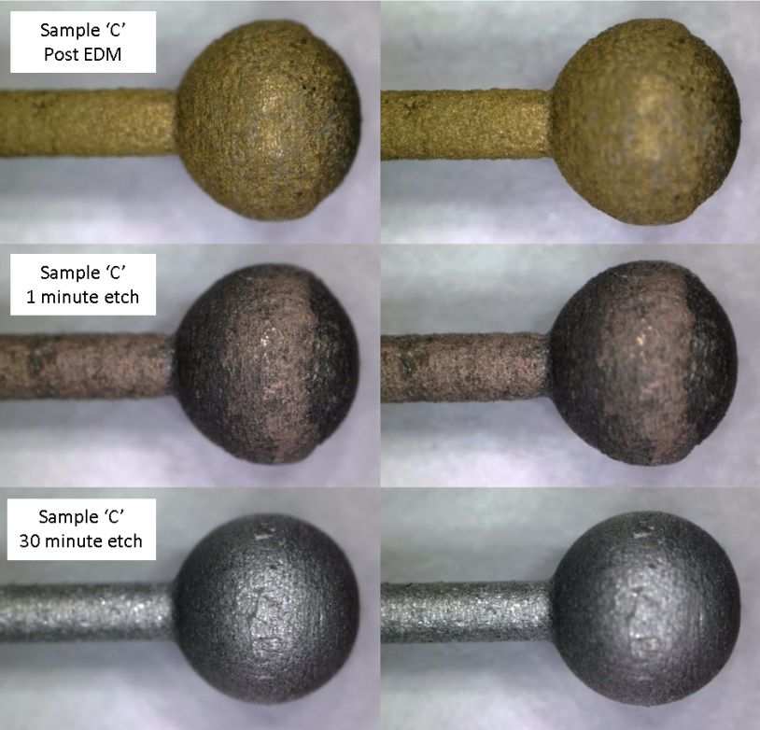
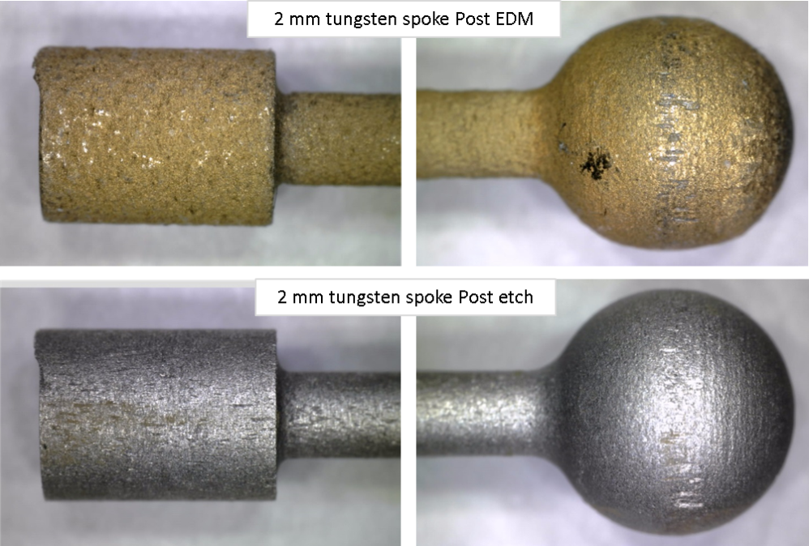
Post EDM surface treatments
EDM machined components from manufacturing tests exhibited a brassy scale. Due to the brittle nature of tungsten, mechanical means of abrading or polishing have been avoided. Instead a chemical etch has been successfully trialled.

Slide 22
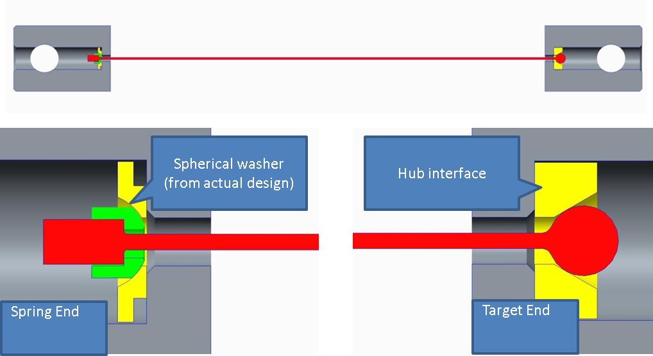
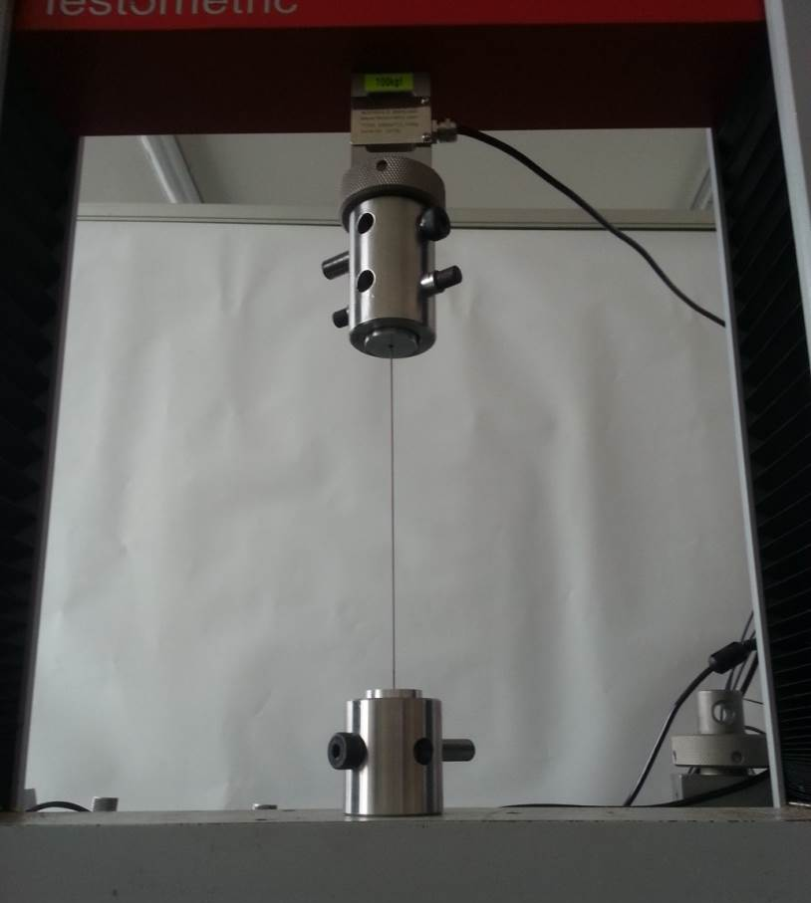
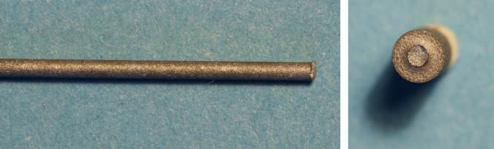
Spoke pull testing
The 1mm spoke broke at a tension of 392N, at which the stress in the spoke was ~550MPa
This is approximately forty times greater than the expected working tension of the spoke

Slide 23
Summary
Radiation cooled target for Mu2e at 7.7 kW beam power appears realistic
~5 x 10⁷ representative fatigue cycles on first test piece so far, equivalent to few years running
Spoke support system demonstrated
Jury still out on lifetime in expected vacuum quality
Continuation of test program planned
  total hemispherical emissivity
  coatings and micro-finned surface tests
  reduced vacuum quality tests
  bending + thermal fatigue tests
  prototyping

