Slide 1
LIEBE: Design of a molten metal target based on a Pb-Bi loop at CERN-ISOLDE
T. De Melo Mendonca, M. Delonca, D. Houngbo, C. Maglioni, L. Popescu, P. Schuurmans, T. Stora

Slide 2
Outline
Introduction/context
Proposed design
Diffusion simulations
Numerical results
Heat Exchanger (HEX)
Beam impact
Conclusion & next steps

Slide 3
Introduction/context…

Slide 4
Introduction/context (1)
Some keywords: high power target, short-lived isotopes, …
Collaboration started in May 2012 for the LIEBE (Liquid Eutectic Lead Bismuth Loop Target) project:
WP definition WP holder Coordinator
WP1 : Coordination CERN T. Stora
WP2 : Conceptual Design and simulations SCK-CEN P. Schuurmans
WP3 : Construction, assembly CERN M. Delonca
WP4 : Instrumentation CERN T. Mendonca
WP5 : Safety and Licensing CEA A. Marchix
WP6 : Target characterization and analysis PSI D. Schumann
WP7 : Radiochemistry SINP S. Lahiri
WP8 : Offline commissioning IPUL K. Kravalis
WP9 : Online operation CERN T. Mendonca
Aim of LIEBE target: validation of conceptual design for the EURISOL direct target by developing a prototype for CERN-ISOLDE.

Slide 5
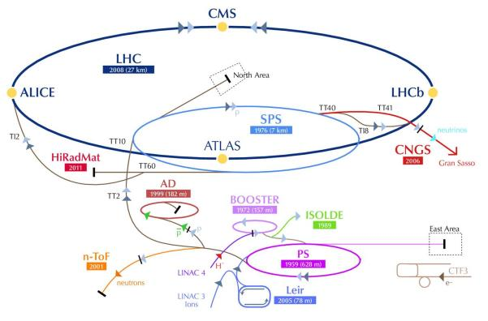
Introduction/context (2)
ISOLDE: on-line isotope mass separator @ CERN
Proton beam from PSB:
1.4 GeV
2 µA
3e13 protons/pulse
Cycle: 1.2 s
3 kW average power
Instantaneous power: ≈ 1 GW

Slide 6
Introduction/context (3)

Slide 7
Proposed design…

Slide 8
Proposed design (1)
Proposed by EURISOL

Slide 9
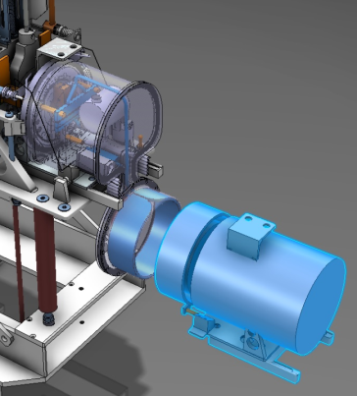
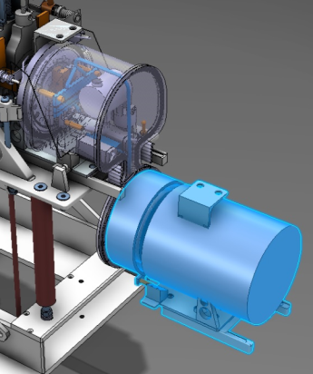
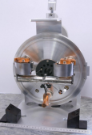
Proposed design (2)
Current front end + target
Main loop
Pump/motor
Current target unit
Diameter: 300 mm

Slide 10
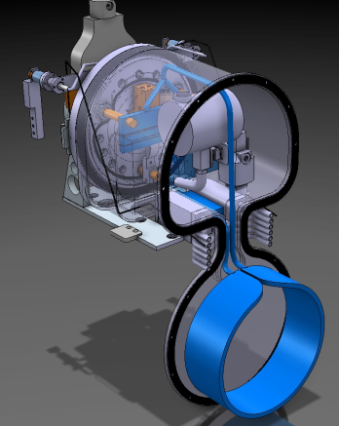
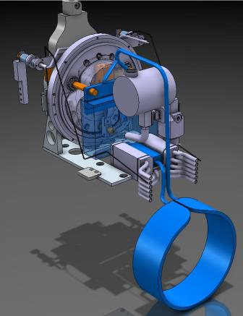
Proposed design - main part (3)
Container *
Filling tank
Beam
≈ 650 mm
HEX
Diffusion chamber
Pump pipes
+ heating/isolating elements all along the loop
* D. Houngbo, SCK-CEN

Slide 11
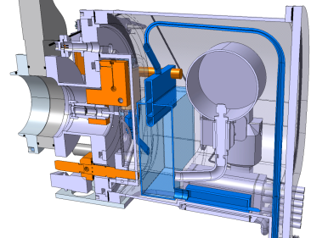
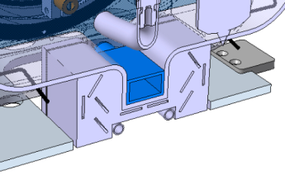
Proposed design – HEX (4)
HEX
LBE
“Casserole” in between water and LBE
LBE circulation
Water block

Slide 12
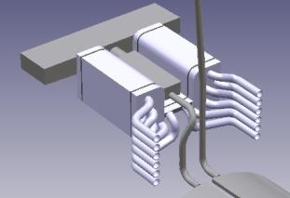
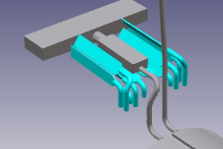
Proposed design – HEX (5)
5 working temperatures defined in step of 100 ºC
5 inlets on each side
1 outlet on each side
For each working temperature defined, only two inlets are used.
400 ºC
600 ºC
500 ºC
200 ºC
300 ºC

Slide 13
Diffusion simulations …

Slide 14
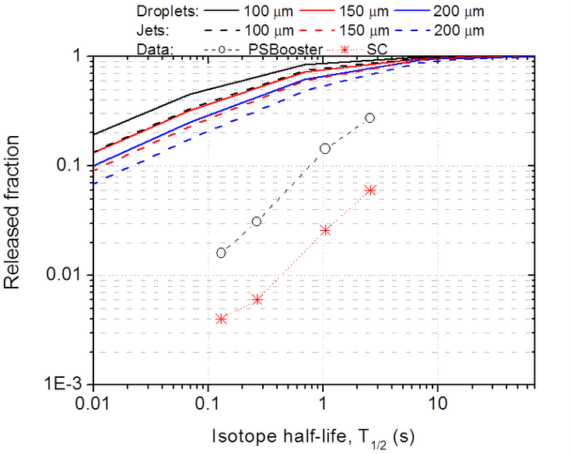
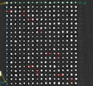
Diffusion simulations (1)
Diffusion: model from Fujioka et
al. (NIM 186 (1981) 409)
$$f\left(\hat{t}\right)=\frac{2.n}{π^{2}}\sum_{m=1}^{∞}{\frac{1}{c_{m+ {τ_{D}}/{τ_{N}}}}}$$
With $τ_{D}=characteristic diffusion time= {a^{2}}/{π^{2}∗D}$
$a=radius of droplet$ $D=diffusion coefficient of tallium in LBE at 600 ℃$
$τ_{N}=mean life of isotope$
Static units
Diffusion optimized for droplets shape
Need a grid on the container to create the shower
Holes diameter: 0.1 mm,
Thickness plate: 0.5 mm
Material: SS304L
10 mm
Courtesy T. Mendonca, CERN

Slide 15
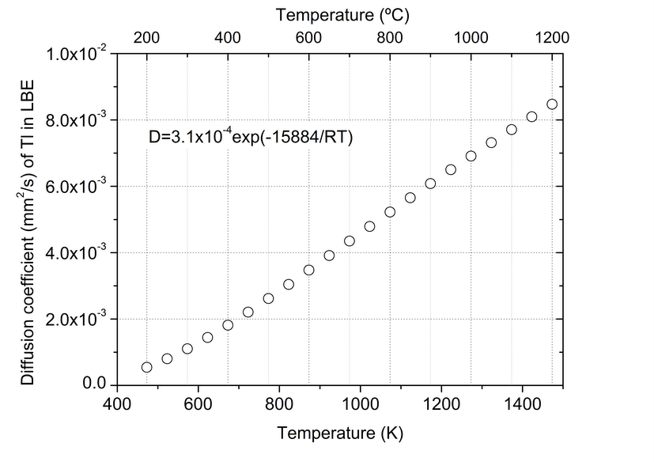
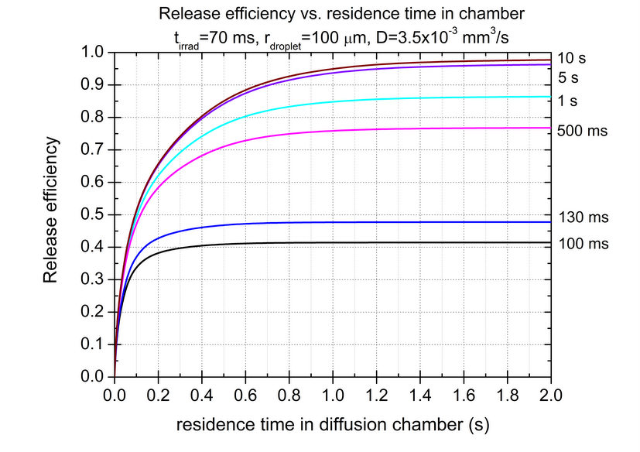
Diffusion simulations (2)
¹⁷⁷Hg (T_{1/2}= 130 ms) as reference:
Increasing droplet radius will decrease the released fraction
Diffusion efficiency of 38% for 100 ms, 44% for 200 ms in the diffusion chamber
Diffusion
Improvement of diffusion with temperature
Maximum operating temperature limited by vapor pressure of LBE
Courtesy T. Mendonca, CERN

Slide 16
Diffusion simulations (3)
Conclusions
Diffusion efficiency is improved with:
Droplet shape
Temperature
Falling time of the droplets (lower outlet velocity, longer falling distance)

Slide 17
Numerical results…

Slide 18
Numerical results – HEX (1)
Need to keep the target at the desired working temperature for temperature ranging from 200 ºC till 600 ºC
Power contributions:
Pump power extraction
+ | -
Beam | Pump
Pump | Radiation
- | HEX
Radiation power extraction
Beam | 330 to 990 W
Pump | 2 200 W

Slide 19
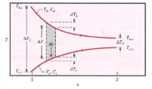
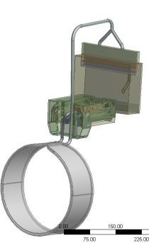
Numerical results – HEX (2)
Assessment of HEX behavior with CFX
Dimensioning of an HEX:
$$P=H∗S∗{∆T}_{lm}{ with ∆T}_{lm}=\frac{{∆T}_{2}−{∆T}_{1}}{\ln\left(\frac{{∆T}_{2}}{{∆T}_{1}}\right)} and H= \frac{1}{\frac{1}{h_{1}}+\frac{1}{h_{2}}}$$
 | Water | LBE
Flow rate (l/s) | 0.22 | 0.23
T _{inlet} (ºC) | 27 | Variable
T _{outlet} (ºC) | < 90 | Variable
Problem: The HEX must extract less power @ 600 ºC than @ 200 ºC BUT power extracted depend on the surface of exchange, the average heat exchange coefficient and the temperature of both fluids involved -> need of a variable HEX!

Slide 20
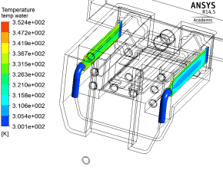
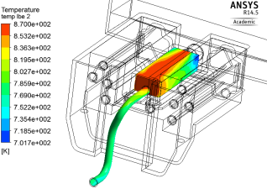
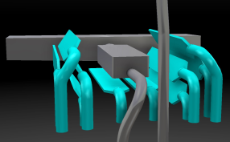
Numerical results – HEX (3)
Summary of results:
Example @ 600 ºC
 | T _{max} water (ºC) | P _{extracted} (W)
200 ºC | 78 | 3 180
300 ºC | 83 | 3 050
400 ºC | 73 | 2 890
500 ºC | 68 | 2 820
600 ºC | 79 | 2 650
T_{max} water = 79 ºC
T_{max} LBE = 597 ºC

Slide 21
Numerical results – HEX (4)
Conclusions
Temperature and power extraction are in the proper range (values have been checked over the full range of temperature, from 200 ºC up to 600 ºC)
Further analysis must be computed considering bad thermal contact between the different parts
Prototype will validate the design
Temperature controlled with heating elements installed all along the loop

Slide 22
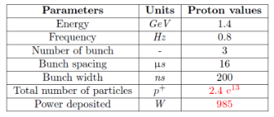
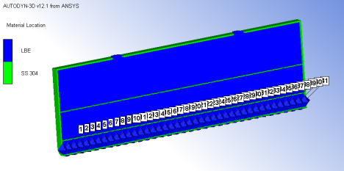
Numerical results – Beam impact (1)
Assessment of beam impact with Fluka &
Ansys Autodyn
Geometry considered
Isolde beam parameters
Container: Stainless Steel 304, solid part, Lagrangian part
Liquid: LBE, SPH elements
Use of 40 gauges along beam axis

Slide 23
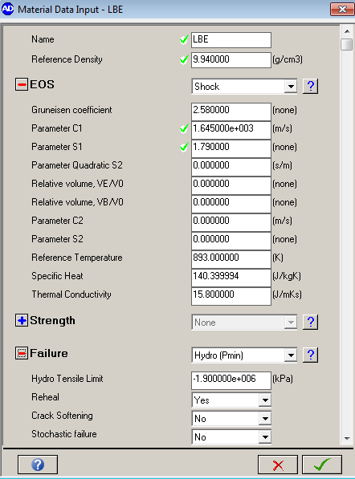
Numerical results – Beam impact (2)
Material definition
Standard variables @ 600 ºC.
ρ, Cp, k
Shock EOS (Linear model)
Gruneisen model
U_{s} = shock velocity, $Г$ = Gruneisen coefficient, $μ_{p}$= particle velocity, C₀ and S = fitting parameters
Failure mechanism
Hydrodynamic tensile limit
2 values considered: -150 kPa and -1.9 GPa (no value available for LBE)
$$U_{S}=C_{0}+S∗μ_{p}$$
$$S=\frac{1}{2}∗\left(1+Г\right)$$
$$Г=\frac{α∗K_{S}}{ρ∗C_{p}}$$
Courtesy E. Noah, Un Geneva

Slide 24
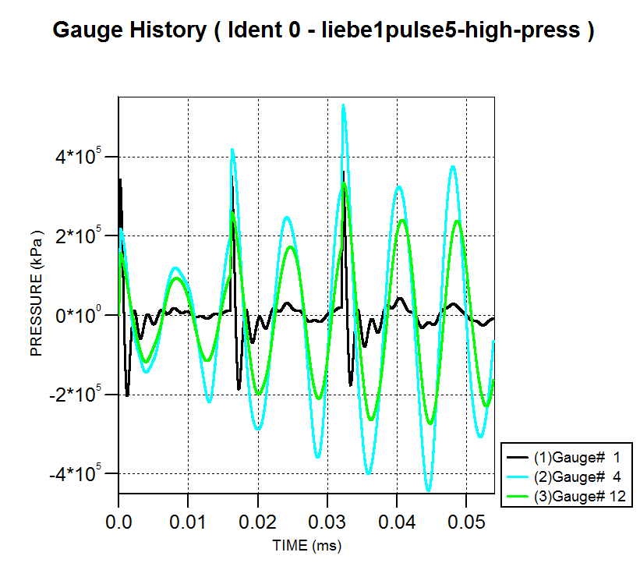
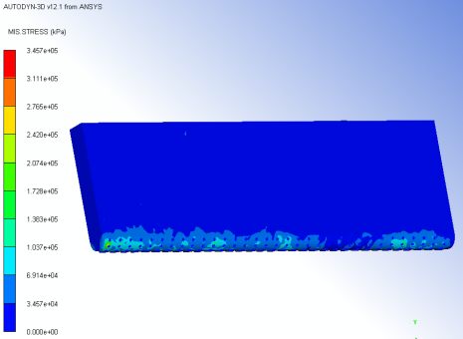
Numerical results – Beam impact (3)
Analysis for 50 µs (1 pulse = 32.6 µs) – under hydrodynamic tensile limit
Shock waves deposit energy onto the weakest point of the container (grid part).
Stresses up to 350 MPa (Yield = 390 MPa) in less than 1 ms.

Slide 25
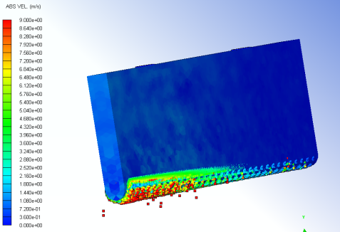
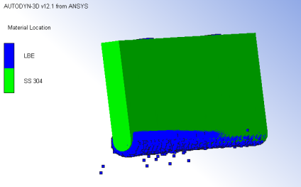
Numerical results – Beam impact (4)
Analysis for 50 µs (1 pulse = 32.6 µs) – over hydrodynamic tensile limit
Deformation scale: *9
Cavitation in the liquid will induce splashing of the LBE and projection of droplets with very high velocity in the diffusion chamber.

Slide 26
Numerical results – Beam impact (5)
Conclusions & Outlook
The geometry needs an improvement to avoid resonant shock waves
Impact of beam onto the container should be further investigated:
Negligible impact expected
Need more detailed simulation to prove it
Simulation must be computed for longer time

Slide 27
Conclusion & next steps…

Slide 28
Conclusion & next steps
Preliminary design is available, under optimization
Test of the Heat Exchanger foreseen
Optimization of the irradiation container under beam impact on-going
Off-line tests scheduled in the near future

Slide 29
Thank you for your attention!

Slide 30
Thanks to all the contributors…
V. Barozier
A. P. Bernardes
K. Kravalis
F. Loprete
S. Marzari
R. Nikoluskins
F. Pasdeloup
A. Polato
H. Znaidi
… (and many others…)

Slide 31
Back up slides…

Slide 32
Introduction/context (4)
Specificity of RIBs (Radioactive Ion Beam) production via the ISOL (Isotope separation on-line) technique: Isolde target unit
Extraction electrode
Diffusion
Effusion
Target
Ion source
Transfer line
Plasma
Extracted ion beam
Primary beam
Leaks
Condensation
Isotope production
Leaks
Decay loss
Leaks
Neutrals
Release loss
Condensation
Sidebands
Decay loss
Decay loss
Multiply charged

Slide 33
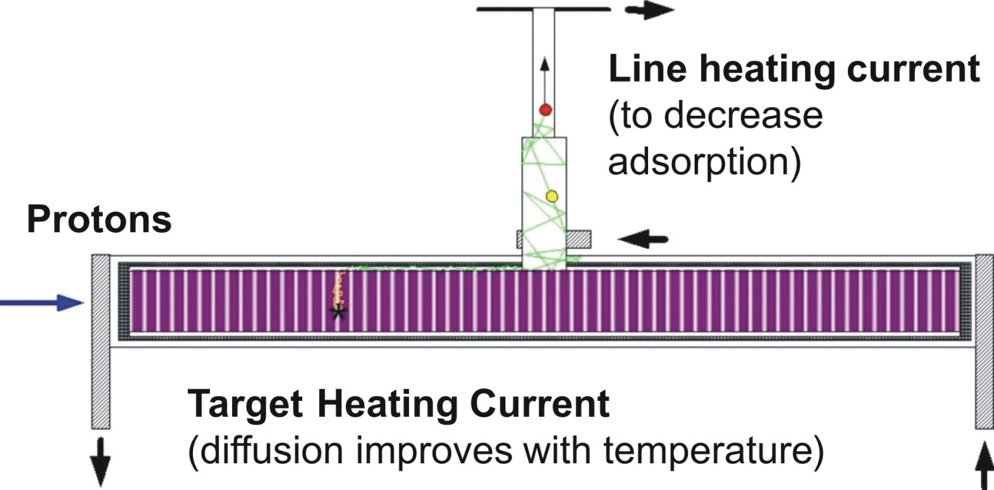
Introduction/context (5)
Specificity of RIBs (Radioactive Ion Beam) production via the ISOL (Isotope separation on-line) technique: Isolde target unit
Radioactive ion beam (RIB) intensity:
Transfer line
Heated: decrease adsorption in effusion process
Cooled: trap condensable isobaric contaminants
RIB intensity
[s⁻¹ μA⁻¹]
Target density
[atom cm⁻²]
Diffusion+effusion efficiency
Cross section
[cm²]
Proton beam intensity
[s⁻¹ μA⁻¹]
Ionization
efficiency
Target Heating
Diffusion improves with temperature

Slide 34
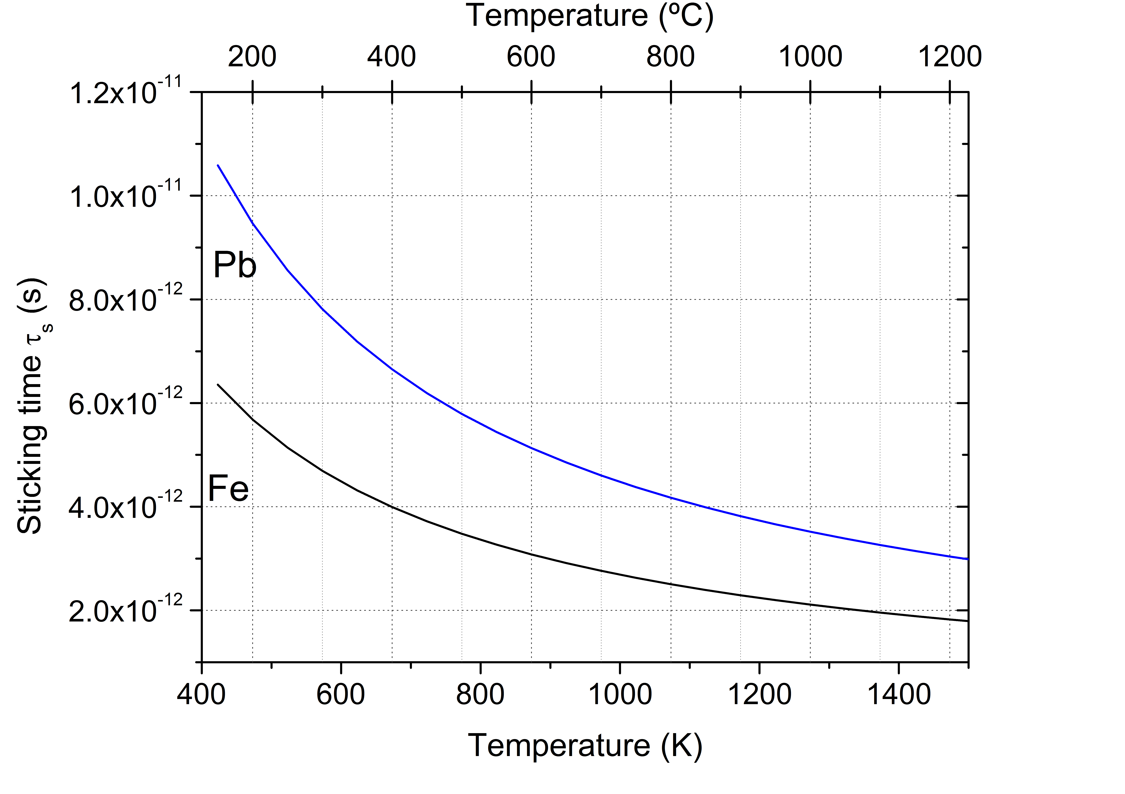
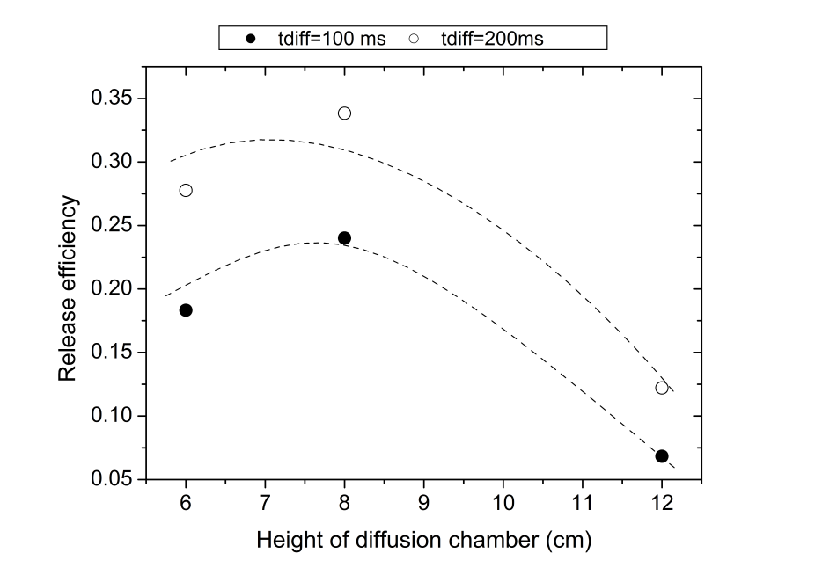
Diffusion/effusion simulations (3)
Effusion: Monte Carlo
The effusion efficiency is dependent on the geometry of the container/diffusion chamber, the sticking time, the mean free path and number of collisions with droplets and surface of containment.
Sticking times of ~10⁻¹² s – negligible effect in efficiency
Effusion release efficiencies between 22% and 34% for residence times in the diffusion chamber between 100-200 ms
Estimated release efficiencies (diff+eff) of ~ 8% for 100 ms and ~ 15% for 200 ms.
Thanks to T. Mendonca

Slide 35
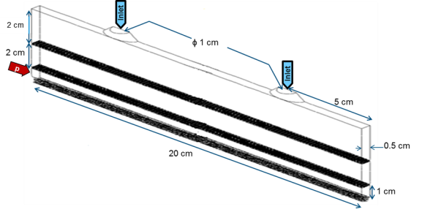
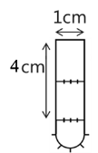
Concept 5 - Results
1 kg of LBE in Feeder Volume,
2 feeder grids of 2520 apertures
1-mm or 0.5-mm thick feeder grids
2520 evacuation apertures
1.5-m/s inlet velocity
~0.2-bar pressure drop
Stable uniform flow between 500 K – 1500 K
Static-Pressures (Pa)
Velocity Vectors (m/s)
Feeder Volume
Irradiation Volume
35
Houngbo D.- LIEBE project, Computational Fluid Dynamics (CFD) analysis.- Workshop on Radioactive Ion Beam Production and High-Power Target Stations.- Mol, Belgium, 16-18 September 2013.- [Presentation]

Slide 36
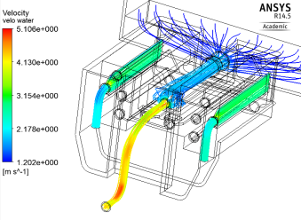
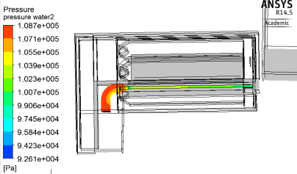
Numerical results – HEX (3)
Example @ 600 ºC
T_{max} water = 79 ºC
Velocity in water and LBE
T_{max} LBE = 597 ºC
Pressure in water for case LBE @ 200 ºC

Slide 37
Numerical results – HEX (4)
Summary of results:
 | T _{max} water (ºC) | P _{extracted} (W)
200 ºC | 78 | 3 180
300 ºC | 83 | 3 050
400 ºC | 73 | 2 890
500 ºC | 68 | 2 820
600 ºC | 79 | 2 650
200 ºC
300 ºC
400 ºC
500 ºC
600 ºC

