Slide 1
Practical Experiences from Remote Handling in Fusion
Alan Rolfe
(Oxford Technologies Ltd)
23rd May 2014

Slide 2
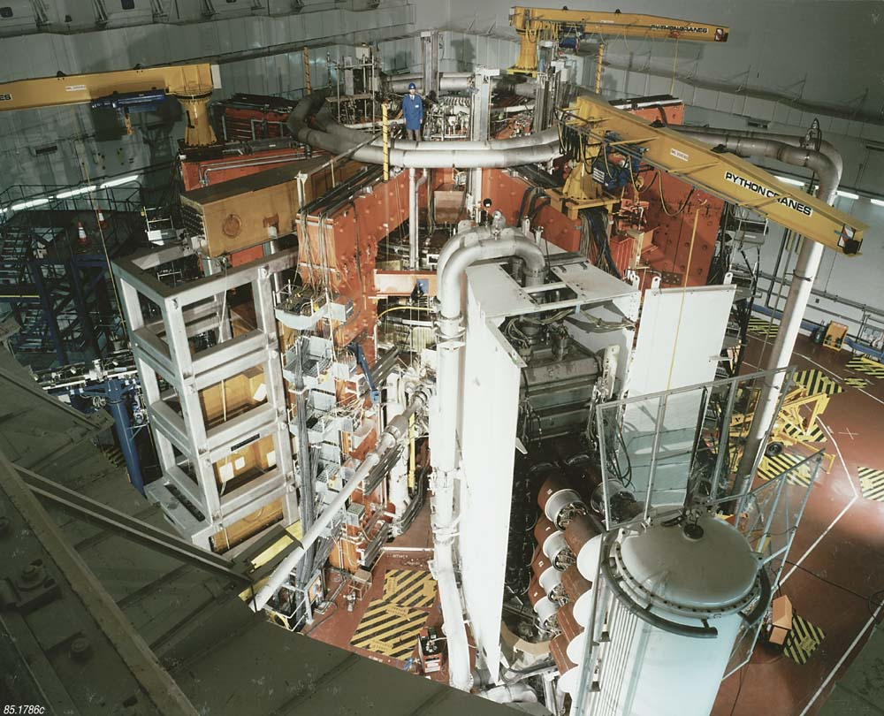
Aim
“Stimulate your thoughts about the meaning of Remote Handling”

Slide 3
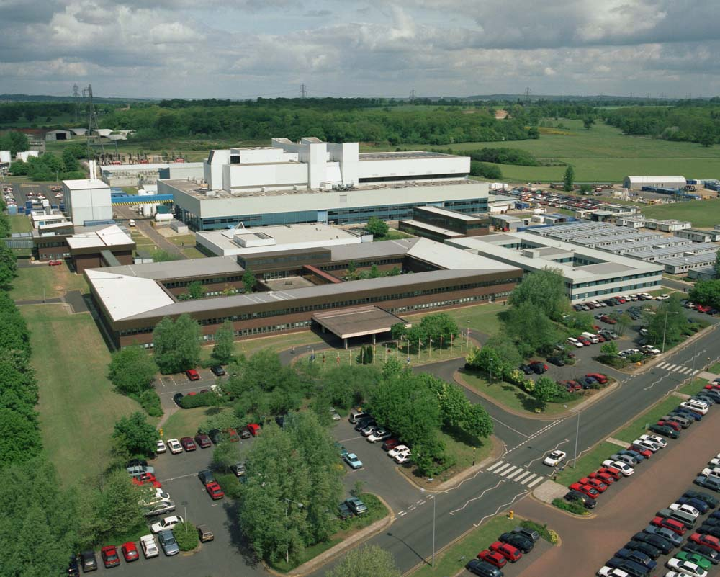
Context
Large Science Experiment
  Operational since 1983
  > £1B spent to date
  > 20 Nations involved
  > 500 Scientists & Engineer
  Remote Maintenance since 1998
High Energy
  Generated >16MW Fusion Power
  >10kV plasma
  Total input power ~50MW
  4 Tesla Field
Maintenance & Modifications in a hostile environment
  Gamma
  Beryllium
  Tritium

Slide 4
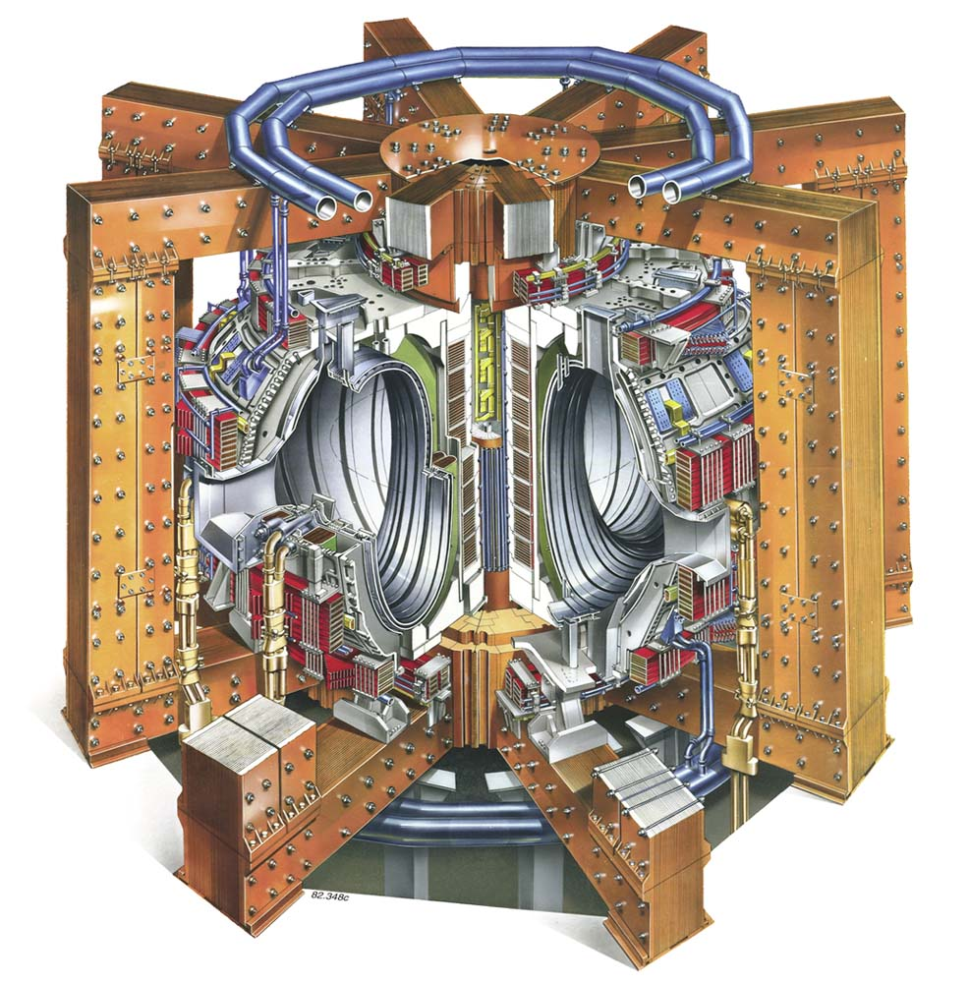
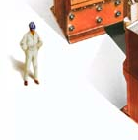
The JET Tokamak

Slide 5
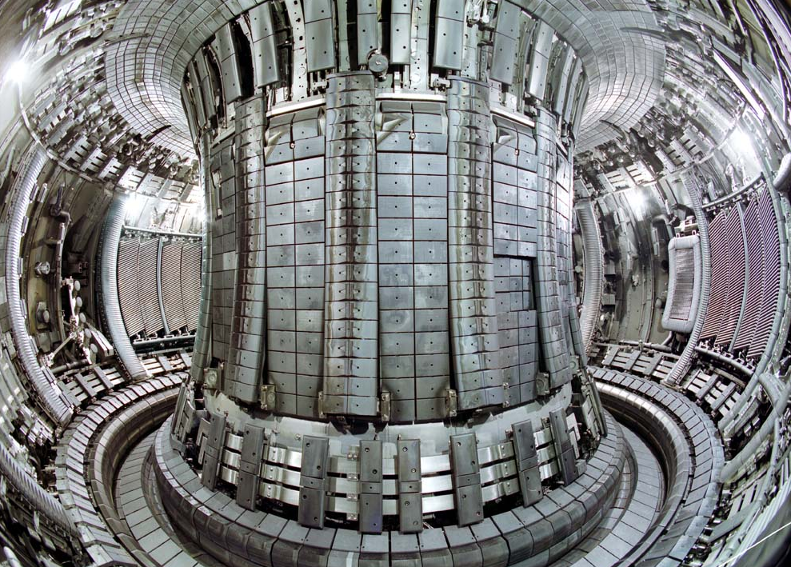
The JET Tokamak : In-Vessel Tasks
1st Remote Handling Campaign – 1998

Slide 6
JET Remote Handling : Requirements
>20yr operational lifetime
>1000 different types of task
Handling components - grams to tonne
Fixed duration shutdowns – intensive operations
Dealing with damaged components
Inaccurate/Incorrect Configuration Control data
Recovery from failure of RH equipment
Rescue of failed RH equipment
Tolerance to radiation environment
High Availability

Slide 7
JET Remote Handling : Key System Drivers
Large variety of task
Need for Adaptability
Location & Recovery/Rescue after RH System Failure
Delicate components
Limited Working Space
RH Compatibility of the Plant
Site regulator

Slide 8
JET Remote Handling : Philosophy Adopted
Human-in-the-loop (Aiming for “Telepresence”)
HMI and Control System support to the operator for
  Safety
  Operational efficiency
  Minimising Operator fatigue

Slide 9
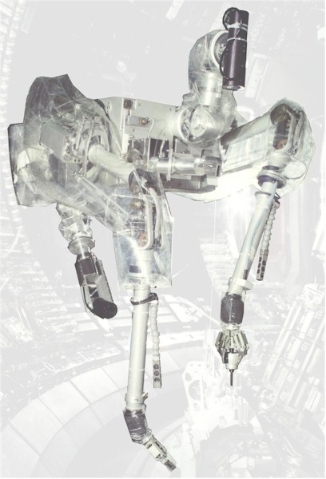
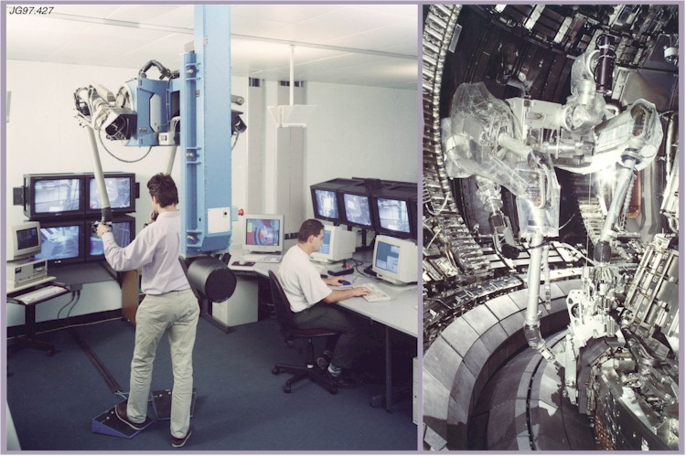
JET Remote Handling System : Dexterous Manipulator
Dexterous, Force Reflecting, Master-Slave Manipulator
  20kg per arm
  100gm sensitivity
  High bandwidth
  Very smooth motion
  High resolution

Slide 10
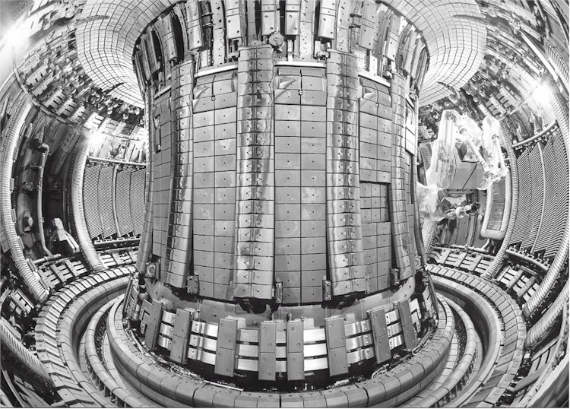
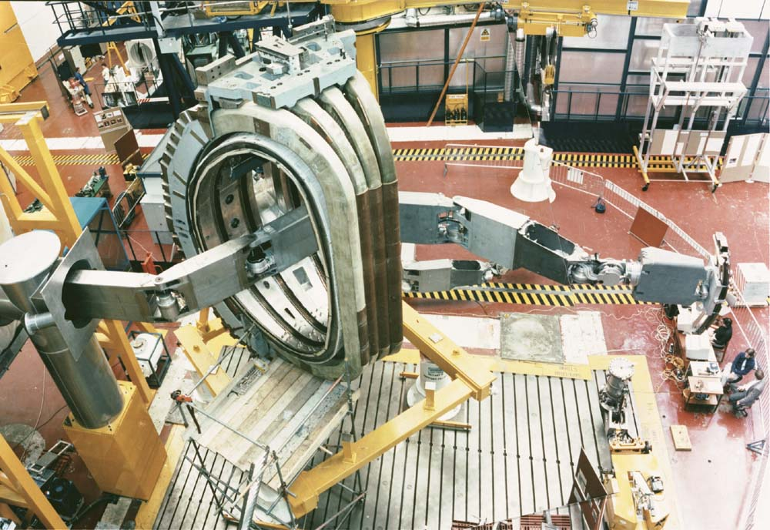
JET Remote Handling System : Transporter

Slide 11
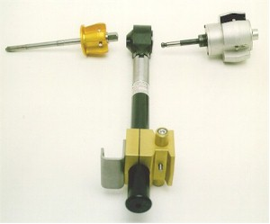
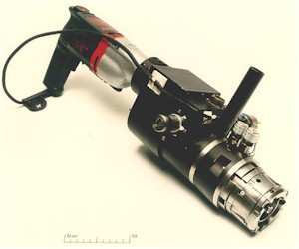
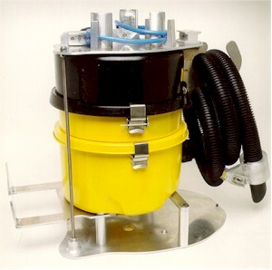
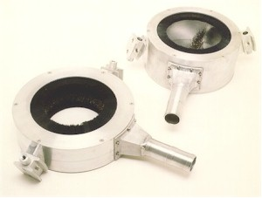
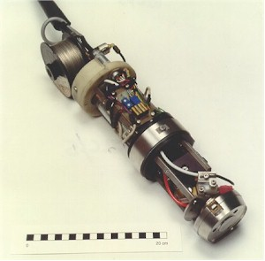
JET Remote Handling System : Tooling
  Fastening & Torqueing
  Lifting/Manipulation/Handling
  Inspection
  Cutting
  Vacuum Quality Welding
  Structural Welding
  2D & 3D Metrology
  Swabbing / Sampling
  Monitoring
  Cleaning

Slide 12
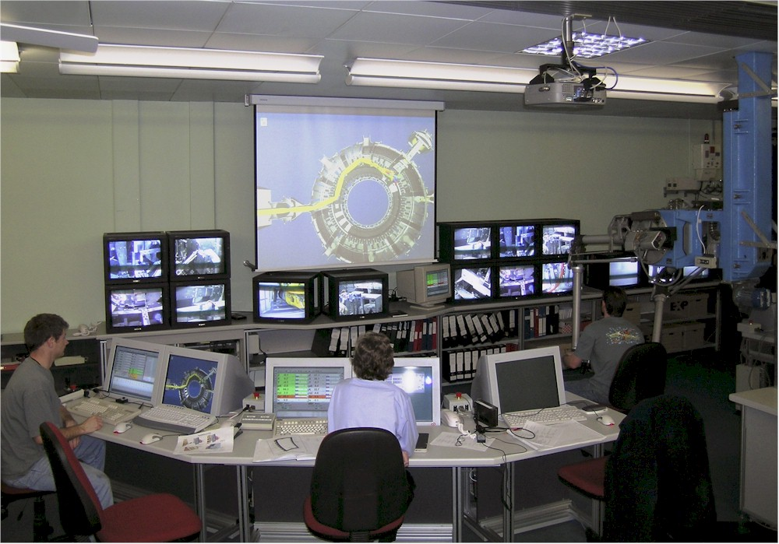
JET Remote Handling System : Control Room

Slide 13
JET Remote Handling Achievements
Fully Operational since 1997
  >10,000hrs remote operations
  > 20,000 individual RH tasks
  > 30 fully trained operators
  < 5 RH system failures needing recovery
  0 RH system failures needing rescue

Slide 14
JET Remote Handling Challenges
Unplanned Operations
  Damaged components
  New tasks
Components not designed for RH compatibility
Changes driven by the Experimental results
Faults within the RH system
JET Unplanned

Slide 15
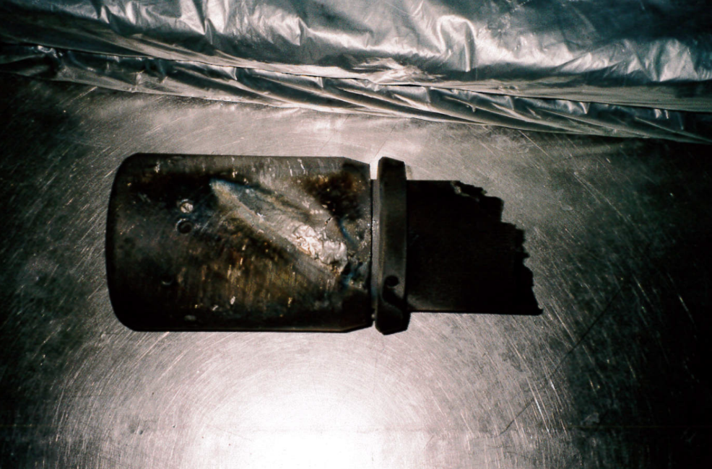
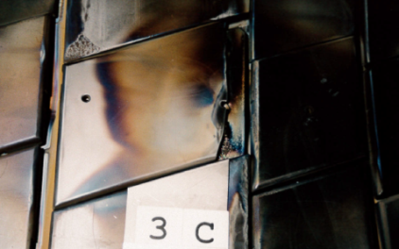
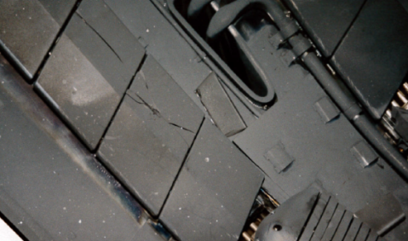
JET RH Challenges – Damaged Components

Slide 16
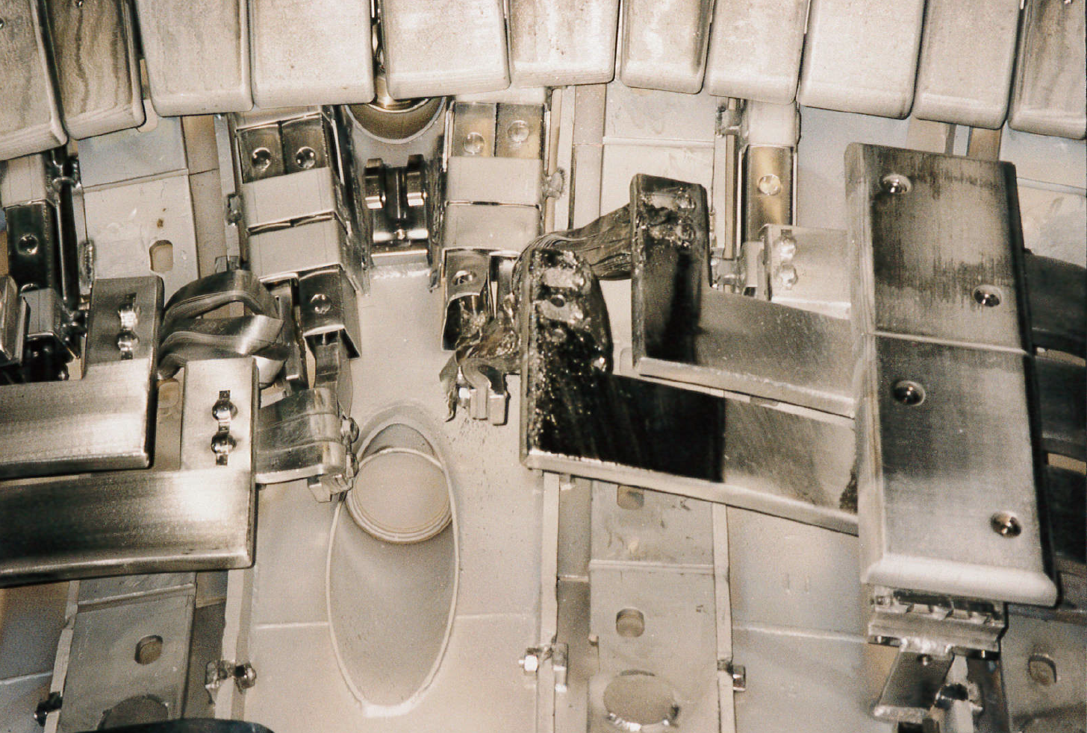
JET RH Challenges – Damaged Components

Slide 17
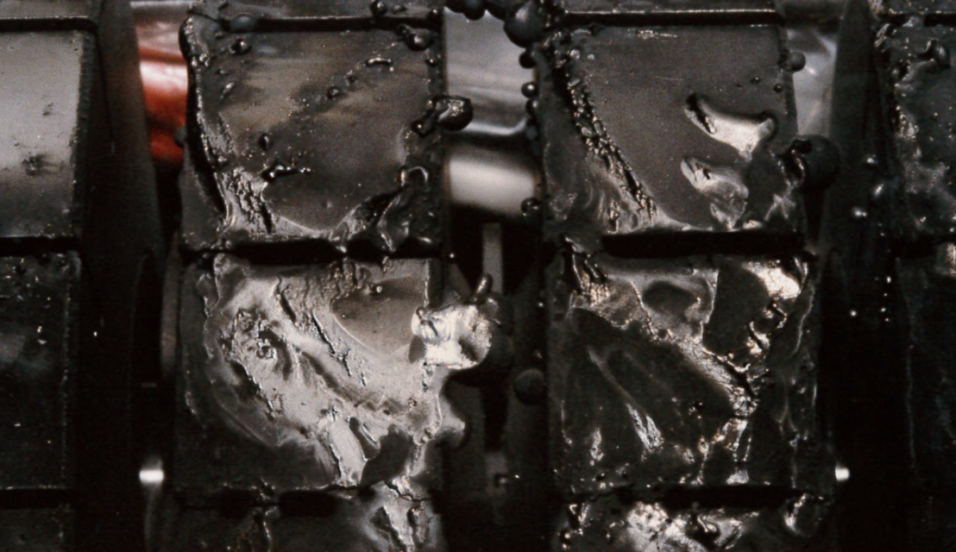
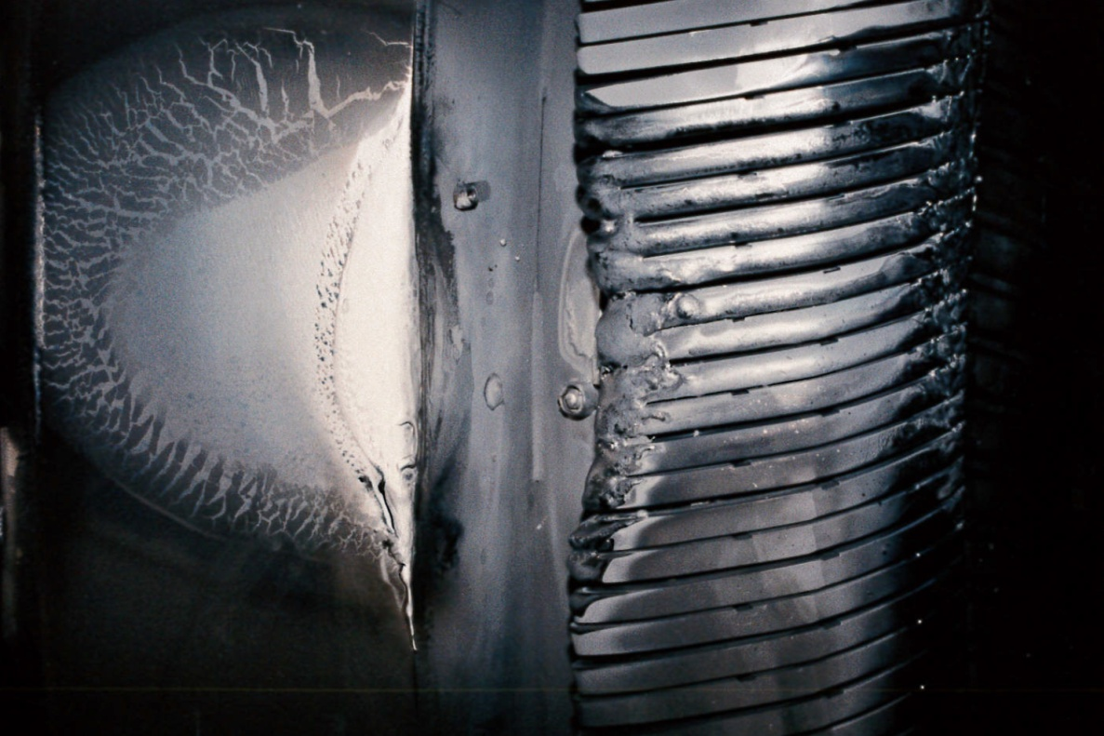
JET RH Challenges – Damaged Components

Slide 18
JET Remote Handling Challenges – Component Design
Components not designed for RH compatibility
  Typical problems are:-
    lack of small part captivity
    no visual cues
    no alignment guides
    no information about weights and c of g
  Tasks take 5-10x longer than with RH compatible components

Slide 19
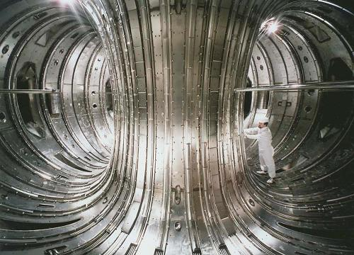
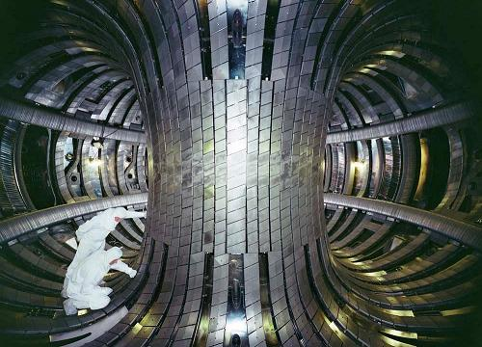
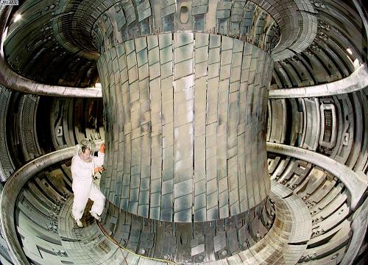
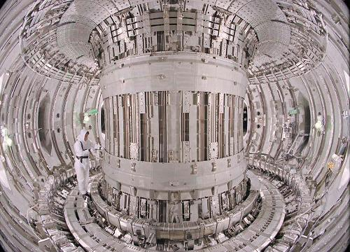
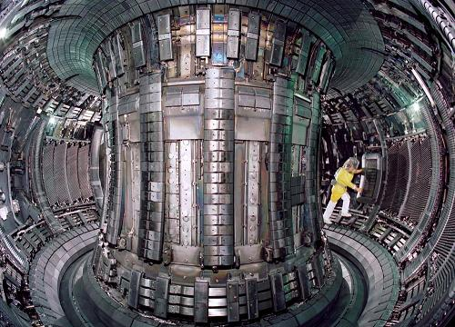
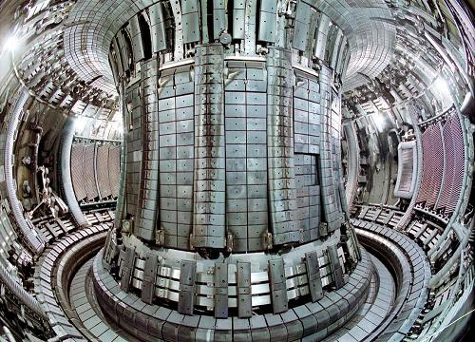
JET Remote Handling Challenges : Experiment
Long term changes to JET configuration

Slide 20
JET Remote Handling Challenges : RH System Faults
Faults within the Remote Handling system
  Detection
  Location
  Recovery or Rescue
  Repair

Slide 21
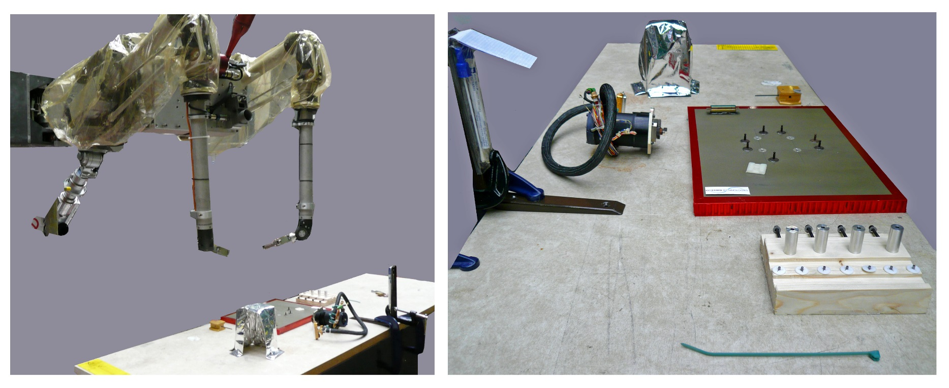
Dexterous Capability
“A trained JET operator can do any task remotely that the same operator could do hands-on”
  Challenge from the Space Sector

Slide 22
Dexterous Capability
“A trained JET operator can do any task remotely that the same operator could do hands-on”
  Challenges from CERN
    Handling of chain type clamps for water pipes
    Handling of gaskets
    Disconnection & reconnection of electrical connectors
    Cutting of cable ties
    Guidance during crane lifting
    Disconnection & reconnection of vacuum flange
    Painting resin around beam pipe bellows

Slide 23
Summary
The experimental nature of Fusion development demands an adaptable RH approach
The JET RH System has demonstrated the feasibility and practicality of creating “Telepresence”
Acknowledgments:
The work presented here is the result of the combined efforts of the JET remote handling team 1984-2006.
All images of JET have been reproduced with the kind permission of EFDA-JET.

