Slide 1
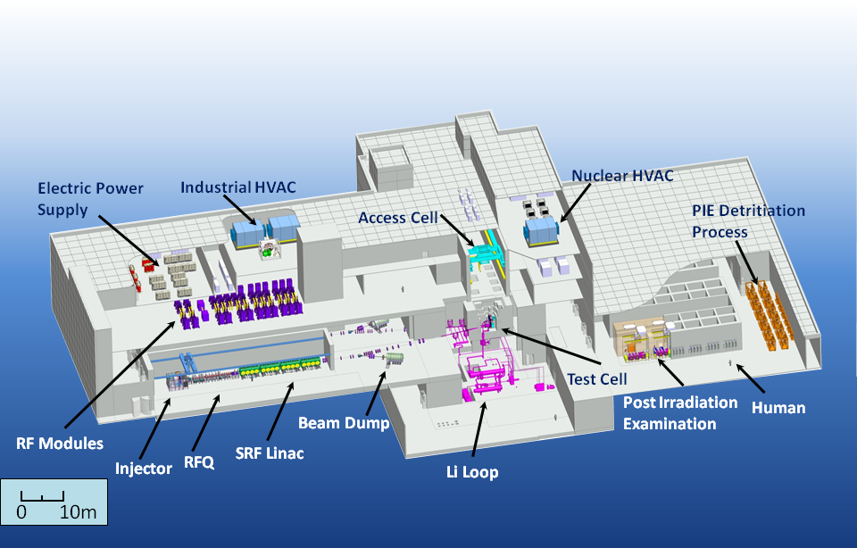
The IFMIF/EVEDA Target Facility Design –
From CDR to IIEDR
F. Groeschel, D. Bernardi, M. Ida, E. Wakai
5th High Power Targetry Workshop
20 - 23 May 2014
Fermi National Accelerator Laboratory

Slide 2
Contents
IFMIF mission
IFMIF/EVEDA Project
CDR Baseline
Target Facility Design
Design Evolution to IIEDR
Conclusions
Misprints
Mistakes
Contradictions
Misunderstanding
Missing data
New information
‘Better’ ideas
……..

Slide 3
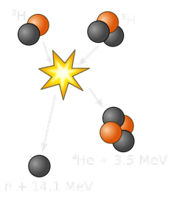
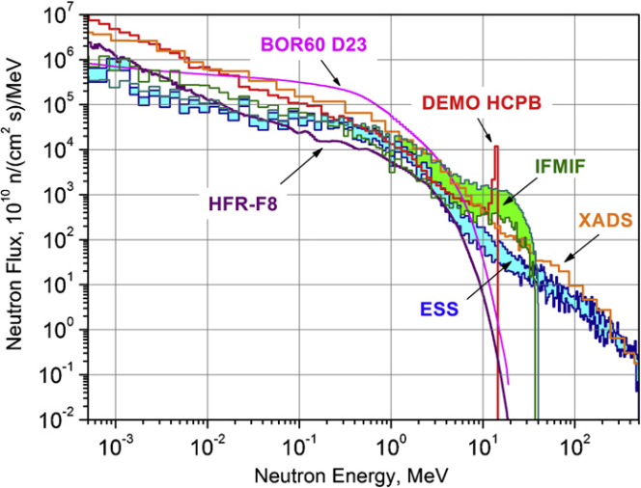
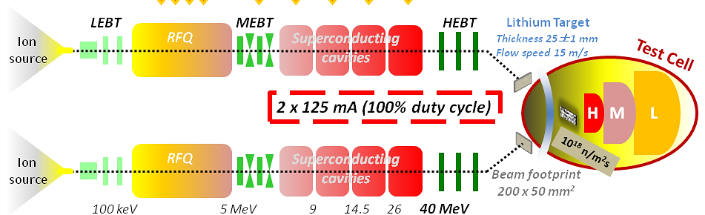
IFMIF Mission
The primary mission of IFMIF will be to generate a materials database for the design, construction, licensing and safe operation of a DEMO reactor and ensuing fusion power plants
Damage in the first wall of a Fusion Power Plant may reach ≈150 dpa within 5 years
The specific damage due to the 14.1 MeV neutrons, characterized by a He/dpa-ratio of about 10, requires material qualification with a corresponding spectrum
IFMIF exploits the Li(d,xn) stripping reaction with two 125mA, 40 MeV deuteron beams to generate 10¹⁸ n/m²s creating > 20 dpa/y in a 0.5 l volume behind the target

Slide 4
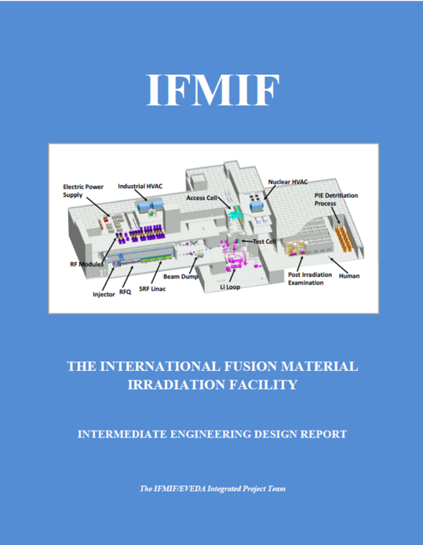
IFMIF/EVEDA Project
Activity within the Broader Approach Agreement between Japan and the EU to
Validate key issues
  Accelerator prototype up to 9 MeV → LIPAC
  Lithium target free surface flow and purification → ELTL
  Test module prototypes
Prepare the Engineering Design of IFMIF for the CODA phase
  Engineering Design
  Cost Estimate
  CODA Planning
Project duration 2008 to 2013, now extended to 2017 to complete the validation tasks
Engineering Design have been terminated by issuing an Intermediate Engineering Design Report

Slide 5
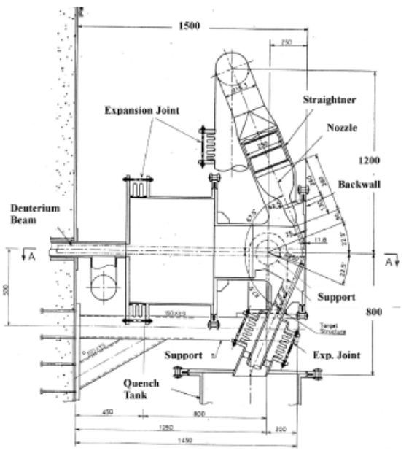
CDR Baseline
Fusion materials irradiation facility designs have evolved since the 80s as national activities under several names
International efforts concentrated on IFMIF for which an important milestone was reached in 2003 with the issue of the Comprehensive Design Report
Li-jet cross-flowing in a concave open channel
Nozzle dimension | 260x25 mm
Curvature radius | 250 mm
Beam footprint area | 200x50 mm
Power deposition | 10 MW (1 GW/m²)
Jet velocity | 15 m/s
Thickness variation | < ±1 mm
Vacuum pressure in TA | 10⁻³ Pa
Flow rate | 97.5 l/s
Li-inventory | 9 m³
Li impurity level (N, T) | < 10 ppm, < 1 ppm
Availability | > 95%

Slide 6
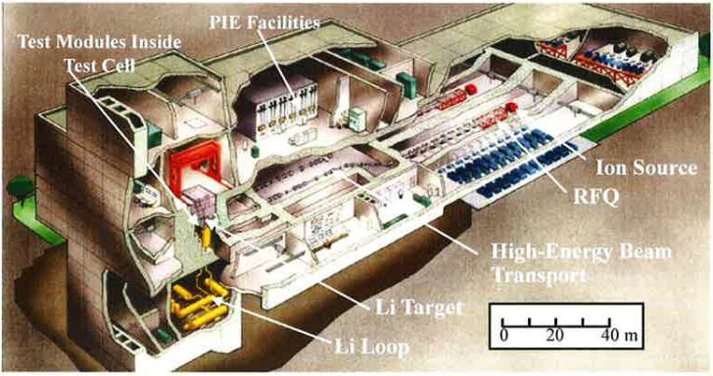
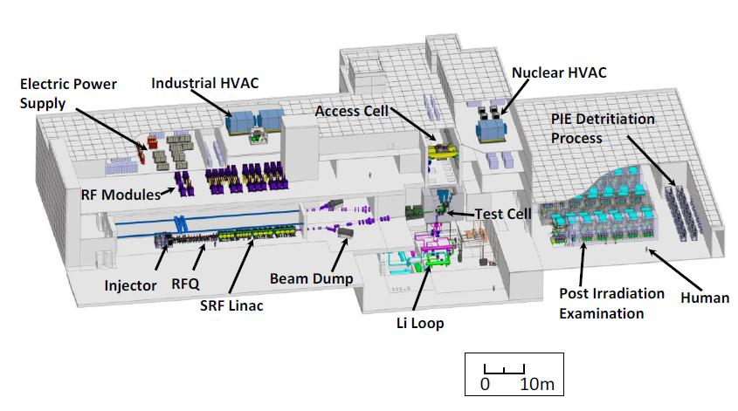
IFMIF Layout evolution
 | CDR Design | EVEDA Design
Building Dimension | 170x60x26, 11 m deep; | 189.4x98.5x27, 12.5 m deep;
HVAC | 270 000 m³/h | 638000 m³/h
Electric Power | 50 MVA | 85 MVA
Heat Rejection | 40 MW | 39 MW + 12 MW air
Operation Staff | 166 | 121 (w/o PIE)
Considerable increase in building size due to
Separation of PIE
Increased space requirement for the accelerators auxiliaries and the conventional facility
Conceptual changes in maintenance scheme
Defense in depth approach and corresponding zoning
Implementation of stricter safety importance classification

Slide 7
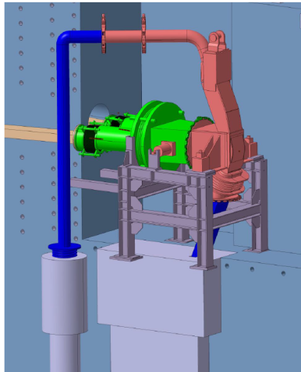
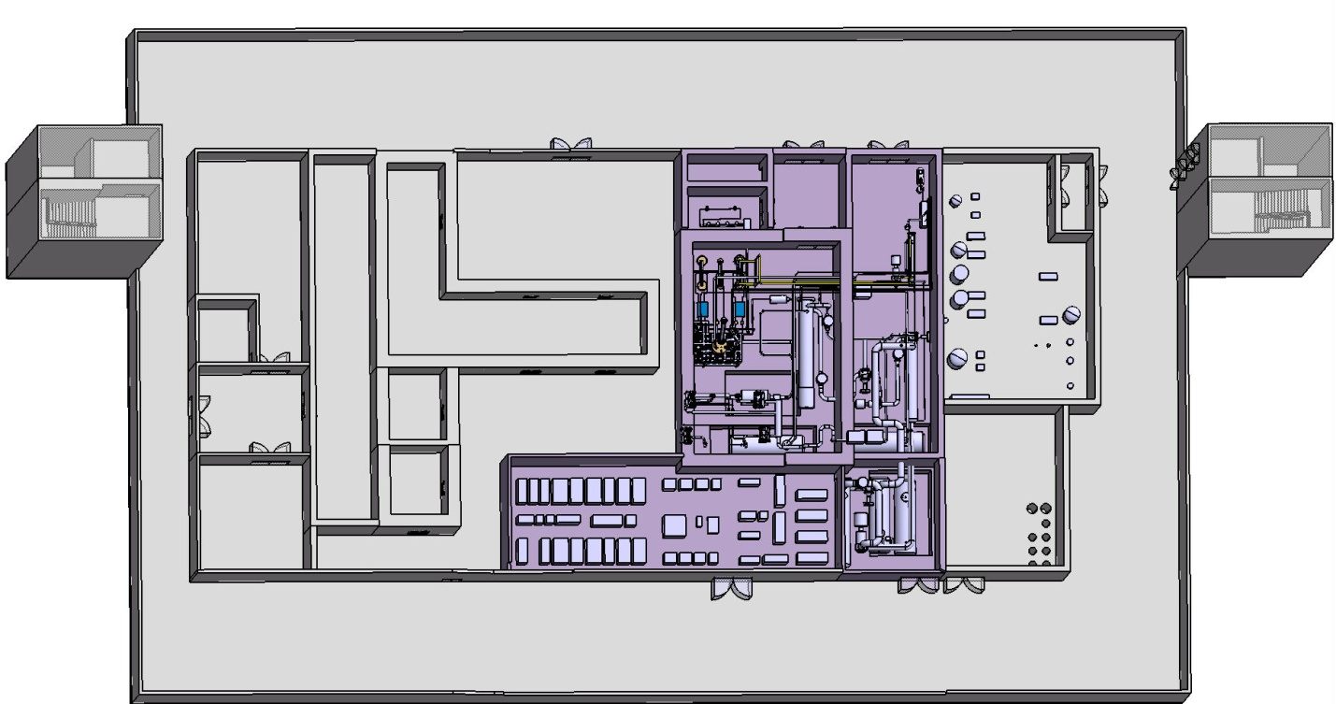
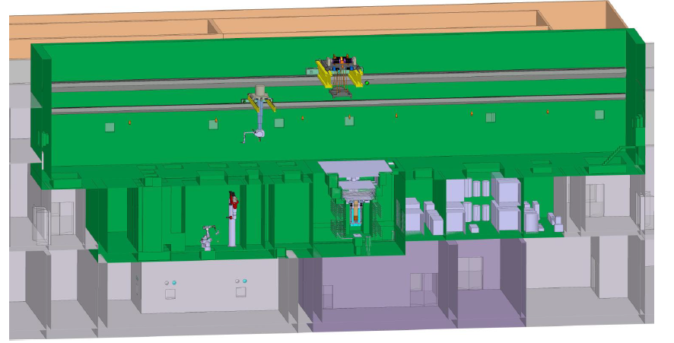
IFMIF Layout evolution
Basement with Li loop and waste management area
10 m wide corridors to handle largest Li loop components (heat exchangers) – transfer hutches to upper floors
Large room for auxiliaries
Storage of irradiated components
Access cell perpendicular to accelerator
Easy transfer of TA to Handling and Waste treatment cells
Drawback for TIR and RIR
Detritiation Unit
Access cell
Waste treatment cells
LF Utility Room
Trap storage
Waste treatment cells
Li loop area
Basement

Slide 8
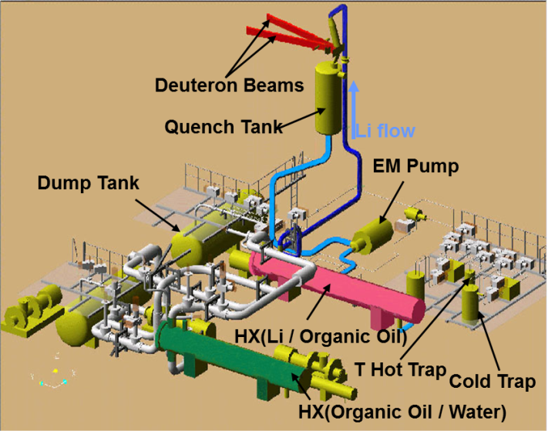
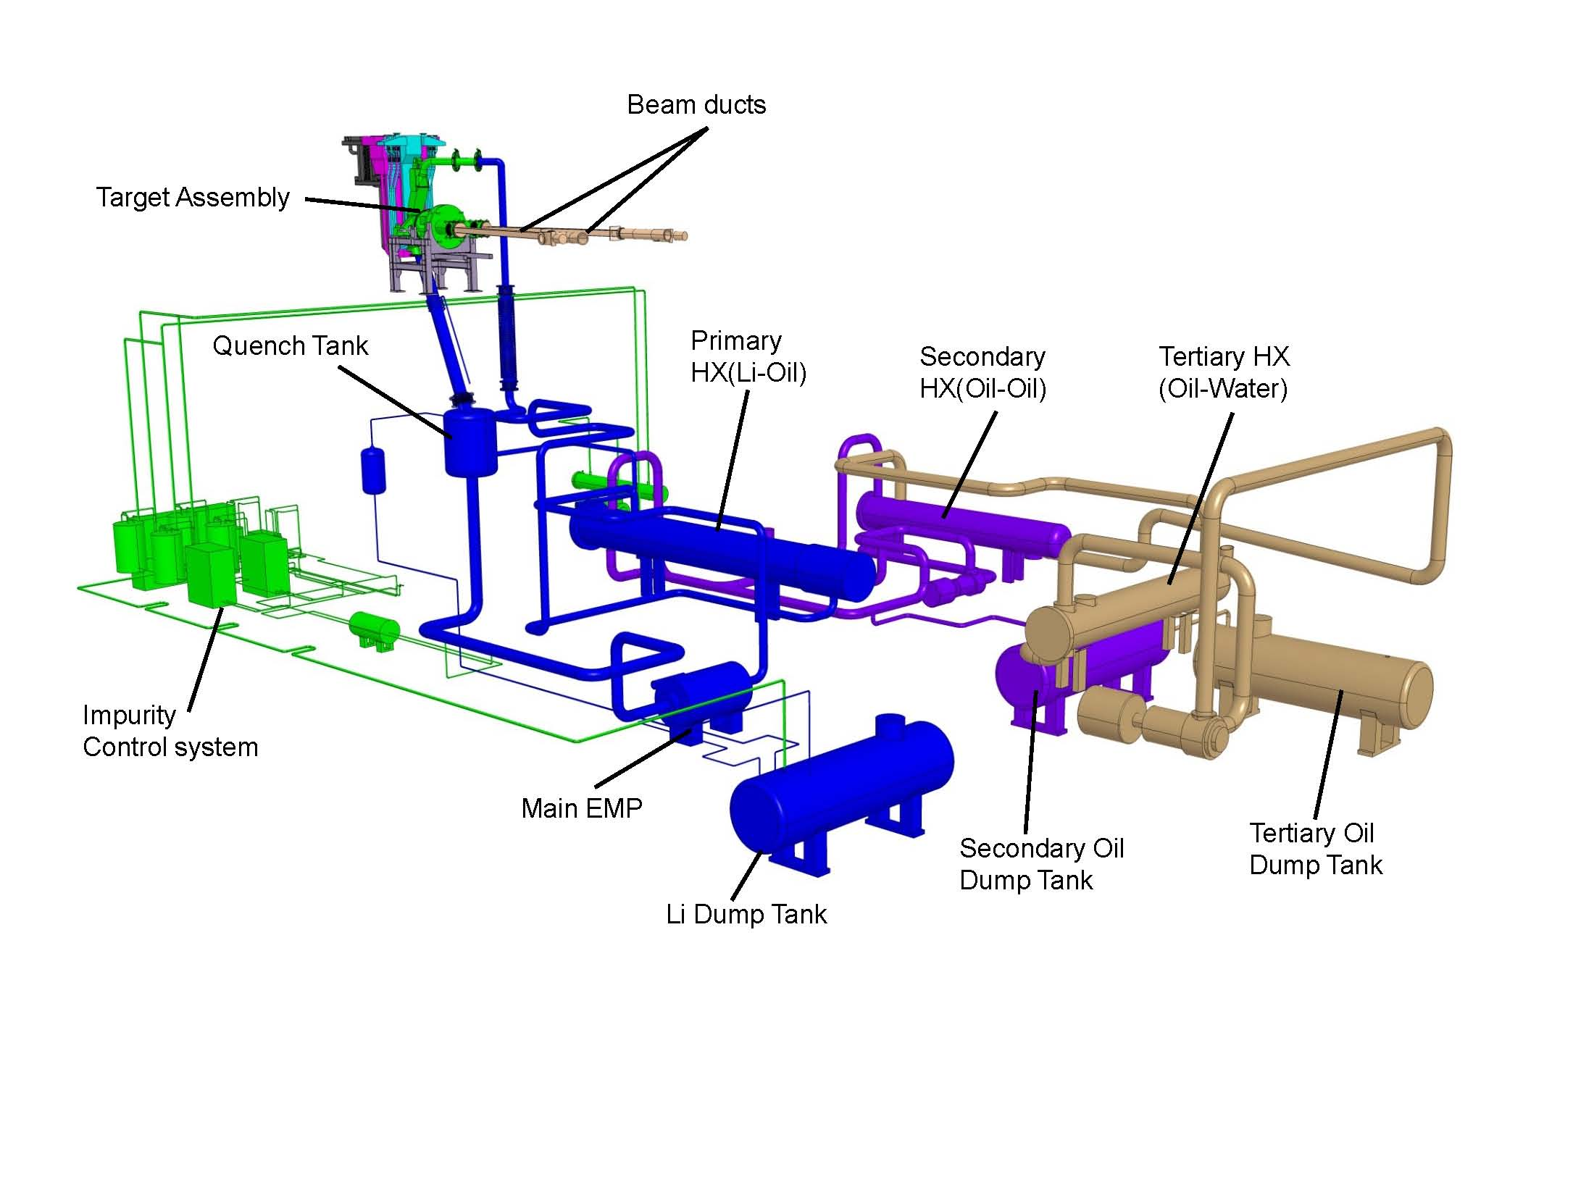
Target Facility Layout evolution
Design activities shared between JAEA and ENEA
1 | 0 | Target System | JAEA
 | 1 | Target Assembly (Integral type) | JAEA
 | 2 | Target Assembly (Replaceable back-plate type) | ENEA
2 | 0 | Heat Removal System | JAEA
 | 4 | Lithium Recovery
3 | 0 | Impurity Control System | JAEA
4 | 0 | Maintenance System | JAEA
 | 1 | Target Assembly (Integral type) Handling
 | 2 | Target Assembly (Replaceable back-plate type) Handling | ENEA
5 | 0 | Auxiliaries | JAEA
Li-loop cannot be pressurized due to open surface to accelerator vacuum
Mitigation of cavitation by static Li column
→ Height of the loop is the issue
Floor space increased from 550 to 900 m²
Additional intermediate oil loop
Auxiliaries
Pipe stresses at limits
Redundancies not yet considered
 | CDR Design | EVEDA Design
Li inventory | 9 m³ | 12.6 m³
Flow rate max. | 133 l/s | 106 l/s
Heat removal | 1 intermediate oil loop | 2 intermediate oil loops
EMP | ALIP return flow | ALIP
Purification system | Singular traps | Redundant traps

Slide 9
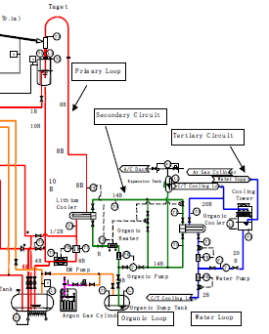
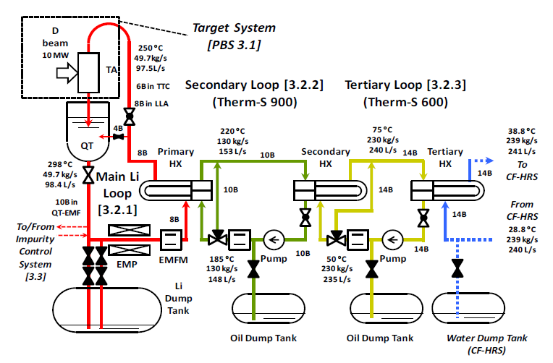
Design Evolution – Heat Removal
Implementation of a 2nd intermediate oil loop to
Reduce temperature gradient in HX
Mitigate tritium transfer to cooling water
Avoid pressure build-up in cooling water in case of loss of flow
Size of HX 1 and HX2 could be reduced from 9 to 6.4 m, but HX 3 length of 12 m → plate type HX
 |  | Fluid | Q [kg/s] | T in-out [C]
HX 1 | Shell | Li | 48.4 | 300 | 250
 | Tube | oil | 230 | 200 | 220
HX 2 | Tube | oil | 230 | 220 | 200
 | Shell | H₂O | 472 | 32 | 37
HX 1 | Shell | Li | 49.7 | 298 | 250
 | Tube | S-900 | 130 | 185 | 220
HX 2 | Tube | S-900 | 130 | 220 | 185
 | Shell | S-600 | 230 | 50 | 75
HX 3 | Tube | S-600 | 230 | 75 | 50
 | Shell | H₂O | 239 | 28.8 | 38.8

Slide 10
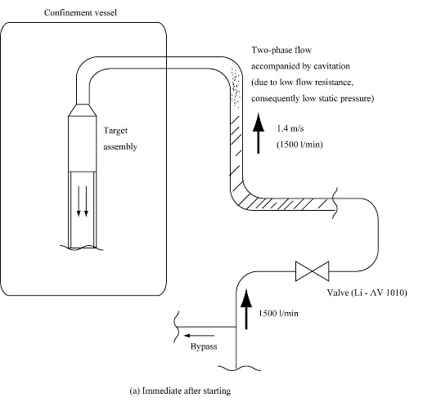
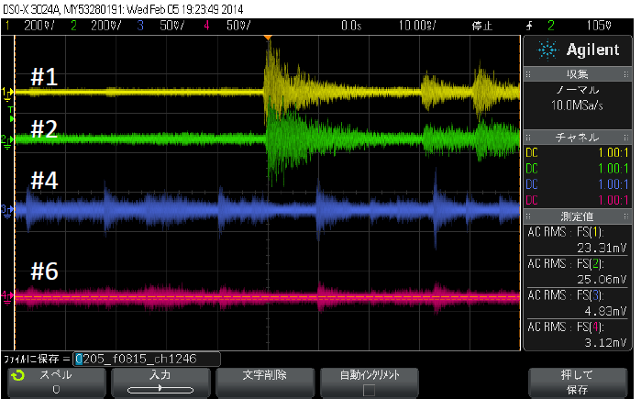
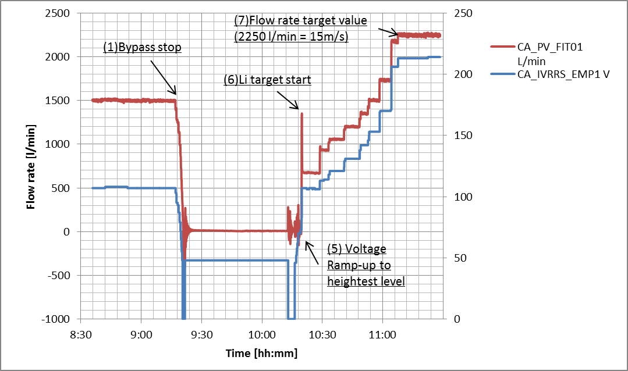
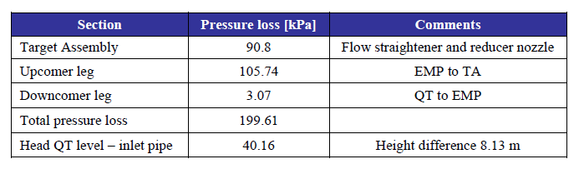
Design Evolution – TA Bypass
Start-up of flow through the TA should limit splashing
CDR considered direct flow through the TA by rapid ramp up resulting in a very simple main loop without valves and low hydraulic resistance
ISTC recommended implementation of a TA bypass and switching to the TA at velocities > 5 m/s
EVEDA Design implemented a 4” bypass with 2 valves
Configuration was tested in ELTL showing that direct flow start-up is equivalent
  Fluid hammer under high vacuum remains

Slide 11
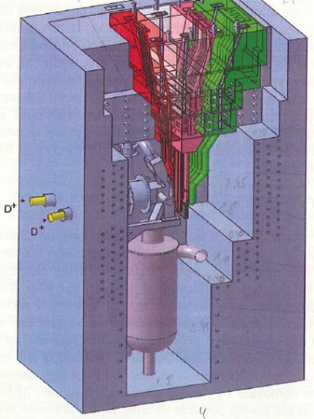
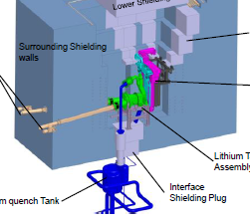
Design Evolution – Quench Tank Location
The function of the quench tank is to slow down and homogenize the Li jet. It free surface level controls the pressure of the Li column
→ Large volume and close to the target outlet
CDR design placed QT into the TC, which is good from the hydraulics point of view, but has several disadvantages
Tritium production due to Li(n,T) reaction → 15% of annual production
Activation of critical component with critical instrumentation → level meters
Deep TC pit → maintenance system in access cell
Heavy penetration plugs due to inclined channel (8 t)

Slide 12
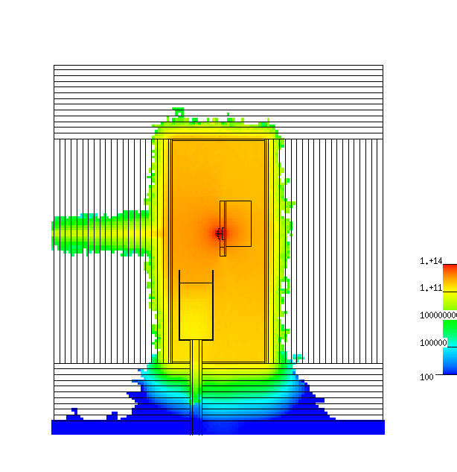
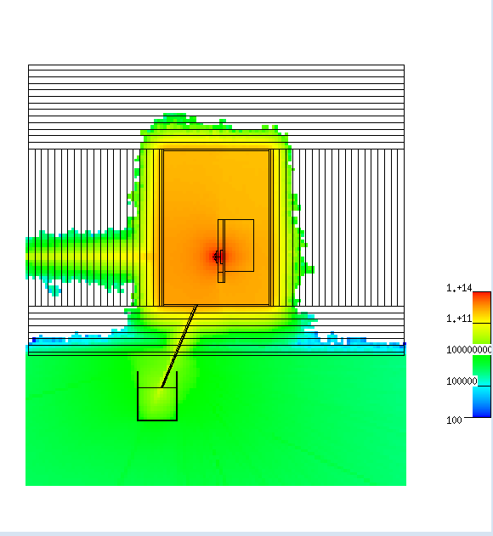
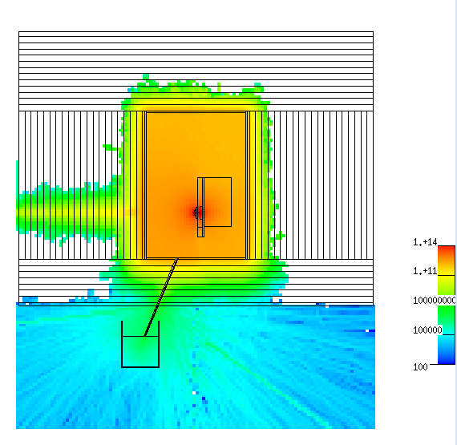
Design Evolution – Quench Tank Location
Tritium production is effectively reduced. Concept yields disadvantage of
Loss of containment of neutron and gamma shielding by TC
  Stronger activation of penetration ducts on loop area side
  Activation of QT top at hands-on limit
  Effective internal shielding of duct and local shielding of QT required (not yet solved)
Contact dose rate after 1 fpy irradiation and 1-10 d cooldown) | QT [mSv/h] | Duct [mSv/h]
Inside TC | 10E4 | Only Li film
Loop area with open channel | 1.5 | 1E3
Loop area with shielded channel | 0.1 | 10
Tritium production:
0.82 mg/kg Li/fpy
Open channel
Channel with internal shielding
Reduced thickness
n/cm²/s
5.6E11
1.0E9
8.4E10
1.4E8
1 μg T/kg Li/fpy
1.7E6
Courtesy K. Kondo

Slide 13
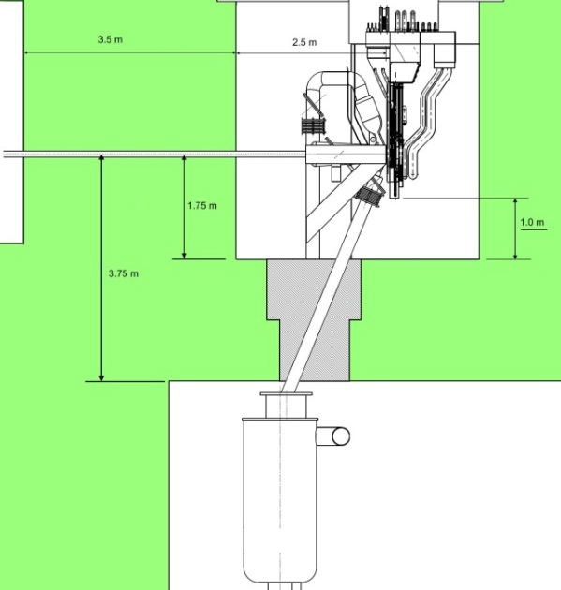
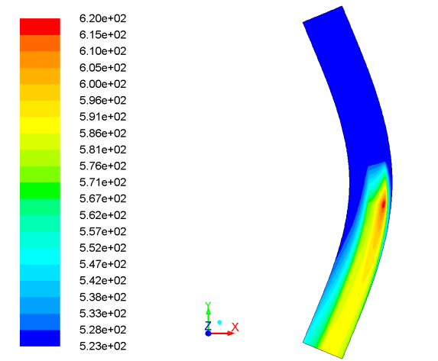
Design Evolution – Quench Tank Location
Hydraulic conditions in the target outflow are considerably changed
Long straight duct (FMIT-1, ELTL) → loss of fluid compression
  Stratified flow and thermal homogenization, outgasing and risk of boiling
  Increased distance nozzle to Li surface in QT → Increase of head
Injection into Li pool (CDR, ISTC) through closed instead of open duct
  Two independent gas spaces → pressure control more difficult
Reduced QT volume
  Effect on transient behaviour
Peak temperature at the end of curvature is about 310C (15 m/s), lower than boiling temperature of 344 C at 10E-3 Pa
Δ = 4.5 m
Distance increased by 2.6 m compared to CDR, which increases required head by 0.13 bar (15%)

Slide 14
Flow resistance and design pressure
Li loop design temperature and pressure: 350C and 0.43 MPa (hydraulic resistance and maximum pressure developed by EMP)
Limitation of maximum flow rate to 106 l/s (16 m/s) vs. 133 l/s in CDR
Design limits for target assembly backwall (min. thickness 1.8 → 3 mm)
Hydraulic resistance of loop about 200 kPa
Reduced NPSH_{required} vs. CDR
Required discharge pressure and flow rate can be achieved by two ELTL pumps
Component | Pressure Loss [kPa]
Piping | 34.1
Globe valve | 57.7
HX1 | 17.0
Flow straightener | 15.7
TA nozzle | 75.1

Slide 15
Loop transient behaviour
Li volume determines tritium inventory to be considered for accident case
Volume in QT was reduced from 2.2 to 1.2 m³
  Impact on transient behavior
  Thermal homogenization
350
300
250
200
150
100
50
Li HX1 in
Li HX1 out
S900 HX1 out
S900 HX1 in
Beam trip without T control
0 100 200 300 400
Time [s]
350
300
250
200
150
100
50
Beam trip with T control after 100 s
Li HX1 in
Li HX1 out
S900 HX1 out
S900 HX1 in
0 100 200 300
Time [s]

Slide 16
Design Evolution – Purification System
RAMI analysis showed importance of purification system for 95% availability
Redundant layout of traps vs. singular traps in CDR
Operation independent from main loop due to separate EMP (like in ELTL)
All traps can be operated independently, in parallel or in series
Li sampling during beam operation implemented (no weekly beam-stop)
Limitation of need of operation during beam operation → still to be validated
RAMI analysis recommends maintenance feasibility of system during beam operation → not yet implemented

Slide 17
Design Evolution – Cold trap
Trapping of oxygen, carbon and other products with low solubility by precipitation
Source term and trap design based on ELTL and Na experience
Target value < 10 wppm each (same as CDR)
100 l 304 wire mesh packing, forced cooling by Ar-flow
Operation during commissioning and after maintenance and loop opening
Plating out of ACPs and Be-7 causes residual dose rate of several mSv/h 10 cm
Replacement after commissioning phase
EVEDA suggests stepped cool down to avoid blockage

Slide 18
Design Evolution – Nitrogen trap
Trapping of nitrogen by chemical binding
Target value < 10 wppm to limit enhanced corrosion by ternary compound formation
Getter material Ti or Fe5-10%Ti pebbles
Ti absorption model based on N diffusivity in TiN layer, operation temperature 600C
30 l of Ti pebbles, design based on ELTL, experience in FMIT (Ti-foils)
qualification of Fe-Ti alloy at University of Tokyo, validation of Ti at ENEA
Operation during commissioning and after maintenance and loop opening
Replacement after commissioning phase, residual dose rate > 100 mSv/h due to large surface
Cartridge approach to benefit from high initial reactivity

Slide 19
Design Evolution – Hydrogen trap
Trapping of hydrogen isotopes by chemical binding
Target value < 10 wppm (same as CDR) → Tritium < 1 wppm (D is 92%)
Getter material Yttrium pebbles, operation at 280-300C
10 l of Y pebbles, concept based on ELTL
Material qualified at University of Kyushu, achievement of <1 wppm D demonstrated
Operation during commissioning to remove dissolved hydrogen, replacement after commissioning phase
Operation during beam operation (83 mol of H-isotopes/fpy) to limit T inventory to 1400 TBq in the Li, build-up due to by-pass ratio
Regular exchange (annually or bi-annually) to limit captured inventory
Residual dose rate about 6 mSv/h in 10 cm
Cartridge approach seems a good approach due to the small volumes

Slide 20
Design Evolution – Diagnostics
Control of the free surface flow and the thickness of the Li jet is indispensable for the safe operation of the target
In CDR several methods were proposed (visual, IR and contact probe)
Based on ELTL and Osaka loop level gauge system (resistance type) was designed to probe the jet thickness inside the TA with potential to operate during beam-on
A concept to assess the surface structure and the thickness of the jet via the beam ducts was developed based on a laser distance meter
  Proof of principle in ELTL
Both methods still need validation
under IFMIF-like conditions
Courtesy T. Kanemura

Slide 21
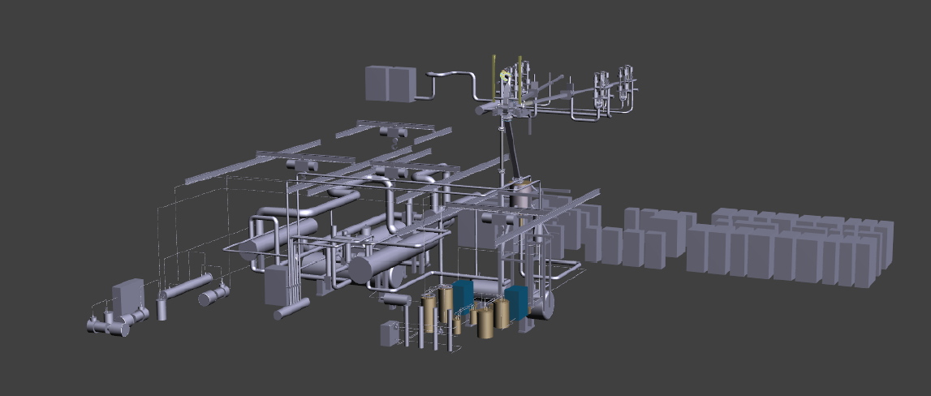
Conclusions
The LF design started rather late and with very limited resources. Only an intermediate design could be reached (conceptual/basic engineering stage)
Design optimization, detailed design and integration is still to be done
Some issues of the CDR could be clarified and improvements could be made
Some solutions, however, need to be reconsidered in view of the RAMI analysis and a better integration
Critical issues like the purification still wait for their validation
In-beam flow diagnostics still needs to be developed and validated under IFMIF conditions
More
Misprints
Mistakes
Contradictions
New information
…….

Slide 22
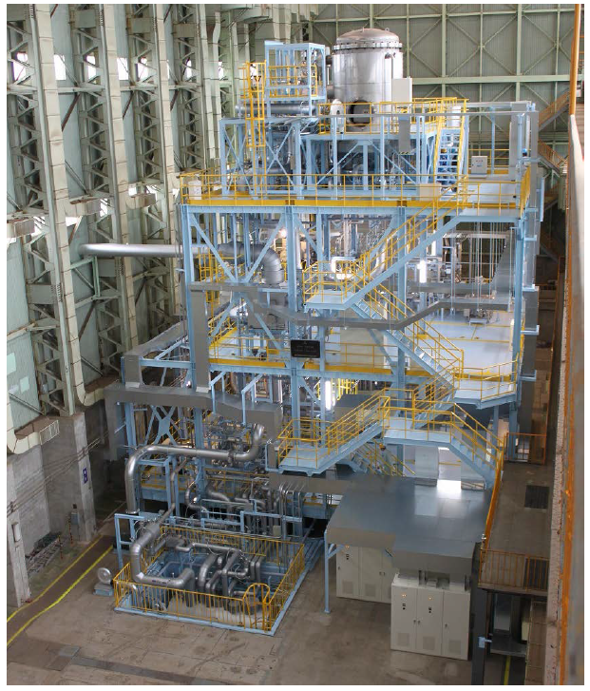
Conclusions
15 m/s, 300 deg. C

