Slide 1
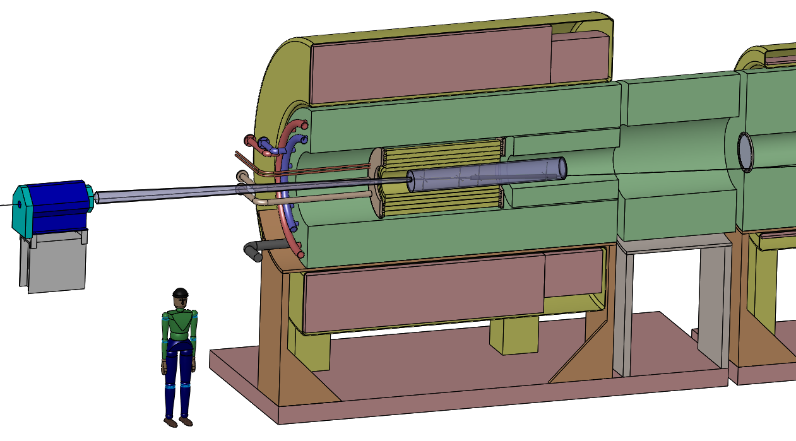
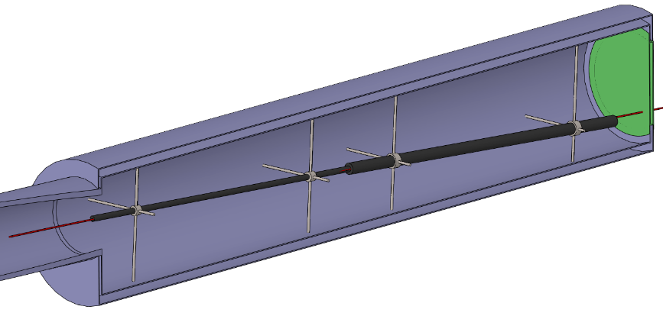
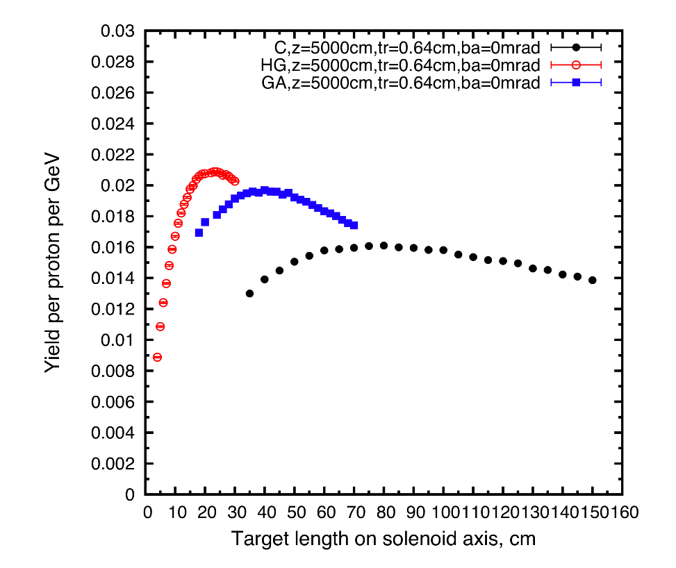
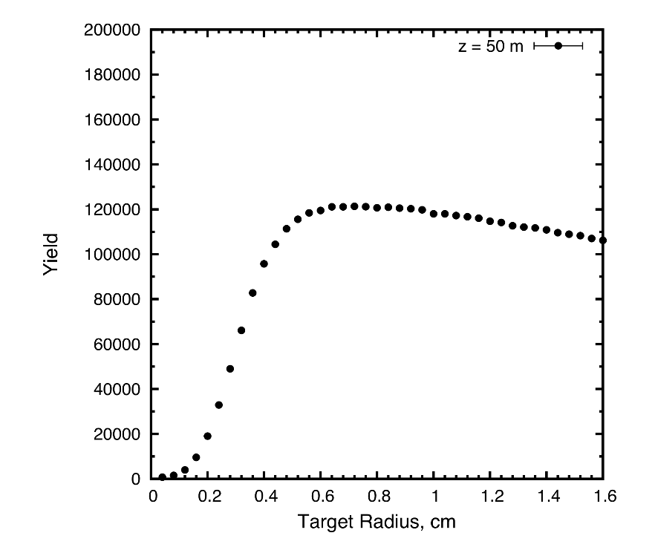
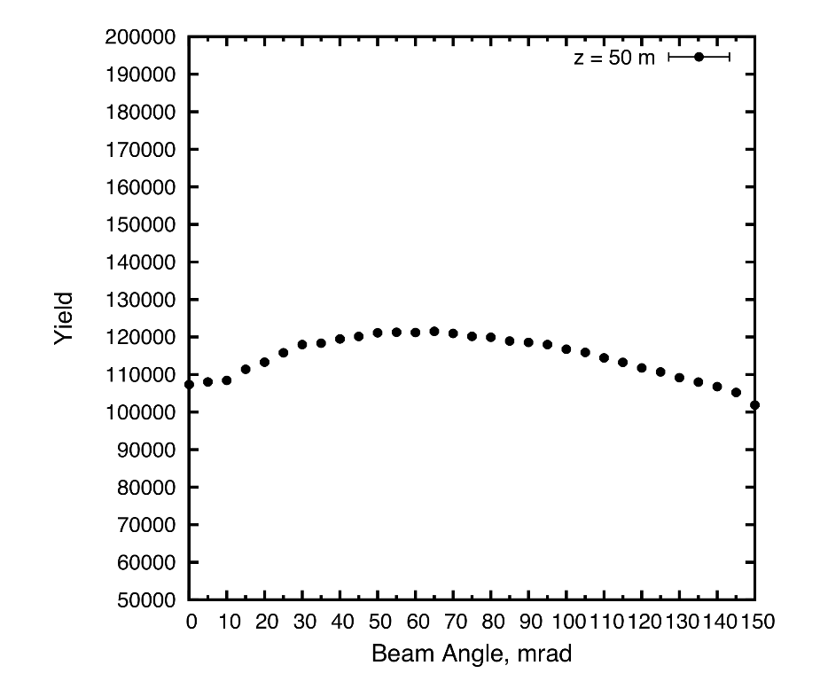
Target System Concept for a Muon Collider/Neutrino Factory
(5th High Power Target Workshop, Fermilab, May 20, 2014)
K.T. McDonald,⁵ X. Ding², V.B. Graves,³ H.G Kirk,¹ H. K. Sayed,¹ N. Souchlas,⁴ D. Stratakis,¹ R.J. Weggel⁴
¹Brookhaven National Laboratory, Upton, NY 11953, ²UCLA, Los Angeles, CA 90095
³ORNL, Oak Ridge, TN 38731, ⁴Particle Beam Lasers, Inc., Northridge, CA 91324
⁵Princeton University, Princeton, NJ 08544
Specifications from the Muon Accelerator Staging Scenario
6.75 GeV (kinetic energy) proton beam with 3 ns (rms) pulse.
1 MW initial beam power, upgradable to 2 MW (perhaps even to 4 MW).
60 Hz initial rep rate for Neutrino Factory;
15 Hz rep rate for later Muon Collider.
The goal is to deliver a maximum number of soft muons,
~40 < KE < ~ 180 MeV.
Target System Concept
Graphite target (ρ ~ 1.8 g/cm³), radiation cooled (with option for convection cooling); liquid metal jet as option for 2-4 MW beam power.
Target inside high-field solenoid magnet (20 T) that collects both µ±.
Target and proton beam tilted with respect to magnetic axis.
Superconducting magnet coils shielded by He-gas-cooled W beads.
Proton beam dump via a graphite rod just downstream of the target.
Some of the proton and π/µ transport near the target is in air.
15 T superconducting coil outsert,
Stored energy ~ 3 GJ, ~ 100 tons
Proton beam tube
Last Final-Focus quad
Upstream proton beam window
Stainless-steel target vessel (double-walled with intramural He-gas flow for cooling) with graphite target and beam dump, and downstream Be window.
This vessel would be replaced every few weeks at 1 MW beam power.
5 T copper-coil insert. Water-cooled, MgO insulated
He-gas cooled W-bead shielding (~ 100 tons)
Target System Optimizations
High-Z favored.
Optima for graphite target: length = 80 cm (for ρ = 1.8 g/cm³),
radius ~ 8 mm (with 2mm (rms) beam radius),
tilt angle = 65 mrad.
nominal geometric rms emittance ε⊥ = 5 µm.
β* = σ_{r}² /ε⊥ = 0.8 m.
Graphite proton beam dump, 120 cm long, 24 mm radius to intercept most of the (diverging) unscattered proton beam.
The 20 T field on target should drop to the ~ 2 T field in the rest of the Front End over ~ 5 m.
Issues for Further Study
Thermal “shock” of the short proton pulse on the graphite target.
Probably OK for 2 MW and 60 Hz operation; 15-Hz option needs study.
Cooling of target, and the W beads.
Lifetime of target against radiation damage.
Beam windows.
β* and beam emittance at the target.
To preserve liquid-metal-jet upgrade option, need related infrastructure installed at t = 0.

