Slide 1
NuMI Target Hall Reconfiguration for NOνA
5th High Power Targetry Workshop - FNAL
Target Facility Challenges
May 23, 2014
Salman Tariq¹, Eric Pirtle¹, Tony Busch², Gary Lauten², Michael Andrews³
¹AD/Mech Support ²AD/ES&H Rad Safety ³AD/LBNE ES&H
HPT_2014_NuMI_TH_Reconfiguration_NOvA_final1.ppt 5/22/2014

Slide 2
Outline
The NuMI Beamline & The NOvA Experiment
NuMI Target Hall Design
NuMI Target Hall upgrade requirements for NOvA
  Horn 2 Relocation to Medium Energy
  Pictorial walk-through of the Horn 2 move
  Results and Lessons Learned
Other Target Hall infrastructure upgrade work
Summary & Discussion
Focus of
this talk

Slide 3
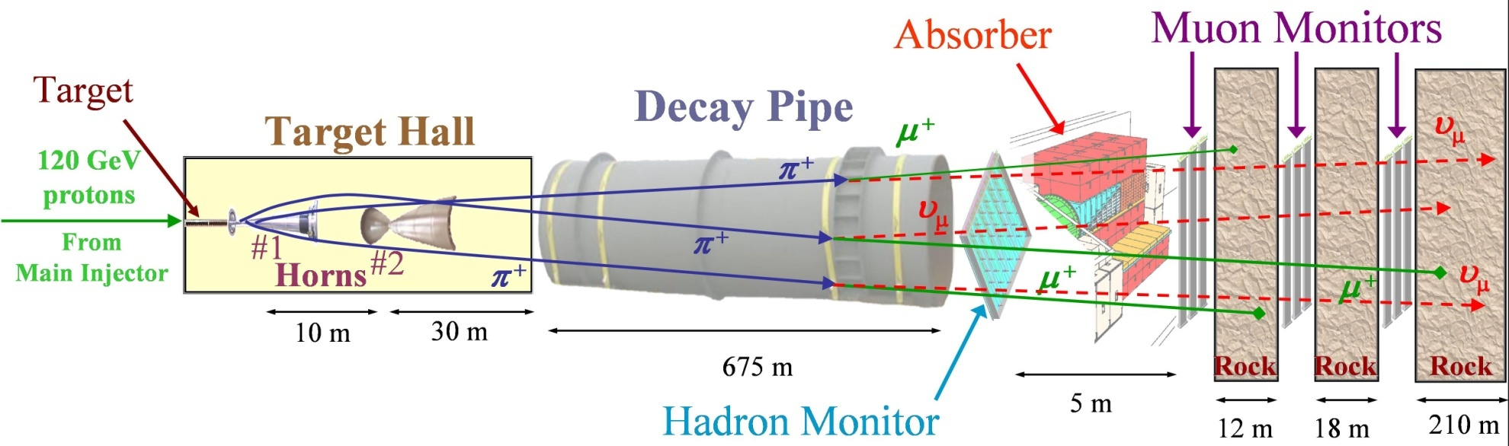
The NuMI Beamline
120 GeV Protons delivered from the Main Injector
Target & Horn position (optics) configurable to change the neutrino energy spectrum
Initially designed for 400 kW proton beam power on target
Achieved to date (2012) in the low energy configuration for MINOS:
~1.57×10²¹ POT, ~320 kW beam power, and 4.0×10¹³ Protons/pulse
Approximately 7 years of running
May 23, 2014
NuMI Target Hall Reconfiguration for NOvA – 5th High Power Targetry Workshop

Slide 4
The NOvA Experiment
NOvA is a second generation experiment on the NuMI beamline which is optimized for the detection of muon neutrino → electron neutrino oscillations
NOvA is: NuMI Off-axis v_{e} Appearance
  An upgrade of the NuMI beam intensity from 400kW to 700kW – change to Medium Energy configuration
  A 15kt “totally active” tracking liquid scintillator calorimeter far detector sited 14 mrad off the NuMI beam axis at a distance of 810 km in northern Minnesota
  A 220 ton near detector identical to the far detector sited 14 mrad off the NuMI beam axis at a distance of 1 km
May 23, 2014
NuMI Target Hall Reconfiguration for NOvA – 5th High Power Targetry Workshop

Slide 5
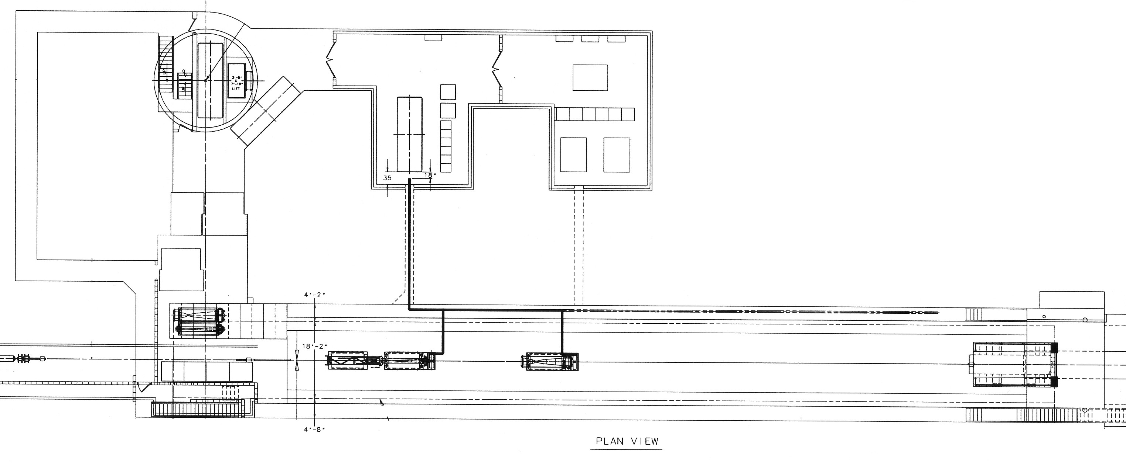
NuMI Target Hall (Plan View)
RAW
Systems
Target Pile
Re-circulating Air
Cooling System
Horn Power
Supply
Stripline
Target Pile
Shielding
Work Cell
Primary
Beamline
~9m
Target
Horn 1
Horn 2
Low Energy
Configuration
Horn 2
Medium Energy
Configuration
(MINOS/MINERvA)
(NOvA)
May 23, 2014
NuMI Target Hall Reconfiguration for NOvA – 5th High Power Targetry Workshop
5
Notes:
Cartoon of the detector: walk through from inside

Slide 6
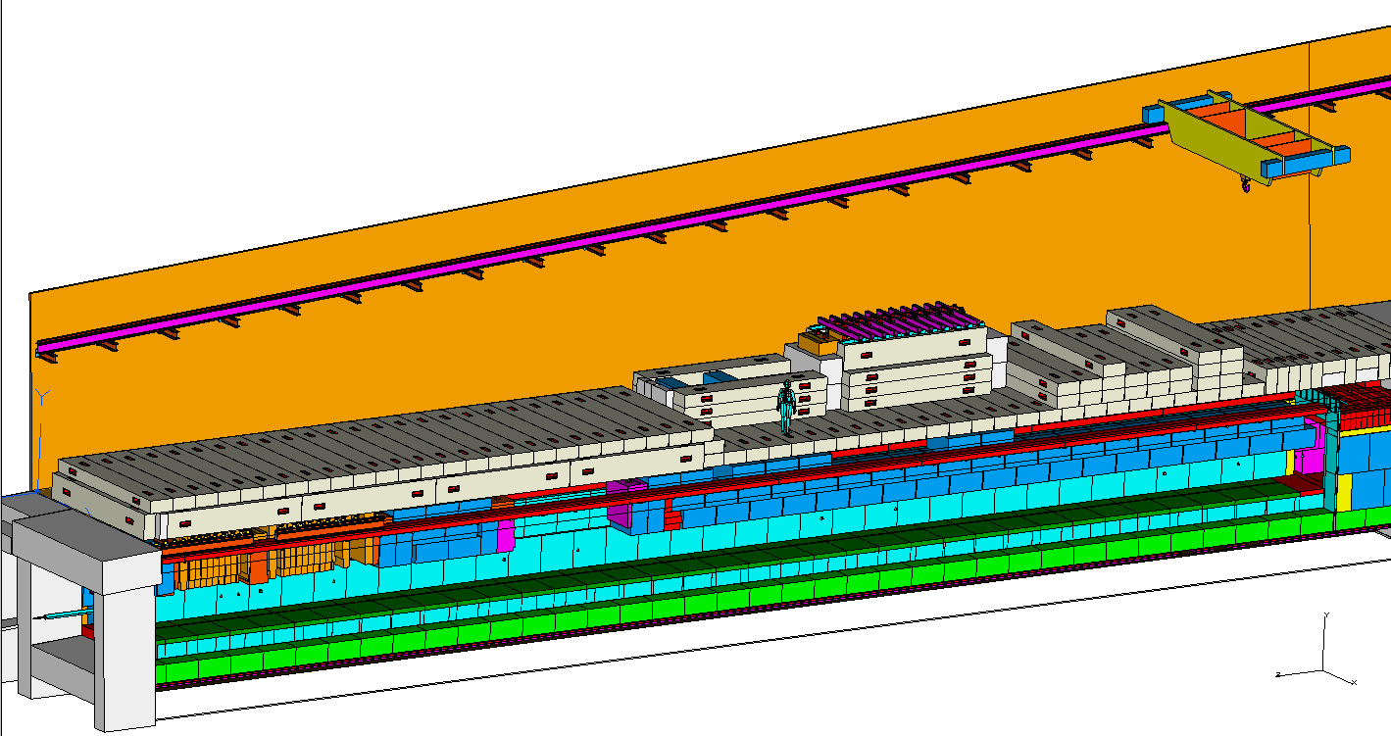
NuMI Target Hall – Low Energy
30T
Bridge Crane
T-Block
Staging
R-Block
Staging
Work
Cell Location
Blue Block
Staging
Concrete R-Blocks
Steel Blue Blocks
Horn 2
ME
Horn 2
LE
Target Chase
NOvA
Target
Horn 1
MINOS
Beam direction
‘Blue Block’ Specs.
Material: Carbon Steel
Dimensions: 52” x 52” x 26”
Weight: 10 Tons
Battlement
May 23, 2014
NuMI Target Hall Reconfiguration for NOvA – 5th High Power Targetry Workshop
6
Notes:
Cartoon of the detector: walk through from inside

Slide 7
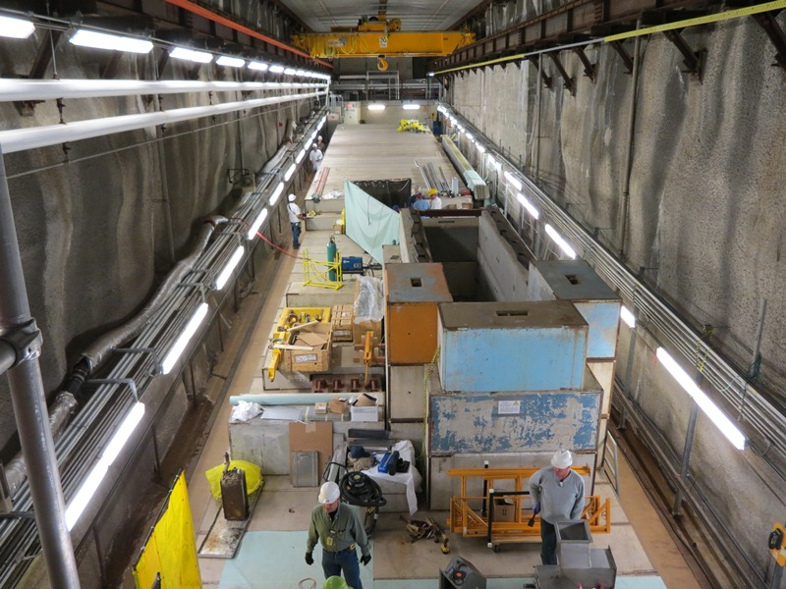
NuMI Target Hall at LE – Looking US
Space is very limited -
Not a lot of room to work in
May 23, 2014
NuMI Target Hall Reconfiguration for NOvA – 5th High Power Targetry Workshop

Slide 8
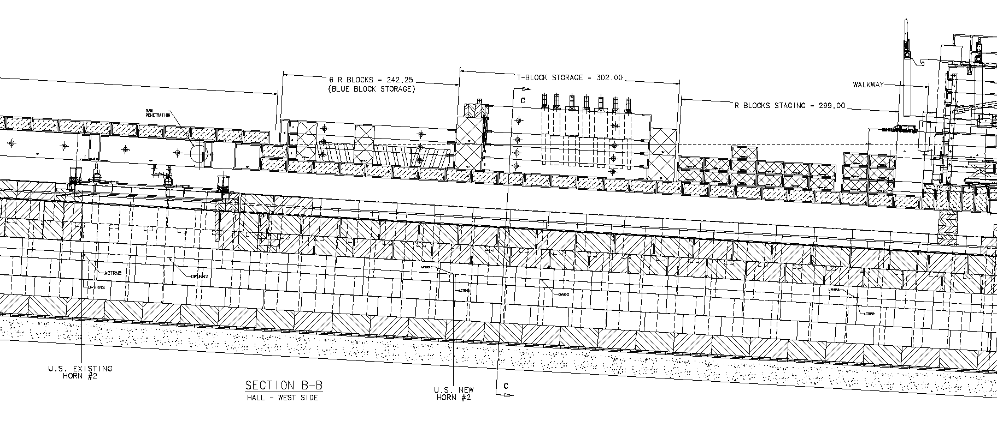
NuMI Target Hall – Long. Section View
Work Cell
R-Blocks
Blue Block
Staging
T-Block Staging
C
R-Block
Staging
Beamline
Blue Blocks
Horn 2 US End
Low Energy
Configuration
C
Horn 2 US End
Medium Energy
Configuration
‘Blue Block’ Specs.
Material: Carbon Steel
Dimensions: 52” x 52” x 26”
Weight: 10 Tons
9m
(29.5’)
MINOS
NOvA
May 23, 2014
NuMI Target Hall Reconfiguration for NOvA – 5th High Power Targetry Workshop

Slide 9
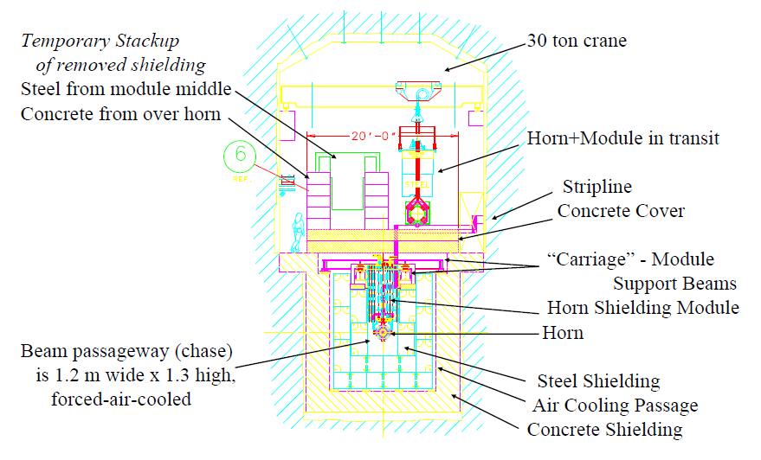
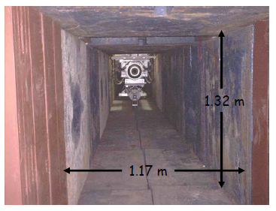
NuMI TH – Section View at Horn 2
(Blue Blocks)
Slide Credit: J. Hylen - AHIPA09
May 23, 2014
NuMI Target Hall Reconfiguration for NOvA – 5th High Power Targetry Workshop

Slide 10
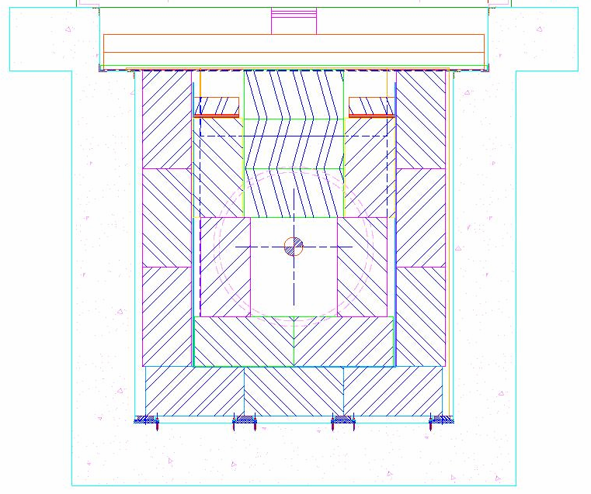
NuMI TH – Section View at ME
Section C-C Showing Blue Block Stacking Order
Concrete Cover
3
Sheet-metal
air dam
2
Blue Blocks that
need to be
removed at ME for NOvA
1
Air cooling
passages
Blue Blocks
TARGET CHASE
Concrete
Target Hall Shielding Section C-C
at Medium Energy Location
May 23, 2014
NuMI Target Hall Reconfiguration for NOvA – 5th High Power Targetry Workshop

Slide 11
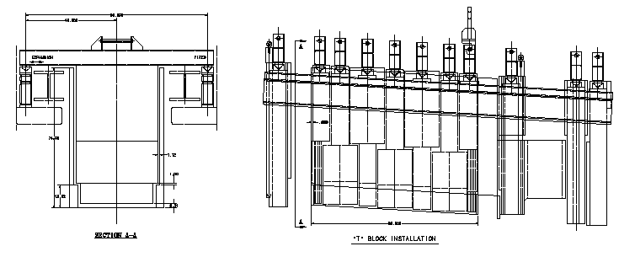
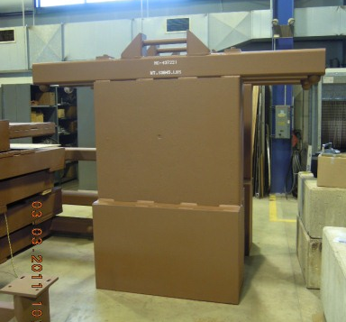
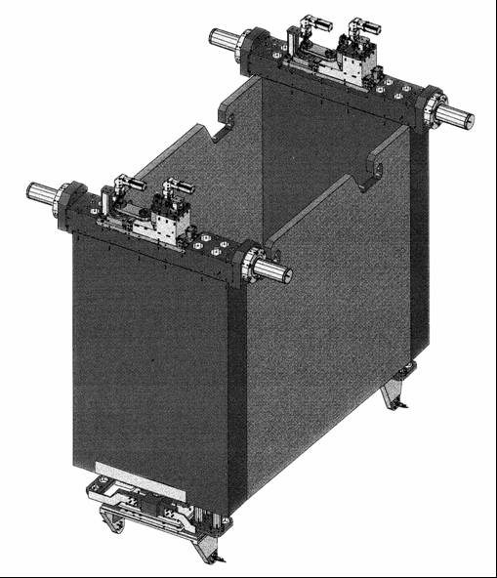
NuMI TH – Component Support
T Block
Support
Tubes
US End Block
T-Blocks
DS End
Blocks
T-Block
T-Blocks
Stripline Block
Module
Horn 2 Module
Horn 2
May 23, 2014
NuMI Target Hall Reconfiguration for NOvA – 5th High Power Targetry Workshop

Slide 12
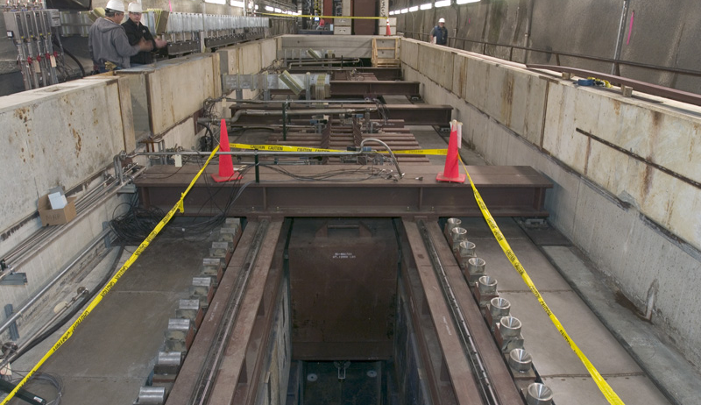
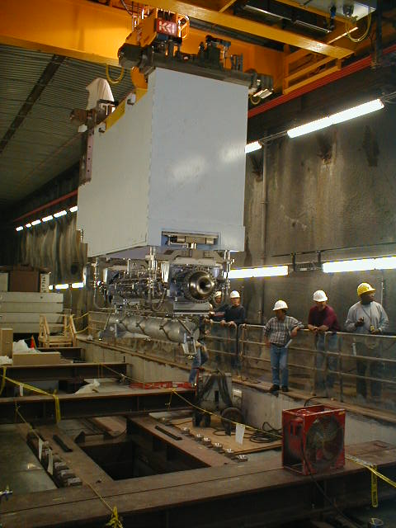
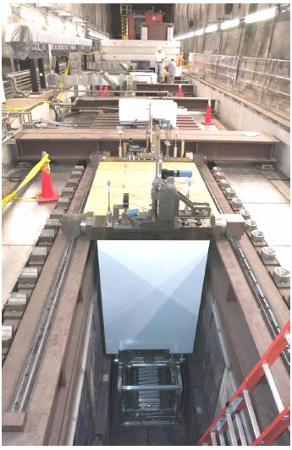
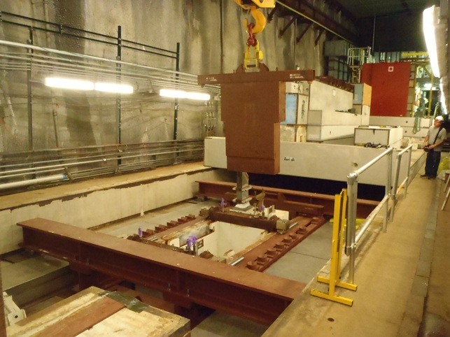
NuMI Target Hall – Shielding Removed
Carriage
Support
T-Block Support
Horn
Module
Module
May 23, 2014
NuMI Target Hall Reconfiguration for NOvA – 5th High Power Targetry Workshop

Slide 13
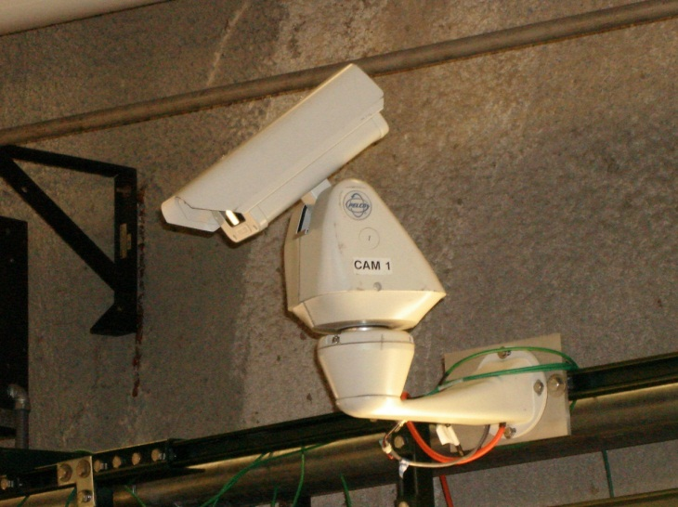
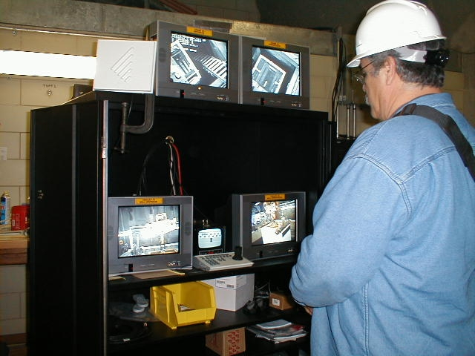
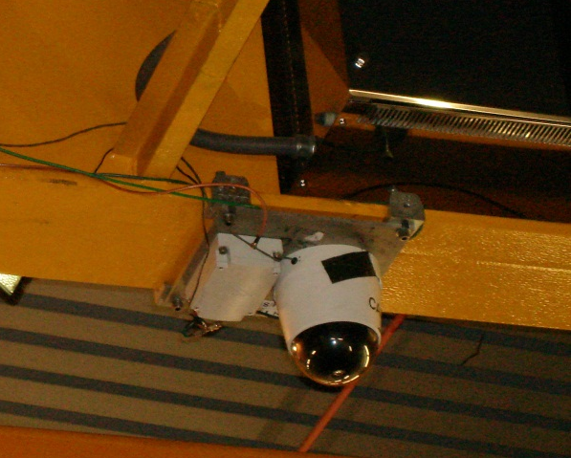
NuMI TH – Remote Handling
Remote Handling Video Control System
Remote handling capability:
Target and horn module assemblies
T-blocks, Stripline Blocks
Blue-Blocks
Horn Magnetic field measurements, etc.
NUMI Target Hall Operations Center
Cameras
May 23, 2014
NuMI Target Hall Reconfiguration for NOvA – 5th High Power Targetry Workshop

Slide 14
Summary of NuMI Target Hall/Chase Design
Top-Load design; ~3.5° pitch (pointing down)
30 ton bridge crane with rotating hook
Video control system for Remote Handling
Target shield pile constructed of steel Blue-Blocks (1.32m×1.32m×0.66m)
Target/Baffle and Horns suspended by modules that are supported by a carriage support system – carriage is thermally isolated from the shield pile
Removable T-shape steel shielding blocks (T-blocks) fill the volume inside the module and at the ends (supported independently of the modules)
Removable concrete R-blocks cover the top of the shielding steel
Air-cooled Target Chase – air flows US on the top/sides/bottom of the shield pile, makes a 180 ° turn, and then flows DS through the chase
Shielded ‘staging areas’ are used to store T-blocks and Blue-Blocks during a component change-out
Work Cell for radioactive component handling and temporary storage
May 23, 2014
NuMI Target Hall Reconfiguration for NOvA – 5th High Power Targetry Workshop

Slide 15
NuMI TH requirements for NOvA
Medium Energy Configuration at 700kW
  Horn 2 relocation 9m downstream – significant reconfiguration of existing steel shielding and the overall TH operational layout
  Preserve the full operational capacity of the Target Hall facility
Beam, Target & Horn Alignment Tolerance of 1.5mm
Maintain acceptable temperatures in Target Chase at the higher beam power
  Comprehensive thermal analysis & assessment of the chase region
  Calculation of Target and Horn thermal offsets
  Cooling upgrades to existing air and water cooling systems
Environmental Safety and Health (ES&H)
  Maintain shielding integrity – Minimize worker exposure to residual radiation both during reconfiguration and beam operation
May 23, 2014
NuMI Target Hall Reconfiguration for NOvA – 5th High Power Targetry Workshop

Slide 16
NuMI Target Hall – Medium Energy
RAW
Systems
Target Pile
Re-circulating Air
Cooling System
Horn Power
Supply
Stripline
Target Pile
Shielding
Work Cell
Primary
Beamline
~9m
Target
Horn 1
Horn 2
Low Energy
Configuration
Horn 2
Medium Energy
Configuration
MINOS
NOvA
May 23, 2014
NuMI Target Hall Reconfiguration for NOvA – 5th High Power Targetry Workshop
16
Notes:
Cartoon of the detector: walk through from inside

Slide 17
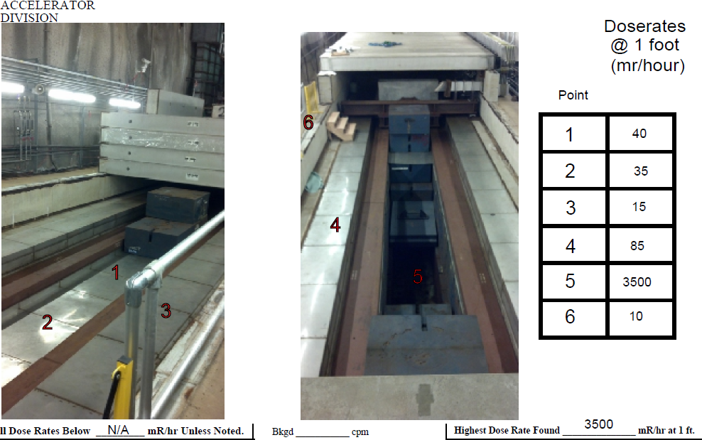
Horn 2 Relocation – 2 Main Challenges
Limited space to work in (had to carefully orchestrate all steps)
High residual dose rates (minimize exposure – ALARA*)
Dose rates
reasonable
at the sides
*ALARA: As Low As Reasonably Achievable
May 23, 2014
NuMI Target Hall Reconfiguration for NOvA – 5th High Power Targetry Workshop

Slide 18
Fermilab Radiation Dose Limits
DOE Legal Dose Limits:
Whole Body: 5,000 mrem/yr
Extremities/Skin: 50,000 mrem/yr
Fermilab Administrative Dose Limits:
1,500 mrem/yr (total effective dose)
350 mrem/quarter (whole body dose)
  Placed on ALERT List if exceeded
AD local control limit of 100 mrem/week – anything above this requires RSO (Radiation Safety Officer) approval
[1 mrem = 10⁻² mSv]
May 23, 2014
NuMI Target Hall Reconfiguration for NOvA – 5th High Power Targetry Workshop

Slide 19
Horn 2 Relocation – Approach
Make the opening at ME identical to the LE location
  Horn 2 + associated module and T-block shielding can then be moved directly into the ME position
  Will require new Horn 2 Carriage and T-Block Support assemblies
Construct new (special) T-Blocks to fill the LE opening
  T-blocks are very easy to handle remotely
  Decided against re-using the extracted Blue-Blocks due to their high residual dose rates and difficulty in remote handling
The above would allow for easy conversion back to the LE configuration if needed in the future (i.e. Horn 2 could be moved relatively easily back to the LE position)
Construct temporary steel shielding to go inside the chase opening at ME (and LE) during the reconfiguration work
May 23, 2014
NuMI Target Hall Reconfiguration for NOvA – 5th High Power Targetry Workshop

Slide 20
Horn 2 Relocation - Basic Sequence
Remove Horn 1 and place in work cell (to reduce residual dose rates)
Move and relocate T-block staging area
Remove concrete R-blocks over ME
Remove stainless-steel sheet metal air-dam over ME
Remove 12 Blue-Blocks from ME (8 blocks completely removed from TH using coffins), install custom blocks at the ends
Install temporary steel shielding inside newly created ME void
Install new T-block support tubes and Horn Carriage support
Move Horn 2 from LE to ME position (T-blocks in new staging area)
Bring down shaft & install new special T-blocks in LE position (“plug”)
Install new air-dam at LE location (over T-blocks)
Install Horn 2 stripline extension and utility extensions
Rearrange vertical R-blocks to build new battlement over ME
Move T-block staging area to final position, re-install all R-blocks
May 23, 2014
NuMI Target Hall Reconfiguration for NOvA – 5th High Power Targetry Workshop

Slide 21
NuMI Target Hall – Low Energy
30T
Bridge Crane
T-Block
Staging
R-Block
Staging
Work
Cell Location
Blue Block
Staging
Concrete R-Blocks
Steel Blue Blocks
Horn 2
ME
Horn 2
LE
Target Chase
NOvA
Target
Horn 1
MINOS
Beam direction
‘Blue Block’ Specs.
Material: Carbon Steel
Dimensions: 52” x 52” x 26”
Weight: 10 Tons
Battlement
May 23, 2014
NuMI Target Hall Reconfiguration for NOvA – 5th High Power Targetry Workshop
21
Notes:
Cartoon of the detector: walk through from inside

Slide 22
Horn 2 Relocation
Pictorial Walk Through
May 23, 2014
NuMI Target Hall Reconfiguration for NOvA – 5th High Power Targetry Workshop
22
Notes:
Cartoon of the detector: walk through from inside

Slide 23
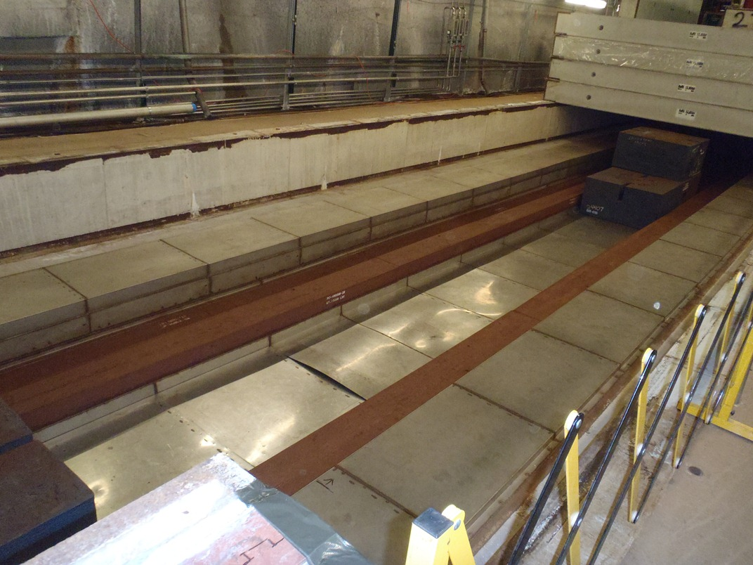
Horn 2 Relocation – Pictures
R-blocks removed over ME, sheet-metal yet to be removed
35-40 mrem/hr
May 23, 2014
NuMI Target Hall Reconfiguration for NOvA – 5th High Power Targetry Workshop

Slide 24
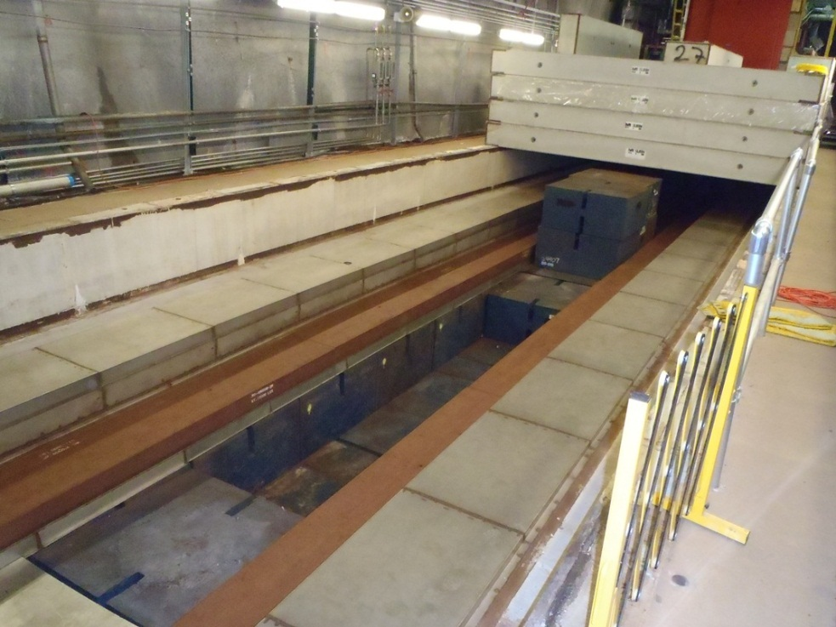
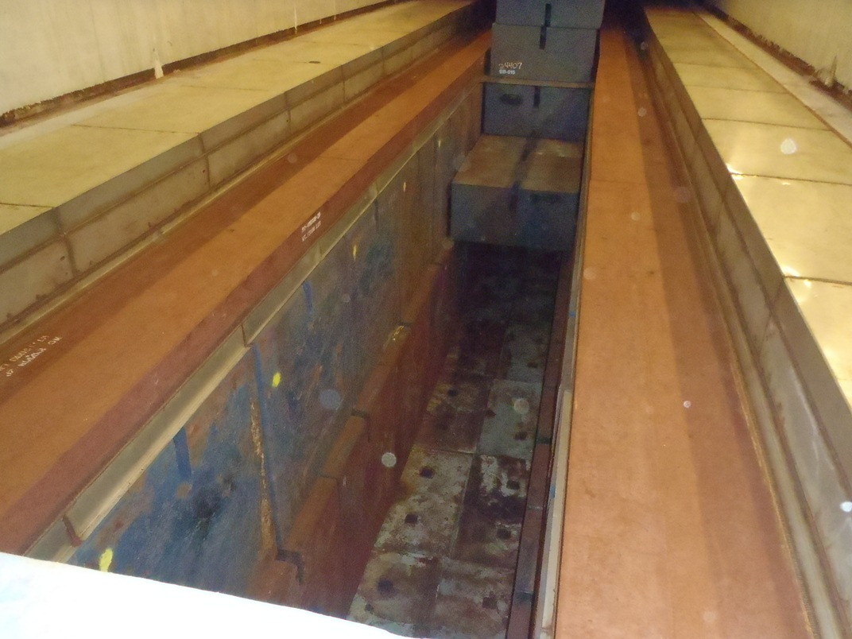
Horn 2 Relocation – Pictures
ME location - Sheet metal removed, Blue-Blocks removed
1st Layer of BB Removed
2nd Layer of BB Removed
3,500 mrem/hr
@ opening
May 23, 2014
NuMI Target Hall Reconfiguration for NOvA – 5th High Power Targetry Workshop

Slide 25
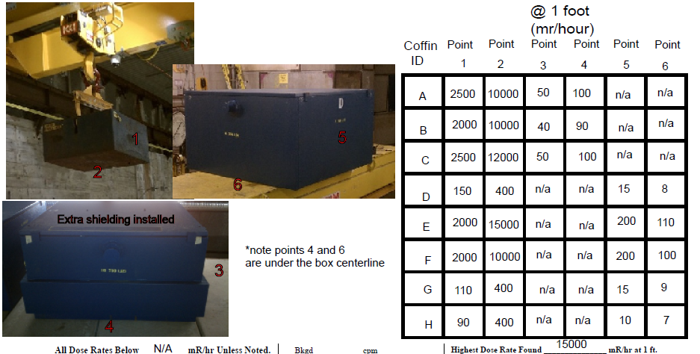
Horn 2 Relocation – Dose Rates
Most radioactive Blue-Blocks were removed from the TH
Extracted Blue Blocks that were removed using coffins
May 23, 2014
NuMI Target Hall Reconfiguration for NOvA – 5th High Power Targetry Workshop

Slide 26
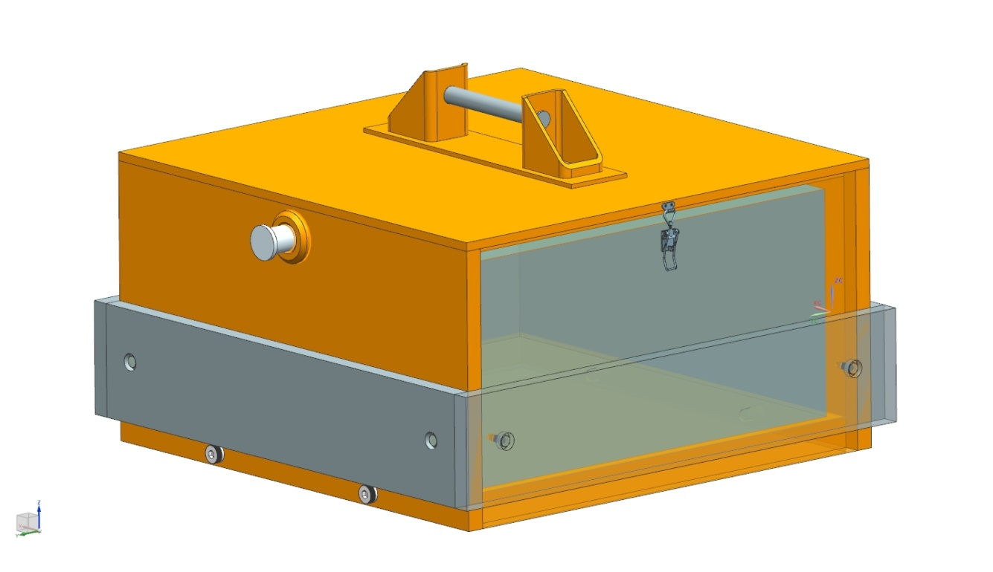
Horn 2 Relocation – Coffins
Blue-Block Coffin Design
2-4 inch thick side walls
1 inch thick top cover plate
~5 inch thick base
Fully remote operation (fully remote placement of BB in coffin)
Removable lifting handle on lid (makes coffins stackable)
Uses special spreader bar for lifting
May 23, 2014
NuMI Target Hall Reconfiguration for NOvA – 5th High Power Targetry Workshop

Slide 27
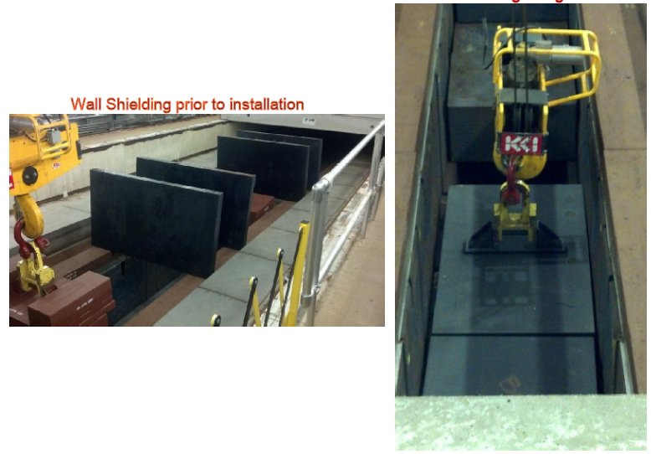
Horn 2 Relocation – Temporary Shielding
Temporary Shielding
Wall Shielding prior to installation
Floor Shielding Being Installed
May 23, 2014
NuMI Target Hall Reconfiguration for NOvA – 5th High Power Targetry Workshop

Slide 28
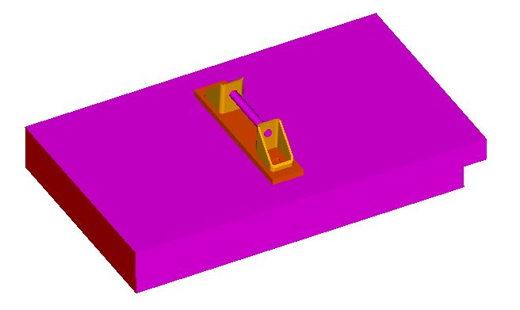
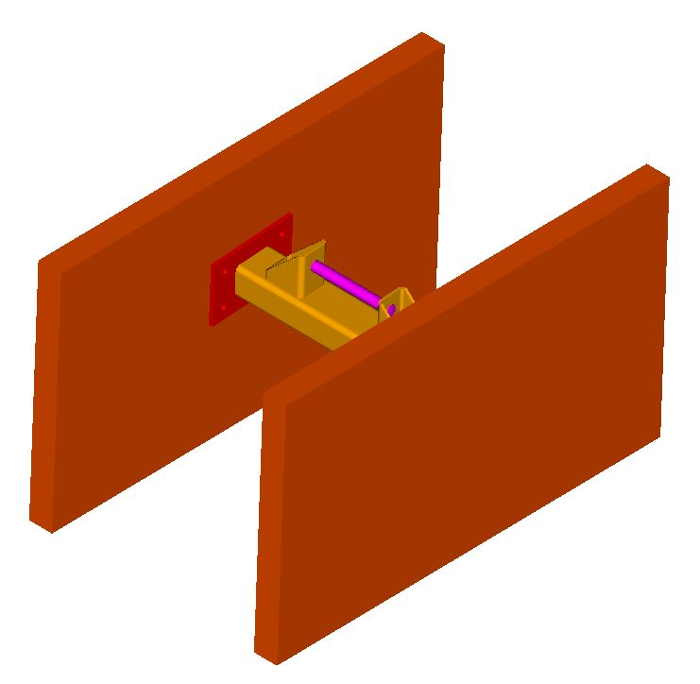
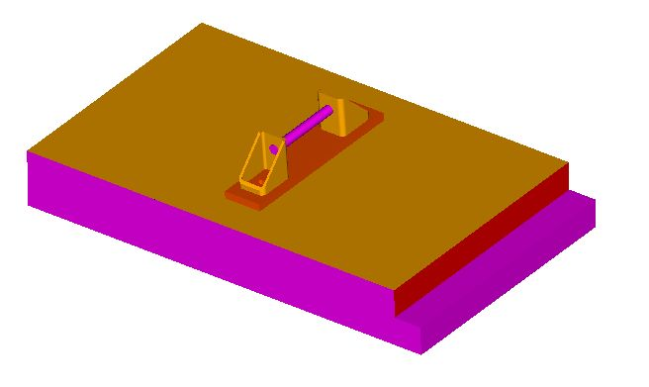
Horn 2 Relocation – Temporary Shielding
Temporary Chase Shielding Blocks (Steel)
Void Floor Shielding 12 inch thick (1 each)
Void Side Wall Shielding 5 inch thick (Qty 2)
Uses standard T-block lifting fixture
Installs remotely
May 23, 2014
NuMI Target Hall Reconfiguration for NOvA – 5th High Power Targetry Workshop

Slide 29
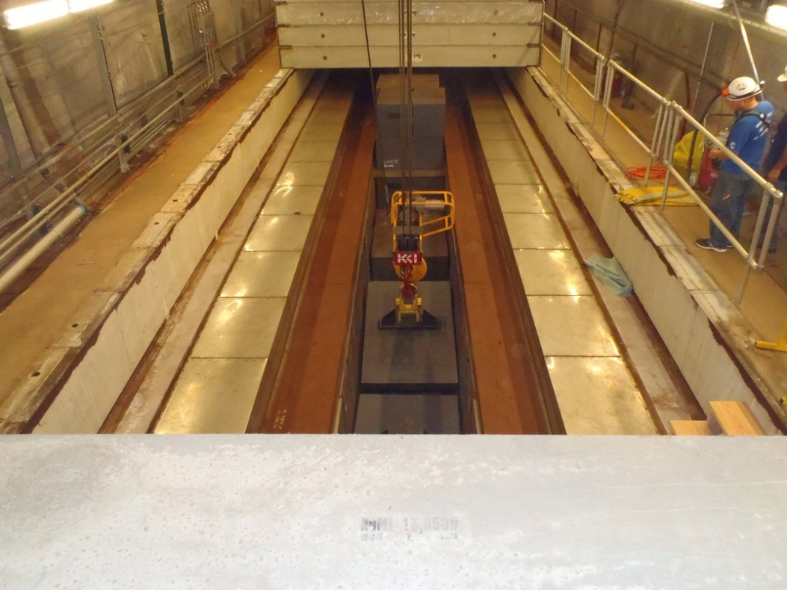
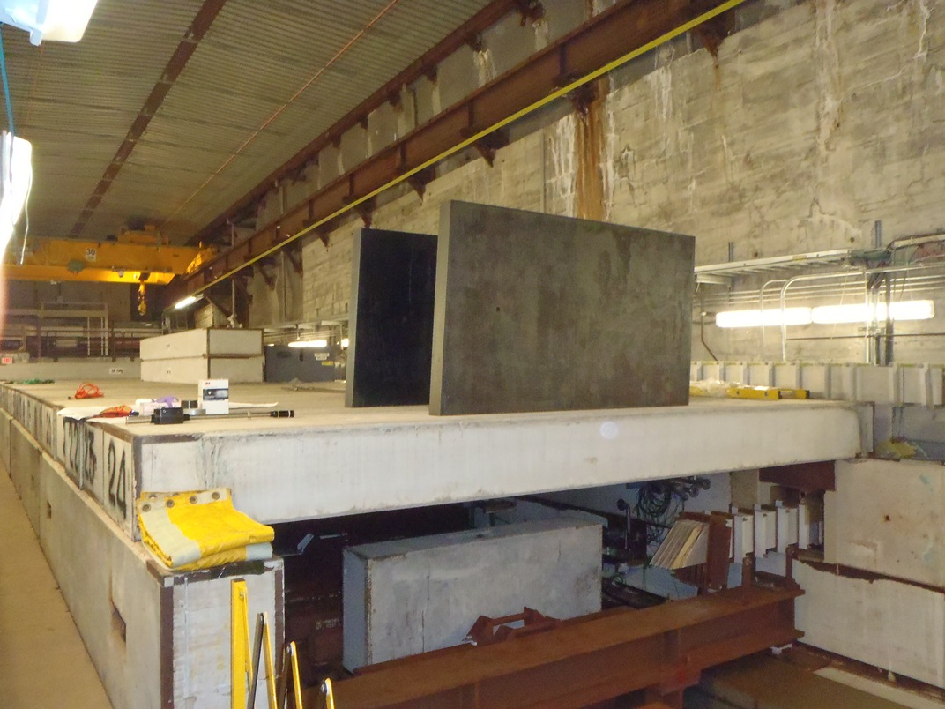
Horn 2 Relocation – Pictures
Installing floor shielding and staging the wall shielding
The wall shielding was also used for the alignment personnel to survey the ME opening
May 23, 2014
NuMI Target Hall Reconfiguration for NOvA – 5th High Power Targetry Workshop

Slide 30
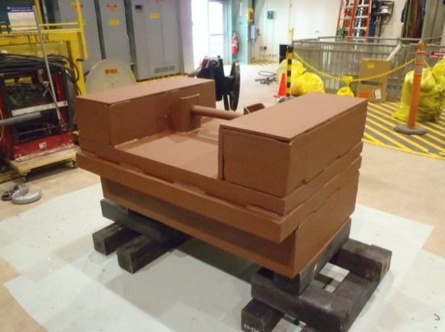
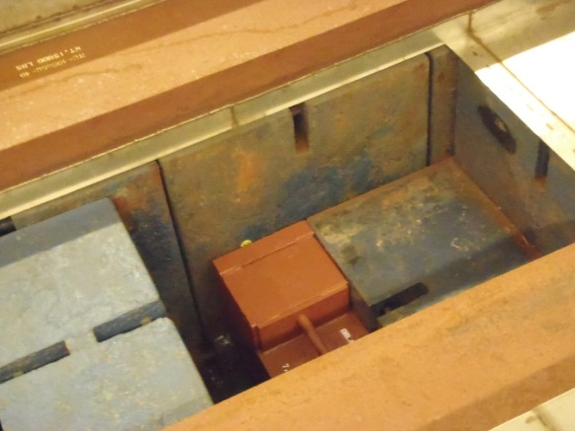
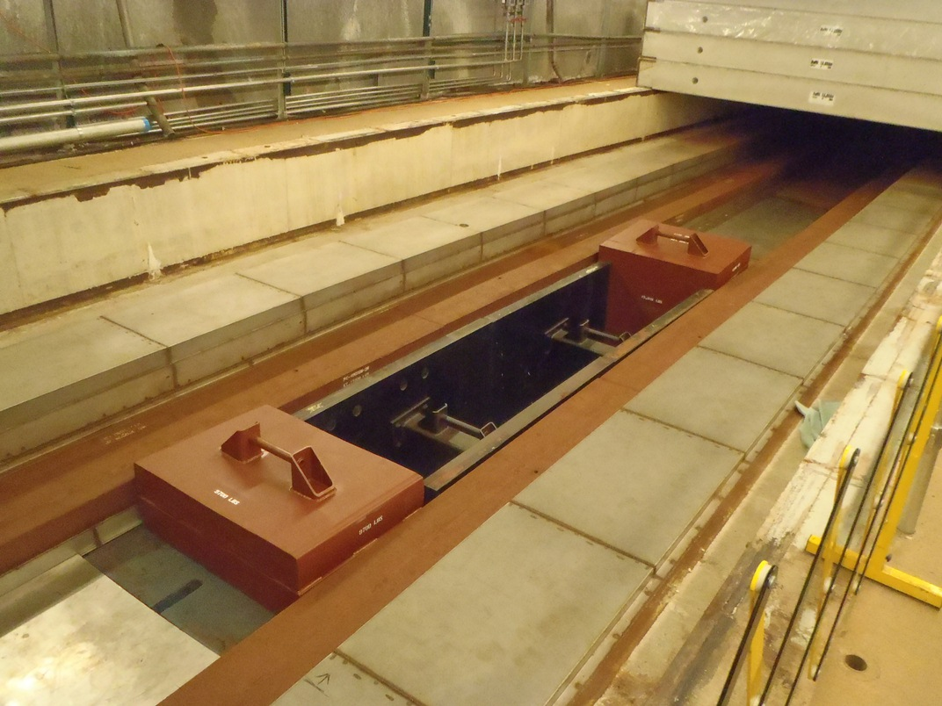
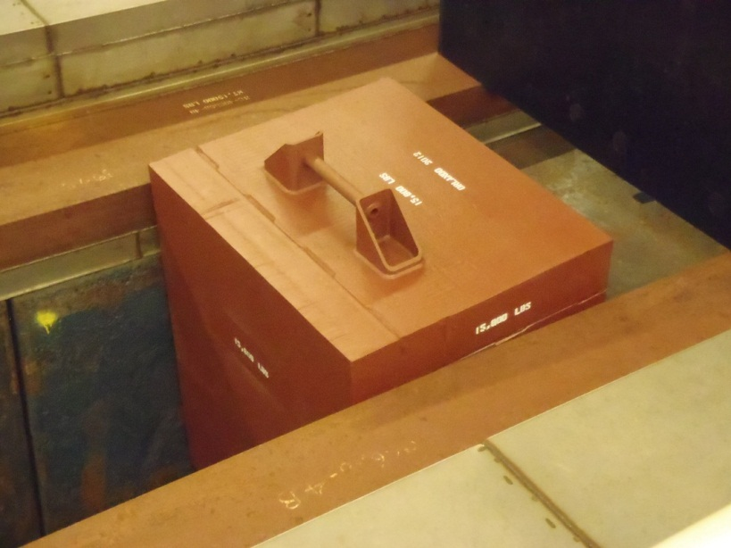
Horn 2 Relocation – Pictures
Custom Shielding Installed at the ends of the ME opening
Note that all blocks use the same lifting handle design
Custom End Shielding Installed Below
This ME horn 2 opening is now identical to the LE position
May 23, 2014
NuMI Target Hall Reconfiguration for NOvA – 5th High Power Targetry Workshop

Slide 31
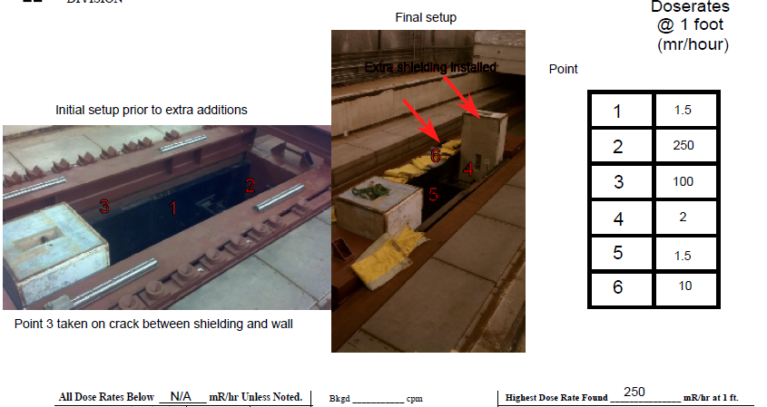
Horn 2 Relocation – Dose Rates
ME Opening after installation of Temporary Shielding
In the final setup, had to use concrete blocks at the ends plus lead blankets at the crack openings to fully mitigate residual dose rates
Recall
3,500 mr/hr
before
May 23, 2014
NuMI Target Hall Reconfiguration for NOvA – 5th High Power Targetry Workshop

Slide 32
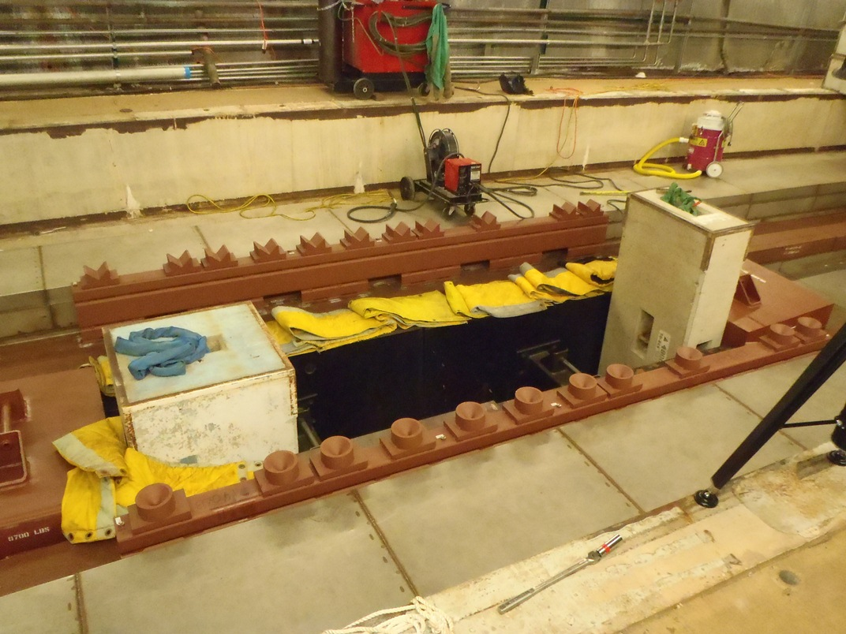
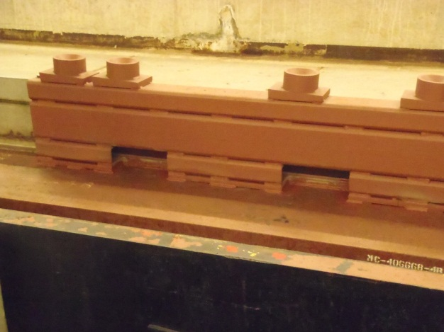
Horn 2 Relocation – Pictures
Welding the T-block Support Tubes
Cut-outs on the bottom of tube allowed for welds at the back end
1.5-2 mrem/hr
May 23, 2014
NuMI Target Hall Reconfiguration for NOvA – 5th High Power Targetry Workshop

Slide 33
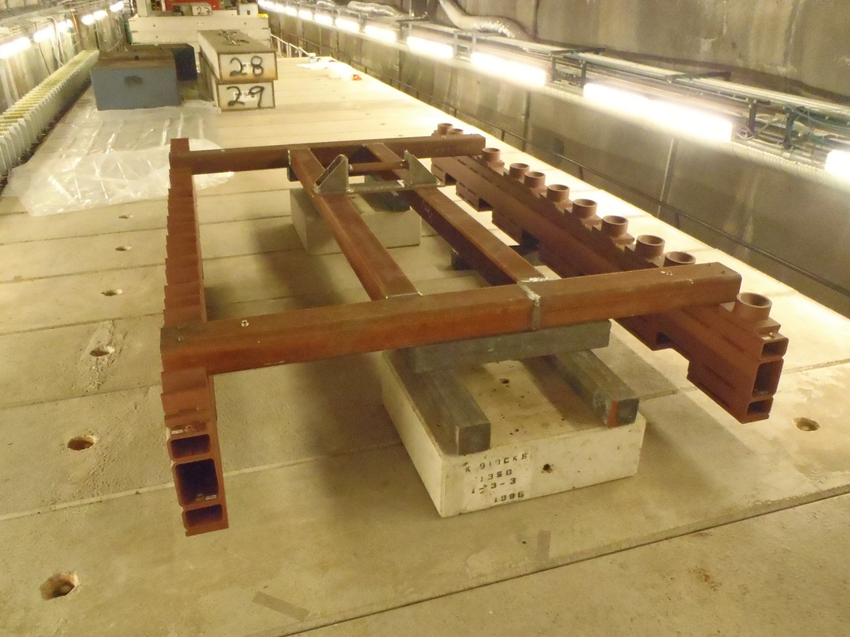
T-Block Support Tubes Installation
Support Tube Alignment & Installation Fixture
Significantly helped reduce installation time & accumulated dose
May 23, 2014
NuMI Target Hall Reconfiguration for NOvA – 5th High Power Targetry Workshop

Slide 34
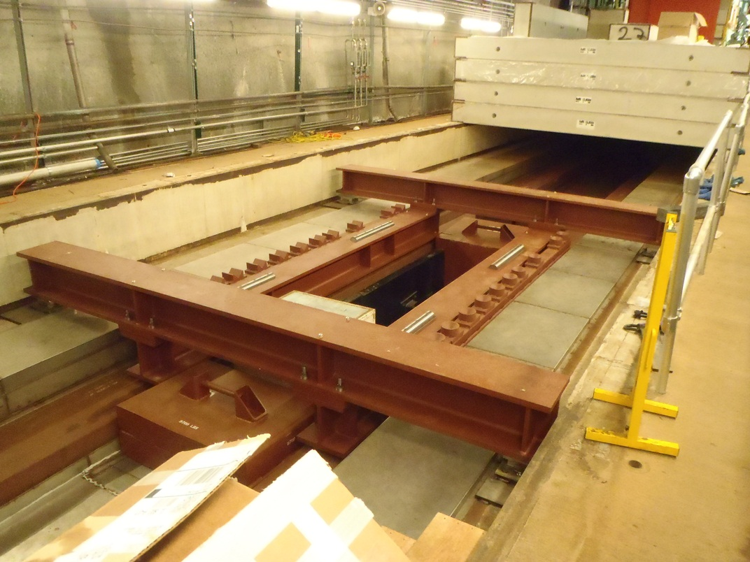
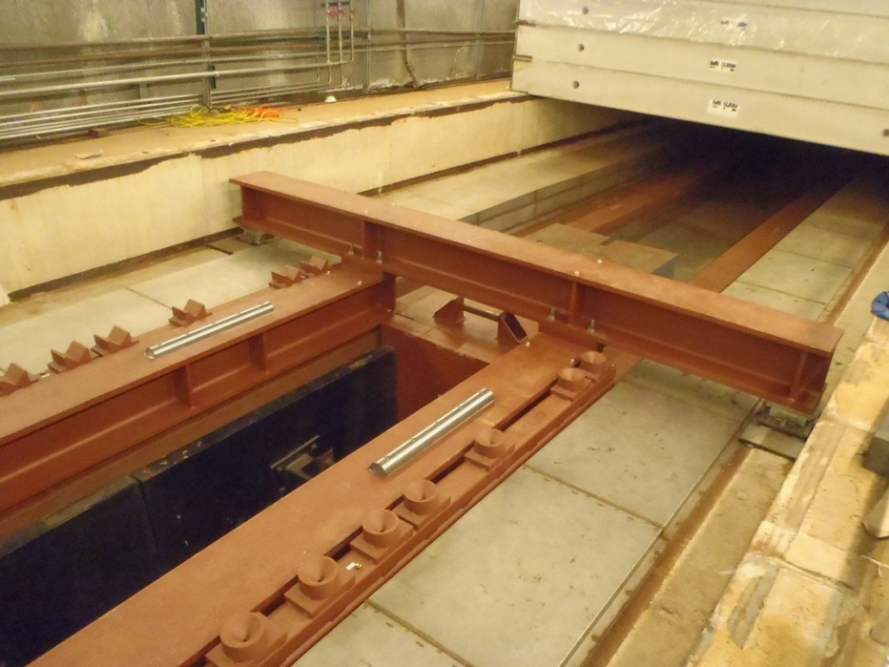
Horn 2 Relocation – Pictures
Horn 2 new Carriage Support installed
Note that the temporary shielding is still in place
May 23, 2014
NuMI Target Hall Reconfiguration for NOvA – 5th High Power Targetry Workshop

Slide 35
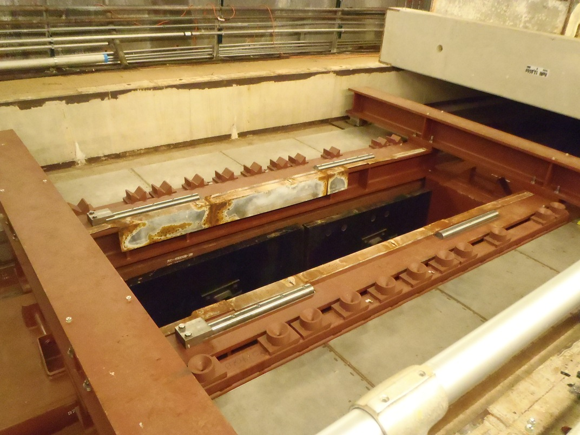
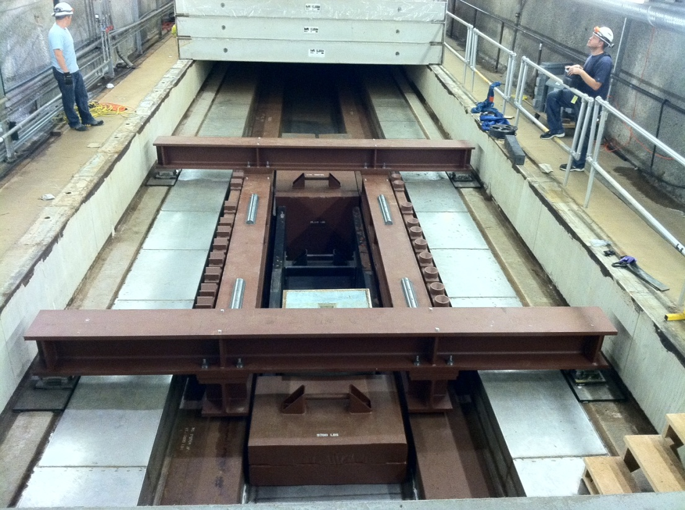
Horn 2 Relocation – Pictures
Medium Energy now ready for Horn 2 installation
Note that the temporary shielding is still in place
May 23, 2014
NuMI Target Hall Reconfiguration for NOvA – 5th High Power Targetry Workshop

Slide 36
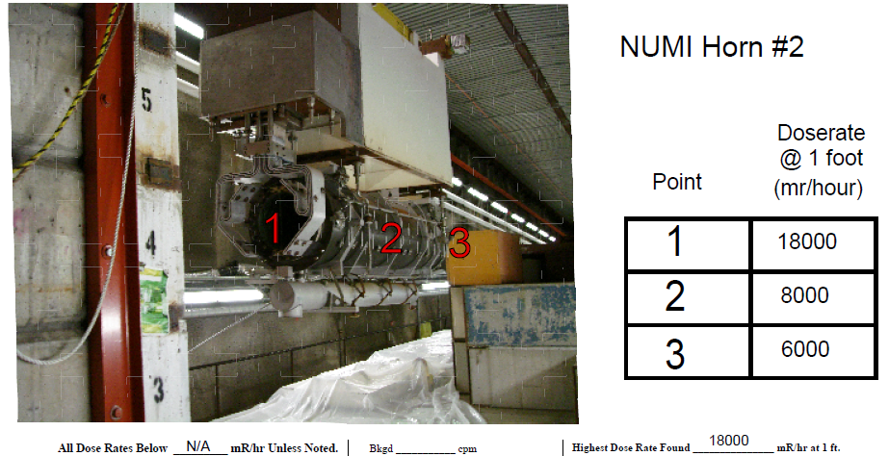
NuMI Horn #2 – Dose Rates
Horn 2 installation
May 23, 2014
NuMI Target Hall Reconfiguration for NOvA – 5th High Power Targetry Workshop

Slide 37
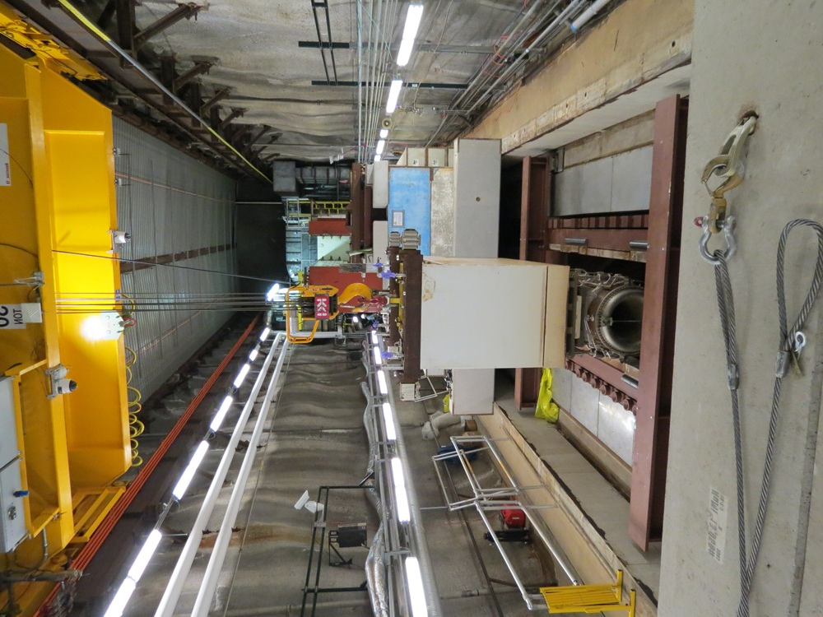
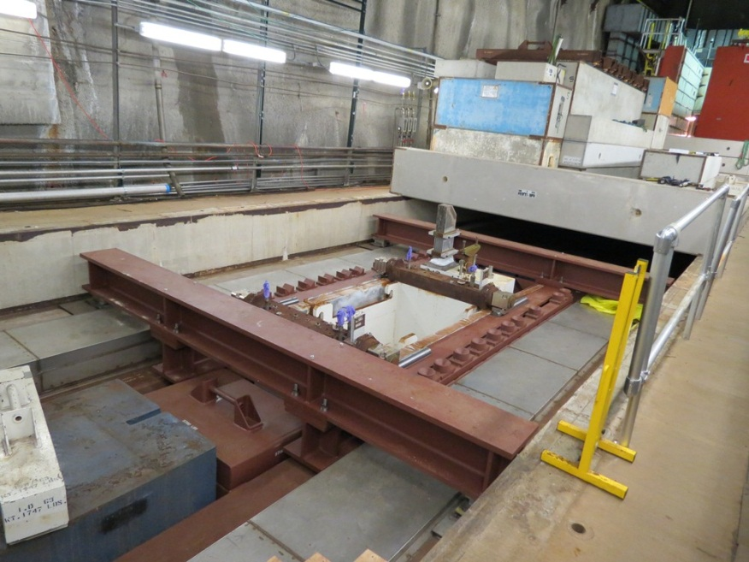

Horn 2 Relocation – Pictures
Horn 2 installation
Horn 2 being lowered
Horn 2 installed in ME
Lowering T-blocks
May 23, 2014
NuMI Target Hall Reconfiguration for NOvA – 5th High Power Targetry Workshop

Slide 38
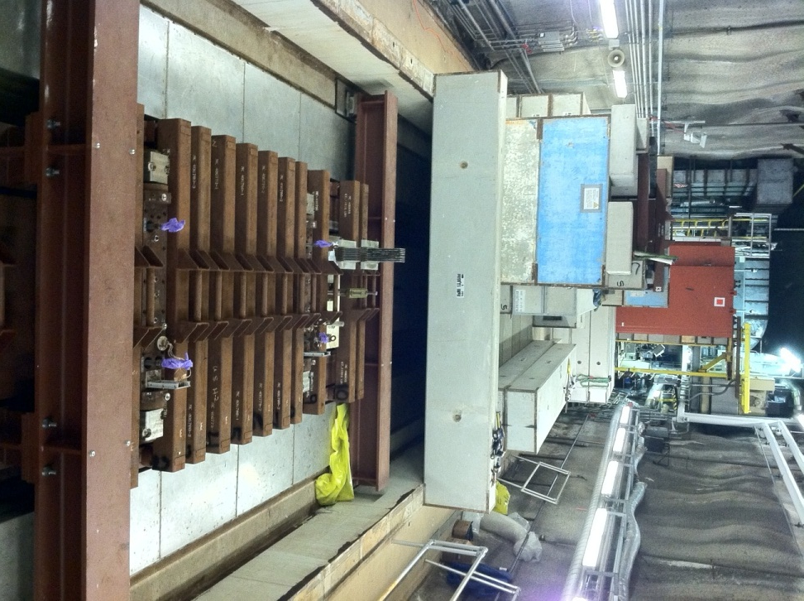
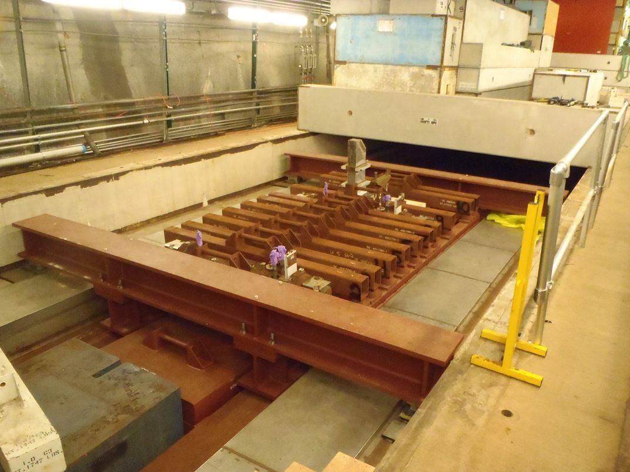
Horn 2 Relocation – Pictures
Horn 2 T-Block Installation Complete
May 23, 2014
NuMI Target Hall Reconfiguration for NOvA – 5th High Power Targetry Workshop

Slide 39
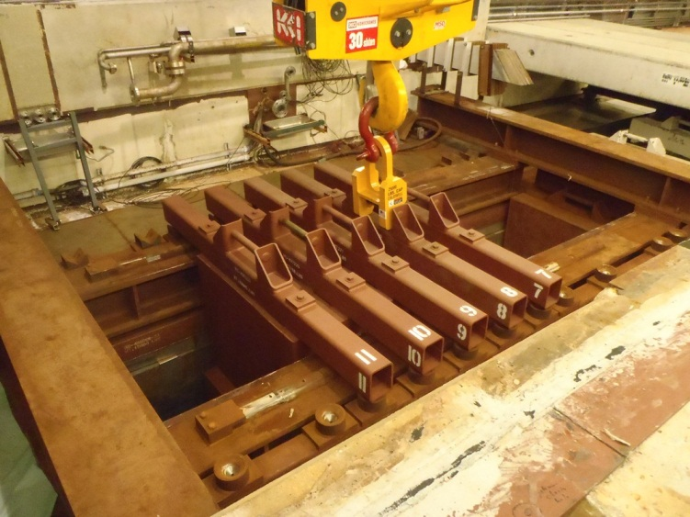
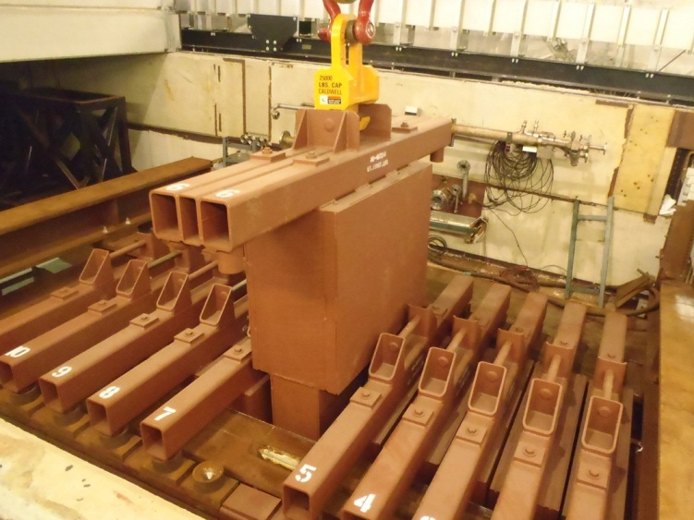
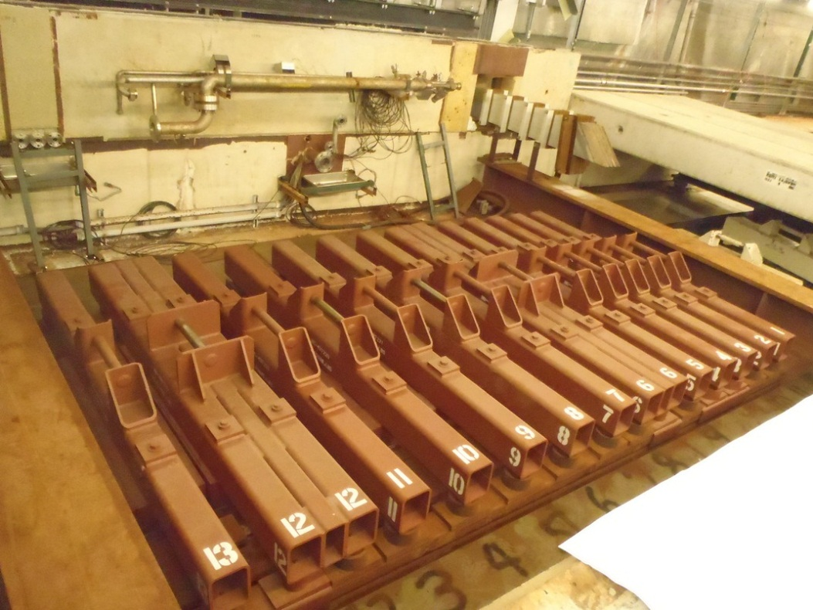
Horn 2 Relocation – Pictures
New T-Blocks installed in the LE void (wider design T-Block)
May 23, 2014
NuMI Target Hall Reconfiguration for NOvA – 5th High Power Targetry Workshop

Slide 40



Horn 2 Relocation – Pictures
Air dam installed over the LE T-blocks
This required significant custom field work trying to seal up at the ends (i.e. below the Carriage I-beams) and resulted in the highest accumulated dose of 370 mrem
May 23, 2014
NuMI Target Hall Reconfiguration for NOvA – 5th High Power Targetry Workshop

Slide 41

Horn 2 Relocation – Pictures
Horn 2 Stripline Extension Installation Complete
May 23, 2014
NuMI Target Hall Reconfiguration for NOvA – 5th High Power Targetry Workshop

Slide 42



Horn 2 Relocation – Pictures
Horn 2 Stripline Penetration & Air Seal Through the Battlement
May 23, 2014
NuMI Target Hall Reconfiguration for NOvA – 5th High Power Targetry Workshop

Slide 43


Horn 2 Relocation – Pictures
Utility Penetrations
Forms ready to pour concrete
May 23, 2014
NuMI Target Hall Reconfiguration for NOvA – 5th High Power Targetry Workshop

Slide 44


Horn 2 Relocation – Pictures
East and West Battlements Complete
May 23, 2014
NuMI Target Hall Reconfiguration for NOvA – 5th High Power Targetry Workshop

Slide 45


Horn 2 Relocation – Pictures
NuMI Target Hall Reconfigured for ME Operation for NOvA
http://cropoverbarbados.com/calypsotents/celebration-time
May 23, 2014
NuMI Target Hall Reconfiguration for NOvA – 5th High Power Targetry Workshop

Slide 46


Horn 2 Relocation – Pictures
NuMI Target Hall ME versus LE
Medium
Energy
Low
Energy
May 23, 2014
NuMI Target Hall Reconfiguration for NOvA – 5th High Power Targetry Workshop

Slide 47
Results & Lessons Learned
Result: 2,432 person-mrem estimated; 1,538 person-mrem actual
All work completed safely, on schedule, and on budget
Detailed upfront planning – detailed step-by-step Horn 2 Move Procedure and ALARA plan (with associated drawings for each step). Attention to detail - mistakes can be costly!
  ~70 steps, over 225 lines of procedure!
  Every items movement was tracked for every step
  Operations planning was included (e.g. target change-out scenario)
  Regularly consulted with NuMI operations & Rad safety personnel
Use of temporary steel shielding inside the ME opening proved very effective – reduced dose rates to ≤ 2 mrem/hr
What worked really well:
May 23, 2014
NuMI Target Hall Reconfiguration for NOvA – 5th High Power Targetry Workshop

Slide 48
Snapshot of Detailed Horn 2
ALARA Plan/Move Procedure
Step | Description | Week | Location/Remote Operation | Total Task Duration Time days | # Workers | Worker Description | Time - minutes (actual worker time) | Estimated Dose Rate mrem/hr | Estimated Dose person-mrem | Comment
1.0 | BEGINNING OF SHUTDOWN - 4 week cooldown time |  |  | (20) |  |  |  |  |  | Ensure Chase ventilation system air flow turned down to minimal flow
1.1 | Deliver/stage all T-blocks, T-Block support tubes, and BB coffins at MI-65. | 1
1.2 | Check alignment of T-block support tube assembly | 2 |  |  | 3 | alignment | 240 | 0.1 | 1.2
1.3 | Begin RAW pipe extension work. | 3,4 |  | 10 | 2 | pipe-fitters | 4800 | 0.1 | 16
1.4 | Begin preliminary stripline extension work | 3,4 |  | 10 | 2 | technicians | 4800 | 0.1 | 16 | Possible to install chase stripline extension (which will require more manpower)
2.0 | Open the door plug | 5 |  | 0.5 | 4 | technicians | 240 | 0.1 | 1.6
2.1 | Install the rail system. | 5 |  | 0.5 | 3 | technicians | 240 | 0.1 | 1.2 | Three operators downstairs.
 |  |  |  |  | 2 | technician upstairs | 240 | 0 | 0.00 | Two operators upstairs.
3.0 | Move existing T-Block staging area downstream. Upstream end of staging area (R-blocks) is to be placed directly above the joint between the 8th and 9th horizontal R-blocks as counted from the work-cell. | 5 |  | 1 | 2 | technician | 480 | 2 | 32.00 | Moving the T-Block Hangar may block access to future horn ceramic repairs at the work cell because there won't be enough room to install the extra rifle slit shielding. Very good possibility of contamination on floor of former storage area
 |  |  |  |  | 1 | crane operator | 480 | 0.1 | 0.80
3.1 | Remove upstream C-blocks plus stripline “doghouse” and stage temporarily away from work area. ~11 blocks total. | 5 |  | 1 | 2 | technician | 480 | 0.1 | 1.60 | Need to determine where to temporarily store these items, need to check residual dose rates (any control measures?). Two additional people upstairs if moving blocks upshaft.
Note 3.1 | Possibly store these items on the side of the T-block staging area |  |  |  | 1 | crane operator | 480 | 0.1 | 0.80
May 23, 2014
NuMI Target Hall Reconfiguration for NOvA – 5th High Power Targetry Workshop

Slide 49


Results & Lessons Learned
Using the same (T-block) lifting fixture for all the rigging operations
  Made the rigging operations smooth and efficient
Using the NuMI Operations group to do all the heavy rigging operations – since they had the most skills & experience
Conducting Practice runs:
  Remote handling of Blue Blocks and remote placement in coffins
  Dry setting the new LE T-Block shielding plug assembly – replicated the full set-up
  Testing and alignment of the T-Block support tube alignment & installation fixture
Installation oversight: Direct oversight by lead engineer and designer throughout the relocation work
Re-use of low level radioactive steel from on-site for constructing all the T-blocks, custom shielding blocks, and the temporary shielding
  Significant cost savings to the project + less radioactive waste creation
In-house construction of all shielding – especially useful during installation
What worked really well (Contd.):
May 23, 2014
NuMI Target Hall Reconfiguration for NOvA – 5th High Power Targetry Workshop

Slide 50

Results & Lessons Learned
Overall things went better than expected!
Sheet-metal cover construction over LE
  Took much longer than expected
  Cost more than planned
  Highest radiation dose (370 person-mrem)
Some minor rigging challenges with the new (larger) T-Blocks
  Ran out of headroom for lifting T-block out of basket
  Required some creative rigging techniques to get basket and T-block off the rail cart
  Again, spaces are very tight in our facilities!
What didn’t work as well:
May 23, 2014
NuMI Target Hall Reconfiguration for NOvA – 5th High Power Targetry Workshop

Slide 51
Target Hall Thermal FEA
Other Target Hall Infrastructure Upgrade Work
70kW heat load
(half-model)
Maximum steady state temperature of 153ºC (on chase side walls, downstream end of Horn 1) – Acceptable for all materials/coatings used in target chase
Thermal Radiation heat load to Horn 1 and water tank of 4.3kW
After all active cooling and heat are shut off, the horn temperature does not exceed 100ºC
Air Cooling system capacity upgrade for 700kW – a third chilled water cooling coil was added in the by-pass section of the air handling unit
May 23, 2014
NuMI Target Hall Reconfiguration for NOvA – 5th High Power Targetry Workshop

Slide 52
Horn 1 Thermal Offsets
Other Target Hall Infrastructure Upgrade Work
Horn 1 maximum predicted thermal offsets for 700kW beam:
Horizontal: 0.40mm (west–beam left)
Vertical: 0.80mm (down)
These values are within the 1.50mm alignment tolerance specified by NOvA for the Medium Energy Configuration
May 23, 2014
NuMI Target Hall Reconfiguration for NOvA – 5th High Power Targetry Workshop

Slide 53



Horn 1 Stripline Thermal FEA
Other Target Hall Infrastructure Upgrade Work
Redesigned stripline geometry for enhanced cooling + improved cooling at Horn 1
Maximum stripline temperature of 82ºC
Other Miscellaneous Target Hall Upgrades:
High Strength Steel is bad for radiation + moisture + air environment (NOx) – Changed all HSS spring washers to Inconel in the stripline
Also used Titanium Grade 5 fasteners together with Inconel-718 spring washers for the new Horn 2 Carriage system
May 23, 2014
NuMI Target Hall Reconfiguration for NOvA – 5th High Power Targetry Workshop

Slide 54
Summary & Discussion
Horn 2 was successfully moved 9 meters downstream from the LE to the ME configuration in the NuMI Target Hall – all work was completed safely within budget and on schedule
The total radiation exposure ended up being roughly just over half of what was predicted in the ALARA plan
  The temporary void shielding proved to be the single most effective measure
  Detailed upfront ALARA planning, practicing key steps/RH dry runs, and careful oversight during work also proved vital for the successful completion
Reconfiguration work such as this is doable but does not come cheap – the Horn 2 reconfiguration cost the NOvA project ~$3.5M
High residual dose rates and limited space will continue to pose challenges in future facilities running at even higher beam powers
  For new facilities, potential future upgrades should be thought through at the initial design stage – but not always possible given all the funding constraints! Will need more creative & sophisticated Remote Handling capabilities
May 23, 2014
NuMI Target Hall Reconfiguration for NOvA – 5th High Power Targetry Workshop

Slide 55
Acknowledgements
The success of this work was due to the excellent team effort of several individuals across the three Fermilab Divisions (AD/PPD/TD), plus several outside contractor personnel:
Bob Albrecht, Keith Anderson, Kris Anderson, Mike Andrews, Wojciech Blaszynski, Tony Busch, Cervando Castro, Mike Cooper, Abhishek Deshpande, Dave Erickson, Jack Flynn, John Flynn, Ralph Ford, Bill Gatfield, Lee Hammond, Yun HE, Jim Hylen, Steve Johnson, Chris Kelly, Gary Lauten, Hiep Le, Ryan Mahoney, Eric Pirtle, Mike Stiemann, Frank Schneider, Henry Schram, Paul Sedory, Vladimir Sidorov, Matt Slabaugh, Zhijing Tang, David Tinsley, Dan Watkins, Karl Williams, Jim Zahurones, (plus others I might have missed)…
May 23, 2014
NuMI Target Hall Reconfiguration for NOvA – 5th High Power Targetry Workshop

Slide 56
Thank you!
Back-up Slides
May 23, 2014
NuMI Target Hall Reconfiguration for NOvA – 5th High Power Targetry Workshop
56
Notes:
Cartoon of the detector: walk through from inside

Slide 57
Beam Parameters
 | NuMI Design | NOνA | What it means for NuMI
Beam Power (kW) | 400 | 700 | 75% more DC beam power (Cooling Issues)
ν Energy Spectrum | Low Energy | Medium Energy | Reconfigure target chase
Cycle time (s) | 1.87 | 1.33 | Faster cycle time
Intensity (ppp) | 4.0×10¹³ | 4.9×10¹³ | 20% higher protons/pulse
Spot Size (mm) | 1.0 | 1.3 | Larger Spot size on Target
May 23, 2014
NuMI Target Hall Reconfiguration for NOvA – 5th High Power Targetry Workshop
57
Notes:
Cartoon of the detector: walk through from inside

Slide 58
NuMI TH- Section View at ME
Section C-C Showing Blue Block Stacking Order
Changes Required:
Removal of the SS air dam
Removal of the center row of Blue-Blocks (marked 1 & 2) to make space for Horn 2
Total of 12 blue-blocks were extracted (8 blue-blocks were completely removed from TH in coffins)
Custom steel blocks fabricated to match the
3
Sheet-metal
air dam
2
Blue Blocks that
need to be
removed
1
Blue Blocks
Target Chase
Concrete
Target Hall Shielding Section C-C
at Medium Energy Location
May 23, 2014
NuMI Target Hall Reconfiguration for NOvA – 5th High Power Targetry Workshop

Slide 59

NuMI Horn #1 – Dose Rates
May 23, 2014
NuMI Target Hall Reconfiguration for NOvA – 5th High Power Targetry Workshop

Slide 60






Blue Block & Coffin Remote Handling
Practice Runs at the CO Remote Handling Facility
May 23, 2014
NuMI Target Hall Reconfiguration for NOvA – 5th High Power Targetry Workshop

Slide 61


LE & ME T-Block ‘Plug’ Construction
Manufactured in-house at Fermilab (PPD/MAB)
May 23, 2014
NuMI Target Hall Reconfiguration for NOvA – 5th High Power Targetry Workshop

